Slide 1
Hypothesis Testing on Patch Spaces via
Manifold Moving Least Squares with Application to Evolutionary Anthropology
Robert J. Ravier
Duke University + Sarcos Technology and Robotics Corp.
BIRS
9/7/2023

Slide 2
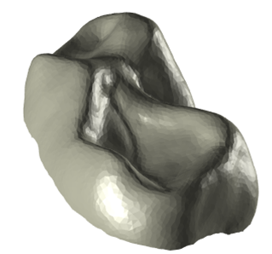
Recently discovered fossils from kenya may give great evolutionary insight
Rasmussen et al 2019 (PNAS): Discovery of Old World Monkey dentition from 22 million years ago
  Prior to discovery: first 12 million years of Old World monkey fossil record was limited to two teeth
On right: digitized version of different molar from same region
  Known to belong to a particular suborder of primates, which is composed of 2-4 infraorders (depends on anthropologist)
Question: Can we determine which of the infraorders this specimen is closest to, and how, IN A NONPARAMETRIC FASHION?
  Being able to do this helps address gaps in evolutionary timelines
  Nonparametric tests reduce risk of future misapplication by practitioners

Slide 3
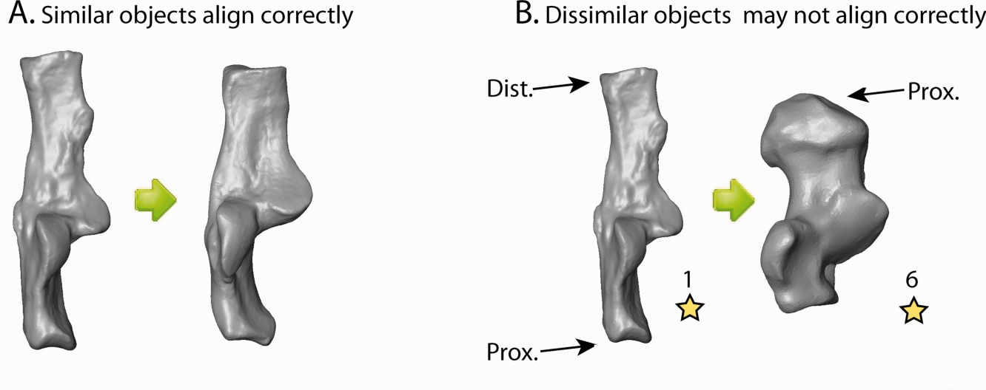
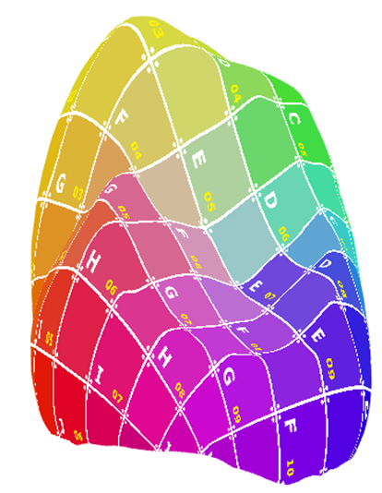
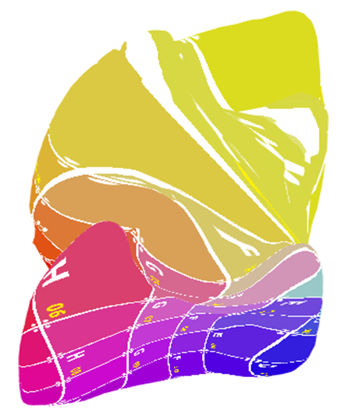
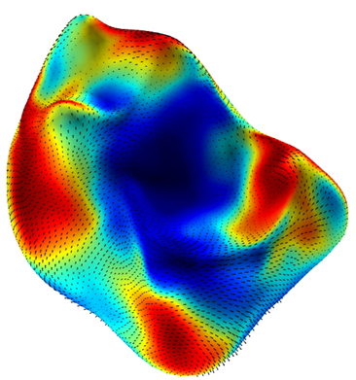
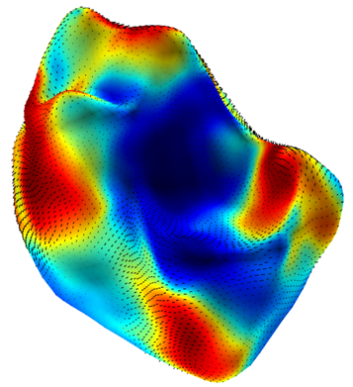
Anthropological data provides failure cases for USUAL biological shape analysis methods
Alignment/Procrustes (Kendall Shape Space) methods produce nonbiological alignments for dissimilar objects, including cases where global optima of Procrustes is obtained
FOCUS OF TALK
NO CORRESPONDING CUSP ON DOMAIN
Continuous registration methods yield questionable results for nonisometric surfaces
Statistical methods for (registered) group comparison (Hotelling T with multiple testing correction) yield little insight for inference
NON NAVY BLUE POINTS HAVE p-VALUE BELOW 0.001

Slide 4
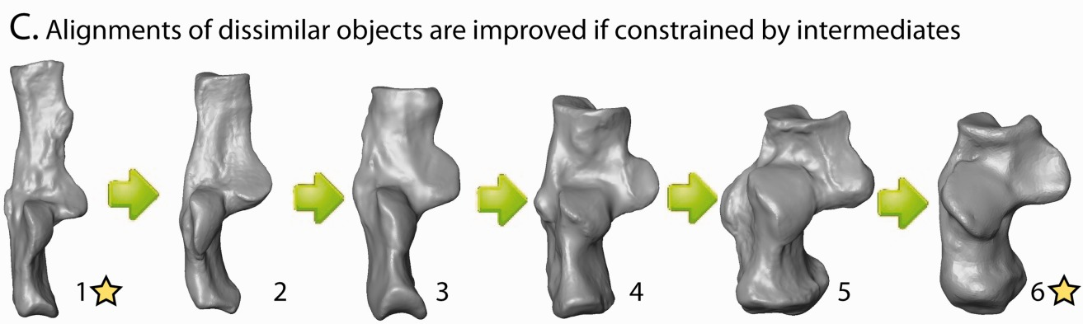
Experimental evidence shows that manifold learning provides a way forward
Right: Biologically correct alignments obtained when composing alignments between similar shapes (Boyer et al 2014)
This can be formalized using (not necessarily Riemannian) manifold terminology
  Connections, parallel transport, etc.
What more can we get out of using geometric language while keeping compute cost cheap?
  Practitioners may not have good hardware
https://www.github.com/ToothAndClaw/Auto3dgm_Python

Slide 5
Consistent shape registration is necessary for good statistical analysis
Problem: Given collection of shapes, find unambiguous consistent corresponding points between each pair of shapes
Consistent: do so in an unambiguous way amongst all surfaces (picking a point on one surface unambiguously picks a corresponding points on others)
  Consistency gives a notion of canonical comparability between two objects, making statistics possible
  Though not strictly necessary (see: robust statistics under uncertainty), makes life easier
This is often posed (and solved) as an optimization problem over space of maps between two surfaces
  Correspondences should be derived as optima of some energy
  What counts as “good” is ill-defined, generally…

Slide 6
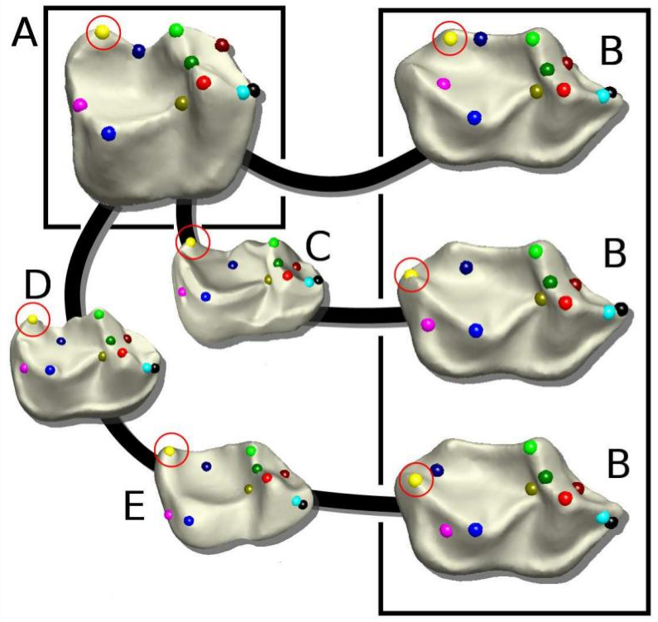
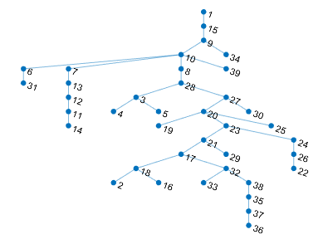
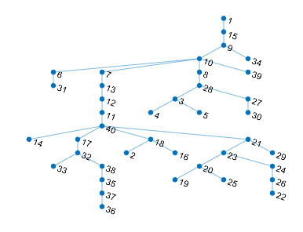
Minimum spanning trees give consistent registration, albeit without stability
Composing correspondences over intermediaries gives more biologically accurate results, albeit not consistent
Minimum spanning trees provide a way to enforce consistency; composing over trees gives unambiguous correspondence due to only one path existing between any two shapes
Minimum spanning trees are horribly unstable
  Remove one node and tree topology becomes unstable
  Not ideal especially given low sample size

Slide 7
Registration Fails with Nonisometric Surfaces
Significant difference: cusp on one tooth not remotely present on the other, something screws up

Slide 8
Probability theory allows for constructing Accurate solution
A priori, there is no reason why one composition is favored over another.
Theoretically, we can construct a probability measure with domain being all possible maps, but this quickly becomes computationally infeasible
Does not mean we’re done, we can select intelligently!

Slide 9



THE SETUP: VARIABLE QUALITY MAPS
Meshes
Correspondences
Distances
Goal: Make new maps that are better (and consistent)

Slide 10

PROBABILITY MEASURE ON CORRESPONDENCES CAN BE OBTAINED FROM WEIGHTED GRAPH
Graph
Vertices = meshes
Edges = pairwise correspondences, distances
Paths between two vertices = correspondences between two meshes
Gibbs measure on correspondences = Gibbs measure on paths
  Energy = sum of squares of distances along edges

Slide 11
Fiber Bundles and Parallel Transport
Can think of collection of datapoints (surfaces) used as samples from a fiber bundle
  Fiber bundle: manifold that is locally a product of a neighborhood of base manifold with a fixed fiber
  Our situation: each surface is a point on the base manifold, the fiber is the Riemann surface with the same topology of the surfaces.
Parallel transport along paths on base manifold induces diffeo/homeomorphisms of the fibers!
  Can think of parallel transport for topological fiber bundles as a choice of homeomorphisms between fibers

Slide 12
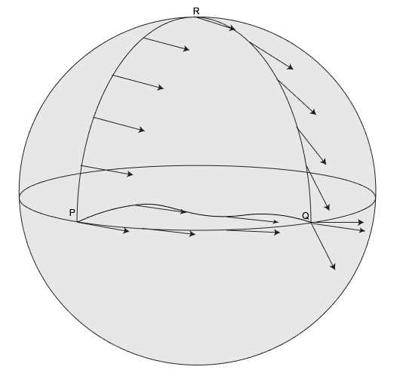
Using Parallel Transport to Find Good Compositions
Our assumption: good registrations correspond to geodesics
  At least in shape space…
This assumption lets us automatically toss out many of the compositions we started out with
  Each composition is a path between two surfaces
  Loops don’t add much and should tossed away
  Inefficient paths = inaccurate ones

Slide 13
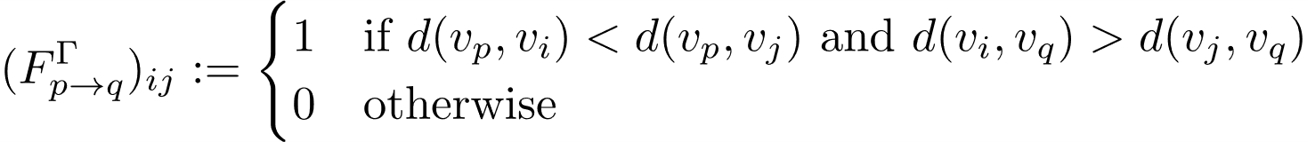

A SIMPLE METRIC BASE CONDITION IS ENOUGH RESTRICTION
Restrict measure to paths generated by
  Plus threshold on energy...
Called “Eyes on the Prize” flow: always move forward, never back
In theory: mild assumptions give bounds on parallel transports
In practice: restricts space of registrations to something where full iteration possible via depth first search

Slide 14
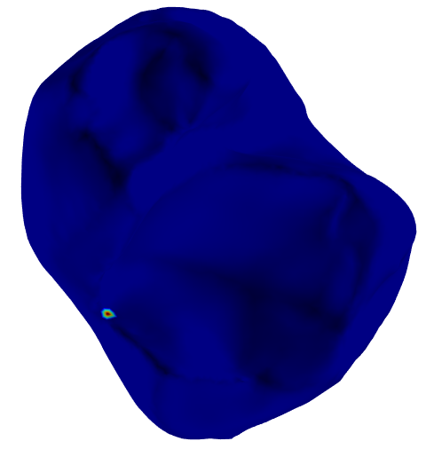
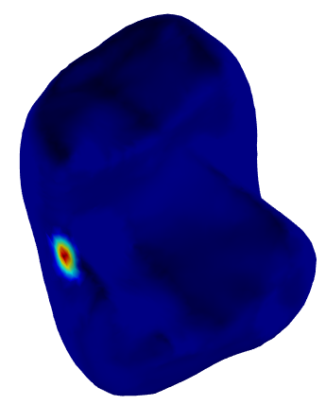
EOP YIELDS SOFT CORRESPONDENCES BY PROPAGATING DISTRIBUTIONS BETWEEN MESHES

Slide 15
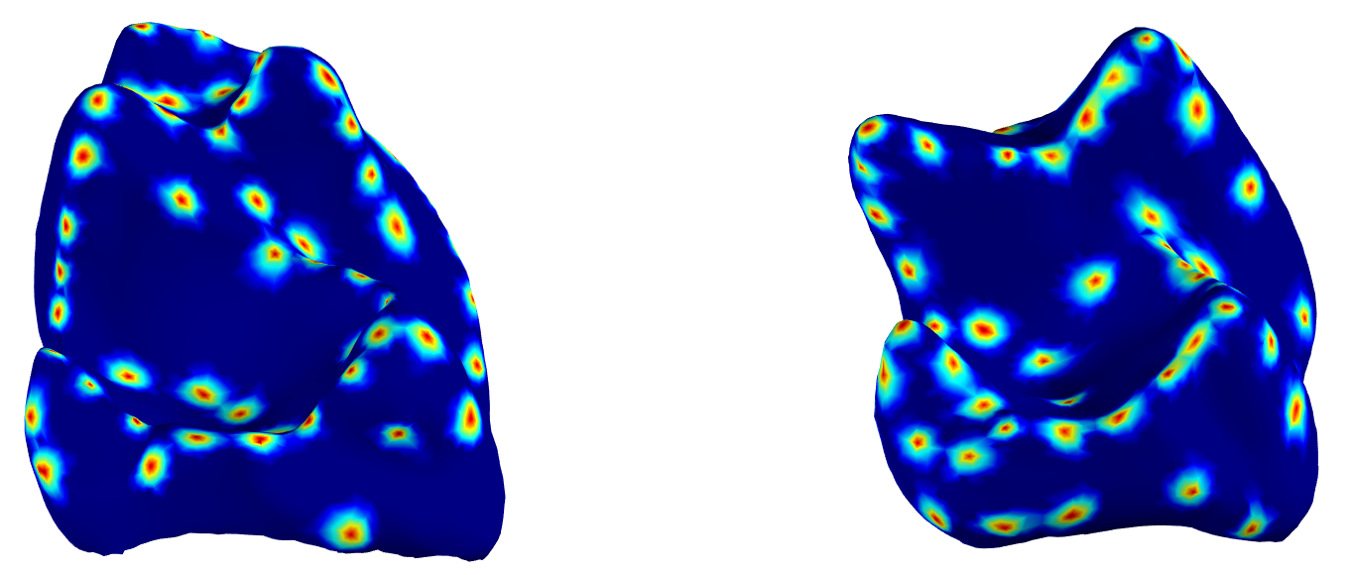
OUR SAMS PIPELINE GIVES END-TO-END REGISTRATION
Extract salient landmarks from each surface in a collection via Gaussian Processes (Gao et al 2019), and place distribution centered at each landmark

Slide 16
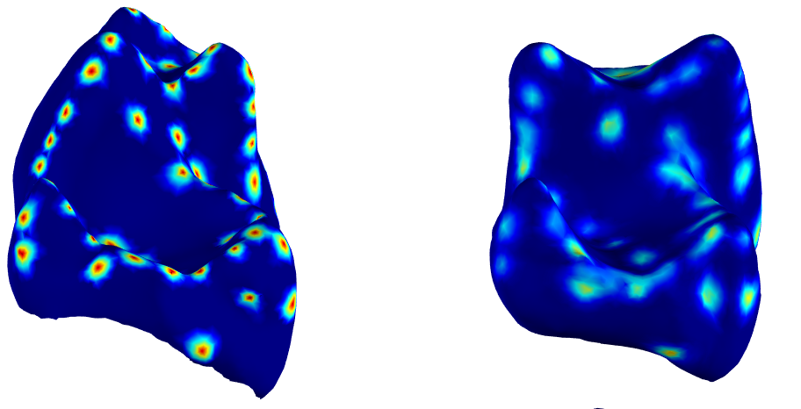
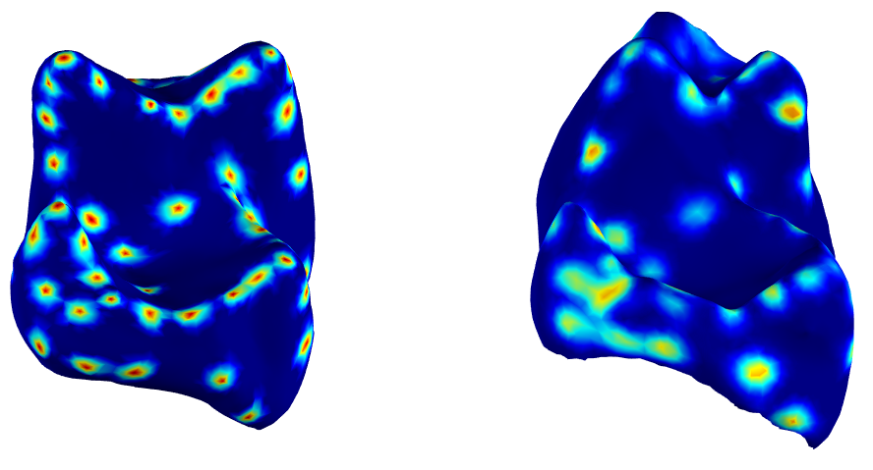
OUR SAMS PIPELINE GIVES END-TO-END REGISTRATION
Select template surface (needed for consistency guarantees)
Propagate distributions on each pair to get soft correspondences on each mesh

Slide 17
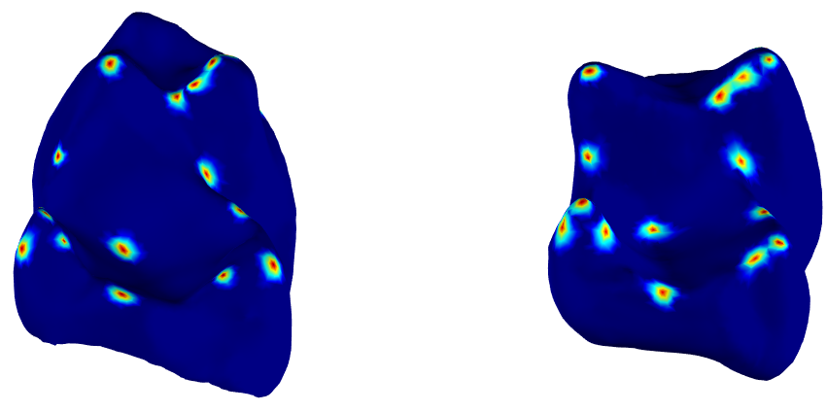
OUR SAMS PIPELINE GIVES END-TO-END REGISTRATION
CUSP NOT MATCHED TO ANYTHING!
Register landmarks that are mutually registered on each surface (approximate cycle consistency)

Slide 18
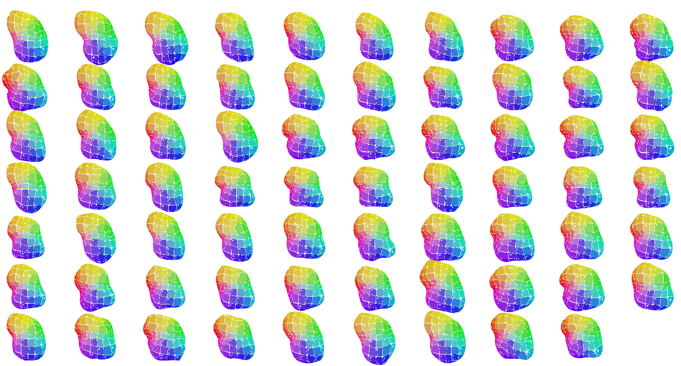
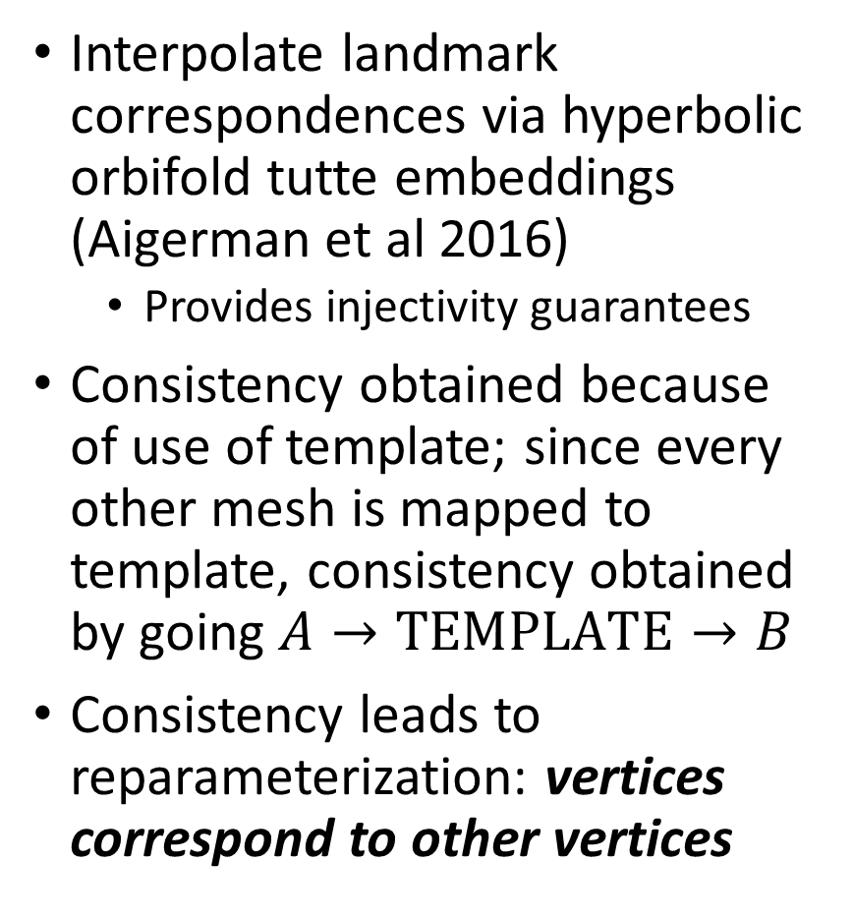
OUR SAMS PIPELINE GIVES END-TO-END REGISTRATION
Interpolate landmark correspondences via hyperbolic orbifold tutte embeddings (Aigerman et al 2016)
  Provides injectivity guarantees
Consistency obtained because of use of template; since every other mesh is mapped to template, consistency obtained by going $A→TEMPLATE→B$
Consistency leads to reparameterization: vertices correspond to other vertices
  Code Available: https://www.github.com/rravier/SAMS
Current implementation works for all genus 0 surfaces

Slide 19
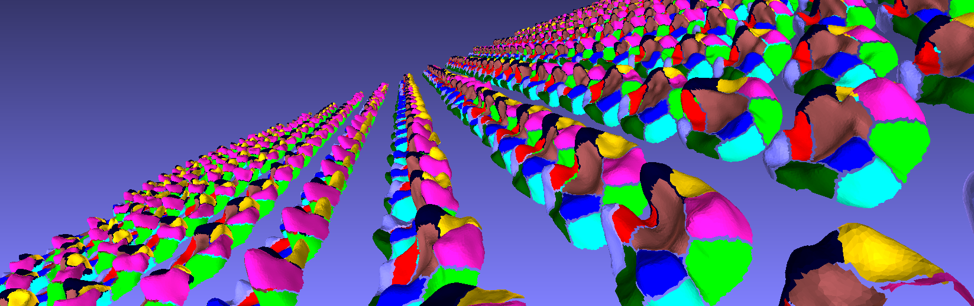
SAMS REGISTRATIONS YIELD ACCURATE SEGMENTATION OF DIVERSE COLLECTION OF PRIMATE MOLARS
Right: collection of approximately 500 molars representative of all known extant/extinct primates
Segmentation obtained via spectral clustering + horizontal diffusion maps (Gao 2021): augmenting diffusion maps with correspondence information
Big validation of SAMS: anthropologists found minimal problems with results AND thoughts segmentations were meaningful

Slide 20
Recently discovered fossils from kenya may give great evolutionary insight
Rasmussen et al 2019 (PNAS): Discovery of Old World Monkey dentition from 22 million years ago
  Prior to discovery: first 12 million years of Old World monkey fossil record was limited to two teeth
On right: digitized version of different molar from same region
  Known to belong to a particular suborder of primates, which is composed of 2-4 infraorders (depends on anthropologist)
Question: Can we determine which of the infraorders this specimen is closest to, and how, IN A NONPARAMETRIC FASHION?
  Being able to do this helps address gaps in evolutionary timelines
  Nonparametric tests reduce risk of future misapplication by practitioners

Slide 21
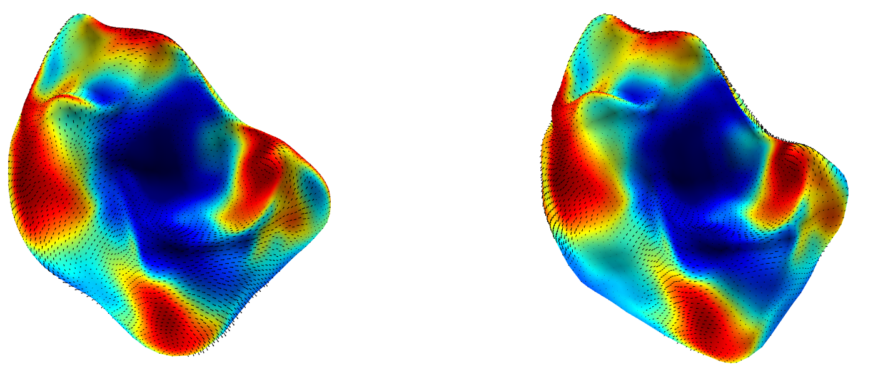
STANDARD methods for outlier detection on anatomical shapes yield…?????
Go to method for outlier detection in neuroimaging: some sort of multivariate outlier test based on T-statistics
  Yields p-values and heatmaps illustrating regions of different
Case study in dissertation (2018): compare T. asiatica (right) with other species in Teilhardina genera (one on left)
  18 samples of T. asiatica existed at the time, most not digitized
Applying neuroimaging techniques to explain mechanism of difference yielded…nothing of worth
Likely culprit: global alignment screwing up local testing
EVERYTHING IS SIGNIFICANT
NOTHING IS SIGNIFICANT

Slide 22
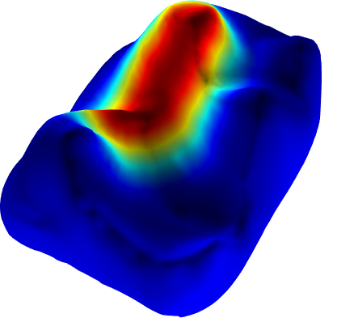
PATCH SPACE PROVIDES AN ALTERNATIVE WAY FORWARD
Analyze surfaces patch by patch
  Consistent patches can be extracted after registration
  Significantly lowers dimensionality, leads to better guarantees
  Prevents other parts of surface from screwing up alignment
Build statistical tests for each patch space…unclear how to do that
  Manifold hypothesis tests exist, but rely on Riemannian structures from a model space
    E.g. exponential and logarithm maps
  There is no “model” for patch space in our setting

Slide 23
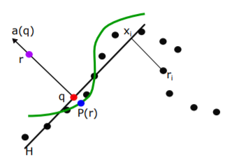
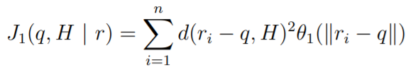
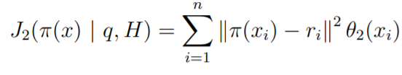

Manifold Moving Least Squares GIVES WAY TO MODEL POINT CLOUDS IN DATA-DRIVEN FASHION
Given high dimensional point cloud, get approximating manifold via MMLS
  First find local coordinate system by minimizing (under constraints)
  For each point, fit polynomial around learned coordinates

Slide 24
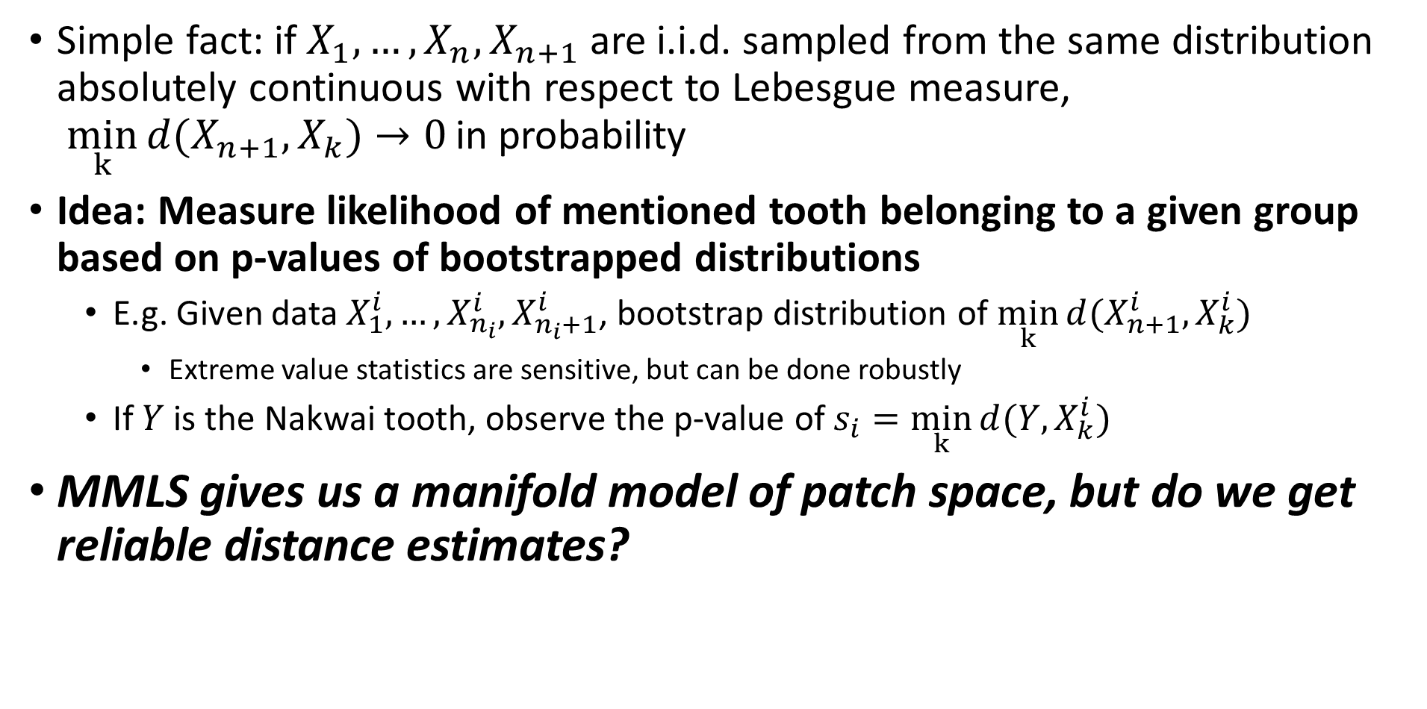
BOOTSTRAPPED DISTRIBUTIONS OF DISTANCES GIVE A POTENTIAL NONPARAMETRIC SOLUTION
Simple fact: if${ X}_{1},…,X_{n},X_{n+1}$ are i.i.d. sampled from the same distribution absolutely continuous with respect to Lebesgue measure,
$\min_{k}{d(X_{n+1},X_{k})}$ $→0$ in probability
Idea: Measure likelihood of mentioned tooth belonging to a given group based on p-values of bootstrapped distributions
  E.g. Given data $X_{1}^{i},…,X_{n_{i}}^{i},X_{n_{i}+1}^{i}$, bootstrap distribution of $\min_{k}{d(X_{n+1}^{i},X_{k}^{i})}$
    Extreme value statistics are sensitive, but can be done robustly
  If $Y$ is the Nakwai tooth, observe the p-value of $s_{i}=\min_{k}{d(Y,X_{k}^{i})}$
MMLS gives us a manifold model of patch space, but do we get reliable distance estimates?

Slide 25
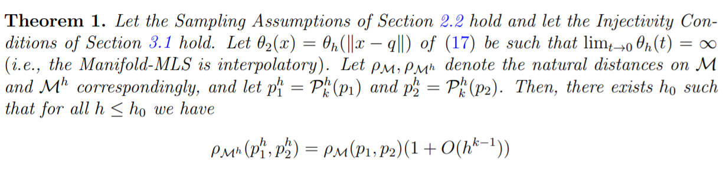
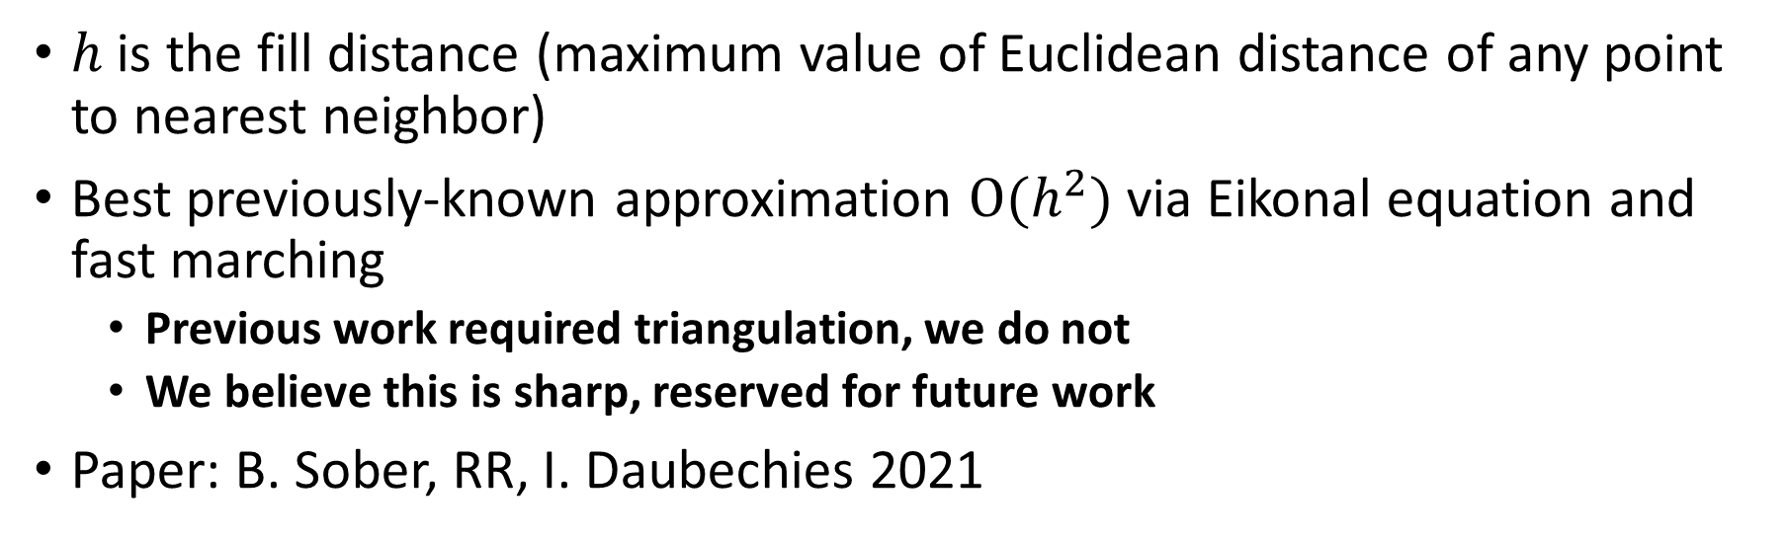
MMLS CAN ACCURATELY RECOVER THE RIEMANNIAN METRIC OF THE UNDERLYING MANIFOLD
$h$ is the fill distance (maximum value of Euclidean distance of any point to nearest neighbor)
Best previously-known approximation $O(h^{2})$ via Eikonal equation and fast marching
  Previous work required triangulation, we do not
  We believe this is sharp, reserved for future work
Paper: B. Sober, RR, I. Daubechies 2021

Slide 26
Experimental setup: simple pipeline
Given consistently registered surfaces, extract consistent patches around each vertex
  User specified radius
Use MMLS to estimate geodesic distances
Bootstrap distributions of distances of each of four possible infraorders to the tooth of interest
Observe p-values of tooth of for each group
Apply Wilcoxon rank sign test to each pair of groups (1 biggest, 2 smallest)
  One ranking for each patch
  Null hypothesis: the rankings are indistinguishable
  Works for dependent data

Slide 27
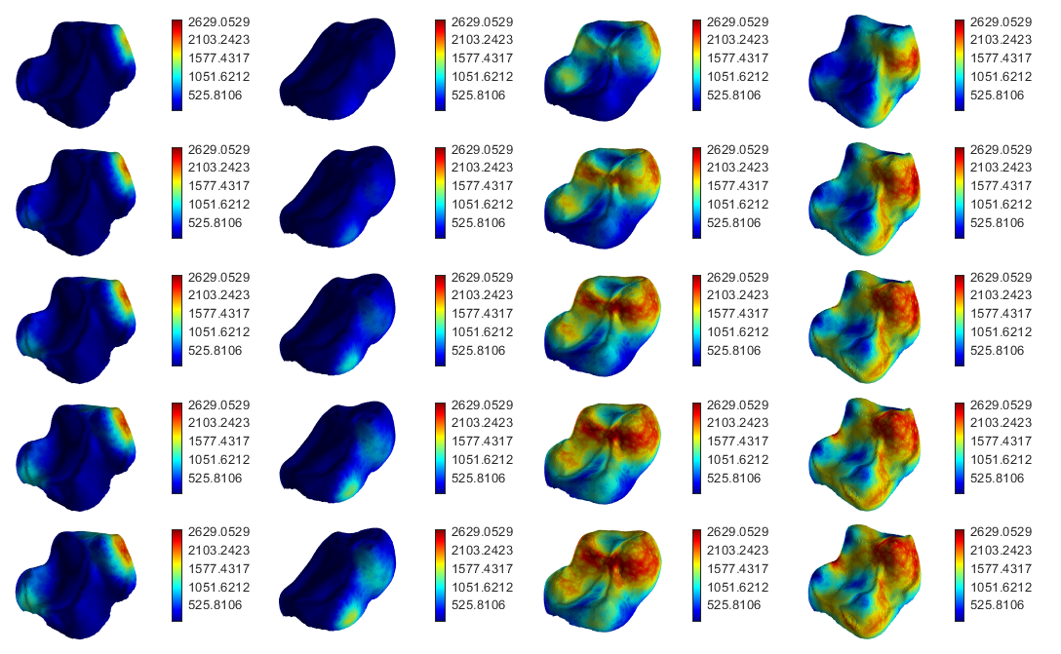
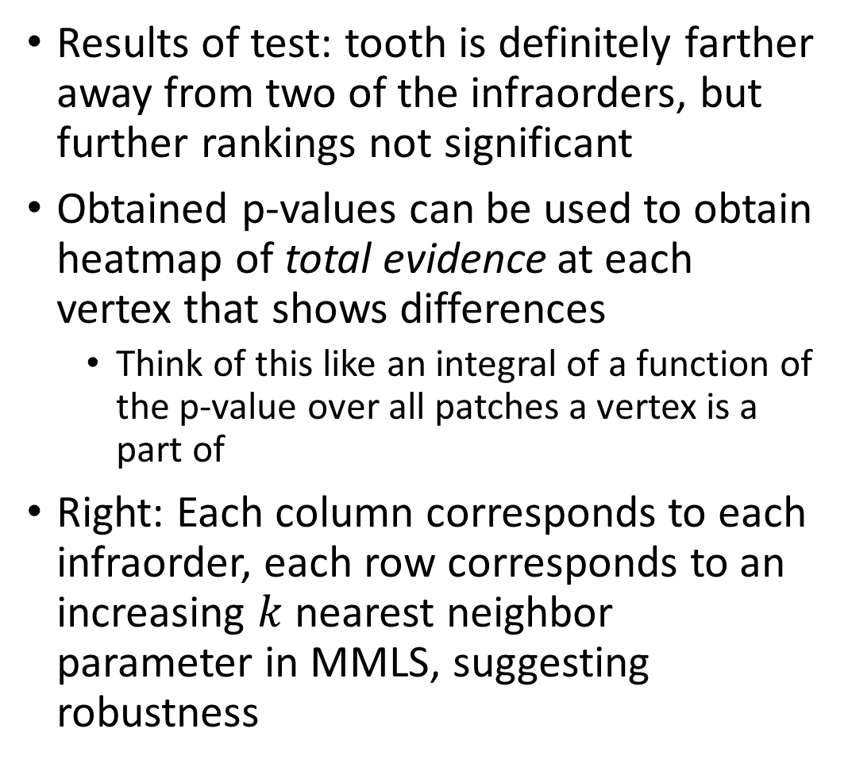
TOOTH IS FAR AWAY FROM TWO OF THE INFRAORDERS, WITH HEATMAPS TO SHOW HOW
Results of test: tooth is definitely farther away from two of the infraorders, but further rankings not significant
Obtained p-values can be used to obtain heatmap of total evidence at each vertex that shows differences
  Think of this like an integral of a function of the p-value over all patches a vertex is a part of
Right: Each column corresponds to each infraorder, each row corresponds to an increasing $k$ nearest neighbor parameter in MMLS, suggesting robustness

Slide 28
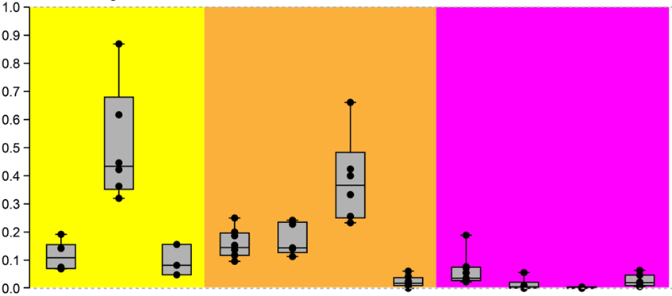
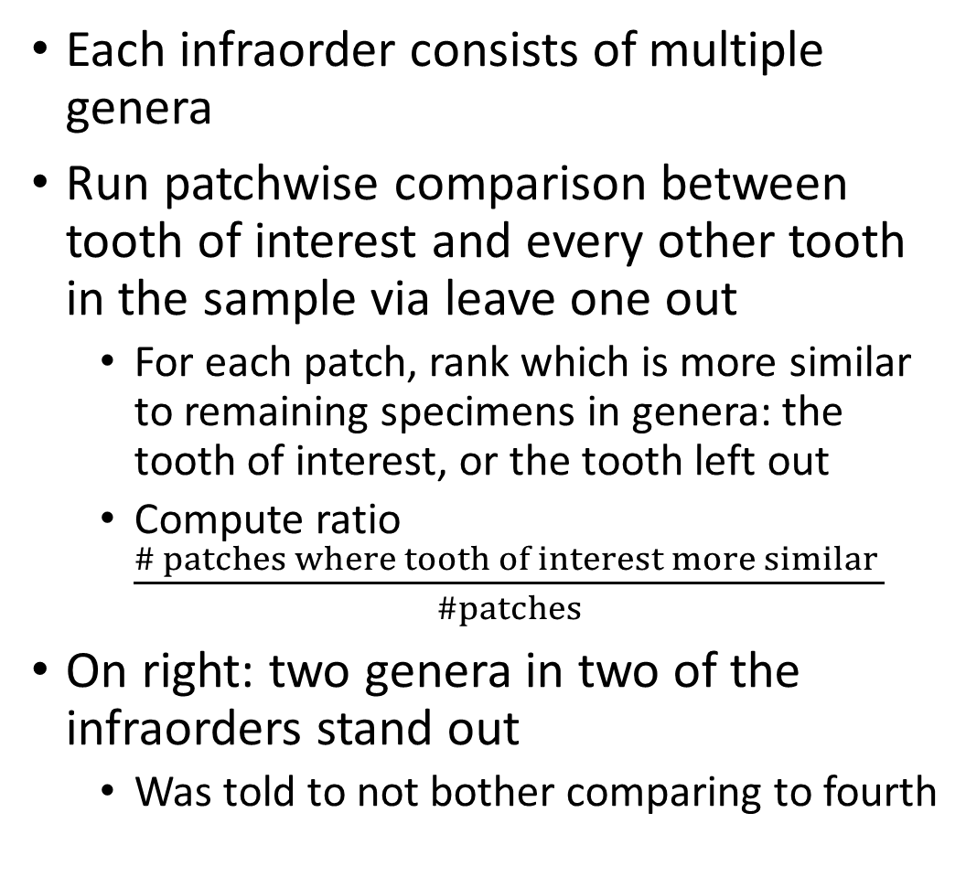
BOX PLOTS GIVE ANOTHER VIEW OF MECHANISM OF SIMILARITY OF TOOTH TO INFRAORDER
Each infraorder consists of multiple genera
Run patchwise comparison between tooth of interest and every other tooth in the sample via leave one out
  For each patch, rank which is more similar to remaining specimens in genera: the tooth of interest, or the tooth left out
  Compute ratio $\frac{\# patches where tooth of interest more similar }{\#patches}$
On right: two genera in two of the infraorders stand out
  Was told to not bother comparing to fourth

Slide 29
Conclusions
Summary: a little bit of geometric language goes an absurdly long way
  Provides alternative solution to challenging optimization problem (partial landmark matching) that’s cheap to implement
  Provides nonparametric statistical outlier detection methodology
  A LOT OF THE IDEAS I PRESENTED APPLY QUITE GENERALLY AND NOT JUST TO TEETH/GENUS 0 SURFACES
    We’ve tried to have minimal assumptions in the above and not go past manifold hypotheses
Future Work:
  Main priority: clean up existing code (SAMS) to become a bit more professional
    And adapt to higher genus if possible
  Two-sample testing (there’s moduli spaces that come up naturally, things get weird)
  Generative modeling via data-driven X-lets

Slide 30
ACKNOWLEDGEMENTS
Collaborators for the work (alphabetical): D. Boyer, I. Daubechies, B. Sober
Other people I talk to about this type of thing (alphabetical) : S. Faigenbaum-Golovin, T. Gao, S. Kovalsky, S. Mukherjee, S. Shan, AFOSR/NDSEG for funding the registration work
Denis Garagic (my boss, who let me take a week off to come here)

