Slide 1

Trace cell state transition in collective cell feature space using live-cell imaging
Jianhua Xing
Department of Computational & Systems Biology
School of Medicine
UPMC Hillman Cancer Center
Department of Physics and Astronomy
University of Pittsburgh
xing1@pitt.edu

Slide 2





Acknowledgements
Personnel Involved
Xing lab
Weikang Wang (ITP, CAS), Yan Zhang (Illumina), Dante Poe, Ke Ni, Jingyu Zhang (currently postdoc, Harvard), Huijing Wang, Sophia Hu, Yong Lu, Yaxuan Yang, Yajushi Khurana, Yan Dai (visiting student)
Guang Yao (U Arizona)
Simon Watkins (Pitt)
Callen T. Wallace
Weiguo Shu (ATCC)
Diana Douglas, Sangeeta Kumari, Metewo Selase Enuameh
C Z Biohub
Shayan Hosseinzadeh, Spyros Darmanis
Joanathan Weissman lab (WI, MIT)
Xiaojie Qiu, Dian Yang, Joseph Replogle
Li Wang ( UT Arlington)
Ruoshi Yuan (Berkeley)
Song Xu (Stanford)
Yian Ma (UC Berkeley)
Ivet Bahar (Pitt)
Vijay G. Sankaran (Broad/Harvard)
Eric S. Lander (Broad)
Jorge D. Martin-Rufino
Chen Weng
Kazuhide Watanabe (Riken)
Funding

Slide 3
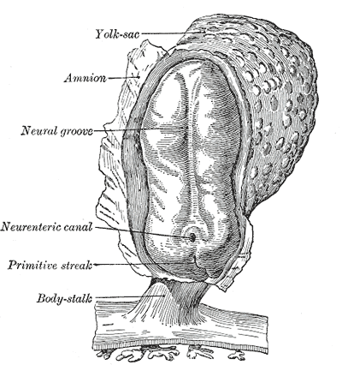
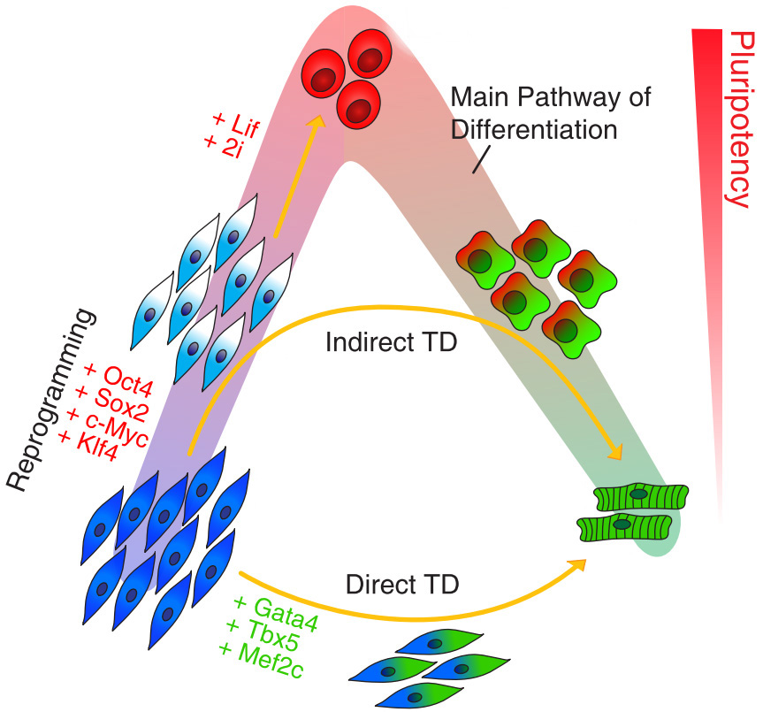
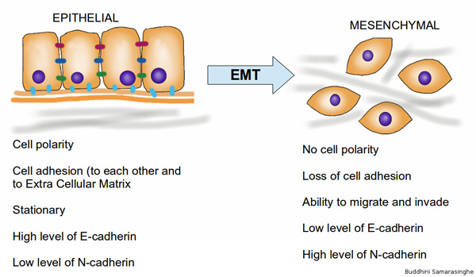
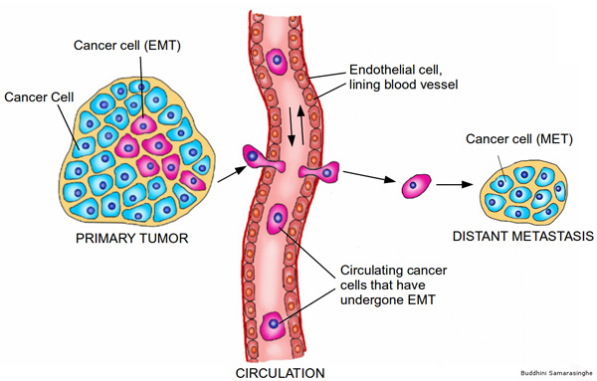
Cells exist in different interconvertible phenotypes
Induced pluripotent Stem Cells
https://en.wikipedia.org/wiki/Epithelial-mesenchymal_transition
Developmental process
Cardiomyocytes
Fibroblasts
Epithelial-to-mesenchymal transition (EMT)
Cell reprogramming
Tian et al., Biophys. J. 105:1079 (2013)
Zhang, Tian, et al., Sci Signaling, 7, ra91 (2014)
Zhang, et al., NPJ Sys Biol Appl, 4:18 (2018)
Zhang et al. Plos Comp Biol, 15: e1006786 (2019)
Tian, Zhou, et al., iScience, 23:101047 (2020)
Wang et al., Science Adv, 6:eaba9319 (2020)
Yu et al., Science, 339:580 (2013)
Cancer metastasis
Notes:
I always find it fascinating that cells, esp. mammalian cells can assume different phenotypes and cells can convert between phenotypes

Slide 4
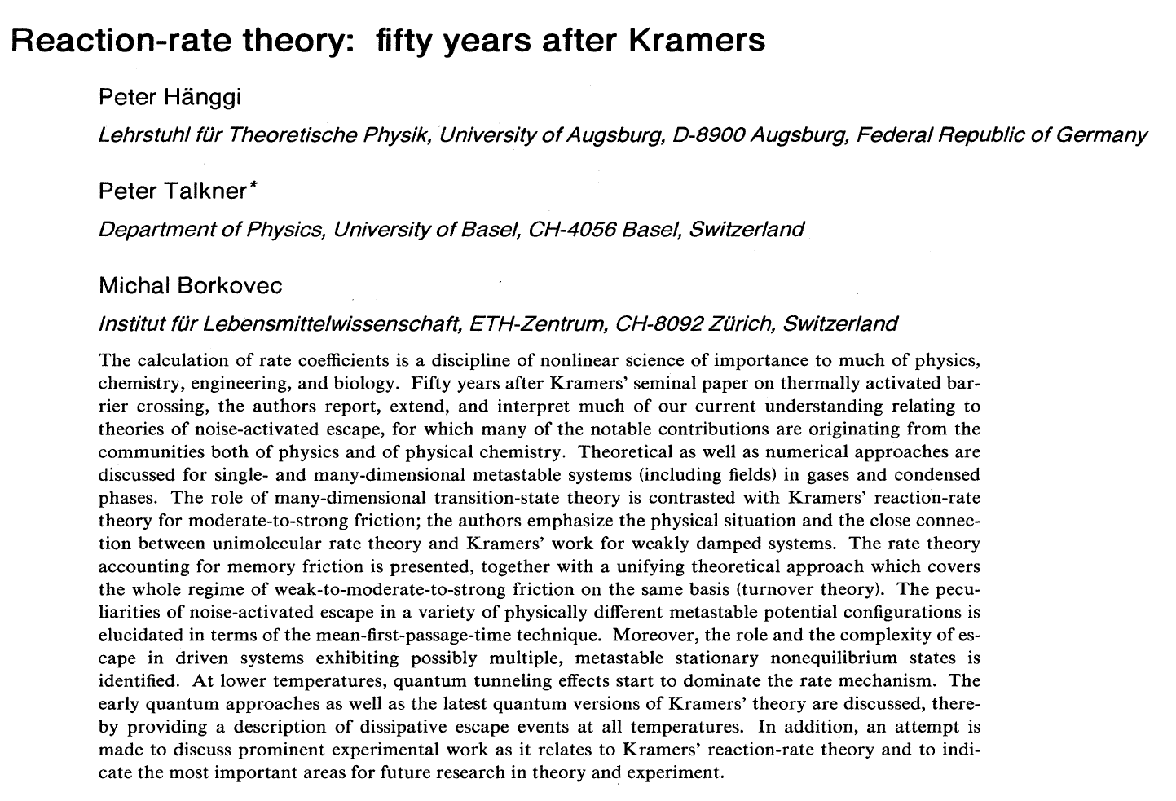
State transitions: An old problem in physics and chemistry
Cell type B
b
Dynamical equations describe cellular dynamics
a
Variable 2
c
Cell type A
Cell death
Variable 1
Rev Mod Phys. 62: 251 (1990)
Notes:
With the same set of genome, cells can exist in different phenotypes. Mathematically we can represent the state of a cell based on its gene expression profile or other features in a state space. Then different types of cells cluster into distinct regions. For a cell transitions from one state to another, it must follows some continuous paths. Especially we want to know the dominant paths, since they contain important information on the regulation mechanism and key regulators that we can perturb to modulate the transitions. For example, we see from A to B, both gene 1 and 2 are up-regulated. If this transition follows path a, upregulating both gene 1 and 2 may accelerate the process. For path b, we see upregulating gene 2 may help the transition at the beginning since the path is mainly along the gene 2 axis, but no much at the second stage when the path is mainly along the gene 1 axis. For path c, upregulating gene 1 may help the transition first but then slow down the transition.

Slide 5
Mathematical considerations on possible algorithms
Z: state vector completely specifies the internal cellular state at a given time
n(z,t): the number density; D(z): the diffusion “constant” matrix.
n
Under Stratonovich interpretation
n
The last nonlocal term accounts for discrete changes due to cell division, and its diagonal terms also include contribution from cell death.
Also here we have neglected explicit treatment of cell-cell interactions (assuming a mean field background, but can be easily added with agent-based modeling).
Numerical algorithms:
Population-based: A time series of n(z,t) to regress the PDE--- sensitive to accuracy of n(z,t)
Particle-based: (z, dz/dt) --- insensitive to accuracy of n(z,t)
Xing, J. Phys A: Math Theor Phys (2010); Xing, Physical Biology, 19: 061001 (2022)

Slide 6


Genome-wide transcriptomic vector field reconstructed from scRNA-seq data
Measured/derived (with any RNA/cell velocity estimation method) from single cell data
Dr Xiaojie Qiu
(Weissman lab at WI, MIT)
Nonlinear multi-dimensional vector function learned from x and dx/dt
https://github.com/aristoteleo/dynamo-release
https://dynamo-release.readthedocs.io/en/latest/Tutorial.html
Yan Zhang
Graduate student
Current: Illumina scientist
Qiu, Zhang, et al. Cell, 185 (4): 690-711 (2022)
Zhang et al., to be submitted

Slide 7
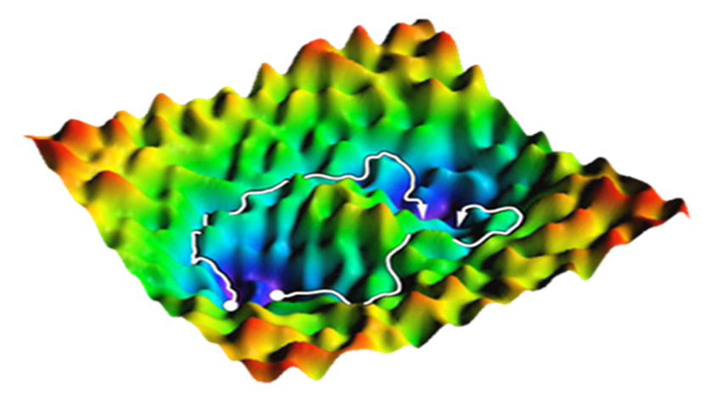
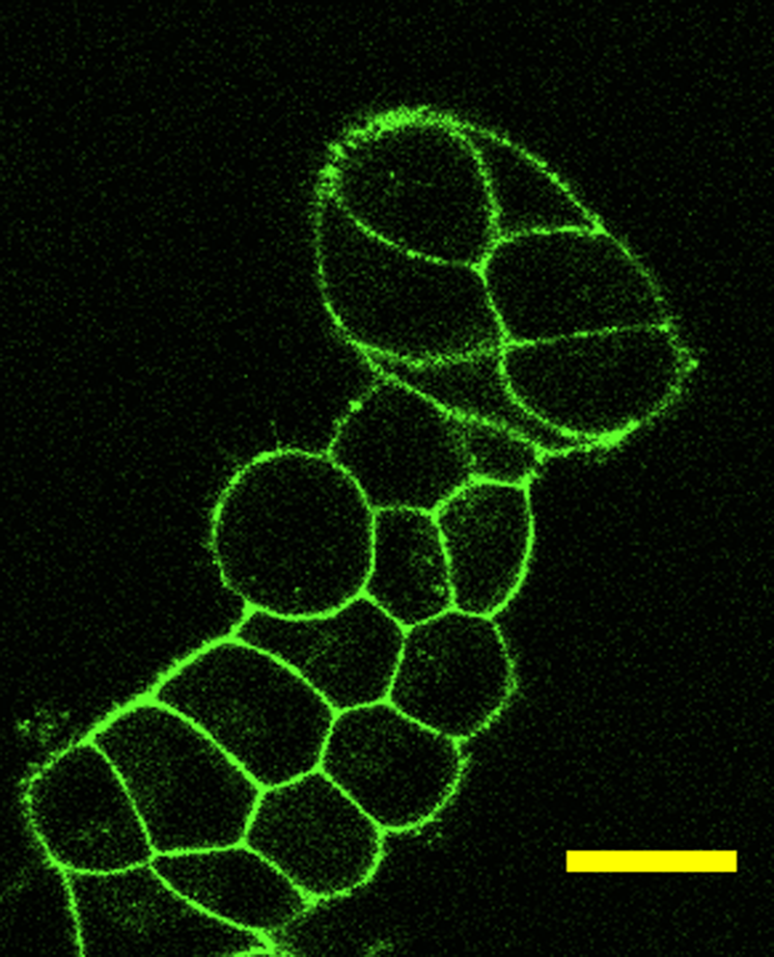
Choose coordinate systems for describing cell transformation
Level of gene expression is not good for live cell imaging
20 μm
Live cell trajectory tracing
Reflect the course of transformation: better collective coordinate
Easily measurable in high dimensions
Minimally intrusive and minimal damage to cells
Chen et al., Biol Method Protocol, 5:bpaa006 (2020)
Large cell morphological changes typically accompany cell phenotypic conversion
Multiplex (10² to 10³ DoF) live cell imaging of collective cell features

Slide 8



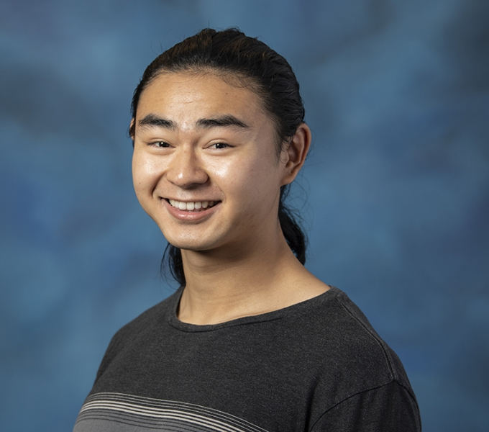
Live cell imaging studies on A549 cells undergoing EMT
Weikang Wang, Postdoc
Current: ITP/CAS
Dante Poe
Graduate student
Yaxuan Yang
Undergraduate student
Thomas Hyatt
Graduate student
1) Wang et al., Comp. Biol. Med, 108:133-141 (2019)
2) Wang et al., Science Adv, 6:eaba9319 (2020)
3) Wang et al. eLife, 11:e74866 (2022)

Slide 9
How do Epithelial-to-Mesenchymal Transition (EMT) proceed, one path or parallel paths?
Epithelial
Mesenchymal
It is possible that …multiple alternative paths can operate to enable an epithelial cell to advance towards a mesenchymal state
----Yang et al. Guidelines and definitions for research on epithelial–mesenchymal transition, Nat Rev MCB, 21, pages 341–352 (2020)

Slide 10
Human A549 cell line with endogenous Vimentin-RFP labeling
Morphology
(quantified by active shape model, 296 dimensions)
DIC channel
Vimentin
(quantified by Haralick features, 13 dimensions)
Fluorescent channel
(for Vimentin)
Before
2 days after TGF-β treatment
Wang et al., Science Adv, 6:eaba9319 (2020)
Wang et al. eLife, 11:e74866 (2022)
Chen et al., Biology Methods & Protocols, 5:bpaa006 (2020)

Slide 11
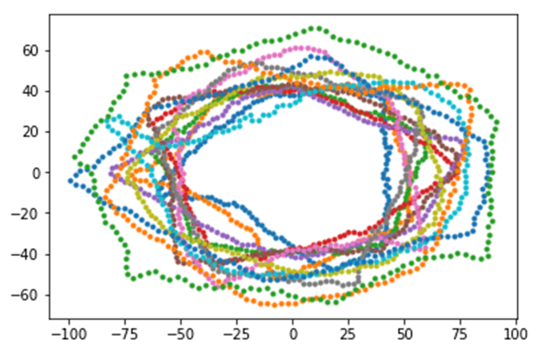
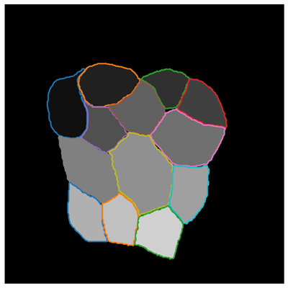
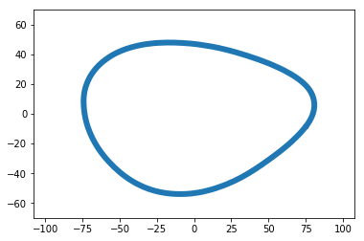
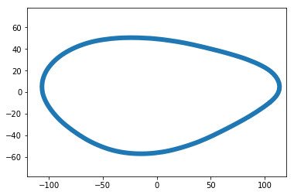
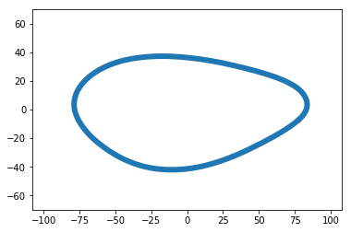
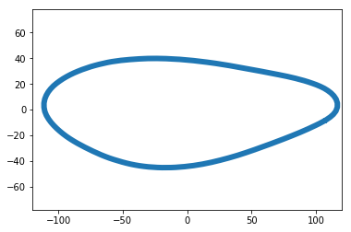
Mathematical representation of cell morphology
N
1
2
Y
DCNN-based cell segmentation
x
Wang et al., Comp. Biol. Med, 108:133-141 (2019)
Alignment of cells and active shape model representation
2N dimensional shape space
Pincus & Theriot, J Microsc, 227:140 (2007)
keren et al., Nature, 435: 475 (2008)
PC2
Expressing arbitrary cell shape by principal modes
(0,1)
(1,1)
Wang et al., Science Adv, 6:eaba9319 (2020)
(0,0)
(1,0)
PC1
Wang et al., Science Adv, 6:eaba9319 (2020)
Complete orthonormal basis set for cell shape

Slide 12
An integrated live cell imaging and quantitative image analysis procedure
Wang et al., Comp. Biol. Med, 108:133-141 (2019)
Wang et al., Science Adv, 6:eaba9319 (2020)
Wang et al. eLife, 11:e74866 (2022)

Slide 13

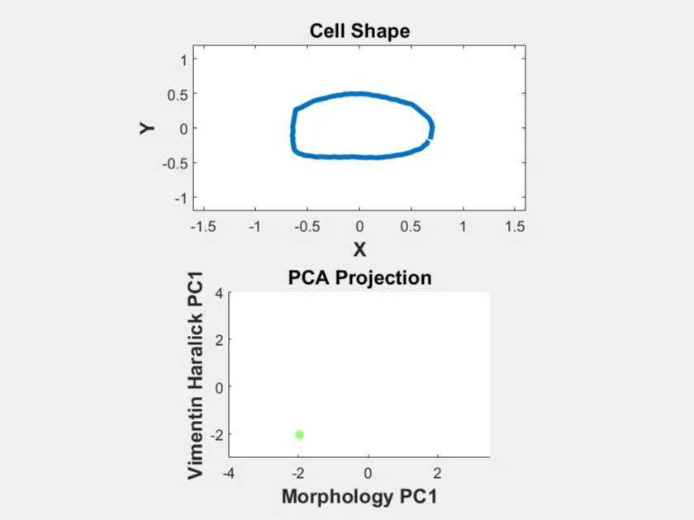
Typical single cell trajectory

Slide 14
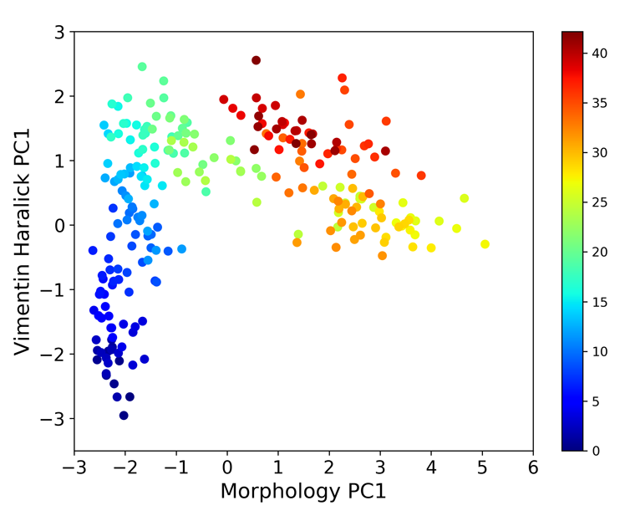
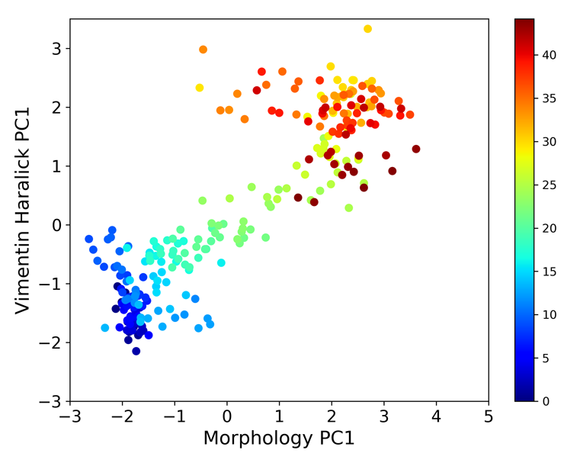
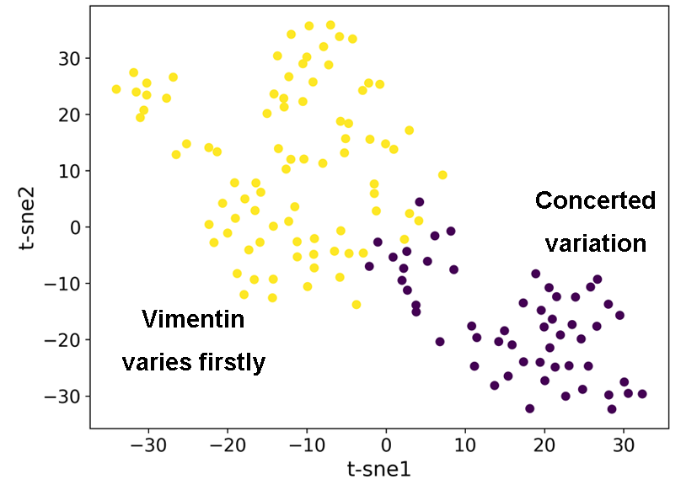
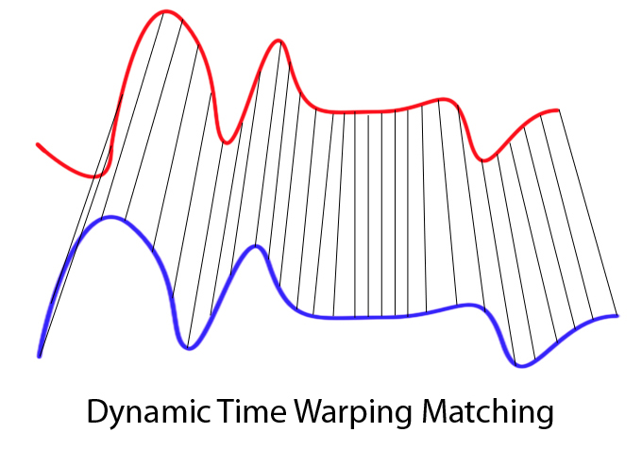
Single cell trajectories can be classified into two distinct groups
Time (hour)
Typical single cell trajectories
Clustering based on dynamic time warping distances between trajectories

Slide 15

Transition path ensemble and transition path theory
Transition path sampling
Reaction coordinate
Reactive trajectories
Reactive flux
Reaction tube
Non-reactive trajectories
Bolhuis et al. Annu Rev Phys Chem, 53:291 (2002)
E, Vanden-Eijnden, Annu Rev Phys Chem, 61:391 (2009)
http://gold.cchem.berkeley.edu/statmech/
A theoretician’s dream comes true: Now we can monitor high-dimensional reactive/non-reactive trajectories!

Slide 16
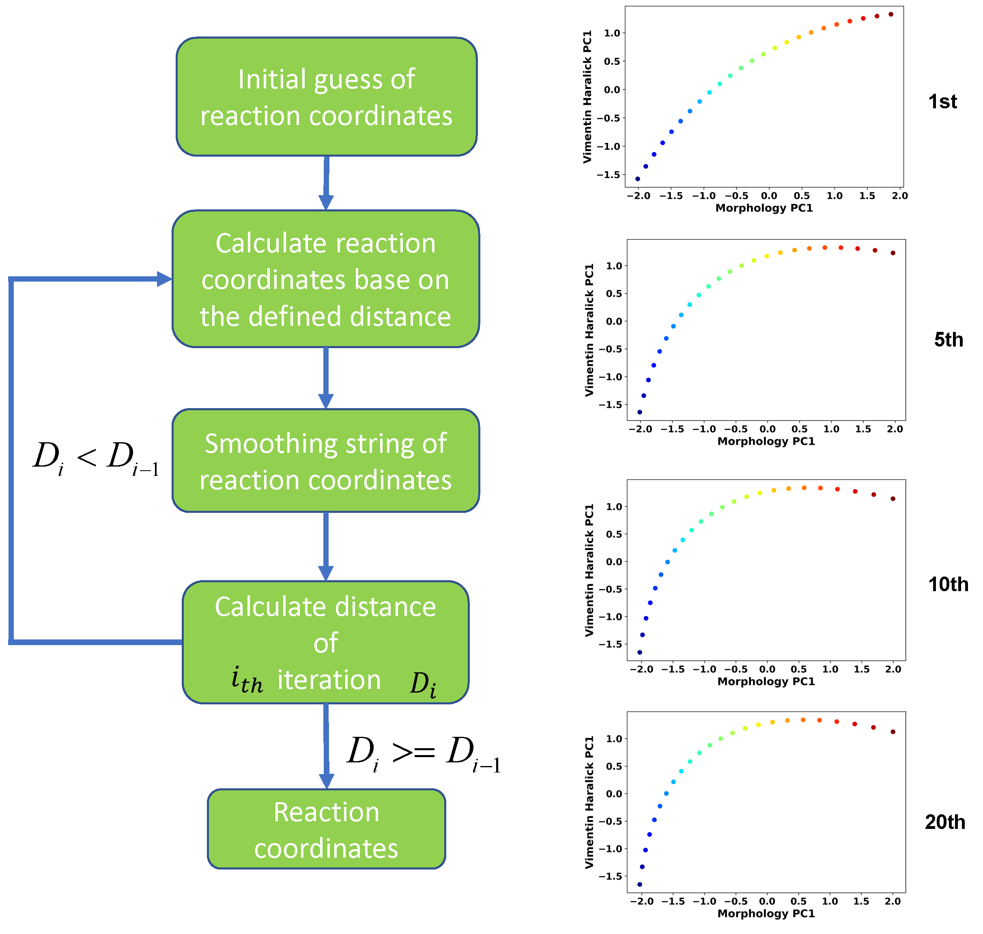
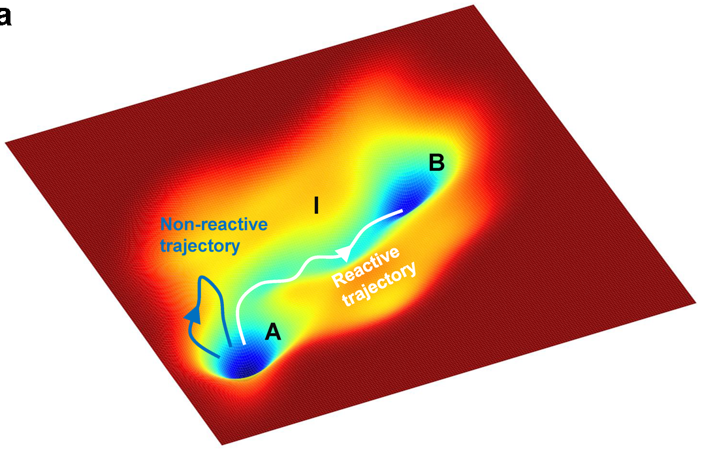
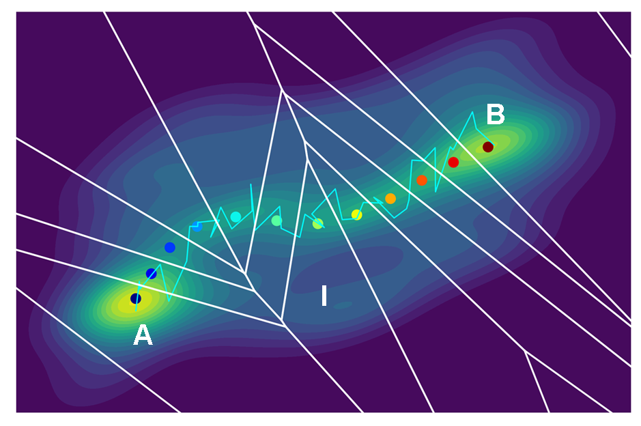
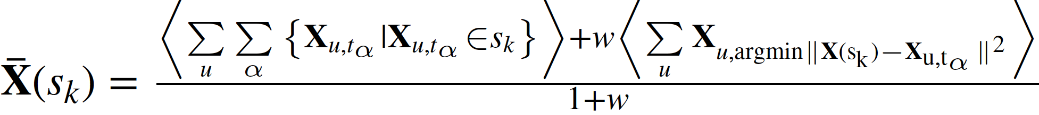
Reconstruct reaction coordinate in multi-dimensional state space with revised finite temperature string method
Reaction tube
E, W., Vanden-Eijnden, E., Annu Rev Phys Chem, 61:391-420
Wang et al. eLife, 11:e74866 (2022)

Slide 17
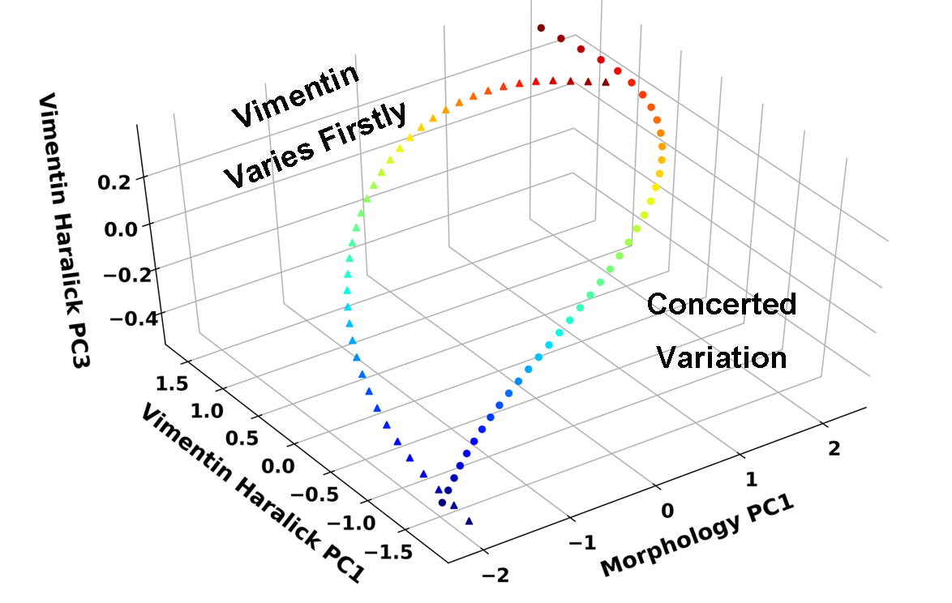
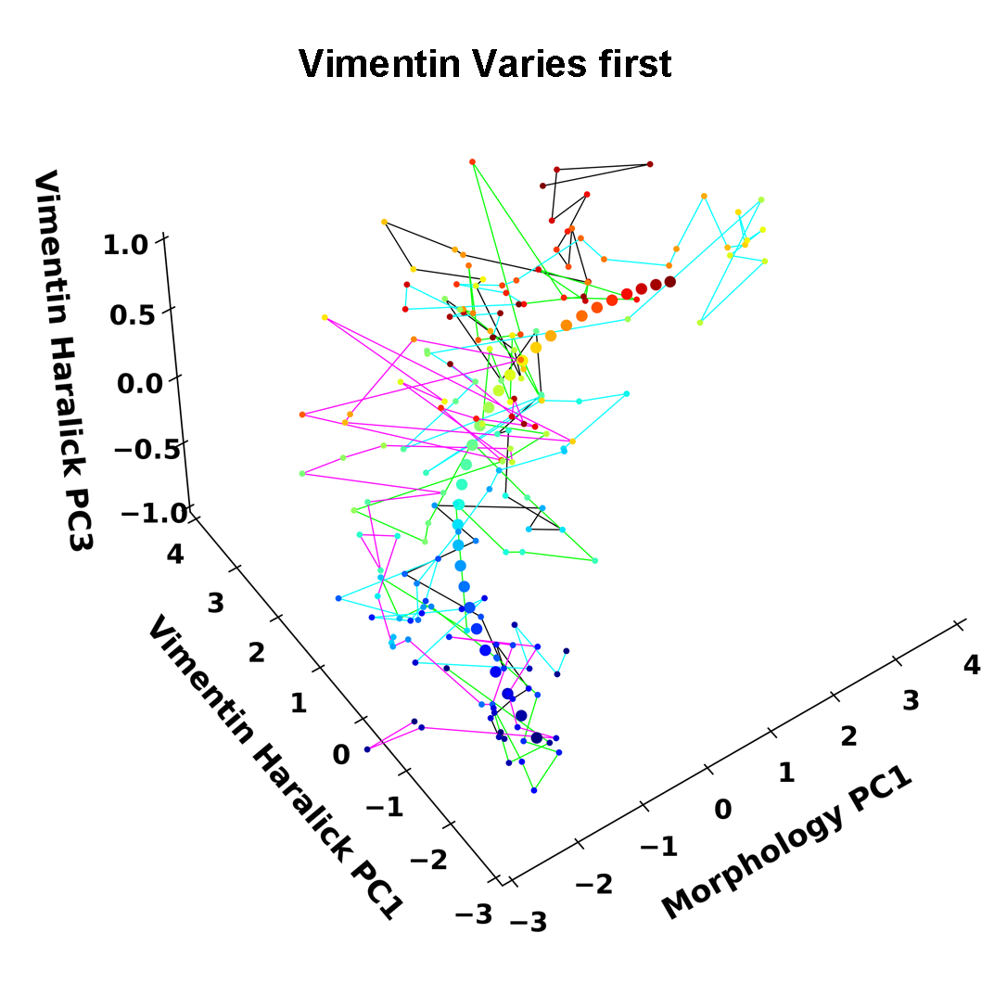
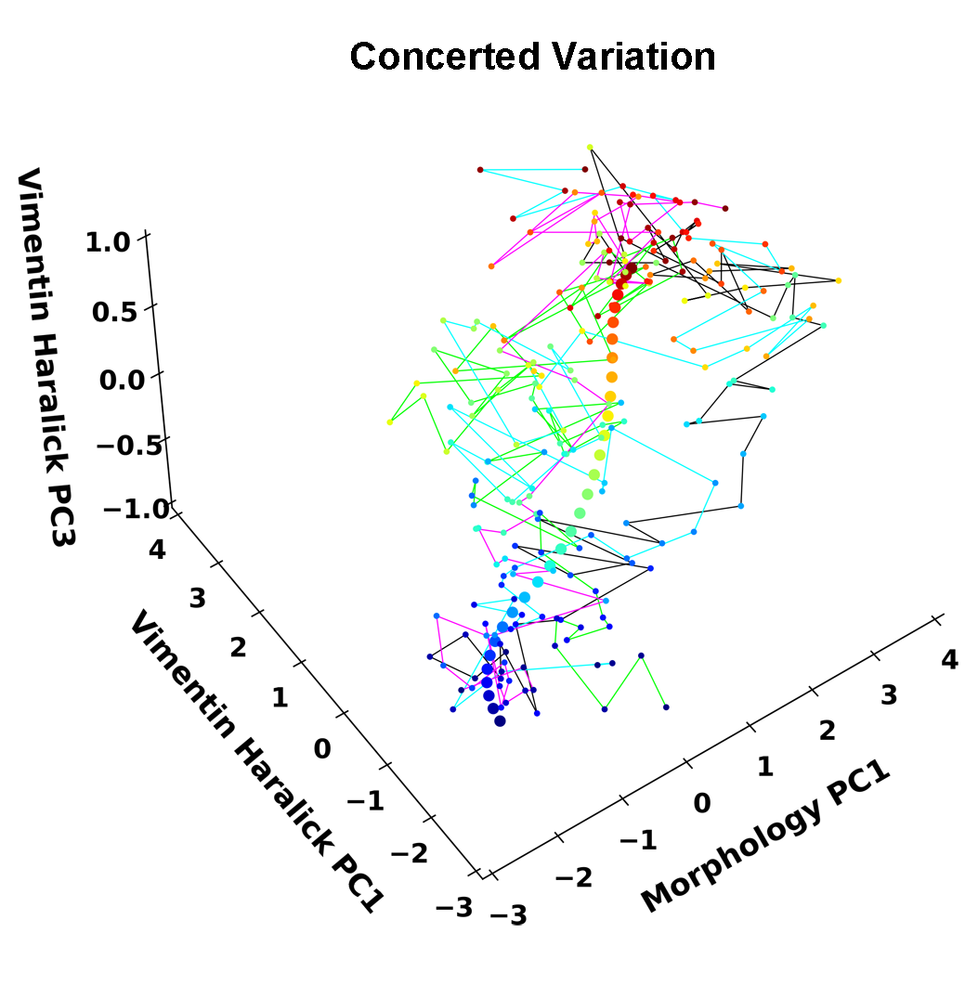
Live cell imaging reveals two parallel EMT transition paths
Vimentin
varies first
Reconstruct reaction coordinate in multi-dimensional state space with revised finite temperature string method
Concerted
variation
E, W., Vanden-Eijnden, E., Annu Rev Phys Chem, 61:391-420
Wang et al. eLife, 11:e74866 (2022)

Slide 18
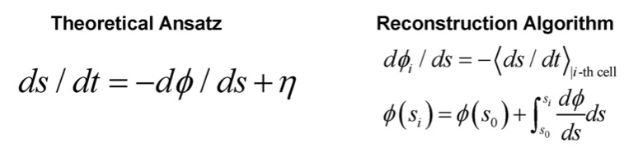
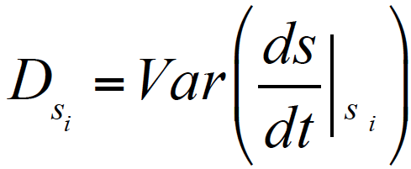
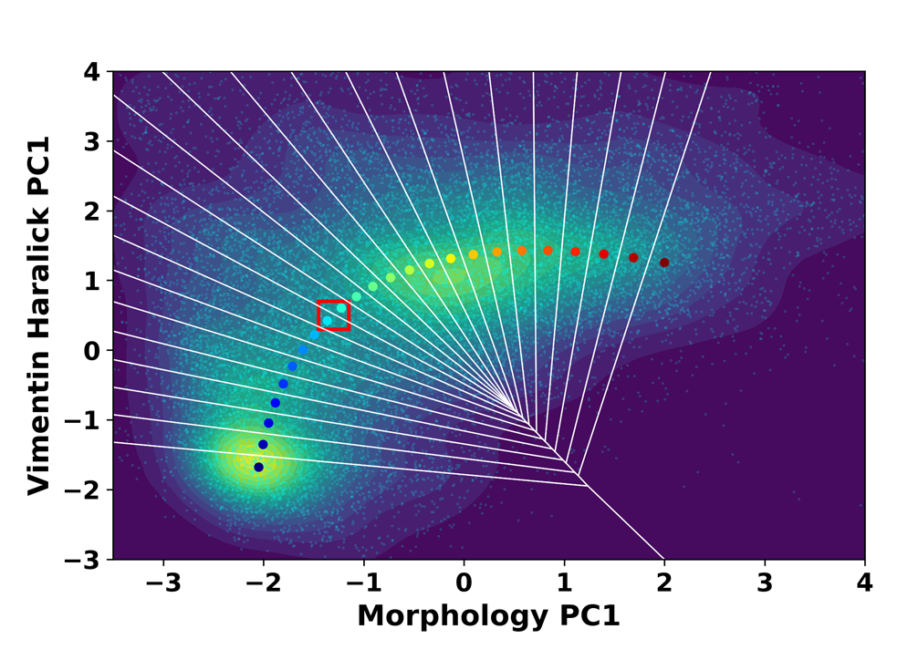
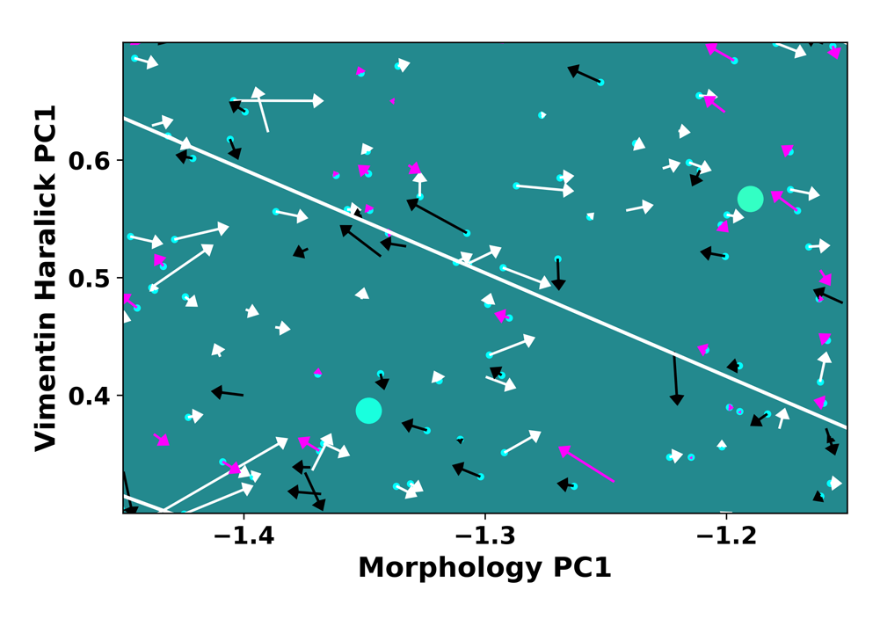
Rigorous reconstruction of cell dynamics from imaging data
i-th Veronoi cell
Wang et al. eLife, 11:e74866 (2022)

Slide 19
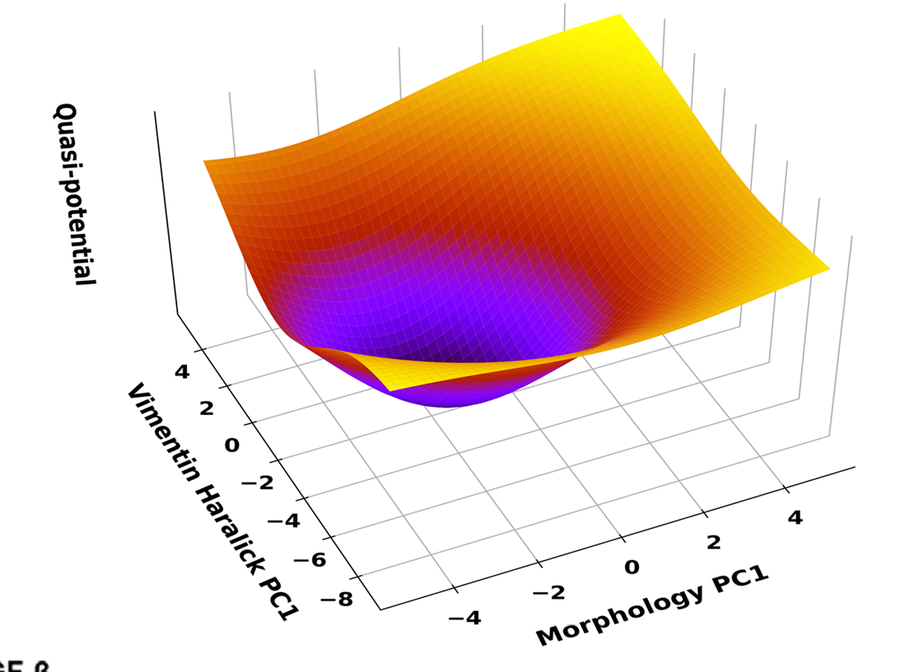
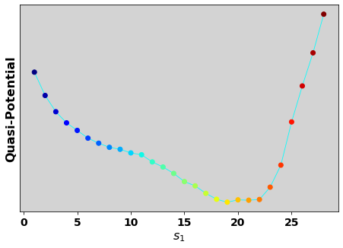
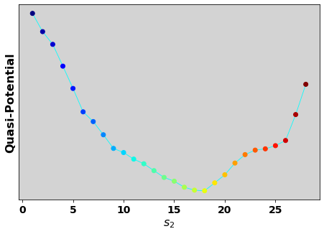
Rigorous reconstruction of cell dynamics from imaging data
i-th Veronoi cell
Vimentin varies first
Concerted variation
Cells treated with 4 ng/ml TGF-β for two days
Wang et al. eLife, 11:e74866 (2022)

Slide 20
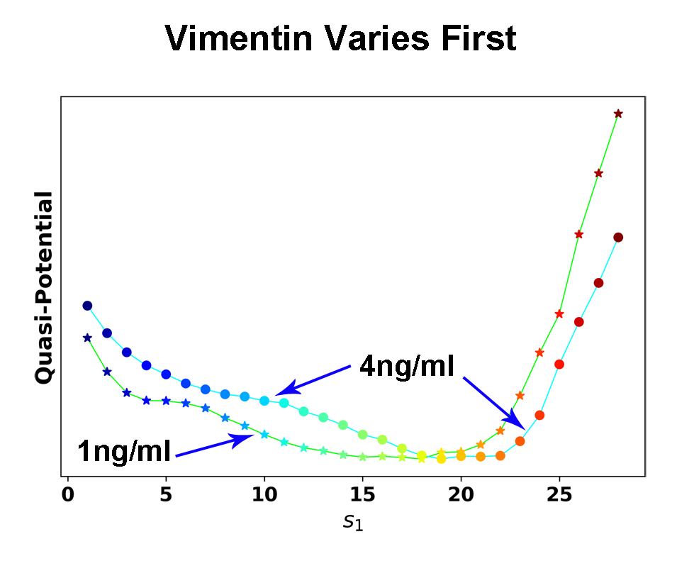
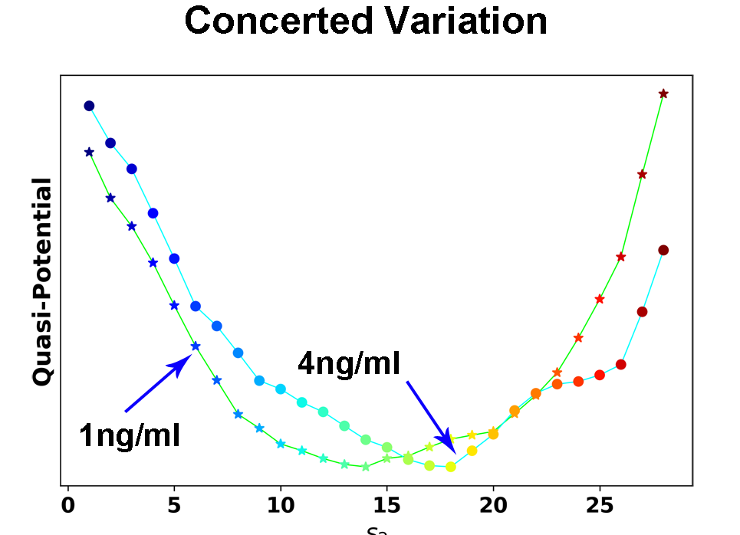
Rigorous reconstruction of cell dynamics from imaging data
i-th Veronoi cell
Vimentin varies first
Concerted variation
Cheap experiment,
rich information revealed through quantitative analyses!
1 ng/ml: Concerted trajectories dominate
4 ng/ml: Vimentin first trajectories dominate
Wang et al. eLife, 11:e74866 (2022)

Slide 21

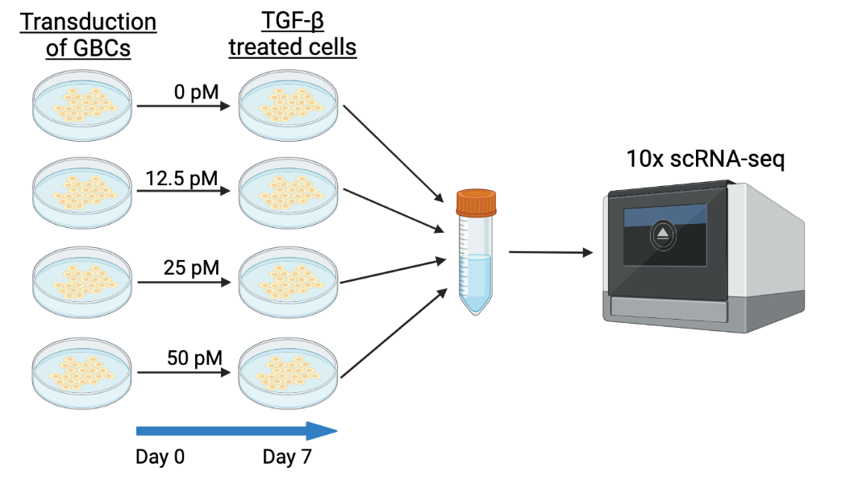
Genome-wide transcriptomic vector field reconstructed from scRNA-seq data
Measured/derived from single cell data
Sophia Hu
Graduate student
Human MCF10A cells treated with TGF-beta
Nonlinear multi-dimensional vector function learned from x and dx/dt
Qiu, Zhang, et al. Cell, 185 (4): 690-711 (2022)
Zhang et al., to be submitted

Slide 22
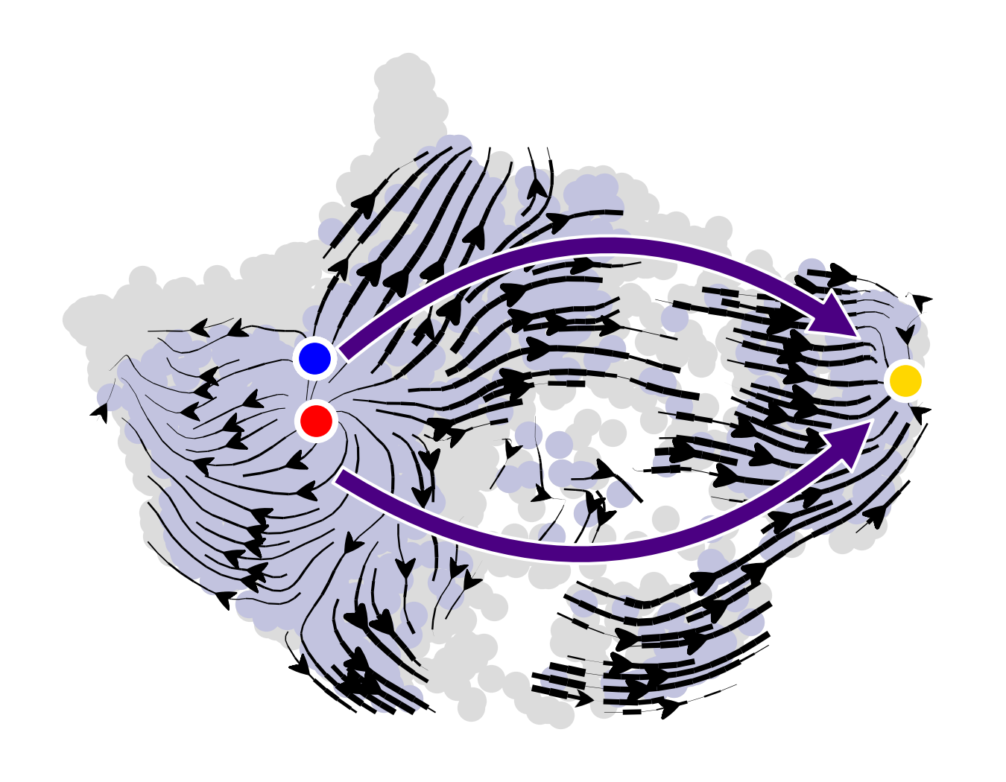
Vector field reconstruction for each TGF-β concentration (projected to 2D space for visualization)
Stable fixed point
TGF-beta Dose 12.5 pM
Unstable fixed point
E
M
Notes:
Still use these vector fields?

Slide 23
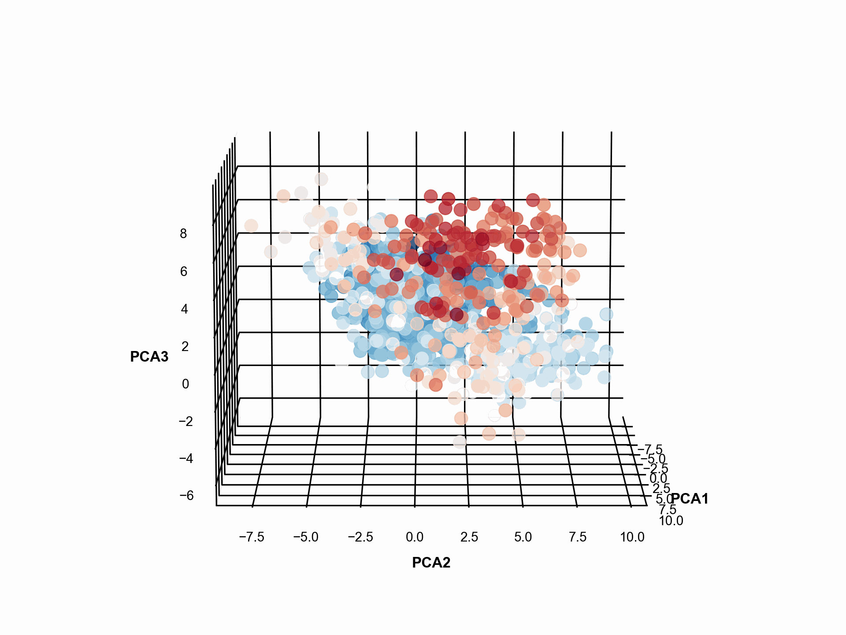
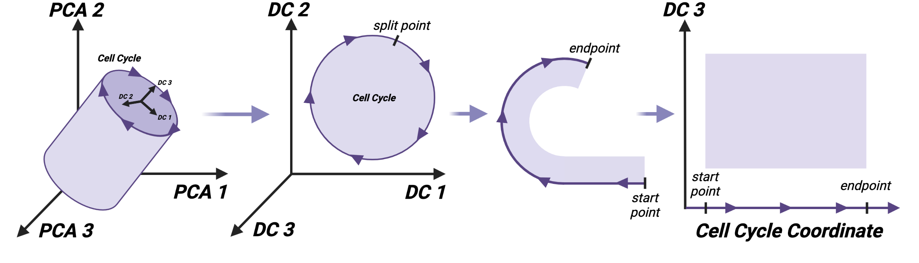
Coordinate rotation reveals topological structure of the manifold
Dose 0
Schwabe et al., Mol Sys Biol, 16(11):e9946 (2020)
Notes:
For untreated cells: See if the potential G0 cells correspond to the upper left region of the Cell cycle coordinate/DC3 representation
What are the swirly vectors in the vector field near G2M region?
Cell cycle related genes: how they change along this coordinate: along cell cycle coordinate
boxplot?
When cells divide: there is a gap (choose that as the starting point) --> need objective criteria
Present in a systematic waY

Slide 24
Coordinate rotation reveals topological structure of the manifold
Dose 0
Schwabe et al., Mol Sys Biol, 16(11):e9946 (2020)
Notes:
For untreated cells: See if the potential G0 cells correspond to the upper left region of the Cell cycle coordinate/DC3 representation
What are the swirly vectors in the vector field near G2M region?
Cell cycle related genes: how they change along this coordinate: along cell cycle coordinate
boxplot?
When cells divide: there is a gap (choose that as the starting point) --> need objective criteria
Present in a systematic waY

Slide 25
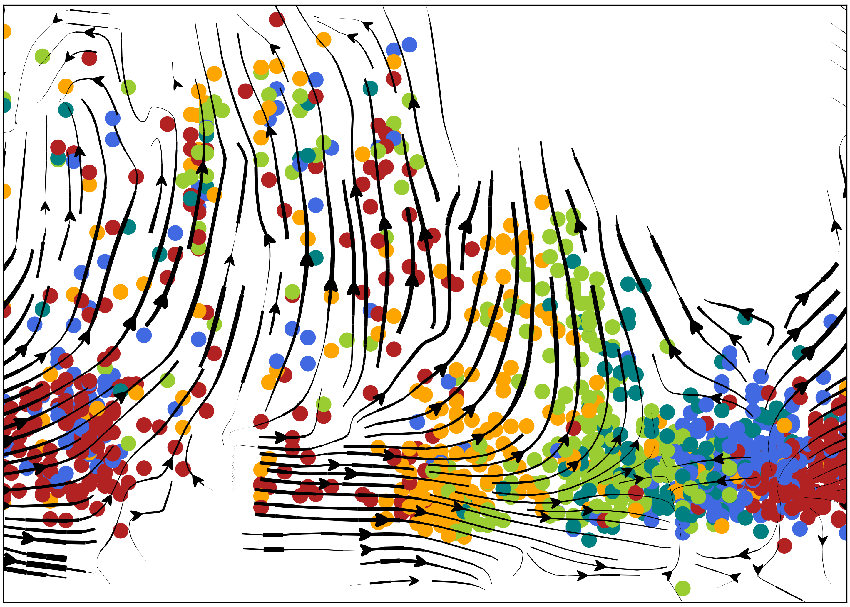
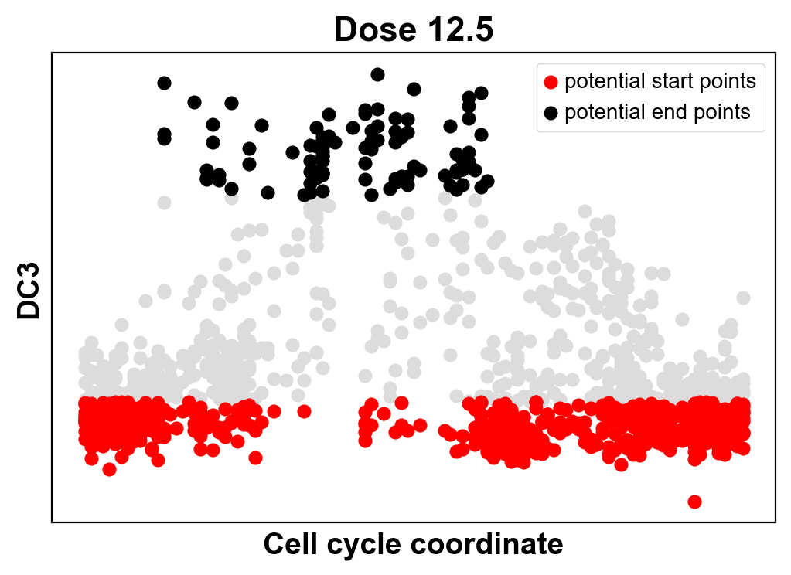
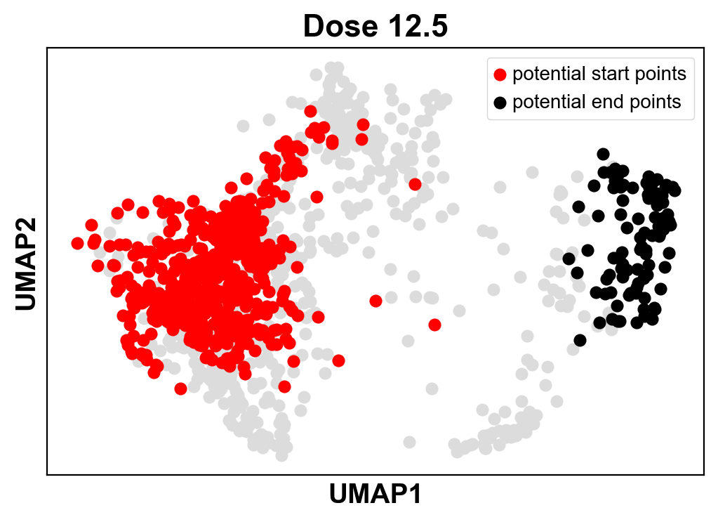
The vector field projected to the cell cycle-EMT plane
Dose 12.5 pM
DC3
M
M
Reactive
I
Nonreactive
E
E
Cell cycle coordinate
Nonreactive
Reactive
Vanden-Eijnden, E., Annu Rev Phys Chem, 61:391-420
Zhang, Qiu, et al., to be submitted
Non-reactive trajectories
Notes:
Switch back to less than for E and more than for M cells

Slide 26
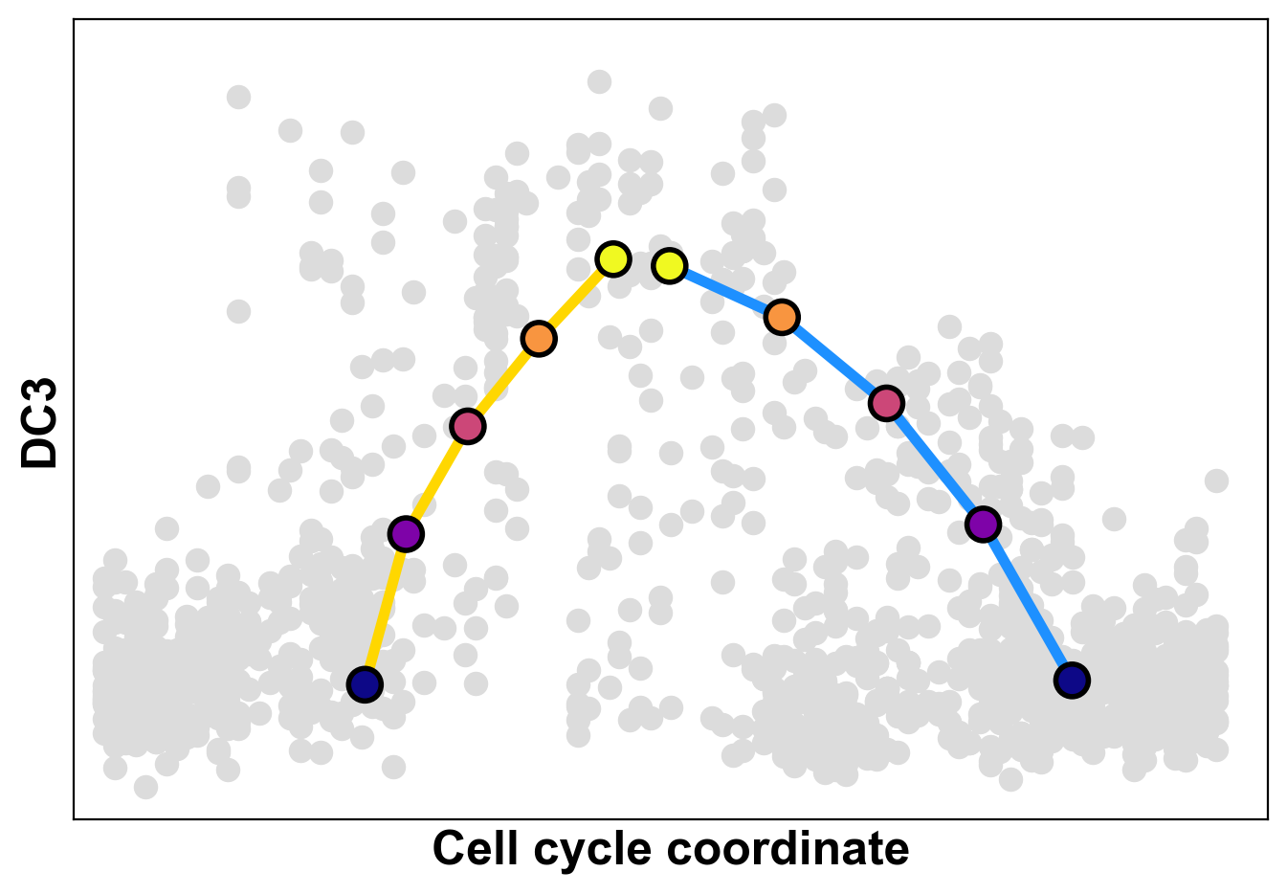
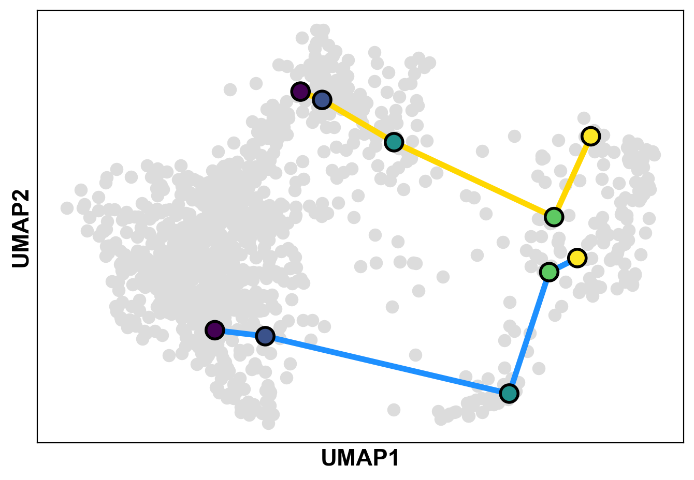
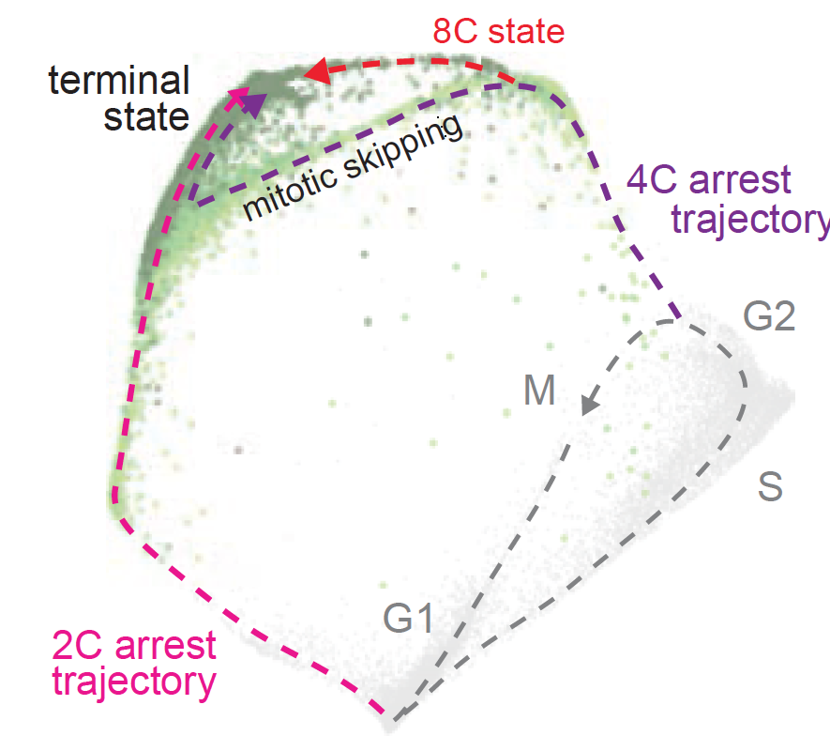
Cells undergoing G2/M arrest moves to a G1/S attractor without cell division
M
M
E
E
G1-S
S
G2
G2M
MG1
Hu et al., to be submitted
Cells that exited the cell cycle from G2 (with 4 copies of DNA) converged on a molecular state expressing high levels of G1 cyclins and CDKs… through a phenomenon known as “mitotic skipping”
Stallaert et al., Mol Sys Biol, (2022)18:e11087

Slide 27
Jacobian analyses suggest top genes contributing to the coupling
Rb/E2F
USP51-P
USP51
Cyclin D1
ZEB1
CDK4
Cyclin B1
G2/M arrest
EMT
M
Cyclin D
Cyclin B
Expression levels
EMT
M
E
G1
S
G2
M
Cell cycle coordinate
Hu et al., to be submitted
Notes:
USP51: Involved in histone deubiquitination; regulation of cell cycle process

Slide 28
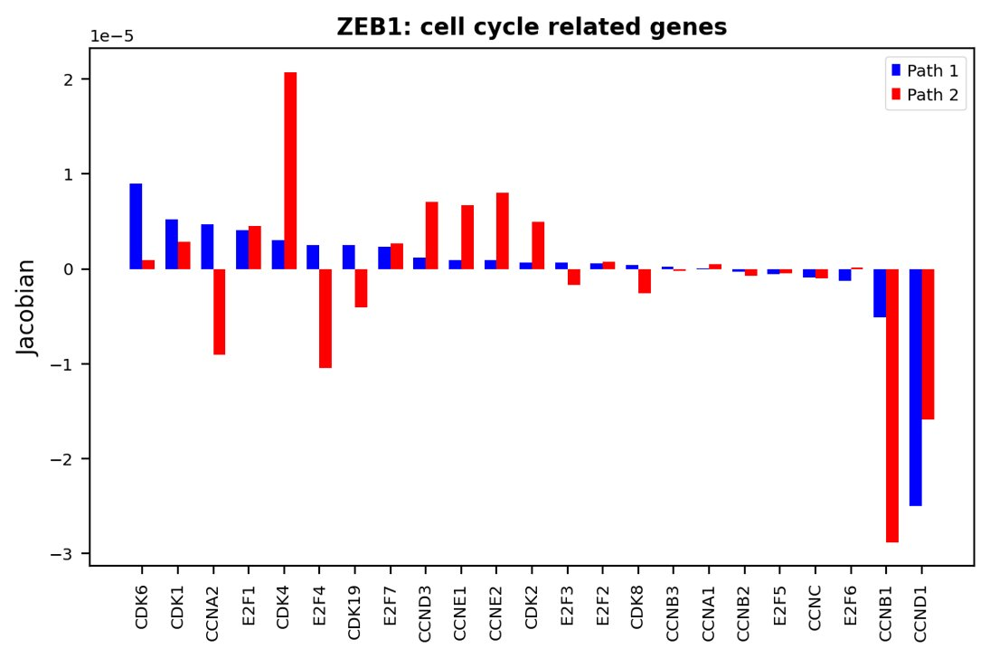
Jacobian analyses suggest top genes contributing to the coupling

Slide 29
Interim Summary
M
M
Vimentin
varies first
Concerted
variation
EMT
M
E
E
Cell cycle coordinate
Wang et al., Sci Adv 2020, eLife 2022
Hu et al., to be submitted

Slide 30

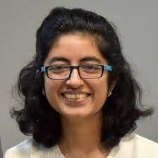
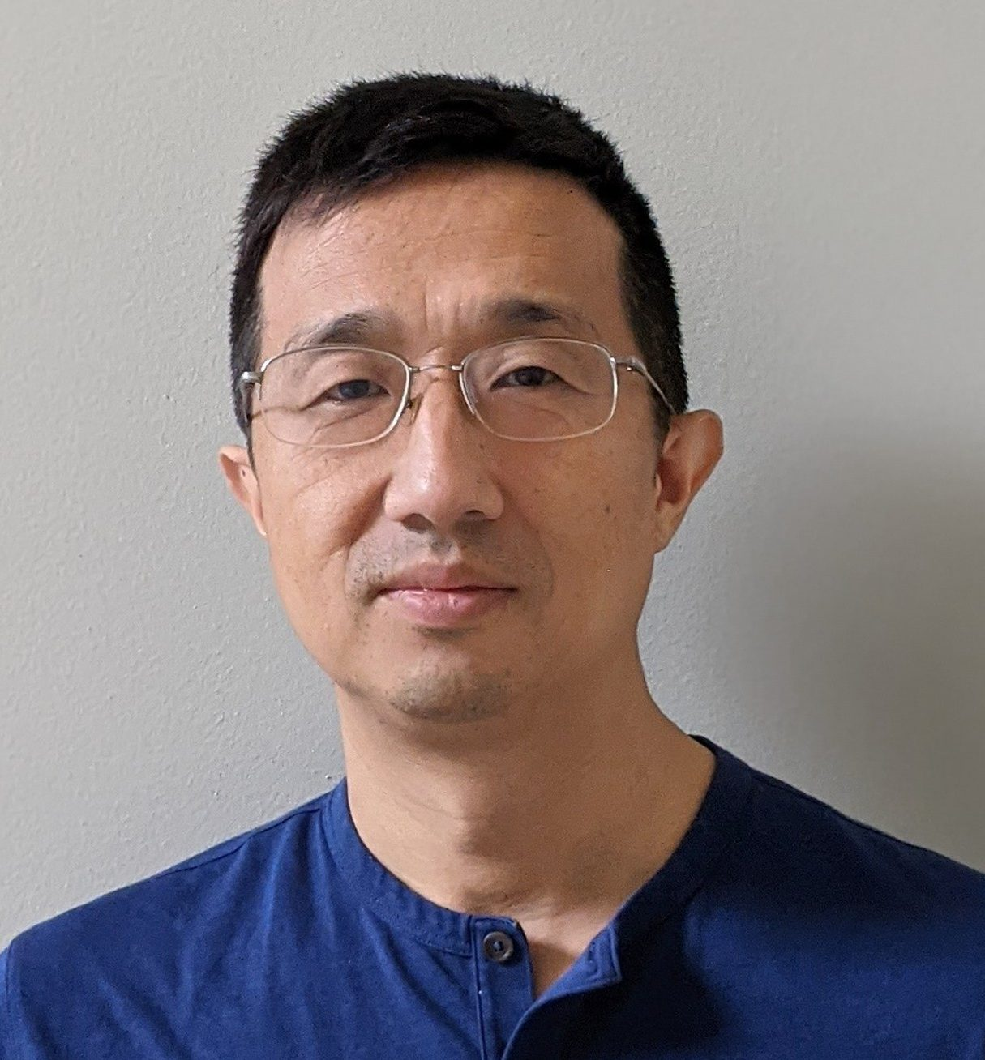
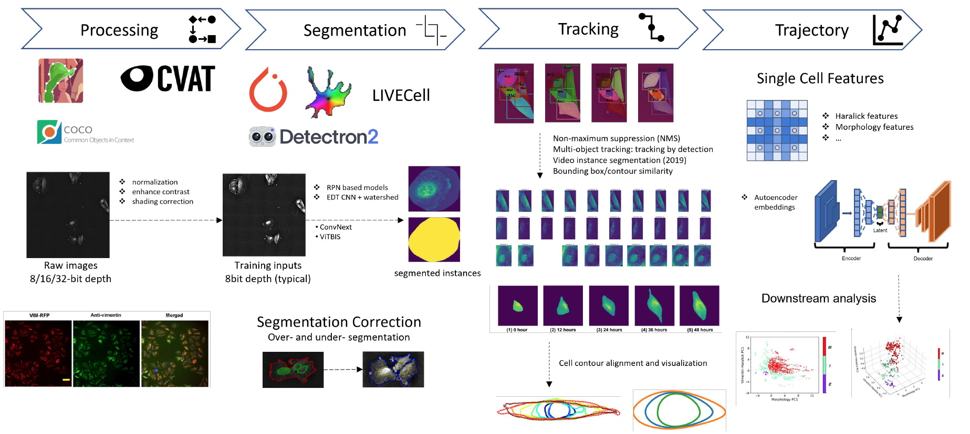
Some ongoing efforts
Ke Ni
Graduate student
Yajushi Khurana
Graduate student
Dante Poe
Graduate student
Yaxuan Yang
Master student
Weikang Wang, Former postdoc
Yong Lu
Postdoc
LiveTracker: a versatile package for live cell image and trajectory analyses

Slide 31
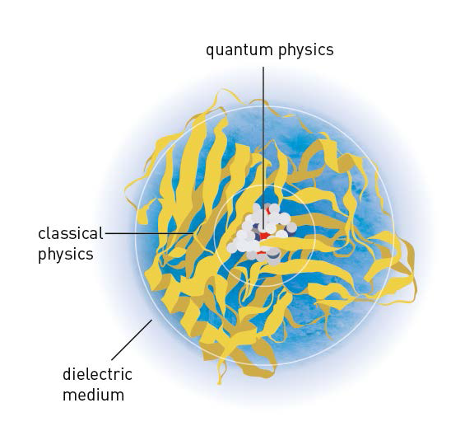



Summary
Emerging trend of data sciences
Statistics
Statistical Physics
Mathematical representation
Quantitative data
Governing dynamical equations
Live cell imaging
Fixed cell data
2013 Nobel Prize in Chemistry for the development of multiscale models for complex chemical systems
 | Xing, Physical Biology, 19: 061001 (2022)

