Slide 1

Power of Bayesian Methods in Stellar Evolution
Ted von Hippel (PI, Embry Riddle)
Anna Childs (astro, Northwestern)
Aaron Geller (astro, Northwestern)
Joey Hammill (astro, Embry Riddle)
Elizabeth Jeffery (astro, Cal State SLO)
Erin Motherway (astro, U Wisconsin)
Elliot Robinson (software, Embry Riddle)
David Stenning (stats, Simon Fraser)
Alisa Tiselska (astro, Embry Riddle)
David van Dyk (stats, Imperial College)
+ additional current and past undergraduate students
Astrostatistics in Canada and Beyond, Banff 1 Nov 2023

Slide 2
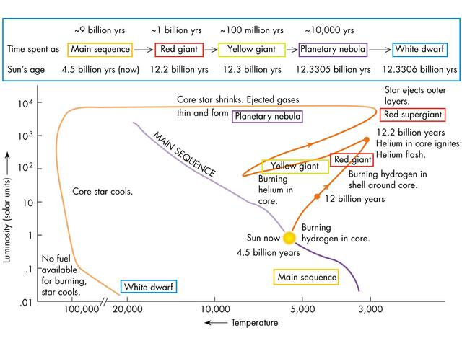

Slide 3
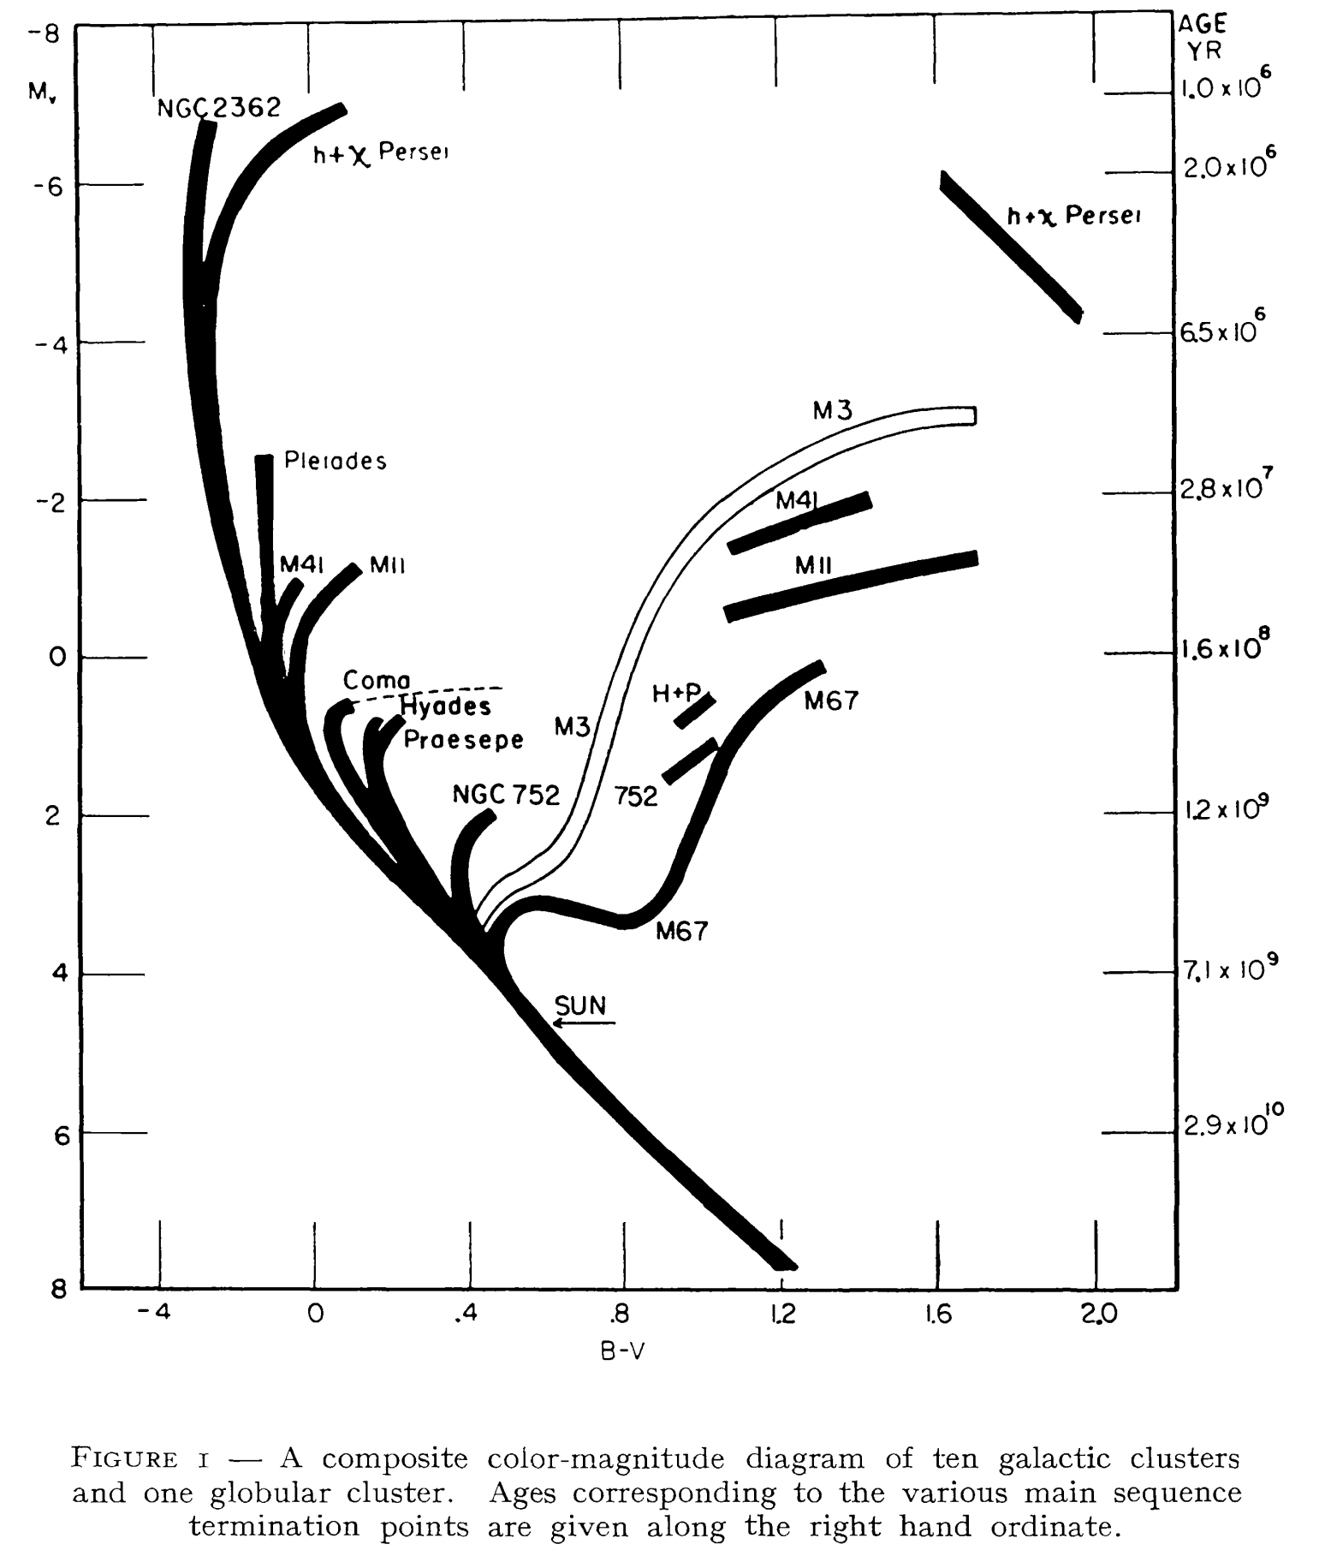
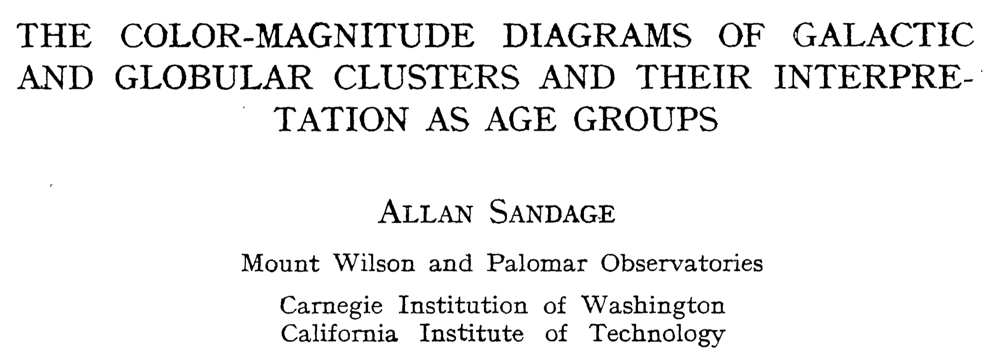
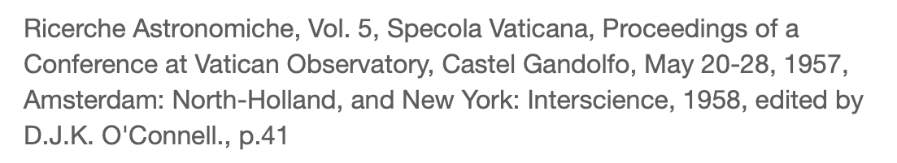
Discussion chaired by J Oort: Qs from Baade, Hoyle, Morgan, Oort, Salpeter, Schwarzschild, Spitzer, Strömgren

Slide 4
from Hugh Harris:
“160 WDs with new
or improved USNO
parallaxes”
age
Goal: Age & Mass
Note: unknown distances yield unknown radii & masses
mass
hydrogen
helium
Notes:
To get age, determine Mv, mass, H/He
I don’t believe this was ever published

Slide 5
BASE-9 Overview
(Bayesian Analysis of Stellar Evolution)
Simulate star or cluster
Bayesian MCMC + numerical integration

Slide 6
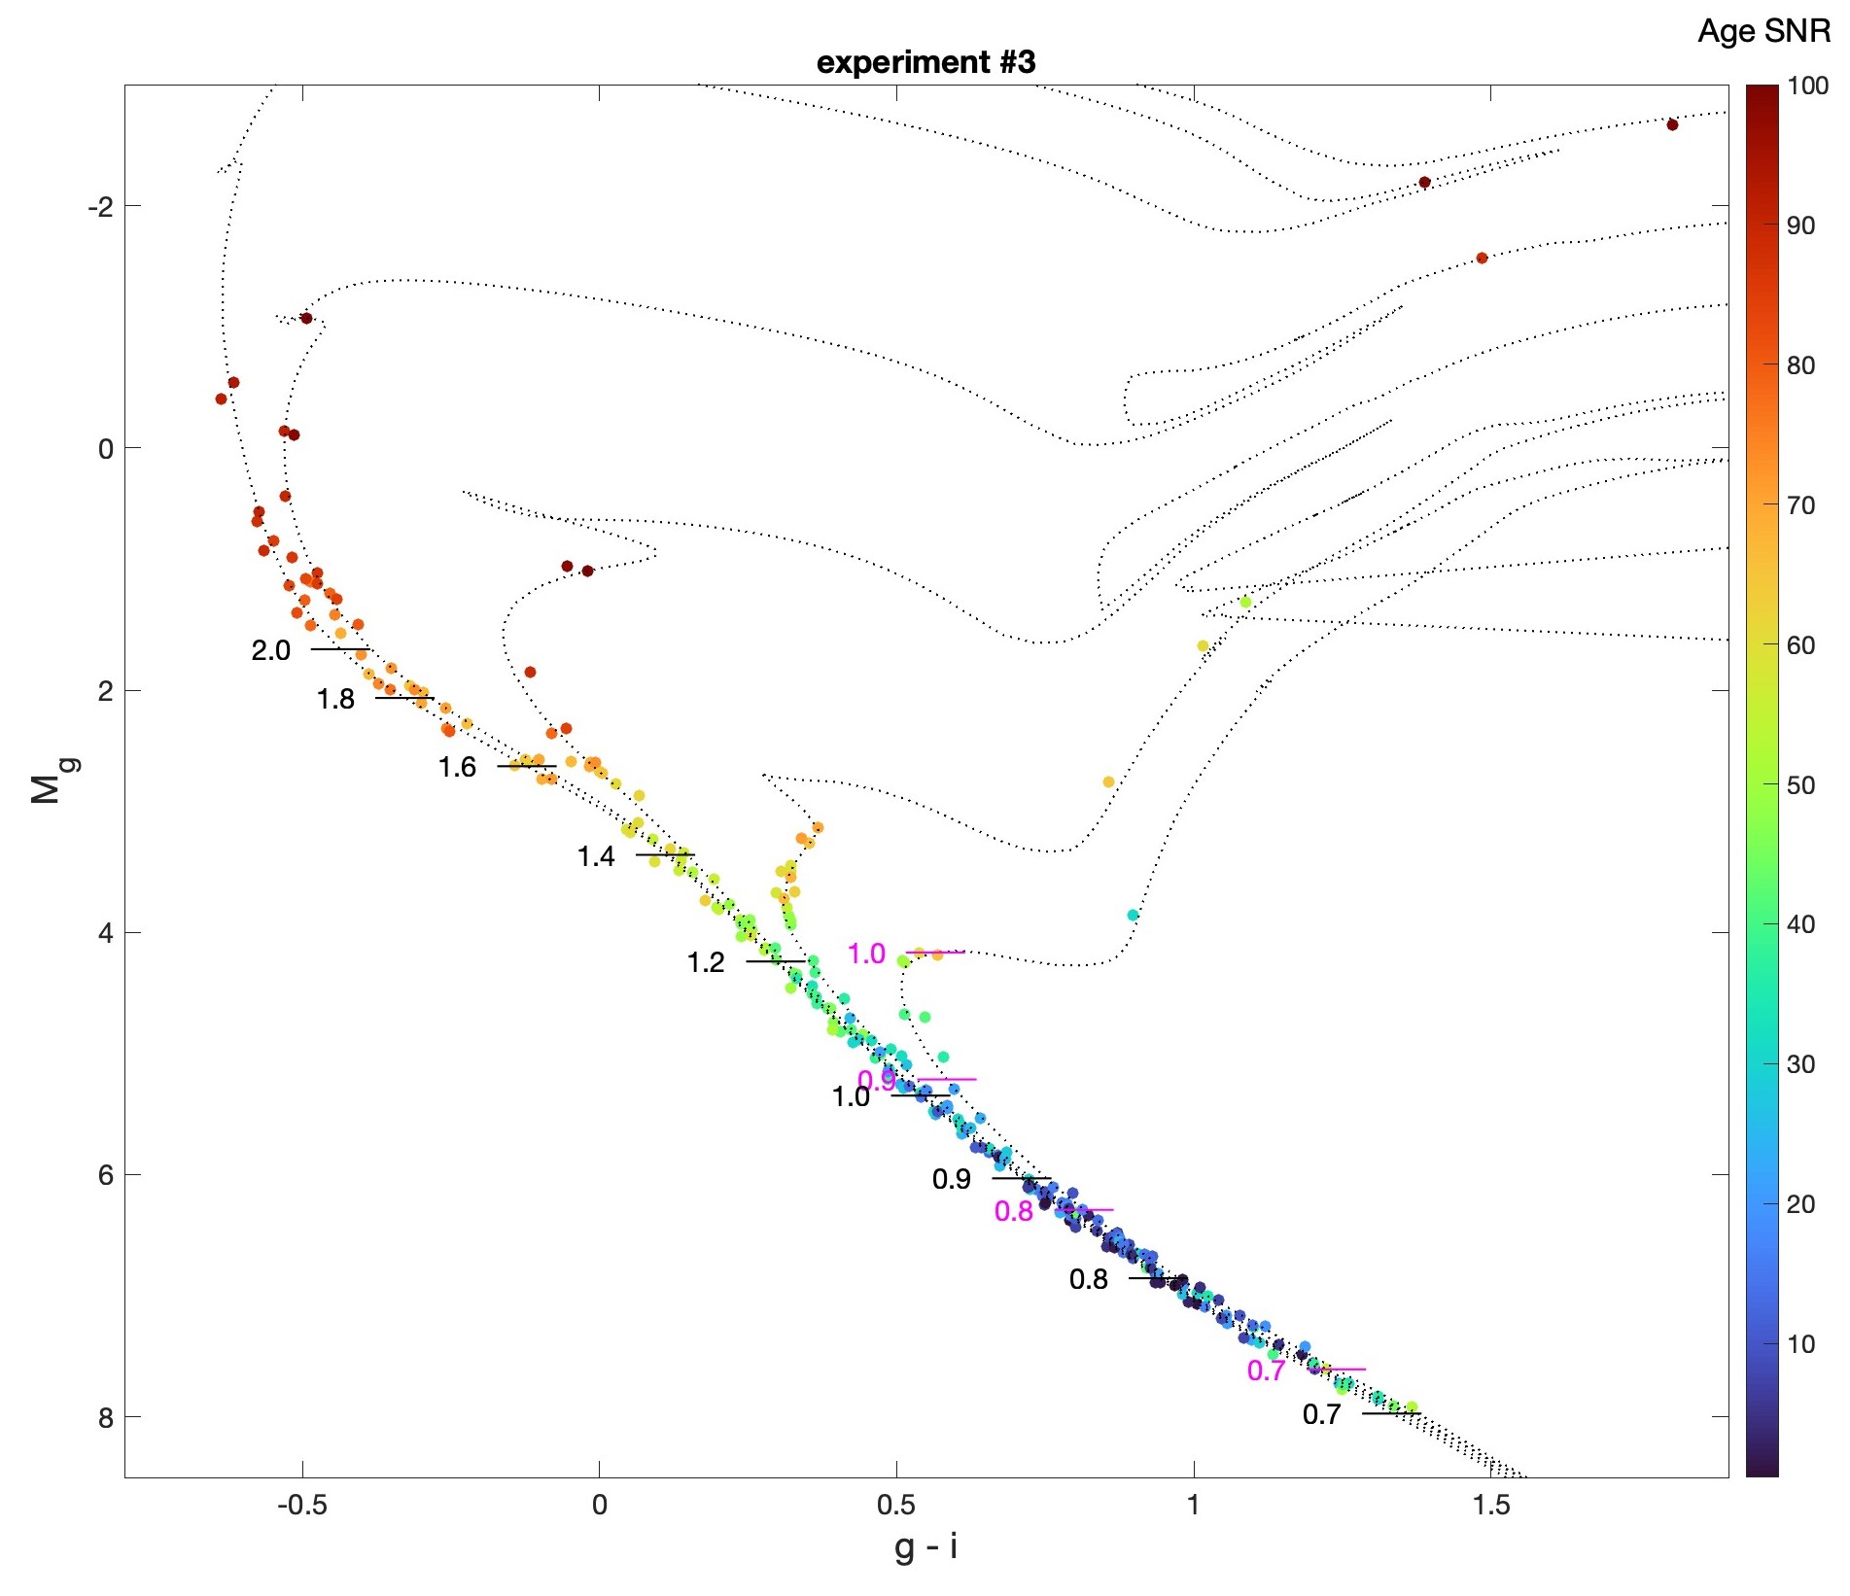
Simulation parameters
[Fe/H] = 0
Age = 0.1, 0.33, 1, 3.3, 10 Gyr
Pan-STARRS grizy
Models
PARSEC stellar evolution
Montgomery 2018 WDs
Bergeron 2020 WD atmos
Cummings PARSEC IFMR
Introduced errors
𝝈 = 0.01 mag (photometry)
𝜹𝝕/𝝕 = 0.01 (parallax)
Priors for BASE-9 recovery
[Fe/H] = 0 ± 0.05
Av = 0 ± 0.05
𝜹𝝕/𝝕 = 0.01

Slide 7
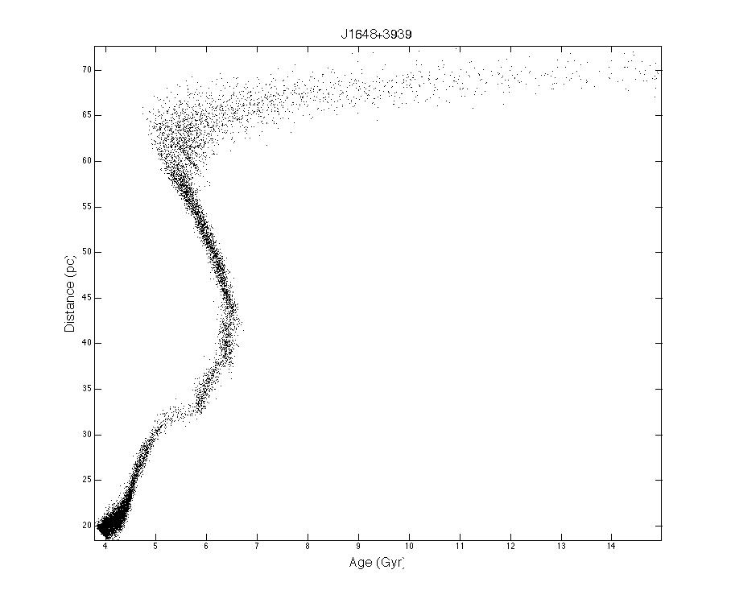
0.54 Mo
precursor age dominated = f(IFMR, Z)
latent heat dominated
Mass
Remember: Unknown distance means unknown radius & mass
crystallization important
1.4 Mo
4
14
Age (Gyr)
Notes:
Explain M axis means stellar radius means L means distance

Slide 8
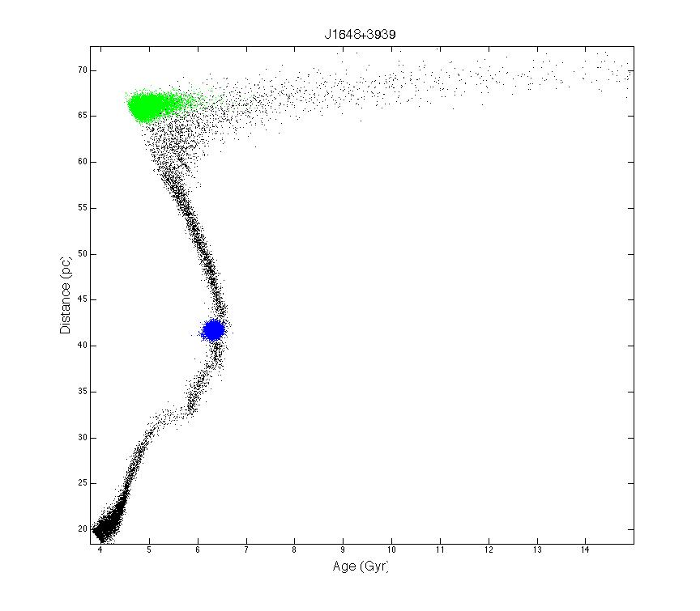
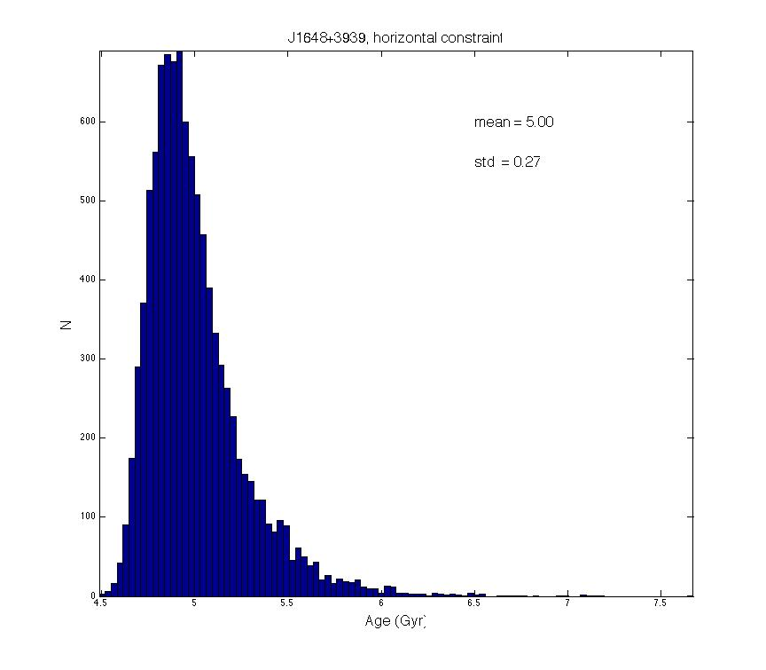
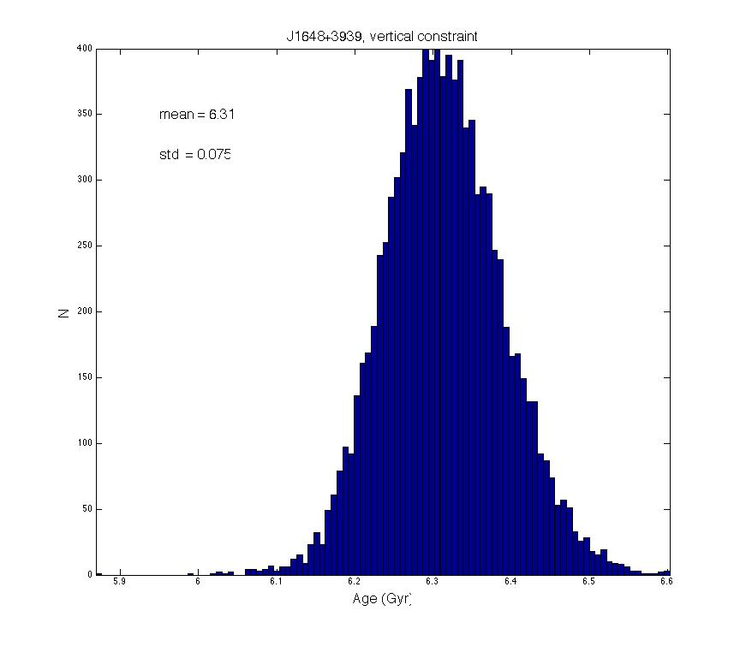
70
66.07 ± 0.6 pc
5.00 ± 0.27 Gyr
(5.4%)
Distance (pc)
5
6
7
41.7 ± 0.4 pc
6.31 ± 0.075
(1.2%)
20
6
6.5

Slide 9
Conclusions
1. Excellent data quality, particularly from Gaia
2. Single star age precision can reach 5 to 10%
3. On-going work/priors can further improve ages
BASE-9: 17 published + 3 submitted group + 3 non-group papers
Notes:
Fernweh

Slide 10
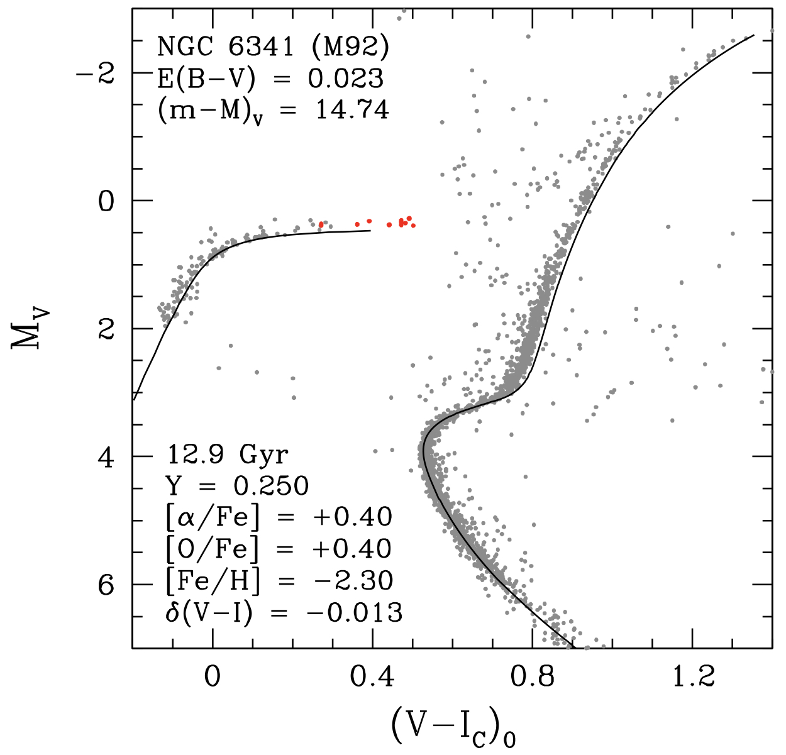
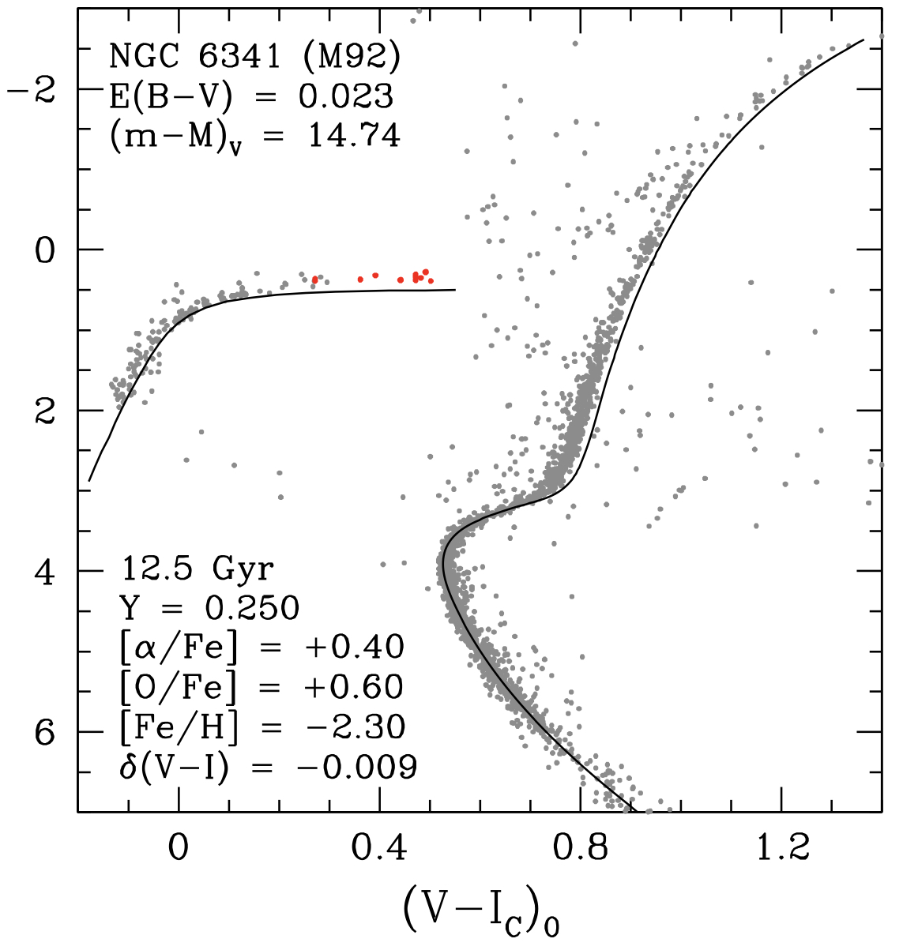
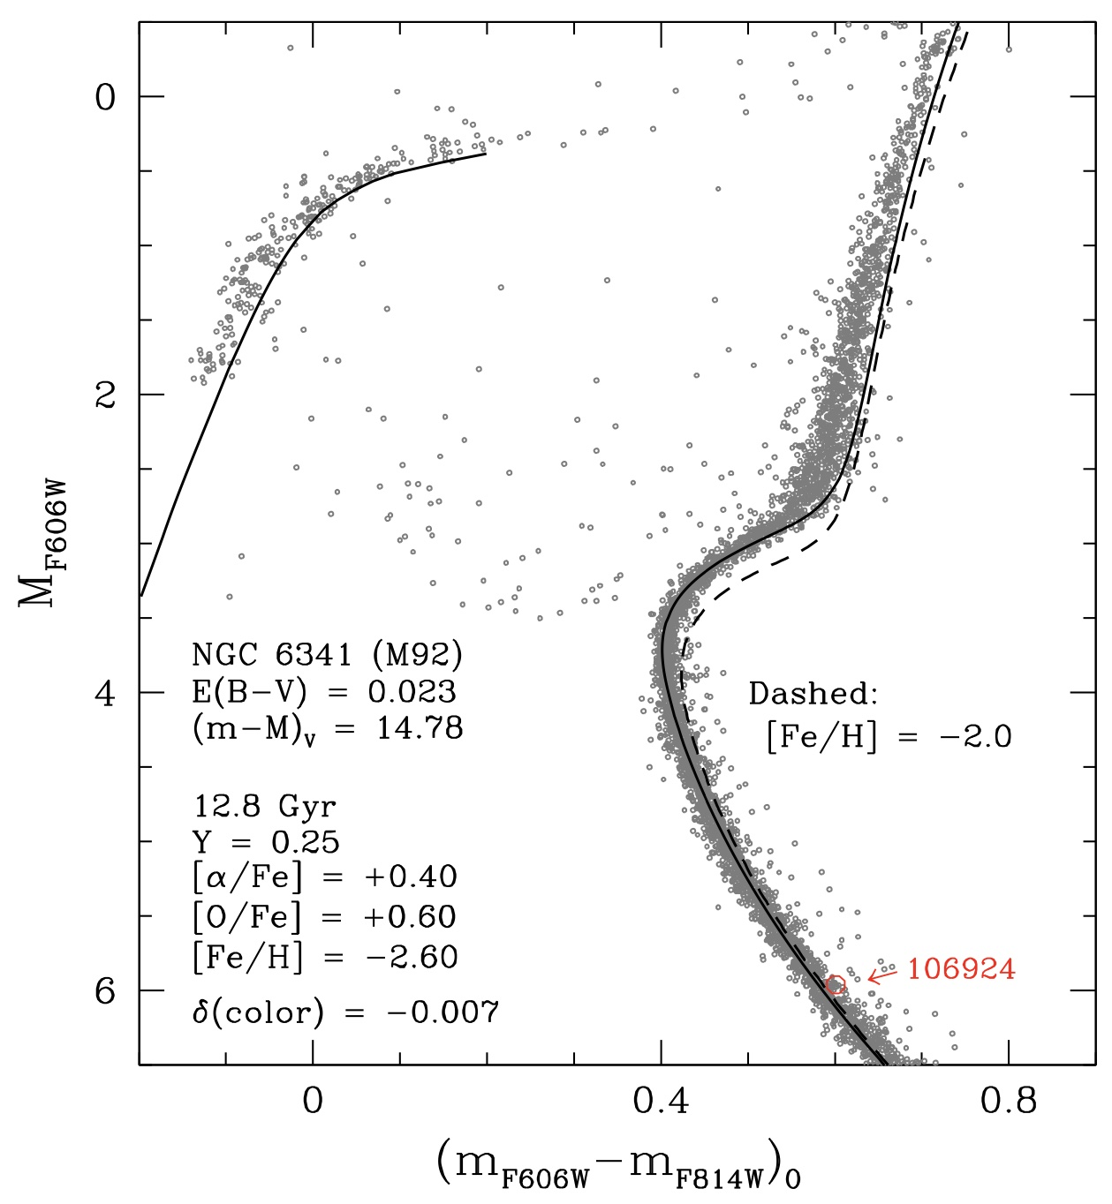
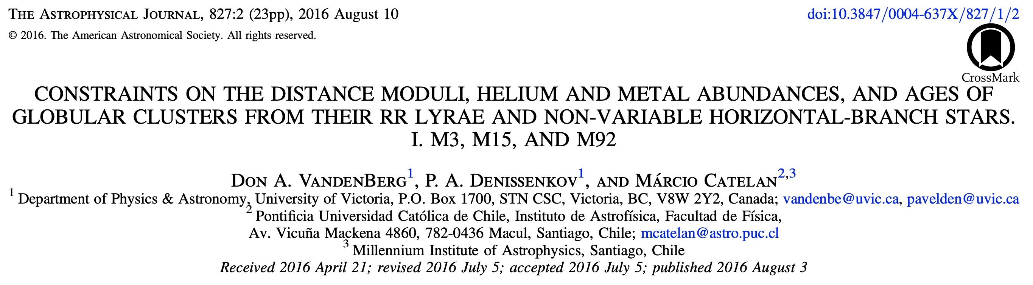
M3, M15, M92 all ~ 12.5 Gyr
distance
Fe
Abs

Slide 11
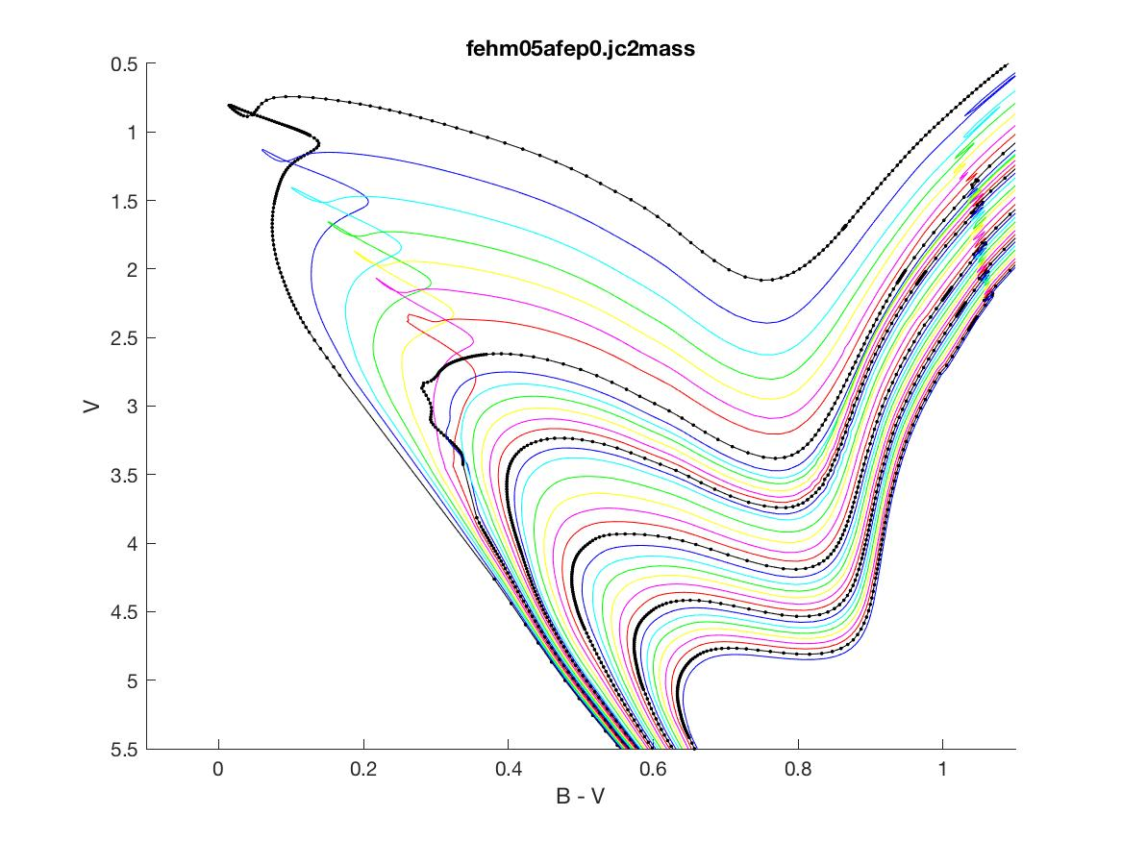
1 Gyr
15 Gyr
DSED models: 1, 1.25, 1.5 … 5.0, 5.5, … 15 Gyr

Slide 12
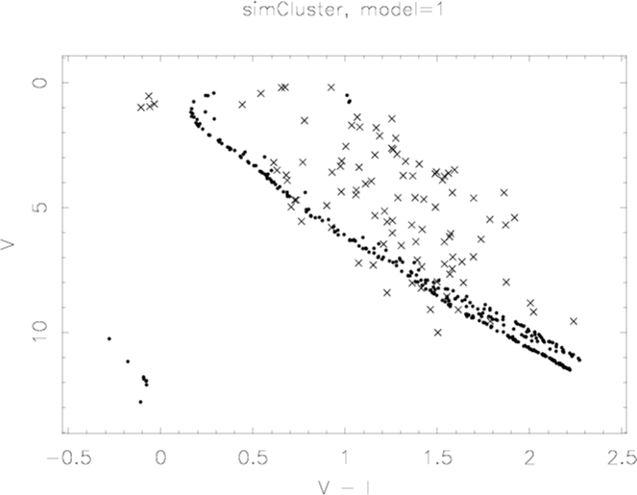
An Example

Slide 13
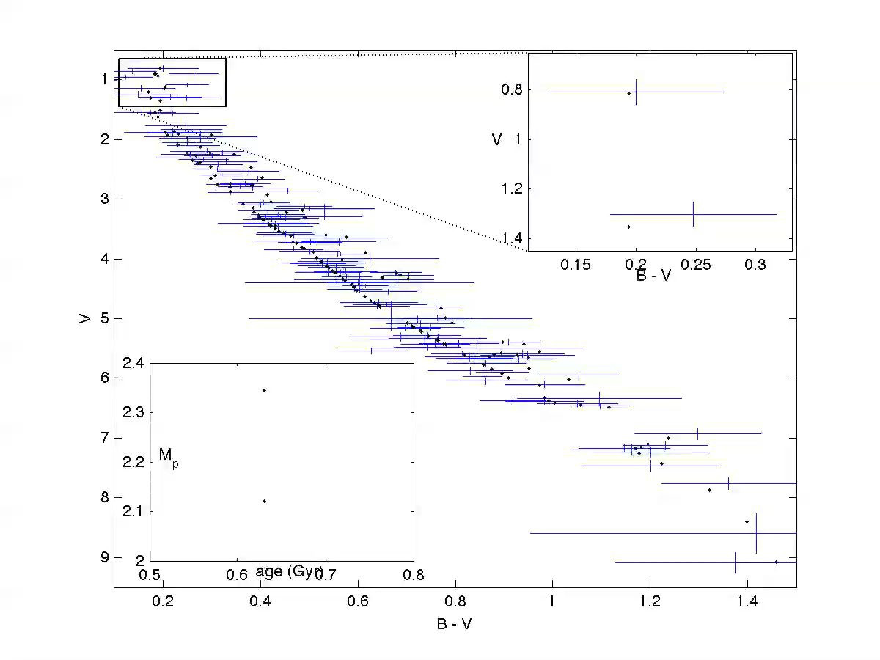
under the hood demo

Slide 14
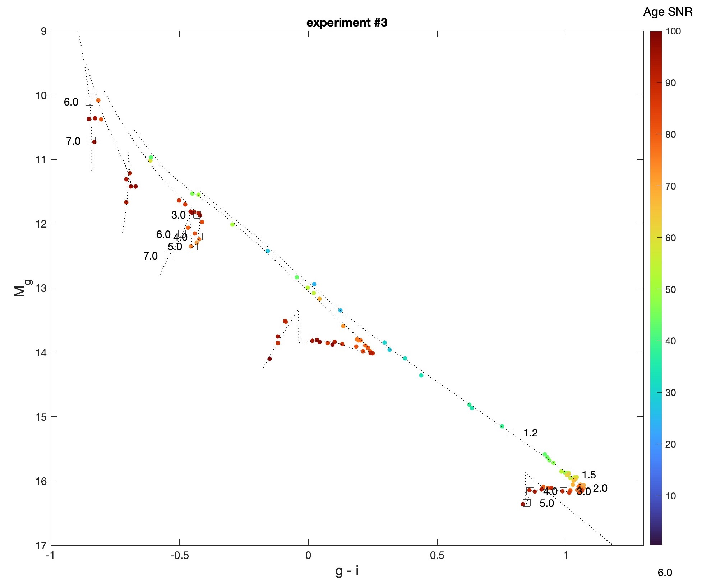

Slide 15
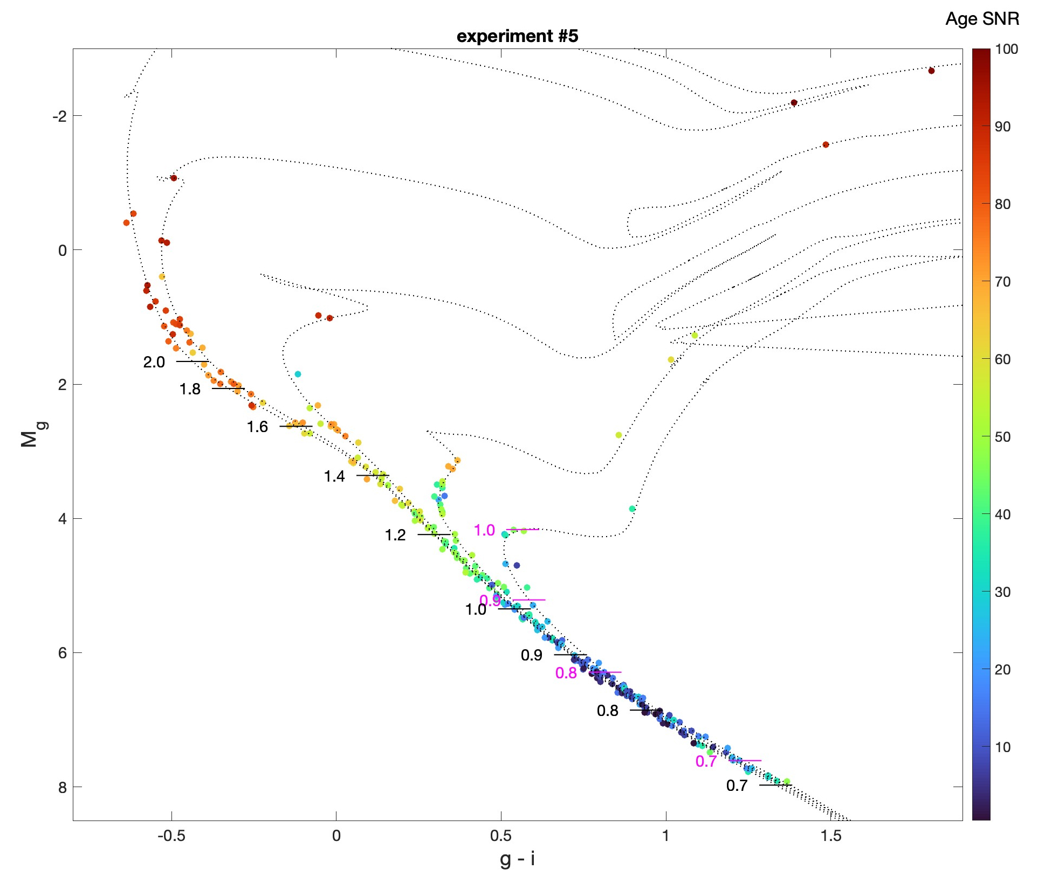
Priors for BASE-9 recovery
[Fe/H] = 0 ± 0.05
Av = 0 ± 0.05
𝜹𝝕/𝝕 = 0.01
binary recover on
When binary recovery is turned on, some stars can be created by combinations of age and binary mass ratio.

Slide 16
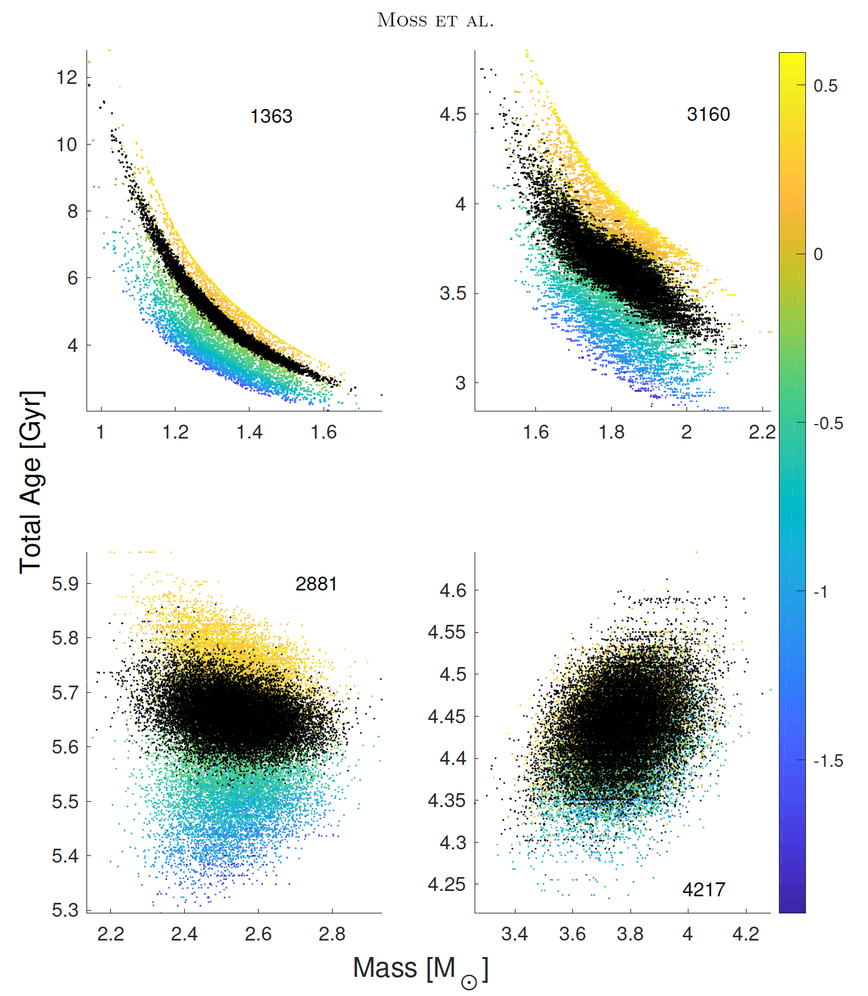
Extra information from white dwarf + main sequence binary with spectroscopic metallicity
−0.219 ± 0.099
[Fe/H]
−0.057 ± 0.05
−0.131 ± 0.049
+0.009 ± 0.05
Reminder: We don’t directly measure mass or age, but rather color, brightness, and distance
ZAMS

Slide 17
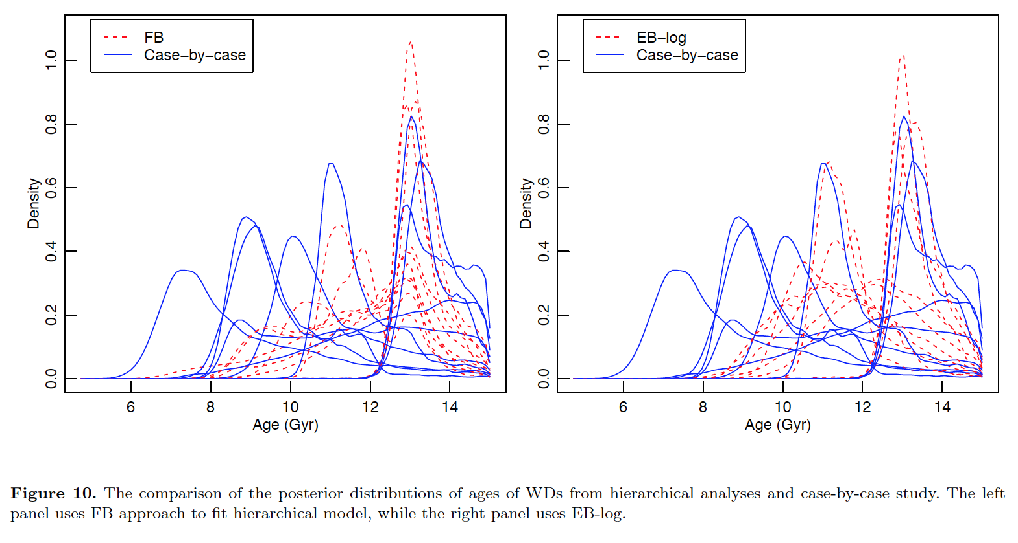
Hierarchical Analysis
Fully Bayesian (e.g. Gelman et al. 2014)
Empirical Bayes (e. g. Morris 1983; Casella 1985; Efron 1996)
Si, van Dyk, von Hippel+ (2017, MNRAS, 468, 4374)
Notes:
Gelman, Carlin, Stern, Rubin 2014 Bayesian Data Analysis, Vol. 2 (Taylor and Francis, London)
Morris, 1983, J. Am. Stat. Assoc., 78, 47
Casella, 1985, Am. Stat., 39, 83
Efron, 1996, J. Am. Stat. Assoc., 91, 538
FB algorithm is less time-consuming in terms of computational investment

Slide 18
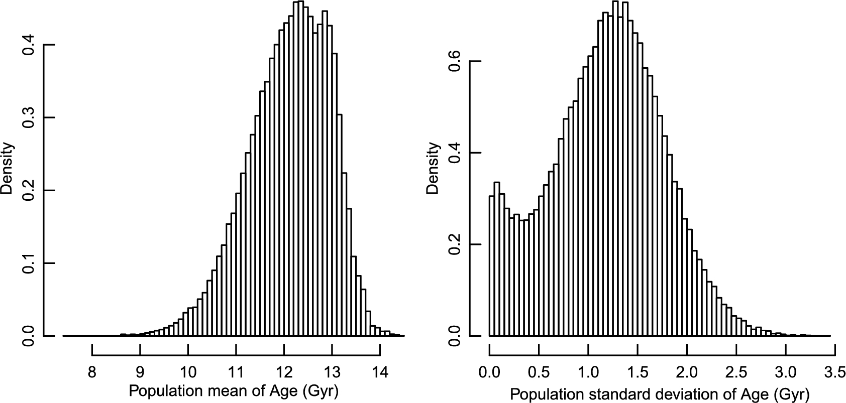

Figure 5. Histograms of MCMC samples from the posterior distribution of the mean and standard deviation of the ...
Notes:
Figure 5. Histograms of MCMC samples from the posterior distribution of the mean and standard deviation of the population of halo WD ages on the Gyr scale, obtained using FB fit to 10 candidate Galactic halo WDs.
Unless provided in the caption above, the following copyright applies to the content of this slide: © 2017 The Authors Published by Oxford University Press on behalf of the Royal Astronomical Society

Slide 19
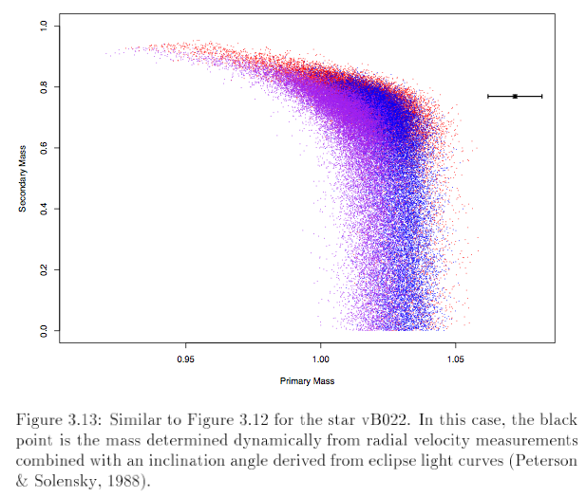
Yale-Yonsei
Girardi
Dotter
DeGennaro 2009 (PhD thesis)

Slide 20
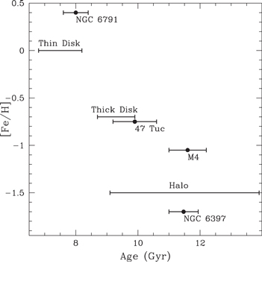
Age–metallicity relation based on WDLFs for the open cluster NGC 6791, globular clusters 47 Tuc, M4, and NGC 6397 (Hansen et al. 2013, and references therein), and thin disk, thick disk, and halo stars from this study. Error bars cover age ranges estimated from both the 40 pc local sample and the Munn+ (2017) p.m. sample.
Kilic, Munn, Harris, et al. 2017, ApJ, 837, 162

Slide 21
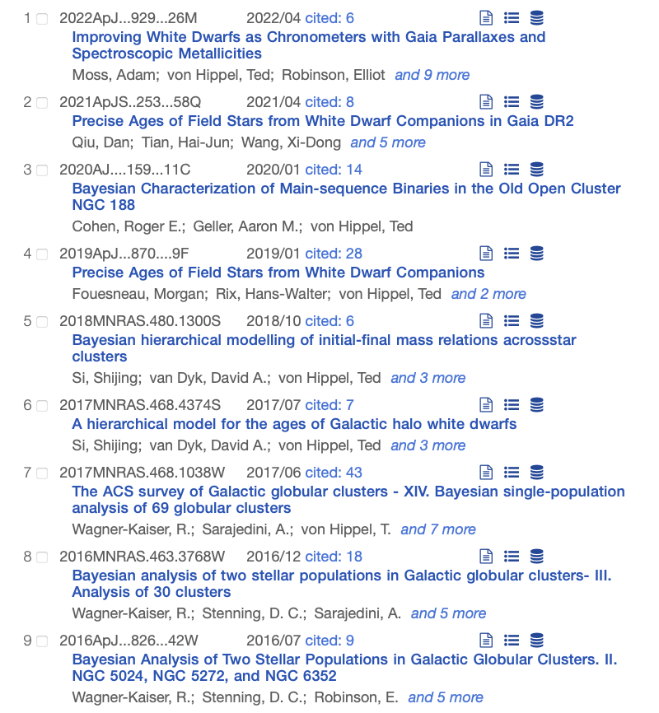
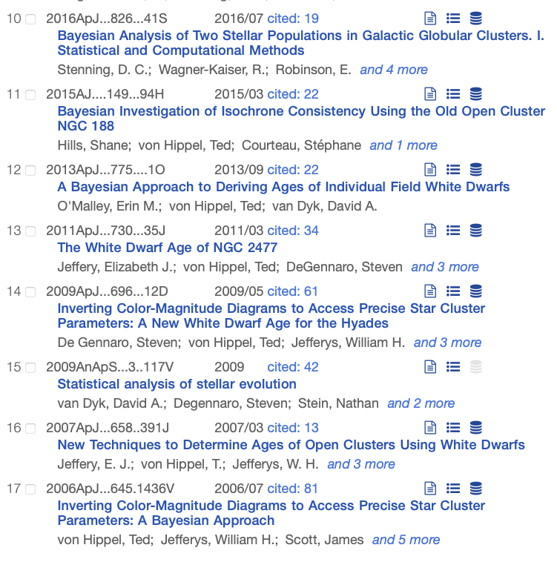

Slide 22
