Slide 1
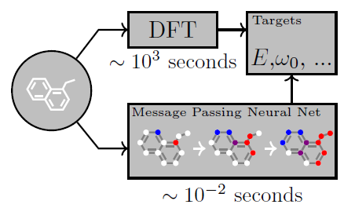
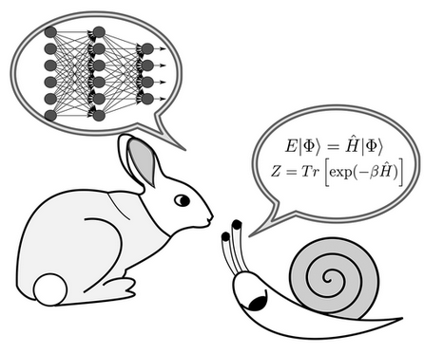
Machine Learning in Computational Chemistry
Presented by Olga Lyubimova
Justin Gilmer et. al. ICML'17, Volume 70, 2017, 1263–1272
Combining Machine Learning and Computational Chemistry for Predictive Insights Into Chemical Systems. John A. Keith, Chem. Rev. 2021, 121, 9816−9872

Slide 2
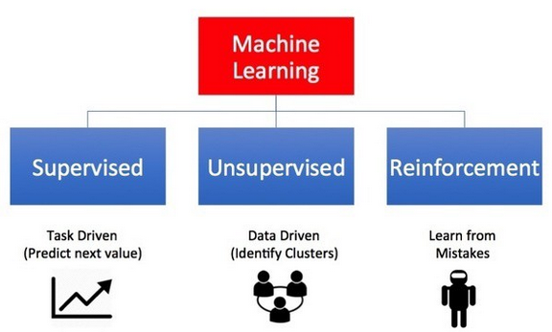
ML algorithms estimate functional relationships without being given any explicit instructions of how to analyze or draw conclusions from the data
Learning algorithms can recover mappings between a set of inputs and corresponding outputs or just from the inputs alone

Slide 3
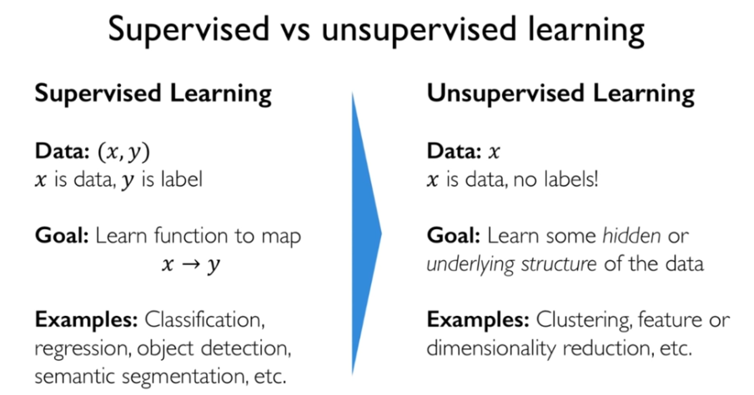

Slide 4
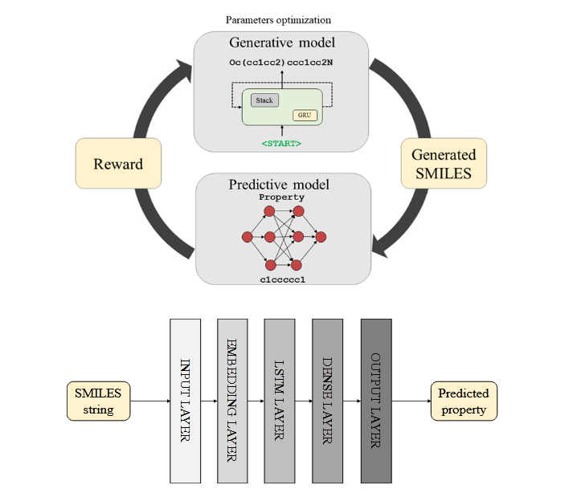
Reinforcement Learning
Science Advances, 2018, Vol 4, Issue 7
DOI: 10.1126/sciadv.aap7885

Slide 5
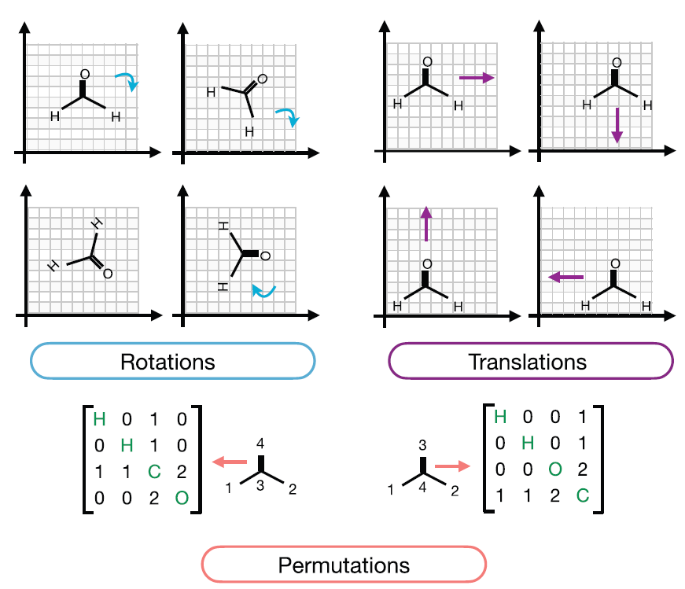
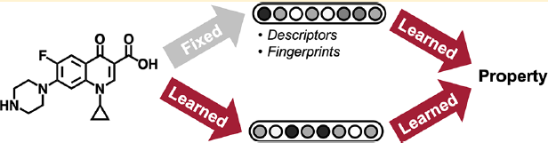
Molecular Featurization
Rotational invariance
Translational invariance
Permutation invariance
Invertibility*
* For inverse design, a desired property is invertibility— the capability to map back to a molecule structure that can then potentially be synthesized and characterized.
Analyzing Learned Molecular Representations for Property
Prediction. Kevin Yang et. Al,
DOI: 10.1021/acs.jcim.9b00237
J. Chem. Inf. Model. 2019, 59, 3370−3388
Shampa Raghunathan et.al Int J Quantum Chem. 2022;122:e26870
https://doi.org/10.1002/qua.26870

Slide 6
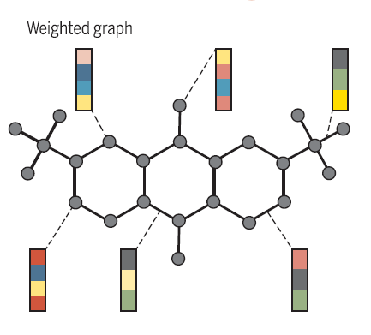
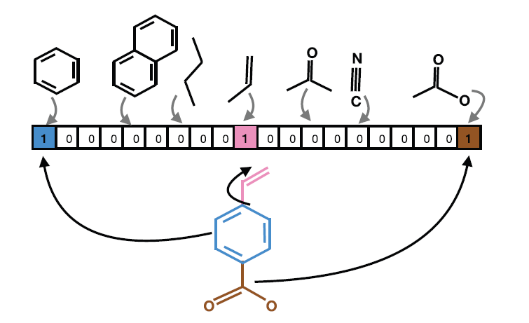
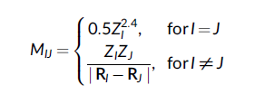
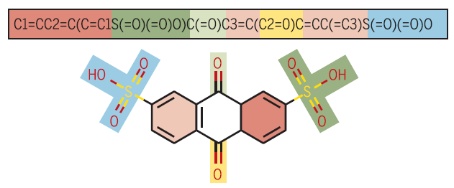
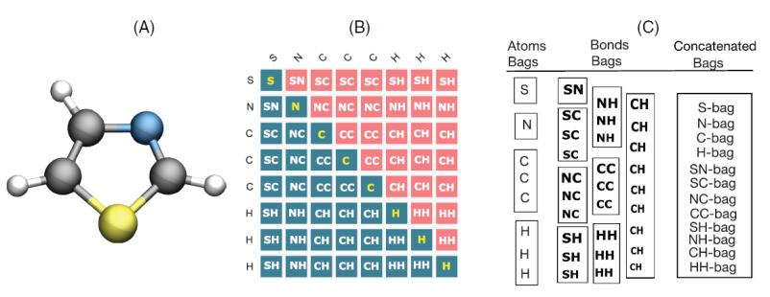
Molecular Representations
Graphs
Molecular fingerprinting
Coulomb matrix and Bag-of-bonds
SMILES Simplified molecular input line entry system representation

Slide 7
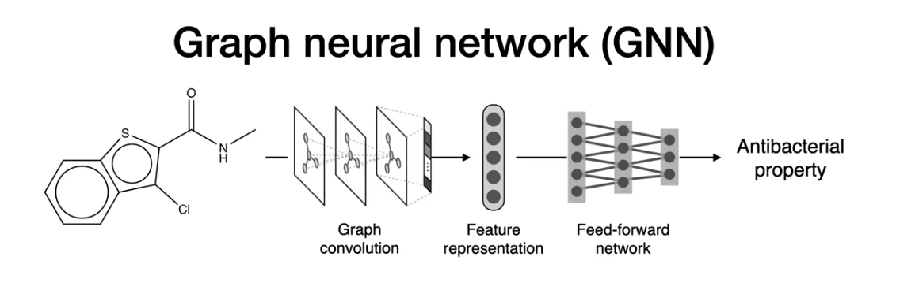
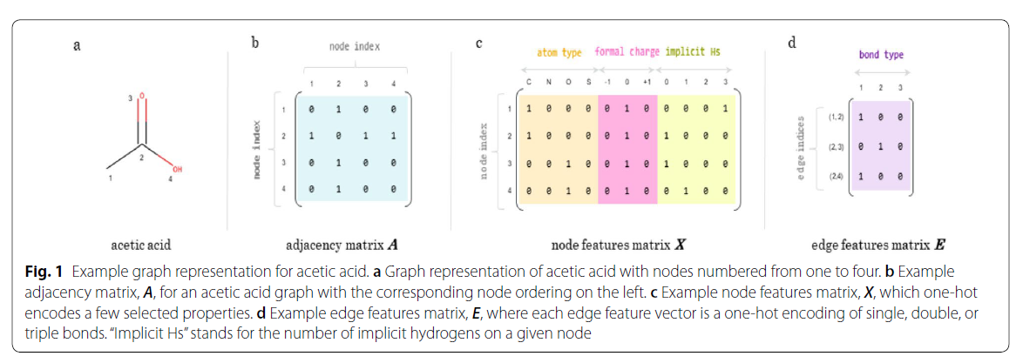
Abstract mathematical structure/data structure of a graph
Mathematical definition: of A graph is formally defined as a tuple G = (V, E) of a set
of nodes V and a set of edges E, where each edge e ∈ E connects pairs of nodes in V.
Reconstruction accuracy
(in case of new molecules generation)
https://youtu.be/AHVJv5RNqKs
Stokes et al., 2020, Cell 180, 688–702

Slide 8
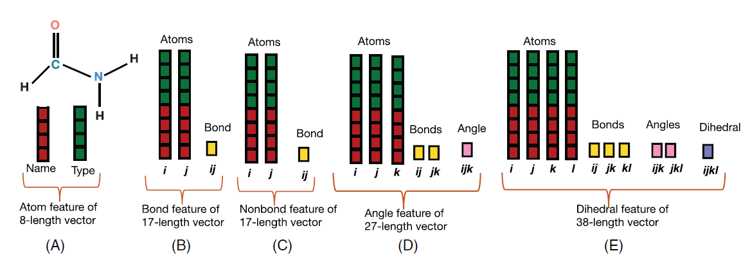
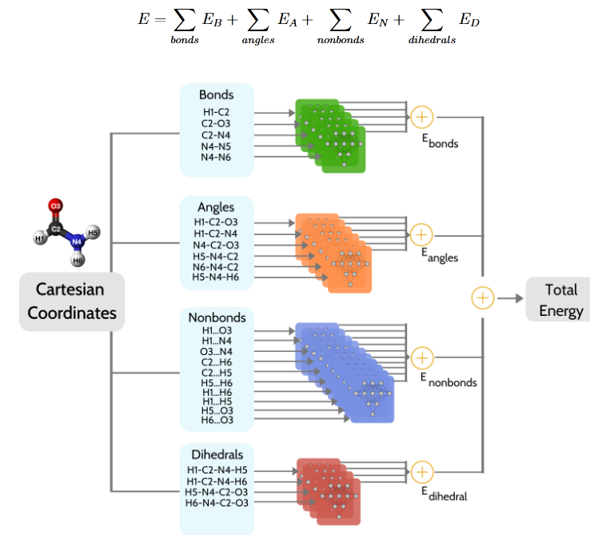
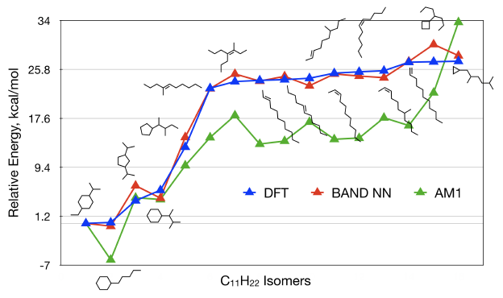
Bonds–Angles–Nonbonds–Dihedrals BAND
∼6.1 million data points in training set
760,000 data points in test and validation sets
No info on time/resources
Schematic representation of the feature vectors of (A) atoms, (B) bonds, (C) nonbonds, (D) angles, and (E) dihedrals in BAND representation of a formamide molecule
The relative energies (in kcal/mol) of select isomers of C11H22 relative to the least energy isomer
Keras, TensorFlow, Scikit-learn
Siddhartha Laghuvarapu J Comp Chem, Volume41, Issue8, 2020, Pages 790-799

Slide 9
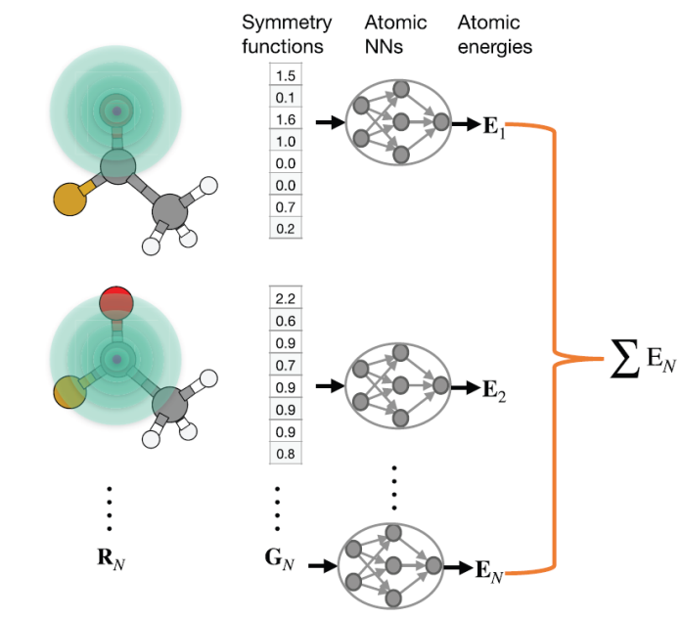
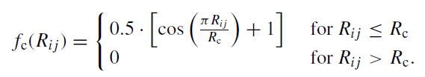



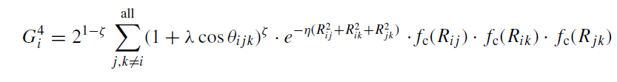

Atom-Density Representations
There are many other descriptors based on the atomic density (Smooth Overlap of Atomic Positions (SOAP)). They differ mainly by how the density is projected onto basis functions
Radial and angular symmetry functions
Behler and Parrinello symmetry functions project the atomic densities over selected 2-body or 3-body symmetry functions

Slide 10
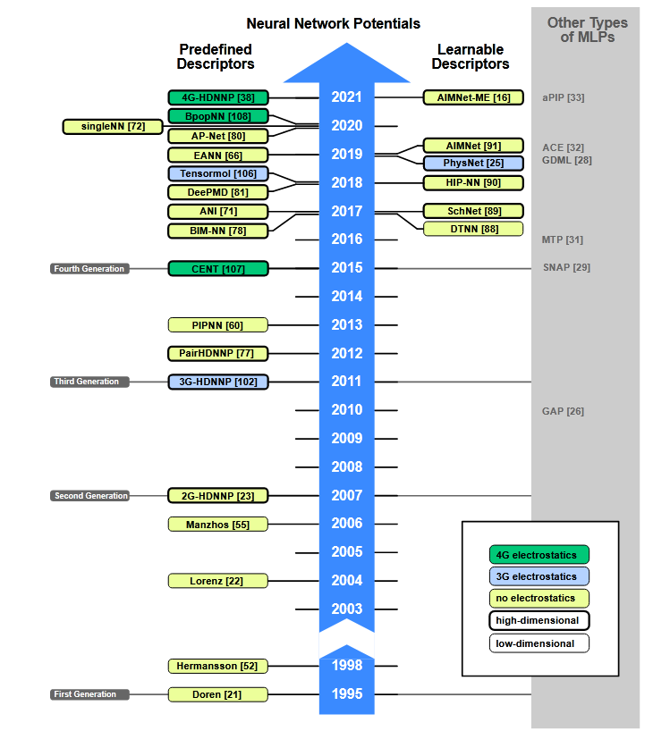
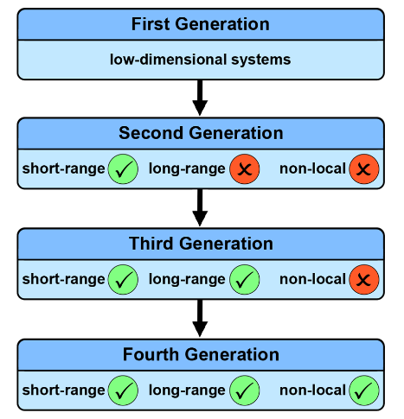
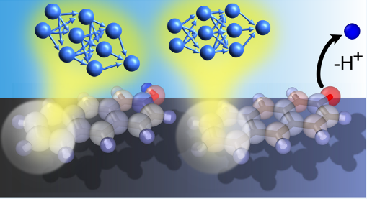
Annual Review of Physical Chemistry Vol. 73:163-186, 2022
Neural Network Potentials: A Concise Overview of Methods
Emir Kocer, Tsz Wai Ko, J ̈org Behler
https://doi.org/10.1146/annurev-physchem-082720-034254
General-Purpose Machine Learning Potentials Capturing Nonlocal Charge Transfer
Tsz Wai Ko et. al. Acc. Chem. Res. 2021, 54, 4, 808–817

Slide 11
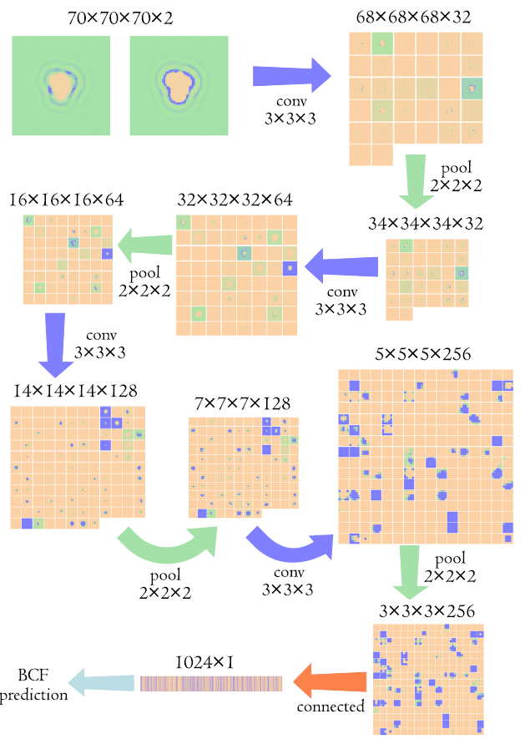

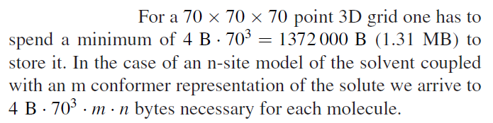
Recently proposed descriptors
☺
3D distributions from 3DRISM (ConvNN)
Through a set of mathematical operations in convolutional neural network a 3D volume transformed to a set of features which then passed through a fully connected layer and gives a BCF prediction (Bioconcentration factor*)
*This factor is an important parameter for estimating the potential danger of an organic compound. The ability of a compound to penetrate and remain in an organism may influence the toxicity and mutagenicity, and so may eveal potential environmental risks.
S. Sosnin, M. Misin, D. S. Palmer, M. V. Fedorov
https://doi.org/10.1088/1361-648X/aad076

Slide 12
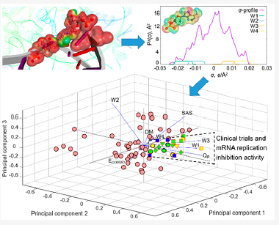
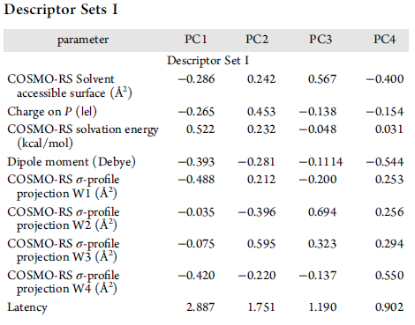
Recently proposed descriptors
Solvent accessible surfaces, σ-profiles by COSMO-RS
  COSMO-RS is a fast and efficient tool for molecular similarity screening. These methods rely on solvent-accessible surfaces with induced charges screening the electrostatic potential produced by nuclear charges and electronic density. The COSMO-RS σ-profiles capture in a one-dimensional (1D) format the entire set of chemical properties calculated from quantum chemistry, including hydrogen bond donor and acceptor, and hydrophobic (lipophilic) interactions.
Sergey Gusarov and Stanislav R. Stoyanov
J. Phys. Chem. Lett. 2020, 11, 21, 9408–9414
https://dx.doi.org/10.1021/acs.jpclett.0c02836

Slide 13
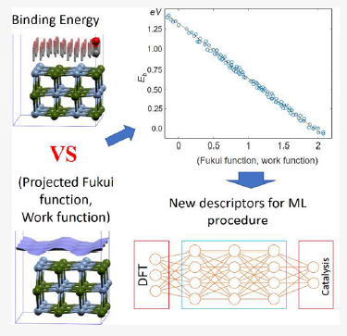
Recently proposed ML descriptors
2D Fukui Functions (catalysis)
The concept of the FF was introduced as the response of the electronic density of a molecular system to the addition or removal of a given number of electrons. There is a strong connection of the FF to chemical activity and catalytic properties
The FF characterizes the local ability of a molecular system to donate and accept electrons. For example, the regions with large positive values of f+ are the most favorable for a nucleophilic attack, while the regions with large positive values of f− are the most suitable for electrophilic attack.
S. Gusarov, S. R. Stoyanov, S. Siahrostami
J. Phys. Chem. C 2020, 124, 10079−10084

Slide 14
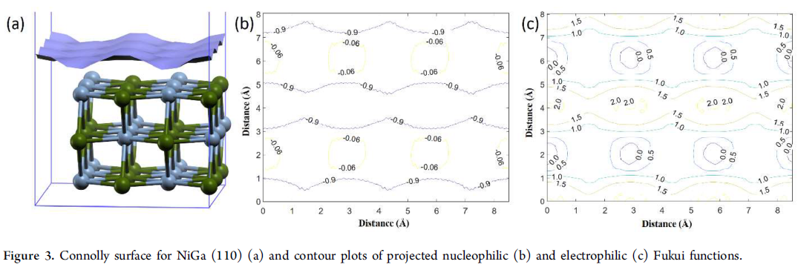
Recently proposed ML descriptors
CNNs?

Slide 15
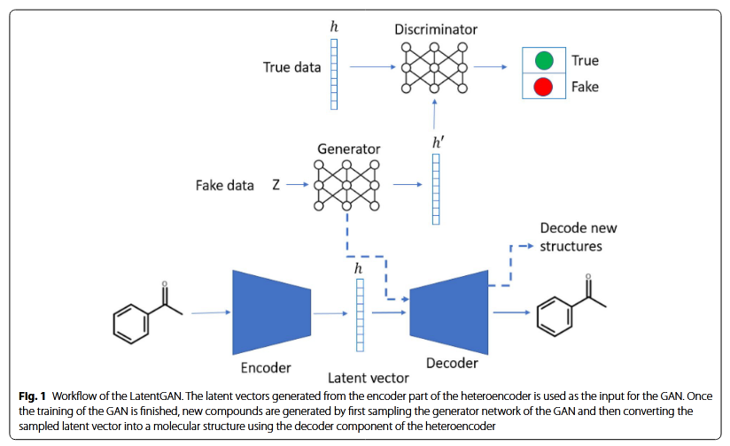
A de novo molecular generation
Python
TensorFlow
Scikit-learn (SVM)
heteroencoder was trained on 1,347,173 SMILES from the ChEMBL [36] datase
The goal of a generative model is to model a data distribution, by training a model on large amounts of data and attempting to generate data like it. The loss function encodes the notion of likeness, measuring the differences between two distributions, the empirically observed and the generated.
A de novo molecular generation method using latent vector based generative adversarial network Prykhodko et al. J Cheminform (2019) 11:74

Slide 16
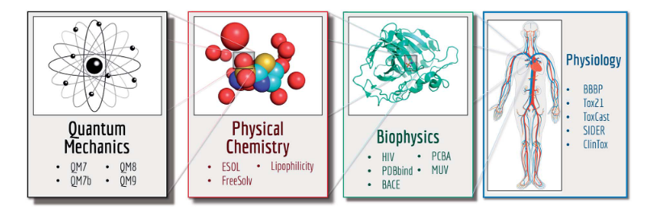

Data sets
https://cccbdb.nist.gov/geom2x.asp
http://quantum-machine.org/
https://pubchem.ncbi.nlm.nih.gov/
https://moleculenet.org/datasets-1

Slide 17
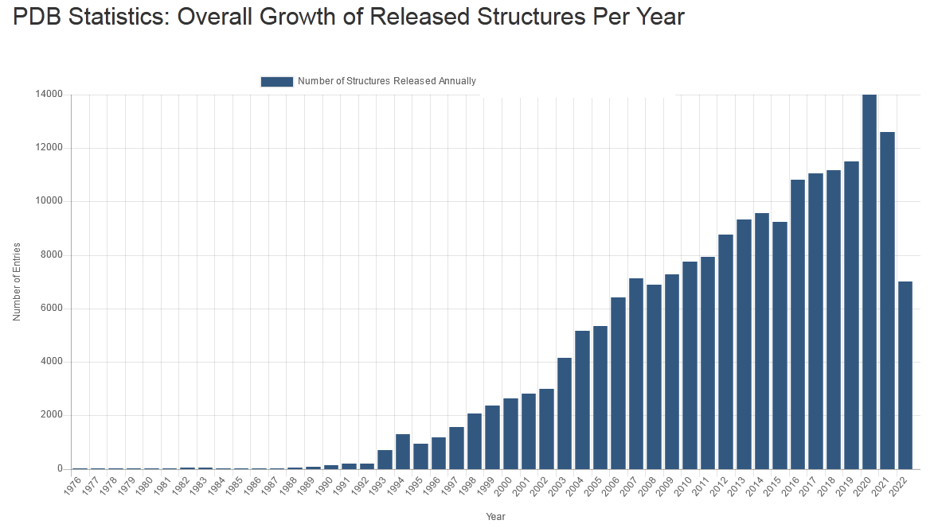
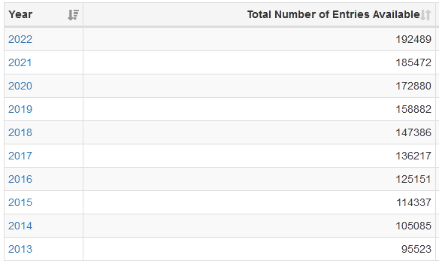
Biological Macromolecular Structures

Slide 18

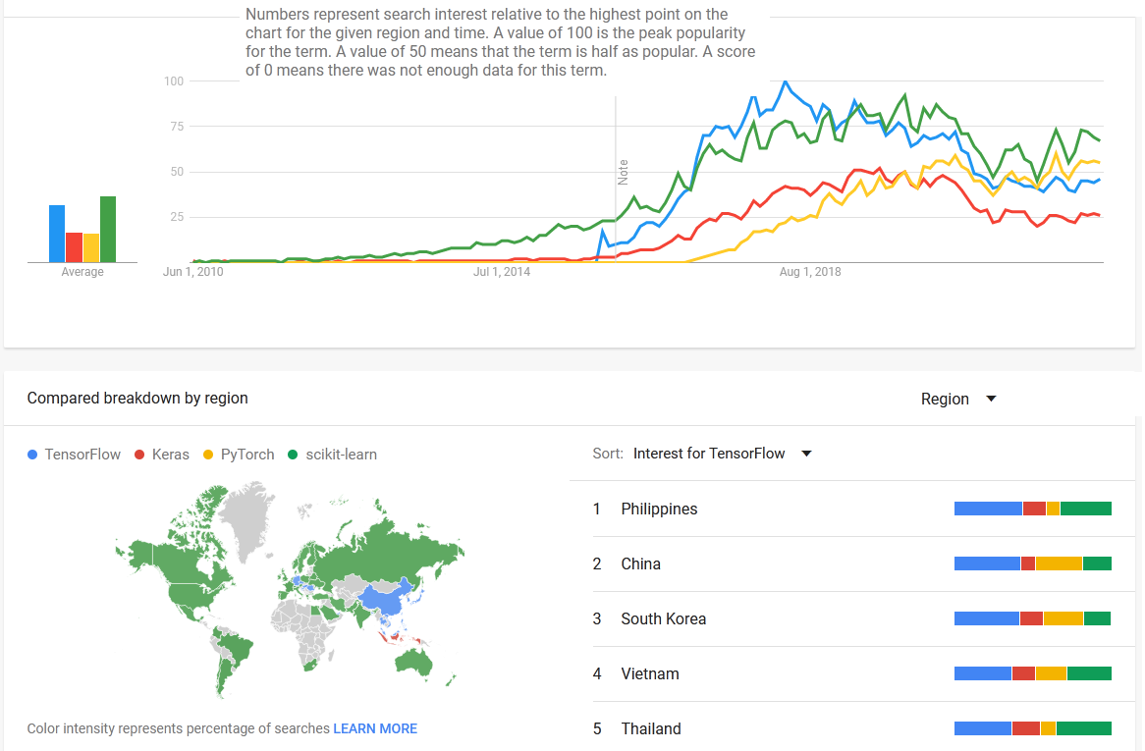
Keyword search statistics

Slide 19
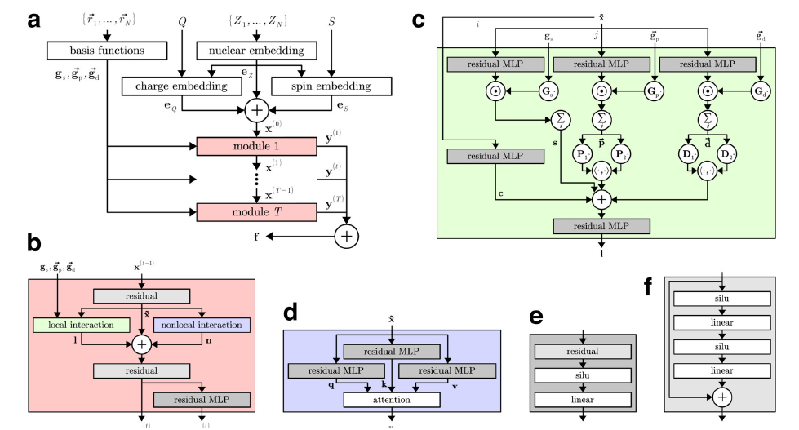
Thank you!
PyTorch
Unke, O.T., Chmiela, S., Gastegger, M. et al. SpookyNet: Learning force fields with electronic degrees of freedom and nonlocal effects. Nat Commun 12, 7273 (2021). https://doi.org/10.1038/s41467-021-27504-0

Slide 20
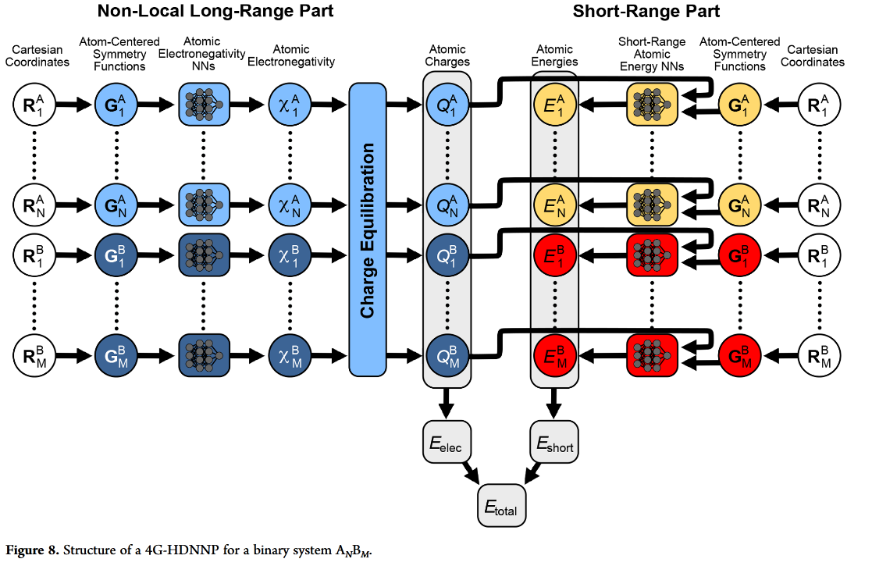
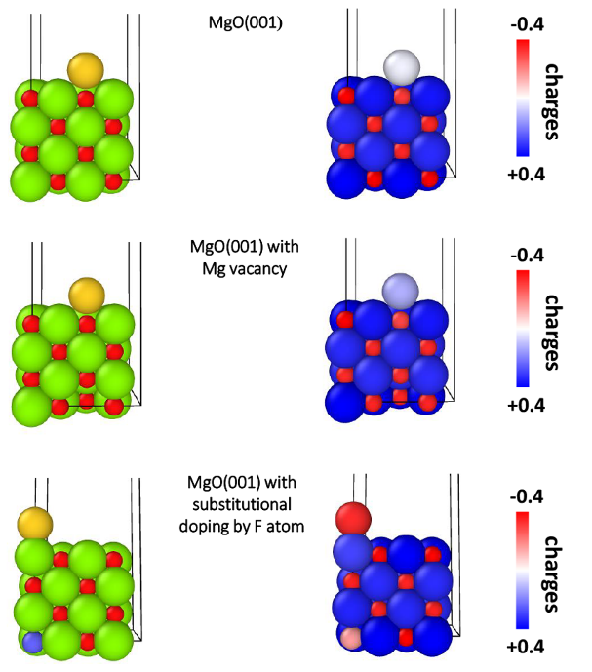
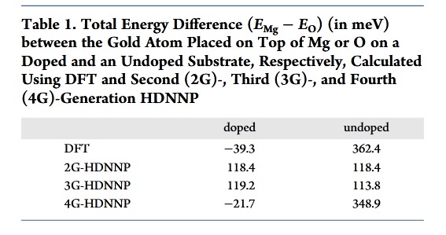
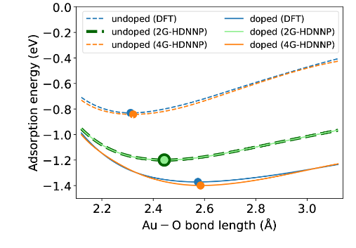
4G-HDNNP
General-Purpose Machine Learning Potentials Capturing Nonlocal Charge Transfer
Tsz Wai Ko, Jonas A. Finkler, Stefan Goedecker*, and Jörg Behler*
Acc. Chem. Res. 2021, 54, 4, 808–817

Slide 21
Reinforcement Learning
Science Advances, 2018, Vol 4, Issue 7
DOI: 10.1126/sciadv.aap7885

Slide 22
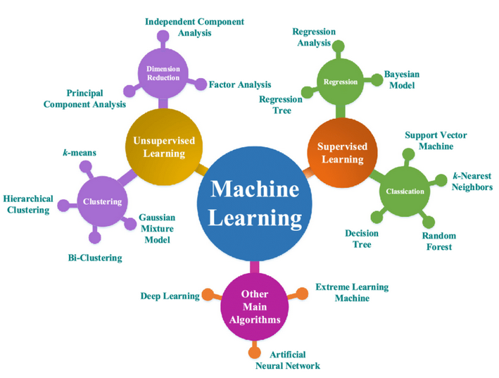

Slide 23
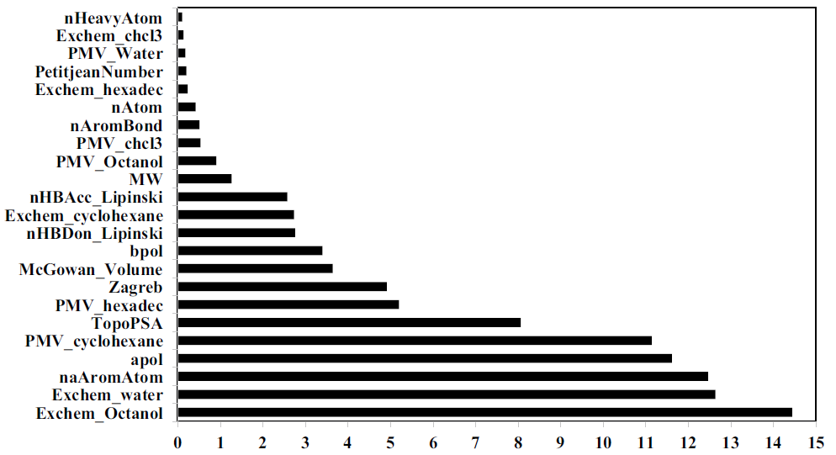
Prediction of P‑glycoprotein inhibitors with machine learning classification models and 3D‑RISM‑KH theory based solvation energy descriptors
Vijaya Kumar Hinge, Dipankar Roy, Andriy Kovalenko
Journal of Computer-Aided Molecular Design (2019) 33:965–971
https://doi.org/10.1007/s10822-019-00253-5

Slide 25
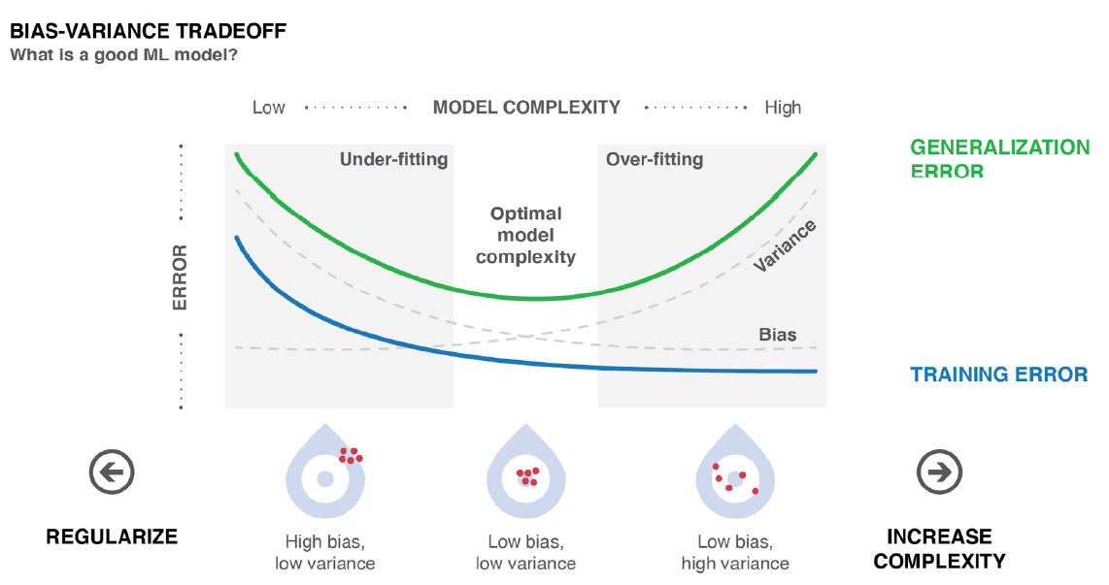
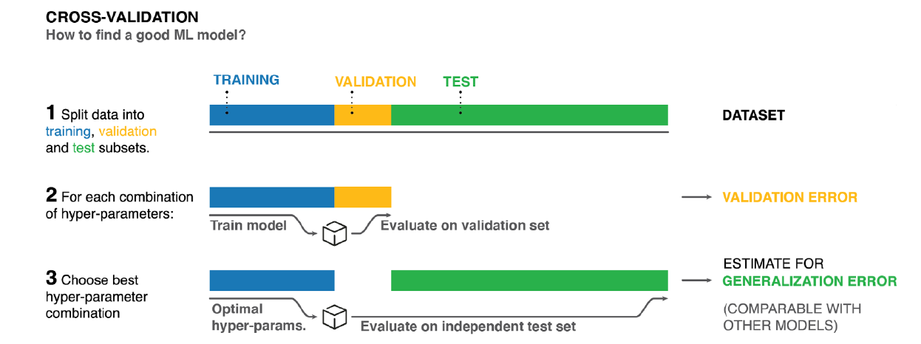
Combining Machine Learning and Computational Chemistry for Predictive Insights Into Chemical Systems
John A. Keith
Chem. Rev. 2021, 121, 9816−9872

Slide 26
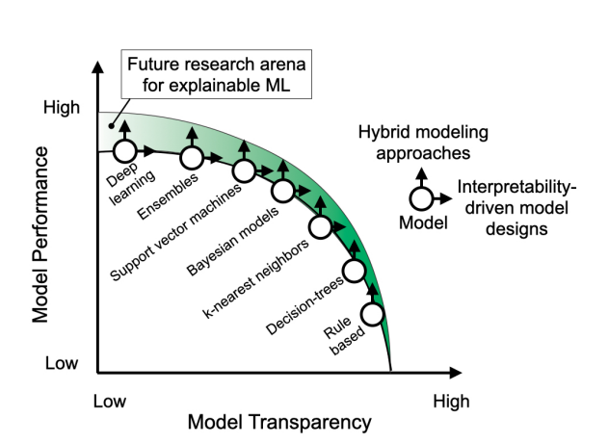
Schematic showing Trade-off between model performance and transparency.
The area of potential future improvement due to improved explainable
AI techniques and tools is highlighted in green with the improvement directions
represented with arrows
Explainable Artificial Intelligence (XAI): Concepts, Taxonomies,
Opportunities and Challenges toward Responsible AI
AlejandroBarredo Arrieta
Information Fusion
Volume 58, June 2020, Pages 82-115
Given the common scenarios where model performance
closely accompanies model complexity, model transparency
(and therefore, interpretability and explainability) exhibits a
downwards slope that has largely remained unavoidable in the
past.

Slide 27
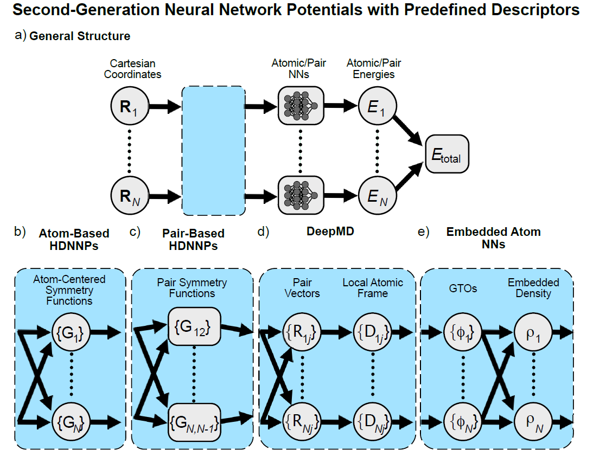

Slide 28
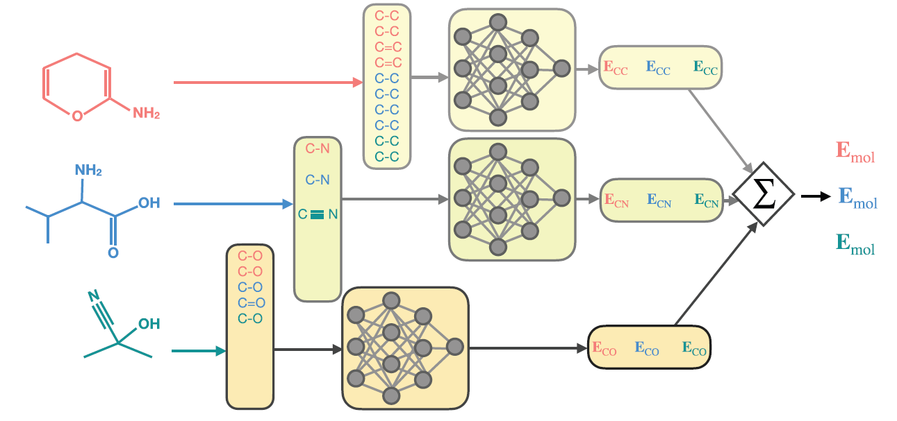
Bonds-in-molecules
FIGURE 1 Formaldehyde molecule undergoing rotation and translation operations in a fixed reference grid. Permutation operation showing
two equivalent formaldehyde representations. The atom connectivity matrix introduced by Spialter has atomic symbols (alternatively, atomic
numbers) listed along the diagonal [33]. The off-diagonals represent interatomic connectivities, for example, bond order values 0, 1, and 2 for
none, single and double bonds, respectively

Slide 29
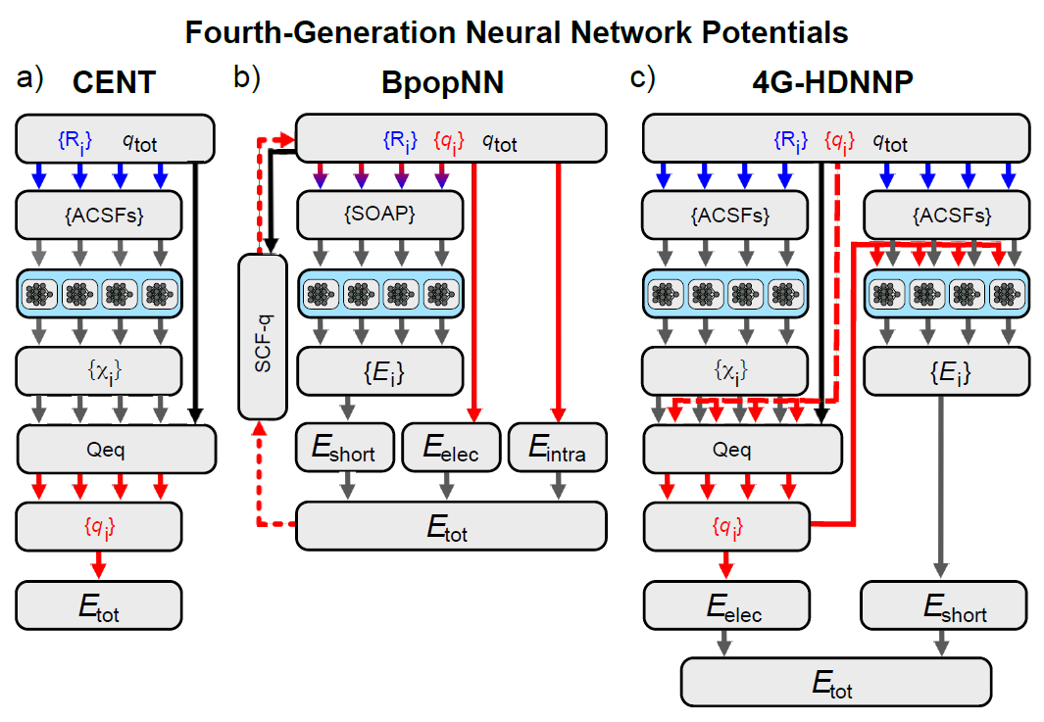
In 4G-HDNNPs, the neural
networks predicting the electronegativities are trained to
minimize the difference between the predicted charges and
reference charges from electronic structure calculations.

Slide 30
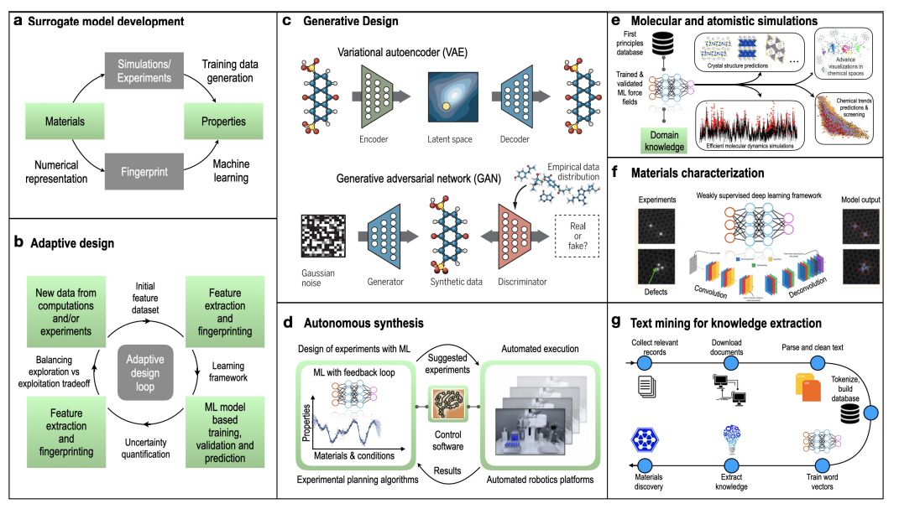
Machine Learning in Materials Science:
From Explainable Predictions to Autonomous Design
Ghanshyam Pilania
Computational Materials Science
Volume 193, 1 June 2021, 110360

Slide 31
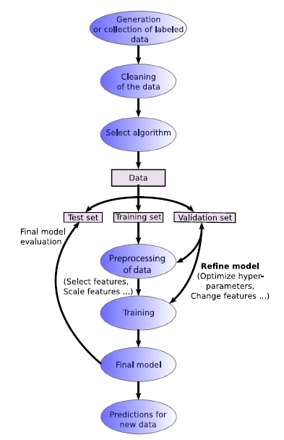
Supervised learning workflow
Recent advances and applications of machine learning in solidstate
materials science J. Schmidt et al.
Computational Materials (2019) 5:83

Slide 32
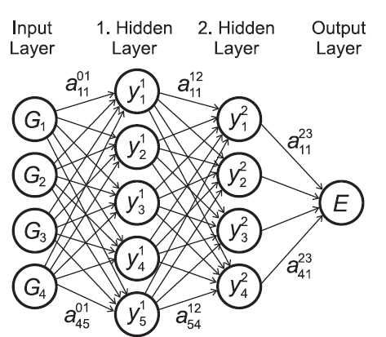





Slide 33


Slide 34






Slide 35

Molecular representations
FIGURE 2 (A) Graph representation of a chemical structure, tyrosine. Carbon, nitrogen and oxygen atoms are colored in black, blue, and red
circles, respectively. Single and double bonds are marked in black and green colors, respectively. (B) Simplified molecular input line entry system
(SMILES) representation of 4-chloro-1-pentene, cyclohexane and aniline

Slide 36

Combining Machine Learning and Computational Chemistry for Predictive Insights Into Chemical Systems
John A. Keith
Chem. Rev. 2021, 121, 9816−9872

Slide 37

Neural Message Passing for Quantum Chemistry
Justin Gilmer 1 Samuel S. Schoenholz 1 Patrick F. Riley 2 Oriol Vinyals 3 George E. Dahl

Slide 38
https://cccbdb.nist.gov/geom2x.asp
http://quantum-machine.org/
https://pubchem.ncbi.nlm.nih.gov/
https://moleculenet.org/datasets-1

Slide 39


Slide 40


ML
Methods, such as, clustering, K-means clustering,
principal component analysis and outliers detection are typical examples of unsupervised models

Slide 41

Many ML representations of excited state properties, such as HOMO-LUMO gaps,73–75 excited-state energies,21,76–78 or band gaps79–82 have been proposed and were mainly based on NNs or kernel methods
ML-based interatomic potentials and continuous regression models already play an important role across almost all domains of MD simulations
predict correlated total energies of molecules based on Hartree-Fock or DFT results.

Slide 42






Slide 43






Slide 44

Clustering algoritms (K-means clustering),
principal component analysis (PCA), outliers detection are typical examples of unsupervised models

Slide 45
ML force fields are examples of regression tasks where often the squared error is used as loss function.

Slide 46


Slide 47

Molecular Representations
Engineered
Learned

Slide 48


Slide 49


Slide 50


Slide 51


Slide 52


Slide 53


