Slide 1
Perspectives: what the future holds for us
Ph.D. Student Gabriel Pereira da Costa
University of Alberta
Supervisors: Dr. Phillip Choi and Dr. Stanislav Stoyanov

Slide 2
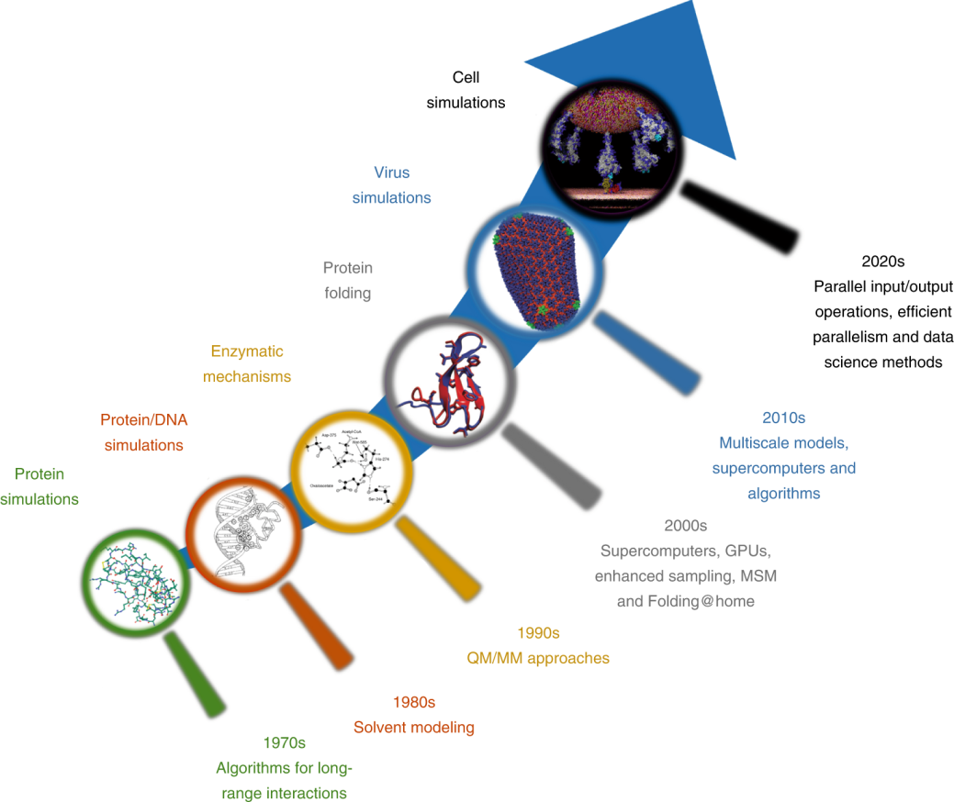
Brief review: where we are
“It is difficult to make predictions, especially about the future” - Niels Bohr
Molecular Simulation (MS) is key for future scientific development
  Great advance in the past 50 years.
Major scientific breakthroughs:
  The constraint method;
  Multiple time-scale algorithms;
  Variational Monte Carlo;
  Car-Parrinello method.
Technological advance:
  Moore’s law – 2x transistor counts/2 yr.
Schlick, T. et al. Nat. Comput. Sci. 1, 321–331 (2021)

Slide 3


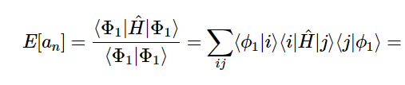



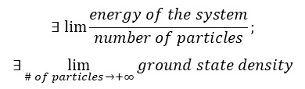

Brief review: current challenges
Variational definition of excited states:
Nonlinear variational models;
Linear scaling algorithms for metallic systems:
Close-to-zero gap between Eigenvalues.
An excited state is mathematically unclear.
Thermodynamic limit (or bulk limit) problems:
The crystal problem at 0K;
Coupling and change of scales:
Current pseudopotentials still lack mathematical rigour;
The limit of largely correlated systems.
Analytical solution for Quantum Mechanics/Molecular Mechanics models;
Newton equation of motion for large systems.
Excited state:
Thermodynamic limit:
$$∃ lim\frac{energy of the system}{number of particles};$$
$$∃\lim_{\# of particles→+∞}{ground state density}$$
Coupling approximation:
$$≈$$
Cances, E. et al. Nonlinearity 21, T165 (2008)

Slide 4
Major contributors
Hardware development
Extensive GPU utilization;
Software/Algorithms refinement:
Physics-based methods:
Cloud-based;
Parallelization;
Quantum computers (QC).
Knowledge-based methods:
Databases and analytical tools.
Theory and mathematical refinement.

Slide 5
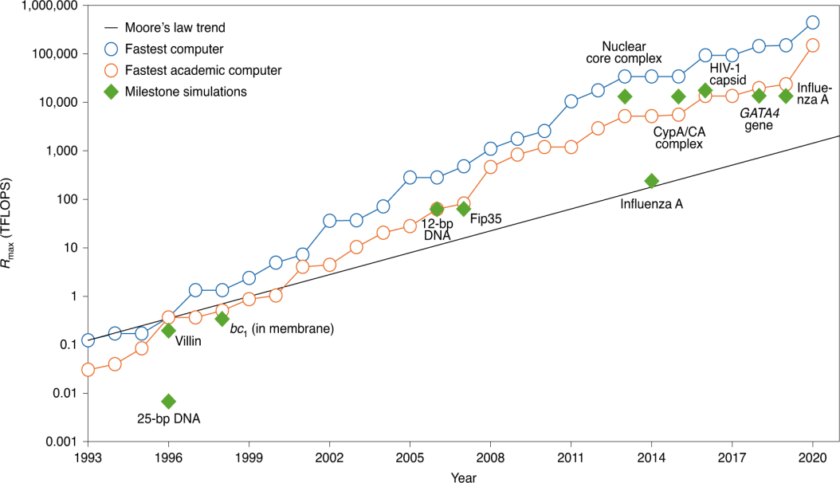
Hardware vs. Algorithm
Hardware:
  GPU:
    Current algorithms – 200x faster than CPU.
  Cloud-based computing:
    Remote high-performance computing.
  Parallelized calculations:
    Stochastic parallel tempering;
    Parallel replica dynamics;
    Optimized architectures for GPU, CPU and Cloud-based.
Moore’s law and the evolution of supercomputers
Grimme, S. et al. Angew. Chem. Int. Ed. 57, 4170–4176 (2018)
Notes:
“Oak Ridge National Laboratory, with more than 27,000 NVIDIA GPUs and 9,000 IBM Power9 CPUs—was used to explore SARS-CoV-2 virus inhibitors among more than 8,000 compounds. Such simulations were conducted in just a few days, with 77 compound candidates found.”

Slide 6
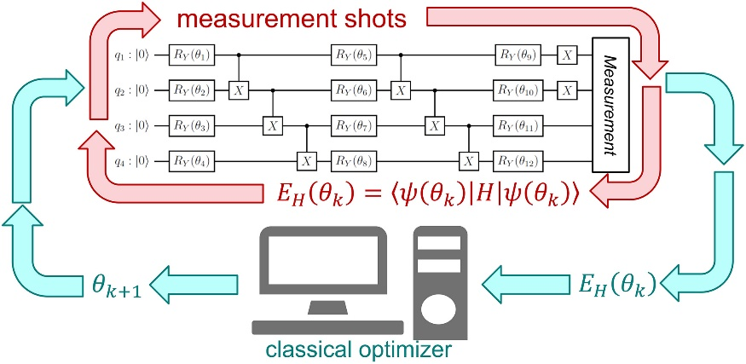
Hardware vs. Algorithm
Hardware:
  Quantum computers:
    The Variational Quantum Eigensolver (VQE) accurately calculates the ground state energy of simple molecules;
    2^{N} dimensional electronic wavefunction can be represented by N qubits;
    Quantum Machine-Learning (QML) methods (e.g. Gaussian Processes, Kernel Ridge Regression, Suport Vector Machines) can solve very complex systems.
Schematic of the Variational Quantum Eigensolver (VQE)
Bernal, D. E. et al. AIChE J. 68, e17651 (2022)
Notes:
“Oak Ridge National Laboratory, with more than 27,000 NVIDIA GPUs and 9,000 IBM Power9 CPUs—was used to explore SARS-CoV-2 virus inhibitors among more than 8,000 compounds. Such simulations were conducted in just a few days, with 77 compound candidates found.”

Slide 7
Hardware vs. Algorithm
Algorithm:
  Physics-based methods:
Physics-based
Knowledge-based
Multiscale and multiple timestep models
Redefinition of concepts mathematically
Current formalism for bigger systems
Unification of potentials

Slide 8
Physics vs. Knowledge-based
Physics-based methods:
Multiscale and multiple timesteps models:
Mathematically sound pseudopotentials;
Redefinition of mathematical concepts:
Rare events;
Analytical representation of potentials;
Current formalism:
Semiempirical Molecular Orbital theory (SMO)
Unification of potentials:
Unification of coarse-grained potentials;
Enhanced sampling;
Resolution-of-the-identity (RI);
Pair-natural orbital (PNO) expansion.
Covalent vs. noncovalent interaction.
Steric effects;
Electronic effects and partial charges;
Solution of DFT inconsistencies;
Wavefunction Theory (WFT) solution
Approximate Full Configuration Interaction (FCI) in Quantum Computers.
Low-cost DFT;
Standardization of Force Field (FF) potentials;
Machine-Learning (ML) for FF restrains

Slide 9
Physics vs. Knowledge-based
Knowledge-based methods:
  Great evolution since 2000s;
  Already proven effective in protein folding and structure prediction;
  Can overcome some of the approximation needed for physics-based methods;
  Artificial Intelligence and Machine Learning:
    Google AlphaFold (CASP11, CASP13, CASP14);
    Transferable Machine-Learning models:
      Δ-learning (Δ-ML) trained on differences between high-level and low-level Quantum Chemistry can corelate different properties (a current challenge on ML);
      On-the-fly Machine-Learning Force Field (ML-FF);
      Coupled to DFT to speed up or design new methods.
  Depends on size and quality of databases;

Slide 10
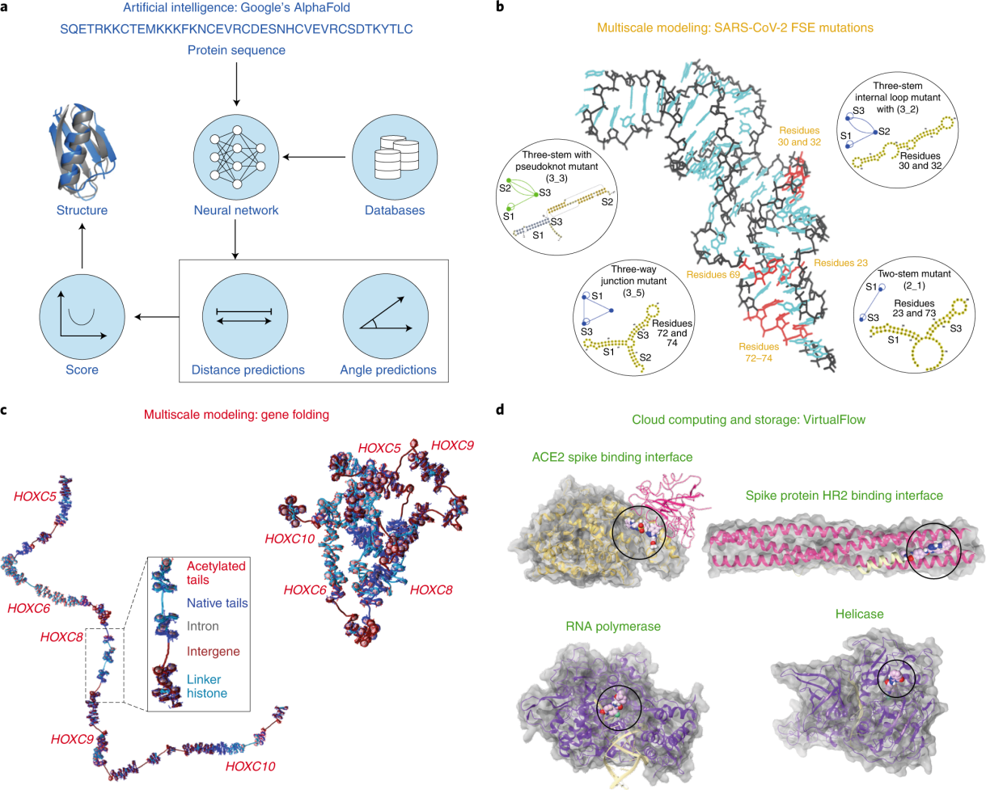
Examples
Applications of biomolecular modeling made possible by technology advances²
a: AlphaFold workflow
  Deep neural networks trained with structures from Protein Data Bank
b: RNA mesoscale modeling
  Target residues for drugs or gene editing in SARS-2-CoV frameshifting element
c: Chromatin mesoscale modeling
  HOXC mesoscale model at nucleosome resolution
d: Cloud-computing
  SARS-CoV-2 with bound ligands
Schlick, T. et al. Nat. Comput. Sci. 1, 321–331 (2021)

Slide 11









What else we expect to compute
Nuclear dynamics:
  Non-Born-Oppenheimer algorithms:
    Tunneling;
    Spectroscopies;
    Electronic and optical properties.
Dynamics of rare events
  Artificially enhancing probability to describe unbiased systems.
Finding new paths and new reactions automatically:
  Inversion of computational vs. experimental priority.
Time-dependant Hartree-Fock:
Ayik, S. et al. Phys. Lett. B 658, 174-179 (2008)

Slide 12
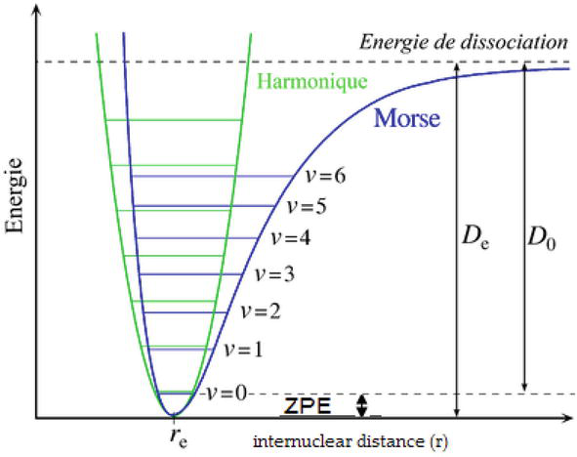
What else we expect to compute
Prediction of bulk properties from molecular level simulation
Entropy calculation:
  Zero-point vibrational energy;
  Free solvation energy.
Transport and non-equilibrium dynamics
  Combination of transport coefficients with spectral analysis of the fluxes;
  Phoretic phenomena (thermo and diffusiophoresis);
  Stochastic thermodynamics for large external perturbation.
Zero-point energy density associated with the free field:
Rahal, M. et al. In Modern Spectroscopic Techniques and Applications IntechOpen (2019)

Slide 13
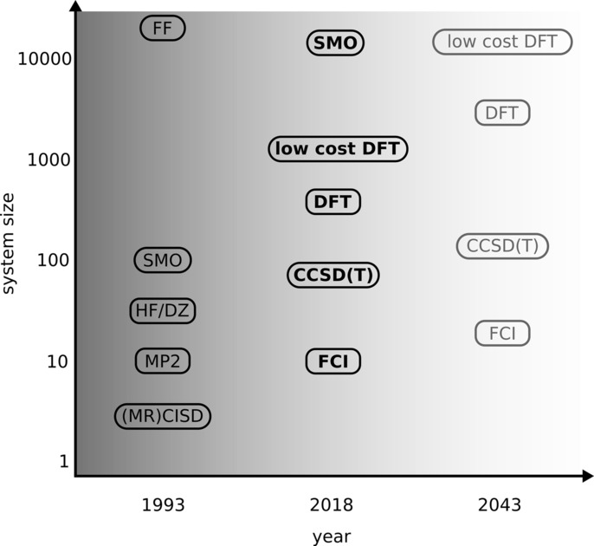
Summary
Prof Grimme and Prof Schreiner’s Perspectives:¹
  “Force Field speed” for full ab initio Molecular Dynamics;
  Force Field replacement with Semiempirical Molecular Orbital/Low-cost DFT;
  Polarizable FF and Machine-Learning FF for large biological systems and coarse-graining approaches;
  Accessible WFT solution with Quantum Computers and interchange with DFT.
Grimme, S. et al. Angew. Chem. Int. Ed. 57, 4170–4176 (2018)

Slide 14
References
Grimme, S., & Schreiner, P. R. Computational chemistry: the fate of current methods and future challenges. Angew. Chem. Int. Ed. 57, 4170-4176 (2018).
Schlick, T., Portillo-Ledesma, S. Biomolecular modeling thrives in the age of technology. Nat. Comput. Sci. 1, 321–331 (2021).
Cances, E., Le Bris, C., & Lions, P. L. Molecular simulation and related topics: some open mathematical problems. Nonlinearity, 21, T165 (2008).
Ciccotti, G., Dellago, C., Ferrario, M. et al. Molecular simulations: past, present, and future (a Topical Issue in EPJB). Eur. Phys. J. B 95, 3 (2022).
Dral, P. O. Quantum chemistry in the age of machine learning. J. Phys. Chem. Lett. 11, 2336-2347 (2020).
Bernal, D. E., Ajagekar, A., Harwood, S. M., Stober, S. T., Trenev, D., & You, F. Perspectives of quantum computing for chemical engineering. AIChE Journal, 68(6), e17651 (2022).
Ayik, S. A stochastic mean-field approach for nuclear dynamics. Phys. Lett. B, 658(4), 174-179 (2008).
Rahal, M., & Hajbi, A. E. Vibrational Zero-Point Energy of Organosilicon Compounds. In M. Khan, G. M. d. Nascimento, & M. El-Azazy (Eds.), Modern Spectroscopic Techniques and Applications. IntechOpen. (2019).

Slide 15
Thank you!
gpereir1@ualberta.ca

