Slide 1
Exploration of single cell spatial proteomics
Lauren Hsu
Culhane Lab
June 15, 2020

Slide 2
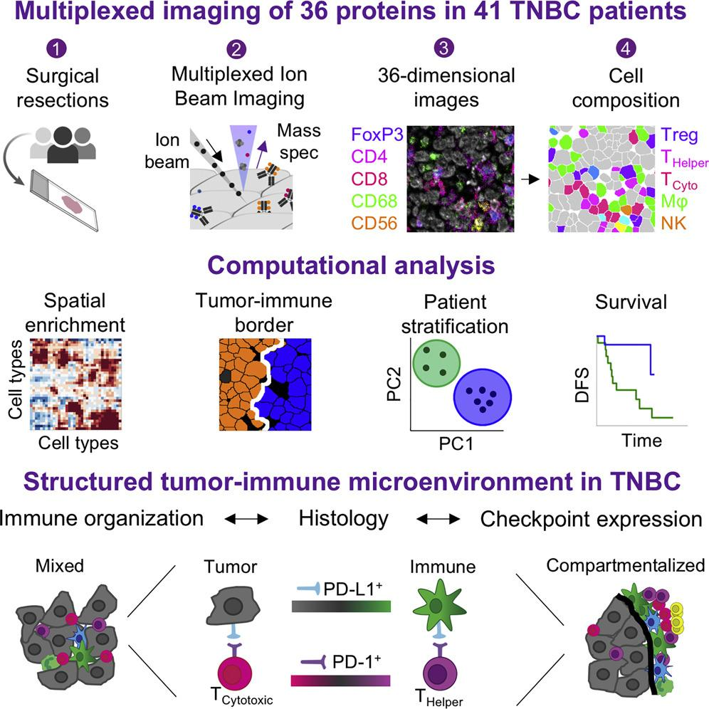
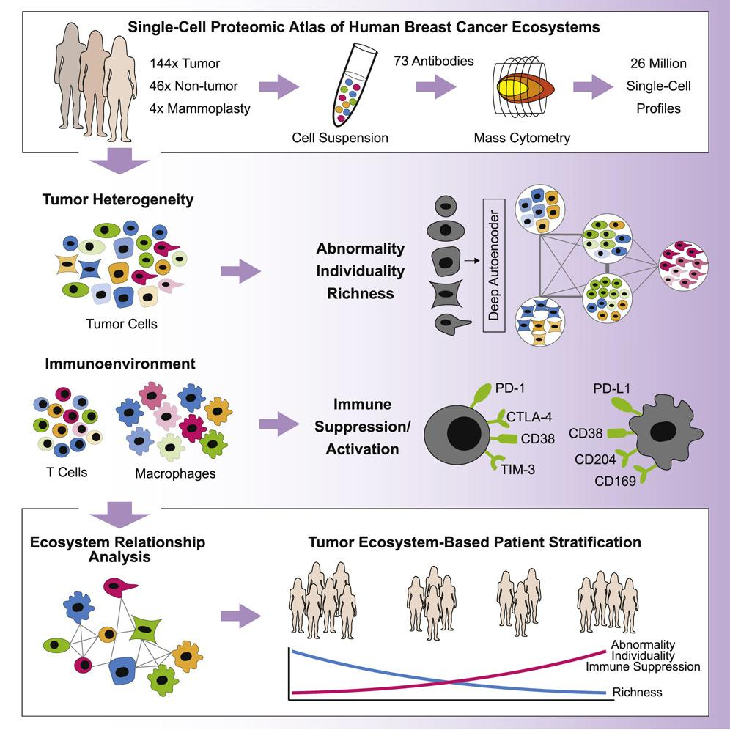
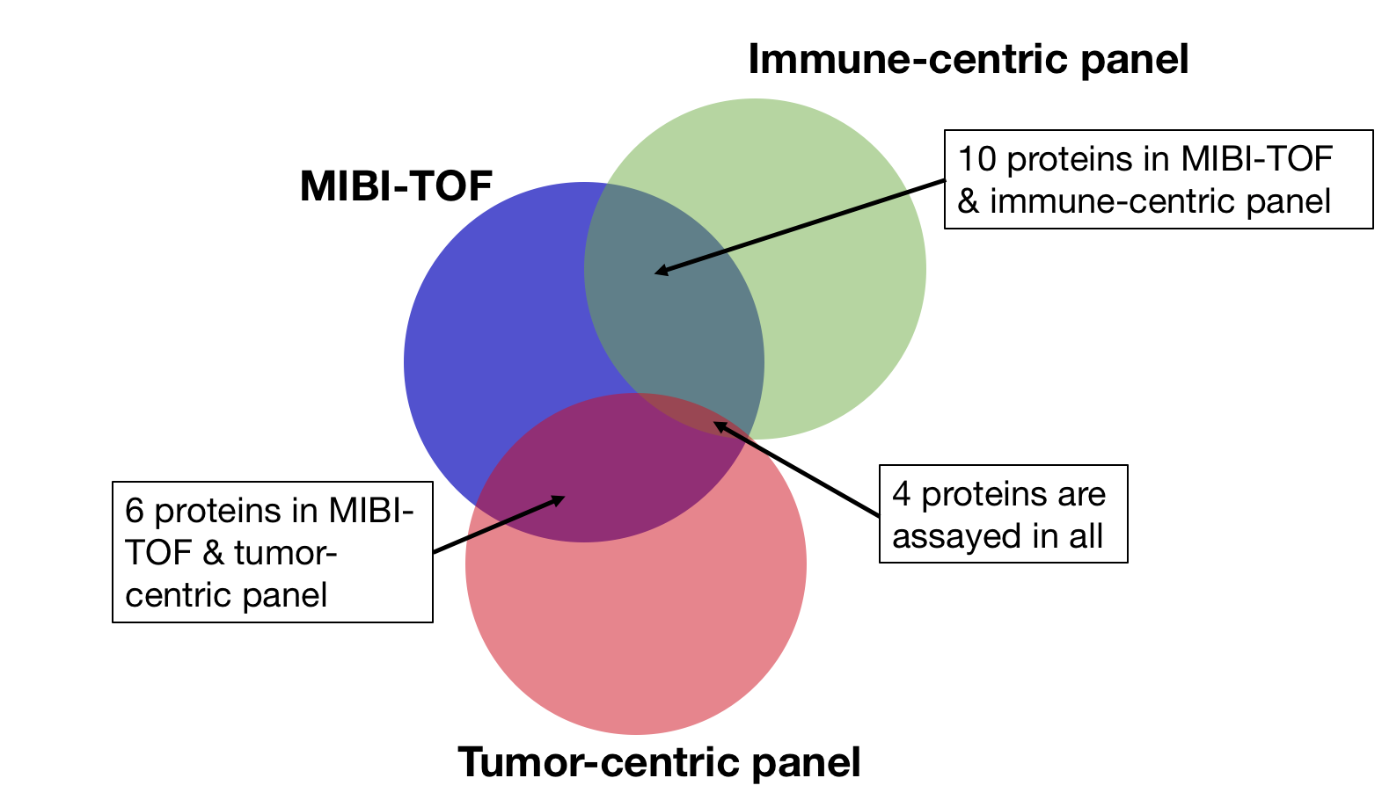
Data challenge
Single-cell targeted proteomics across technologies
Data from 2 studies characterizing the breast cancer tumor immune microenvironment, using:
Multiplexed ion beam imaging by time-of-flight
(MIBI-TOF)
Mass cytometry
(aka mass tag, CyTOF)
36 proteins
41 TN breast cancer patients
73 proteins across 2 panels: tumor and immune
140 breast cancer patients, 6 TN
… with a total of 20 overlapping proteins
Keren, et al. (2018)
Wagner, et al. (2019)

Slide 3
Objectives & challenges
Given two phenotypically similar sc proteomic datasets with some overlap in proteins, two questions:
how well can they be aligned?
to what extent can information be transferred between them?
Motivation: We want to be able to enrich analyses by pooling samples and sharing information across multiple experiments
Different physical technologies: strong batch effects
Limited overlap in datasets
Proteins
Phenotypes
No clear “ground truth” for validation*
Notes:
In particular spatial information

Slide 4
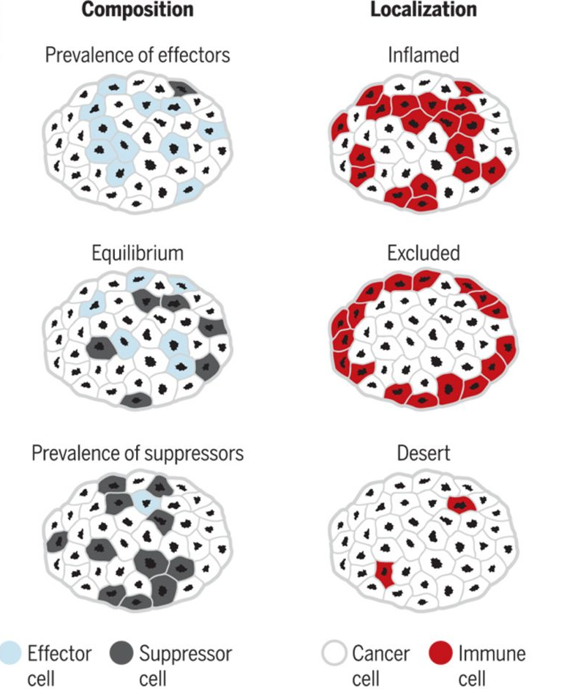
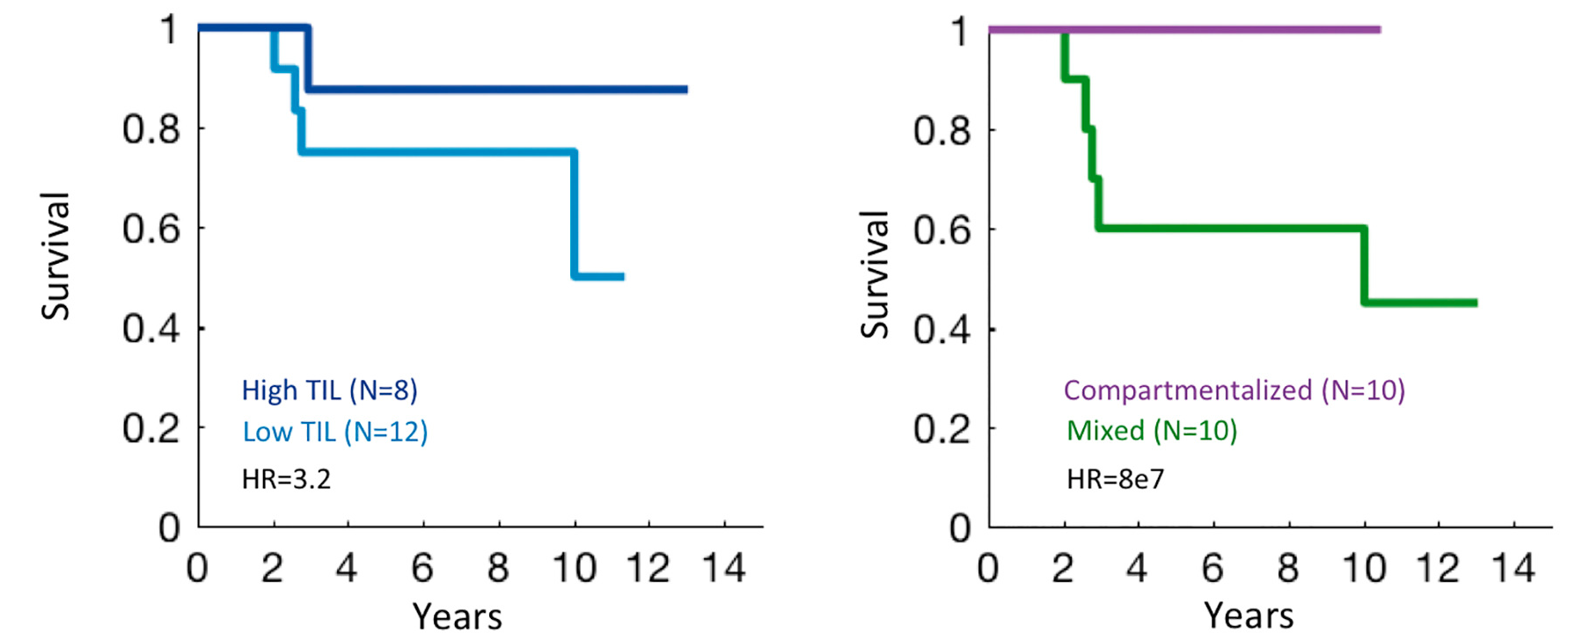
Spatial tumor immunology
What cells?
Where?
Prognostic indicators from the mibi study
1. TIL
2. Tumor/immune mixing score
Keren, et al. (2018)
Adapted from: The hallmarks of successful anticancer immunotherapy BY LORENZO GALLUZZI, TIMOTHY A. CHAN, GUIDO KROEMER, JEDD D. WOLCHOK, ALEJANDRO LÓPEZ-SOTO
SCIENCE TRANSLATIONAL MEDICINE, 19 SEP 2018
https://stm.sciencemag.org/content/10/459/eaat7807?rss=1

Slide 5
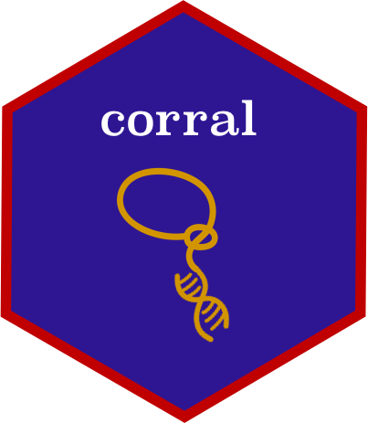
Overview
1
2
3
4
Cross-platform integration with joint dimensionality reduction
Imputing protein measurements across datasets
Transferring cell type labels between datasets
Spatial autocorrelation & clinical significance

Slide 6
Matrix factorization and projection across datasets
X
Find joint cell embeddings
Scale the disjoint protein measurements
Multiply step 2 matrix with cell embeddings → protein embeddings
Multiply the (disjoint) protein embeddings with shared cell embeddings to project (scaled) protein measurements
cells
?
proteins
?

Slide 7
Transferring cell type labels between datasets
3

Slide 8
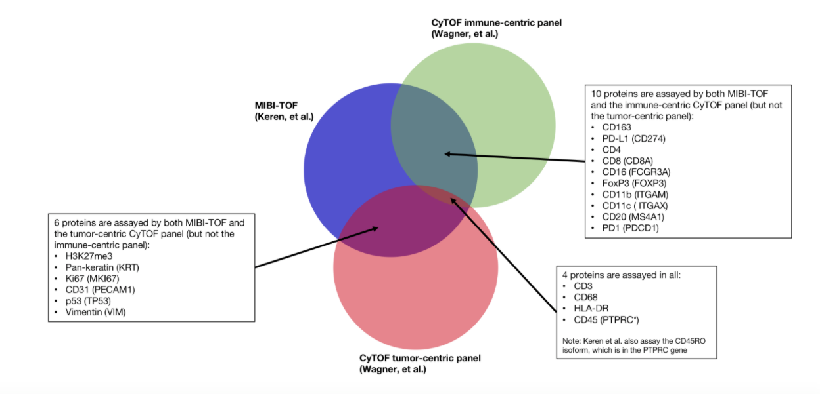
Robustness of classification
Mibi is annotated with cell types, while cytof is not.
Question: given limited overlap in proteins between the two datasets, can the cell type classifications be transferred?
1. mibi
Cell type predictions
Cell types
2. cytof
cytof immune panel
mibi
Assessing ability to recover mibi’s cell type classifications
Prediction Strength, Tibshirani (2012)

Slide 9
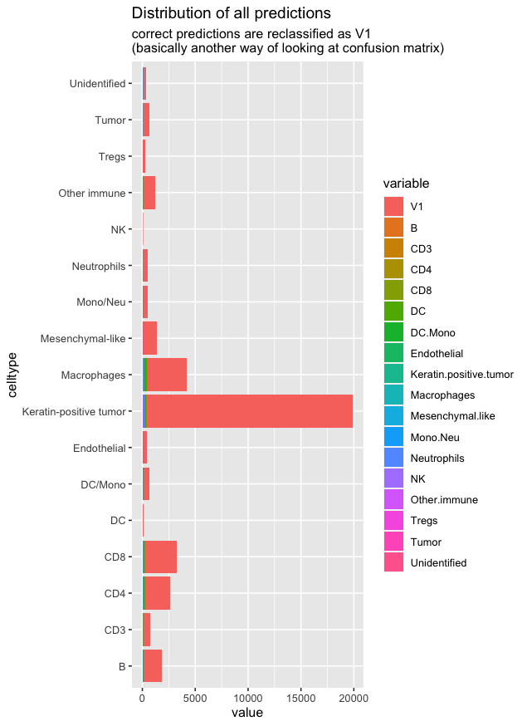
Random forest model with all mibi features
When using all available proteins in the mibi dataset, balanced accuracy > .9 for all classes except rarer cell types
~200k cells; 20% training
Cell types
Cell types
Cell types
mibi
Cell types

Slide 10
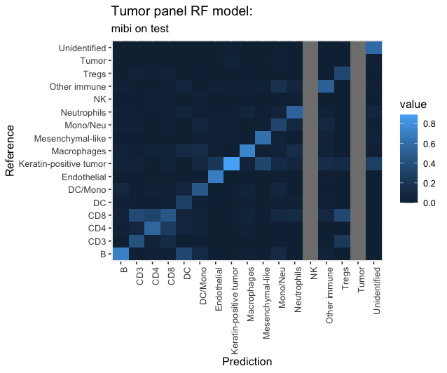
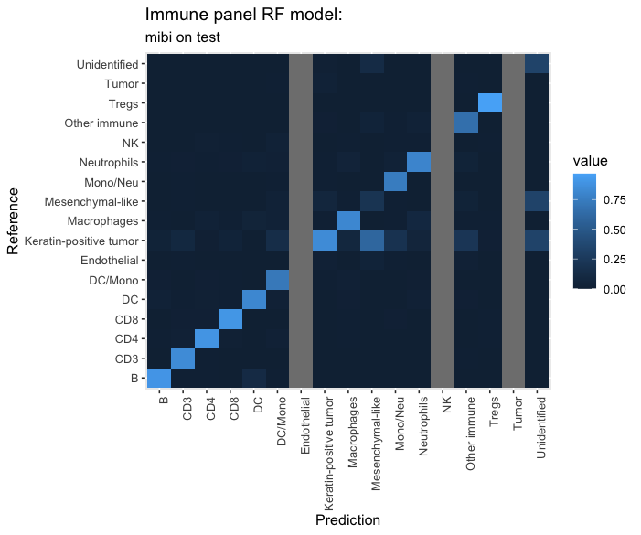
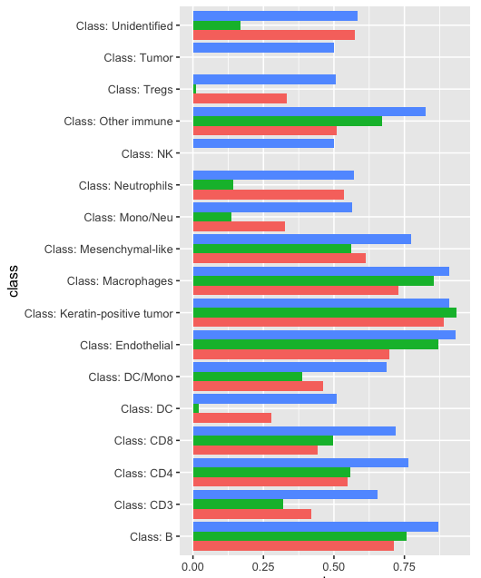
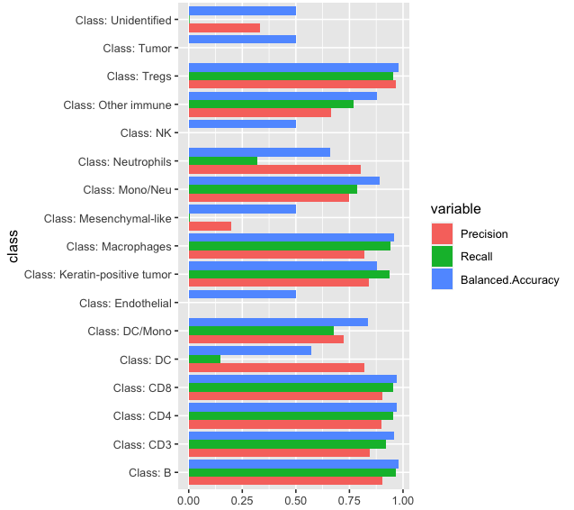
Testing the limited models on mibi
Tumor panel
Immune panel
“Mesenchymal-like” →
Endothelial →
Cell types
Immune subtypes →
mibi
Cell types

Slide 11
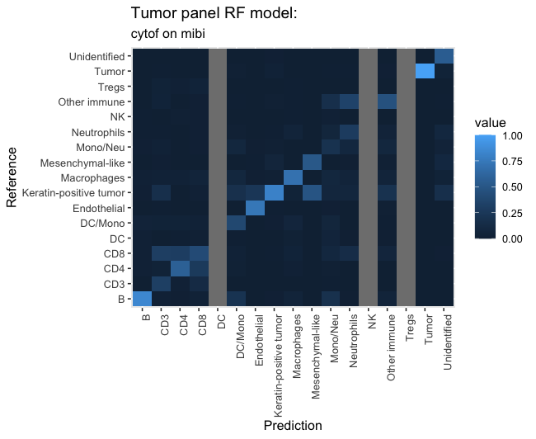
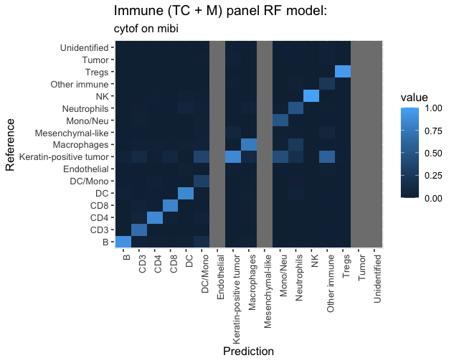
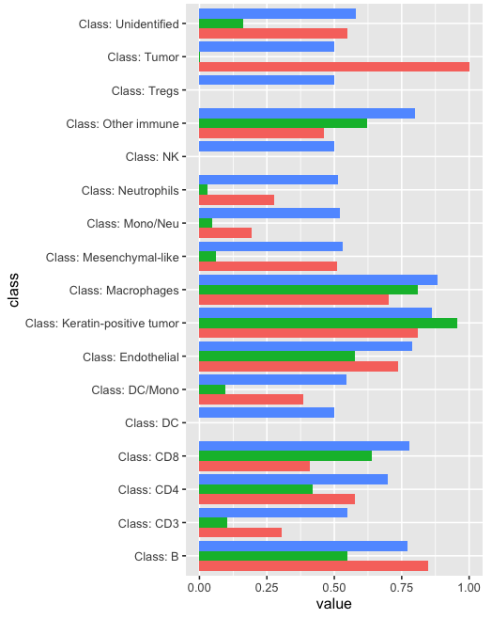
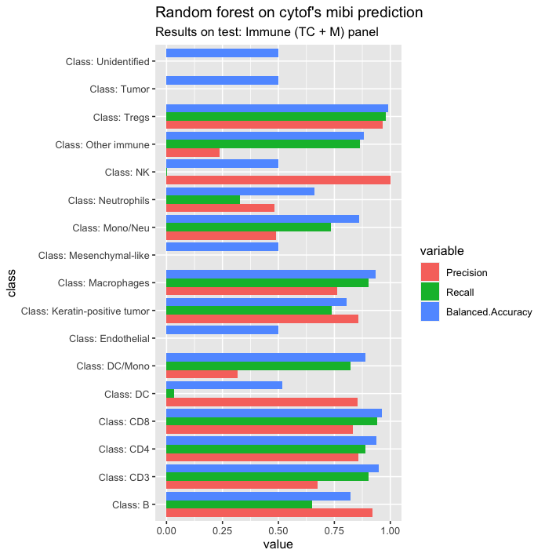
Recovering mibi cell types
?
Tumor panel
Immune panel
Cell type predictions
Cell types
“Mesenchymal-like” →
Endothelial →
Immune subtypes →

Slide 12
Spatial autocorrelation & clinical significance
4

Slide 13
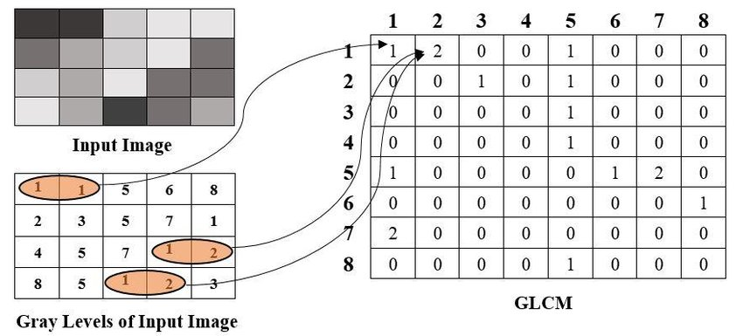
Tumor/immune mixing score
3 categories:
Cold
Compartmentalized
Mixed
Defined based on
Haralick’s gray level co-occurrence matrix
by computing:
Immune-tumor interactions
Immune-immune interactions
Keren, et al. (2018)

Slide 14
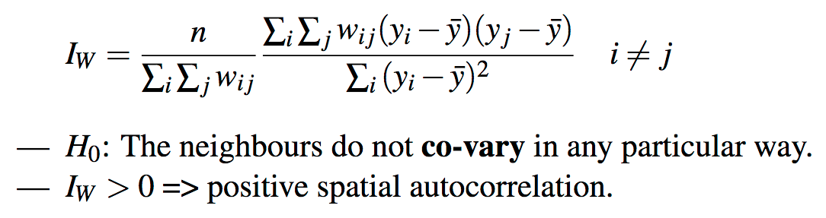
Moran’s index of spatial autocorrelation
Detects non-random spatial patterns
‘neighbors’ have similar values → positive spatial autocorrelation
‘neighbors’ have different values → negative spatial autocorrelation.
e.g. Tax income in Parisian census districts
Random v spatially autocorrelated distribution
Moran’s Index ~ 0
Moran’s Index close to 1
WY is the vector of means of variable Y
W is the spatial weights matrix (SWM) in the neighbourhood.
SWM weights the ‘local’ as opposed to ‘global’ weight wij between the i-th and j-th observables
Tutorial with R Code: https://www.insee.fr/en/statistiques/fichier/3635545/imet131-g-chapitre-3.pdf
Figure from https://www.ncbi.nlm.nih.gov/pmc/articles/PMC5870747/

Slide 15
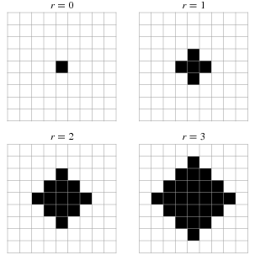
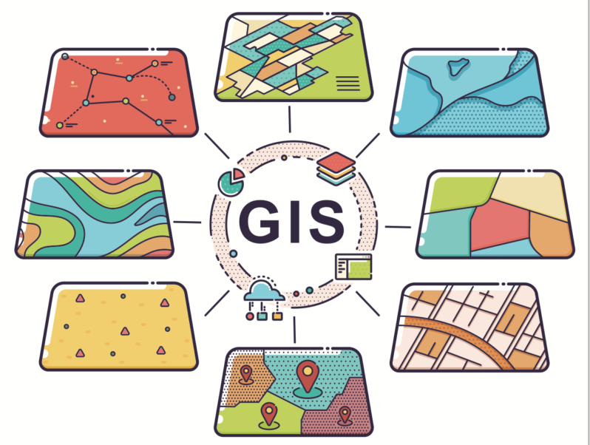
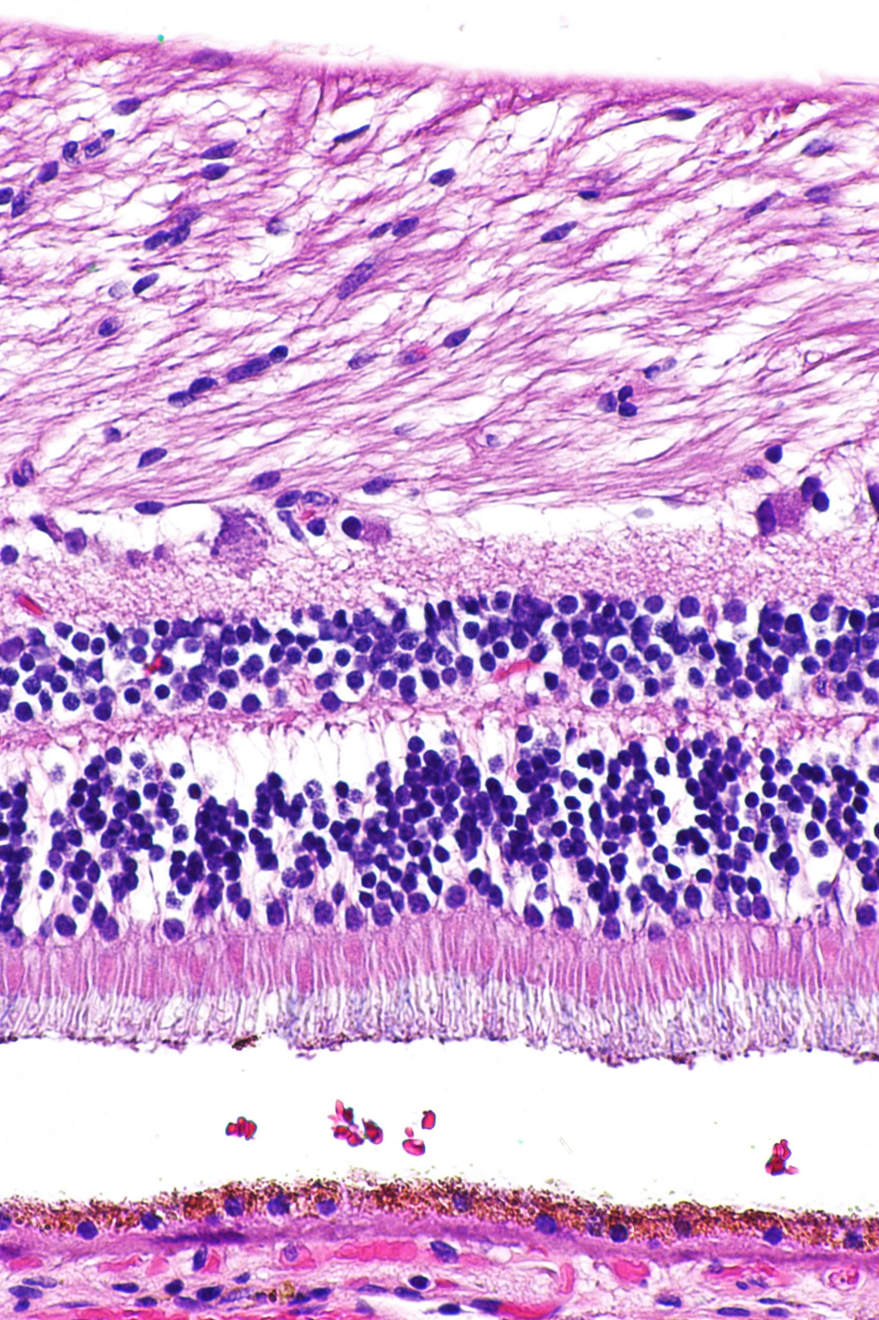
Spatial weight matrix (SWM)
Other options
Images: von Neumann neighborhood
Spatial weight matrix is often the inverse Euclidean distance between two locations Zi and Zj and is given by
where α denotes the decay parameter specifying the typical interaction range.
GIS: geographic boundaries
Tumor biology: anatomical or biological features; distance from endothelial cells (blood vessels), regions of hypoxia, tumor-immune boundary, basement membrane, or populations of tumor cells
For this analysis, we used Gabriel neighborhoods, a graph-based measure.

Slide 16
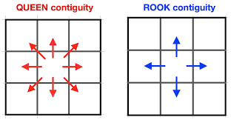
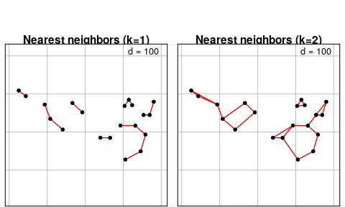
Examples of SWM
Grid
Graph
Tutorial: https://cran.r-project.org/web/packages/spdep/vignettes/nb.pdf

Slide 17
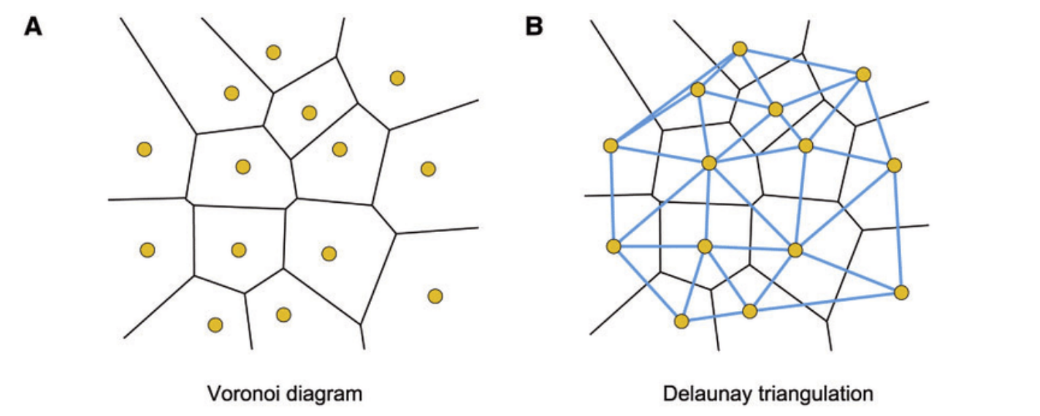
Delaunay neighborhoods
Delaunay triangulation connects points that share common Voronoi face
Figure from Zhou, Weiqiang & Yan, Hong. (2012). Alpha shape and Delaunay triangulation in studies of protein-related interactions. Briefings in bioinformatics. 15. 10.1093/bib/bbs077.

Slide 18
Delaunay neighborhoods
Gabriel neighborhoods are a special case, where an edge is created between a and b if no other points/centroids lie within the circles passing by a and b with diameter ab

Slide 19
Moran’s index: Tumor cells
Assessing autocorrelation of tumor cells
(i.e., groups of tumor cells together)
Moran’s index

Slide 20
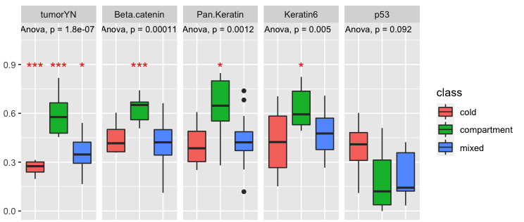
Moran’s index: Tumor markers
Beta catenin
Pan Keratin
Keratin 6
p53
Moran’s index
Notes:
tumorYN, Beta.catenin, Pan.Keratin, Keratin6, p53

Slide 21
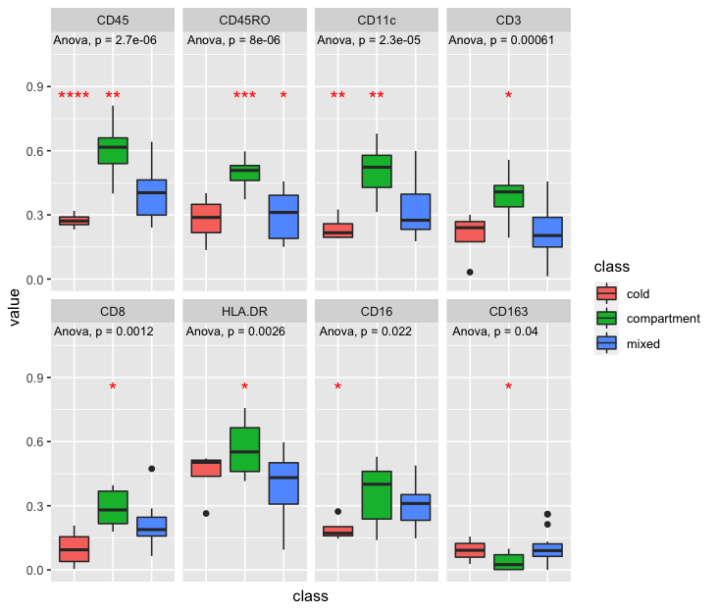
Moran’s index: Immune markers
CD45
CD45RO
CD11c
CD3
CD8
HLA-DR
CD16
CD163
Moran’s index

Slide 22
Summary
Robustness of cell-type classification between datasets
Performance would improve with tuning, etc.
Prediction ability is limited by the small number of intersecting proteins
Moran’s index is a metric for spatial autocorrelation with clinically relevant results
Agnostic to cell type, etc.
Reveals structure in data based on various “layers” of measurement

Slide 23
Thank you
Questions?
Aedín Culhane, DFCI

