Slide 1
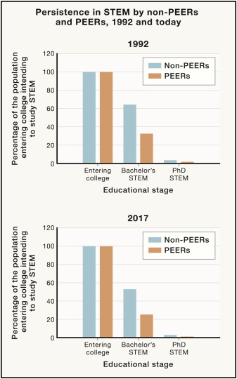
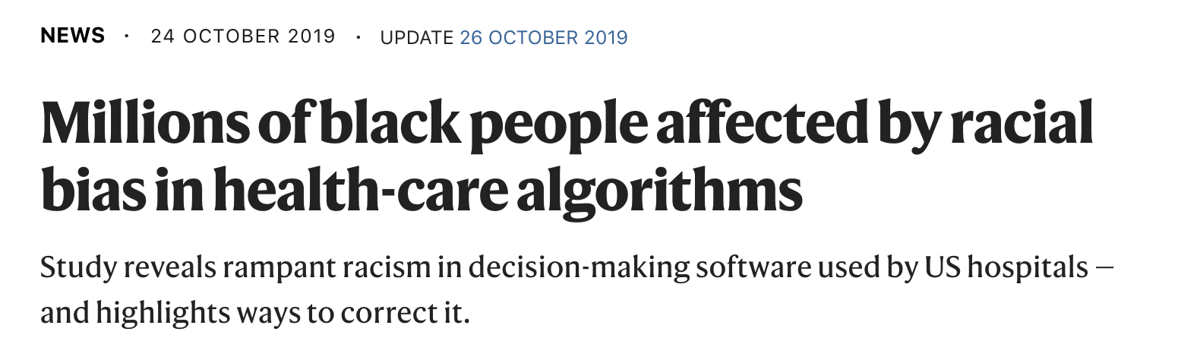
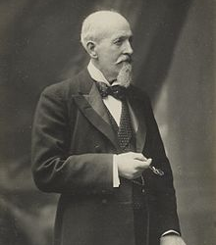
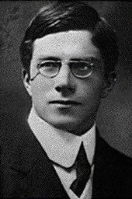
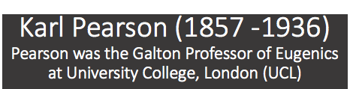
Today is Juneteenth, an Independence Day in the African American community, it marks the day—155 years ago this year—that enslaved African American people in Texas were told of their freedom from bondage.
We recognize racism in STEM and that ardent eugenists developed methods we use. We acknowledge the daily horrific injustice of racism
We will listen and work to end racism in science and in our communities.
We will amplify, promote black voices. We will mentor and promote careers of colleagues who are BIPOC.
We have responsibility to critically evaluate racial bias in study design and ensure that research algorithms do not perpetuate racial injustice.
Resources:https://wit.abcd.harvard.edu/fighting-anti-blackness-harvardwit-resource-list
Asai, David J. Cell 181 (4) 754

Slide 2
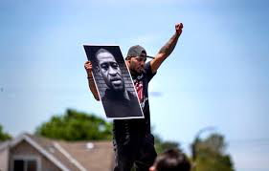
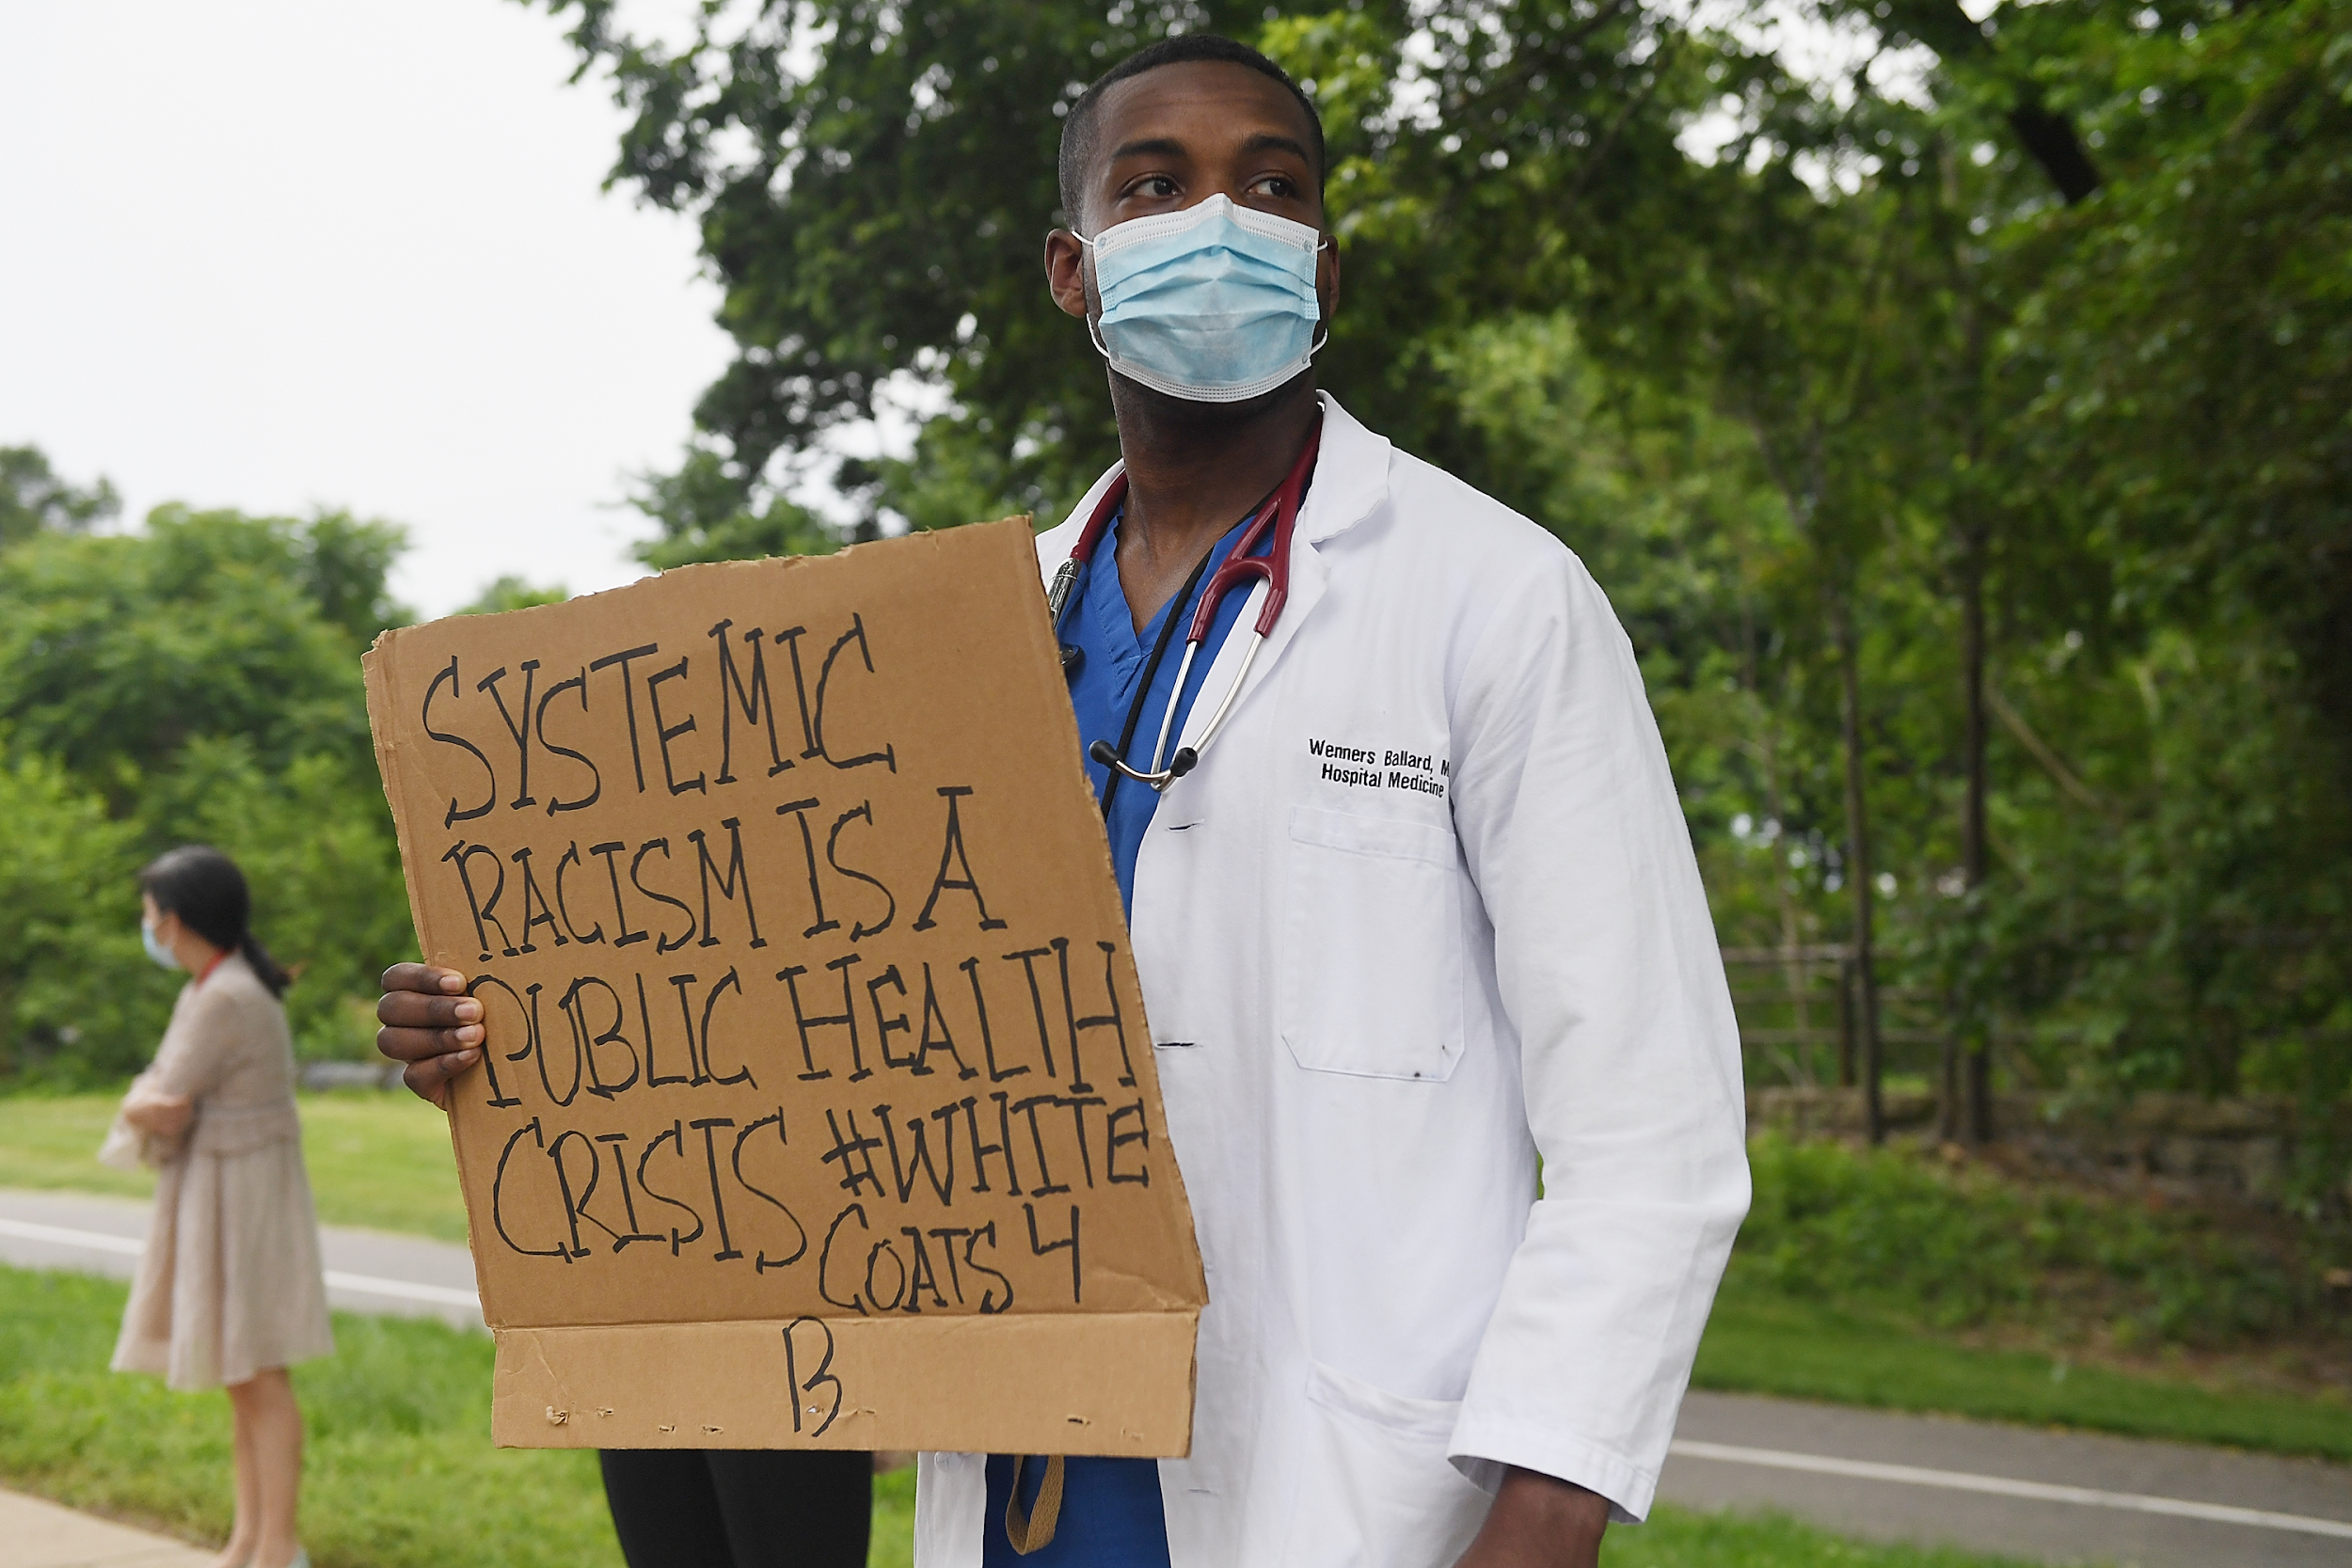
Our Black colleagues face tremendous inequity
#BlackintheIvory
#BlackintheIvory

Slide 3
Let’s use Juneteenth to reflect and make our community more equitable
http://blog.mathematical-oncology.org/black-in-america-and-academia.html

