Slide 1

Examples of Consistency Issues in Atmospheric Physics Parameterization and Process Coupling
Undiscretized equation inconsistent with intended physics
Discretization inconsistent with intended physics
  … in deterministic problems
  … in stochastic problems
Hui Wan (PNNL) and Colleagues
BIRS PDC Workshop, Canada, October 2019
Notes:
Stock image of cloud formations

Slide 2
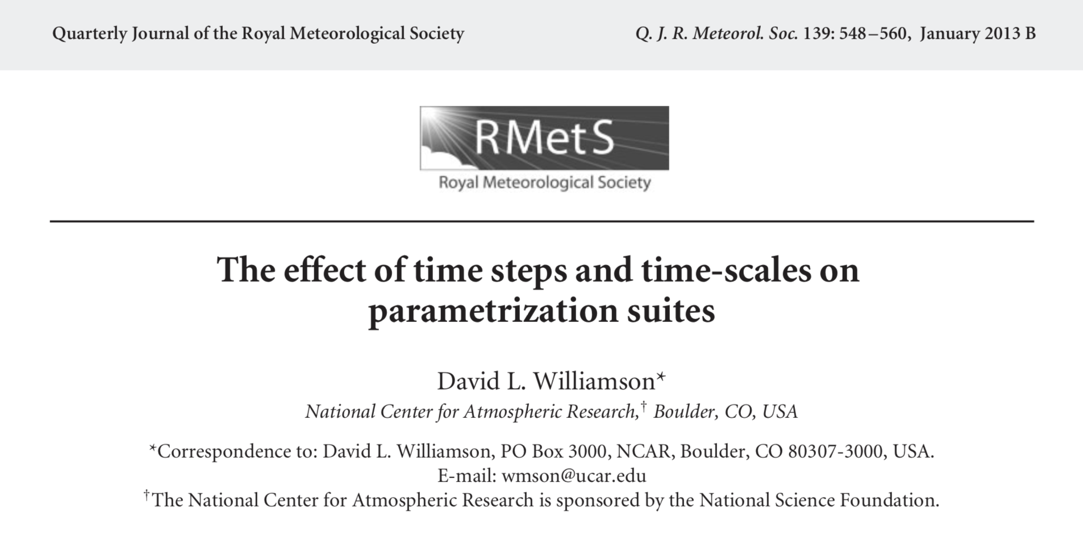
Example 1: Williamson (2013)
High-resolution (~40 km) CAM4 simulation, 5 min time step
Intense, truncation-scale storms (”grid-point storms”) - why do they occur?

Slide 3
Cause of Grid-point Storm Explained by Williamson (2013)
Toy model equation
q: specific humidity
D: dynamics
P: parameterized convection
Q: parameterized large-scale condensation
Convection:
relaxation over a time scale 𝜏
Large-scale condensation:
instantaneous removal of supersaturation

Slide 4
Numerical Results (Williamson, 2013)
Sequential split
(1) Dynamics
(2) Convection
(3) Condensation
∆q over 4 hours
Two parameterizations both attempts to remove supersaturation
Large-scale condensation becomes dominant when smaller step sizes are used
Positive feedback between dynamics (buoyancy generation) and condensation (latent heat release) leads to grid-point storms
Large-scale condensation dominant
Convection dominant
Shorter ∆t
“The problem was traced to the fact that individual parametrizations did not work to return the state to an atmospheric-like trajectory. They were restrained by the time-scales assumed in their formulations, which were appreciably longer than the model time step.”

Slide 5
Further Elaboration
Dave Williamson’s equations:
Let’s slightly revise the last part:
Convection
Large-scale condensation
Large-scale condensation
𝜏₂
We recover the left when 𝜏₂ ➔ 0

Slide 6
Role of Numerical Error in a “Properly-behaving Simulation”
Dave Williamson’s equation revised
Implication: If the equation is solved accurately, then Q will dominate P when 𝝉₂ is small. (But this is what we wanted.)
In the GCM
Sequential splitting in the sequence of D – P – Q
Calling P (convection) before Q (condensation) give P priority
Large ∆t gives P (convection) chance to do more work
Time-stepping error was used to compensate problem in the model formulation
“It is undesirable to make the numerical scheme part of the closure”
– Anton Beljaars, ECMWF

Slide 7
Example 2: A Time-step convergence Problem
Background
Intention to address process coupling errors in CAM (ca. 2013)
Attempt to use very short time steps to get a good reference solution
1h simulations using the global model; solution with ∆t = 1s as reference
Time-stepping error and solution self-convergence in the E3SMv1 atmosphere model
(CAM5 and E3SMv0 results are very similar)
Sensitivity Experiments
(Wan et al., 2015, JAMES)
Dycore + condensation has problem already
Saturation adjustment is not problematic
Shorter

Slide 8
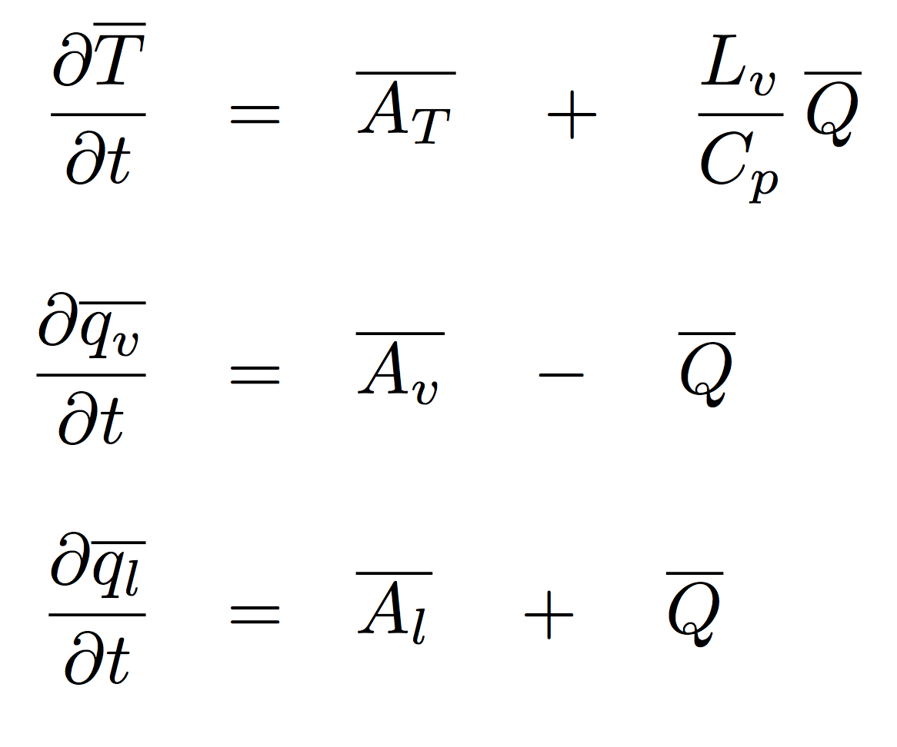




An Intermediate Configuration
E3SM’s dynamical core + a very simple parameterization
Parameterization “suite” contains only large-scale condensation (a bare-bones version of the CAM4 scheme)
Equations directly affected by parameterizations are:
Temperature:
Physics: bare-bones version of the large-scale condensation scheme in CAM2-CAM4
(Zhang et al., 2003; Rasch and Kristjansson,1998; Sundqvist,1978)
Water vapor:
Cloud liquid:
Dynamics (advection): Spectral-element dynamical core on cubed sphere,1-degree, 30 layers

Slide 9
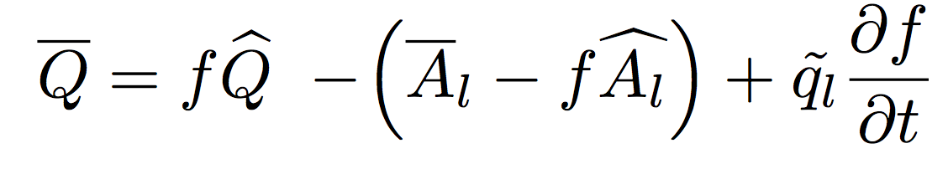
Parameterization of grid-box mean Q
Basic assumptions
    Instantaneous condensation
    Fractional cloudiness
Grid-box mean condensation rate
In-cloud condensation
Clear-sky evaporation
Phase change associated with cloud fraction change
One of the closure assumptions:
“When the cloud is growing (df/dt > 0), the new cloud water increases to match that within the cloudy part of the grid box. Conversely, when the cloud is eroding (df/dt < 0), the cloud water goes to zero in that region.”
— Rasch and Kristjansson (1998); Zhang et al. (2003)

Slide 10
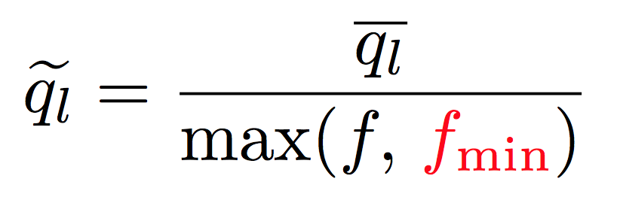
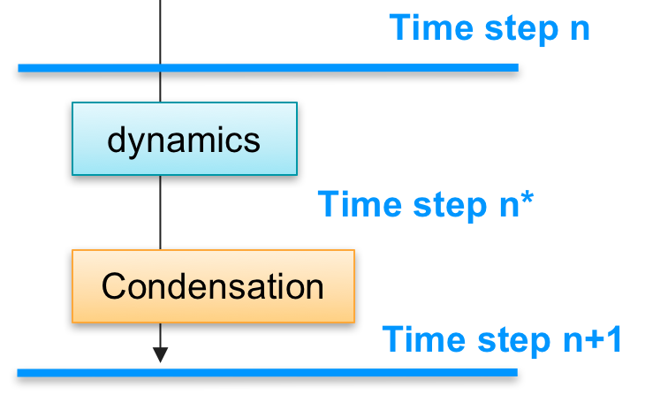
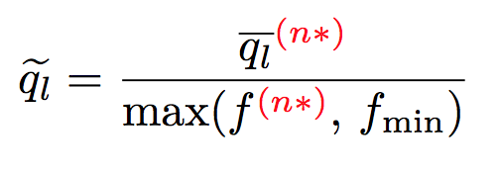
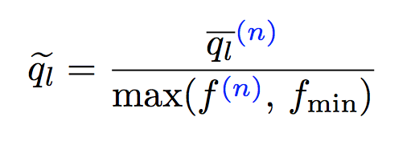
Process Coupling Related to
A ”safeguard parameter” avoids singularity (division by zero)…
We assume/hope it has little impact…
CAM models have been using sequential splitting for over a decade in the parameterization suite
Using sequential splitting
Using step n (in equilibrium)

Slide 11
Short Convergence Tests vs. Long-term Climate
1 h convergence tests conducted with a global dynamical core + simplified physics
Climate simulations conducted with the same dynamical core + a full physics suite
Solution error and self-convergence in 1 h simulations with simplified physics
Impact of splitting on 10-year climate simulated with full physics
Baseline model
Revised splitting
Revised splitting
Baseline model
Shading shows the 2𝜎 range of 6 realizations
Shading shows the 2𝜎 range of 1-year averages

Slide 12
What We Learned from This Little Exercise
Numerical coupling of difference processes need to be
  Not only stable (and preferably accurate)
  But also consistent with the physical concept behind a parameterization
The impact can be seen in both short-term convergence tests and long-term climate

Slide 13
Example 3: Stochastic Problems
Stochastic parameterizations are becoming popular in atmosphere and ocean modeling
Naïve application of traditional time integration methods can lead to incorrect answers
Convergence Diagrams for 4 Time-stepping Methods in a Simple 1D problem
Intensity of hurricane Isaac (2012) measured by max. surface wind speed
Ensemble hindcasts using Euler forward method for stochastic term
Control (deterministic)
Ensemble hindcasts using Euler forward + Ito correction
Figure taken from Hodyss et al. (2014, MWR)
Figure taken from Hodyss et al. (2013, MWR)

Slide 14
Ito Correction from Stochastic Analysis
Can be used to ensure convergence towards the desired interpretation of the solution (Ito or Stratonovich)
Example shown here is the same as in Hodyss et al. (2013): 1D advection-diffusion equation with a noisy forcing term
𝛼 = 0: white noise
𝛼 > 0: red noise
Ito correction for white noise is well known in stochastic analysis
Ito correction for colored noise has been derived (Stinis et al., 2019, under review)

Slide 15
Recommendations
Clearly distinguish the equations (including closure assumptions) and the numerical methods (discretization)
Assess asymptotic behavior; make ensure solution converges to intended physics, both before and after discretization.

