Slide 1


Deep Learning Enables Accurate Clustering and
Batch Effect Removal in Single-Cell RNA-Seq Analysis
Mingyao Li, Ph.D.
Department of Biostatistics, Epidemiology and Informatics
University of Pennsylvania Perelman School of Medicine
February 5, 2019

Slide 2
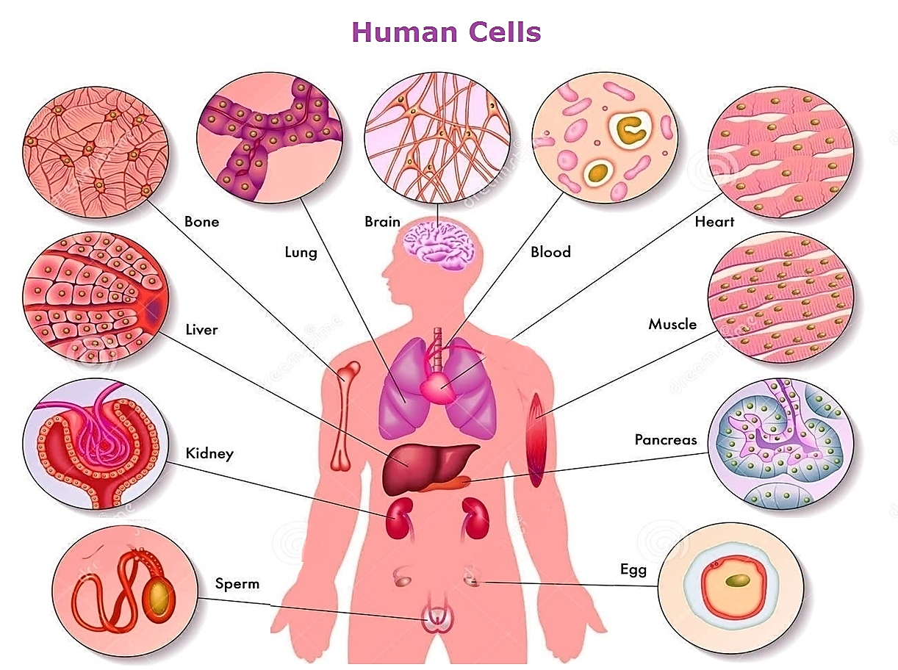


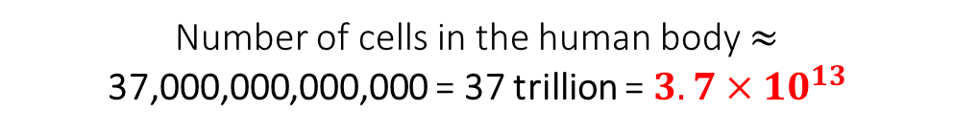
Human and single cells
Almost all cells in the human body contain the same DNA, but in each cell only certain genes are expressed at the same time.
Population of cells
(bulk RNA sequencing)
Single cell
(single-cell RNA sequencing)
Number of cells in the human body $≈$ 37,000,000,000,000 = 37 trillion = $3.7×{10}^{13}$

Slide 3
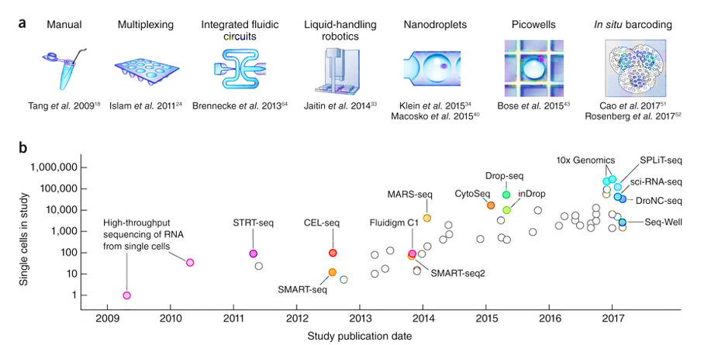

Scaling of single-cell RNA-seq experiments
Svensson et al. (2018) Nature Protocol
Notes:
Science has chosen single-cell analyses of gene activity through time as its 2018 Breakthrough of the Year, honoring a trifecta of methods that together are enabling researchers to determine, at the individual cell level, which genes are turned on and off as an early embryo develops.

Slide 4
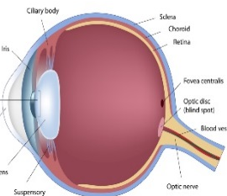
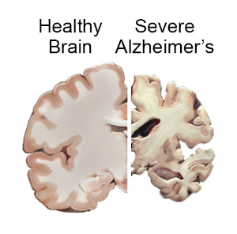
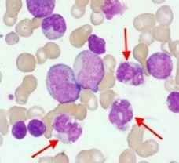
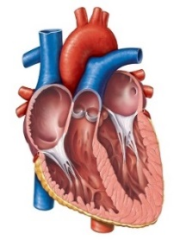
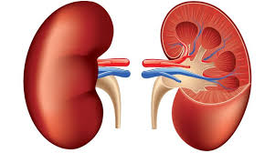
Single-cell RNA-seq is transforming biomedical research
Macular degeneration
Alzheimer’s disease
Cardiometabolic disease
Heart disease
Kidney disease
Wagner et al. (2016) Nature Biotech
Notes:
The biological factors affecting the cell combine to create its unique, instantaneous identity, which is captured in the cell’s
molecular profile. Computational methods dissect the molecular profile and tease apart facets of the cell’s identity, which are akin to ‘basis vectors’ that span
a space of possible cellular identities. Key examples include (counterclockwise from top): (1) discrete cell types (e.g., cell populations in the retina (A.R. and
colleagues30)); cell type frequency can vary by multiple orders of magnitude from the most abundant to the rarest subtype; (2) continuous phenotypes (e.g.,
the pro-inflammatory potential of each individual T cell, quantified through a gene expression signature derived from bulk pathogenic T cell profiles (N.Y.,
A.R. and colleagues1)); (3) unidirectional temporal progression (e.g., normal differentiation, such as hematopoiesis); (4) temporal vacillation between cellular
states (e.g., oscillation through cell cycle; data taken from A.R. and colleagues102); (5) physical location (e.g., a cell’s location during embryo development
determines its exposure to morphogen gradients. Dividing an organ into discrete spatial bins, combined with independent data on landmark genes, allows
inference of spatial bins (highlighted) from which single cells had likely originated (figure adapted from A.R. and colleagues95). The scatterplots represent
single cells (dots) projected onto two dimensions (e.g., first two principal components or using t-SNE).

Slide 5
Single-cell RNA-seq clustering
Motivation: Cell type identification by clustering is typically the 1st step in scRNA-seq analysis.
Example: immune cells in human kidney
Some cells are easier to cluster, but others are not.
Easier-to-cluster cells provide useful information on cell cluster-specific gene expression signatures.
They can help cluster harder-to-cluster cells.

Slide 6
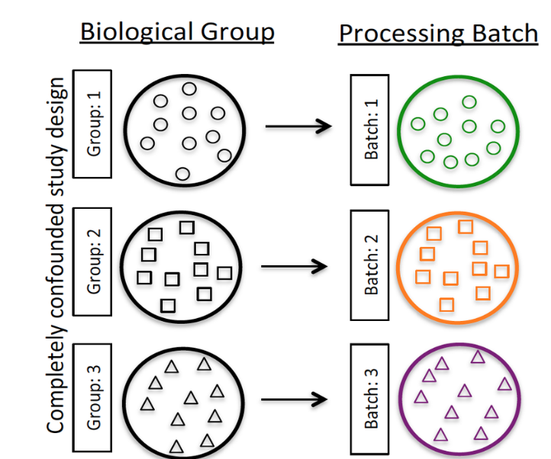


Batch effect and its impact
We cannot determine if difference is due to biology or batch effect.
Batch effect is removed due to random mixing of biological samples from the same group.
Challenge: Batch effects are unavoidable in studies involving human tissues.

Slide 7
Existing methods for scRNA-seq clustering
Kiselev and Satija (2019) Nature Review Genetics

Slide 8
Existing methods for batch effect correction
Shared correlation structure (CCA)
Butler et al. 2018 Nature Biotech
Existing methods treat clustering and batch effect correction as separate problems.
Some cells are more vulnerable to batch effect than others.
Ideal approach: simultaneous clustering and batch effect removal.
Remove batch effect
Mutual nearest neighbors (MNN)
Haghverdi et al. 2018 Nature Biotech
Notes:
The Seurat alignment procedure uses canonical correlation analysis to identify shared correlation structures (i.e., canonical correlation vectors, CC) across data sets, and aligns these dimensions using dynamic time warping. After alignment, cells are embedded in a shared low-dimensional space (visualized here in 2D with t-SNE).
Schematics of batch-effect correction by MNN. (a) Batch 1 and batch 2 in high dimensions with an almost orthogonal batch effect difference between them. (b) The algorithm identifies matching cell types by finding MNN pairs of cells (gray box). (c) Batch-correction vectors are calculated between the MNN pairs. (d) Batch 1 is regarded as the reference, and batch 2 is integrated into it by subtraction of correction vectors. (e) The integrated data are considered the reference, and the procedure is repeated for integration of any new batch.

Slide 9
Deep Embedding for Single-cell Clustering
Cluster assignment
Maximum cluster assignment probability
Batch effect removal
Iterative clustering: 1) use easy-to-cluster cells as “training” set to improve clustering accuracy; 2) iteratively moves cells to cluster center to remove batch effect.

Slide 10
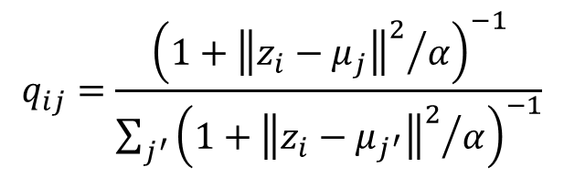
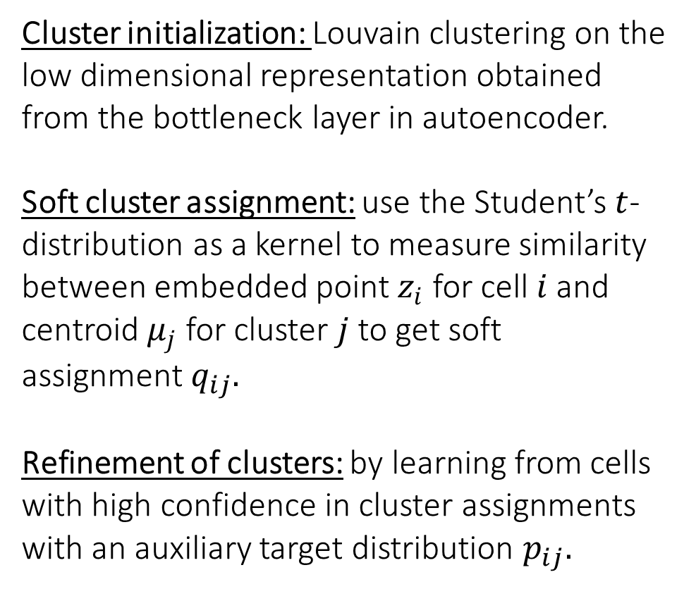
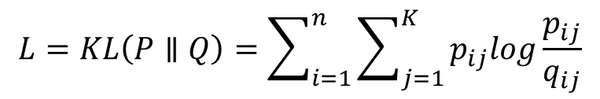
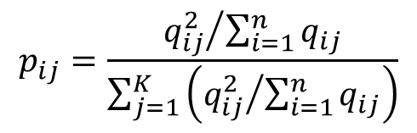
Iterative clustering
Cluster initialization: Louvain clustering on the low dimensional representation obtained from the bottleneck layer in autoencoder.
Soft cluster assignment: use the Student’s $t$-distribution as a kernel to measure similarity between embedded point $z_{i}$ for cell $i$ and centroid $μ_{j}$ for cluster $j$to get soft assignment $q_{ij}.$
Refinement of clusters: by learning from cells with high confidence in cluster assignments with an auxiliary target distribution $p_{ij}.$
$$q_{ij}=\frac{{\left(1+{{\left\|z_{i}−μ_{j}\right\|}^{2}}/α\right)}^{−1}}{\sum_{j^{′}}{{\left(1+{{\left\|z_{i}−μ_{j^{′}}\right\|}^{2}}/α\right)}^{−1}}}$$
$$p_{ij}=\frac{{q_{ij}^{2}}/{\sum_{i=1}^{n}{q_{ij}}}}{\sum_{j=1}^{K}{\left({q_{ij}^{2}}/{\sum_{i=1}^{n}{q_{ij}}}\right)}}$$
Objective function:
$$L=KL\left(P∥Q\right)=\sum_{i=1}^{n}{\sum_{j=1}^{K}{p_{ij}log\frac{p_{ij}}{q_{ij}}}}$$

Slide 11
Analyzed data sets
Species | Tissue | Data source | No. of subjects | Sample size | Protocol
Human | 30 tissues | GTEx | - | 11,687 samples | Bulk RNA-seq
Drosophila | Mid brain | Croset et al. (2018) | 8 | 10,286 cells | Drop-seq
Mouse | Retina | Shekhar et al. (2016) | 6 | 27,499 cells | Drop-seq
Human | Kidney | Generated by us | 4 | 8,544 cells | 10X
Human | Kidney | Young et al. (2018) | 3 | 7,149 cells | 10X
Human | PBMC | Kang et al. (2018) | 8 | 24,679 cells | 10X
Mouse | Brain | 10X website | 2 | 1,306,127 cells | 10X
Gold standard
Increasing complexity

Slide 12
Benchmarking using GTEx data
DESC
ARI = 0.790
ARI = 0.755
11,687 samples
30 unique tissues
ARI = 0.349
ARI = 0.267

Slide 13
Analysis of drosophila data without batch effect
Croset et al. (2018) eLife 7:e34550
Drosophila mid brain : 10,286 cells.
DESC detected 3 Kenyon cells reported in the original paper.
Original paper failed to identify the 3 types of fast-acting neurotransmitters.
DESC identified them with clear clusters.

Slide 14
Analysis of drosophila data without batch effect
Autoencoder in DESC extracts useful information in single-cell clustering
Louvain
Used low-dimension representation from the autoencoder bottleneck layer as input for clustering and tSNE → separation of the 3 neurotransmitters.

Slide 15
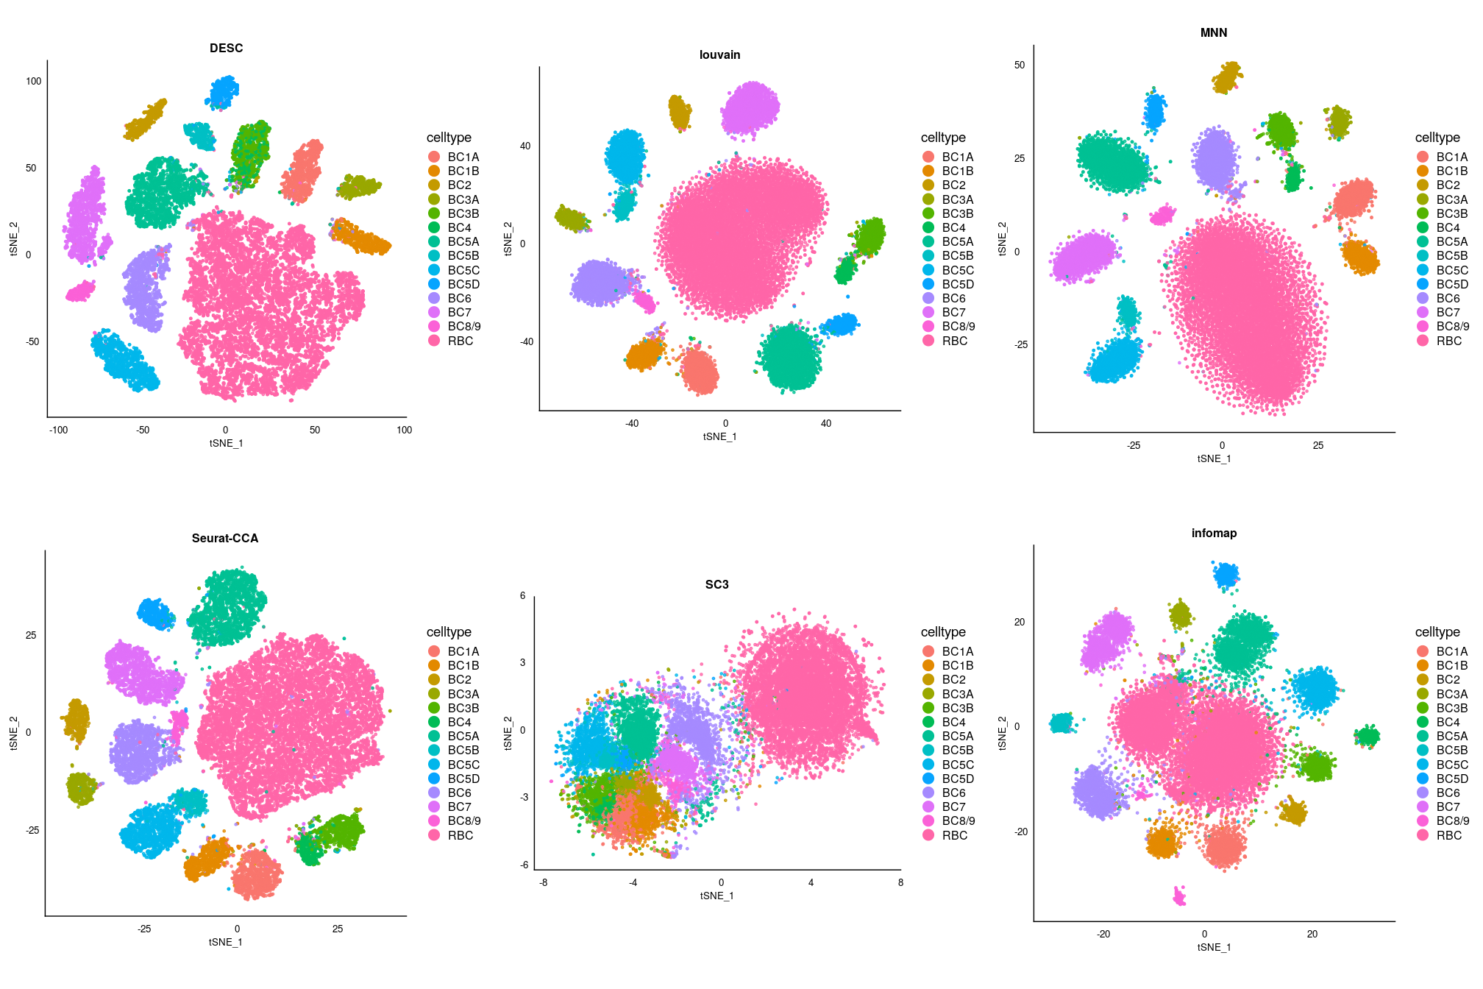
Analysis of mouse retina data with batch effect
DESC
ARI = 0.973
Louvain
ARI = 0.965
MNN
ARI = 0.974
Shekhar et al. (2016) Cell
27,499 bipolar cells
6 replicates in 2 batches
14 bipolar cell types
CCA
Infomap
ARI = 0.560
ARI = 0.637
SC3
ARI = 0.521
15

Slide 16
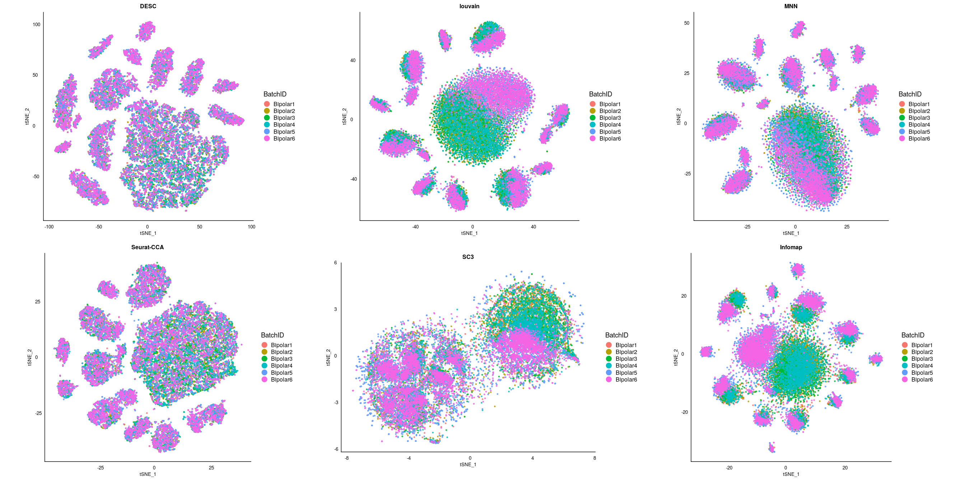
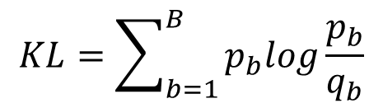
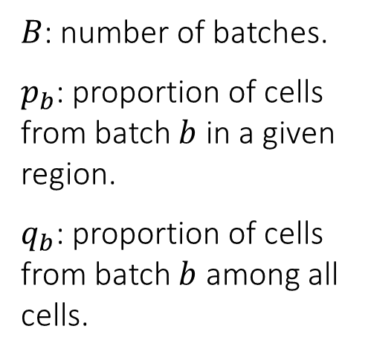
Analysis of mouse retina data with batch effect
DESC
Louvain
MNN
Kullback-Leibler divergence
$$KL=\sum_{b=1}^{B}{p_{b}log\frac{p_{b}}{q_{b}}}$$
$B$: number of batches.
$p_{b}$: proportion of cells from batch $b$ in a given region.
$q_{b}$: proportion of cells from batch $b$ among all cells.
CCA
Infomap
SC3

Slide 17
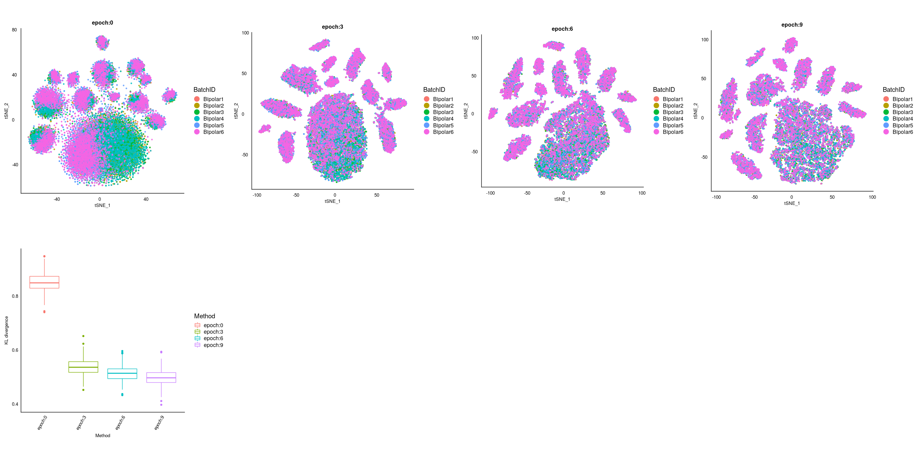
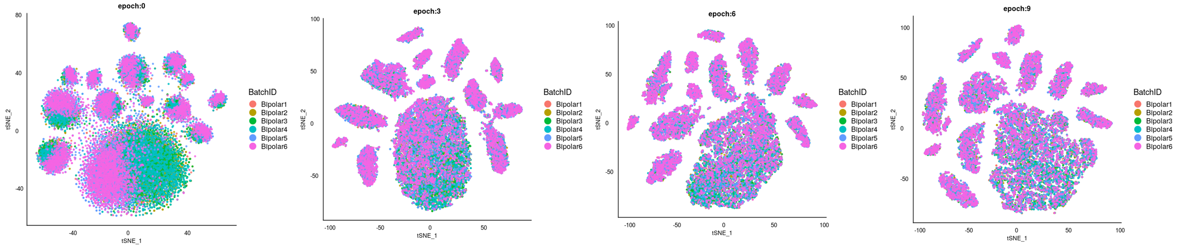
Analysis of mouse retina data with batch effect
Epoch: 0
Epoch: 3
Epoch: 6
Epoch: 9
Batch effect
Over iterations, cells from the same cluster are moved closer and closer to the cluster centroid, and hence help remove batch effect.

Slide 18
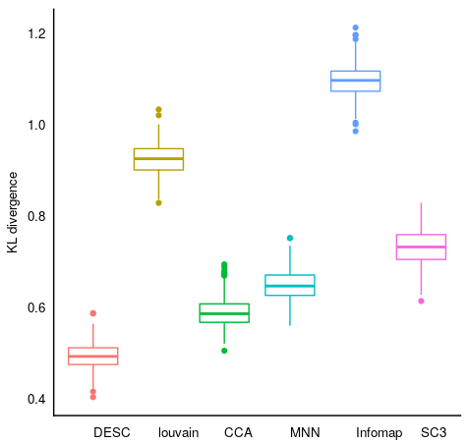
Analysis of mouse retina data with batch effect
Comparison of different methods
Performance of DESC over iterations
KL divergence
KL divergence
DESC Louvain CCA MNN Infomap SC3
Epoch 0 Epoch 3 Epoch 6 Epoch 9

Slide 19
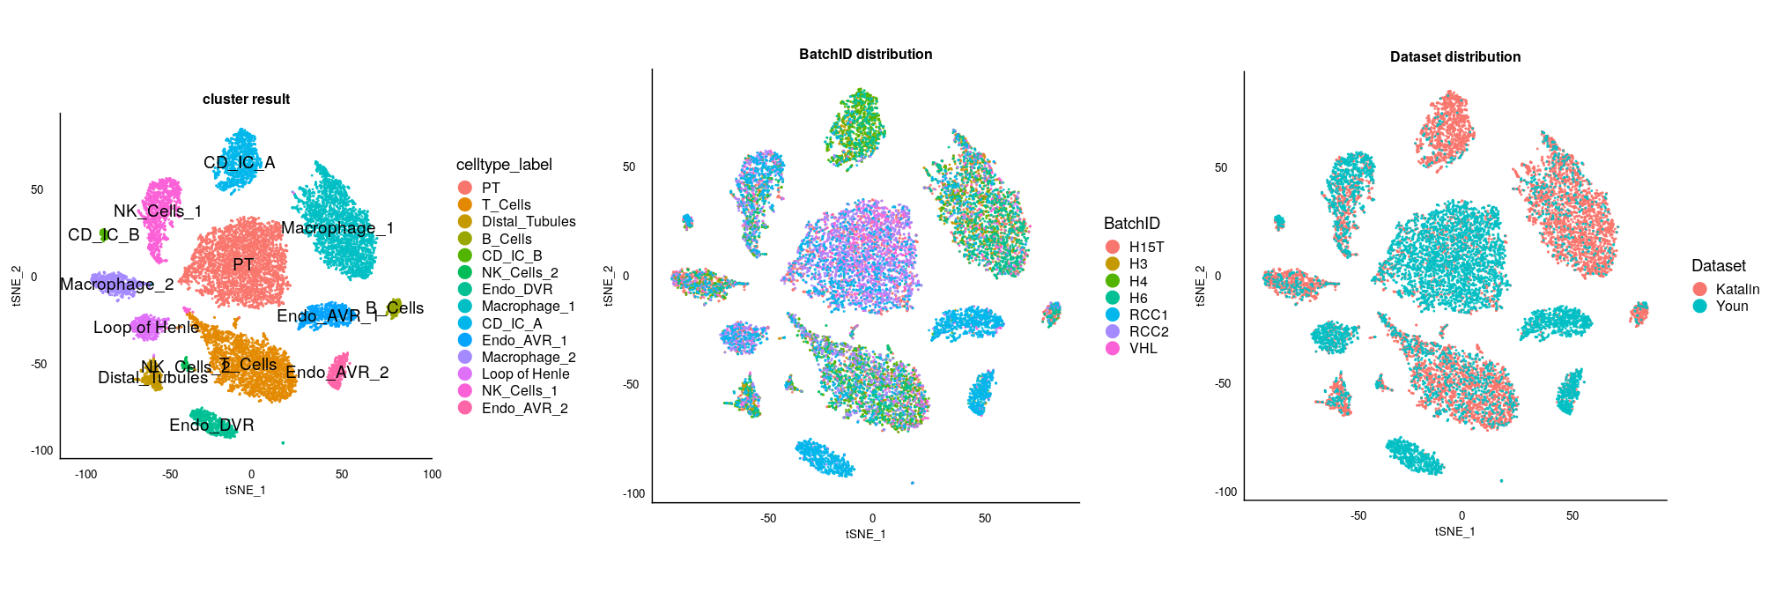
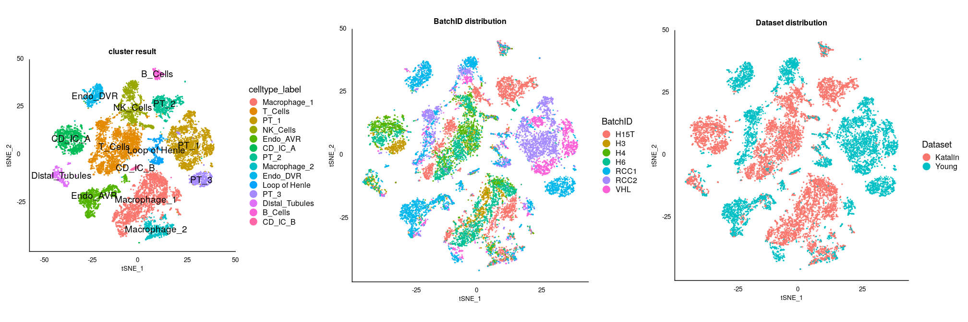
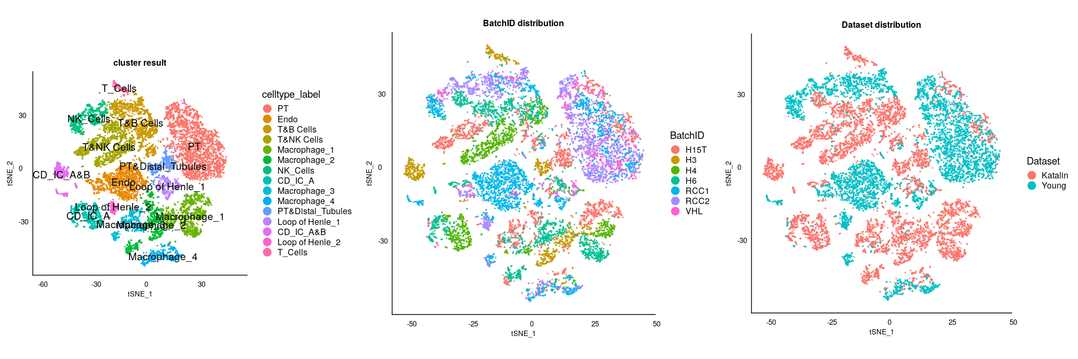
Human kidney data with complex batch effect
Data set 1: 8,544 cells (4 subjects) generated by Katalin Susztak’s lab (UPenn)
Data set 2: 7,149 cells (3 subjects) generated by Young et al. (2018) Science (UK)
Two levels of batch effect: 1) subject level, 2) data set level
DESC
MNN
CCA

Slide 20
Human kidney data with complex batch effect
DESC
MNN
CCA
Median KL-divergence
- DESC: 0.39
- MNN: 0.87
- CCA: 0.89
Dataset
DESC
MNN
CCA
Median KL-divergence
- DESC: 1.21
- MNN: 2.17
- CCA: 2.28
Subject

Slide 21
Human PBMC data with complex batch effect
Kang et al. (2018) Nature Biotech
CTRL
29,065 PBMC cells from 8 lupus patients.
Control (CTRL): unstimulated with interferon β (batch 1).
Stimulated (STIM): cells stimulated with interferon β (batch 2).
Interferon β leads to dramatic cell type specific gene expression changes.
Batch effect is completely confounded with biological variations.
STIM

Slide 22
Human PBMC data – clustering using DESC
DESC
DESC
CTRL and STIM cells were mixed well, except CD14+ monocytes.
22

Slide 23
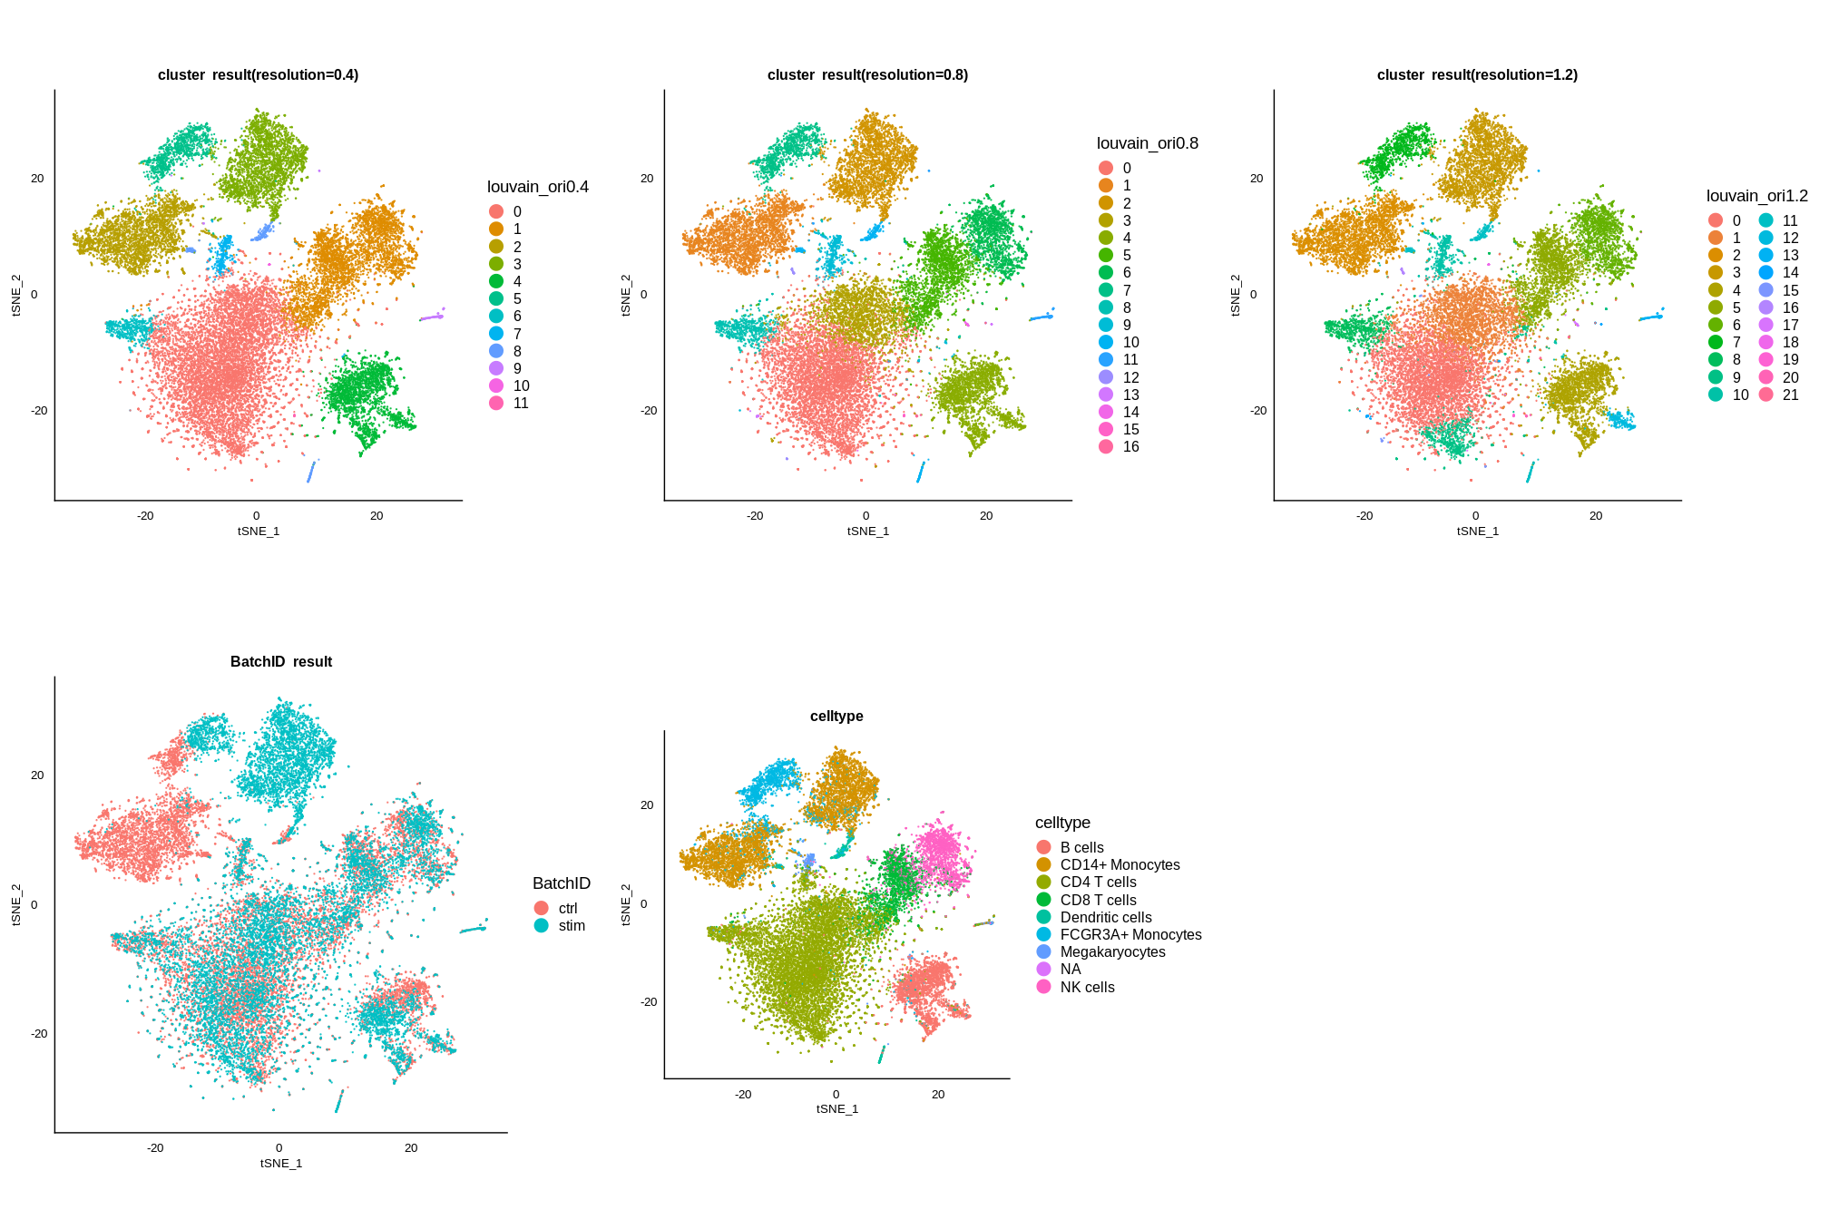
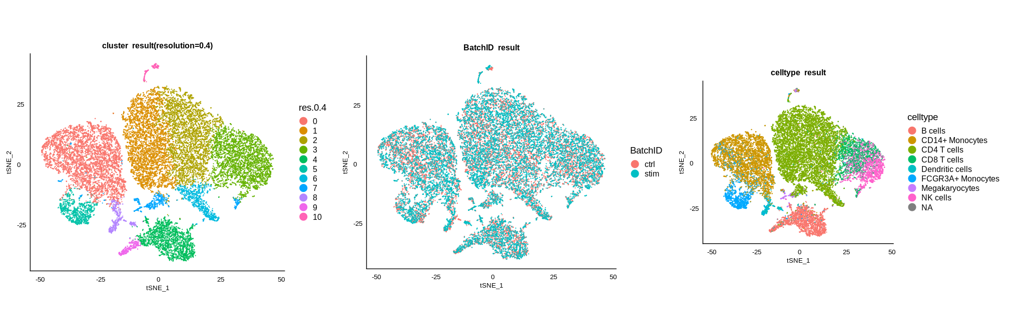
Human PBMC data – clustering using MNN and CCA
MNN clustering
CD14+ monocytes, FCGR3A+ monocytes, and dendritic cells were mixed together.
CD8 T cells and NK cells were mixed together.
CCA clustering
CD14+ monocytes, FCGR3A+ monocytes, and dendritic cells were mixed together.
CD8 T cells and NK cells were mixed together.

Slide 24
Human PBMC data – differential expression
For each cell type, performed differential expression (DE) analysis between CTRL and STIM conditions.
CD14+ monocytes had the most pronounced DE results.
Other cell types had less DE genes.
DESC preserved true biological variations.
24

Slide 25
Human PBMC data – batch effect removal
Evaluation of batch effect removal when considering all cells
CCA has the smallest KL divergence
Followed by DESC and MNN
Evaluation of batch effect removal when CD14+ monocytes were eliminated
Both DESC and MNN have reduced KL divergence
CCA’s KL divergence did not change, suggesting it might have over-corrected batch effect

Slide 26
Computing time and memory usage
DESC
1.3 million embryonic mouse brain cells
(10X Genomics)
26

Slide 27
Summary
Developed a deep learning algorithm that simultaneously performs single-cell clustering and batch effect removal.
DESC improves clustering by iteratively learning cluster-specific gene expression features from cells clustered with high confidence.
This iterative clustering also removes batch effect and maintains true biological variations between clusters.
Its memory usage and running time increase linearly with the number of cells, making it scalable to large datasets.

Slide 28
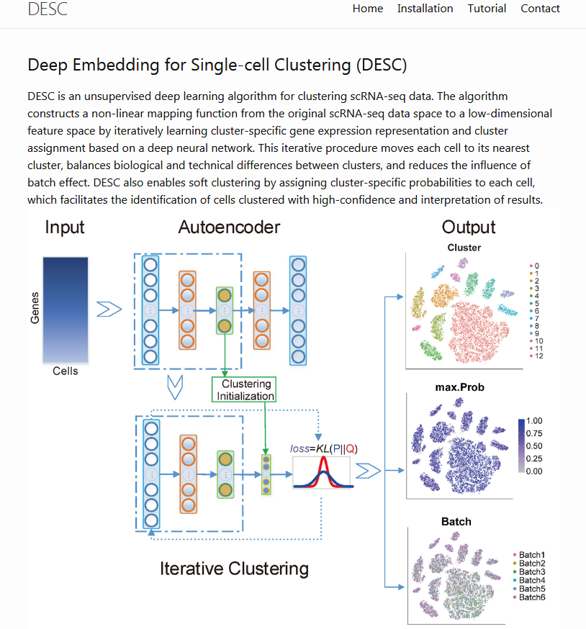
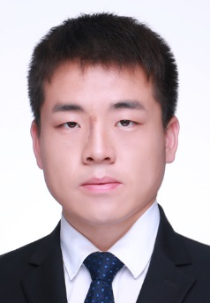
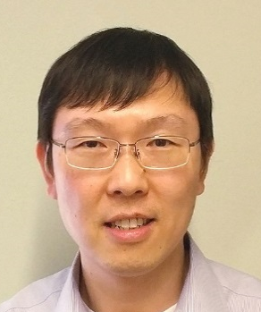

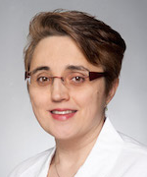


Xiangjie Li Gang Hu Yafei Lyu
Katalin Susztak Jihwan Park Dwight Stambolian
Funding: R01GM108600, R01GM125301, R01HL113147
https://eleozzr.github.io/desc/
28

