Slide 1
Complex Traits: Leveraging Polygenecity to Inform Biology, Causality and Prediction
Nilanjan Chatterjee, PhD
Bloomberg Distinguished Professor
Department of Biostatistics, Bloomberg School of Public Helath
Department of Oncology, School of Medicine

Slide 2
Work Led By
Dora Zhang, Post-doc Fellow
Guanghao Qi, PhD Student

Slide 3
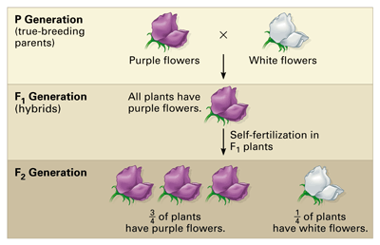
Beginning of Modern Genetics: Mendel vs Galton
1865, rediscovered 1900
1866

Slide 4
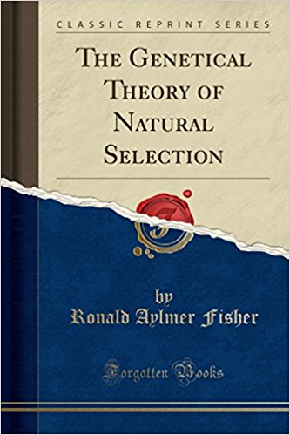
Fisher’s Infinitesimal Model
Fisher’s Infinitesimal Model Bridges Mendel’s Law and Galton’s Observations for Quantitative Traits
1918

Slide 5
Recent Genome-wide Association Studies show Complex Traits are
Highly Polygenic
Discovery
  Dozens to hundreds of SNPs associated with individual traits to disease
  Pleiotropy is ubiquitous
Biology and causality
  Insights to biological pathways
  Gene regulatory mechanisms relevant for diseases
  Mendelian randomization studies
Translation
New targets for therapeutic drugs
Genetic risk prediction

Slide 6
Traditional GWAS Analysis: Single-SNP Centric
Single SNP association tests
Identify those which reach genome-wide significance
Fine mapping around top SNPs
Imputation, multivariate modelling, conditional. analysis
Insight to biology, genetic risk-scores, instruments for MR analysis
In silico functional analysis of top SNPs/regions
eQTL databases, ENCODE annotation, enrichment analysis by pathways, etc etc

Slide 7
Getting More Out of GWAS: Polygenic Analysis
Model association for many (all) SNPs simulteneously
Estimate heritability
Effect-size distribution
Use polygenic model to test enrichment for association
By pathways, population/functional genomic characteristics of SNPs
Perform polygenic MR analysis
Robust to confounding by pleiotropy
Improve genetic risk prediction
Including SNPs below genome-wide significance
Bayesian/shrinkage estimation

Slide 8
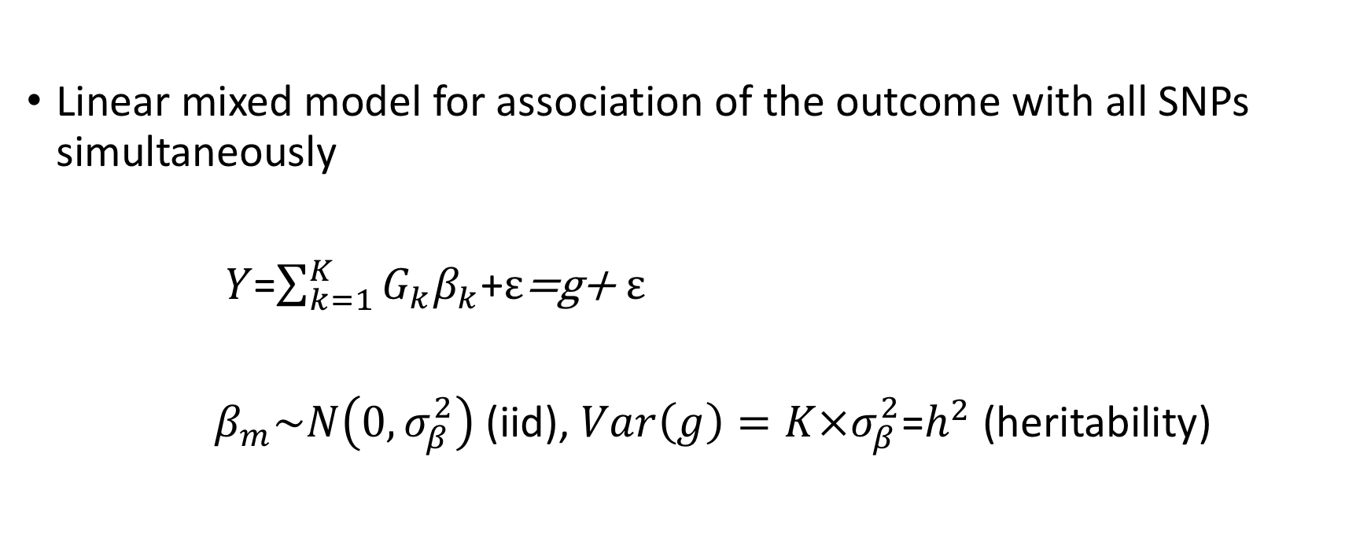
A Model for Joint-Effect of GWAS SNPs
Linear mixed model for association of the outcome with all SNPs simultaneously
$Y$=$\sum_{k=1}^{K}{G_{k}β_{k}}$+$ε$=g+ $ε$
$β_{m}\sim N\left(0,σ_{β}^{2}\right)$ (iid), $Var\left(g\right)=K×σ_{β}^{2}$=$h^{2}$ (heritability)
Yang et al., Nature Genetics, 2010

Slide 9
Common Variants Explain Large Fraction of Variance of Adult Height
Yang et al., Nature Genetics, 2010

Slide 10
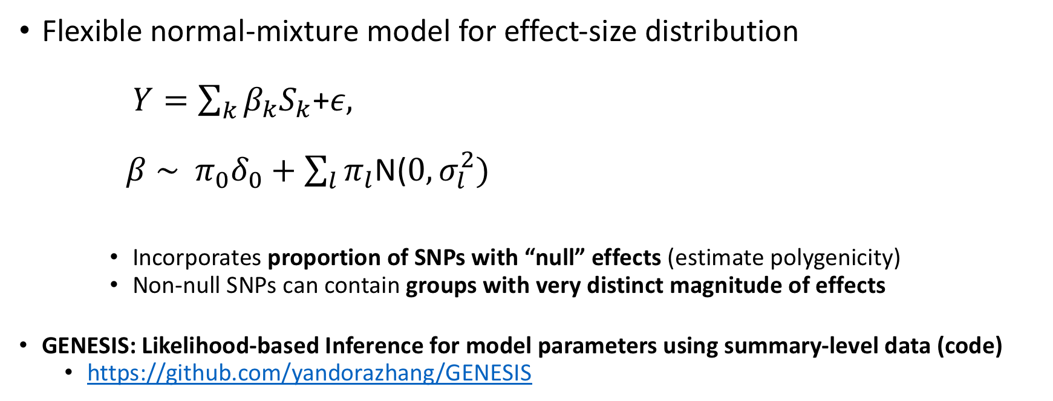
Underlying Models for Effect-Size Distribution
Flexible normal-mixture model for effect-size distribution
  $Y=\sum_{k}{β_{k}S_{k}}$+$ε,$
  $β \sim π_{0}δ_{0}+\sum_{l}{π_{l}}$N($0, σ_{l}^{2})$
    Incorporates proportion of SNPs with “null” effects (estimate polygenicity)
    Non-null SNPs can contain groups with very distinct magnitude of effects
GENESIS: Likelihood-based Inference for model parameters using summary-level data (code)
  https://github.com/yandorazhang/GENESIS

Slide 11
All complex traits are extremely polygenic, some more than others
Quantitative Traits | Est # of Indep Susceptibility SNP (SE), in Thousands
Age at menarche | 13.2 (1.4)
BMI | 15.0 (1.5)
Height | 9.5 (1.2)
Hip circumference | 11.9 (1.4)
Waist circumference | 12.8 (1.4)
Waist-to-hip ratio | 9.2 (1.7)
HDL cholesterol | 10.5 (1.5)
LDL cholesterol | 9.3 (1.9)
Total cholesterol | 6.4 (1.9)
Triglycerides | 9.5 (1.4)
Child birth length | 2.7 (1.1)
Child birth weight | 5.5 (1.9)
Childhood obesity | 6.1 (2.2)
Infant head circumference | 5.3 (6.8)
Childhood IQ | 51.0 (8.6)
Cognitive performance | 11.2 (2.3)
Intelligence | 14.9 (2.0)
Years of schooling | 19.4 (2.2)
Neuroticism | 5.4 (15.9)
Disease/binary Traits | Est # of Indep Susceptibility SNP (SE) In Thousands
Alzheimer | 2.6 (1.9)
Asthma | 1.6 (1.0)
Coronary artery disease | 2.5 (0.9)
Type 2 diabetes | 4.8 (2.4)
Crohn's disease | 6.2 (2.1)
Inflammatory bowel | 5.6 (2.2)
Ulcerative colitis | 2.7 (1.6)
College completion | 12.8 (3.1)
Rheumatoid arthritis | 3.9 (1.5)
Autism spectrum disorder | 10.4 (2.3)
Bipolar disorder | 10.9 (3.6)
Major depressive disorder | 30.4 (4.4)
Schizophrenia | 19.3 (1.9)

Slide 12
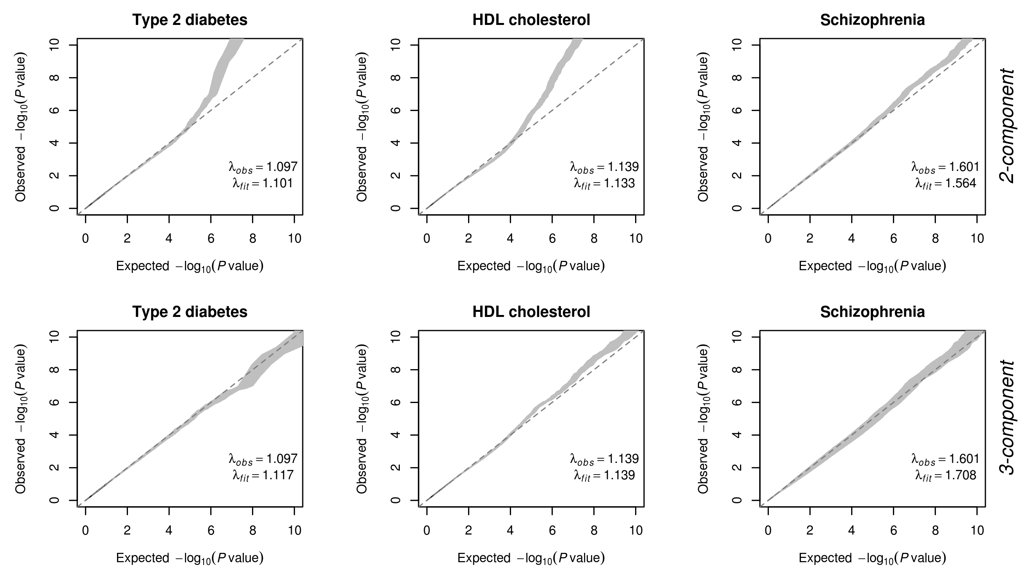
Most Traits have Clusters of SNPs with Distinct Magnitude of Effects,
but Psychiatric Diseases have Continuum of Effect-sizes

Slide 13
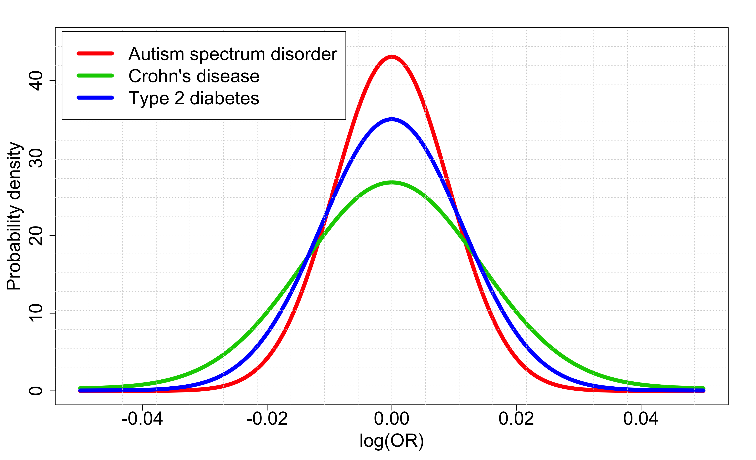
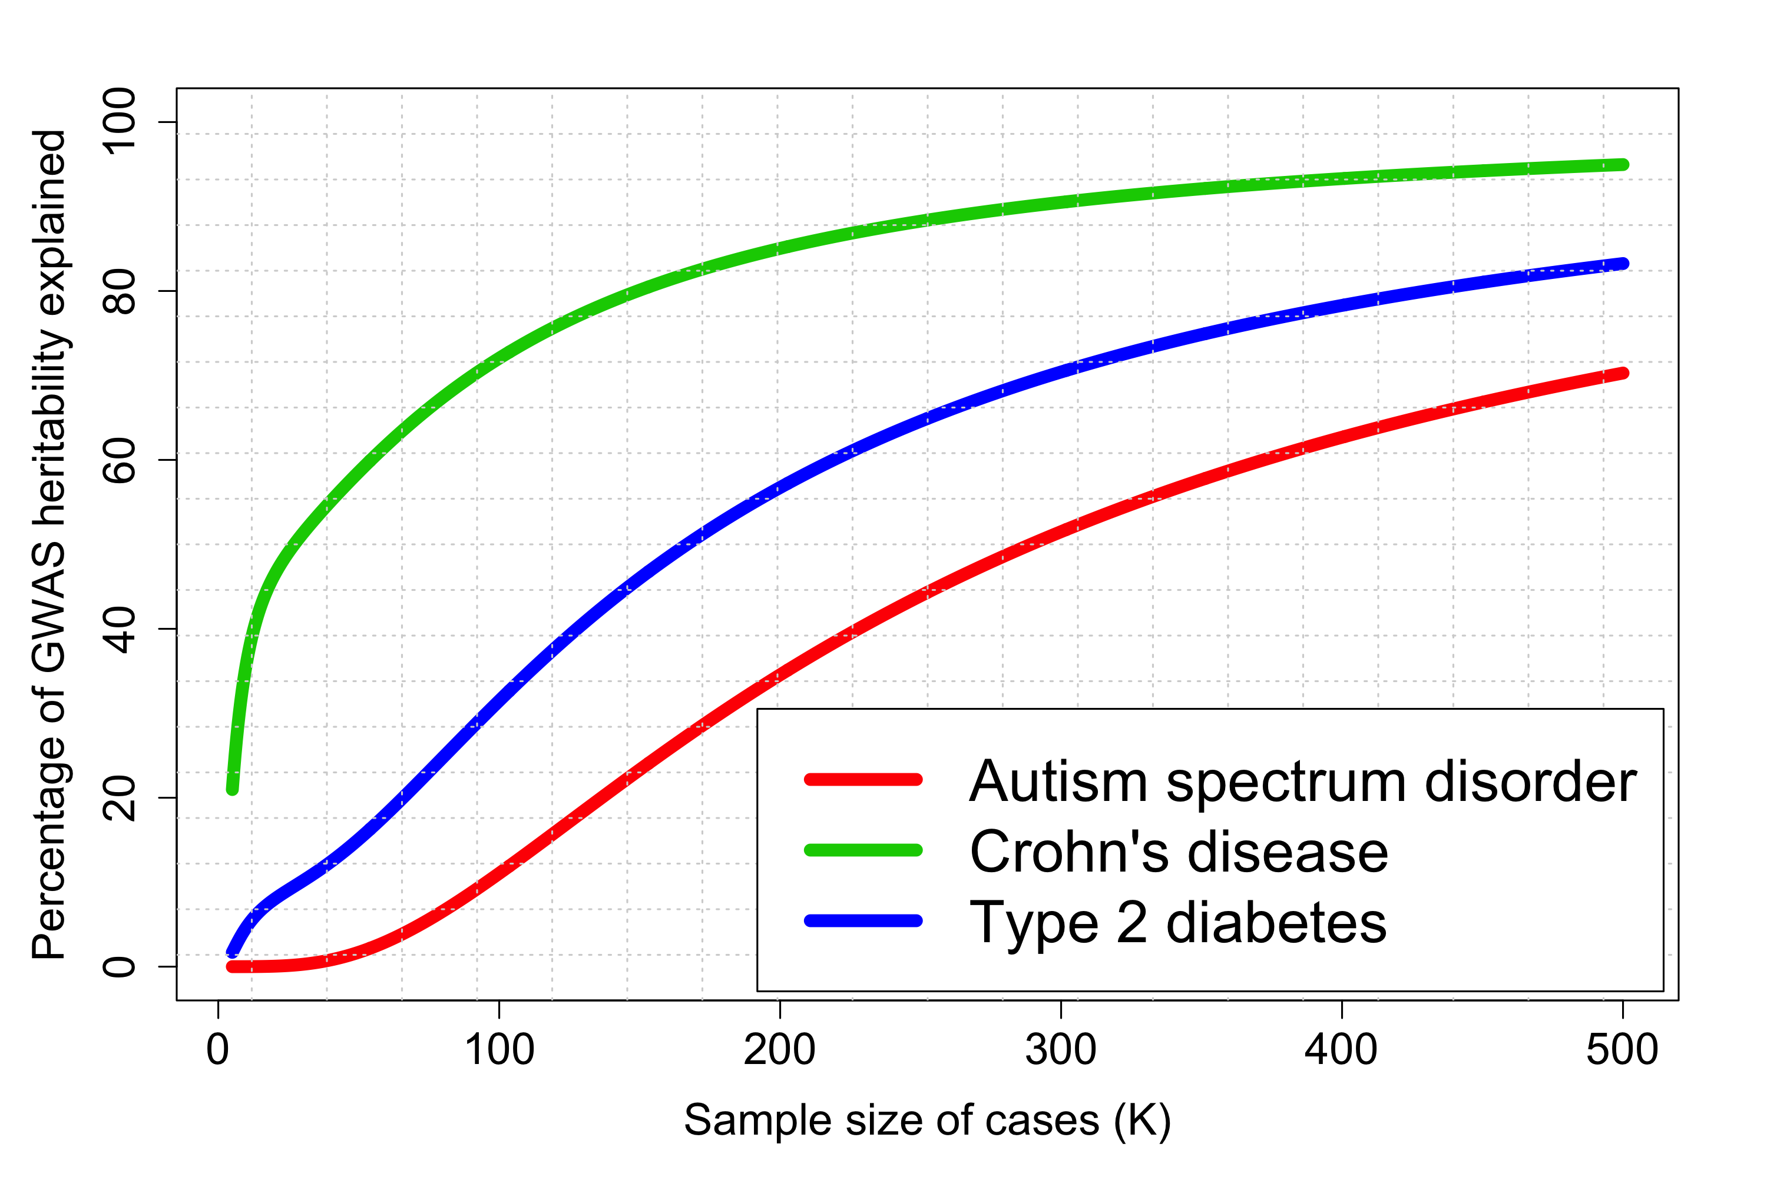
Known Discoveries are Only the Tip of the Iceberg
Effect-size Distribution
Heritability Explained with Cumulative Discoveries
Estimated # of susceptibility
markers
  Autism – 10K
  Crohn’s Disease - 6K
  Type2 Diabetes - 5K
Park et al., Nature Genetics, 2010; Chatterjee et al., Nature Genetics 2013; Chatterjee et al., Nature Review Genetics, 2016
Zhang et al, Nature Genetics, 2018;

Slide 14
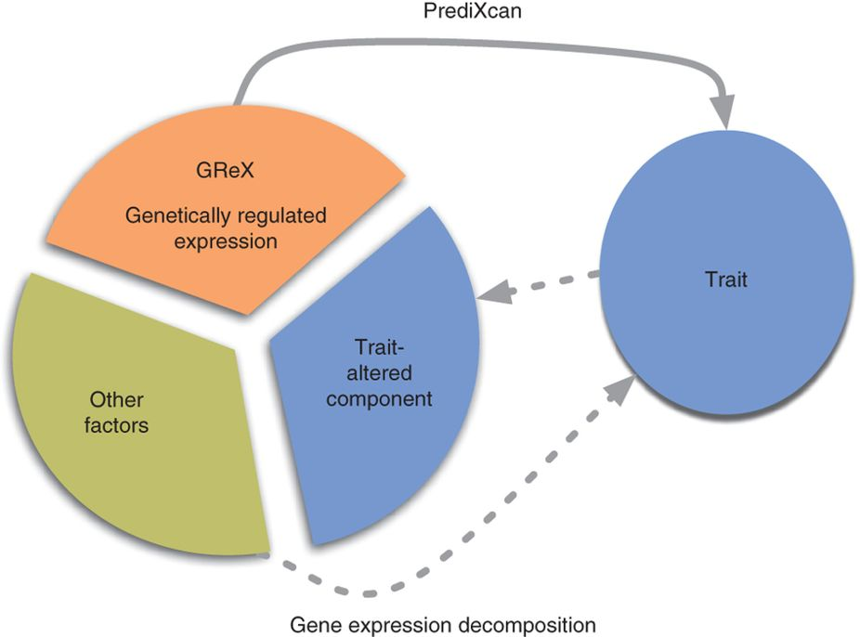
Mendelian Randomization
An approach to use genetically determined variation of a trait to test for “causal” effect of it on another trait
  Component of variation due to genetics is less likely to be affected by confounders and reverse causality
Guanghao Qi
Gamazon et al., Nature Genetics, 2015

Slide 15
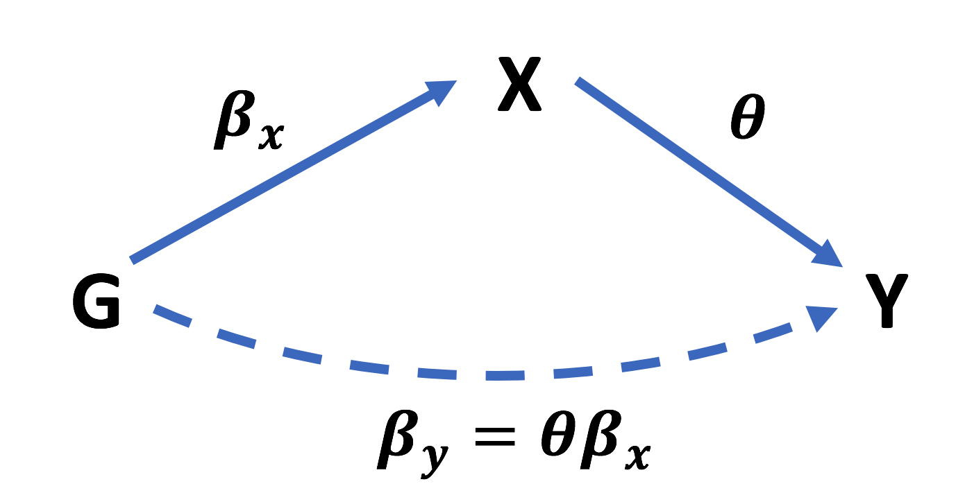
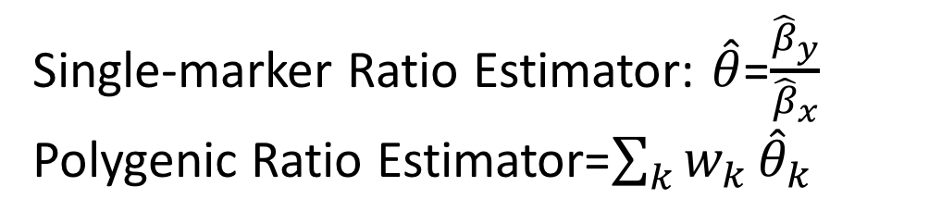
Basic Mendelian Randomization
Use genetic correlation across traits to estimate causal effect
(assuming no horizontal pleiotropy)
Single-marker Ratio Estimator: $\hat{θ}$=$\frac{{\hat{β}}_{y}}{{\hat{β}}_{x}}$
Polygenic Ratio Estimator=$\sum_{k}{w_{k}}{\hat{θ}}_{k}$
Note: the causal effect of X may depend on the mechanism by which it is being modified
Burgess et al., Genetic Epidemiology, 2013

Slide 16
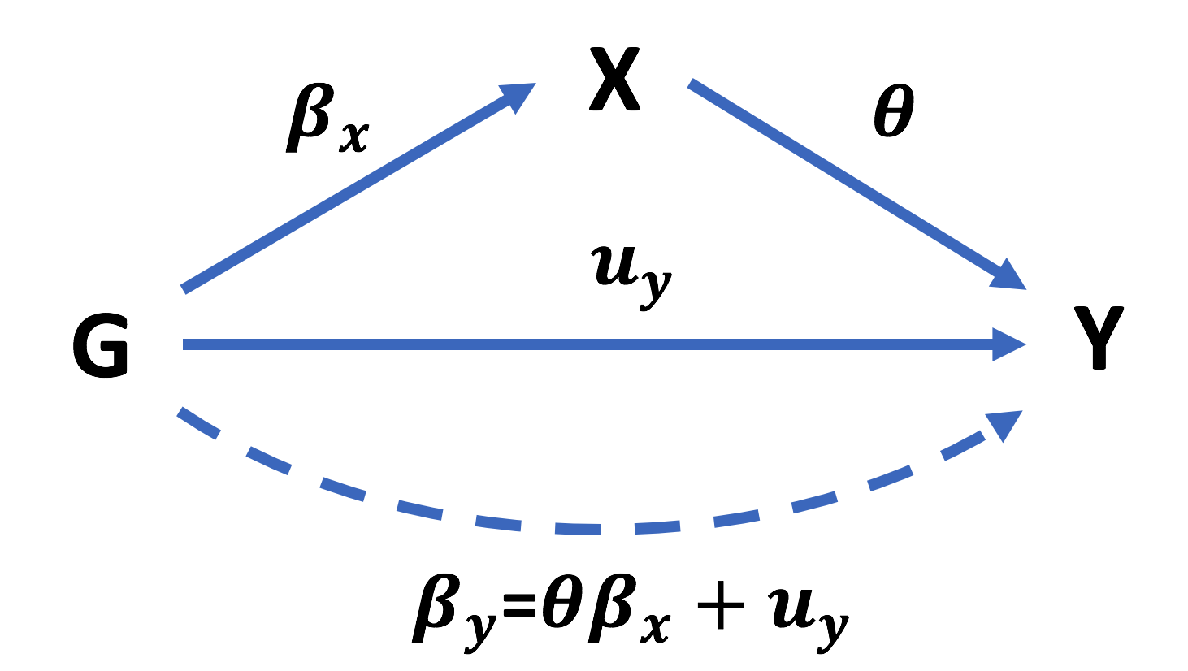
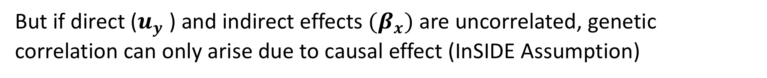
Horizontal Pleiotropy is Ubiquitous
But if direct ($u_{y}$) and indirect effects ${(β}_{x})$are uncorrelated, genetic correlation can only arise due to causal effect (InSIDE Assumption)
Bowden et al., International Journal of Epidemiology, 2015

Slide 17
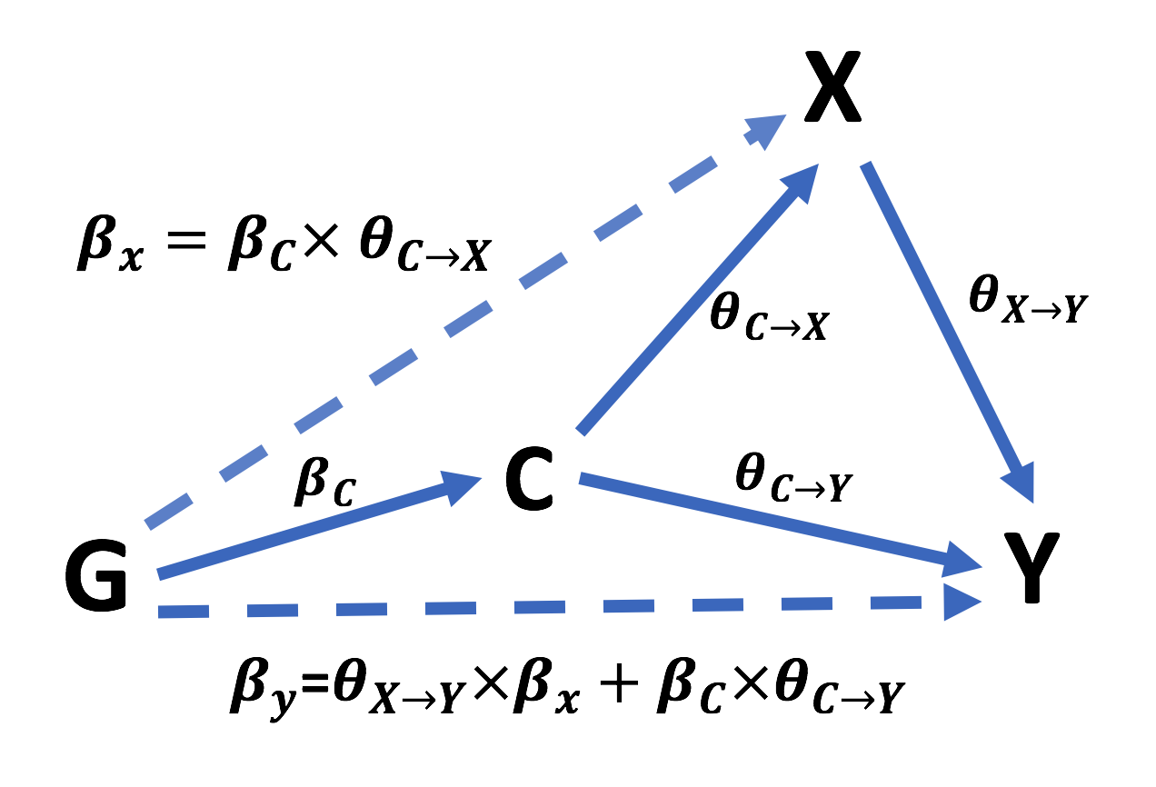
Likely Scenario for Violating InSIDE Assumption: Existence of Heritable Confounders
Genetically determined BMI (early BMI) confounding relationship between age at menarche and
breast cancer
Burgess et al., Genetics, 2017

Slide 18
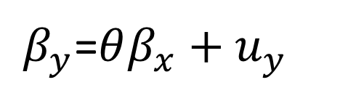
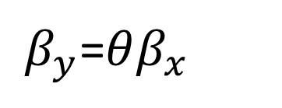
How Can we Ever Distinguish Valid vs non-Valid Genetic Instruments: Leverage Polygenicity🤔
Only across valid instruments, the proportionality assumption is satisfied,
For other potential instruments, there will “extra” variation around the proportional relationship
Use multitude of instruments available to distinguish this pattern and hence estimate causal effect
$β_{y}$=$θβ_{x}$
$β_{y}$=$θβ_{x}+u_{y}$

Slide 20
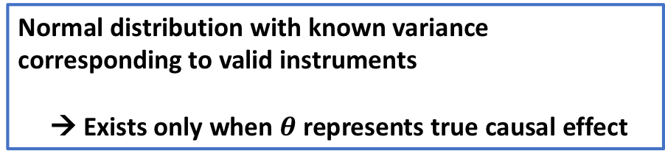
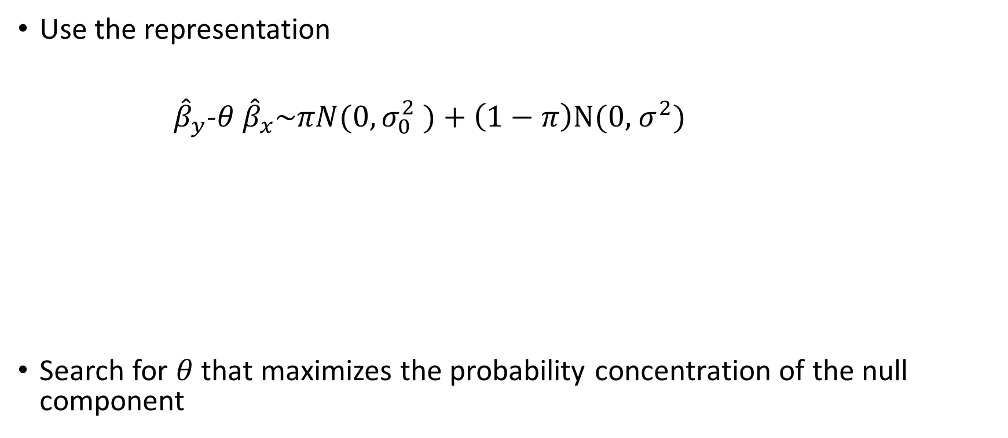
MR analysis using mixture model for effect-size distribution (MR-Mix)
Use the representation
${\hat{β}}_{y}$-$θ$ ${\hat{β}}_{x}\sim πN(0, σ_{0}^{2} )+\left(1−π\right)N(0,$ $σ^{2})$
Search for $θ$ that maximizes the probability concentration of the null component
Normal distribution with known variance
corresponding to valid instruments
→ Exists only when $θ$ represents true causal effect

Slide 22
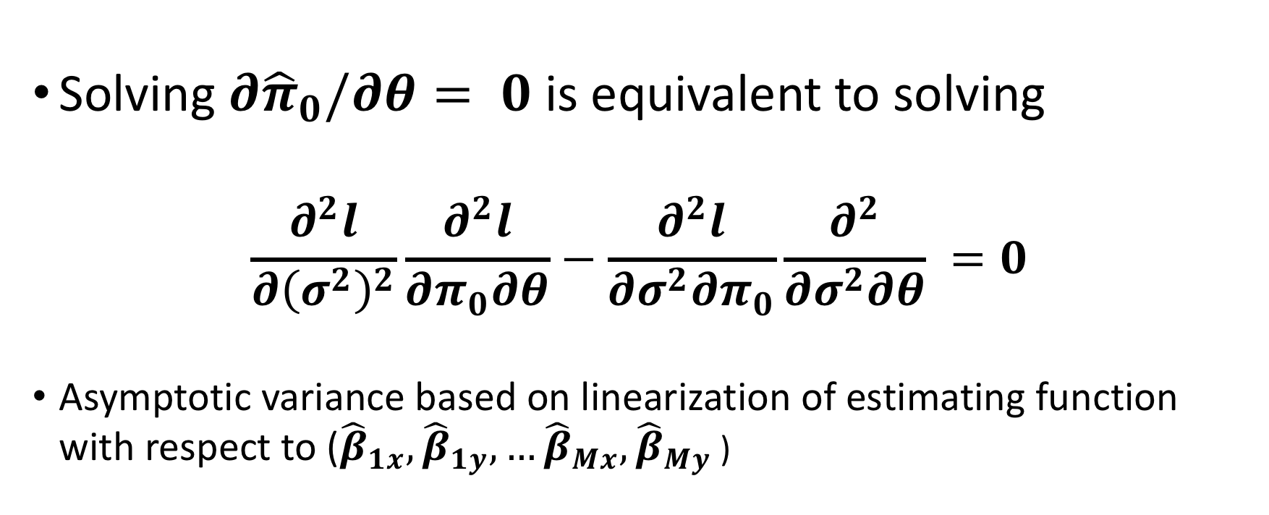
Implicitly Defined Estimating Function: Non-Linear PDE
Solving $∂{\hat{π}}_{0}/∂θ= 0$ is equivalent to solving
$$\frac{∂^{2}l}{∂{\left(σ^{2}\right)}^{2}}\frac{∂^{2}l}{∂π_{0}∂θ}−\frac{∂^{2}l}{∂σ^{2}∂π_{0}}\frac{∂^{2}}{∂σ^{2}∂θ} =0$$
Asymptotic variance based on linearization of estimating function with respect to (${\hat{β}}_{1x},{\hat{β}}_{1y},…{\hat{β}}_{Mx},{\hat{β}}_{My}$ )

Slide 23
Robust MR Analysis
Egger regression
  Corrects for asymmetry in the distribution of ratio estimates, but requires InSIDE assumption to provide unbiased estimate of causal effect¹
Use (weighted) median/mode of the distribution of ratio estimates instead of mean
  Can produce unbiased estimate of causal effects even under certain types of violation of the InSIDE assumption^{2,3}
Sensitivity analysis (e.g using outlier detection method⁴)
¹Bowden et al., International Journal of Epidemiology, 2015
²Bowden et al., Genetic Epidemiology, 2016
³Hartwig et al., International Journal of Epidemiology, 2017
⁴Corbin et al. Diabetes, 2016

Slide 24
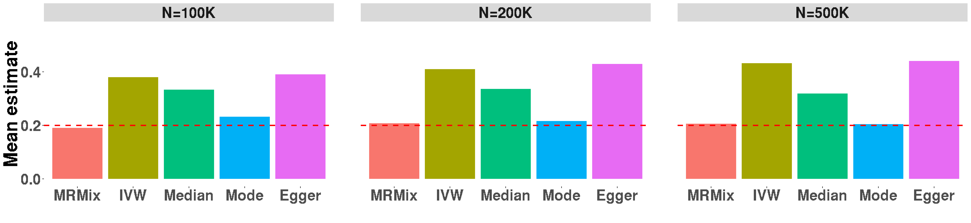
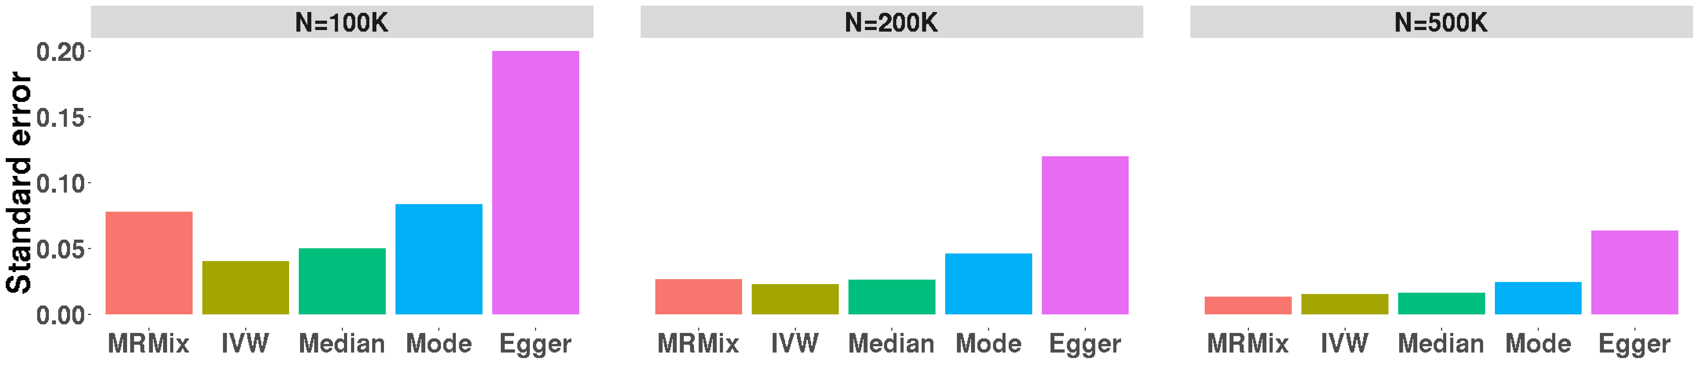
Simulation Studies: 50% Valid Instrument (Invalid Instrument Have Correlated Indirect and Direct Effects)
*
a) * Egger standard error when N=100K has been truncated (true SE=0.33). b) $n_{x}=N, n_{y}=N/3$.

Slide 25
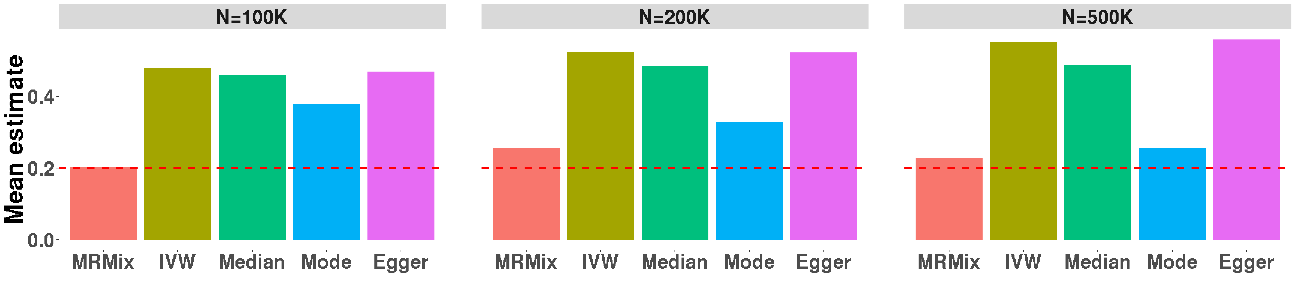
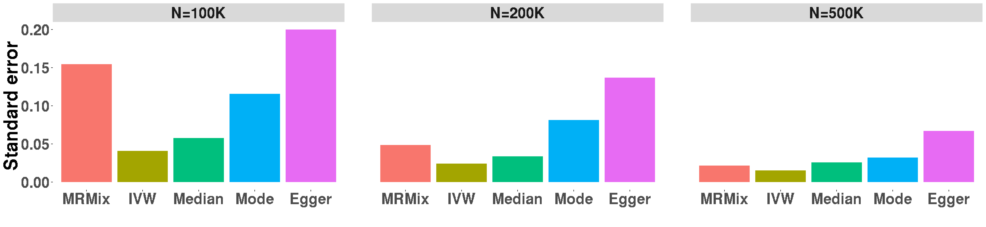
Simulation Studies: 25% Valid Instrument (Invalid Instrument Have Correlated Indirect and Direct Effects)
*
a) * Egger standard error when N=100K has been truncated (true SE=0.37). b) $n_{x}=N, n_{y}=N/3$.

Slide 26
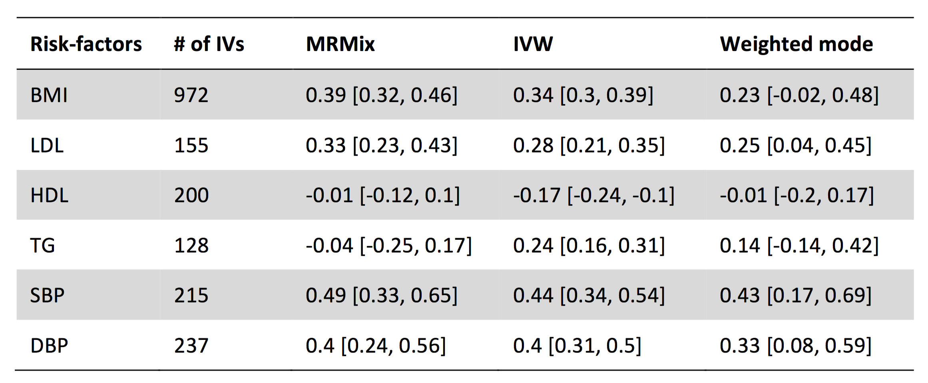
Estimate of Causal Effect (log-OR per SD unit) of Some Known Risk Factors on Risk of CHD

Slide 27
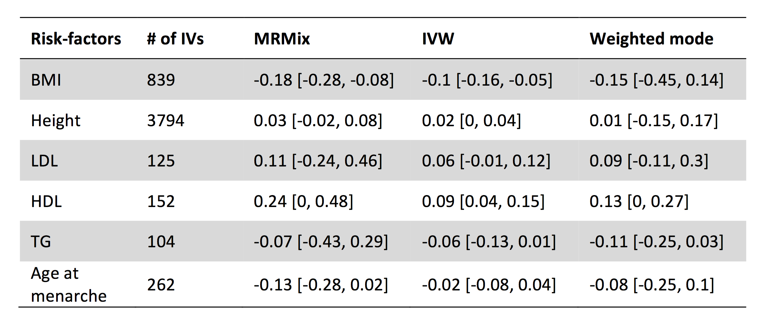
Estimate of Causal Effect of Some Known Risk Factors on Risk of Breast Cancer

Slide 28
Summary
Complex traits are extremely polygenic and we need to better exploit this knowledge for future GWAS analysis
Polygenic risk-scores incorporating SNPs below genome-wide significance can meaningfully improve genetic risk-prediction
Fairly robust MR analysis is possible even in the presence of complex pleiotropic effects

