Slide 1


Using populations and pedigrees structures to identify genetic variations associated with epilepsy.
Simon L. Girard – Professor - Université du Québec à Chicoutimi
simon2_girard@uqac.ca

Slide 2
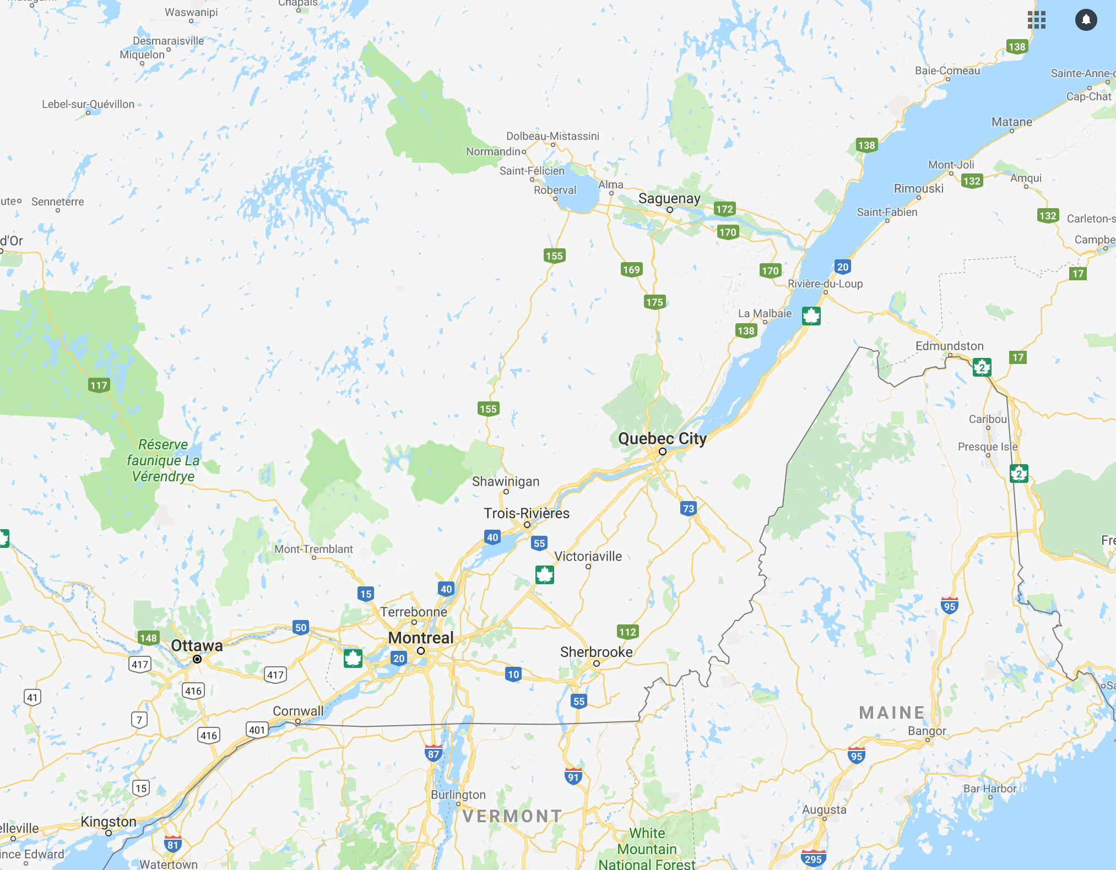

Slide 3

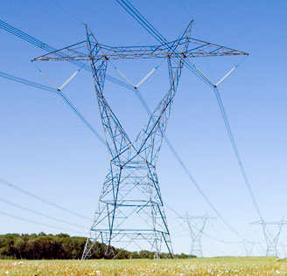
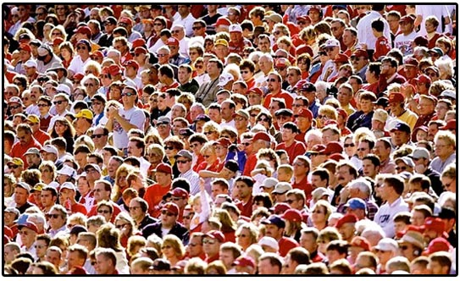
Epilepsy

Slide 4
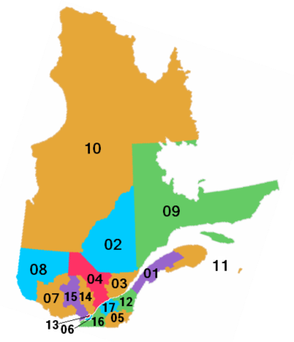
The Quebec Population
Quebec vs French-Canadian
10,000 founders between 1620 and 1720
Regional effect (Charlevoix-Saguenay and Gaspesie)
Mostly french catholics

Slide 5
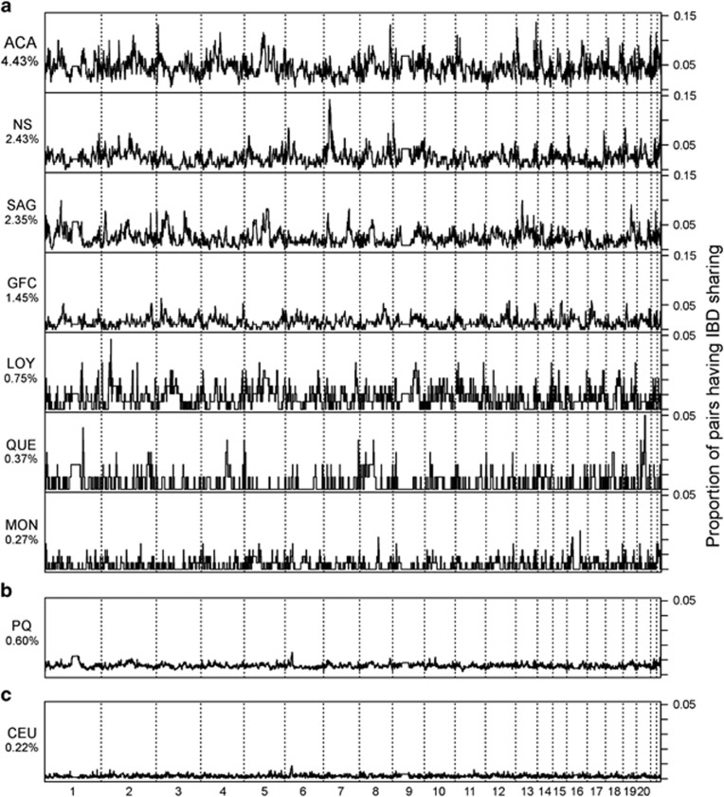
Gauvin. 2014

Slide 6




Canadian Epilepsy Network
Objective: Bringing epilepsy into the era of personnalized medecine.
Dataset: Whole-genome sequencing data from :
320 individuals with familial epilepsy
200 trio with epileptic encephalopathy
Exome sequencing data from :
1000 antiepileptic drugs non-responders
500 antiepileptic drugs responders
Patrick Cossette
CHUM
Jacques Michaud
CHU Sainte-Justine
Berge Minassian
Sick Kids, Toronto
Simon Girard
UQAC

Slide 7
Study Design
Whole genome sequencing of patients with epilepsy
  Generalized epilepsy VS Partial epilepsy
  Genotyping (Illumina Omni Express) of 158 families with PE and 325 families with GE
  We possess WGS for 325 individuals
Genotyping of 964 individuals from the same population
IBD
  Beagle 4.1
  B L Browning (2013). Improving the accuracy and efficiency of identity-by-descent detection in population data. Genetics 194(2):459-71
  Dash 1.1.0
  Gusev A, DASH: a method for identical-by-descent haplotype mapping uncovers association with recent variation. Am J Hum Genet. 2011 Jun 10;88(6):706-717

Slide 8
Hypothesis
Families from the same founder population have higher odds of sharing pathogenic variants
No fully penetrant variants (more on that later)
Haplotypes linked with the disease should have an overrepresentation in cases.

Slide 9
Pathogenic variants screening
 | SNV (PRE-GENE) | CNV (popSV)
Generalized Epilepsy | 34 | 22
Partial Epilepsy | 13 | 5
Pathogenic SNV:
  Rare variant (Exac MAF < 0.001)
  Loss-of-function variant in a loss-of-function intolerant gene (pLI) or in an epilepsy gene panel
variant rare (fréquence < 0,001 dans EXaC)
Pathogenic CNV:
  Exonic CNV in a gene associated with epilepsy
  Frequency < 0,01

Slide 10
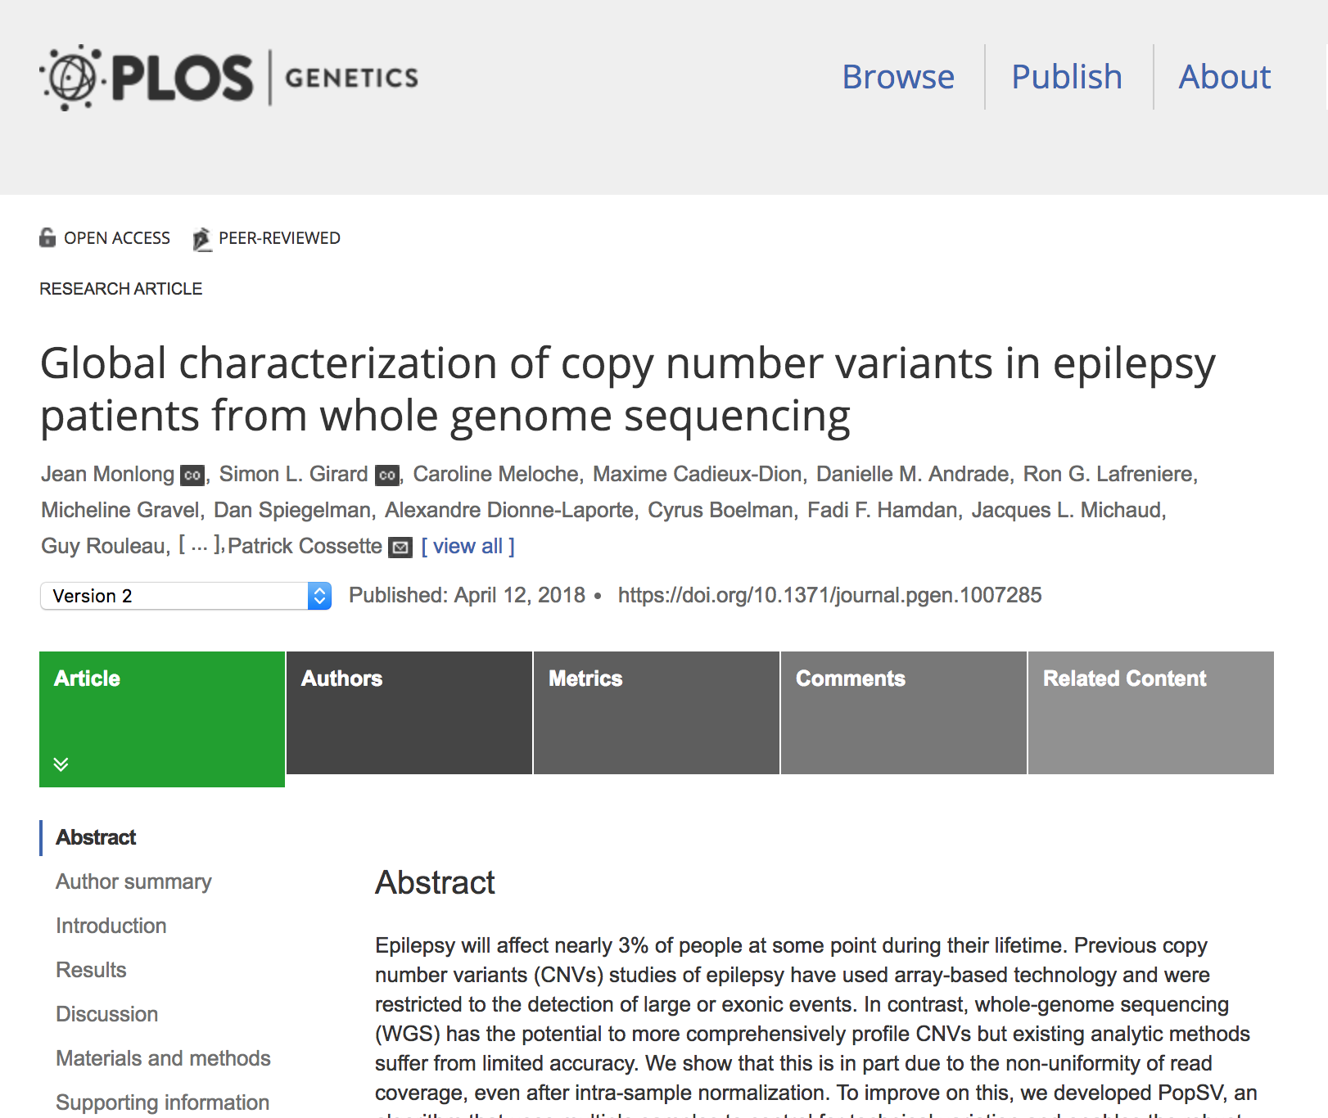

Slide 11
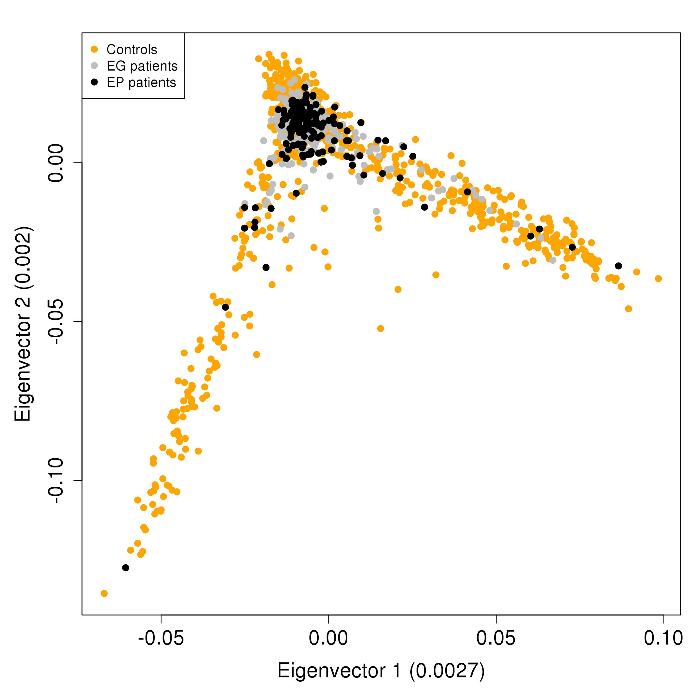
Principle component analysis
Notes:
ICi je dis que les contrôles et les cas peuvent être mis ensemble pour l’étude...

Slide 12
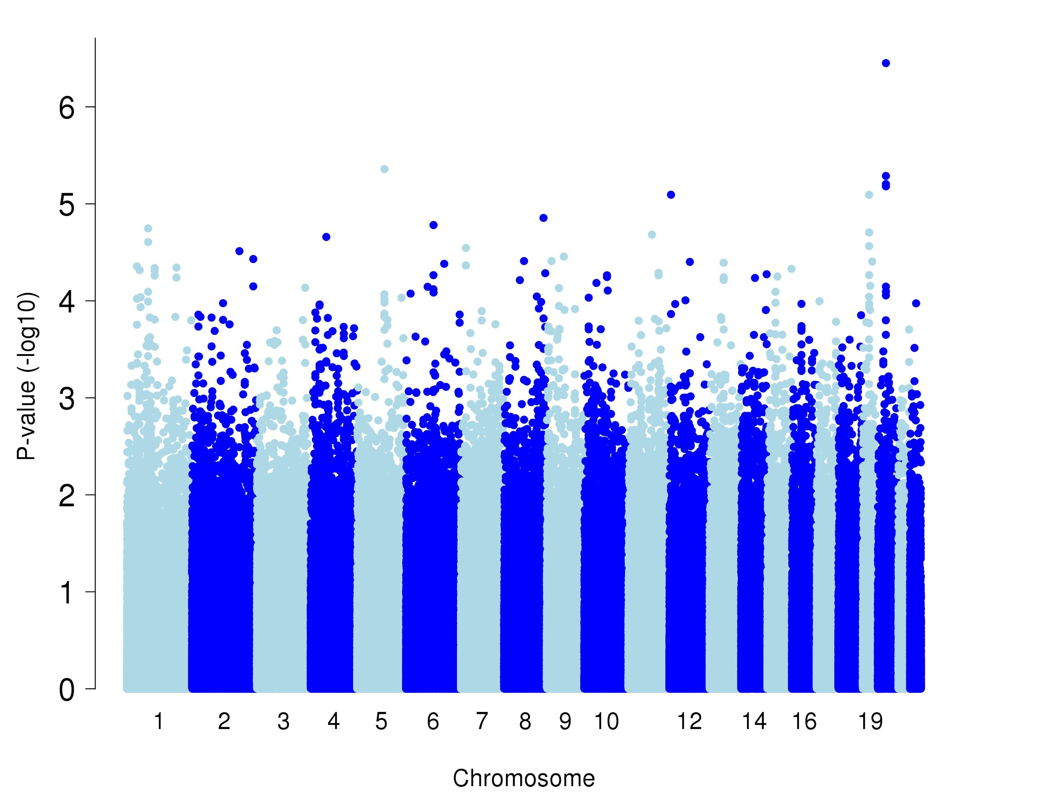
Standard GWAS for unrelated cases and controls
Notes:
Ici je dis qu’on trouve rien avec un GWAS normal

Slide 13
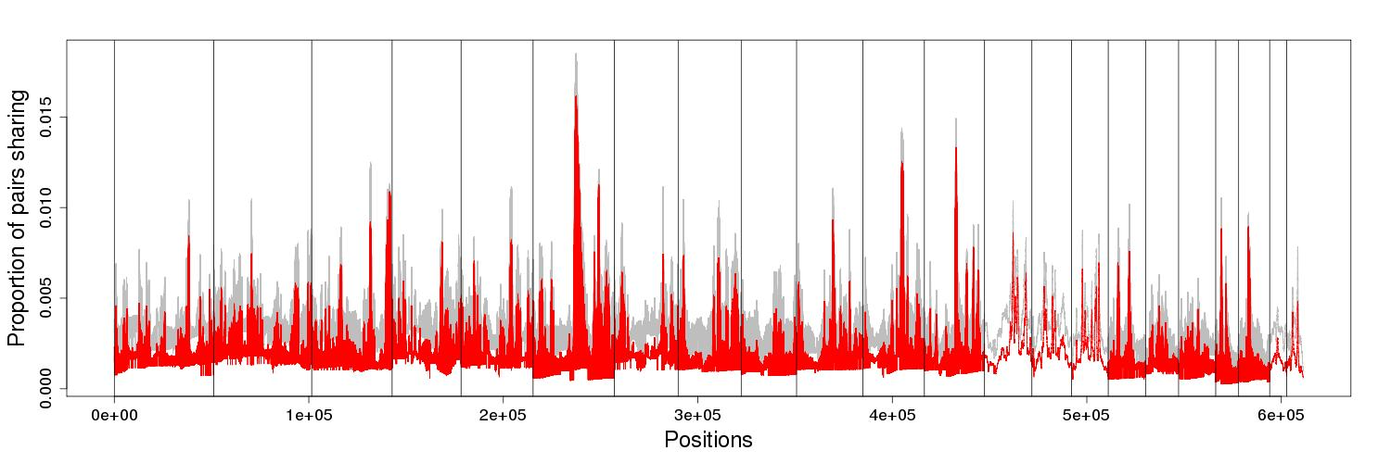
IBD sharing per genomic position
Average pairwise-IBD for patients: 0.2%
Average pairwise-IBD for controls: 0.4%
Notes:
Ça c’est le IBD par paires...Il y a moins de paires de patients qui partagent que de contrôles à chaque position...ça se rapproche quand même de ce qu’il y avait dans l’étude de Gauvin...même que nos patients sont comme les CEU!! Mais je ne vais p-e pas le mentionner...

Slide 14
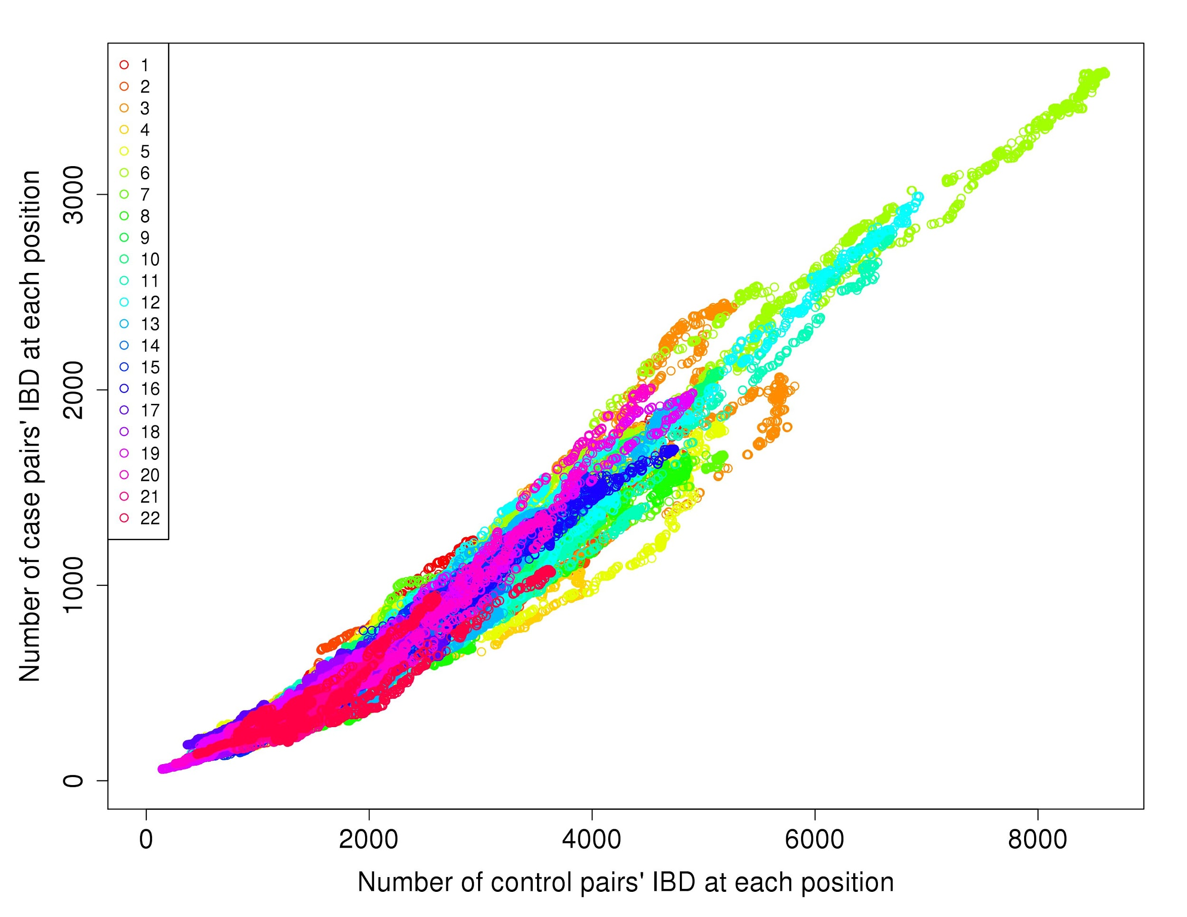
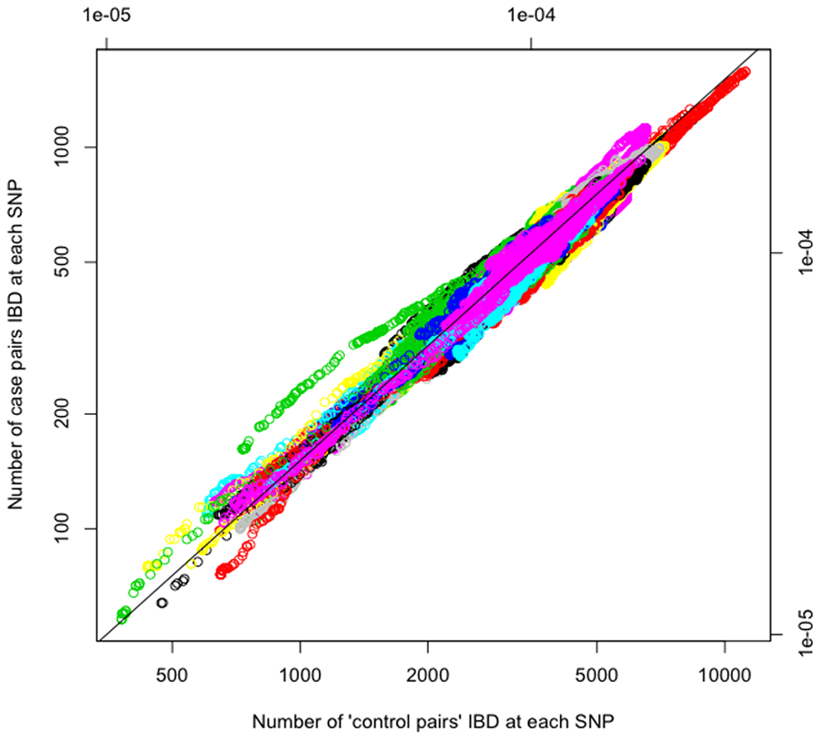
Pairwise IBD segments amongst our cohort
Lin R et al. (2013) Identity-by-Descent Mapping to Detect Rare Variants Conferring Susceptibility to Multiple Sclerosis. PLoS ONE 8(3)
Notes:
Ce que je veux voir à droite...ce que je ne vois pas à gauche...c’est juste un bordel...

Slide 15
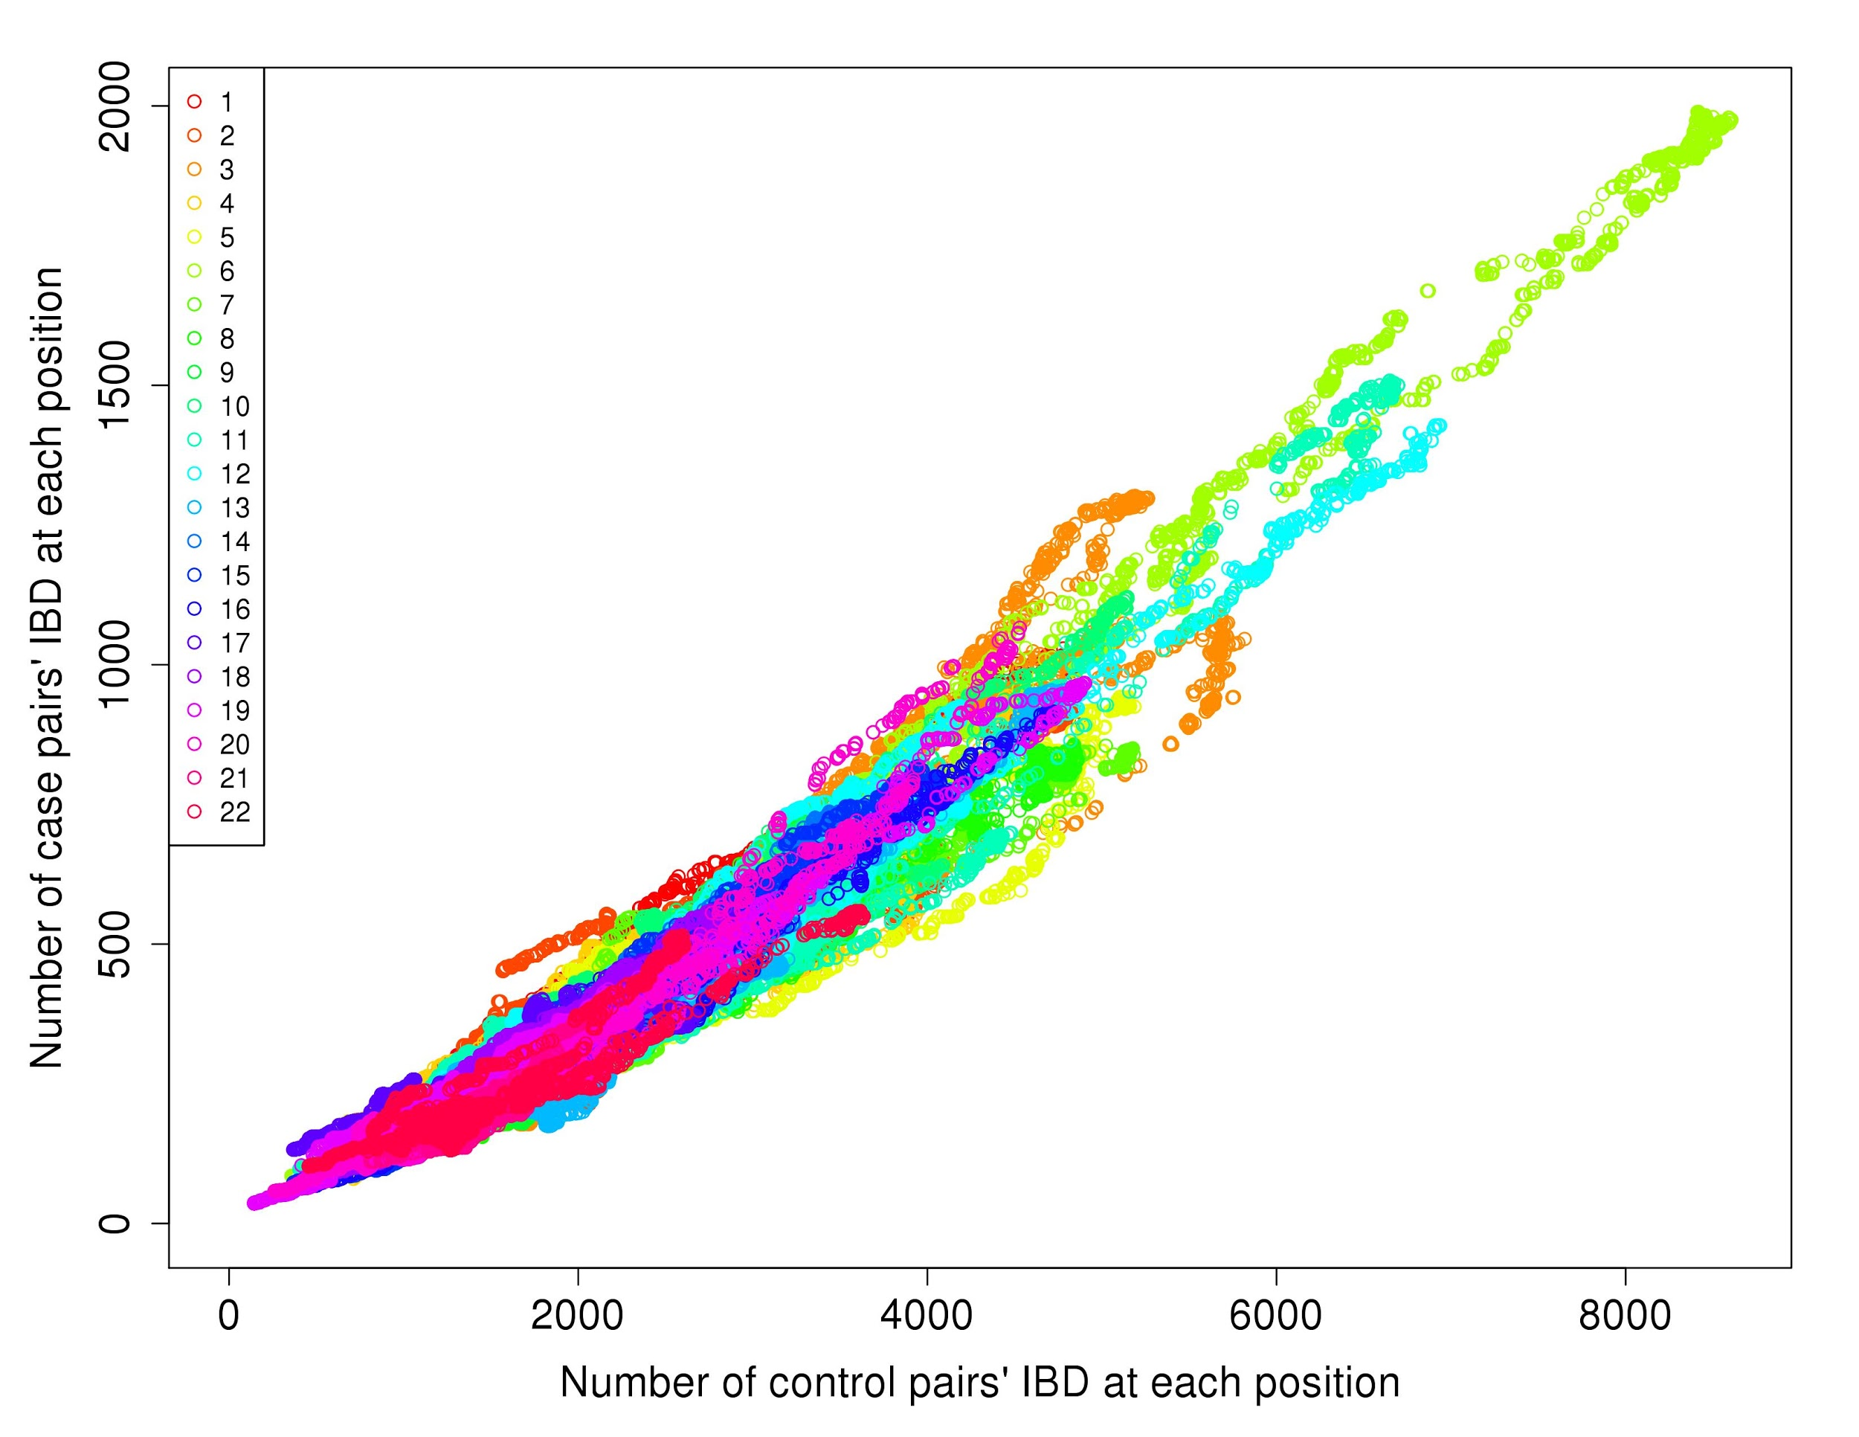
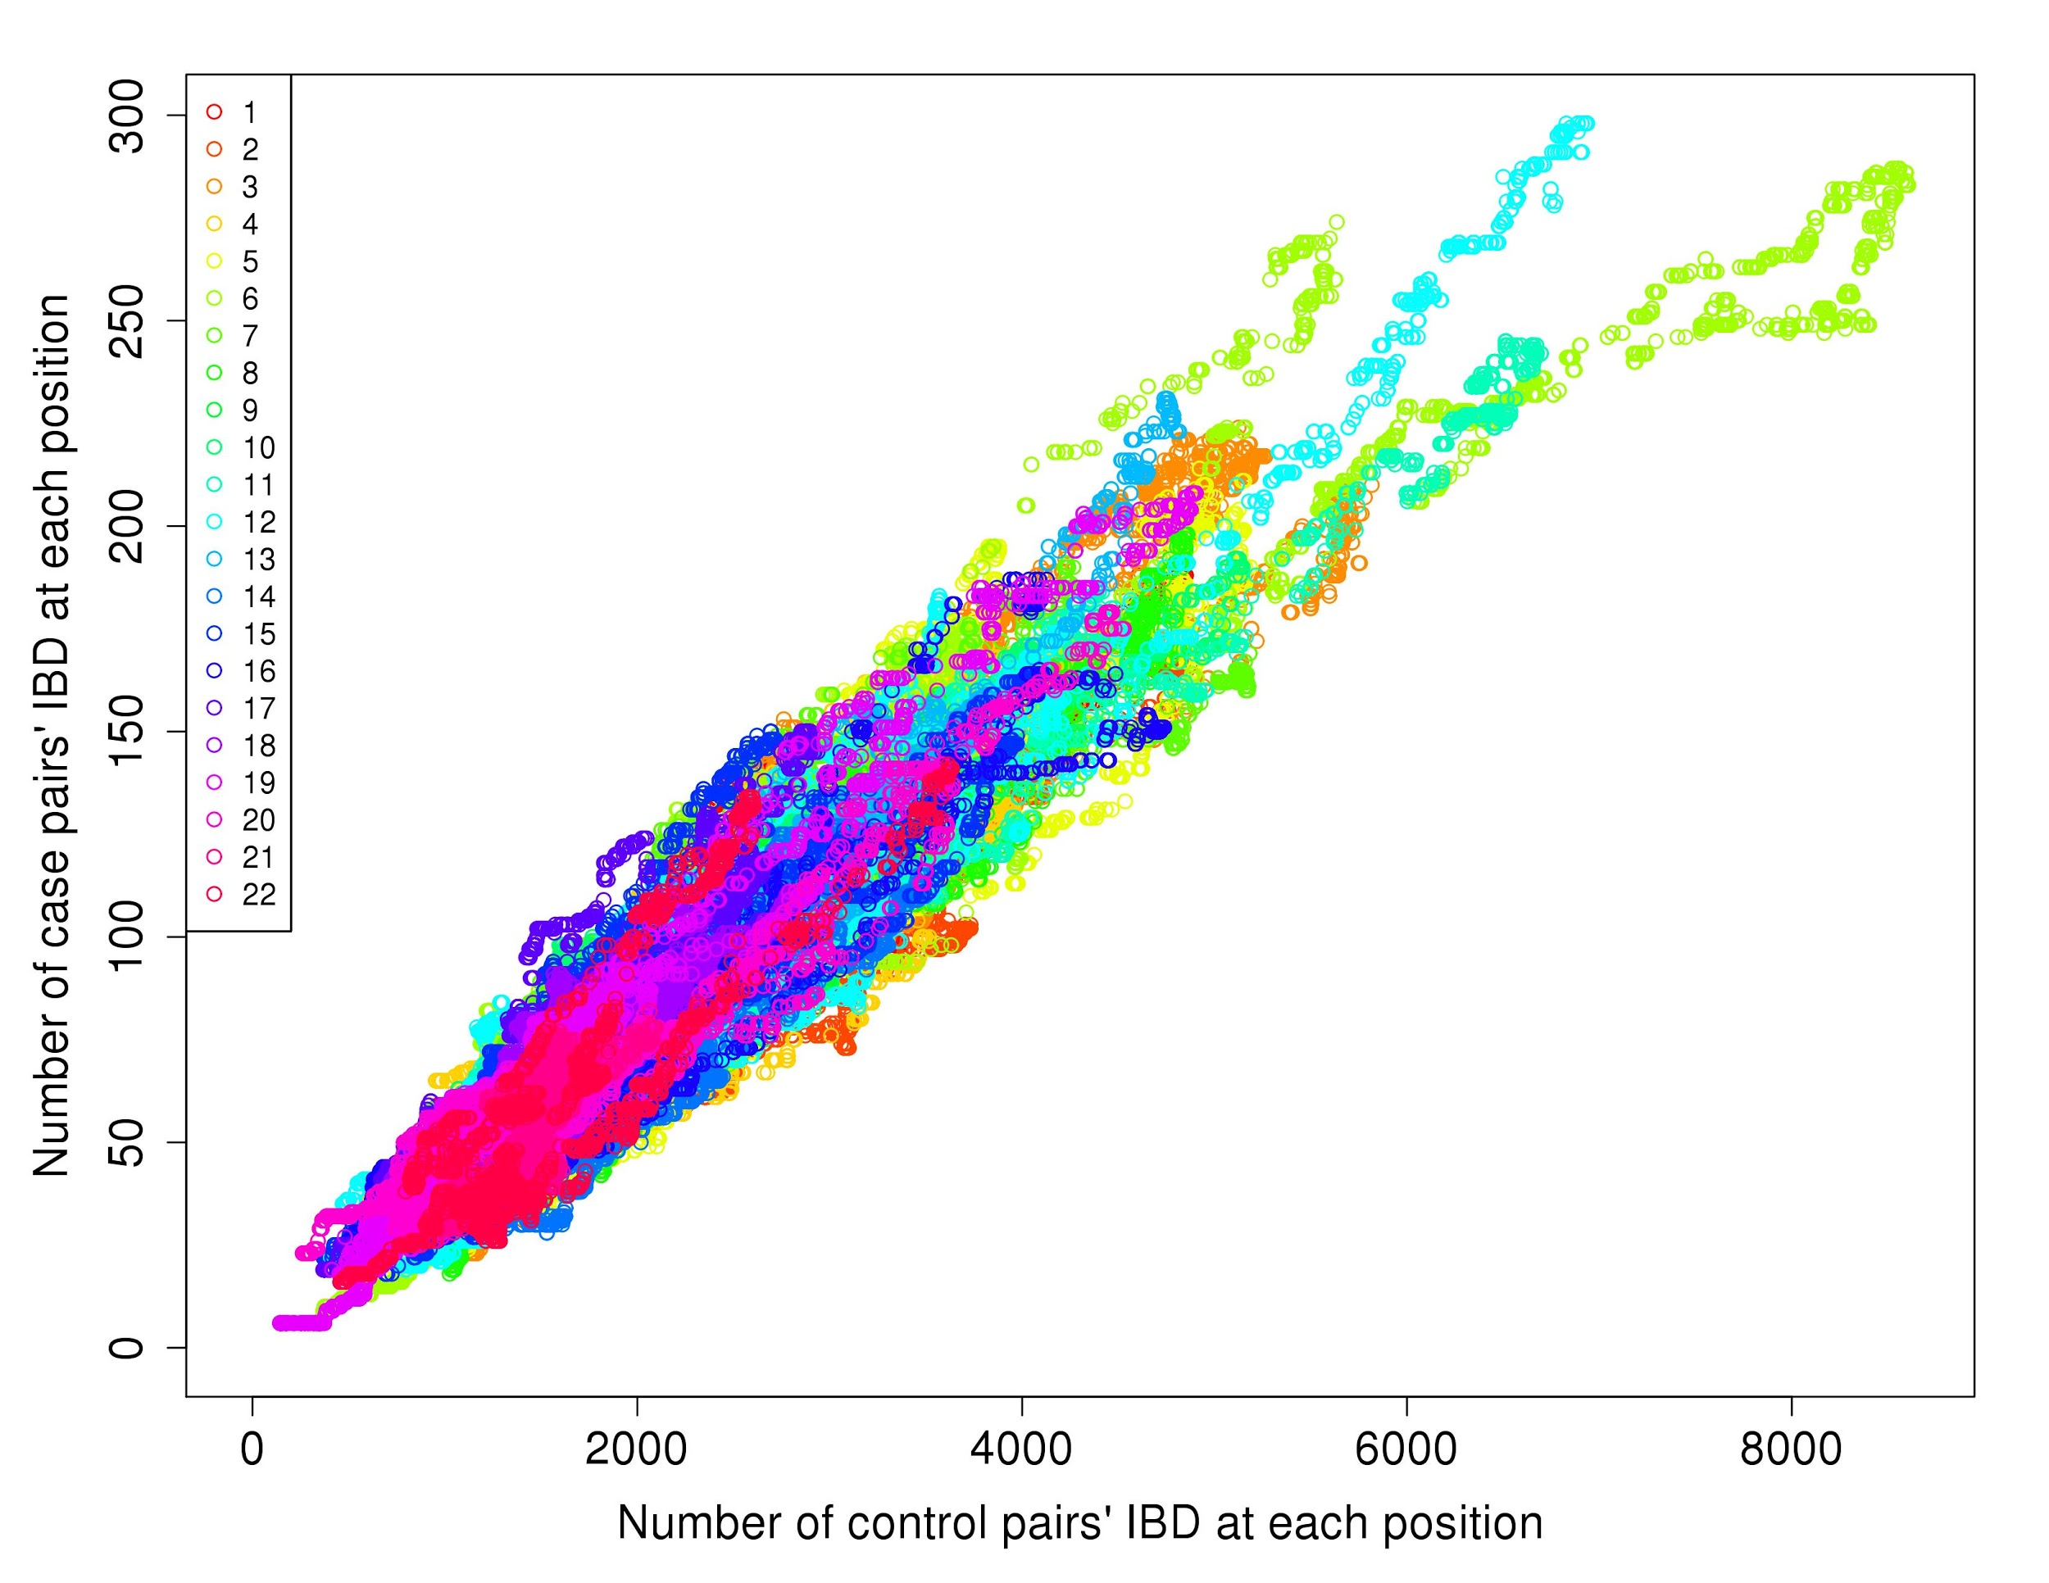
Pairwise IBD segments in stratified cohorts (Types of epilepsy)
Patients EG
Patients EP
Notes:
Il y a un segment ou 2 qui ont l’air de ressortir à gauche pour les EG, mais ils sont partagés par 500 ou 1500 paires de patients...ce qui est très ennuyeux quand on cherche une cause assez rare pour la maladie...

Slide 16
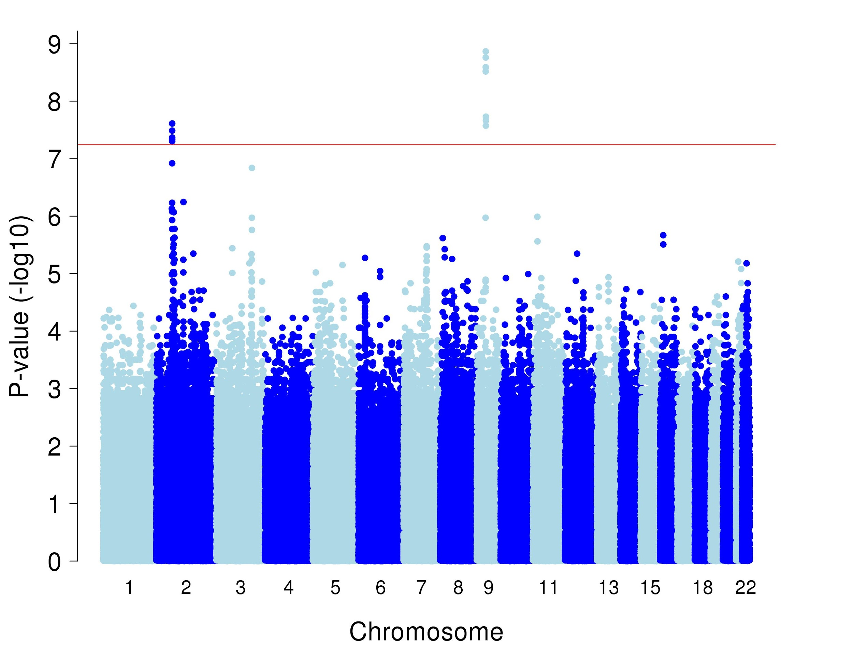
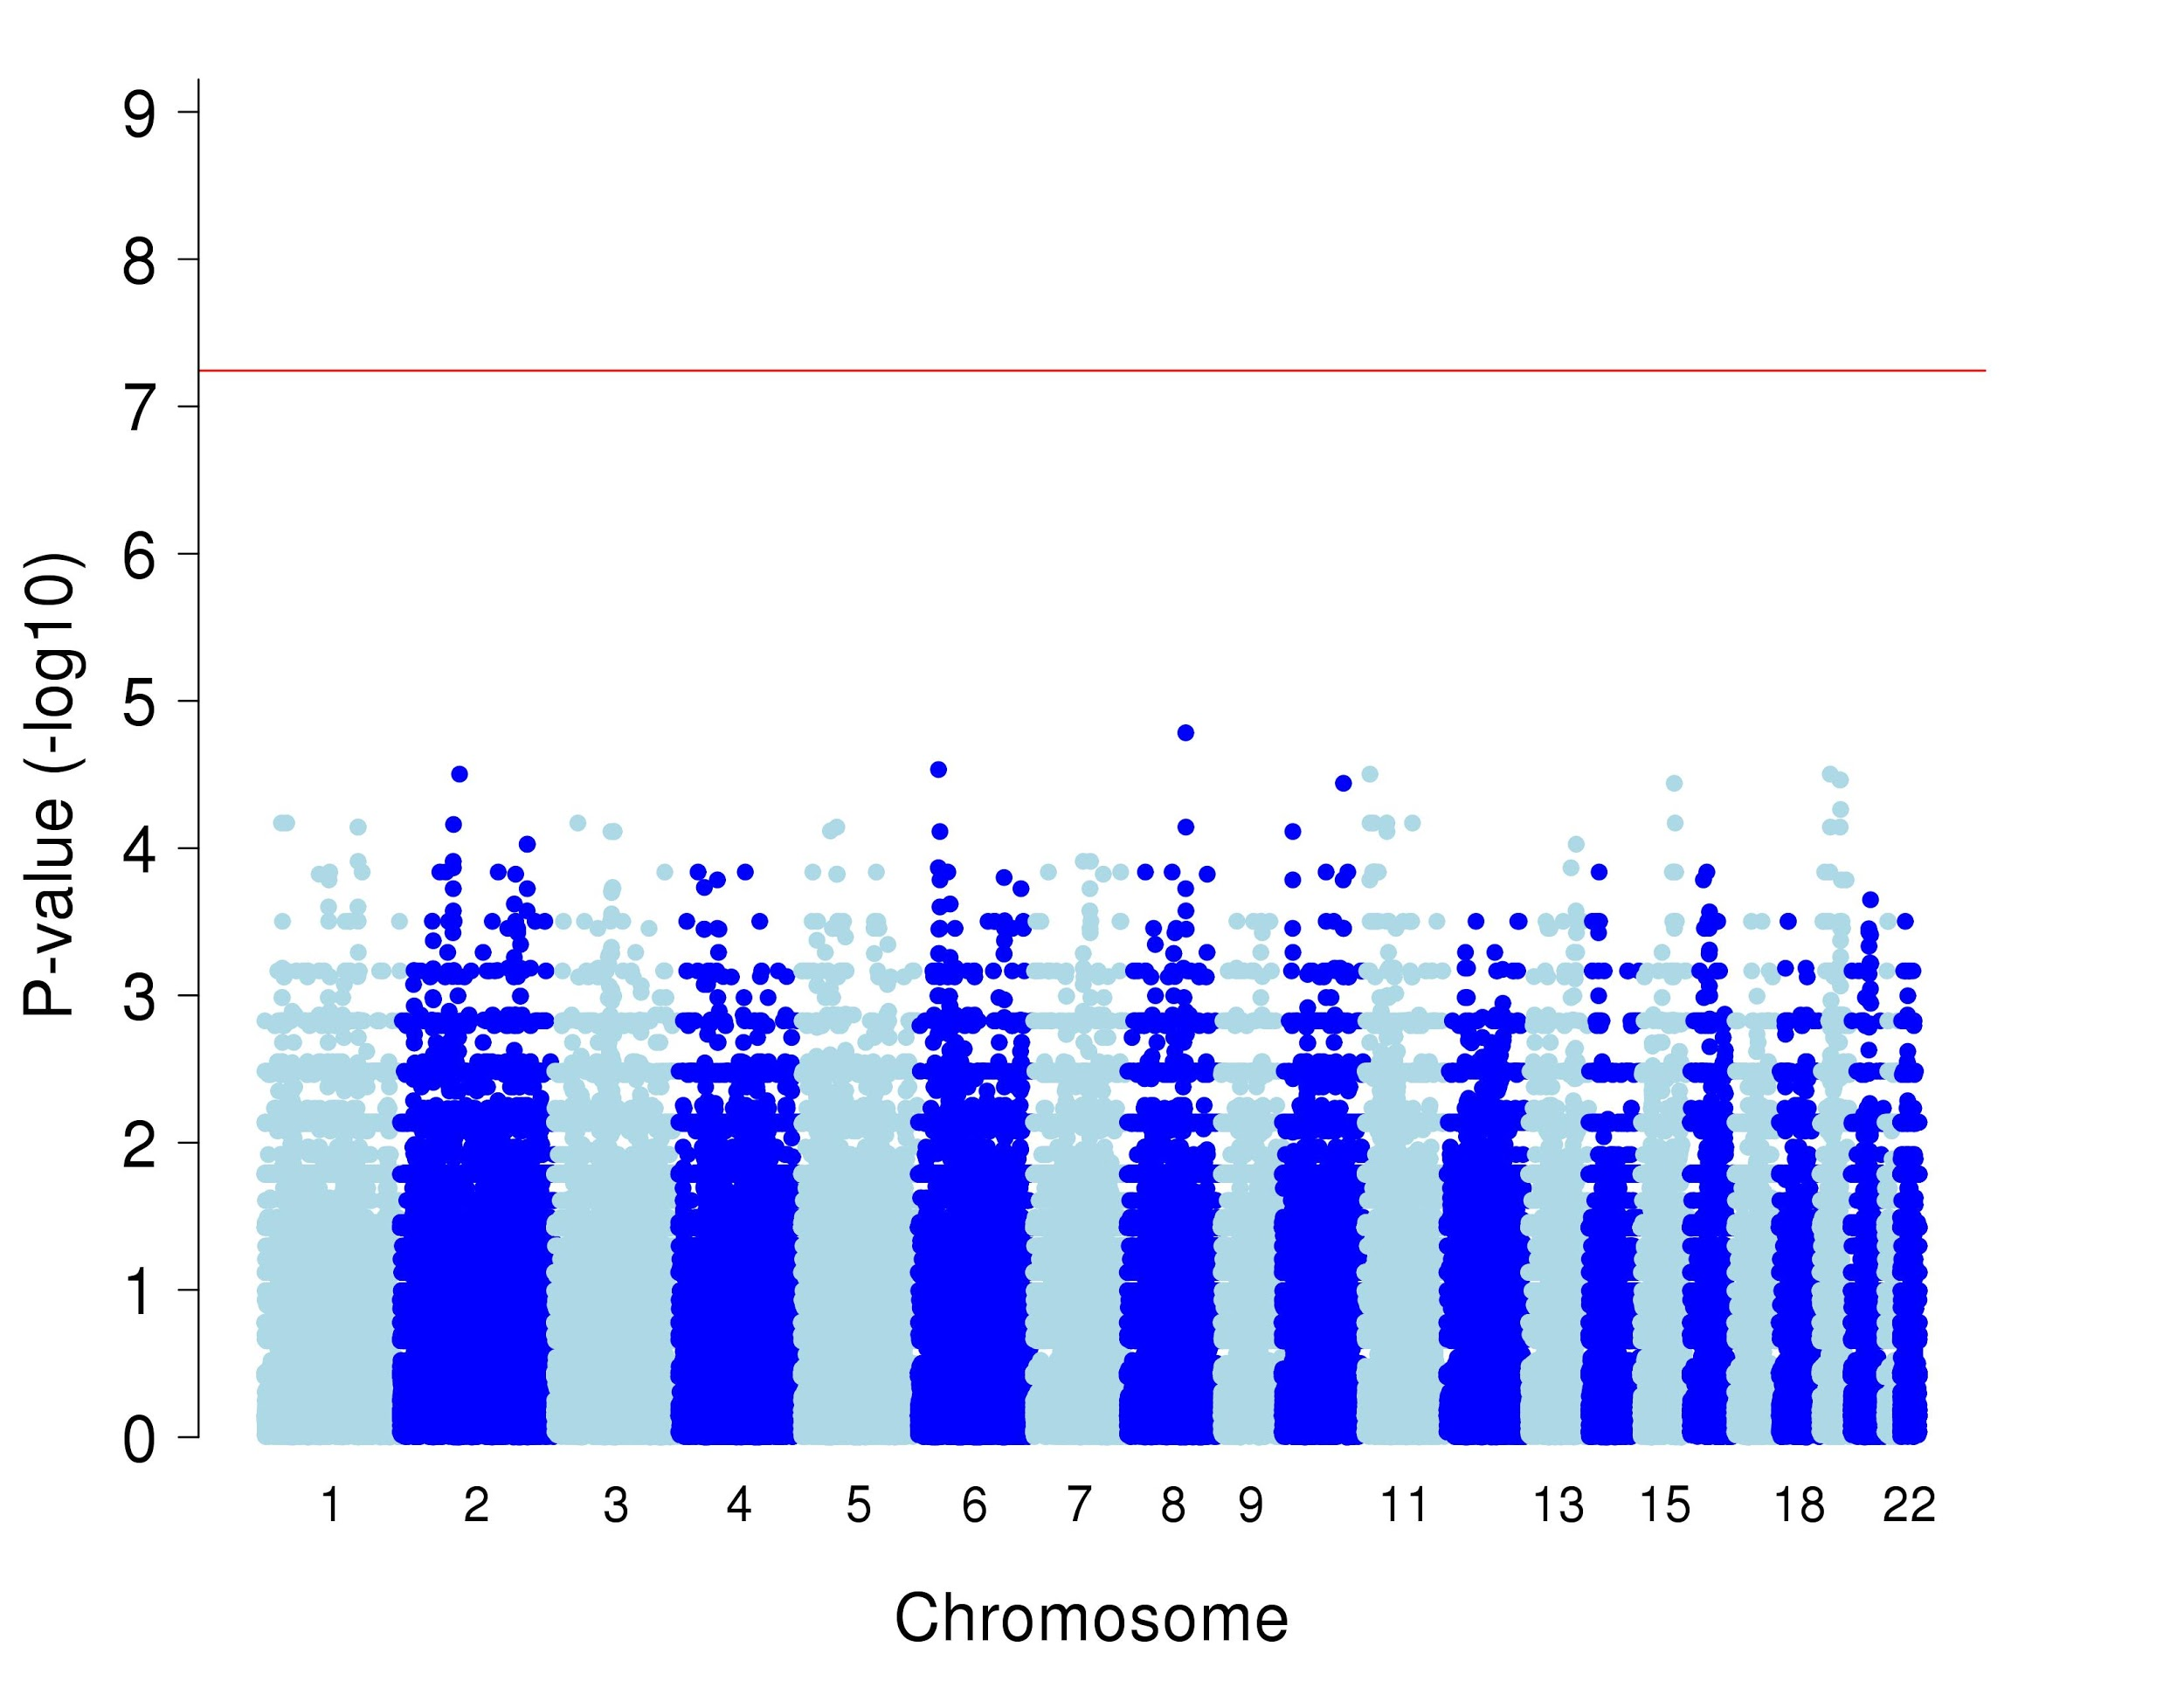
Association study for IBD segments shared amongst many individuals
All IBD segments
IBD segments higher in cases
Notes:
Ça c’est pour les clusters, donc les segments partagés par plusieurs individus. À gauche tous et à droite seulement ceux qui sont partagés par plus de patients...donc à gauche les plus hauts c’est qu’ils sont partagés par plus de contrôles...ce qui ne nous intéresse pas tant à ce stade-ci...

Slide 17
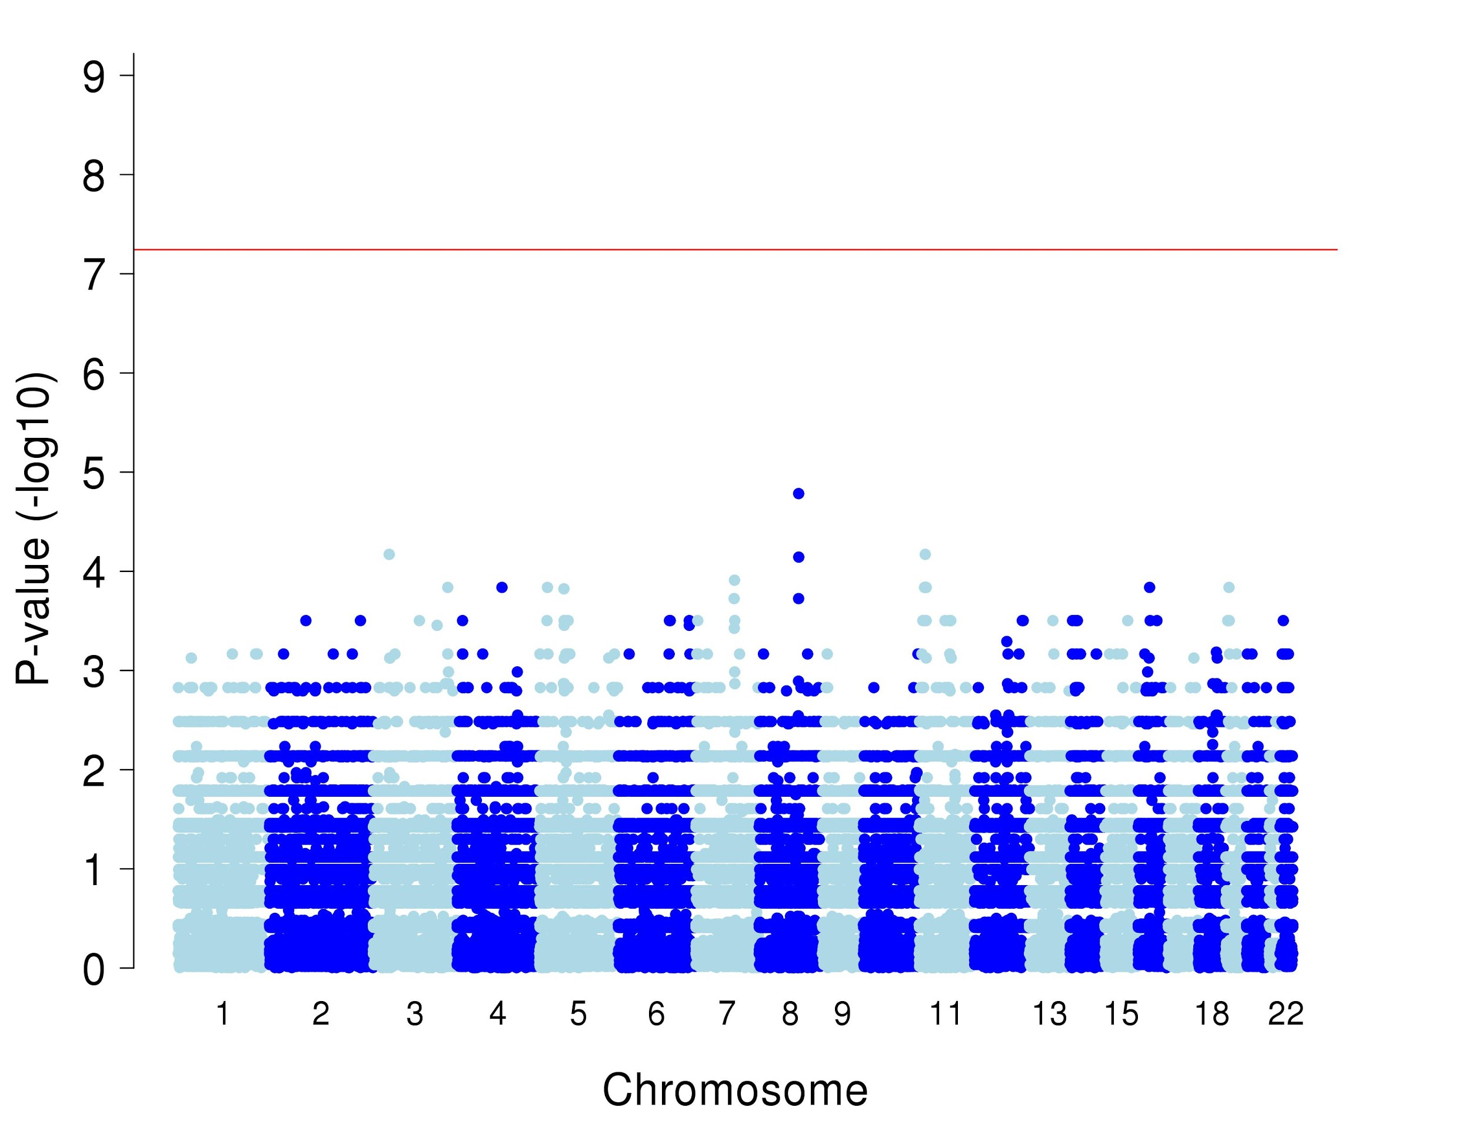
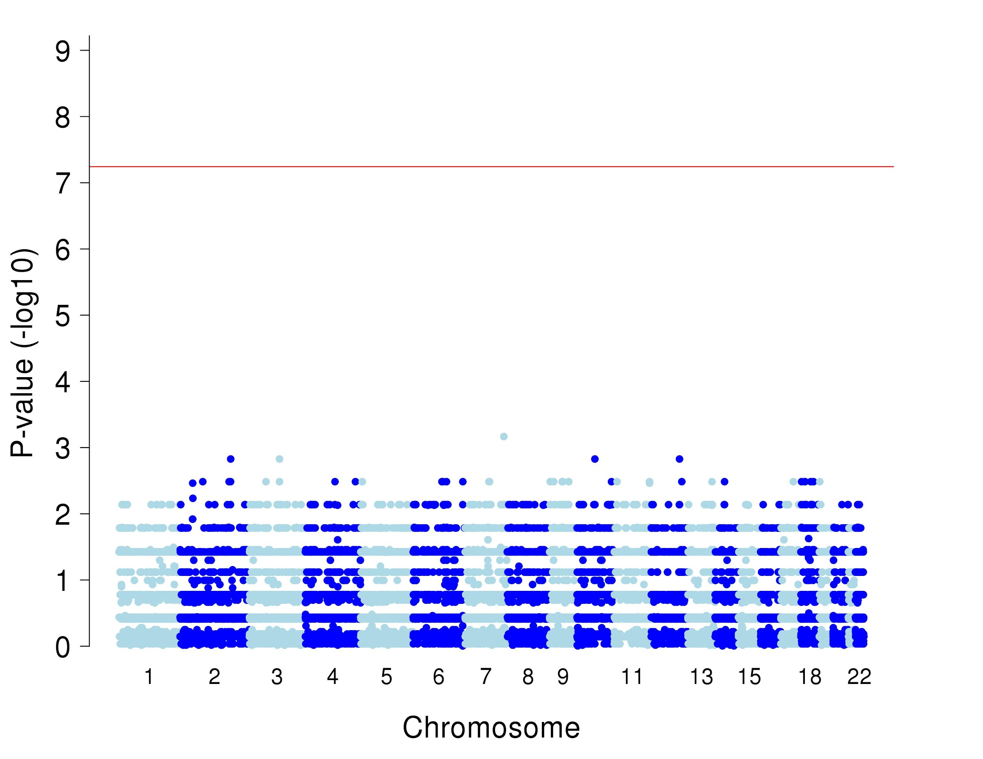
Association study for IBD segments shared amongst many individuals
Generalized Epilepsy
Partial Epilepsy
PLEKHA7, OR7E14P, RPS13, PIK3C2A, NUCB2, LOC105376575, NCR3LG1, KCNJ11, ABCC8, USH1C
No gene
LINC00882
PRSS1,
PRSS3P2
Notes:
Pour les EG et les EP...pas très convainquant...les gènes ne sont pas liés à l’épilepsie et de toute façon pas significatifs...

Slide 18
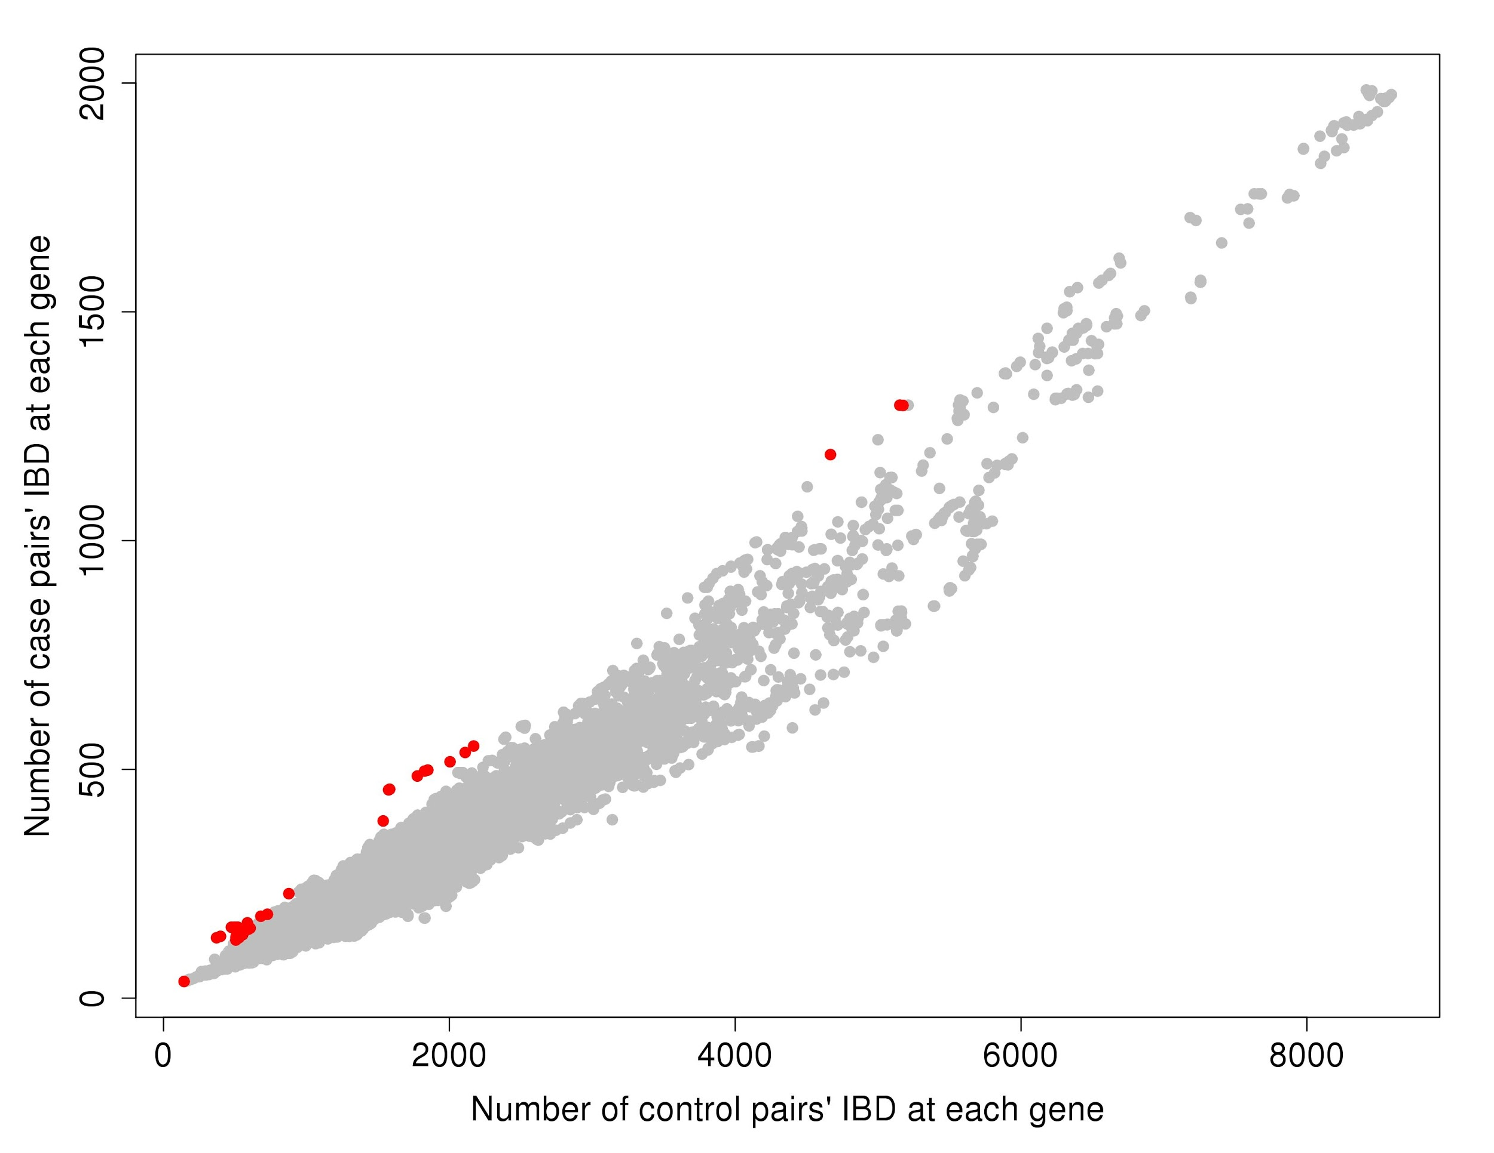
Pairwise sharing in genes in controls vs EG patients
For each gene, comparison of the number of pairwise IBD between patients and control
In red : The top 50 genes enriched in patients

Slide 19
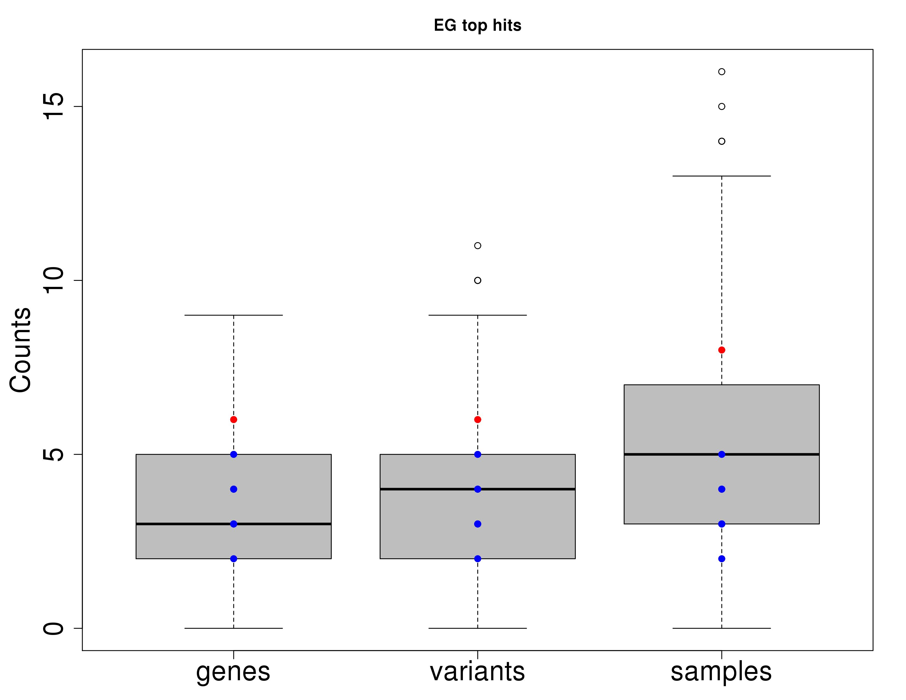
LOF variants in genes found in pairwise-IBD-genes
Generalized Epilepsy
Box : Panel of 50 genes randomly selected in the genome (n=500)
Blue : Panel of 50 genes selected in epilepsy genes (EpiPM) (n=10)
Red : The top 50 genes from the pairwise-IBD gene enrichment

Slide 20
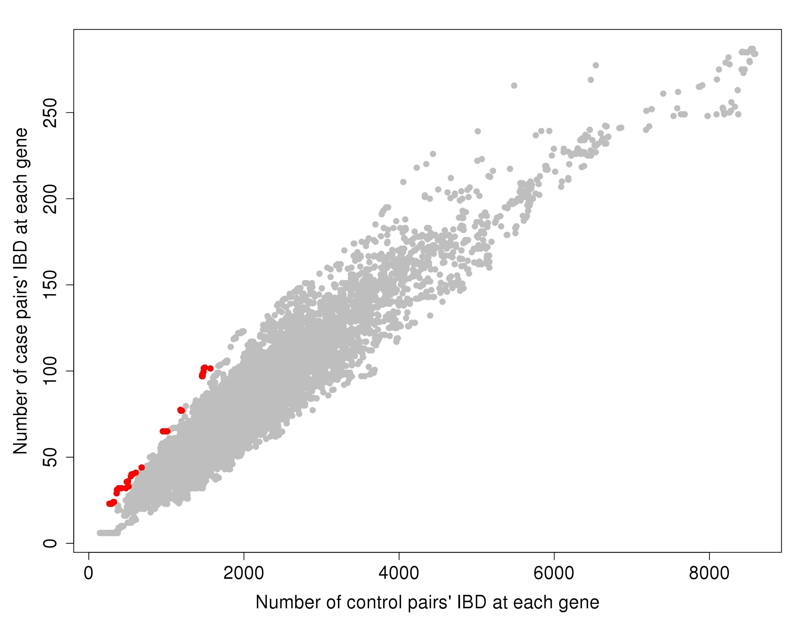
Pairwise sharing in genes in controls vs EPpatients
For each gene, comparison of the number of pairwise IBD between patients and control
In red : The top 50 genes enriched in patients

Slide 21
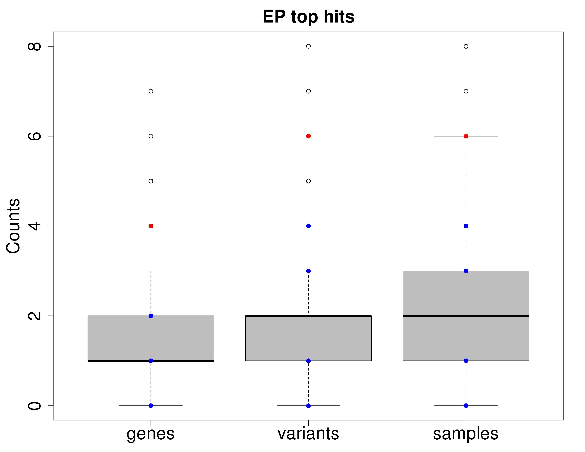
LOF variants in genes found in pairwise-IBD-genes
Partial Epilepsy
Box : Panel of 50 genes randomly selected in the genome (n=500)
Blue : Panel of 50 genes selected in epilepsy genes (EpiPM) (n=10)
Red : The top 50 genes from the pairwise-IBD gene enrichment

Slide 22
Take home
Classical pairwise sharing in a founder population includes background IBD sharing that excludes the possibility to link a shared region to the disease
Classical IBD clusters (segment shared by multiple individuals) are big and include many genes - hard to pointed out one gene as being linked to the disease
IBD clusters are not well delimited (ie the same haplotype a little shifted accounted for a new segment) - hard to pointed out one haplotype as being linked to the disease
Gene-based pairwise sharing approach seems to be more promising
Looking forward to infer haplotypes (with pre-determined boundaries) inside genes that could be more easily linked with the disease and go back to WGS or WES to identify possible causal variants
The control population has a higher number of individuals from regions
Genealogies
  Segregation and heritability of the phenotype regardless of the genotypge
  Possibility to correct for the complex background of the population (observed VS expected)

Slide 24
The BALSAC genealogy project
Primary dataset : Wedding certificates
  95% of wedding certificate from catholic wedding between 1620 – 1965
Secondary dataset : Birth and death certificates
  Birth and death certificate from the beginning of the colony (1620 – 1750) - PRDH
  Birth certificates between 1750 – 1830 - IMPQ
  Birth certificates between 1830 – 1920 (PROJECTED) – iBALSAC
All civil acts are linked per individuals
  2,000,000 million individuals between 1620 – 1960
Reconstruction of high quality genealogy for individuals born of FC parents (in Quebec)

Slide 25
The BALSAC genealogy project
Hosted at UQAC since 1975
  Partnership between McGill, Université de Montréal, Université Laval and UQAC
Available to the research community
  Through researcher service
  Reconstruction of full genealogies
  Access to anonymized complete population structure

Slide 26
Lead PI : Hélène Vézina (UQAC)
Co-PI : Simon Girard (UQAC)
Simon Gravel (McGill)
Marie-Hélène Roy-Gagnon (Ottawa)
Sébastien Jaquemont (Cartagene)
Marc St-Hilarie (Université Laval)
Claude Bellavance (UQTR)

Slide 27
Acknowledgments
UQAC
  Claudia Moreau
CRCHUM
  Patrick Cossette
  Caroline Meloche
  Maxime Cadieux-Dion
McGill
  Guillaume Bourque
  Pascale Marquis
Jacques Michaud
Berge Minassian

