Slide 1
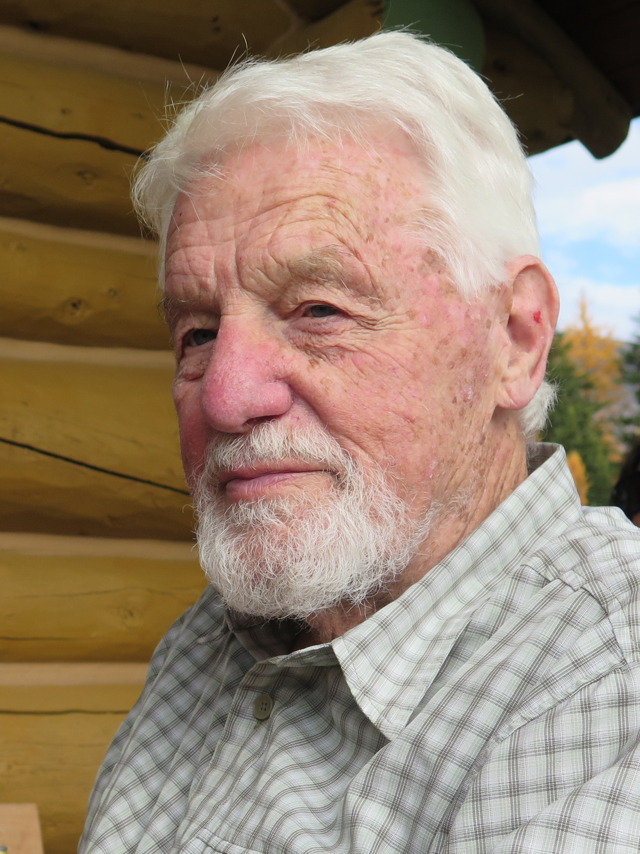
On Working with Peter Lancaster for 60 Years
Richard K. Guy
University of Calgary

Slide 2
Alexander Markowich Ostrowski
By Konrad Jacobs - MFO: http://owpdb.mfo.de/detail?photo_id=3161, CC BY-SA 2.0 de, https://commons.wikimedia.org/w/index.php?curid=5475924

Slide 3
Alston Scott Householder
Inventor of Householder reflections.

Slide 4
Singapore 1957-1962

Slide 5
Saving turtles in Malaya

Slide 7
India enroute to Canada 1962

Slide 9
Climbing on Yamnuska

Slide 10
The summit!

Slide 11
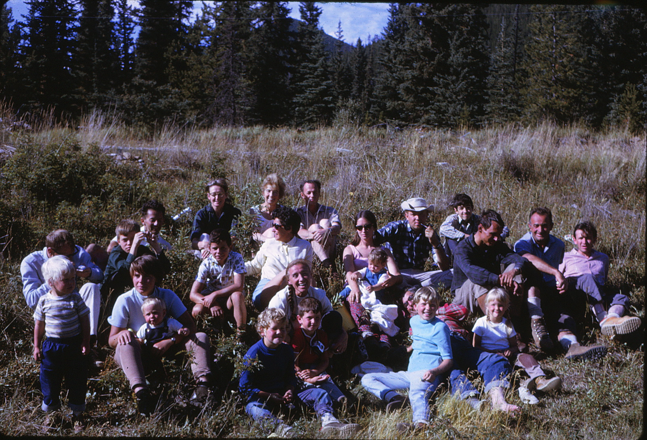
Calgary Math Department Centennial Expedition 1967

Slide 12
North Wales 1969

Slide 13
The Dolomites 1969

Slide 14
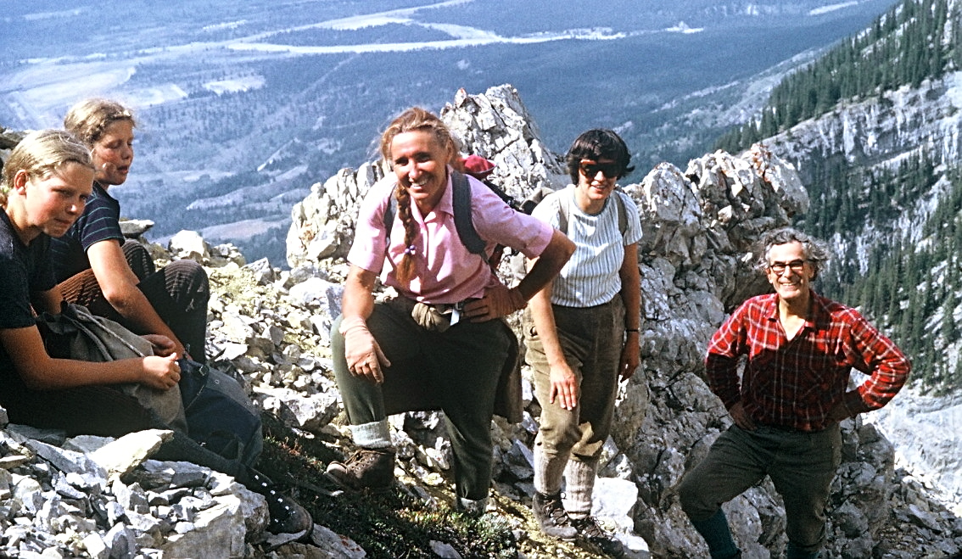
Grotto Mountain, Bow Valley
Photo by Peter Lancaster

Slide 15
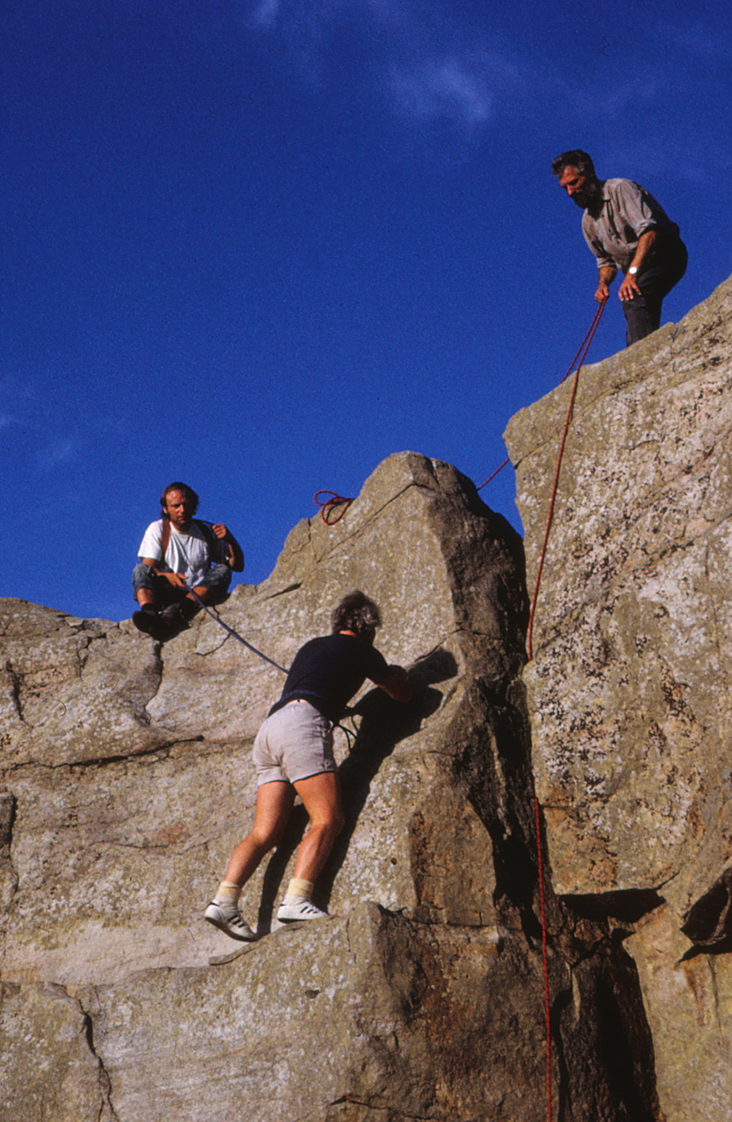
The Math Dep’t on Okotoks Rock

Slide 16
XC Skiing

Slide 17
Colleagues and graduate students at Lac des Arcs

Slide 18
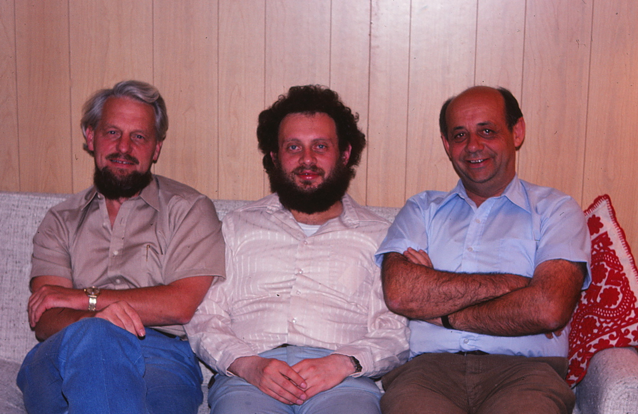
With Leiba Rodman and Israel Gohberg

Slide 19
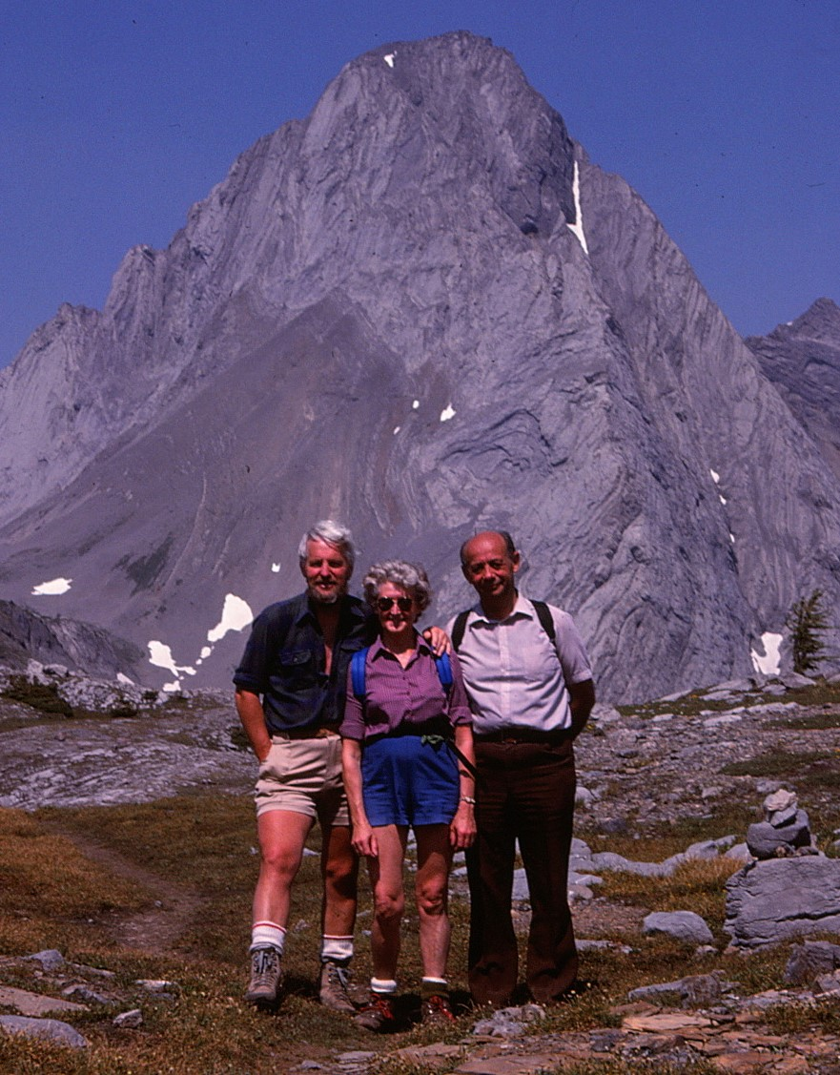
Peter and Edna with Israel Gohberg

Slide 20
In Iran with Hadi Kharaghani and colleagues, 1978

Slide 21
Banff, 1984

Slide 22
Soviet Union, 1985
With a poet and Alec Marcus

Slide 23
The Nottingham Group 2011

Slide 24
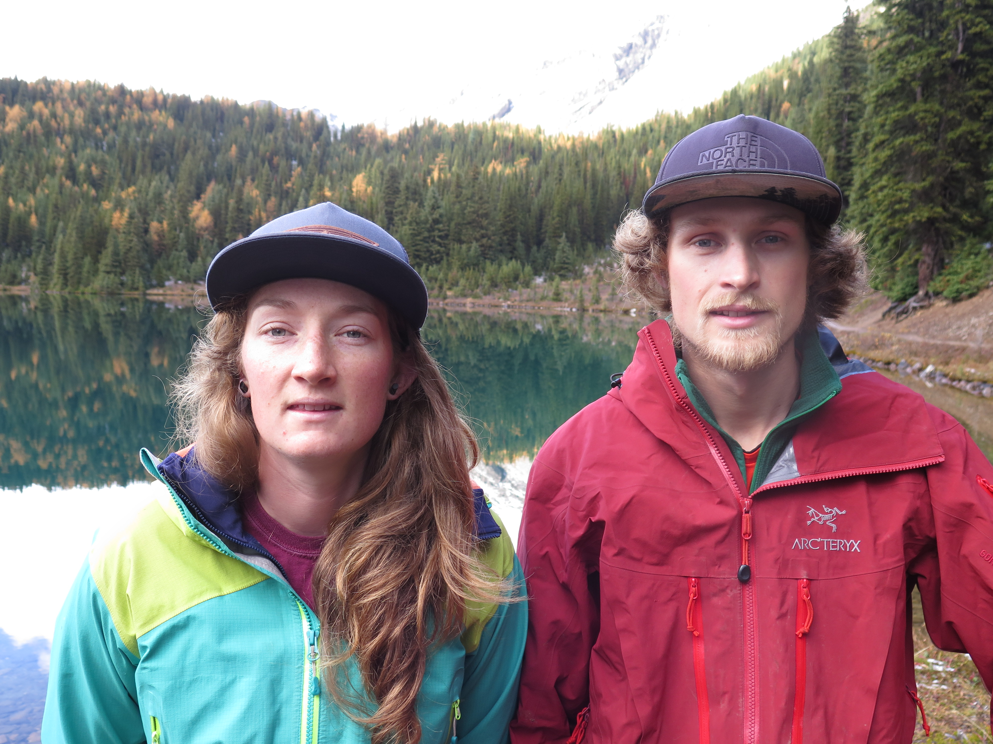
Grandchildren Lynnea and Duncan

Slide 25
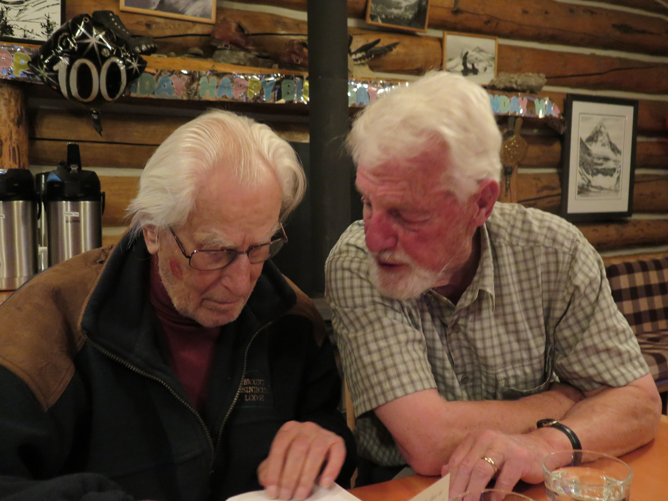
Still at it!

