Slide 1




Spatial Autocorrelation and Uncertainty Associated With Remotely Sensed Data
Daniel A. Griffith
Ashbel Smith Professor of Geospatial Information Sciences
&
Yongwan Chun

Slide 2
Big Data, Statistics, and Environmental Sciences
Results can be extended to billions+ of pixels
An extension of spatial statistics to remote sensing work:
Chen, X-L.; H-M. Zhao; P-X Li; Z-Y Yin. Remote sensing image-based analysis of the relationship between urban heat island and land use/cover changes, Remote Sensing of Environment, 2006, 104, 133-146.
  Uses aspatial regression, and has 447 citations
Relevant to spectral indices analysis
The work most closely relates to Finley’s afternoon presentation:
Computational considerations for applying nearest neighbor Gaussian processes to large spatial data sets

Slide 3
ABSTRACT
Virtually all remotely sensed data contain spatial autocorrelation, which impacts upon their statistical features of uncertainty through variance inflation, and the compounding of duplicate information.
Estimating the nature and degree of this spatial autocorrelation, which usually is positive and very strong, has been hindered by computational intensity associated with the massive number of pixels in realistic sized remotely sensed images.
Recent advances in spatial statistical estimation theory support the extraction of information and the distilling of knowledge from remotely sensed images in a way that accounts for latent spatial autocorrelation.
This paper summarizes an effective methodological approach to achieve this end.

Slide 4
Spatial Autoregression/autocorrelation
Fpr a P-by-Q remotely sensed image:

Slide 5
Estimation of xxx
Replace nonlinear minimization from the condensed likelihood function (regression equation) by a condensed normal equation with a Jacobian approximation:
Griffith, D. (2015). Approximation of Gaussian spatial autoregressive models for massive regular square tessellation data, International J. of Geographical Information Science, 29: 2143-2173.

Slide 6
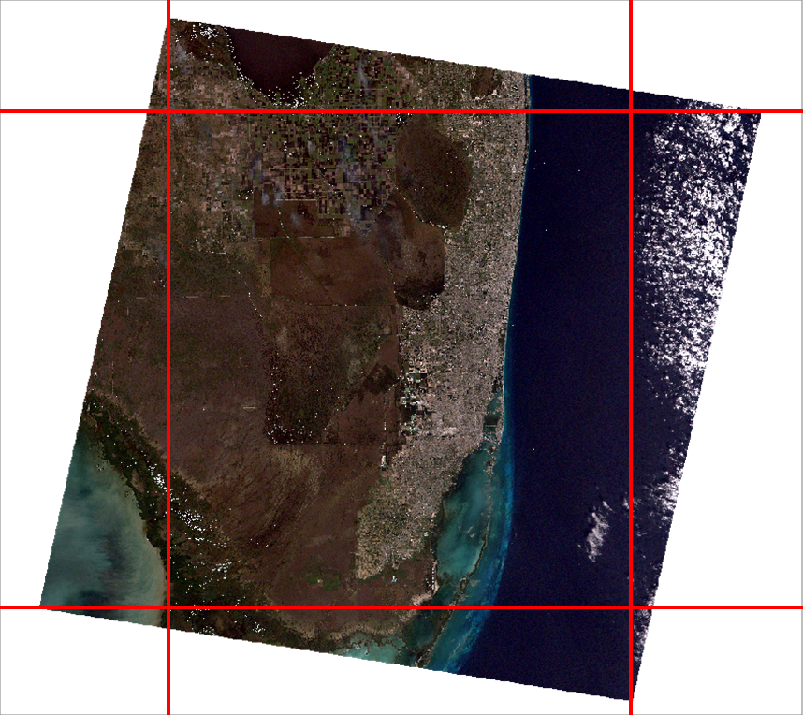
Florida Everglades database
A January 1, 2002 Landsat 7 Enhanced Thematic Mapper Plus (ETM+) image forming a 7,649-by-8,581 (n = 65,636,069 pixels) rectangular region rotated clockwise on the horizontal axis. This image has been orthorectified and converted to the UTM 17-N projection, and includes spectral bands B1-B7; its spatial resolution is 28.5 meters for bands B1-B5 and B7, and 57 meters for B6. Pixels with nonzero spectral reflectance values total 41,611,007, whereas 8,935,349 pixels with a zero value form a white border around the remotely sensed image

Slide 7
Sampling Experiment Empirical Data
A 4800-by-5200 (n = 24,960,000 pixels) rectangular region parallel to the horizontal axis was extracted for analysis purposes.
The sampling experiments use two spectral indices (both indices range from -1 to 1, and have a variance that conceptually can range from 0 to 1):
  the normalized difference vegetation index [i.e., NDVI = (B4-B3)/(B4+B3)]
  NDVI tends to be around 0.95 (the Everglades image analyzed in this paper has a spatial autocorrelation of 0.955), the common upper bound for many remotely sensed images
  Large positive NDVI values indicate dense vegetation land cover, whereas large negative values indicate deep water
  the normalized burn ratio [i.e., NBR = (B4-B7)/(B4+B7)].
  NBR tends to be around 0.85 (the Everglades image analyzed in this paper has a spatial autocorrelation of 0.874), the common lower bound for many remotely sensed images
  Large positive NBR values indicate high severity burn, whereas large negative values indicate high post-fire regrowth.

Slide 8
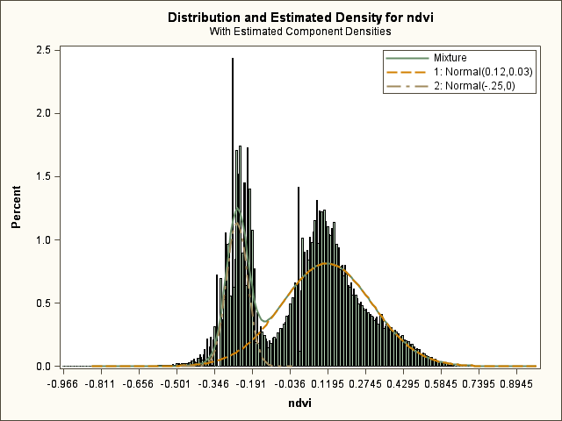
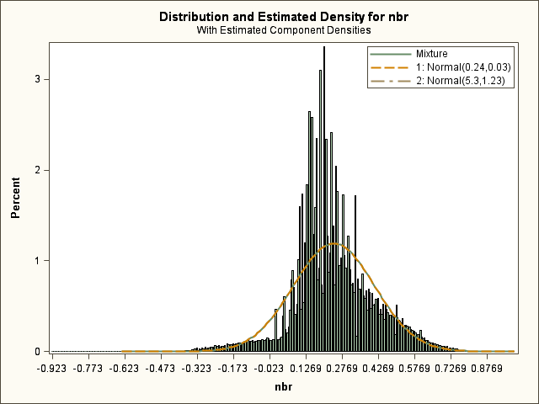
NDVI and NBR for the Florida Everglades
Normal mixtures with two components:

Slide 9
Describing the Asymptotic Sampling Distribution of xxx
Distributed as a beta-beta random variable
Beta 1:
p increasing as spatial autocorrelation increases from -1 to 1
Beta 2: p
K calibrated for = 0: K = 80512 for a 400-by-400 pixel image

Slide 10
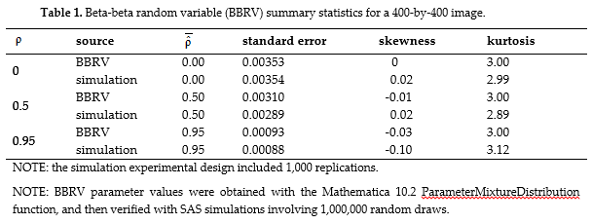
Comparative Simulation Results

Slide 11
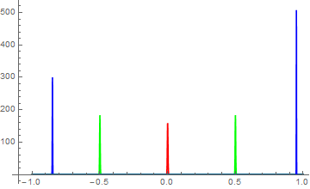
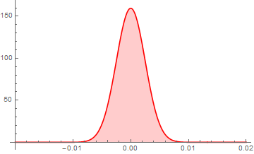
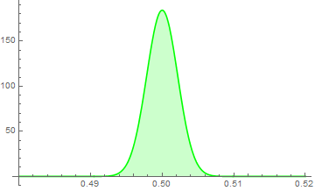
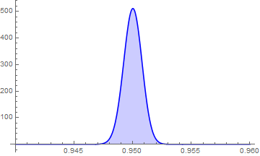
From 400-by-400 Image Simulation Experiments

Slide 12
Principal Implication
Standard errors are so small that virtually everything is significant
FL Everglades NDVI: 95% CI is (0.948, 0.962)
FL Everglades NBR: 95% CI is (0.867, 0.884)
These results indicate what the population spatial autocorrelation might be with repeated remote sensing

Slide 13
Relevant Questions for Spatial Analysts
What happens if I select an image in a different location?
What happens if I select an image that is slightly shifted?
What happens if I randomly sample my geographic landscape?
What happens if I increase the scale of my geographic landscape?

Slide 14
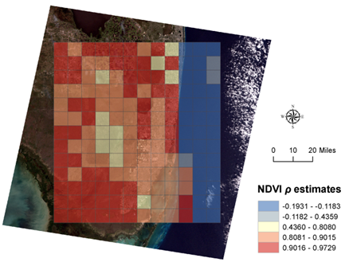
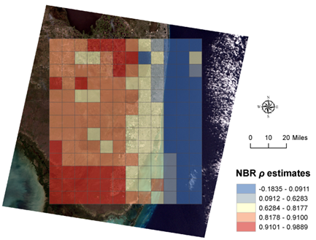
Experiment #1: coterminous images
Geographic variability of is much greater than indicated by it asymptotic variance

Slide 15
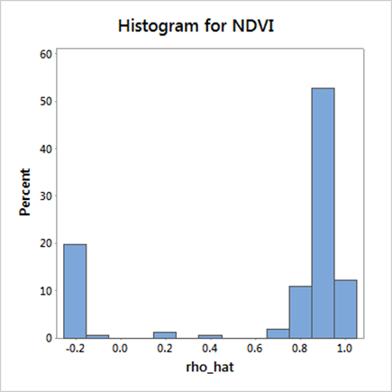
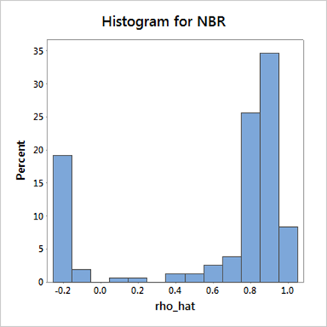
Frequency Distributions: r = 156
water versus land: a heterogeneous geographic landscape

Slide 16
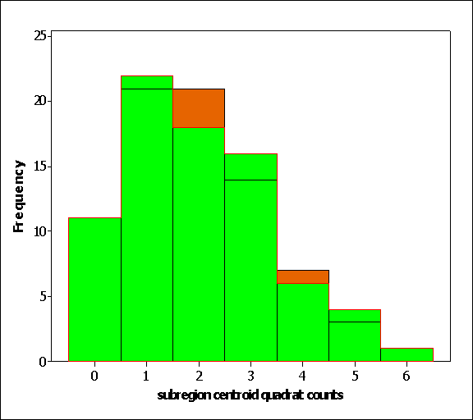
Experiment #2: random images
Geographic distribution of quadrat centroid point densities is a Poisson random variable

Slide 17
Experiment #3: random pixels
N = 400x400 = 160,000
Random sampling without replacement
Jacobian term still problematic:
OLS = 1.006 for NDVI 0.995 for NBR
all 156 for NDVI > 1
retaining the original Jacobian term yields: 0.958 and 0.869

Slide 18
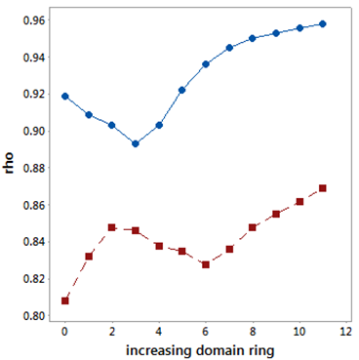
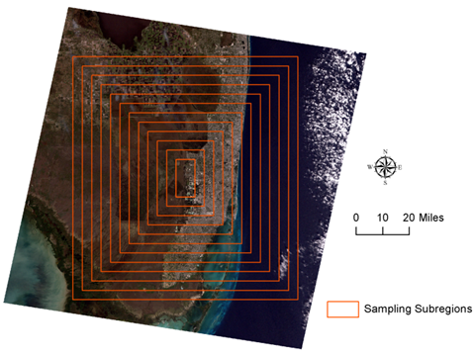
Experiment #4: increasing domain asymptotics

Slide 19
Summary of Results
Sampling
 | NDVI | NBR | NDVI | NBR
None: asymptotic | 0.96 | 0.87 | 0.0069
Coterminous | 0.97 | 0.86 | 0.0320 | 0.0316
Random quadrat | 0.85 | 0.81 | 0.0098 | 0.0127
Random pixels | 0.96 | 0.87 | 0.0006 | 0.0011
Increasing domain | 0.93 | 0.84 | 0.0164 | 0.0164

Slide 20
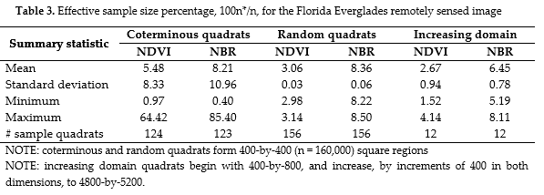
Selected Uncertainty Implications
EFFECTIVE SAMPLE SIZE, n*: original n is 160,000

Slide 21
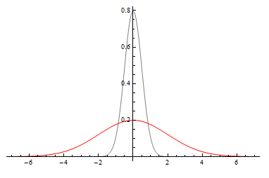

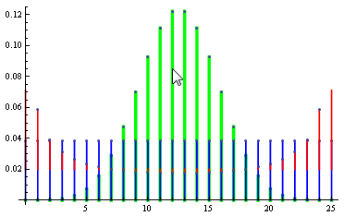
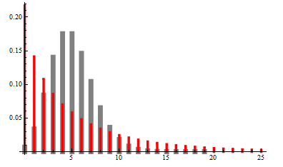

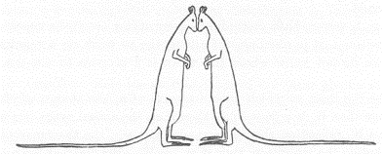
A Principal Impact of Positive Spatial Autocorrelation is Variance Inflation
For the most part, spatial autocorrelation impacts variance, and hence standard errors.
autocorrelation
spatial
Gaussian
Poisson
binomial
The bell shape deflated onto our feet! Darn you spatial
autocorrelation!
My tail! Darn you spatial
autocorrelation!

Slide 22
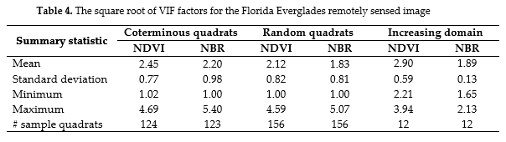
Variance inflation factor (VIF)

Slide 23
Some Concluding Comments
Cressie, N., A. Olsen, and D. Cook. 1996. Massive data sets: problems and possibilities, with application to environmental monitoring, in Massive Data Sets: Proceedings of a Workshop, edited by the Committee of Applied and Theoretical Statistics, pp. 115-119. Washington, DC: National Academy Press.
massively large georeferenced datasets challenge, and may ultimately cause the failure of, spatial statistical methodology initially designed for georeferenced datasets with n in the 100s, which has been extended successfully and effectively to datasets with n in the 10,000s
Statistical significance is one of these challenge areas.
3/7/2016: the American Statistical Association Board of Directors issued a statement on p-values and statistical significance.

Slide 24
Spatial Statistical Methodology Developments
Now supports estimation of spatial autoregressive model specifications for realistic remotely sensed images
Now supports simulation experiments for massively large georeferenced datasets that can include 10,000 replications in order to exploit the Law of Large Numbers
Reveals that remotely sensed images have large VIFs
Quantifies that much information content in remotely sensed images is compounded duplicate information
Shifts some focus to negative spatial autocorrelation

Slide 25



Questions ?

