Slide 1
Diagnostics of data assimilation and models for environmental and climate prediction
Pierre Gauthier
Presentation at the Workshop on
Probabilistic Approaches to Data Assimilation for Earth Systems
February 17-22, 2013
Banff International Research Station (BIRS)
Banff (Alberta), CANADA

Slide 2
Introduction
Observing and Modeling the Earth System
  Virtual laboratory where models and observations are compared to improve our understanding of the physical processes governing the Earth system
Dynamical balance associated with analyses
  Inconsistencies between physical processes acting on fast time scales (e.g., convection, radiation) can be diagnosed in the first moments of a model integration (spin-up)
  Imbalances can create a significant spurious variability that is important for climate simulations (Rodwell and Palmer, 2007)
  Data assimilation can help to
    evaluate the consistencies between physical processes and
    Diagnose differences between observed and modeled processes
Reanalyses for climate studies
  Collecting and validating historical data (1900 to present day)
  Bias corrections
  Ability of data assimilation system to reconstruct the climate of our recent past
  Existing projects to perform reanalyses for the whole XXth century

Slide 3
Outline
Assessing the impact of observations and its applications
Observability of precursors to instability
Diagnosing dynamical balance based on physical tendencies
  Impact of using an analysis produced by a different model
  Driving a limited-area model for regional climate applications with analyses produced by a different model

Slide 4
Approaches to measuring the impact of assimilated observations
Information content
  based on the relative accuracy of observations and the background state
Observing System Experiments
  Data denials
  Global view of the impact of observations on the quality of the forecasts
Observation impact on the quality of the forecasts
  Sensitivities with respect to observations based on adjoint methods (Baker and Daley, 2000; Langland and Baker, 2003)
  Ensemble Kalman filter methods (EFSO, Kalnay et al., 2012)

Slide 5
Diagnosing the statistical information from the results of analysis
Desroziers (2005)
  use the results of the assimilation to estimate the observation, background and analysis error covariances in observation space
  and then,

Slide 6
Estimating the information content
(or Degrees of Freedom per signal, DFS)
Noticing that
If the statistics are consistent then
If they are not
  This gives the same information content with respect to the a priori error statistics

Slide 7
Estimating the information content
(Lupu et al., 2009)
Estimate of the information content is based solely on diagnostics from the assimilation process
Need to estimate and invert which is a full matrix because it contains the background error
Alternate form
Additional assumption: is diagonal

Slide 8
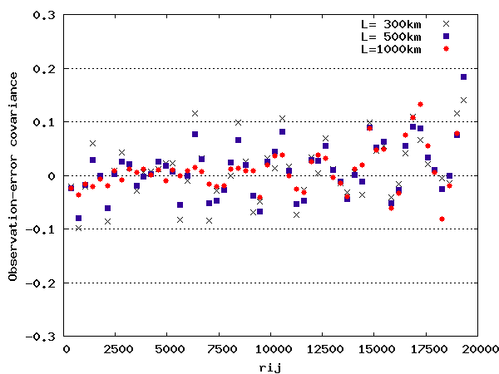
Estimating the observation error covariance
Estimate of the off-diagonal terms of as a function of distance r_{i,j}
L = 300 km
L = 500 km
L = 1000 km
x

Slide 9
Estimation of the information content
: only the diagonal terms of the second method are used
L (km)
300 | 11.03 | 10.88 | 10.81 | 10.80 | 10.70
500 | 9.50 | 9.37 | 9.21 | 9.20 | 9.07
1000 | 7.34 | 7.08 | 6.79 | 6.79 | 6.75
Easiest to compute
: estimation obtained from perturbed analysis
: estimation obtained from the true values

Slide 10
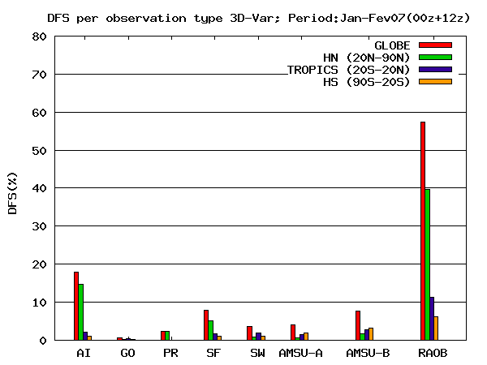
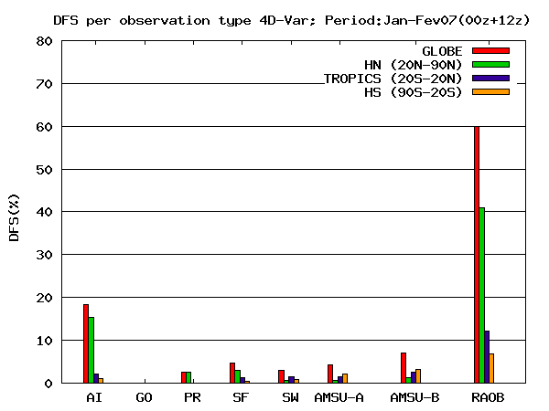
DFS in MSC’s 3D-Var and 4D-Var systems
DFS for each type of observations
We assumed that the complete set of observations can be split in observation subsets with independent errors (R is block-diagonal);
Regions : HN, HS, TROPICS;
Obs_types : AI, GO, PR, SF, SW, AMSU-A, AMSU-B, RAOB;

Slide 11
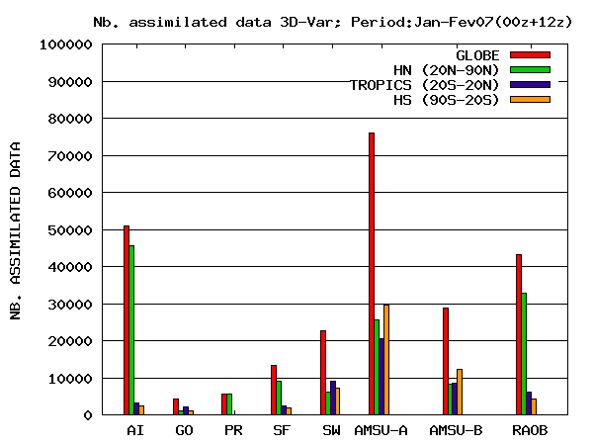

Assimilated observations in each region
Lupu et al. (2009)

Slide 12
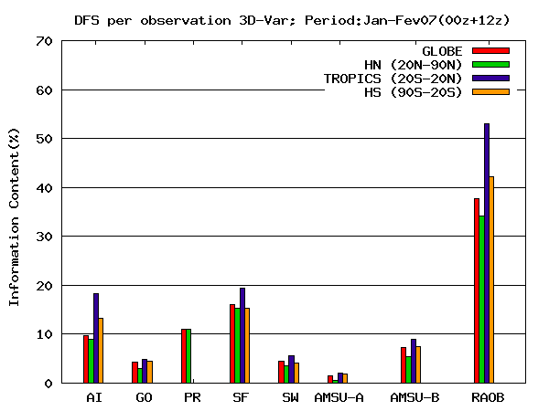
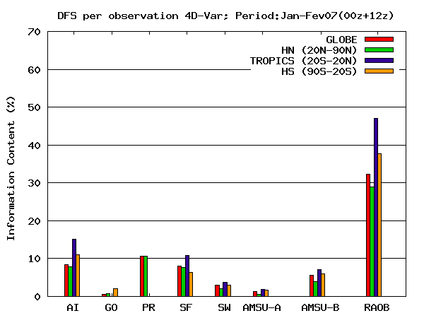
Observation impact per observation in each region
Lupu et al. (2009)

Slide 13
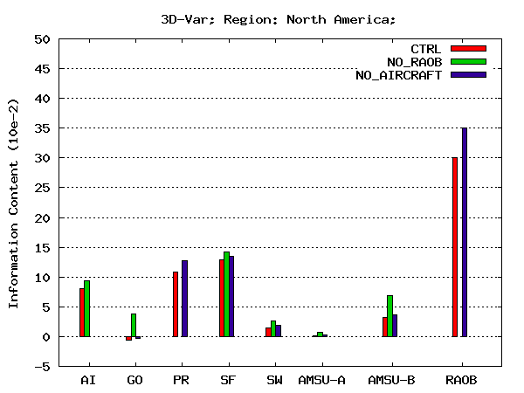
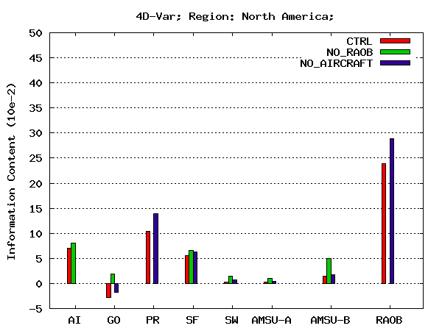
OSEs experiments: 3D-Var and 4D-Var, North America
DFS values per obstype normalized by the number of observations.
NO_RAOB: DFS per single observation notably increases, especially for AMSU-B and GO;
NO_AIRCRAFT: DFS per single observation notably increases, especially for RAOB, SF and PR; For other observations (GO, SW and AMSU-B) DFS per obs also increases slightly.

Slide 14

Observation Impact Methodology
(Langland and Baker, 2004)
OBSERVATIONS ASSIMILATED
00UTC + 24h
Observations move the model state from the “background” trajectory to the new “analysis” trajectory
The difference in forecast error norms, , is due to the combined impact of all observations assimilated at 00UTC
Notes:
14

Slide 15
Observation impact (Langland and Baker, 2004)
Forecast
True state
Analysis error (e₂₄)
Analysis X_{a}
Forecast error
(e₃₀)
Background X_{b}
0-h
24-h
26/01
12 UTC
28/01
12 UTC

Slide 16
Adjoint-based estimation of observation impact
(Pellerin et al., 2007)
Total Observation Impact over the Southern Hemisphere
3D-Var FGAT
Notes:
Following Baker and Daley (2000) and Langland and Baker (2004), it is possible to estimate the impact of observations on a 24-h forecast, say. The results depend on the different components of the assimilation system including the model. Moreover, the computation of the sensitivities involves a metric like total energy (moist or dry), over a given area, which can be also global. All those factors have an impact on the results.
The results presented here were obtained in Canada with our own system and are presented in details in the poster of Josée Morneau displayed on the second floor. This figure represents the total impact of observations on the 24-h forecast measured over a month (August 2004) in the 3D-Var assimilation system. The region represented here is the Southern Hemisphere. The impact is represented here over the 6-h assimilation window. The impact of surface pressure (green), radiosonde (blue) and AMSU-a (red) clearly stand out, the impact of the latter being independent of the time of the observations.

Slide 17
Adjoint-based estimation of observation impact
(Pellerin et al., 2007)
Total Observation Impact over the Southern Hemisphere
4D-Var
Notes:
This is now the impact measured within the 4D-Var assimilation. All other components (e.g., model, observations, background and observation error statistics) are exactly the same. The striking feature is that the impact of observations is more important for observations further down in the assimilation window. This shows that the impact of observations depends on the assimilation method employed and that 4D-Var is more sensitive to the cut-off time than 3D-Var.
The method itself used to evaluate the impact of observations can alter our perception and it is important to compare different approaches to make firm statements on the value of a particular type of observations.

Slide 18
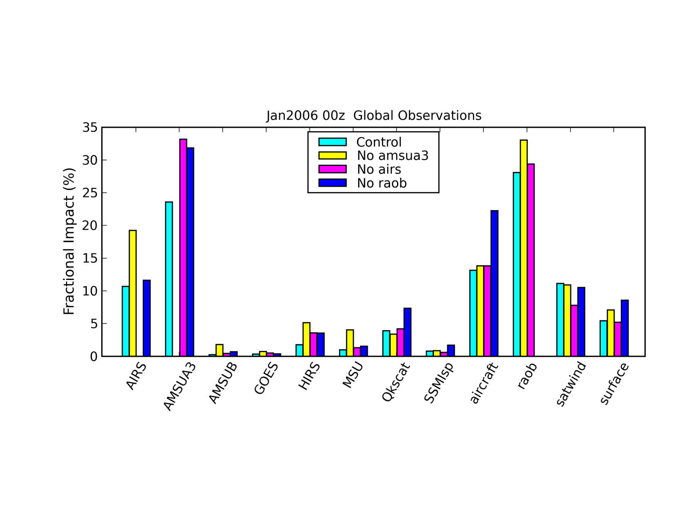
Combined Use of ADJ and OSEs (Gelaro et al., 2008)
…ADJ applied to various OSE members to examine how the mix of observations influences their impacts
Removal of AMSUA results in large increase in AIRS (and other) impacts
Removal of AIRS results in significant increase in AMSUA impact
Removal of raobs results in significant increase in AMSUA, aircraft and other impacts (but not AIRS)
Notes:
Same forward and adjoint systems as in slide 1.
Top panel: Both blue and red are good…more obs improve forecast than degrade. Gray not good…more than half of the obs degrade.
Bottom panel: Magnitude of impact. Note that scale is not linear. Negative (blue) is good. Positive (red) is bad. Sorry for the different color convention than in top panel.

Slide 19
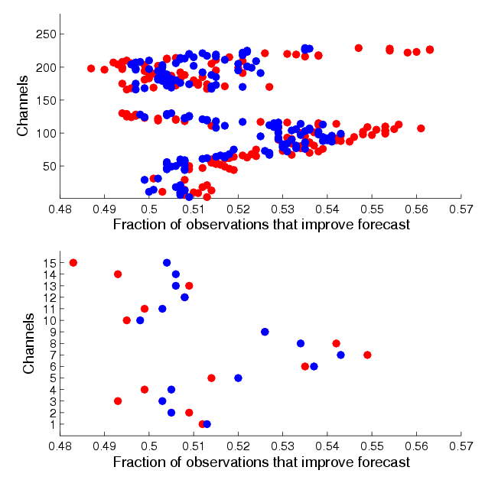
Fraction of Observations that Improve the Forecast
GEOS-5 July 2005 00z (Gelaro, 2008)
Control
AIRS
No AMSU-A
Control
AMSU-A
No AIRS
…only a small majority of the observations improve the forecast

Slide 20
Key analysis errors algorithm – configuration
(Laroche et al., 2002)
True State of the Atmosphere
Reference analysis
GEM
Sensitivity analysis
Forecast error (e₂₄)
Key analysis error
Initial analysis
0 hr
24 hr
Key analysis error
GEM
( Tangent linear )
Minimization algorithm
3 iterations
GEM (Adjoint)
J=Energy of ( )
Notes:
The key analysis error algorithm implemented at MSC is based on the Global Environmental Multi-scale (GEM) model and it’s corresponding tangent linear and adjoint versions.
A reference analysis valid at to+24hr is used to estimate the errors within the operational analysis. The cost function can be defined as the norm of the difference between a 24-h forecast and a verifying analysis and an iterative procedure minimizing the short range forecast errors leads to the so-called key analysis errors. Three iterations provide key analysis increments that, when added to the analysis substantially reduce the forecast error (at short and medium ranges).

Slide 21
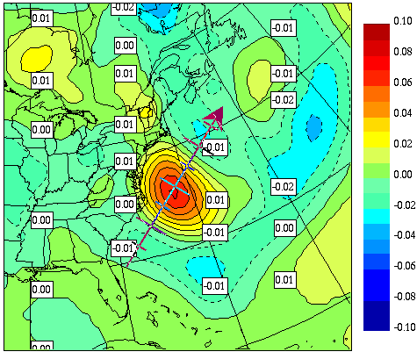
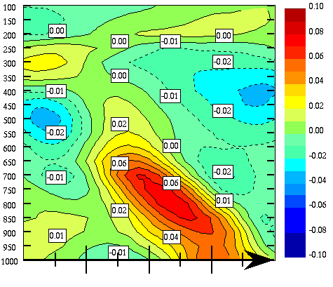
Impact of the adapted 3D-Var in the analysis
700hPa
Difference between the temperature analysis increments for 12 UTC January 27, 2003 analysis 3D adapted -3D standard and cross section.
Notes:
The same global sensitivity function was introduced in the formulation of the background-error covariance B to introduce a similar dynamical structure known to improve the forecast. This adapted 3D-Var assimilation includes the global sensitivity function and its variance is controlled through the variance we assign to it. Here, we have chose the value of σ₁ =100 which amounts to increasing by 25% the effective error variance in this direction.
The picture shows a close-up of the difference between the temperature analysis increments for 12UTC, January 27, 2003 analysis 3D-adapted - 3D-Var standard and cross section. This difference does correspond, as it should, to the global sensitivity function but with a different amplitude.

Slide 22
Modelling background-error covariances using sensitivities
The adapted 3D-Var
Structure functions defined with respect to a posteriori sensitivities;
Flow dependent structure functions were introduced in the 3D-Var;
Error variance along f:
Does a flow-dependent background error formulation improve the analysis and subsequent forecast?
(Lupu 2006)
Notes:
The adapted 3D-Var was first introudced by Hello and Bouttier (2001). In our study, a different algorithm is proposed and tested in the full 3D-Var system of the Canadian Meteorological Centre. The structure functions were defined with respect to a posteriori sensitivities and were introduced in the 3D-Var;
The modification is done on the background term of the 3D-Var. The new background error covariance matrix B includes the original covariance matrix with homogeneous and isotropic error correlation to which is added a modulation in the space spanned by the sensitivity function. The 3D-var then behaves as usual in regions where the sensitivity function vanishes but adopts the structure of the sensitivity function where it does not.
The parameter σ₁ is the constraint imposed on the amplitude of the variance in the sensitive direction within the background error matrix. When λ₁ = 0 and σ₁ =1, we recover the initial covariance model.
Does a flow-dependent background error formulation improve the analysis and subsequent forecast?
The impact of the change brought by the adapted 3D-Var assimilation was studied using the a posteriori sensitivity functions associated to an inaccurate forecast on the East Coast.

Slide 23
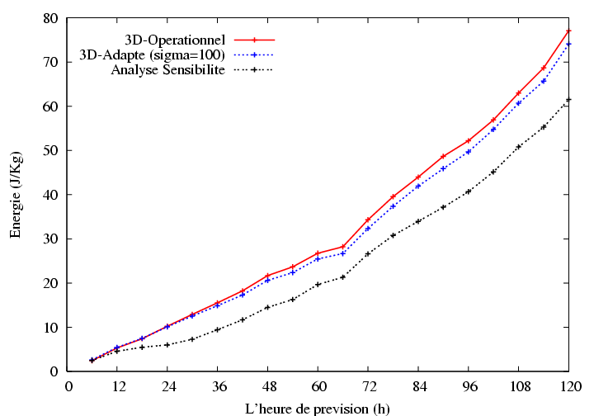
Case study –Forecast improvement
Energy (total) of the forecast error average over Northern Hemisphere Extra-tropics (25N - 90N)
Global-GEM operational forecast
Global-GEM adapted forecast
Energy (J/Kg)
Global-GEM sensitivity forecast
Forecast hour
Notes:
To give a global view, this picture represents the energy (total) of the forecast error (forecast minus reference analysis) averaged over the Northern Hemisphere Extra-Tropics for forecasts with the CMC global model based on the operational analysis (red line), the adapted 3D-Var analysis (blue line) and the sensitivity analysis (black line) valid at 12 UTC 27 January 2003.
The 24 hours forecast error in the Northern Extra-tropics is reduced by 1% in the adapted forecast but by 40% in the sensitivity forecast.
The forecast improvement at 24 hours is also maintained in the medium range as the estimated key analysis errors continues to grow in the nonlinear regime.

Slide 24
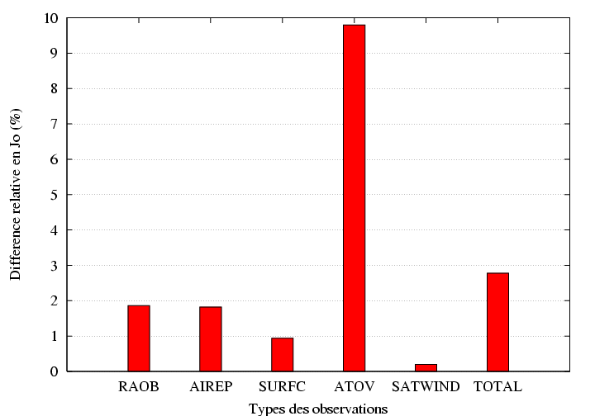
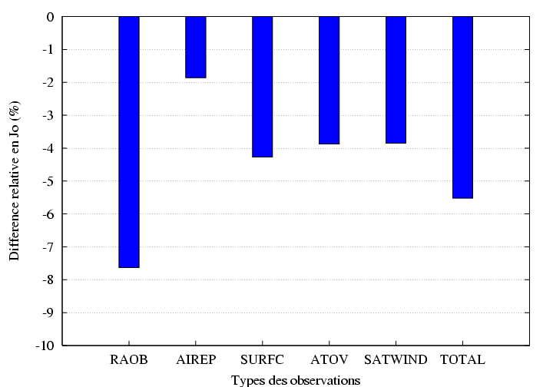
Fit to the observational Data
Do the corrections decrease or increase the departure between the analysis and the observations ?
> 0 = increase
< 0 = decrease
1- Sensitivity analysis
2- Adapted 3D-Var analysis
Difference relative en Jo (%)
Difference relative en Jo (%)
RAOB AIREP SURFC ATOV SATWIND TOTAL
RAOB AIREP SURFC ATOV SATWIND TOTAL
Notes:
The sensitivity analyses are obtained under the only constraint that the resulting 24-h forecast error be reduced. They are not constrained to fit the available observations at initial time while the adapted 3D-Var. Do the corrections decrease or increase the departure between the analysis and the observation?
A measure of the fit to the observations is given by the observation component of the cost function, J_{o}. This figure represents the relative difference between the fit to the observational data (J_{o}) for the sensitivity analysis and the adapted analysis with respect to the operational analysis valid at 12 UTC 27 January 2003 for different family of observational data.
A positive value means that the departure between the analysis and the observations increase and a negative value means that the departure between the analysis and the observations decrease.
Figures present the difference in J_{o} for different of observation types as well as their sum (total).

Slide 25
Fit to the observational Data
Positive values mean that the sensitivity analysis is further away from the obs. than the initial analysis (same conclusions from ECMWF, Isaksen et al., 2004);
Negative values mean that the adapted 3D-Var analysis is closer to the obs. (due to the increase background-error variance);
1- Sensitivity analysis
2- Adapted 3D-Var analysis
Difference relative en Jo (%)
Difference relative en Jo (%)
RAOB AIREP SURFC ATOV SATWIND TOTAL
RAOB AIREP SURFC ATOV SATWIND TOTAL
Notes:
It shows that the sensitivity analysis degrades the fit to the observations (i.e. Jo(x_{s}) > Jo(x_{a})), particularly for satellite data while a slight improvement is obtained with the adapted 3D-Var for each individual type of observation with the exception of the SATWIND wind data derived from satellite imagery where no significant changes are observed.
However recent work at ECMWF by Isaksen et al. (2004) showed from daily application of the key analysis errors algorithm (with the energy norm) over a two month period that the forecast starting from the sensitivity analysis is, on average, further away from the observations not only at initial time but also during the first 12 hours approximately. This corresponds to one quarter of the optimization period since they were seeking initials corrections that minimize the 48 hours forecast errors.

Slide 26
Observability of flow-dependent structures
Adapted 3D-Var for which the structure functions where defined by normalizing the a posteriori sensitivity function
Consider the case where and the analysis increment is then
with
and

Slide 27
Associated information content and observability
Correlation between the innovations and a structure function
This defines the observability of a structure functions
  Can the observations detect a given structure function

Slide 28
Example from 1D-Var experiments
Consider the following cases
  Observations are generated from the same structure function as that used in the assimilation
  Observations are generated from a different structure function (phase shift)
  Signal has an amplitude lower than the level of observation error

Slide 29
Observability as a function of observation error
 | Nb obs. | C₁ | C₂ | ρ
 | 10 obs. | 1.29 | 0.64 | 0.99
 | 20 obs. | 1.96 | 0.97 | 0.99
 | 40 obs. | 2.26 | 1.13 | 1.
=1 | 10 obs. | 0.95 | 0.64 | 0.38
 | 20 obs. | 1.15 | 0.97 | 0.22
 | 40 obs. | 1.48 | 1.13 | 0.20
=4 | 10 obs. | 0.89 | 0.64 | 0.17
 | 20 obs. | 0.89 | 0.97 | 0.11
 | 40 obs. | 0.87 | 1.13 | 0.08

Slide 30
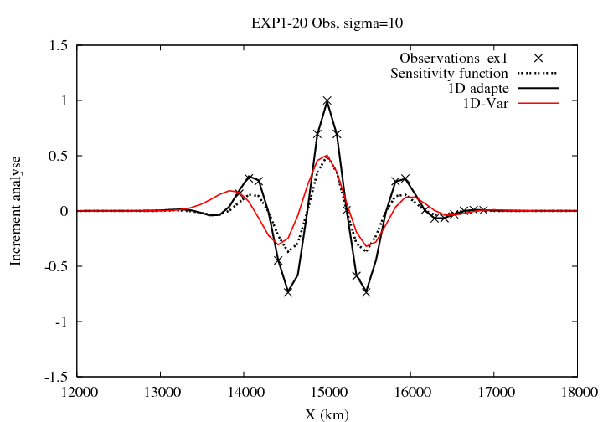
Experiment with the same function

Slide 31
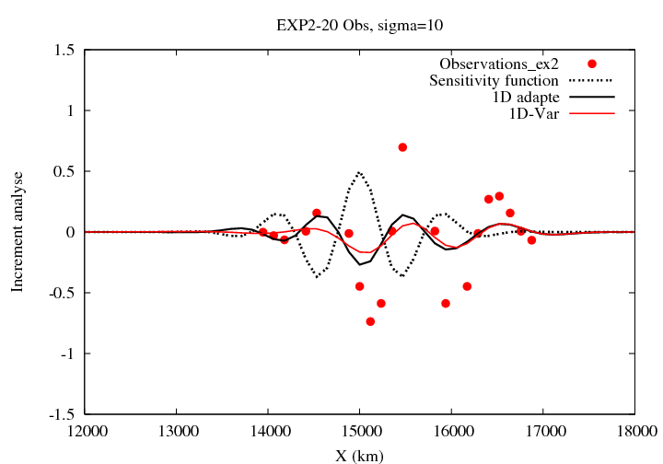
Experiment with a shifted function

Slide 32
Observability of structure functions
A posteriori sensitivities depend on
  Target area
  Norm used to measure the forecast error
  Initial norm
  Definition of the tangent-linear and adjoint model
Experiments with an adapted 3D-Var based on EC’s 3D-Var assimilation
  Dry energy norm
  Four cases documented in Caron et al. (2007):
  January 19, 2002, 00UTC, Feburary 6, 2002, 00UTC
  January 6, 2003 12UTC; January 27, 2003 12UTC
  Target area: global, hemispheric (25-90N) and local (area on the East Coast of North America)
  Imposition of a nonlinear balance constraint (Caron et al., 2007)

Slide 33
Preliminary test: does it work?
Normalized analysis increment of a 3D-Var as a structure function
  Limiting case where B = σ² vv^{T}
  Does the adapted 3D-Var recover the right amplitude
  This particular choice insures that we have a structure that can fit the observations.

Slide 34
Observability for the test case
Obs. type | Correlation coefficient ρ
 | January 27, 2003 | January 06, 2003 | February 06, 2002 | January 19, 2002
RAOB | 0.73 | 0.76 | 0.77 | 0.76
AIREP | 0.73 | 0.73 | 0.73 | 0.72
AMV | 0.68 | 0.72 | 0.72 | 0.73
SURFC | 0.69 | 0.74 | 0.75 | 0.76
ATOVS | 0.59 | 0.58 | 0.71 | 0.65
TOTAL | 0.71 | 0.73 | 0.75 | 0.74

Slide 35
Observability of different structure functions based on key analyses
Structure functions | Obs. type | ρ, correlation coefficient
 |  | January 27, 2003 | January 06, 2003 | February 06, 2002 | January 19, 2002
GLOBAL | RAOB | 0.01 | 0.02 | 0.03 | -0.01
 | AIREP | 0.00 | 0.02 | -0.01 | -0.01
 | ATOVS | 0.13 | 0.11 | 0.07 | 0.12
 | TOTAL | 0.05 | 0.05 | 0.05 | 0.03
LOCAL | RAOB | -0.01 | 0 | -0.01 | -0.02
 | AIREP | -0.03 | -0.01 | -0.03 | -0.03
 | ATOVS | 0.05 | 0.01 | 0.06 | 0.02
 | TOTAL | 0 | 0 | 0 | -0.01
HEMISPHERIC | RAOB | 0.00 | 0.02 | 0.01 | 0.01
 | AIREP | -0.05 | 0.02 | -0.02 | -0.03
 | ATOVS | 0.08 | 0.07 | 0.07 | 0.04
 | TOTAL | 0.03 | 0.04 | 0.04 | 0.02
PV-BAL | RAOB | 0.01 | 0 | 0.01 | 0
 | AIREP | -0.03 | 0.01 | -0.03 | 0
 | ATOVS | 0.09 | 0.08 | 0.08 | 0.05
 | TOTAL | 0.03 | -0.01 | 0.06 | 0.02

Slide 36
Observability of a pseudo-inverse obtained from a finite number of singular vectors (Mahidjiba et al., 2007)
Leading singular vectors are the structures that will grow the most rapidly over a finite period of time
  Leading 60 SVs were computed based on a total dry energy norm at a lead time of 48-h
  The forecast error is projected onto those SVs at the final time which allows to express the error at initial time that explains that forecast error (pseudo-inverse)
Experiments
  18 cases were considered in December 2007
  Are those structures observable from available observations?
  Observability of SV₁, the leading singular vectors
  Observability of the pseudo-inverse

Slide 37
Observability of the leading singular vector and pseudo-inverse
Date | Obs. type | Correlation coefficient ρ
 |  | SV no. 1 Initial time | SV no. 1 Final time | Pseudo-inverse
2007120100 | TOTAL | 0.0098 | 0.0067 | 0.0169
2007120212 | TOTAL | 0.0140 | -0.0179 | -0.0011
2007120400 | TOTAL | -0.0187 | -0.0211 | -0.0034
2007120512 | TOTAL | 0.0022 | -0.0020 | 0.0124
2007120700 | TOTAL | 0.0159 | 0.0020 | -0.0033
2007120812 | TOTAL | 0.0019 | 0.0212 | 0.0062
2007121000 | TOTAL | -0.0029 | -0.0151 | 0.0040
2007121112 | TOTAL | 0.0054 | 0.0148 | 0.0096
2007121300 | TOTAL | 0.0125 | -0.0241 | -0.0028
2007121412 | TOTAL | 0.0224 | -0.056 | 0.0209
2007121600 | TOTAL | 0.0125 | 0.0235 | 0.0234
2007121712 | TOTAL | 0.0041 | 0.0465 | -0.0064
2007121900 | TOTAL | 0.0119 | -0.0097 | -0.0010
2007122012 | TOTAL | 0.0067 | 0.0217 | 0.0047
2007122200 | TOTAL | 0.0103 | -0.0084 | -0.0053
2007122312 | TOTAL | 0.0099 | -0.0068 | 0.0110
2007122500 | TOTAL | -0.0020 | -0.0065 | -0.0059
2007122612 | TOTAL | -0.0086 | 0.0056 | -0.0117

Slide 38
Summary on observability of precursors
Observability of structure functions has been defined in observation space as a correlation between innovations and the structure function
Even though those structures do correspond to structure that will grow the most or grow to correct the forecast error at a given lead time
  A posteriori sensitivities are not well correlated with observations
    This has been tested for different ways to compute the sensitivities
  Singular vectors were not found to be observable either
Reduced rank Kalman filters do not seem to be appropriate to represent the background error covariances in an assimilation system
Evolved covariances as estimated with an Ensemble Kalman filter would be more appropriate for an hybrid 4D-Var assimilation

Slide 39
Using short-term physical tendencies to study the dynamical balance of atmospheric models
work of Kamel Chikhar, UQAM
presented at the 4th WMO conference on reanalyses
7-11 May 2012, Silver Spring, MD, USA

Slide 40
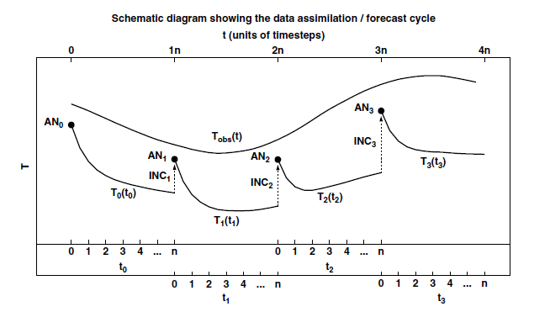
Equivalence between the mean analysis increments and the mean of physical tendencies
Source : (Rodwell et Palmer, 2007)

Slide 41
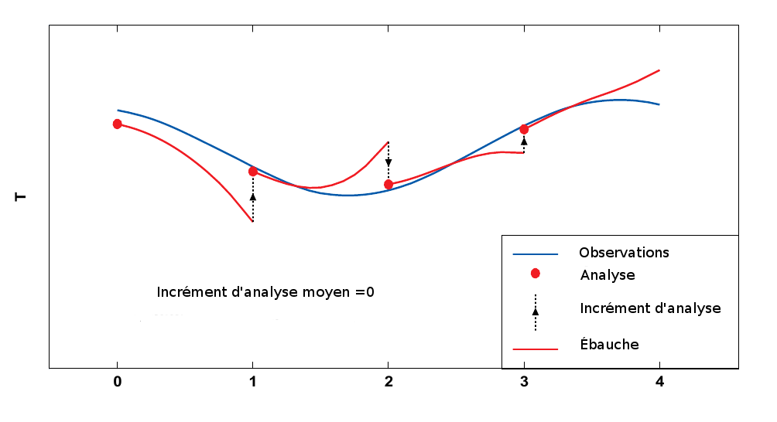
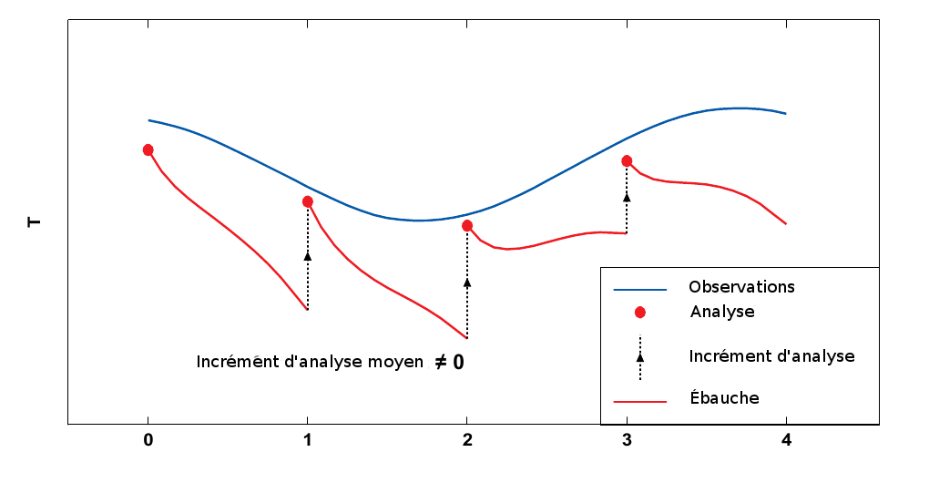
Initial systematic tendency
    Correspondence with the mean analysis increment (but o opposite sign) (Rodwell and Palmer, 2007)
    For an unbiased model, the mean analysis increment should go to zero
    Weak average total tendency Unbiased model
Unbiased model
Biased model

Slide 42
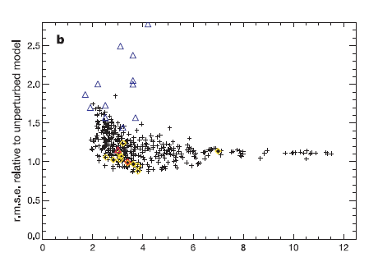
Assessing the uncertainty in climate simulations
(Source : Stainforth et al, 2005)
‘climateprediction.net’, (Stainforth et al, 2005)
45 years climate simulations with different model configurations
to assess the climate sensitivity to a 2xCO₂ scenario

Slide 43
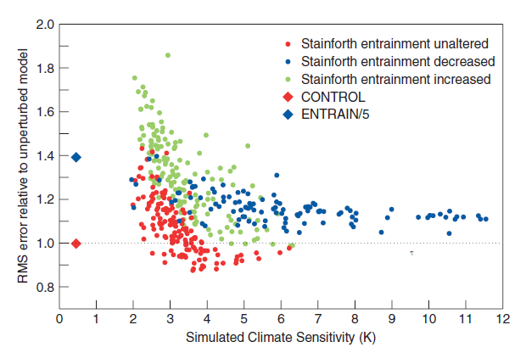
Uncertainty in climate scenarios
(from Rodwell and Palmer, 2007)

Slide 44
The model
GEM (Global Environmental Multiscale)
Global uniform configuration (800x600) ≈ 35 km
80 levels (top at 0.1 hPa)
Physical parameterization schemes
  Radiation : cccmarad
  Deep convection : Kain-Fritch
  Shallow Convection : Kuo Transient
  Surface : ISBA
  Large scale condensation : Sundqvist
  Vertical diffusion : Mailhot and Benoit
Simulations
  Sets of simulations (124) starting every six hours from 01January 2009 at 00Z until 31 January 2009 18Z
Use of an analysis type in each set
  3D-Var and 4D-Var analyses from MSC
  ERA-Interim (ECMWF) reanalysis
  Sets of monthly simulations

Slide 45
Initial tendency diagnostic
The diagnostic parameter applied to temperature is defined as
m total number of simulations
total temperature tendency (in black)
individual temperature tendencies associated with each
physical process considered in the model (radiation,
convection, advection, vertical diffusion and large scale
condensation)

Slide 46
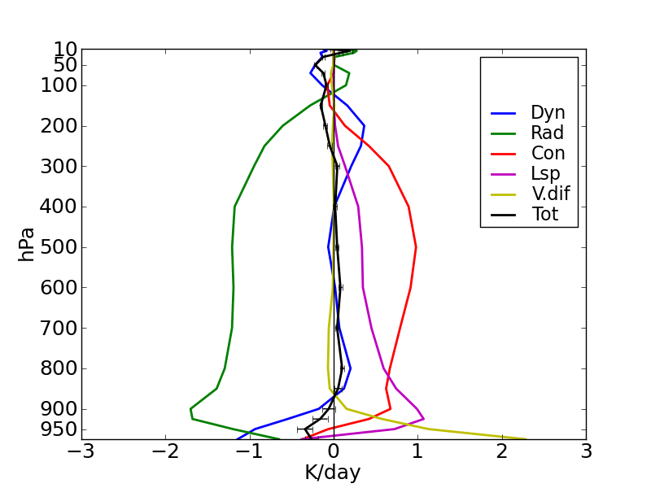
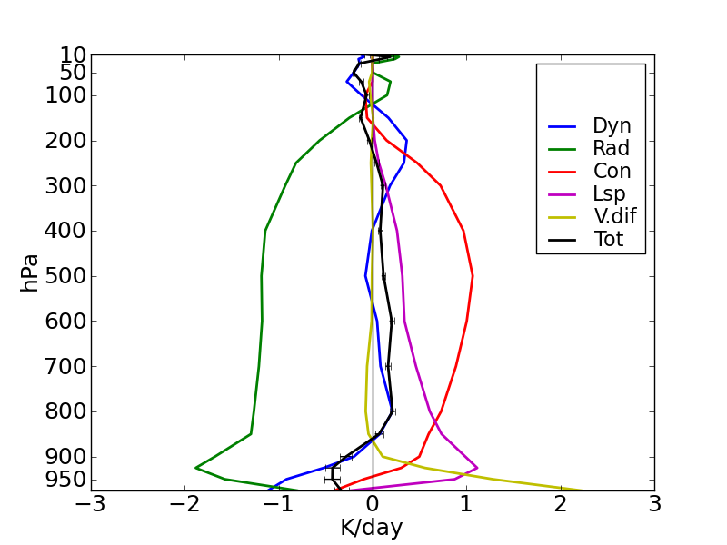
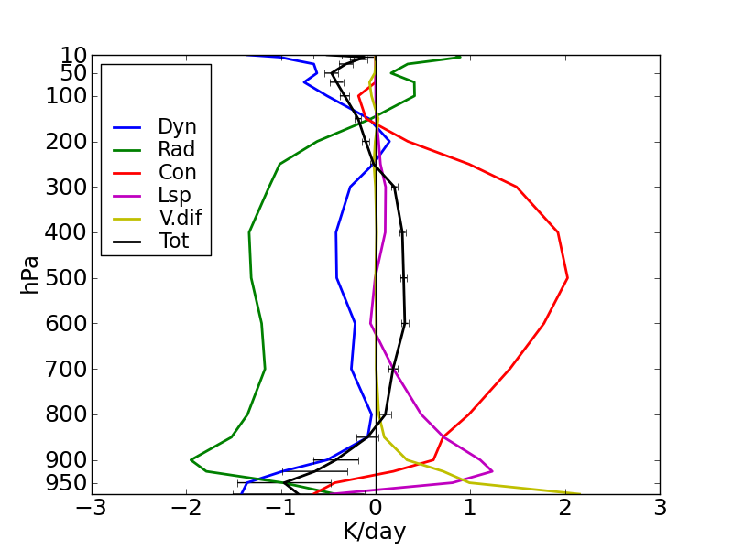
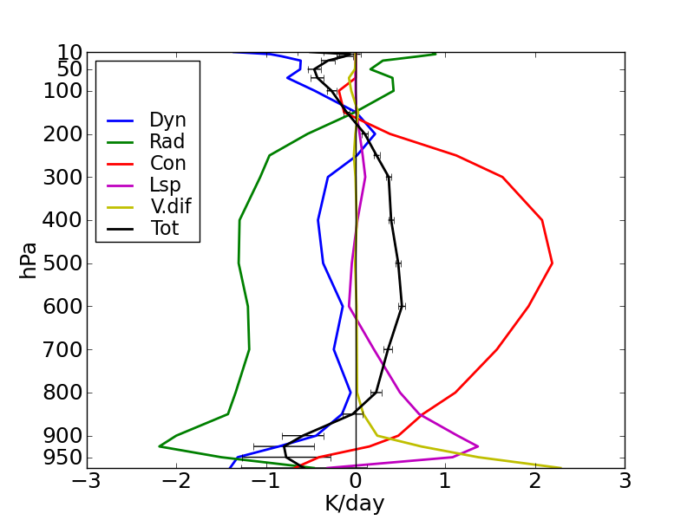
3D-Var vs 4D-Var
Mean 6 hours initial tendencies (1st time step excluded)
Global
Tropics

Slide 47
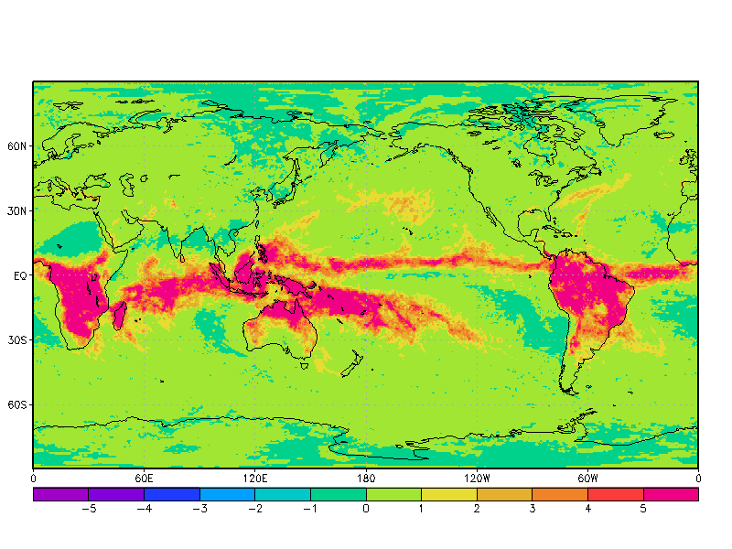
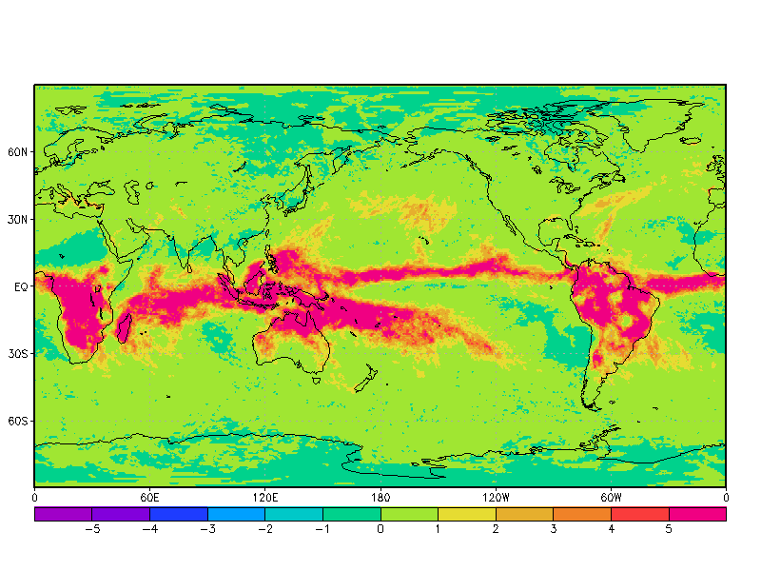
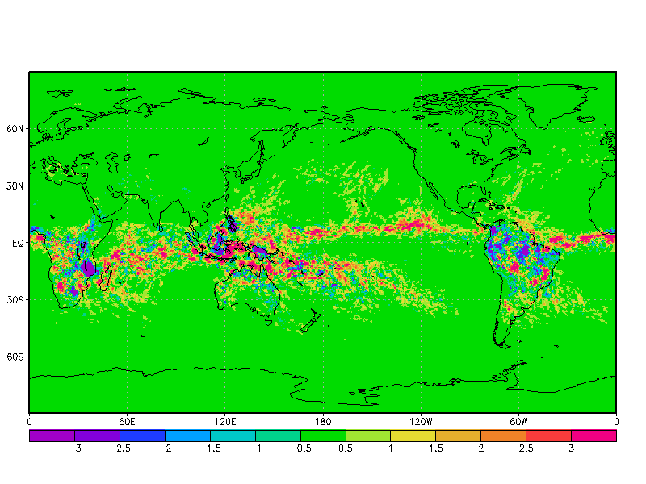
3D-Var vs 4D-Var
3D-Var
Tendency due to convection at level 500 hPa
4D-Var
Stronger convection in the ITCZ when
GEM is initialized by 4D-Var analyses
Adjustments in the convection scheme needed?
Difference: 4D-Var - 3D-Var

Slide 48
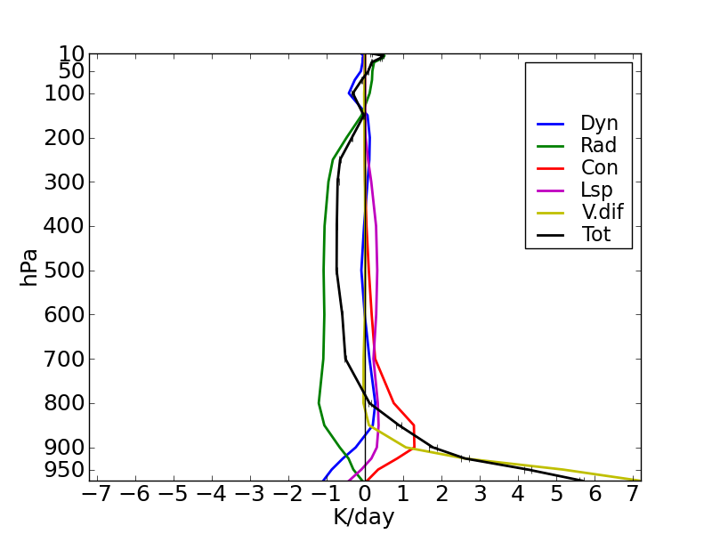
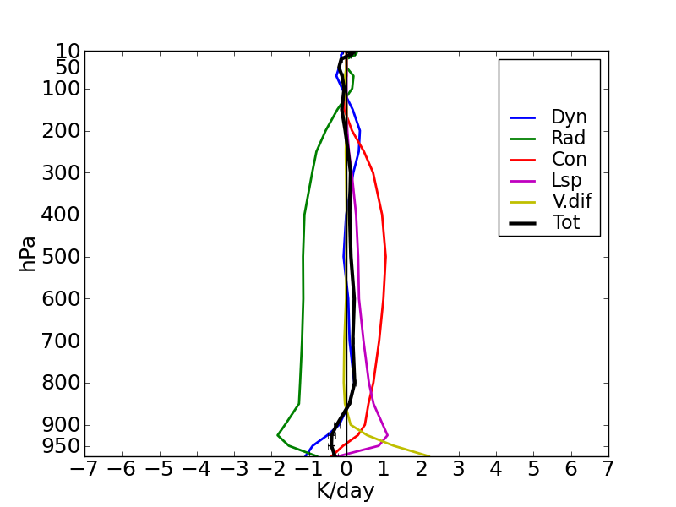
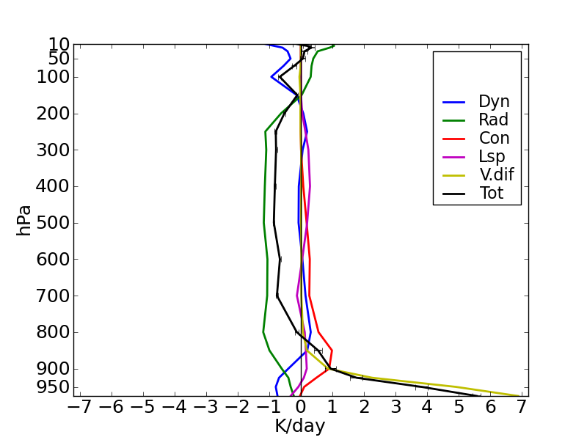
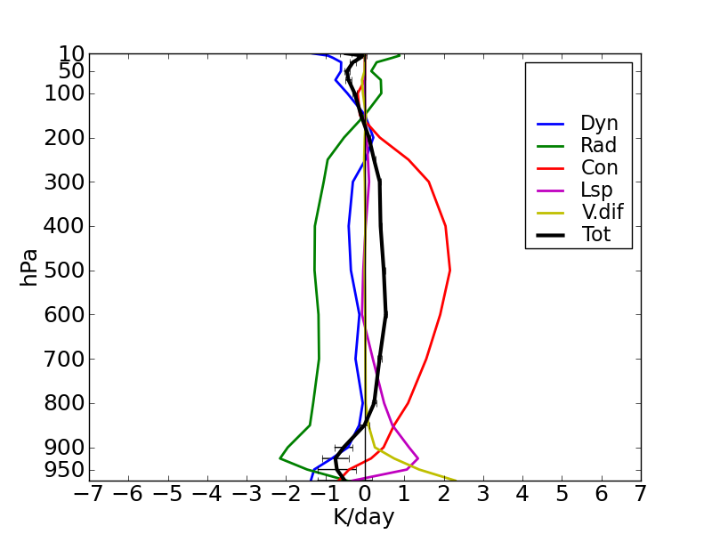
Era-Interim vs 4D-Var (MSC)
Mean 6 hours initial tendencies (1st time step excluded)
Global
Tropics

Slide 49
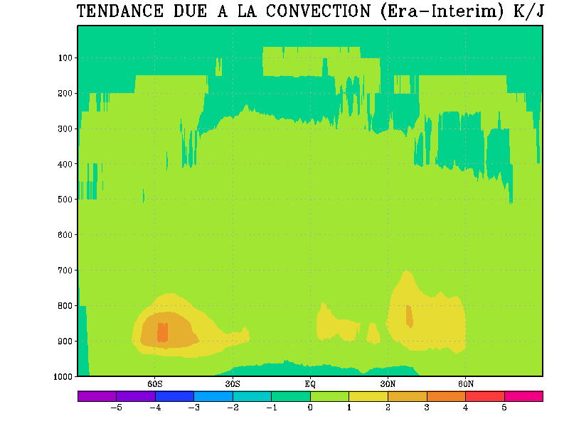
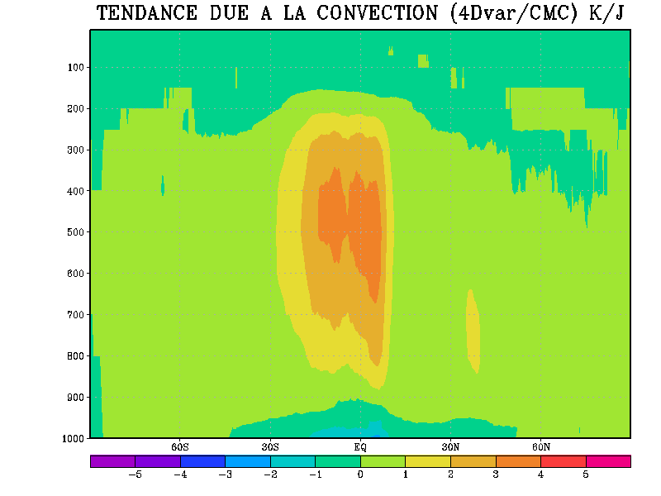
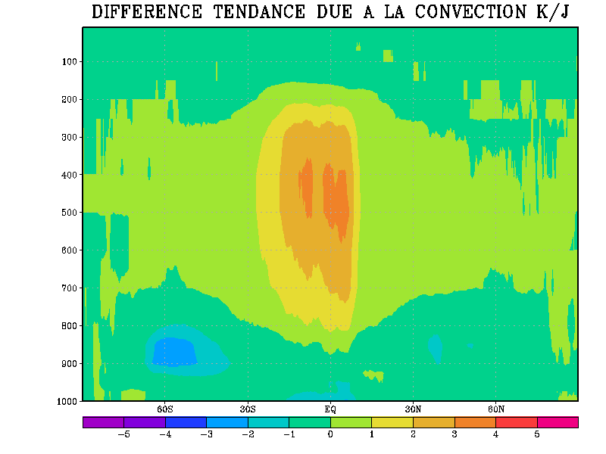
Era-Interim vs 4D-Var (MSC)
Zonal mean tendency due to convection
Era-Interim
4D-Var (MSC)
Missing convection
4D-var/MSC - Era-Interim

Slide 50
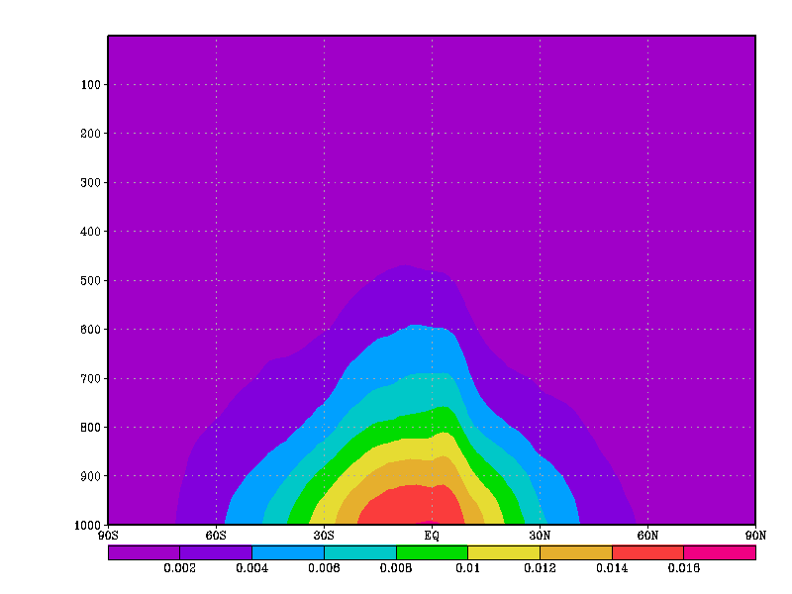
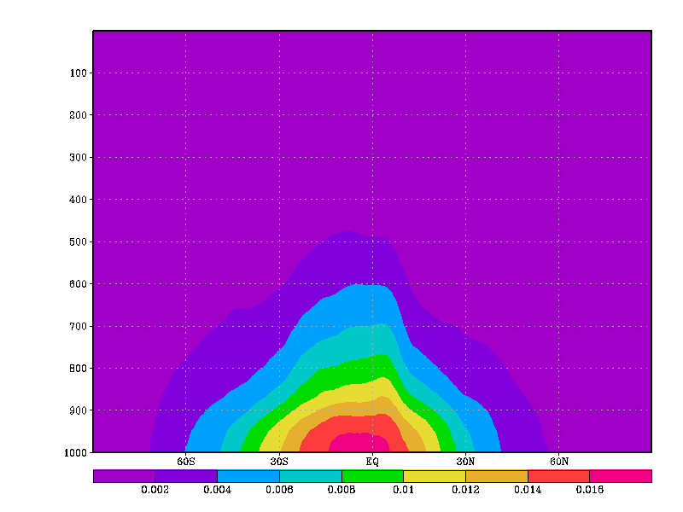
Monthly mean of specific humidity
ERA-Interim
4D-Var / MSC)
More humid
Less humidity in ERA-Interim could prevent convection triggering
in the first time steps of the Canadian model

Slide 51
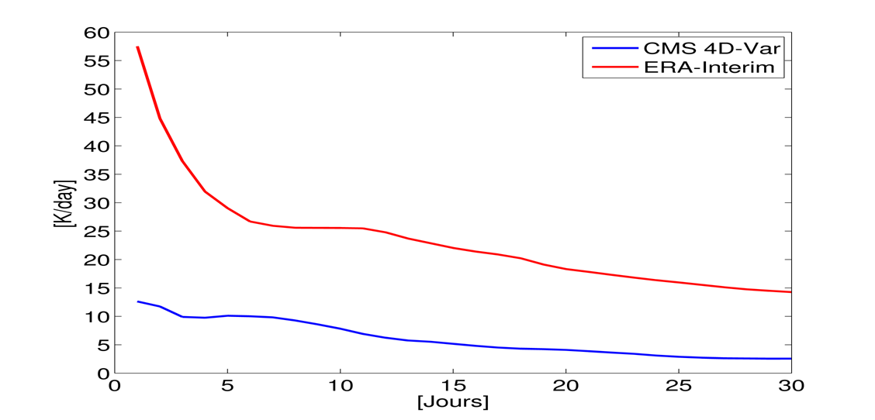
Time series of total physical tendency (Temperature)

Slide 52
Impact of spatial resolution
ERA reanalyses with higher vertical and horizontal resolution

Slide 53
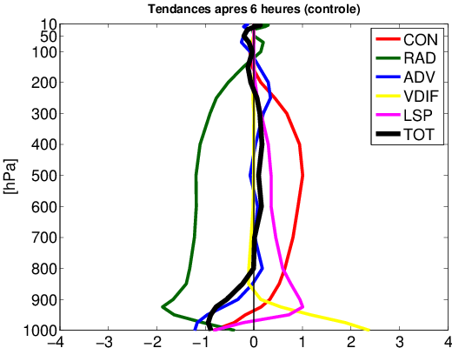
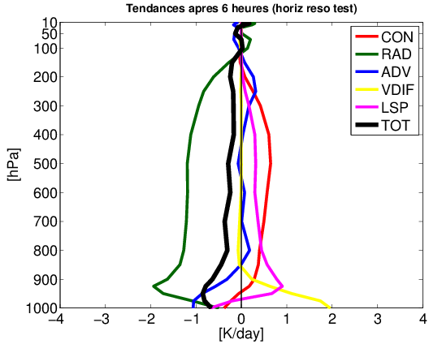
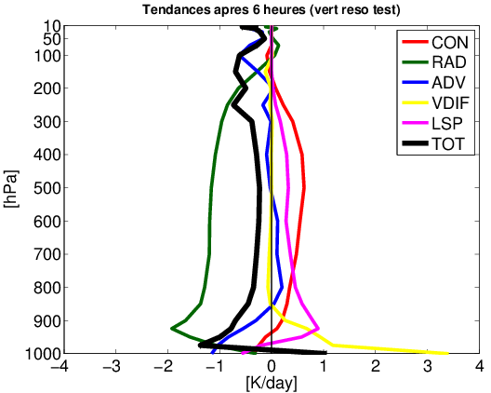
Control (High Res)
Lower Horizontal Res.
Lower
Vertical
Resolution

Slide 54
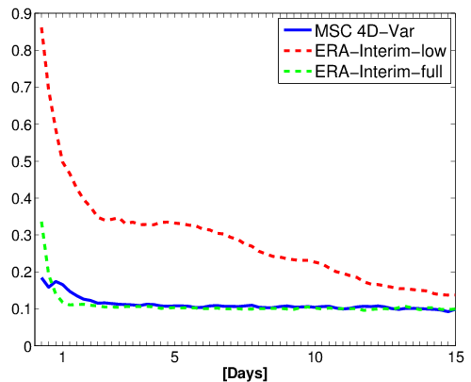
Time series of total physical tendency (Temperature)

Slide 55
Impact for regional climate models
Boundary conditions are imposed from either reanalyses or global climate simulations
Intercomparison experiments of regional climate models assess the impact of having different forcing data on regional climate simulations
Do differences between the driving model and the limited-area regional climate model impact the internal variability of the climate simulation?

Slide 56
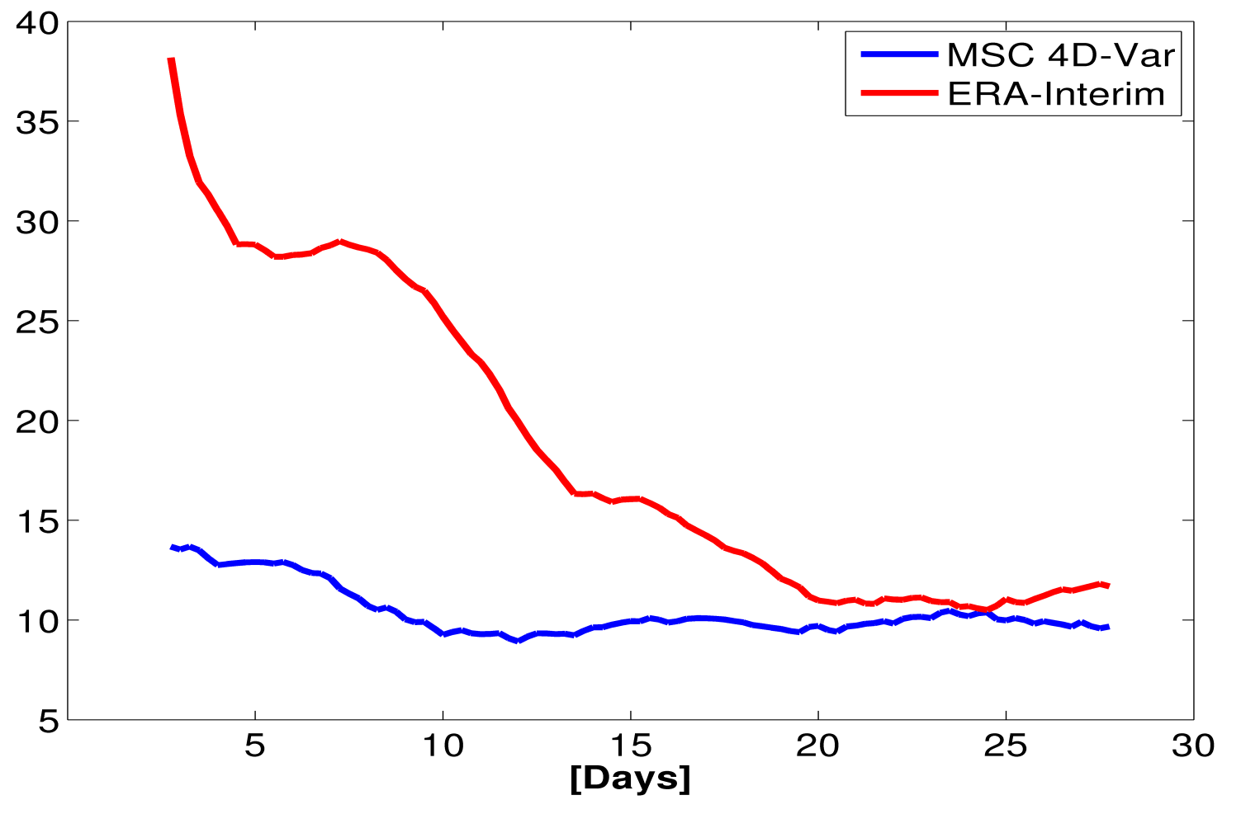
Tendency diagnostic applied to longer runs
Global GEM model
Vertically integrated absolute tendency

Slide 57
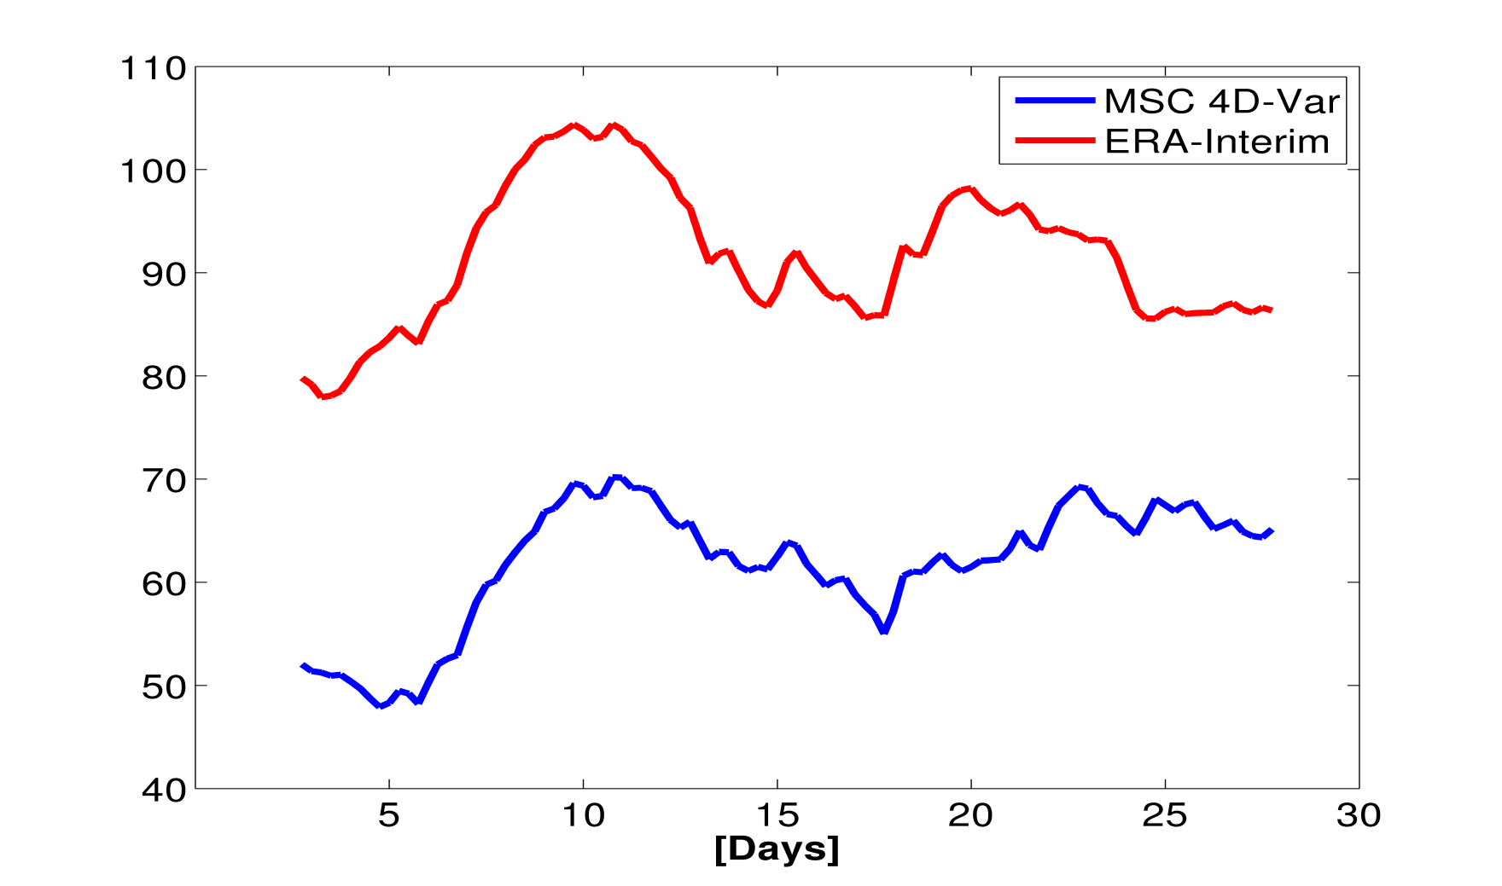
Tendency diagnostic applied to longer runs
CRCM (blending zone included)
Vertically integrated absolute tendency

Slide 58
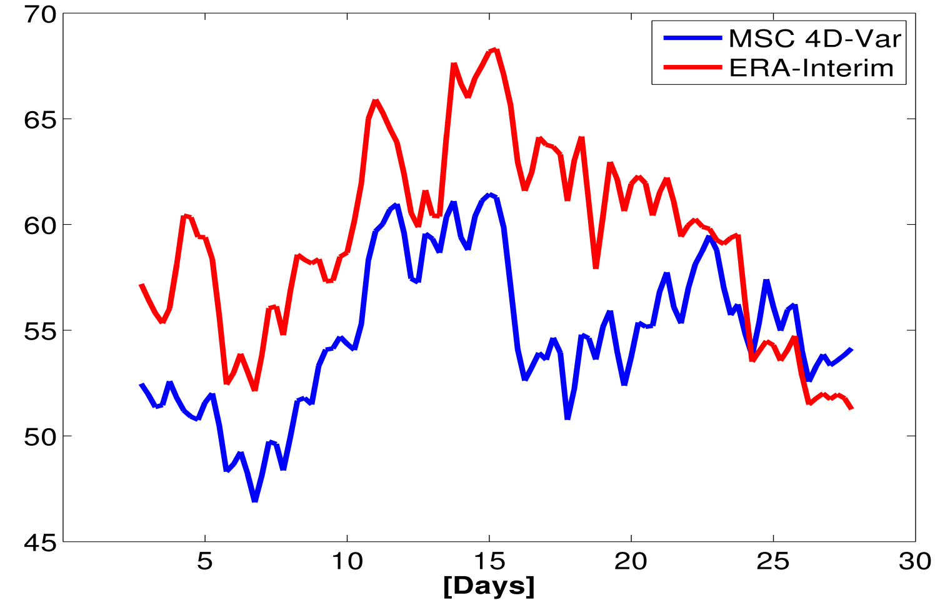
Tendency diagnostic applied to longer runs
Regional Climate Model (free zone)
Vertically integrated absolute tendency

Slide 59
Conclusions
Dynamical equilibrium of a model is sensitive to initial conditions and to boundary forcing.
Significant differences are observed when the global GEM model is initialized from 3D-Var or 4D-Var analyses. For the latter, convection in the ITCZ is stronger
Results show that an external analysis not produced by the model, such as those from ERA-Interim in our case, can induce serious initial imbalances reflecting differences with respect to the model used in the assimilation, particularly vertical resolution.
The analyses used to drive a regional climate model can impact the dynamical equilibrium and induce spurious internal variability
Results from 30-days integrations indicate that a model is converging more rapidly towards its own climatology when initialized and driven by “compatible” analyses .

Slide 60
Conclusion
Numerical simulations of the atmosphere are central to better understanding the complexities of the Earth system
  Climate simulations (global and regional)
  Weather predictions at increasingly higher resolution (simulation of the detailed structures of hurricanes)
  Comparison to observations require the best validated model available to produce analyses which is the best estimate of the atmosphere one can get
Climate and weather forecasting systems now need to take into account interactions with the oceans, the land, ice, snow, atmospheric chemistry
  Modeling the Earth system with data assimilation is certainly the challenge of this century to better understand our changing environment

Slide 61




Thank you
Research partly funded by

