Slide 1
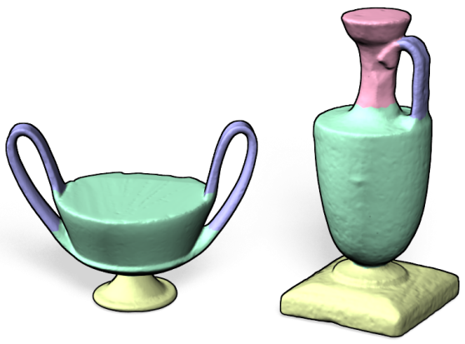
Knowledge-driven shape correspondence Descriptors for partial matching
Oliver van Kaick, Hao (Richard) Zhang, Ghassan Hamarneh,
Daniel Cohen-Or, Oana Sidi, Yanir Kleiman, Andrea Tagliasacchi
Simon Fraser University, Tel Aviv University
BIRS − August 31st, 2011

Slide 2
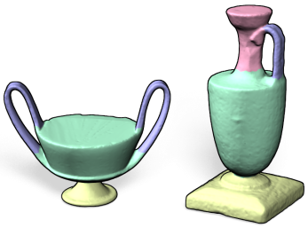
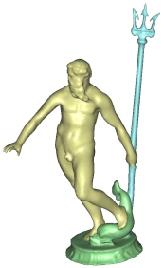
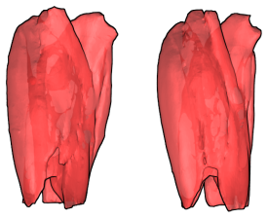
Outline
Introduction
First challenge: shape variability
Knowledge-driven approaches
Second challenge: partial matching
Descriptors for partial matching
Conclusions and future work

Slide 3
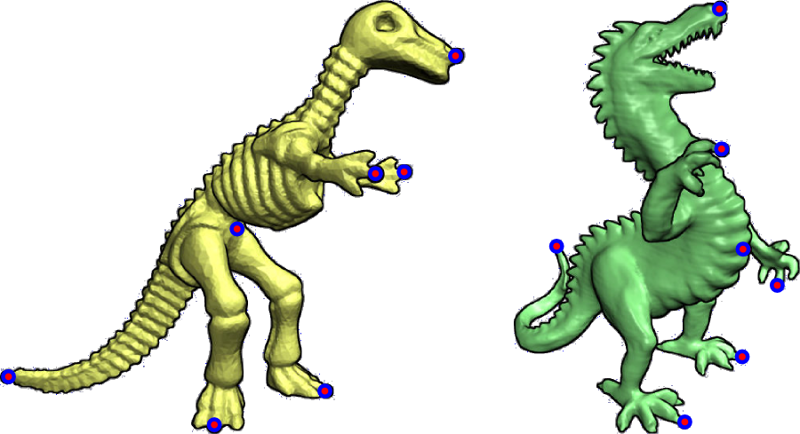
Shape Correspondence
Meaningful relation between shape elements

Slide 4
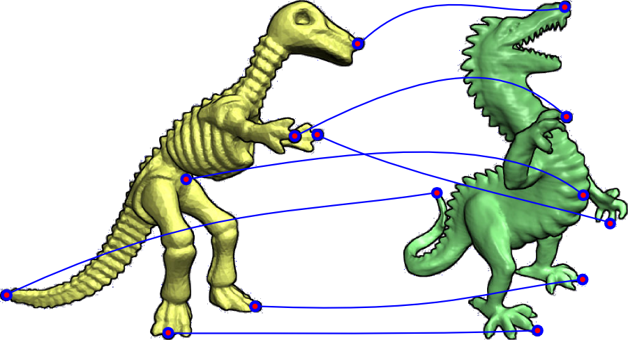
Shape Correspondence
Meaningful relation between shape elements

Slide 5
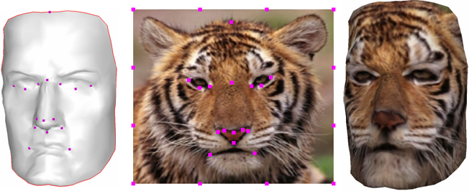
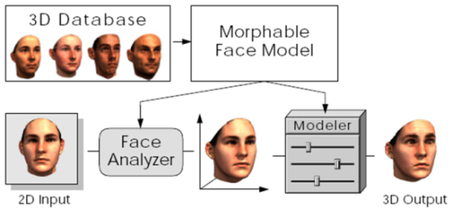
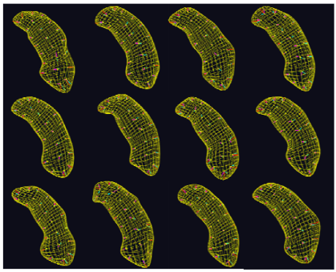
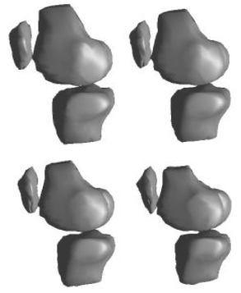
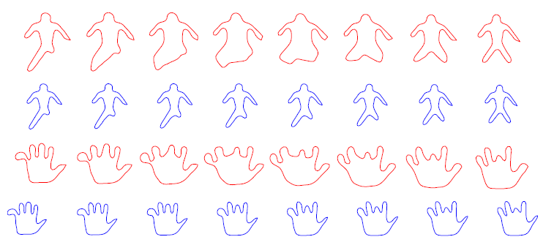
Applications
Texture mapping
Kraevoy et al. SIG 2003
Attribute transfer
Sumner et al. SIG 2004
Morphable faces
Blanz et al. SIG 1999
Statistical shape modeling
Pizer et al. 2011
Davies et al. 2010
Srivastava et al. 2009
Dryden and Mardia, 1998

Slide 6
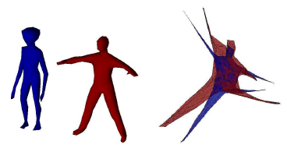
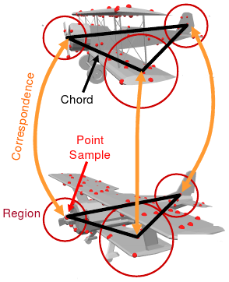
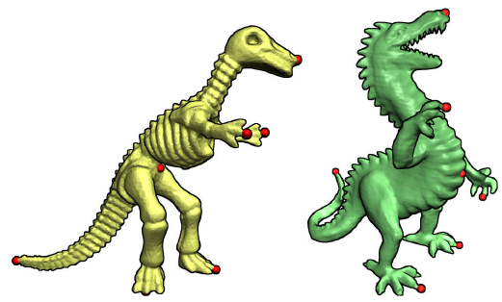
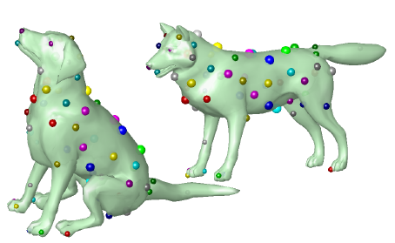
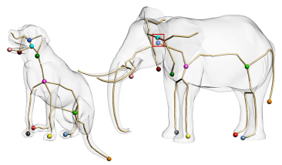
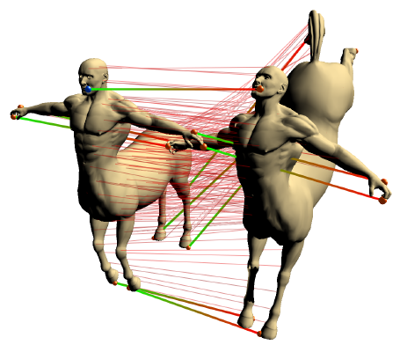
Previous work: content-driven
Spectral correspondence
Jain et al. IJSM 2007
Priority-driven search
Funkhouser et al. SGP 2006
Deformation-driven
Zhang et al. SGP 2008
Möbius voting
Lipman et al. SIG 2009
Electors voting
Au et al. EG 2010
Landmark sampling
Tevs et al. EG 2011

Slide 7
Previous work: content-driven
Feature matching
p₁
q₁
P
Q
p₂
q₂

Slide 8
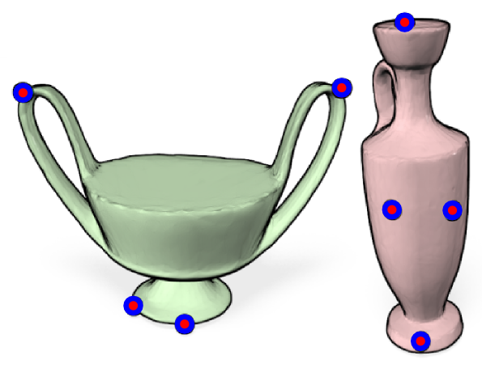
Content-driven methods

Slide 9
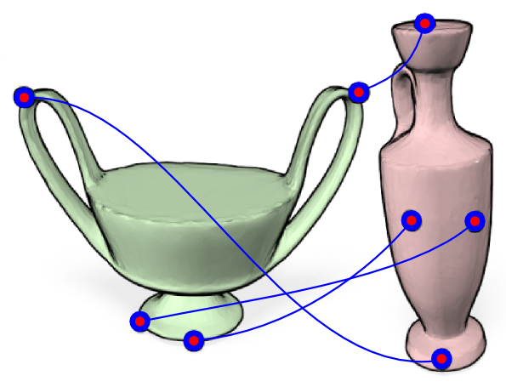
Content-driven methods

Slide 10
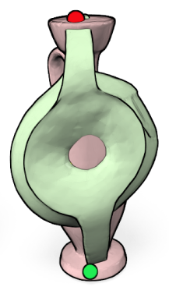
Content-driven methods

Slide 11
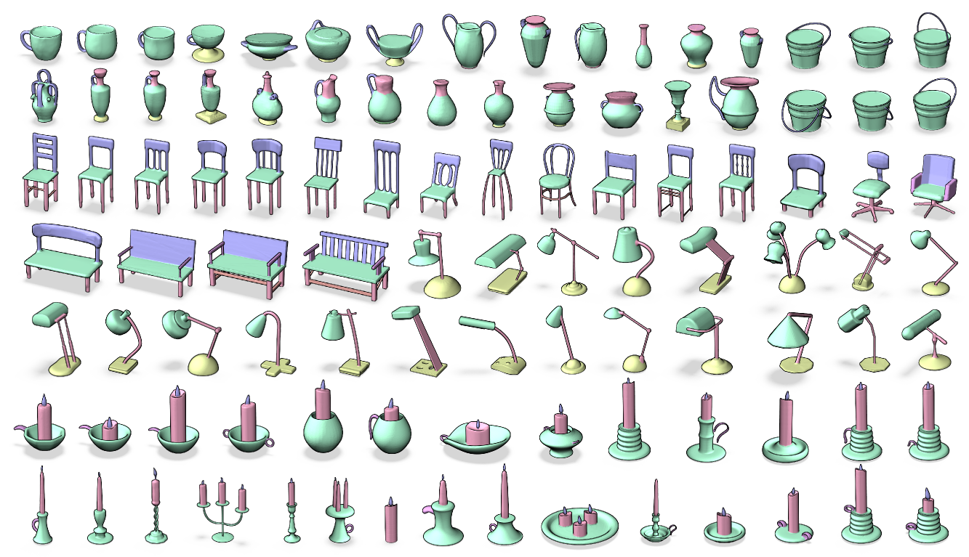
First challenge: shape variability

Slide 12
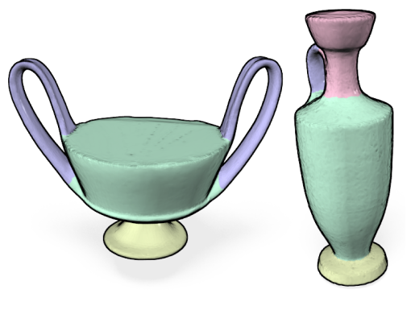
Incorporation of knowledge
Part correspondence or co-segmentation

Slide 13
Knowledge-driven methods
Propose to incorporate prior knowledge into the correspondence computation:
Supervised: using a set of examples (training data) [Eurographics 2011]
Unsupervised: by exploring the knowledge that exists in a set [SIGGRAPH Asia 2011]

Slide 14
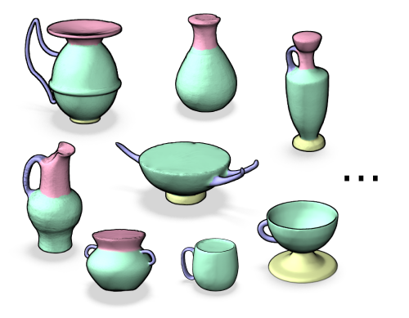
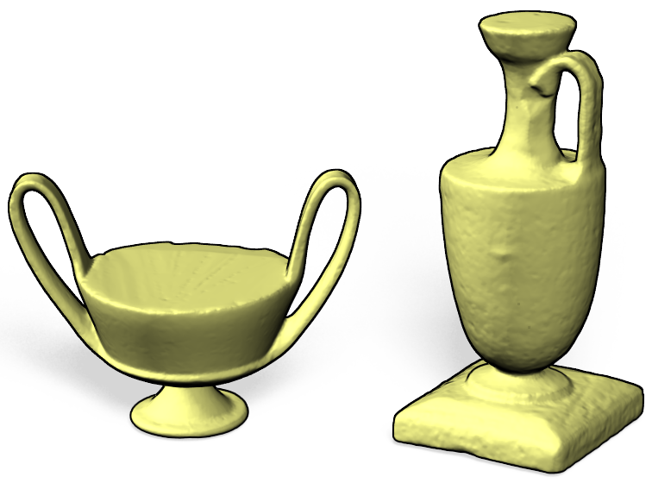
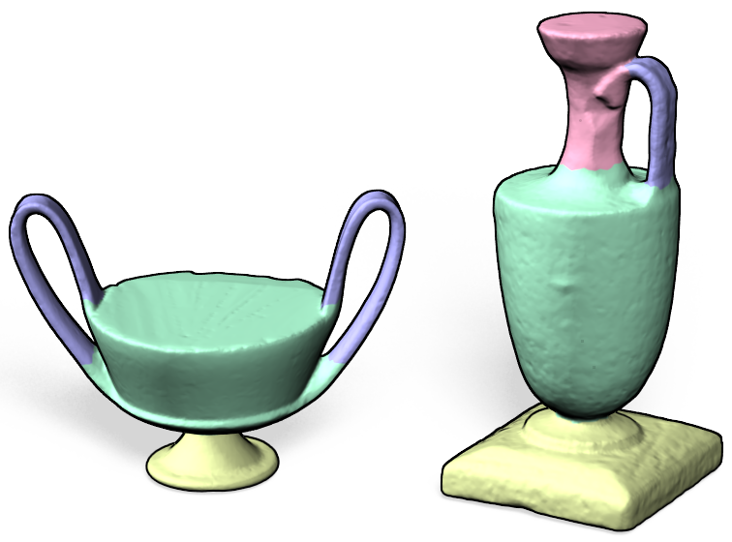
Supervised shape correspondence
Incorporate knowledge by means of a training set

Slide 15
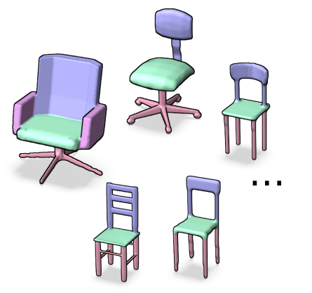
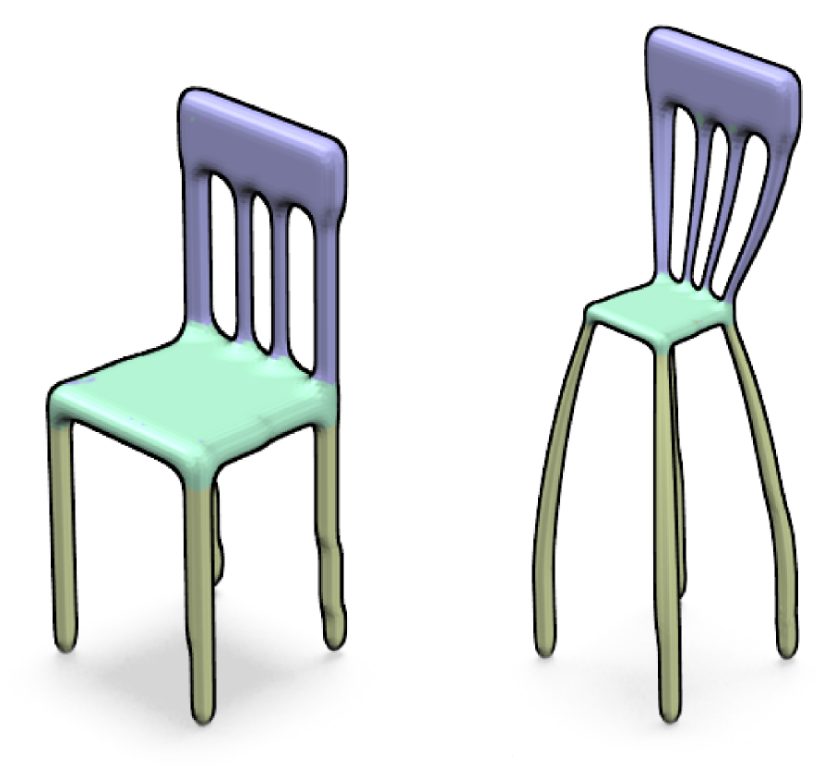
Supervised shape correspondence
?
Additionally, also incorporate content analysis

Slide 16
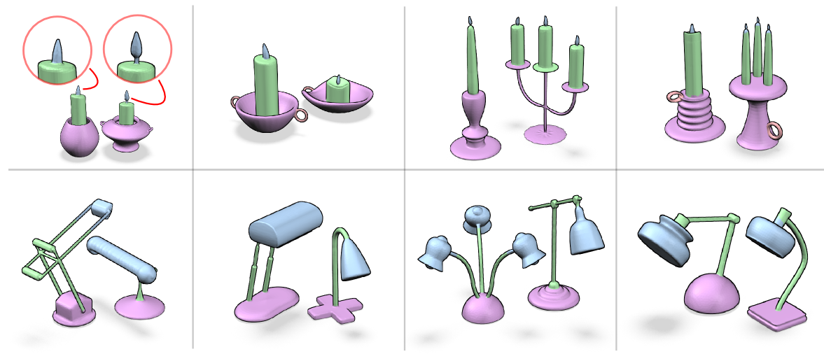
Supervised shape correspondence
Results

Slide 17
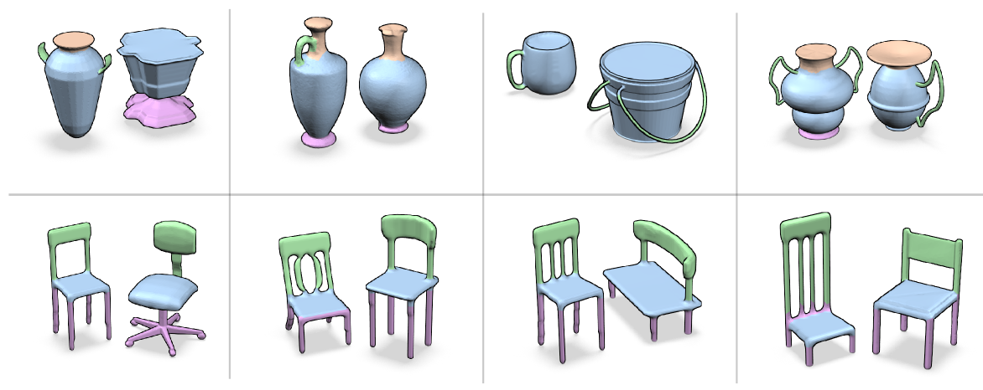
Supervised shape correspondence
Results

Slide 18
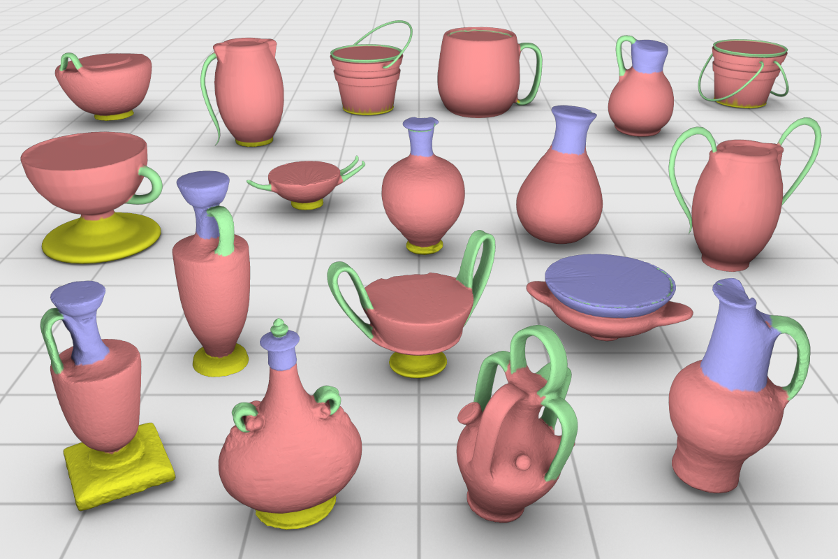
Unsupervised co-segmentation
Exploring the knowledge in the set

Slide 19
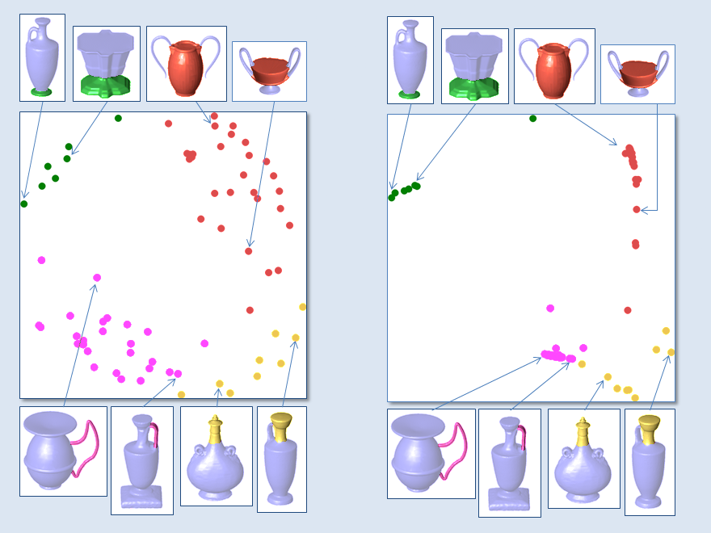
Unsupervised co-segmentation

Slide 20
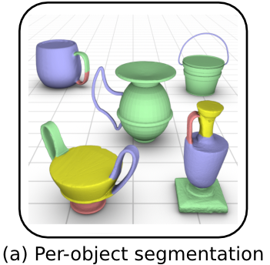
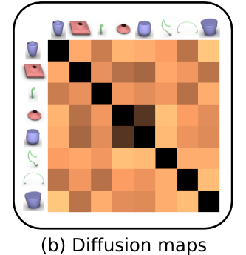
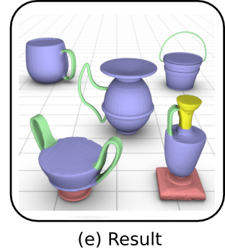
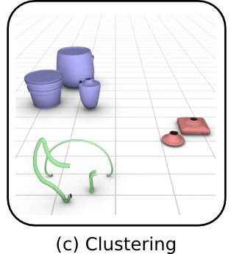
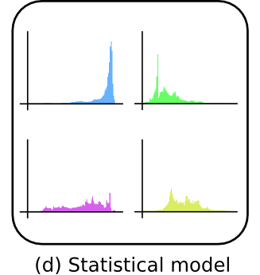
Unsupervised co-segmentation

Slide 21
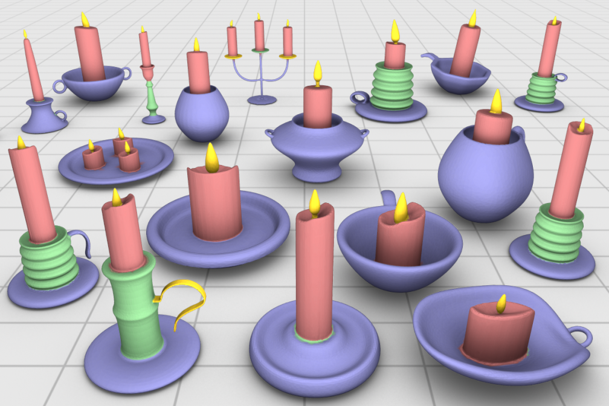
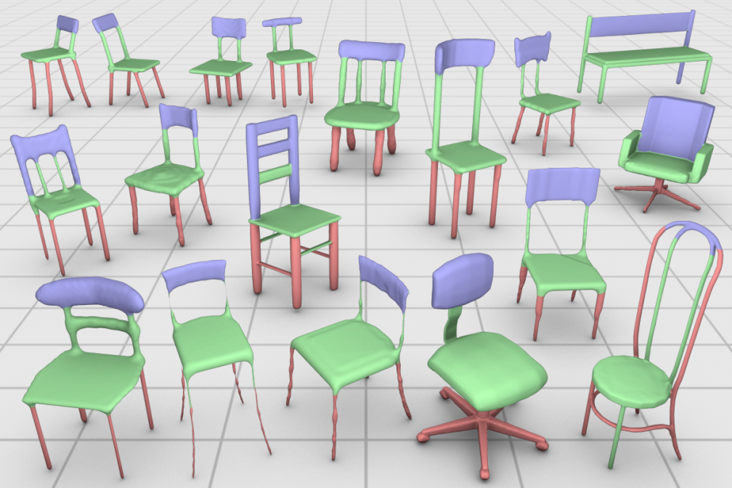
Unsupervised co-segmentation
Results

Slide 22
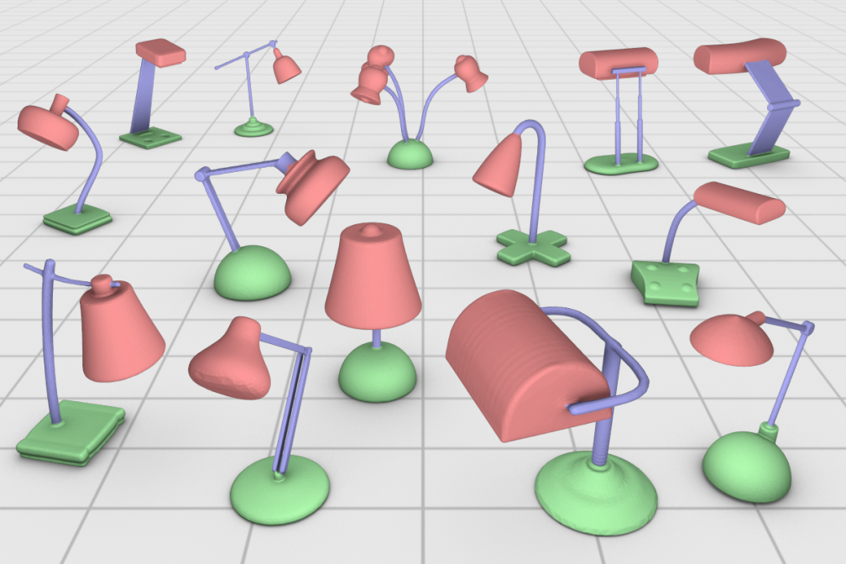
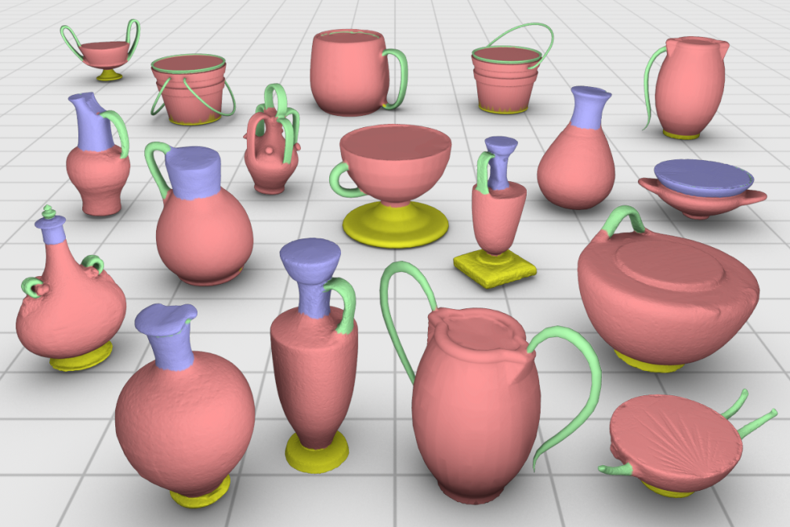
Unsupervised co-segmentation
Results

Slide 23
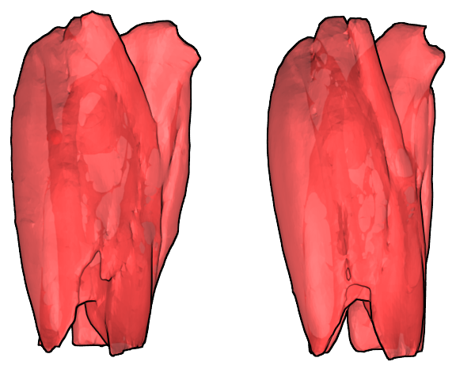
Unsupervised co-segmentation
Applicability to anatomical data?

Slide 24
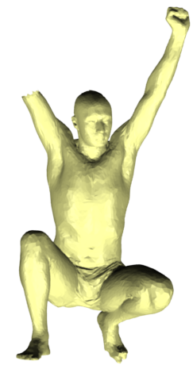
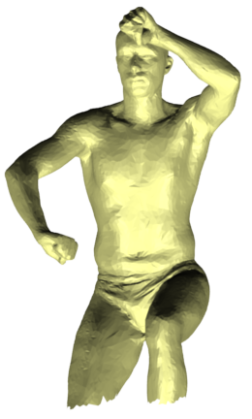
Second challenge: partial matching
Generally a harder problem than full correspondence

Slide 25
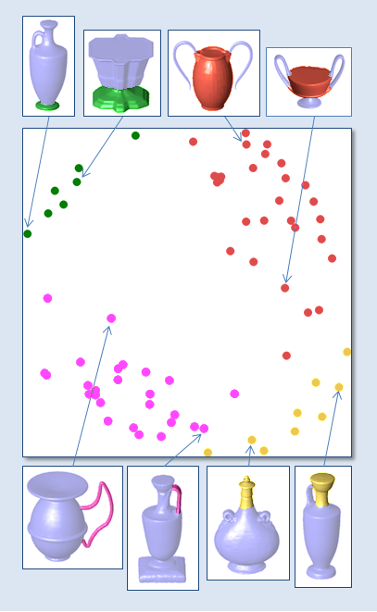
Descriptors for partial matching
Descriptors are important

Slide 26
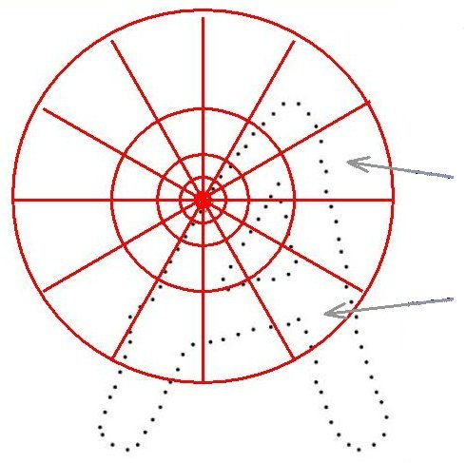
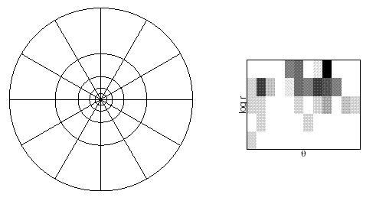
Descriptors for partial matching
Contextual shape descriptors, e.g., shape context

Slide 27
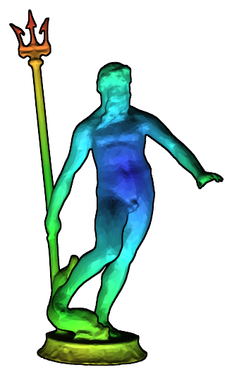
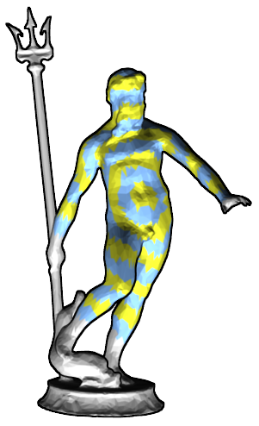
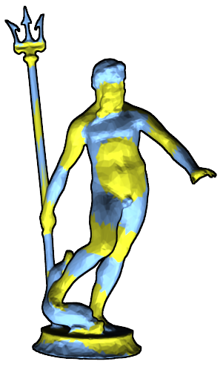
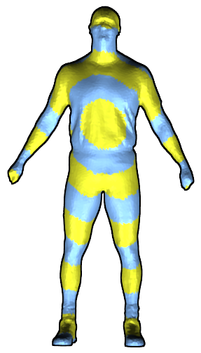
Descriptors for partial matching
Contextual shape descriptors on manifolds

Slide 28
Descriptors for partial matching
Selecting the region of interest is difficult

Slide 29
Descriptors for partial matching
Choose a pair of points

Slide 30
Descriptors for partial matching
Pairwise descriptors

Slide 31
Descriptors for partial matching

Slide 32
Descriptors for partial matching
Size of the region is given automatically
Context region is adaptive
Fit well into existing approaches
a
No pre-segmentation needed
p₁
q₁
P
Q
p₂
q₂

Slide 33
Preliminary results: correspondence

Slide 34
Partial matching in anatomical data
Original CT scan
Reconstructed complete 3D model
→
Pre-operative
→
Stereoscopic video
Surface reconstruction
Final registration
→
→
During surgery
Adapted from Su et al. 2009
Notes:
The one that comes directly to mind and it is indeed important and practical is the following. 1- before surgery (pre-operative) a) 3D image is collected, e.g. MRI b) shapes are extracted (image segmentation) to obtain say a mesh of the liver.... like this (from google images) 2- during surgery a) stereo endoscopy (two cameras inserted into the body) to collect left and right images (sometimes one camera that is moving is used), like the data here: http://www.doc.ic.ac.uk/~pmountne/vision/ b) from stereo (moving) camera 3d scene is reconstructed c) what is needed, is to register (align and correspond) the mesh from 1b to the scene in 2b. The problem is that 2b is missing data, has extraneous parts, etc... see this paper for example: Video to CT Registration for Image Overlay on Solid Organs Balazs Vagvolgyi et al note the snapshot below. The mesh on the topleft (blue) is fit (registered/aligned) to the surfaces extracted from the images....

Slide 35
Anatomical data: thigh muscles
Adapted from HajGhanbari et al. 2011

Slide 36
Preliminary results: anatomical data
Collecting curvature: 82% and 96% correct matches

Slide 37
Preliminary results: anatomical data
Two different muscles

Slide 38
Summary
Knowledge-driven approaches for shape correspondence: supervised and unsupervised
Shape descriptors designed for partial matching by using pairs of points

Slide 39
Future work
Quantitative testing of the descriptors for partial matching
Extension of the descriptors to other domains
How does the sampling of feature points affect the shape descriptors

Slide 40
Thank you!

Slide 41
Appendix

Slide 42
Limitations
Topological shortcuts

