Slide 1
An Efficient Multigrid Solver for (Evolving) Poisson Systems on Meshes
Misha Kazhdan
Johns Hopkins University

Slide 2
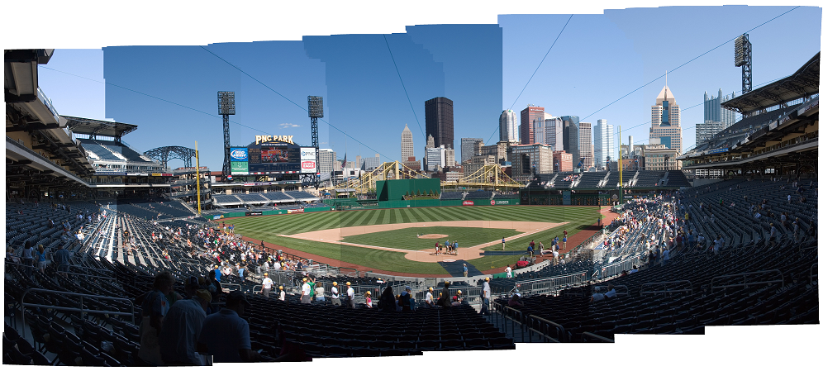
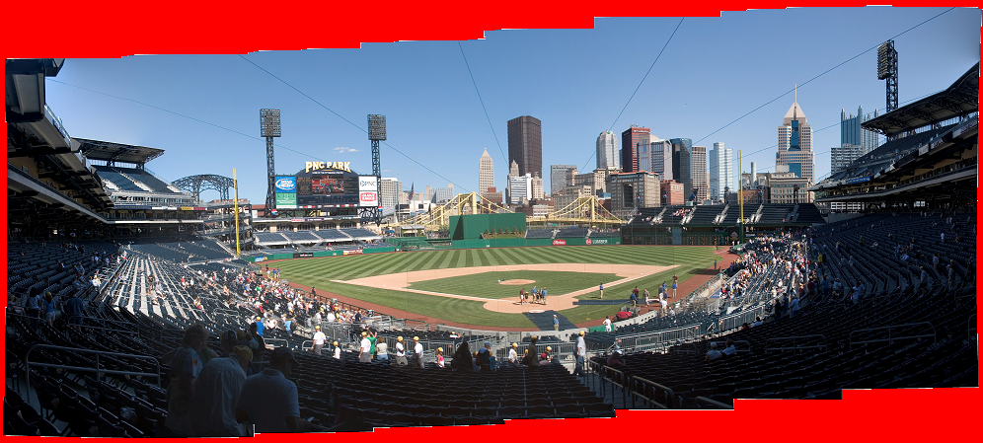
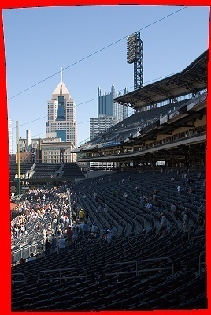
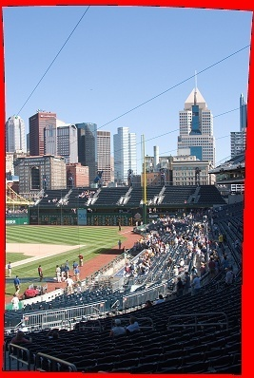
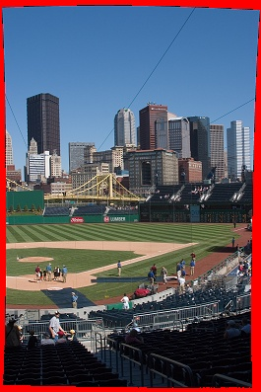
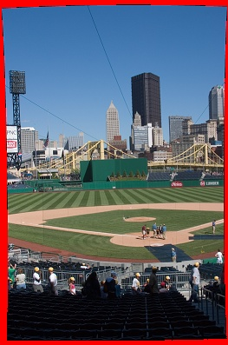
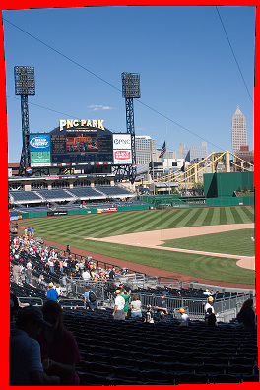
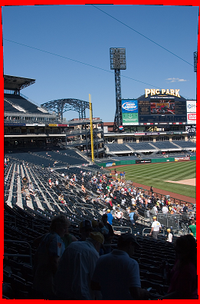
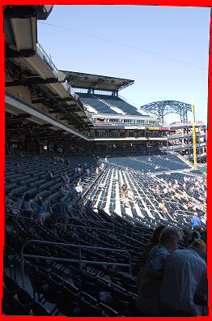
Motivation
Image Stitching
Compute image gradients
Set seam-crossing gradients to zero
Fit image to the new gradient field

Slide 3
Motivation
Gradient-Domain Image Processing
Solving for the scalar field u whose gradients best match the vector field $\vec{g}$ amounts to solving a Poisson system:
This approach is popular in image-processing because multigrid makes solving the system simple and fast.
Can the analog on meshes also be made easy to implement?

Slide 4
Outlook
Two related challenges:
How to define the Laplace-Beltrami operator.
How to implement a hierarchical solver.

Slide 5
Defining the System
Finite Elements (Galerkin)
Define a set of test functions {b₁,…,b_{n}} and discretize the problem:
if appropriate boundary conditions are met.
When n test functions are used, this results in an nxn system:
where L is the Laplacian matrix: and y is the constraint vector:

Slide 6
Solving the System
Multigrid Solvers
Relax the system at the finest resolution
Down-sample the residual
Solve at the coarser resolution
Up-sample the coarse correction
Relax the system at the finest resolution
Relax
Relax
Down- Sample
Up- Sample
Solve

Slide 7
Solving the System
Multigrid Solvers
Relax the system at the finest resolution
Down-sample the residual
Solve at the coarser resolution
Up-sample the coarse correction
Relax the system at the finest resolution
Relaxation: Gauss-Seidel
Solver: Recurse/direct-solve
Up/Down-Sampling: ???
Relax
Relax
Down- Sample
Up- Sample
Solve

Slide 8
Defining the System (Meshes)
Associate a function with each vertex and use the span to define a function space.
b_{i}(p)
When the b_{i}(p) are hat functions, we get the cotangent-weight Laplacian:
p_{i}
p_{i-1}
p_{i+1}
p_{i}
α
β
p_{k}
b_{i}(p)
p_{j}

Slide 9
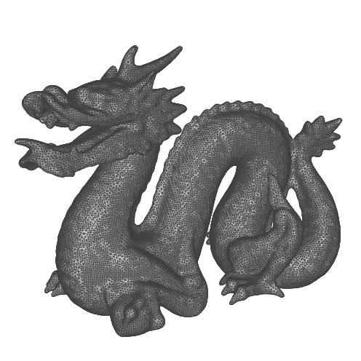
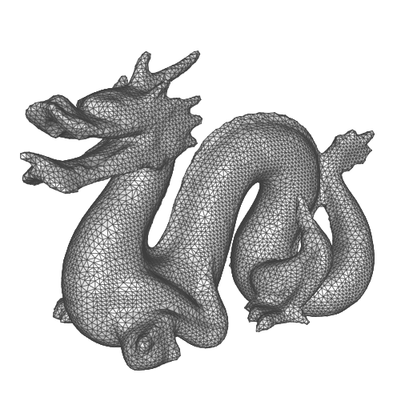
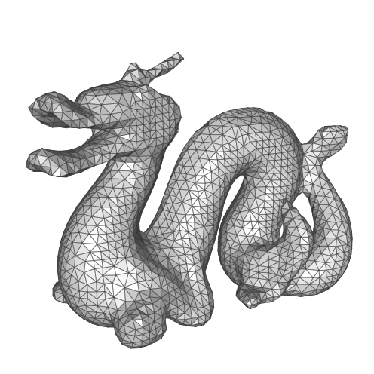
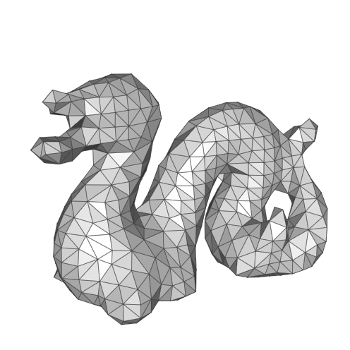
Up/Down-Sampling (Meshes)
Define a coarser surface/graph and a mapping from the coarser topology into the finer:
Geometric Multigrid
[Kobbelt et al., 1998] [Ray and Lévy, 2003] [Aksolyu et al., 2005] [Ni et al., 2004]
Algebraic Multigrid
[Ruge and Stueben, 1987] [Cleary et al., 2000] [Brezina et al., 2000] [Chartier et al. 2003] [Shi et al., 2006]

Slide 10
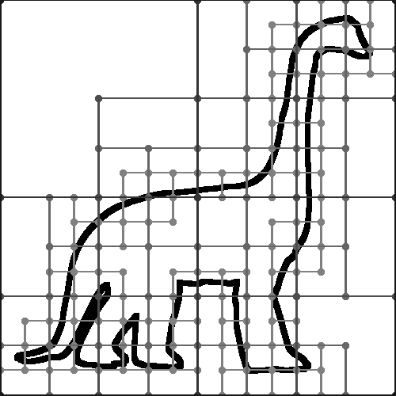
Approach
Impose regular structure by restricting functions defined on a regular grid.

Slide 11
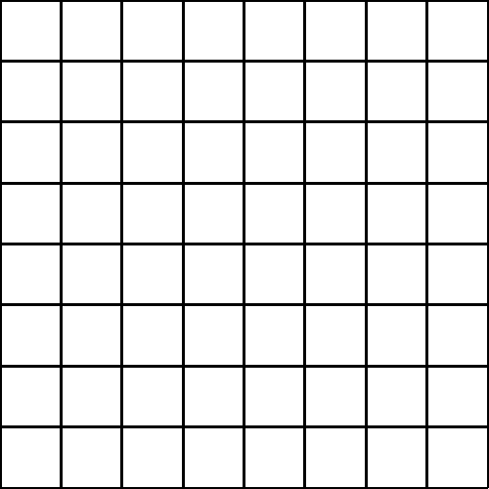
Defining the System (Regular Grids)
In one dimension, use translates of B-splines:
In higher dimensions, use translates of tensor-products:
…
…
b_{i-1}(x)
b_{i}(x)
b_{i+1}(x)
b(x)
-1
1
(i,j)
b_{i}(x)
b_{j}(y)

Slide 12
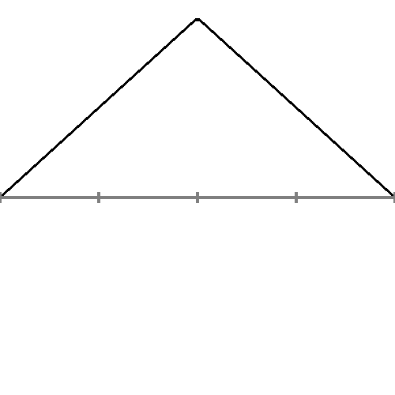
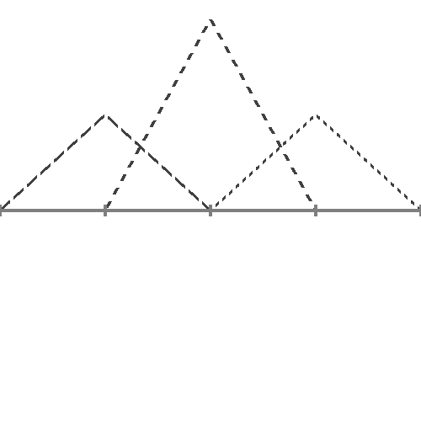
Up/Down-Sampling (Regular Grids)
Use the fact that the B-splines nest, so that coarser elements can be expressed as linear combinations of finer elements:
1
1/2
1/2

Slide 13
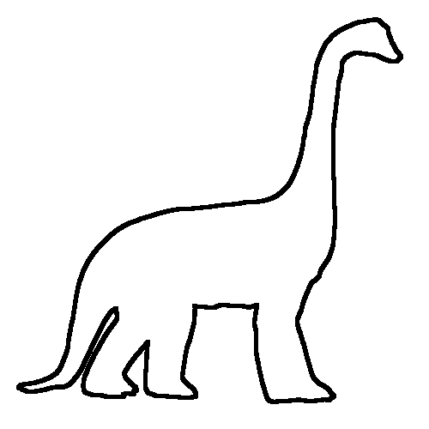
Grid-Based Finite Elements
Define a function space by considering the restriction of regular B-splines to the surface.

Slide 14
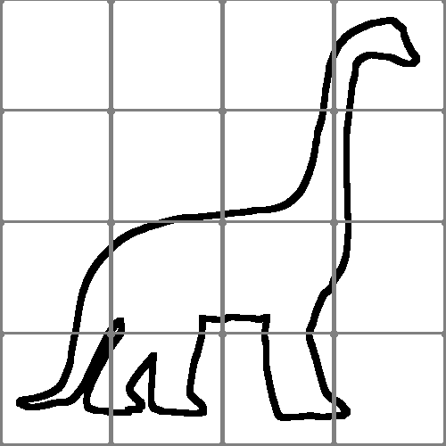
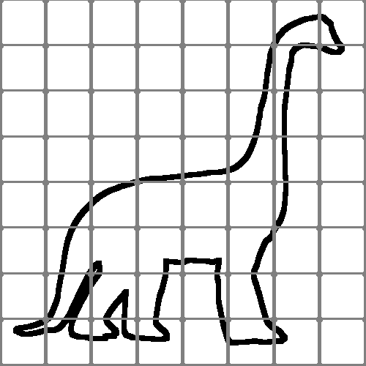
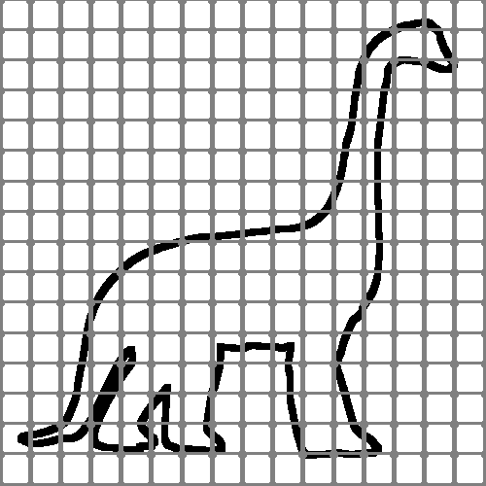
Grid-Based Finite Elements
Advantages:
Supports multigrid
Relax
Relax
Down- Sample
Up- Sample
Solve

Slide 15
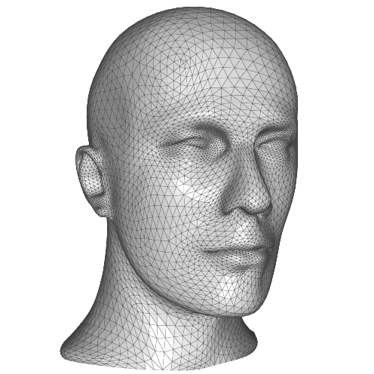
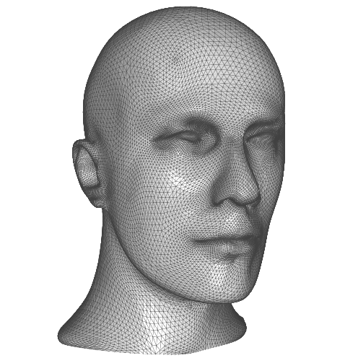
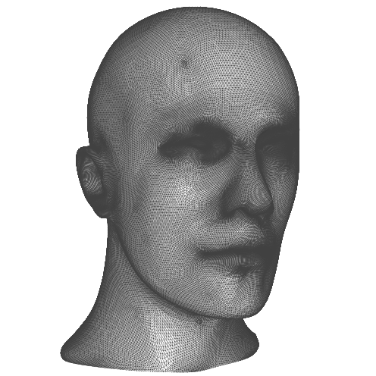
Grid-Based Finite Elements
Advantages:
Supports multigrid
Tessellation independent

Slide 16
Grid-Based Finite Elements
Advantages:
Supports multigrid
Tessellation independent
Controllable dimension

Slide 17
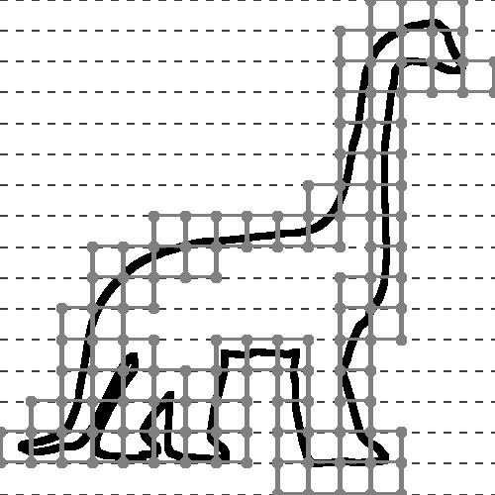
Grid-Based Finite Elements
Advantages:
Supports multigrid
Tessellation independent
Controllable dimension
Supports streaming/parallelization
Thread 1
Thread 2

Slide 18
System Coefficients
Defining the System
Given functions {b₁,…,b_{n}} defined on a regular grid, we define the coefficients of the Laplace-Beltrami operator as integrals of gradients:

Slide 19
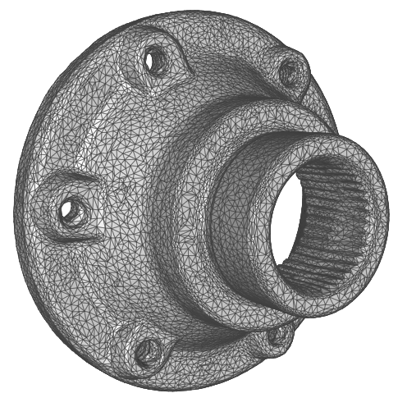
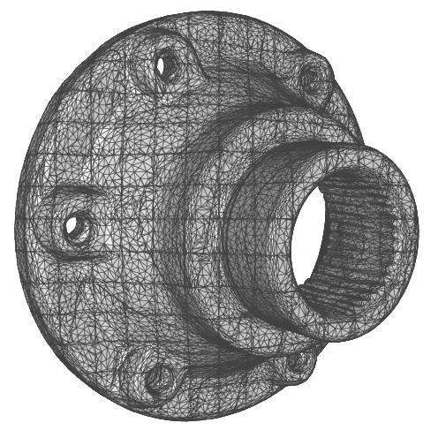
System Coefficients
Defining the System
Given functions {b₁,…,b_{n}} defined on a regular grid, we define the coefficients of the Laplace-Beltrami operator as integrals of gradients: Split triangles to grid cells and use quadrature rules to integrate.

Slide 20
Outline
Introduction
Approach
Applications
Texture processing
Geometry processing
Surface Evolution
Limitations
Future Work

Slide 21
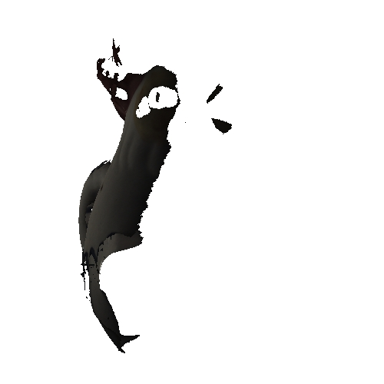
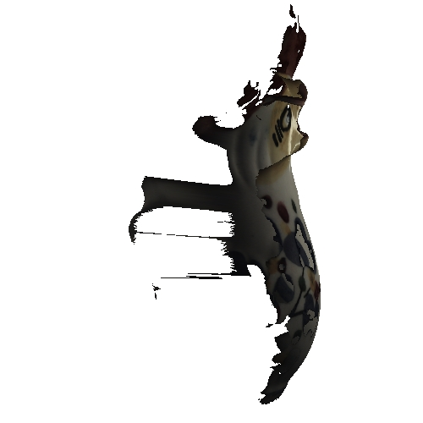
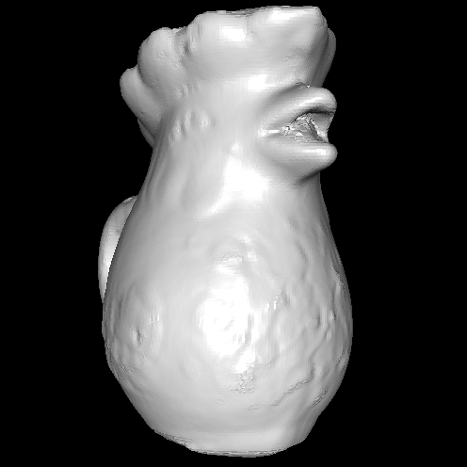
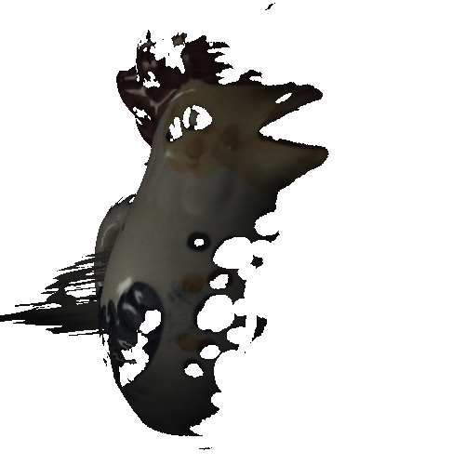
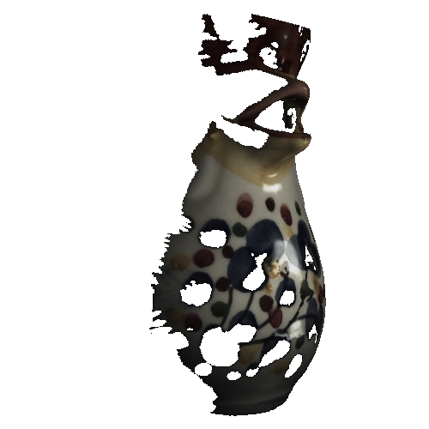
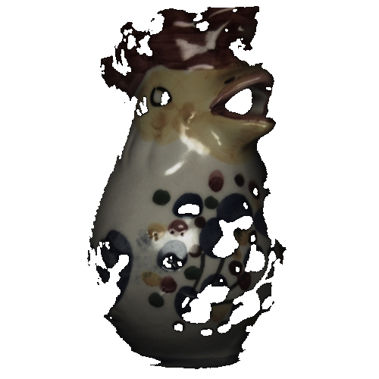
Texture Processing (1)
Goal
Given a base mesh and a set of scans, generate a seamless texture on the mesh.
S₅
M
S₁
S₄
S₃
S₂

Slide 22
Texture Processing (1)
Goal
Given a base mesh and a set of scans, generate a seamless texture on the mesh.
Back-project surface points onto the scans and use data from the closest, consistent scan.
S₅
M
S₁
S₄
S₃
S₂

Slide 23
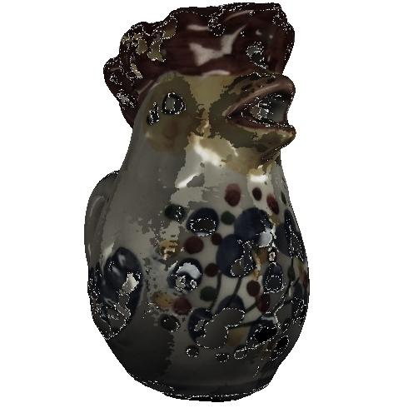
Texture Processing (1)
Challenge
Pulling colors from the nearest scan results in a discontinuous texture.
S₅
M
S₁
S₄
S₃
S₂

Slide 24
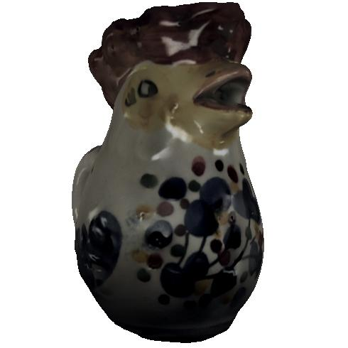
Texture Processing (1)
Solution
Pulling gradients and integrating gives seamless textures (which are smooth in undefined areas).
S₅
M
S₁
S₄
S₃
S₂

Slide 25
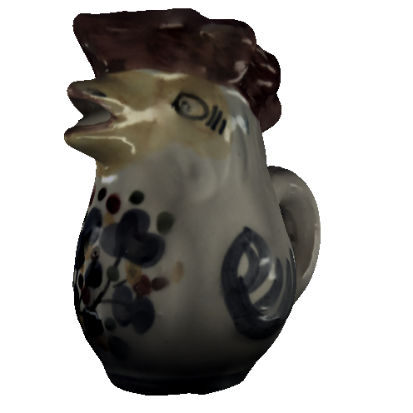
Texture Processing (2)
Goal
Sharpen the detail in a texture.

Slide 26
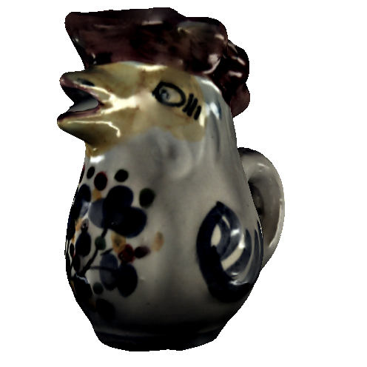
Texture Processing (2)
Solution
Formulate as gradient amplification and solve the associated Poisson equation:

Slide 27
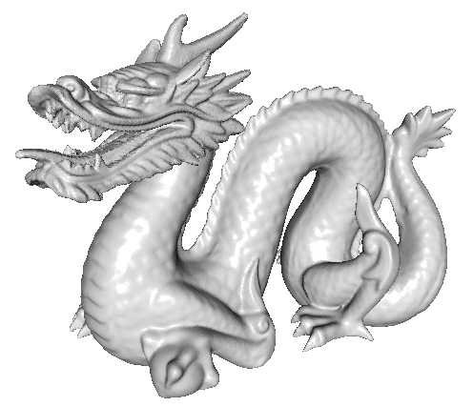
Geometry Processing
Goal
Sharpen the detail in the geometry itself.

Slide 28
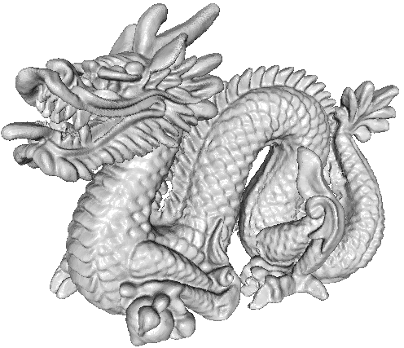
Geometry Processing
Solution
Like texture sharpening, but use the embedding as the signal:
Demo

Slide 29
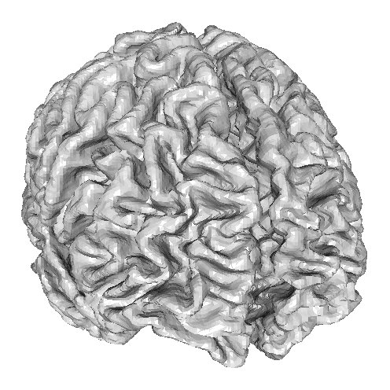
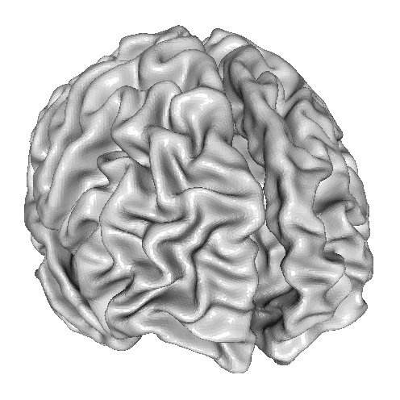
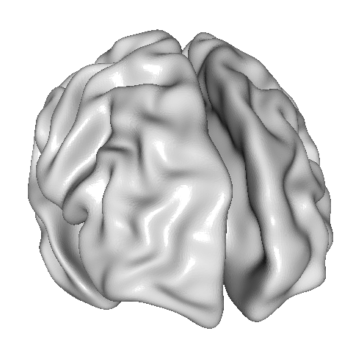
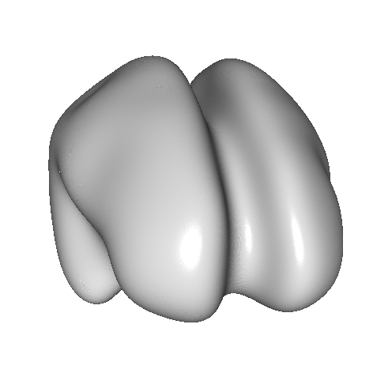
Surface Evolution
Goal
Evolve a surface using Laplacian flow:

Slide 30
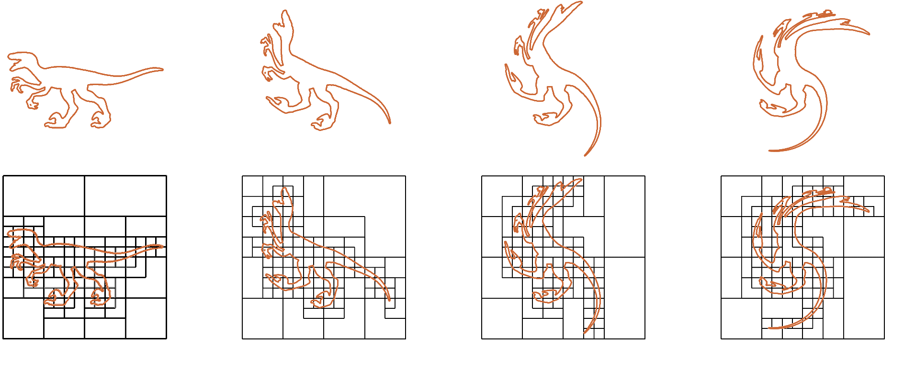
Surface Evolution
Challenge
As the surface evolves, the Laplacian changes.
Computing the new finite-elements is too expensive.

Slide 31
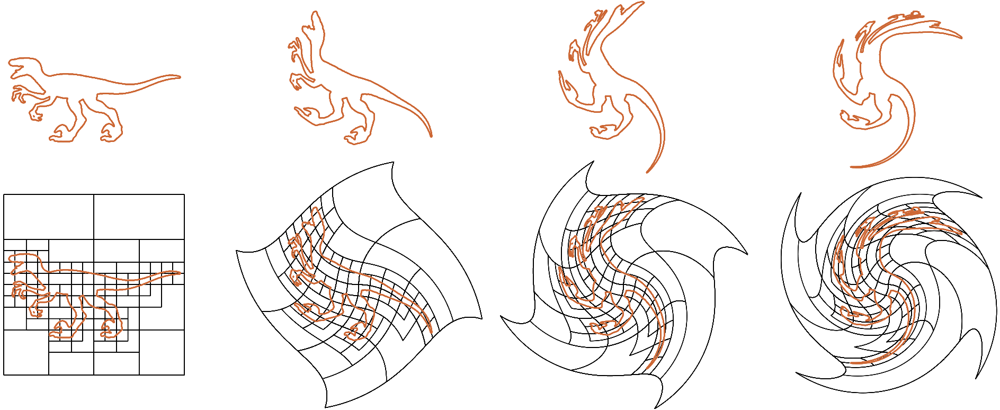
Surface Evolution
Approach
Evolve the finite-elements with the surface.

Slide 32
Surface Evolution
Approach
Evolve the finite-elements with the surface.
Update the quadrature information by using the differential of the embedding:
Demo

Slide 33
Outline
Introduction
Approach
Applications
Limitations
Conclusion

Slide 34
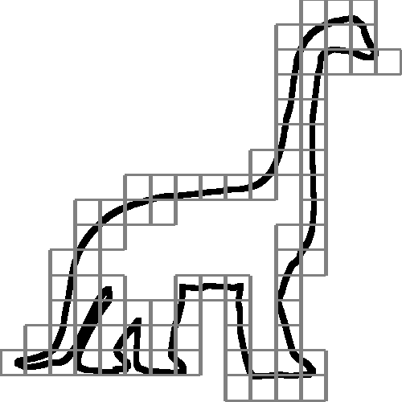
Limitations
Euclidean vs. Geodesic proximity
Poor Conditioning

Slide 35
Limitations
Euclidean vs. Geodesic proximity
Poor Conditioning

Slide 36
Conclusion
Defined an FEM system over a regular grid:
Multigrid solver
Tessellation independent
Low-res w/o mesh simplification
Streaming/parallel implementation

Slide 37
Conclusion
Defined an FEM system over a regular grid:
Multigrid solver
Tessellation independent
Low-res w/o mesh simplification
Streaming/parallel implementation
Applications:
Signal/Geometry Processing
Surface evolution

Slide 38
Thank You!

