Slide 1
Vortex Dynamics: the Crossroads of Mathematics, Physics and Applications
December 3-8, 2023. Hangzhou, China
Vortex interactions shape the evolution of force, acoustics and magnetic field
Linlin Kang
Research Assistant Professor, College of Engineering
Westlake University

Slide 2
Splitting and coupling in vortex dynamics
Magnetic-vortical interactions on magnetic splitting

Slide 3
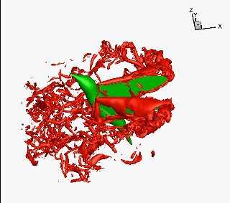
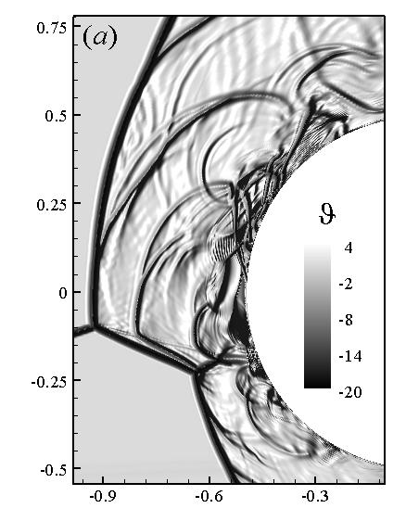
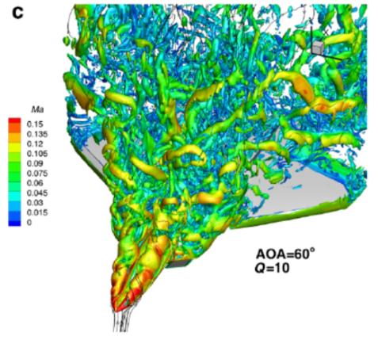
Background: splitting and coupling of fundamental dynamic process
The research objects of modern vortex dynamics focus on nonlinear viscous flow
Aerodynamic diagnosis of complex turbulent flows
Unsteady fluid-structure interaction
Coupling mechanism of shearing, compression and thermodynamics
……
Flow around aircraft
Bird flying
Fish swimming
Hypersonic flow
3

Slide 4
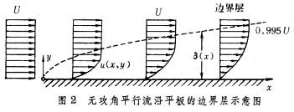
Background: splitting and coupling of fundamental dynamic process
Decomposition is a common approach to study complex flow problems
Spatial domain decomposition, Prandtl’s boundary layer theory
Decomposition of physical quantity, Helmholtz decomposition
$$u=∇φ+∇×ψ, ∇⋅ψ=0$$
$$θ=∇⋅u=∇^{2}φ, ω=∇×u=−∇^{2}ψ$$
Longitudinal and transversal decomposition of fundamental dynamic process
Lagerstrom et al.(1948), Kovasznay(1953), Wu(1956), Chu & Kovasznay(1958)，Mao et al.(2010,2011)
Longitudinal process (sound mode + entropy mode) + transversal process (vortex mode)
4

Slide 5
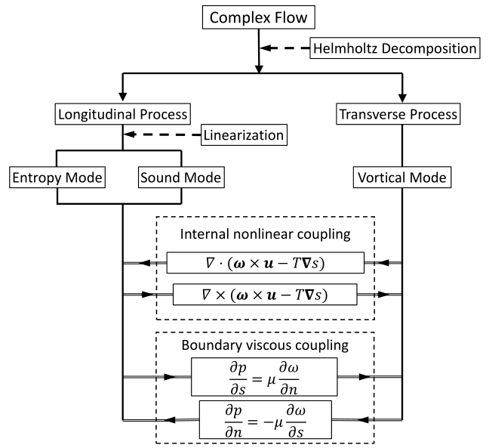
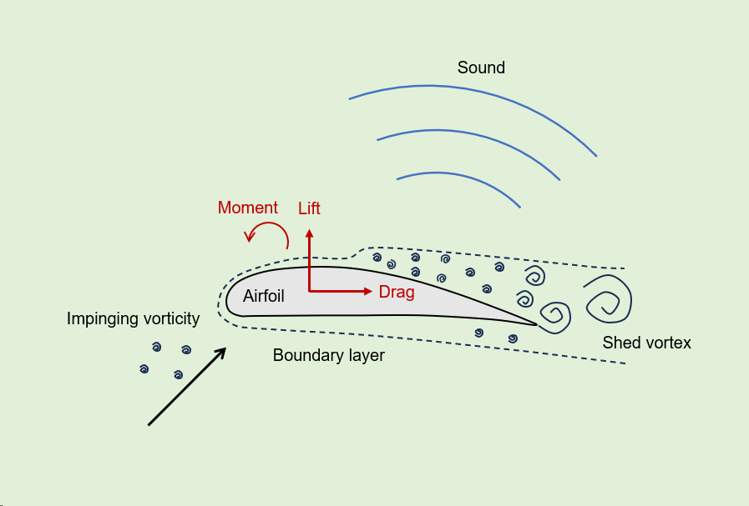
Background: how do vortex affect force dynamics & other process?
How do vortex-structure interaction affect the force?
$$F=\int_{∂B}{t}dS$$
$$t=\left(−p+μ_{θ}θ\right)n+μω×n−2μn⋅\tilde{B}$$
Compression
Shearing
Surface deformation
Replace other variables with vorticity as much as possible
How do vorticity affect the sound and entropy?
Process nonlinearity and coupling inside flow
$$f_{t}+f_{x}^{2}−εg_{x}f=1,$$
$$g_{t}−gg_{x}−ff_{x}=0$$
Cross generation (source): $ff_{x}$
Cross modulation: $εg_{x}f$
Self-nonlinearity: $f_{x}^{2}$ or $gg_{x}$
5

Slide 6
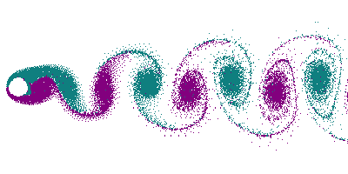
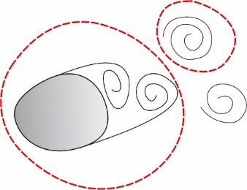
Force Decomposition: impulse theory
Minimum-domain impulse theory
$$V_{fcon}$$
$$V_{fwk}$$
$$F=−\frac{dI_{fcon}}{dt}−\int_{V_{fcon}}{ρω×u}dV+F_{∂B}$$
$$F_{∂B}=\frac{1}{k}\int_{∂B}{x×\left(n×ρa\right)}dS+\frac{1}{k}\int_{∂B}{x×ρuω_{n}}dS$$
Theorem.
When a body moves and deforms arbitrarily in an externally unbounded viscous fluid, if the wake consists of a set of discrete compact structures, then except the driving mechanism $F_{∂B}$, the force fluid reaction to the body’s motion exerts a force that can be solely determined by the rate of change of the impulse of the vortical structure still connecting to the body, along with the vortex force thereof.
Theor. Appl. Mech. Lett., 2017; Phys. Fluids, 2018
6

Slide 7
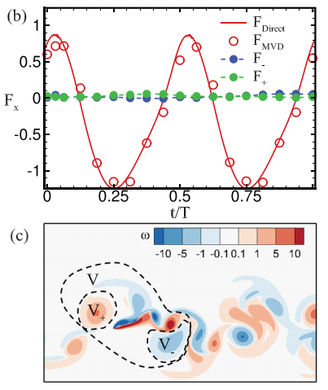
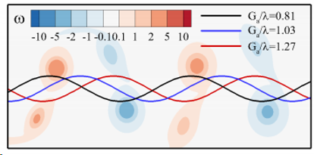
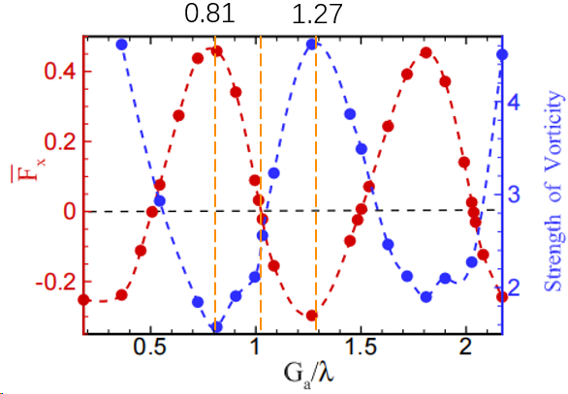
Force Decomposition: impulse theory
Application: “Lighthill’s Conjecture” about fish schooling
$$Re_{f}=200, A=0.5, M=0.2, K=0.8$$
$$Re_{f}=200, A=0.2, M=0.2, K=3.0$$
Evolution of vortical structures of two-plate system
“vortex slaloming” trajectory $→$ enhance vortex generation $→$ enhance thrust effect
“vortex locking” trajectory $→$ reduce vortex generation $→$ inhibit thrust effect
Phys. Fluids, 2021, 2022
7

Slide 8
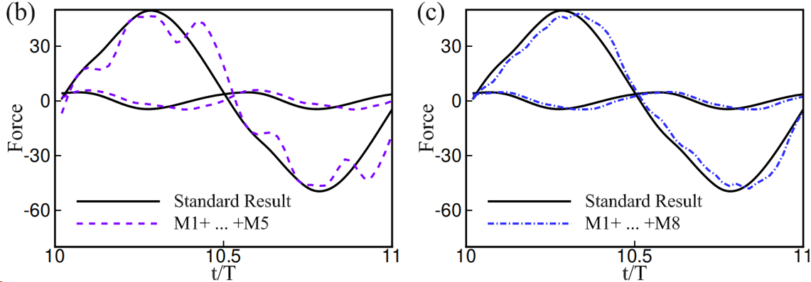
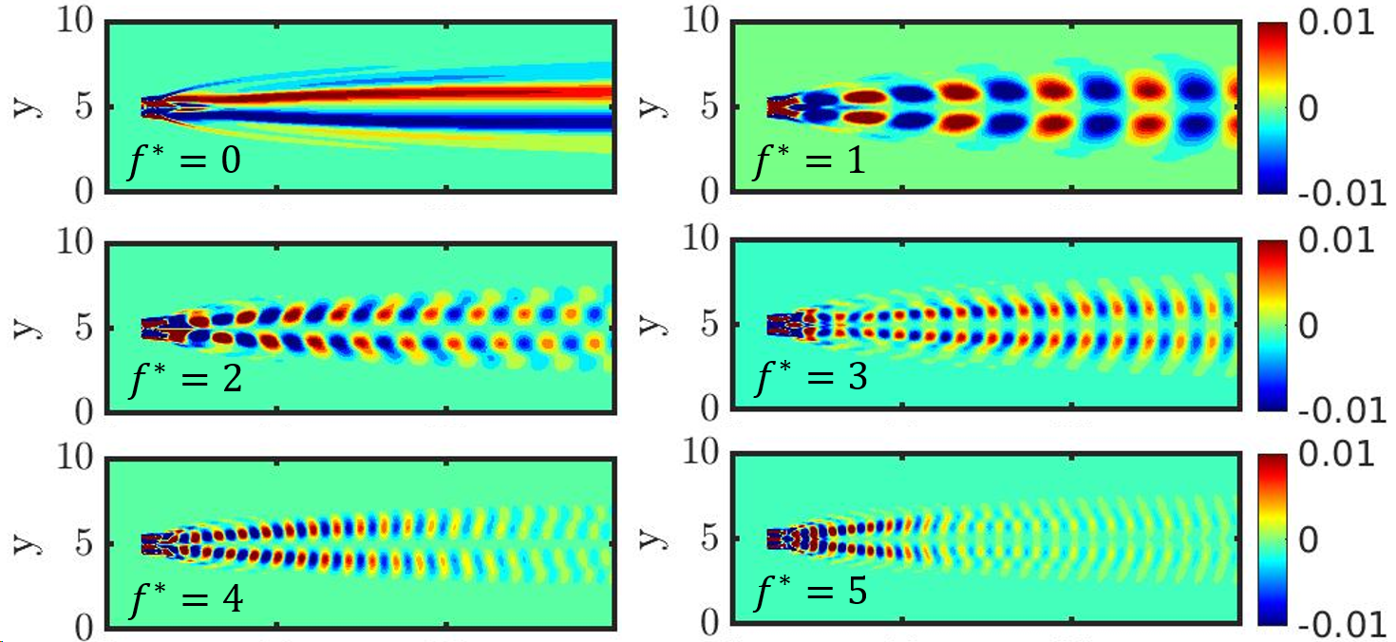
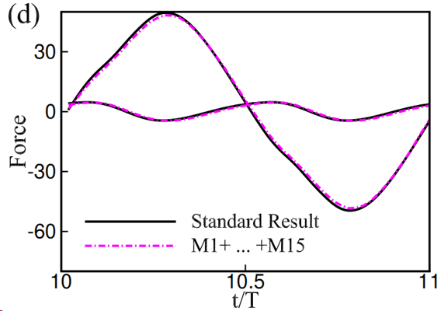
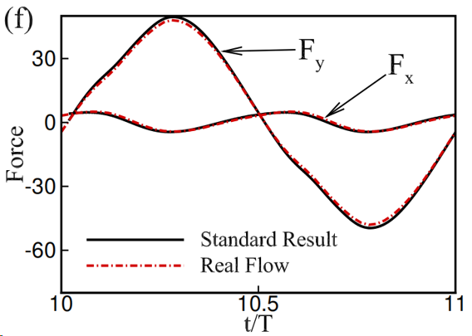
Force Decomposition: impulse theory
Application: Force contributed by DMD modes
$$F\left(t\right)=\sum_{i}{F_{i}\left(t\right),}$$
$$F_{i}=−\int_{V_{f}}{x×\frac{Dω_{i}}{Dt}}+\int_{Σ}{(x×μ\frac{∂ω_{i}}{∂n}+μω_{i}×n)}dS$$
DMD$: ω_{i}=ΦΛW_{i−1}=ΦΛ^{i−1}W_{1}=\sum_{j=1}^{m}{φ_{j}λ_{j}^{i−1}W_{1,j}}$
Phys. Fluids, 2023, Editor’s pick
8

Slide 9
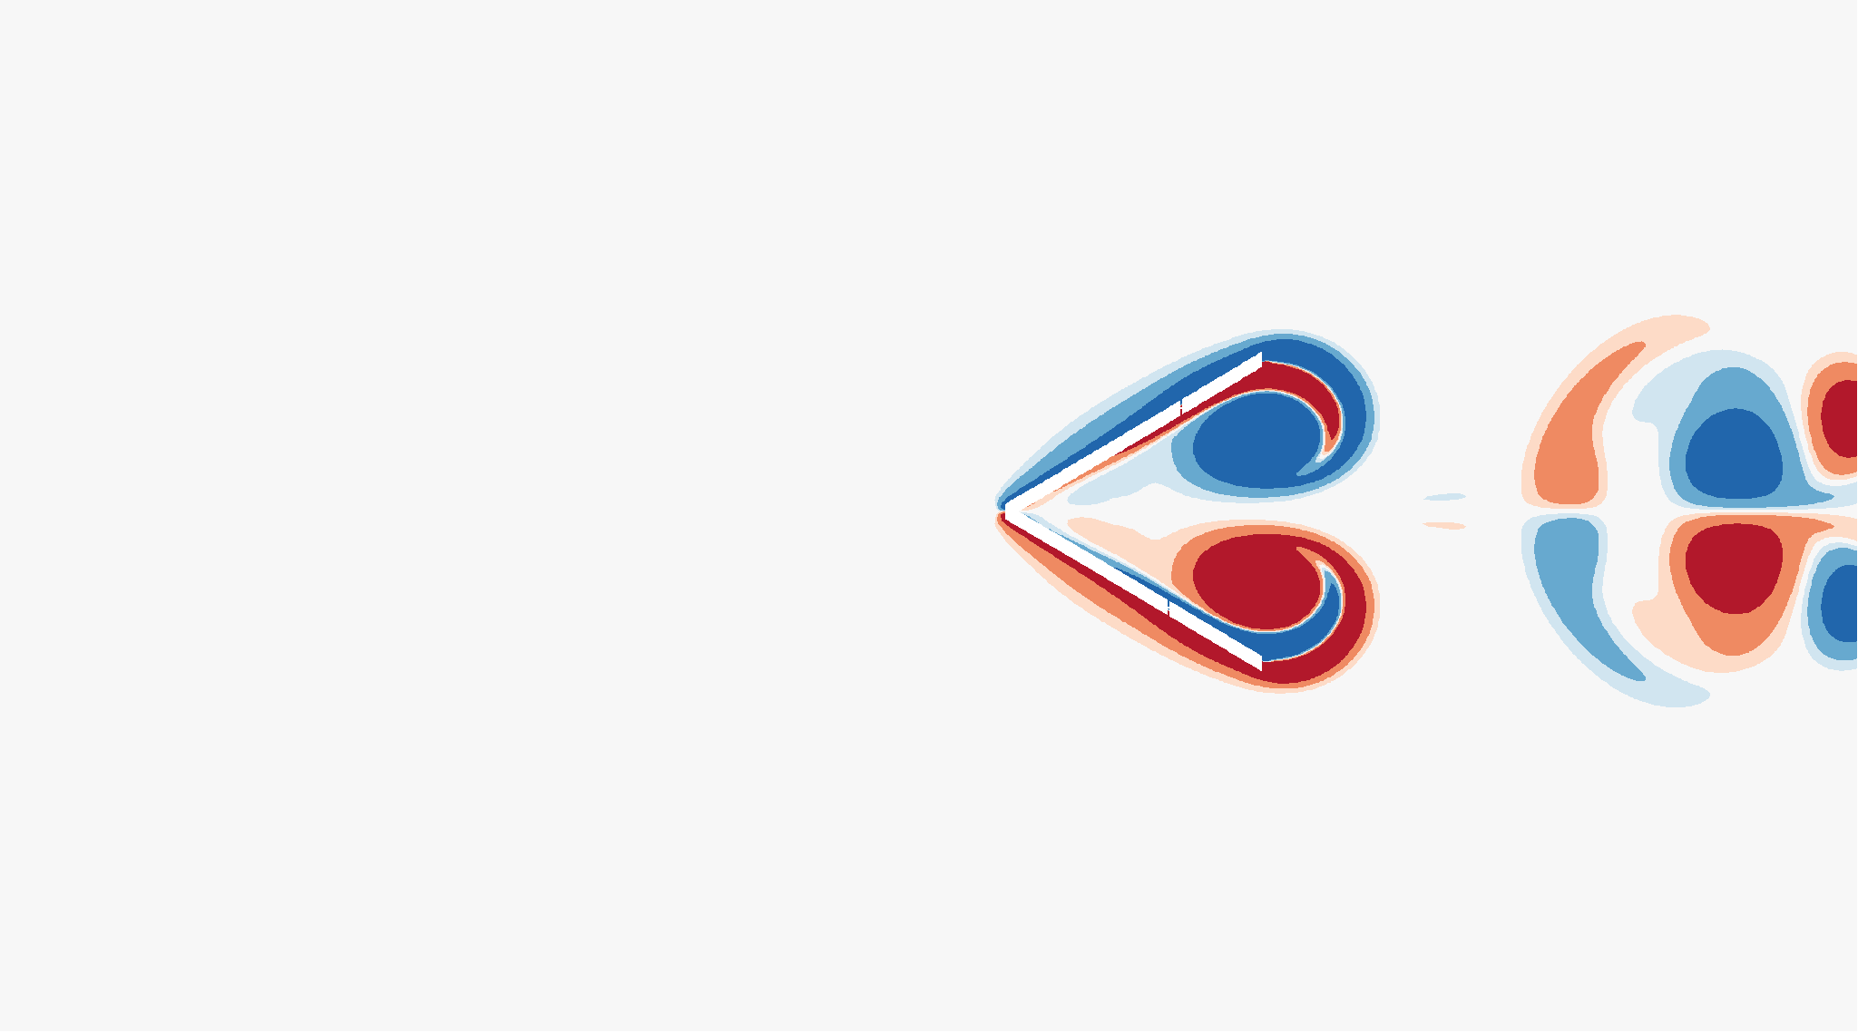
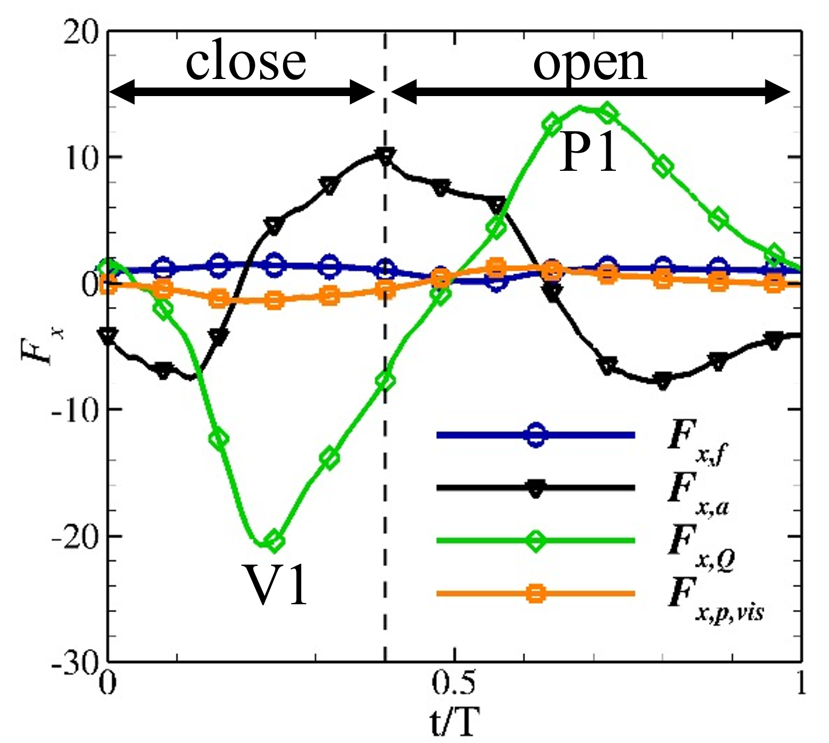
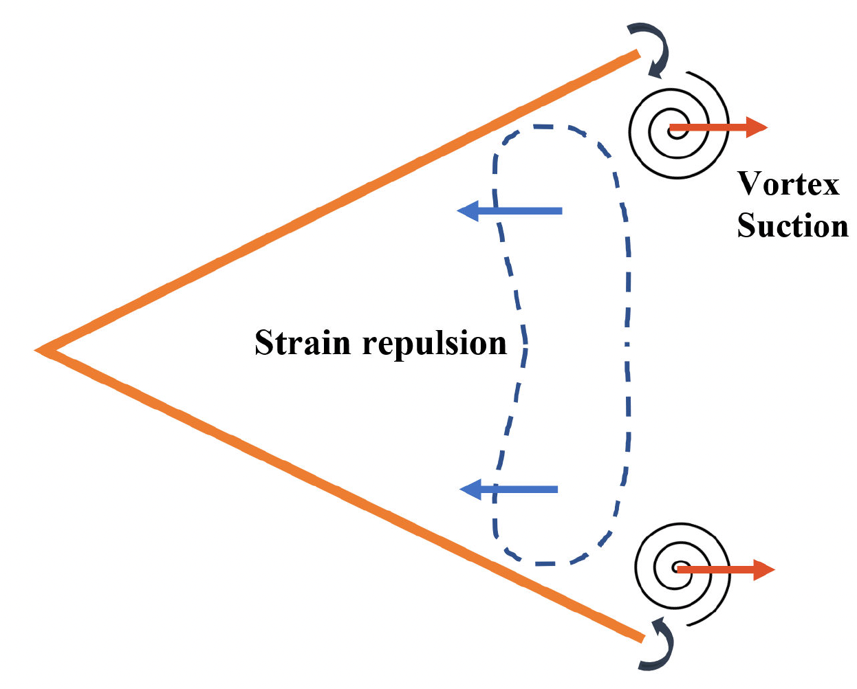
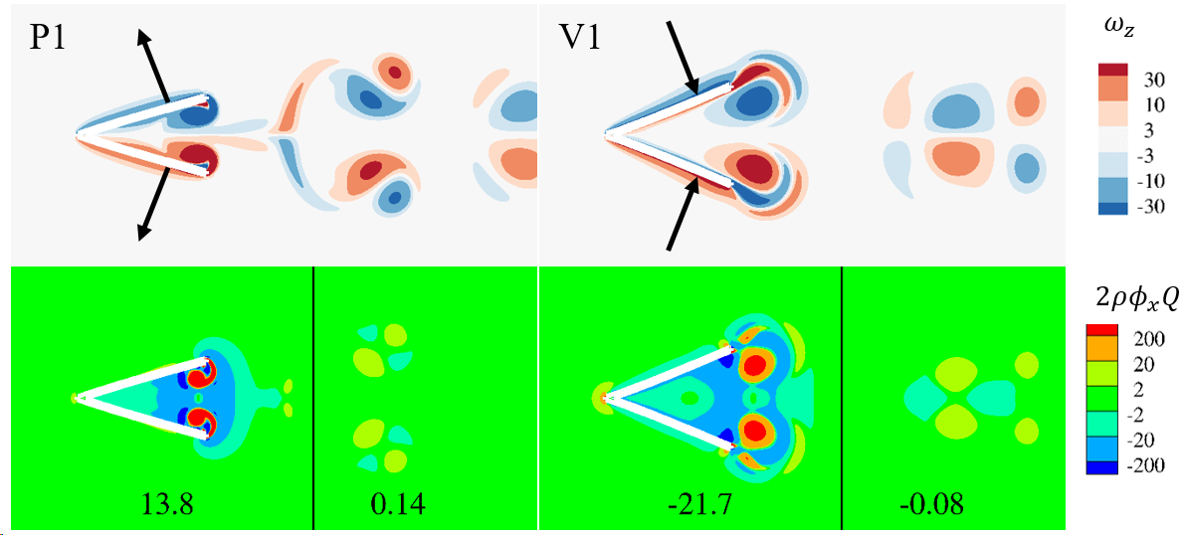
Force Decomposition: modified force element theory
Application: “fast-close-slow-open” motion is beneficial for jellyfish-like propulsion
$$e_{i}⋅F=\int_{∂B}{φ_{i}a⋅ndS}+\int_{V_{f∞}}{2ρQφ_{i}dV}+μ\int_{∂B}{−φ_{i}n⋅∇^{2}udS}+2μ\int_{∂B}{−n⋅D⋅e_{i}dS}$$
Repulsive force induced by the strain-rate field ($Q<0$) is the main driving force.
Capturing the previous vortex pair during the closing phase can significantly enhance the strain rate and the thrust.
Phys. Fluids, 2023, Featured
9

Slide 10
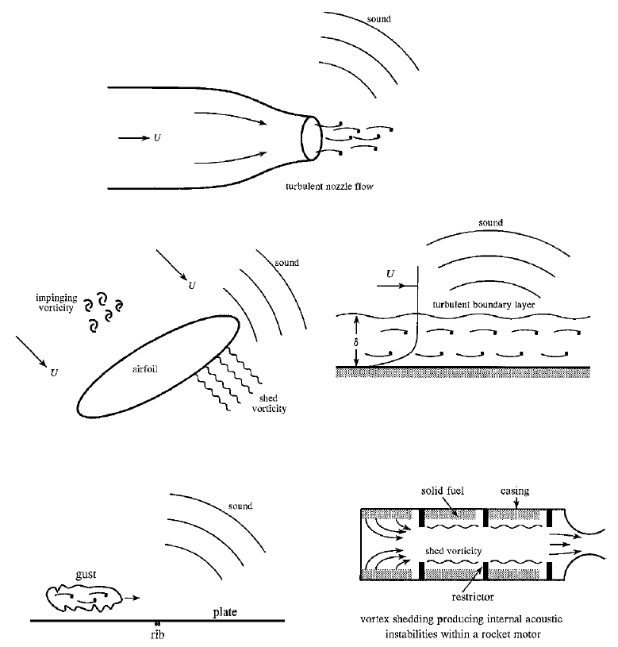
Flow fundamental process decomposition: sound source
Status of acoustics:
More than thirty kinds of acoustic equations
Characteristic variable of sound mode is not unique
Sound source is vaguely defined
Research strategy:
Sound mode + vortical mode + entropy mode
Three nonlinear mechanisms:
$$f_{t}+f_{x}^{2}−εg_{x}f=gg_{x}$$
Self-nonlinearity：$f_{x}^{2}$
Cross modulation：$εg_{x}f$
Source： $gg_{x}$ “produce motion from nothing”
10

Slide 11
Flow fundamental process decomposition: sound source
Characteristic variable: thermodynamic variables $ρ, P, T$
A
$$ℛ$$
$$𝒫$$
$$ℛ≡\ln\left(\frac{ρ}{ρ_{0}}\right), 𝒫≡\frac{1}{γ}\ln\left(\frac{p}{p_{0}}\right), ℋ≡\frac{1}{γ−1}\ln\left(\frac{h}{h_{0}}\right)≡\frac{1}{γ−1}\ln\left(\frac{T}{T_{0}}\right), s^{∗}≡\frac{s−s_{0}}{c_{p}}$$
B
$$D^{2}f−∇⋅\left(c^{2}∇f\right)+g(θ)=−β+q\left(s^{∗}\right), f= ℛ, 𝒫 or ℋ$$
$β$: pseudo surface deformation work
$q(s^{∗})$: entropy source
$q\left(s^{∗}\right)=∇⋅\left(c^{2}∇s^{∗}\right)$ for $ℛ$, $D^{2} s^{∗}$ for $𝒫$, $\frac{1}{γ−1}\left[γD^{2}s^{∗}−∇⋅\left(c^{2}∇s^{∗}\right)\right]$ for $ℋ$
$$θ$$
$$ℋ$$
Characteristic variable: kinematic variables $θ$
Isentropic, inviscid
$n=2: ℒθ+2\left(Dθ^{2}+θ^{3}\right)−3βθ=2Dβ+a⋅\left(∇×ω\right)$
$n=3: ℒθ+2\left(Dθ^{2}+3θ^{3}\right)−6βθ=2Dβ+2Tr\left(B^{3}\right)+a⋅\left(∇×ω\right)$ $ℒθ=D^{2}θ−∇^{2}\left(c^{2}θ\right)+a⋅∇θ$
$$ω$$
$$s$$
Source: surface deformation and vortical mode.
J. Fluid Mech., 2020
11

Slide 12
Splitting and coupling in vortex dynamics
Magnetic-vortical interactions on magnetic splitting

Slide 13
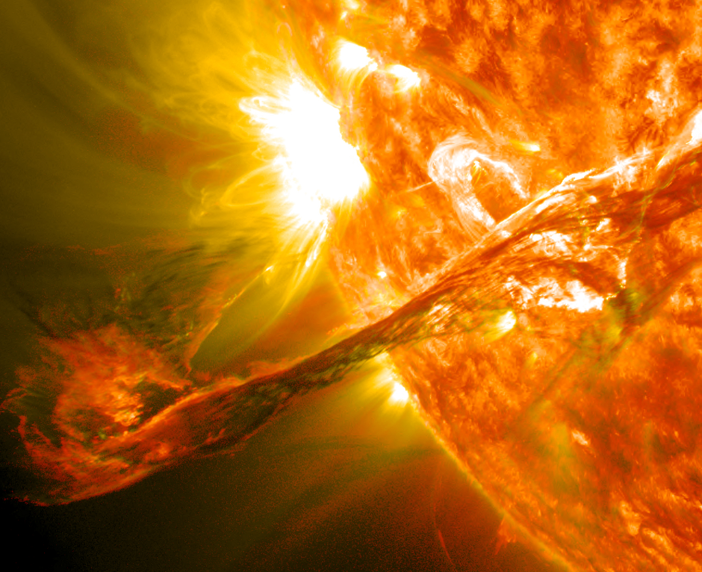
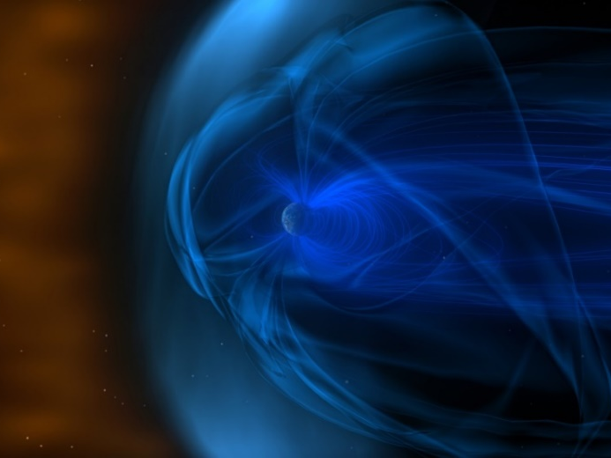
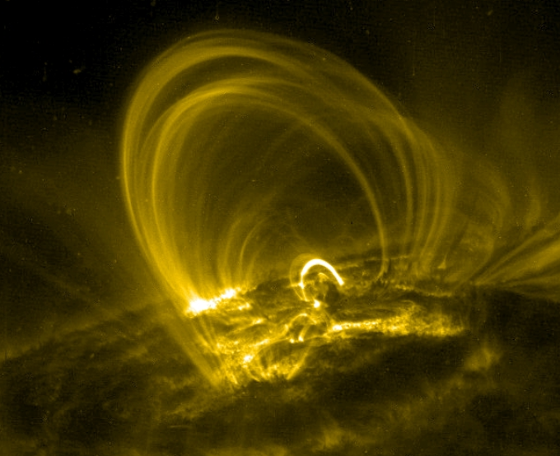
Introduction
Plasma, widely found in stellar systems and intergalactic space, undergoing highly nonlinear fluid-magnetic interactions, resulting in complex physical evolution processes.
Magnetohydrodynamics provides insights into plasma behavior by treating it as a continuous medium.
X-ray images visualizing magnetic reconnection field line structures in solar flares
(Solar Dynamics Observatory, NASA)
Earth's magnetosphere and the solar wind
(Magnetopause-to-Aurora Global Exploration, NASA)
Coronal ring with closed magnetic flux
(Coronal ring with closed magnetic flux, NASA)
Nonlinear interactions lead to complex evolution in the topology of magnetic structures and flow structures.
13
Notes:
涡重联导致的尺度级串是由层流向湍流转捩的关键步骤
磁重联是磁流体中磁场能量快速释放和转化的重要过程

Slide 14
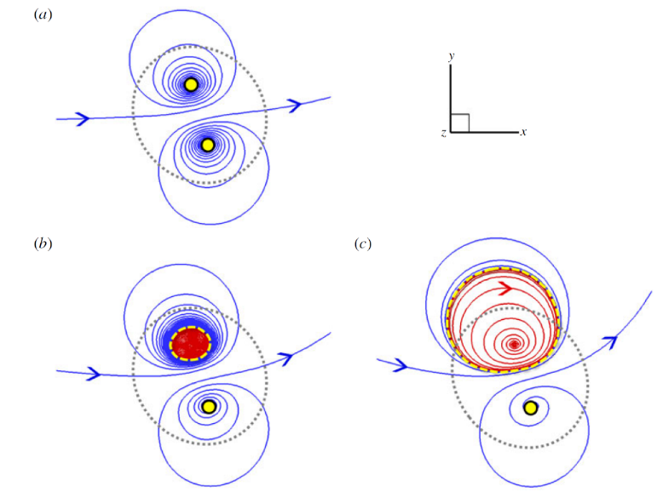
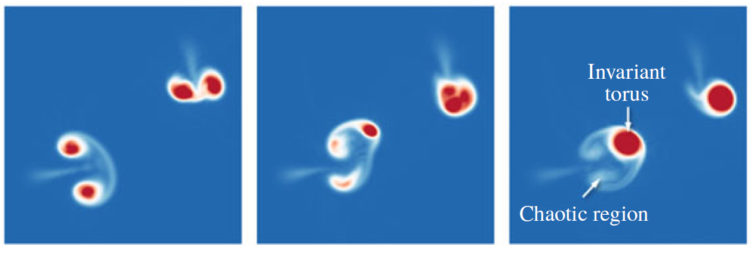
Previous research on magnetic splitting
Twisting has an impact on the evolution of magnetic knots
The effect of twist on the tube splitting is elucidated by the phase portrait of the Lorentz force projected onto the divergence-free space
S. Xiong & Y. Yang, J. Fluid Mech., 2019
Question: How do vortices affect the magnetic splitting?
Study the evolution of magnetic/vortex tubes in MHD flow, in particular how vortices influence MHD flows through their interaction with magnetic fields.
14
Notes:
涡重联导致的尺度级串是由层流向湍流转捩的关键步骤
磁重联是磁流体中磁场能量快速释放和转化的重要过程

Slide 15
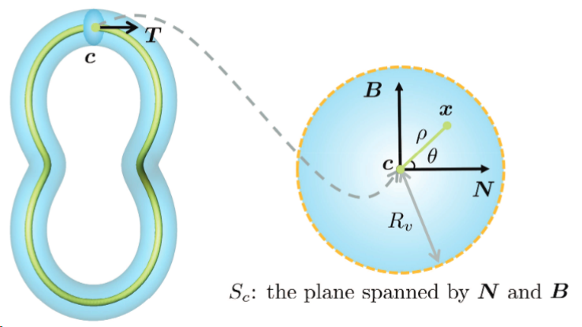
DNS and initial configuration of MHD
Incompressible MHD equations
$$\frac{∂u}{∂t}+u⋅∇=−\frac{1}{ρ}∇p+j×b+ν∇^{2}u$$
$$\frac{∂b}{∂t}=∇×\left(u×b\right)+η∇^{2}b$$
$$∇⋅u=0, ∇⋅b=0$$
DNS is performed in the periodic box of side $2π$ using a standard pseudo-spectral method
Parameters: $ν=η=0.01, Re=Re_{m}=100$; Grid points: ${512}^{3}$
Initial configuration: $x=c\left(s\right)+ρ\cos\left(θ\right)N+ρ\sin\left(θ\right)B$
$c_{x}\left(ζ\right)=π+\left[1+0.5\cos\left(2ζ\right)\right]\cos{(ζ)}$
$c_{y}\left(ζ\right)=π+\left[1+0.5\cos\left(2ζ\right)\right]\sin{(ζ)}$
$c_{z}\left(ζ\right)=π−1.5−0.5\sin{(2ζ)}$
Vector field: $v\left(s, ρ, θ\right)=Γf\left(ρ\right)T$, $f\left(ρ\right)=\exp\left[−ρ^{2}/(2σ^{2})\right]/2πσ^{2}$
S. Xiong & Y. Yang,
Phys. Fluids, 2019
15

Slide 16
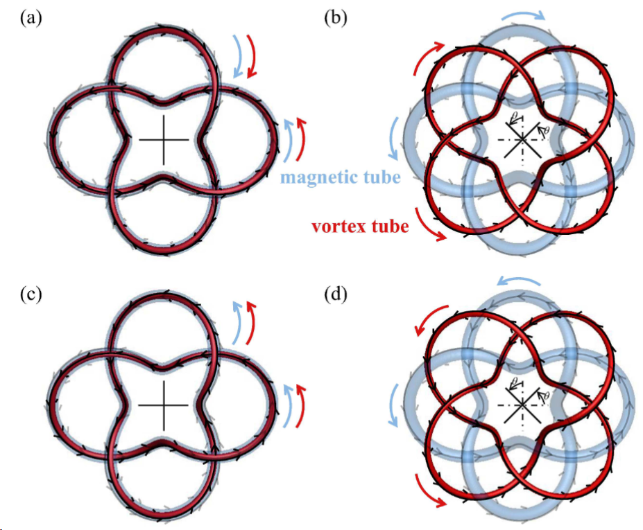
Magnetic tube and vortex tube at initial time
“S” and “D”: flux tubes possessing same and different chirality
“$b$” and “$ω$”: magnetic tubes and vortex tubes
“$θ$”: angle between magnetic and vortex tubes
“red” and “blue”: vortex tubes and magnetic tubes
$$D_{b}D_{ω}$$
$$S_{b}S_{ω}$$
$$θ=0^{∘}$$
$$θ={45}^{∘}$$
16

Slide 17
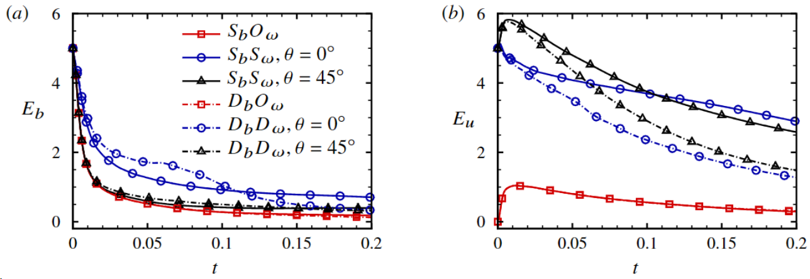
Conversion and release of energy
Magnetic energy decreases monotonically (resistive dissipation, conversion into kinetic energy)
kinetic energy exhibits an overall decrease, with some instances showing temporary increases
When magnetic tubes and vortex tubes overlap each other (isochiral or antichiral), a notable reduction in the release of magnetic energy
Magnetic energy
Kinetic energy
17

Slide 18
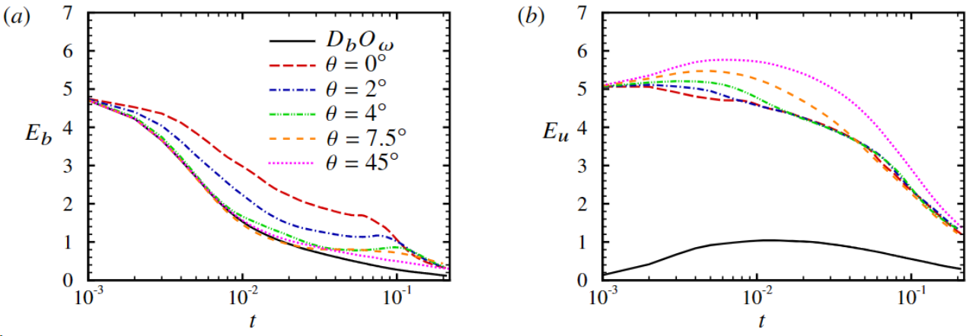
Conversion and release of energy
Small angle ($θ<4^{∘}$) proves effective in curbing magnetic energy release, at the expense of hindering the conversion to kinetic energy.
The decay of magnetic energy and the trend of increasing kinetic energy observed in cases with big angle closely mirror in the case of $D_{b}O_{ω}$
Magnetic energy
Kinetic energy
18

Slide 19
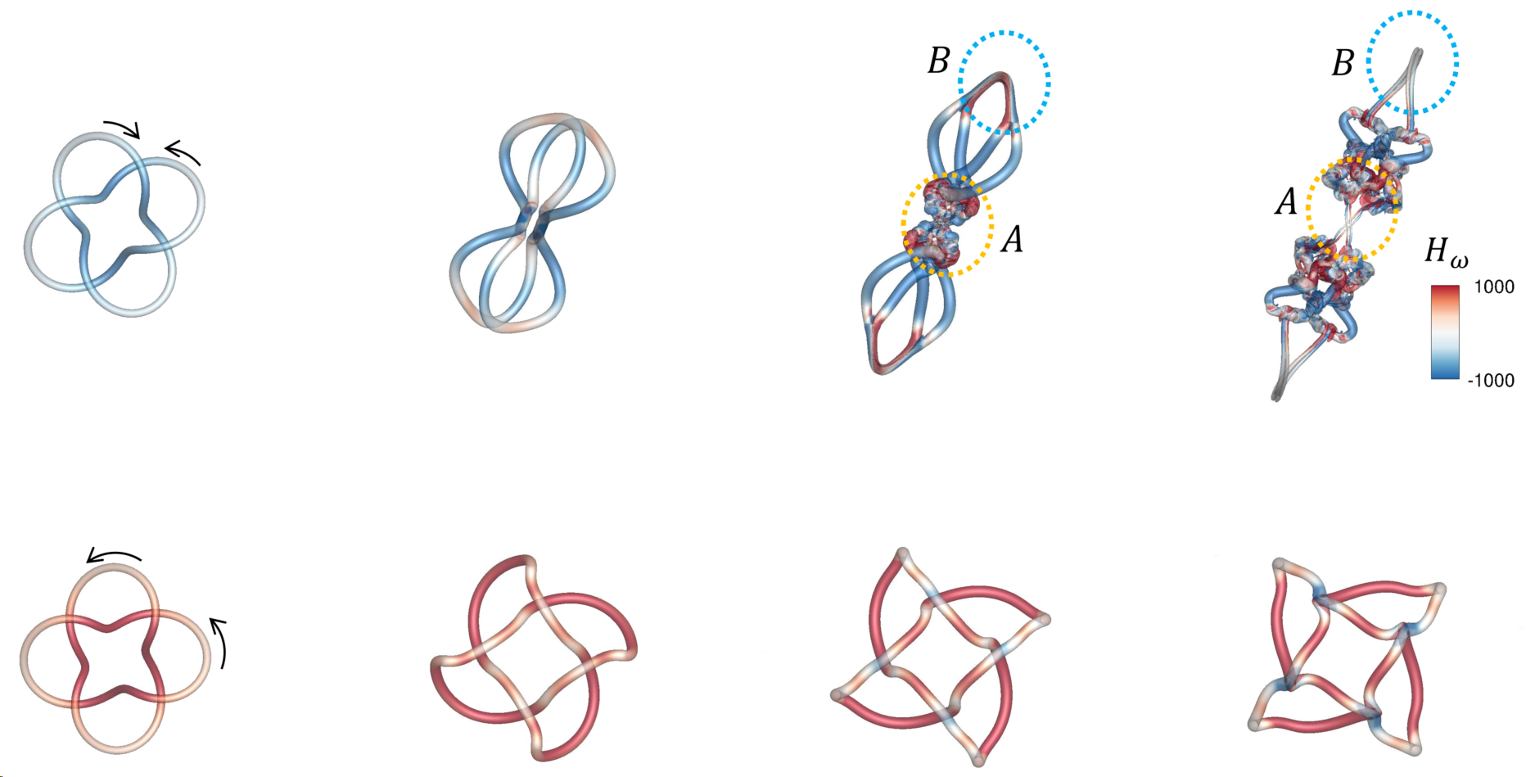
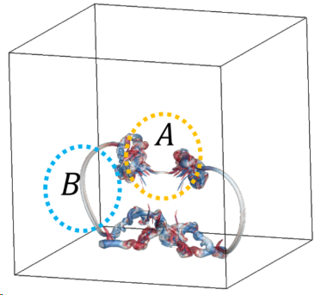
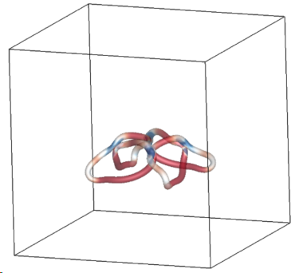
Morphology and dynamics of flowing structures
Evolution of vortex tubes with different chiralities
$$O_{b}D_{ω}$$
$$t=0.01$$
$$t=0.1$$
$$t=0.15$$
$$t=0.2$$
$$O_{b}S_{ω}$$
Antichiral vortex tubes appear elongated, closely positioned, and engaging in mutual interactions
Isochiral vortex tubes exhibit collective rotational motion, separate into unknotted structures.
19
Notes:
Manipulation of vortex tube’s chirality modulates the magnitude and direction of $u$

Slide 20
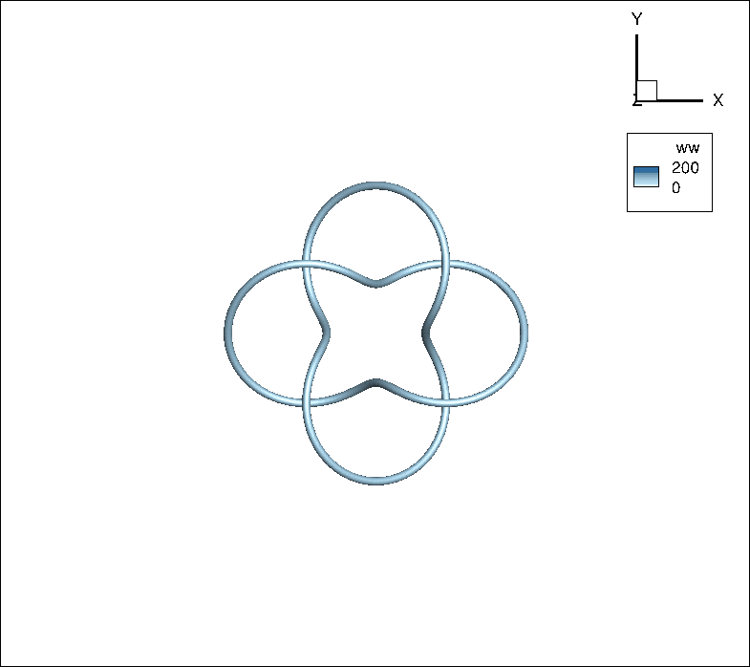
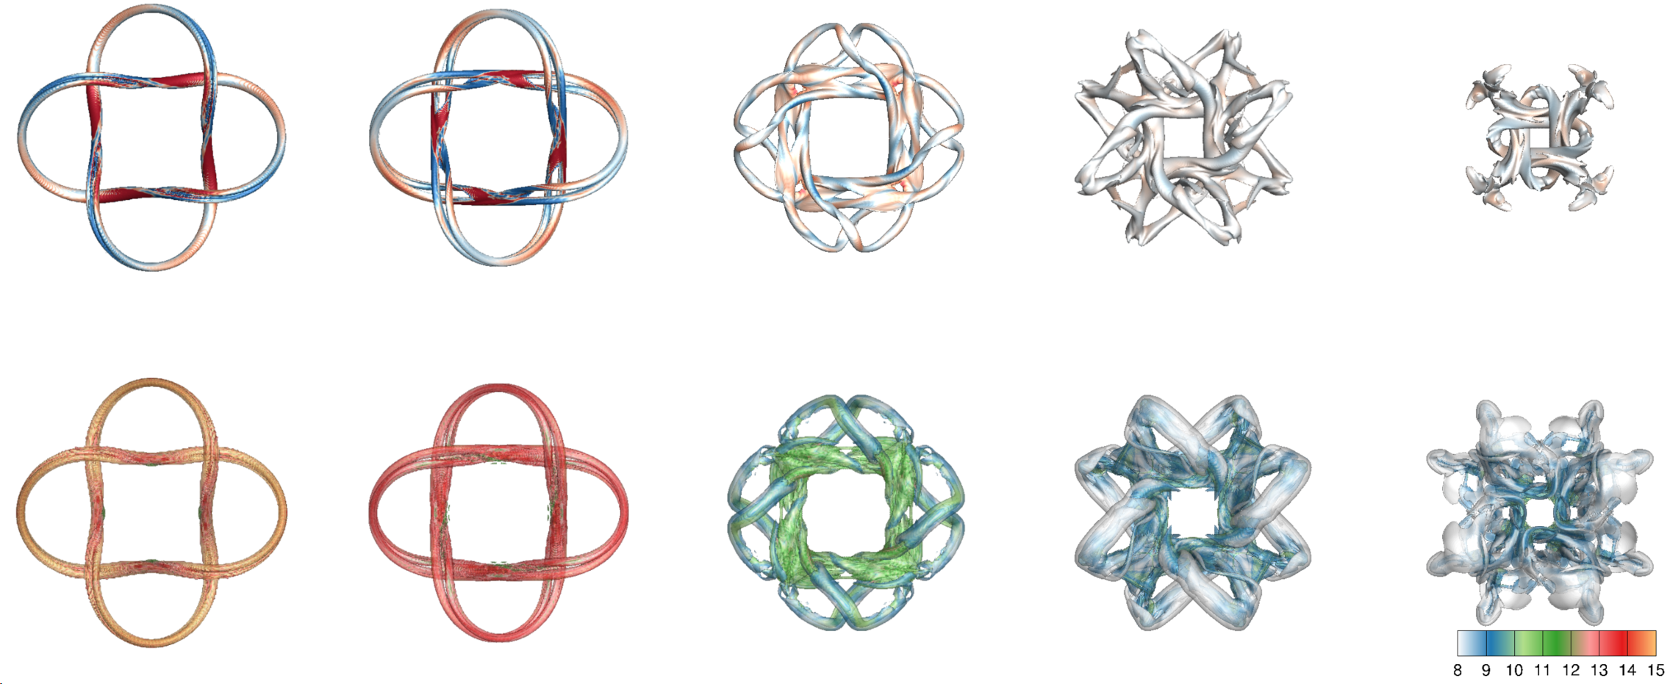
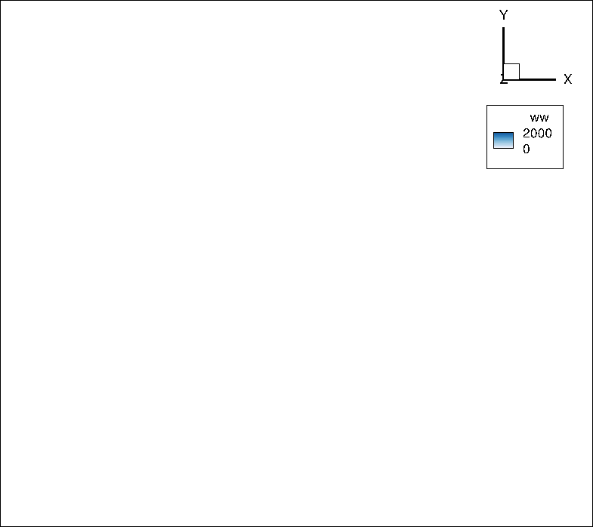
Morphology and dynamics of flowing structures
Flow field triggered by initial magnetic flux tubes
Magnetic
tubes
$$t=0.005$$
$$t=0.01$$
$$t=0.05$$
$$t=0.1$$
$$t=0.2$$
Vortex
tubes
Rapid splitting $→$ tubes move away from each other $→$ octagonal structure $→$ annihilation
Rapid splitting $→$ intense release of magnetic energy
Reversing the chirality of initial magnetic tubes, the evolution of $|b|$ and $|ω|$ remains the same
20
Notes:
Manipulation of vortex tube’s chirality modulates the magnitude and direction of $u$

Slide 21
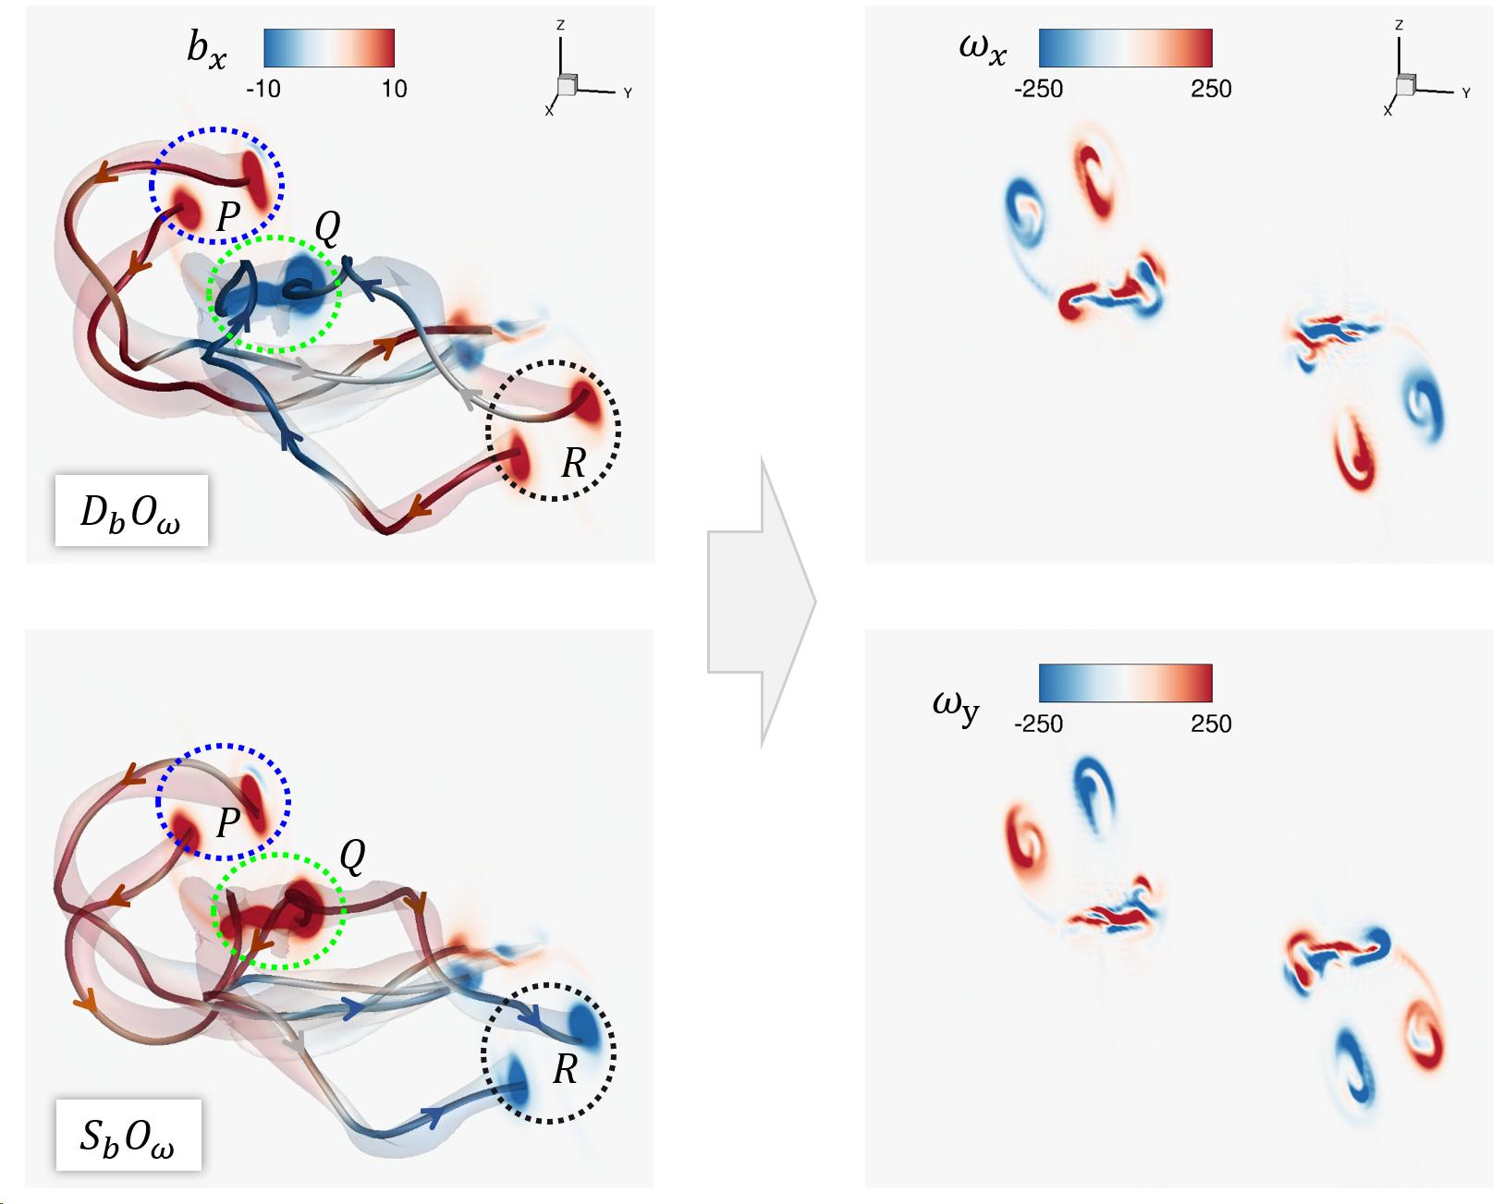
Morphology and dynamics of flowing structures
Flow field triggered by initial magnetic flux tubes
Chirality Change $b→−b$
Lorentz force remains unchanged
$$F_{L}=j×b=\left(∇×b\right)×b$$
Induce the same flow field
$$Du/Dt=−∇p/ρ+F_{L}+ν∇×u$$
Modulation of magnetic field
$\frac{DT}{Dt}=T⋅∇u+η∇^{2}T$
$$\frac{1}{2}\frac{Db^{2}}{Dt}=αb^{2}+\frac{η}{2}\left(∇^{2}b^{2}\right)+∇b:∇b$$
21
Notes:
Manipulation of vortex tube’s chirality modulates the magnitude and direction of $u$

Slide 22
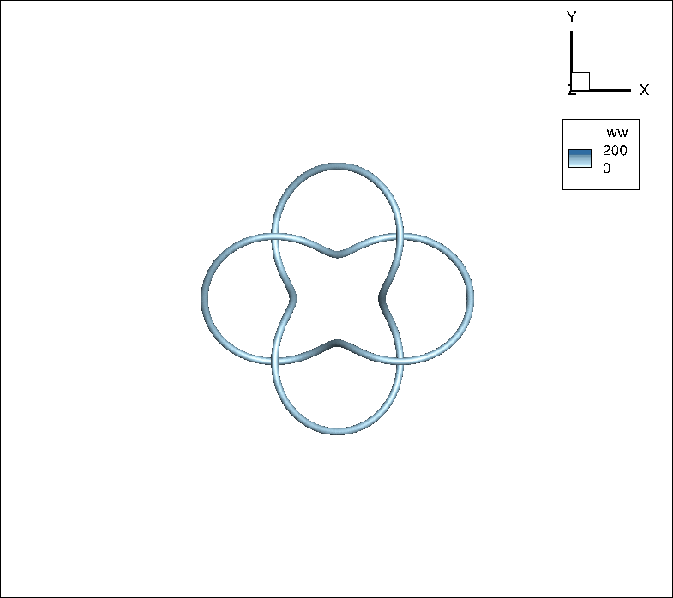
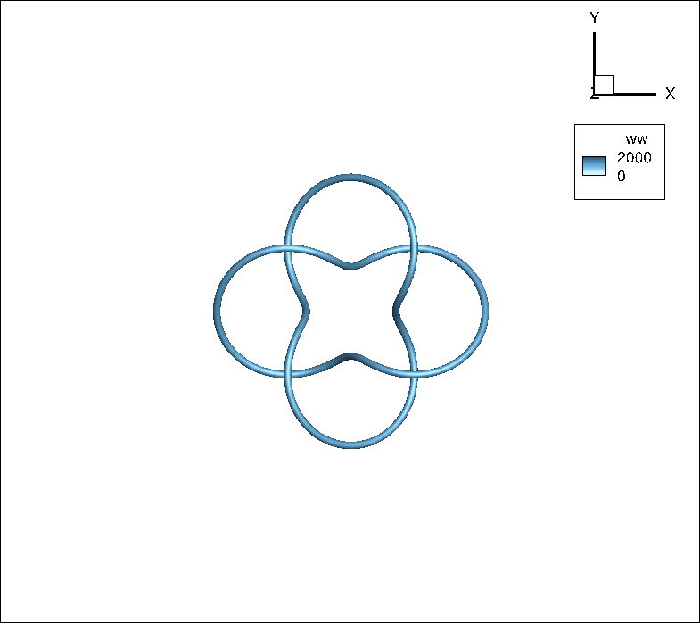
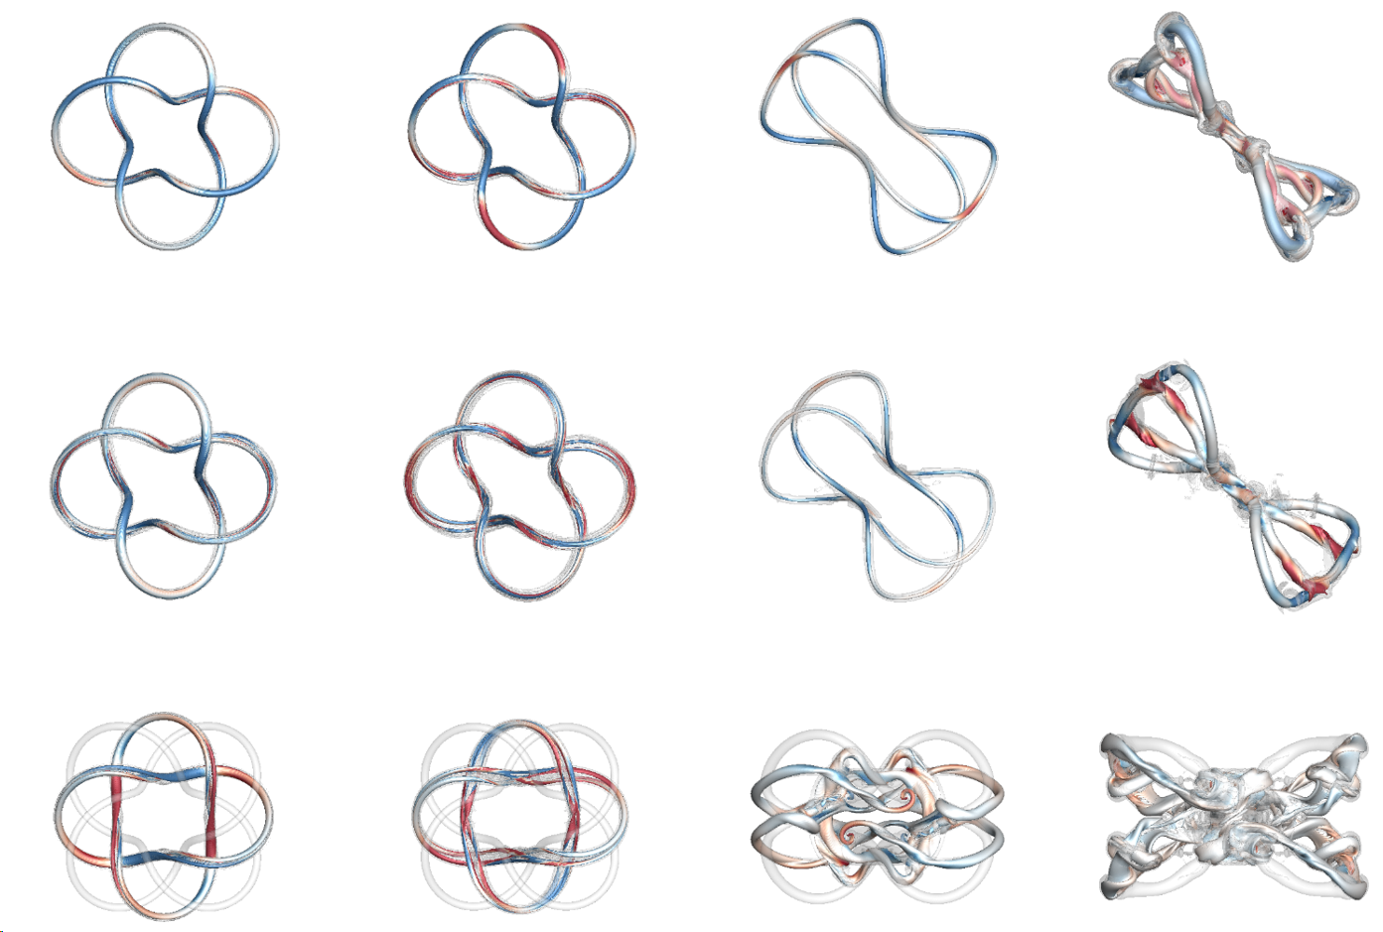
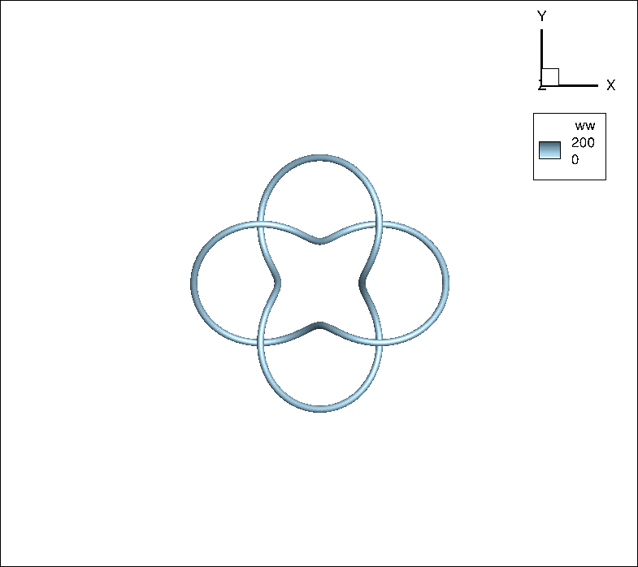
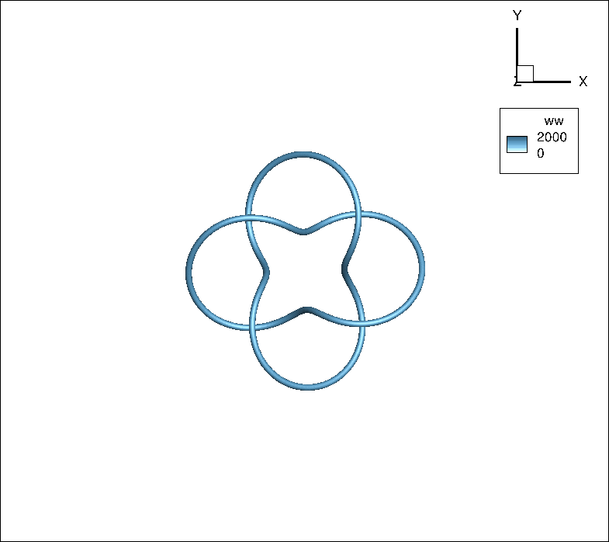
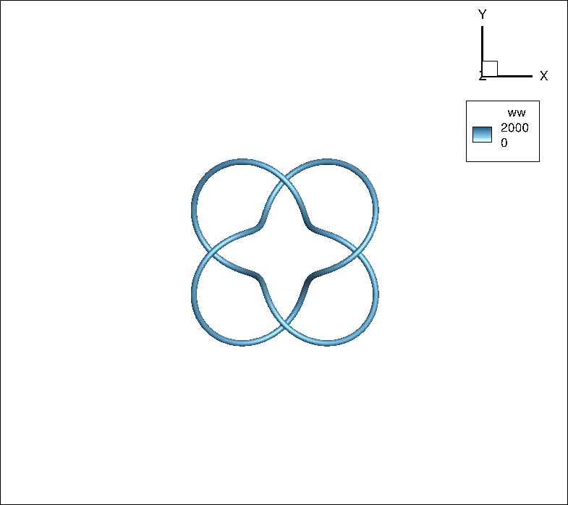
Morphology and dynamics of flowing structures
Influence of angles on the interaction between magnetic and vortex tubes
$$Magnetic tube$$
$$Vorticity tube$$
$$θ=0^{∘}$$
$$θ=0^{∘}$$
$$θ=2^{∘}$$
$$θ=2^{∘}$$
$$θ={45}^{∘}$$
$$t=0.005$$
$$0.01$$
$$0.05$$
$$0.1$$
$$θ={45}^{∘}$$
22
Notes:
Manipulation of vortex tube’s chirality modulates the magnitude and direction of $u$

Slide 23
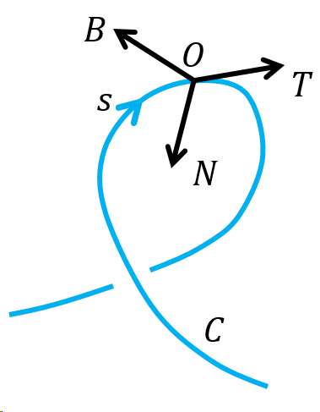
Modulation Mechanism between vortex-magnetic interaction
Impact of Lorentz force on the evolution of vorticity field
$\frac{Dω}{Dt}=ω⋅∇u+ν∇^{2}ω+∇×F_{L}$
$F_{L}=F_{B}B+F_{N}N$
$F_{B}=−∂_{B}E_{b}, F_{N}=κb^{2}−∂_{N}E_{b}$
$∇×F_{L}=\left(\frac{∂F_{B}}{∂N}−\frac{∂F_{N}}{∂B}\right)T−\left(\frac{∂F_{B}}{∂s}+F_{N}τ\right)N+\left(\frac{∂F_{N}}{∂s}−F_{B}τ\right)B$
$+F_{B}\left(N×\frac{∂B}{∂N}+B×\frac{∂B}{∂B}\right)+F_{N}\left(N×\frac{∂N}{∂N}+B×\frac{∂N}{∂B}\right)$
Intrinsic triad along a curve
Case 1: $κ=0, τ=0$
Case 2: $τ=0$
$∇×F_{L}=−κ∂(b^{2})/∂BT$
A pair of vortices with opposite direction
Splitting happens in $B$-direction
$$∇×F_{L}=0$$
$$ω=0$$
No magnetic splitting
23

Slide 24
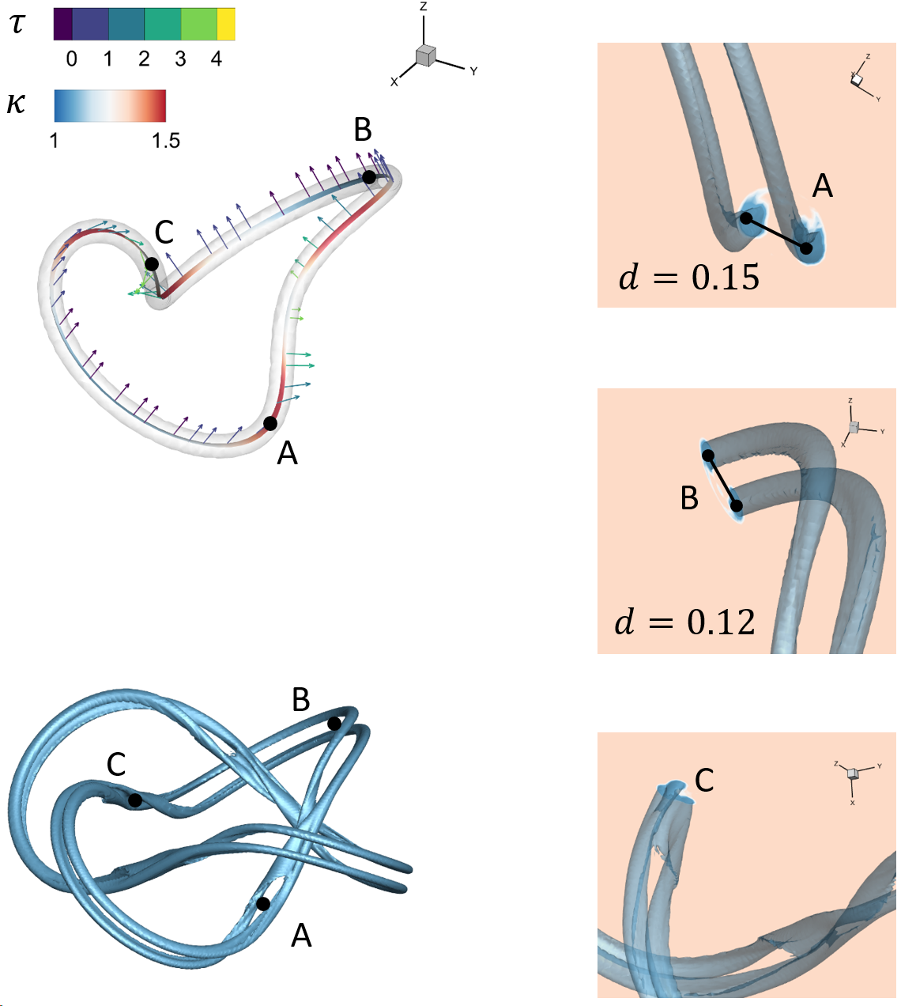
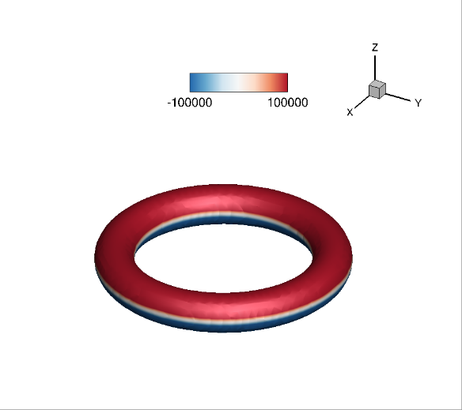
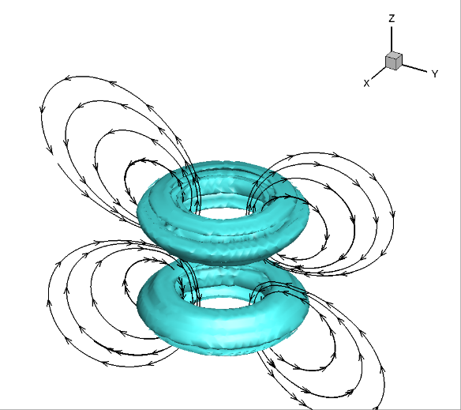
Modulation Mechanism between vortex-magnetic interaction
Impact of Lorentz force on the evolution of vorticity field ($D_{b}O_{ω}$)
Induced vortex tube
Initial magnetic tube
$$t=0$$
$t=0$.05
Distribution of $κ$ and $τ$
Distance $d$ increase with $κ$
Splitting happens in $B$ direction
Big $τ$ inhibits splitting
$$t=0.05$$
24

Slide 25
Modulation Mechanism between vortex-magnetic interaction
Impact of Lorentz force on the evolution of vorticity field ($D_{b}O_{ω}$ vs $D_{b}D_{ω}, θ=0$)
$$D_{b}O_{ω}, t=0.005$$
$$D_{b}D_{ω}, θ=0^{∘}$$
Magnitude estimation
$$b\left(r\right)=Γ_{b}/(2πσ^{2})\exp\left(−r^{2}/2σ^{2}\right)$$
$ω(D_{ω})$ can offset the vorticity $ω(D_{b})$ of different direction
Finial vorticity distribution is the same sign
Splitting of the magnetic tube is suppressed
$$O\left(F_{L}\right)≈8×{10}^{5}$$
$$O\left(ω_{b}\right)≈4×{10}^{3}$$
$$O\left(∇p\right)≈3.4×{10}^{4}$$
$$O\left(ω_{ω}\right)≈4×{10}^{3}$$
25

Slide 26
Modulation Mechanism between vortex-magnetic interaction
Cross modulation mechanism of velocity field to magnetic tube
Surface deformation tensor $\tilde{B}$ reflects material evolution of $dS$ and stretching rate $α$
$$\frac{DT}{Dt}=(ω×T−T⋅\tilde{B})+η∇^{2}T$$
$$\frac{DE_{b}}{Dt}=2αE_{b}+η\left(∇^{2}E_{b}−∇b:∇b\right)$$
$\frac{1}{dS}\frac{D\left(dS\right)}{Dt}=n⋅\tilde{B}$ $α=−T⋅\tilde{B}⋅T$
$$T⋅\tilde{B}$$
$$D_{b}O_{ω}$$
$$D_{b}D_{ω}, θ=0^{∘}$$
$$D_{b}D_{ω}, θ=2^{∘}$$
26

Slide 27
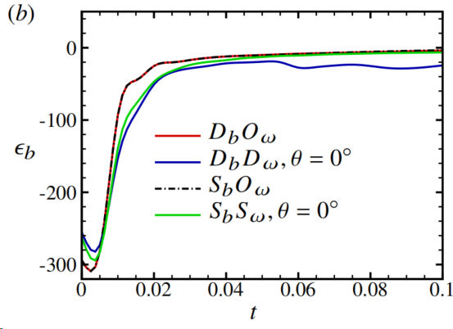
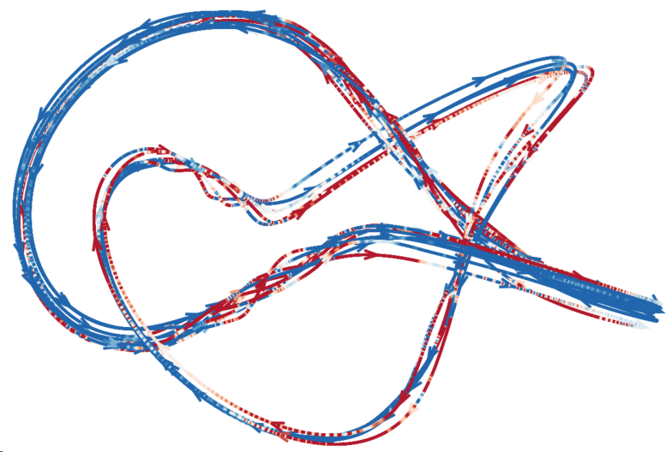
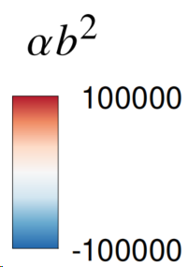
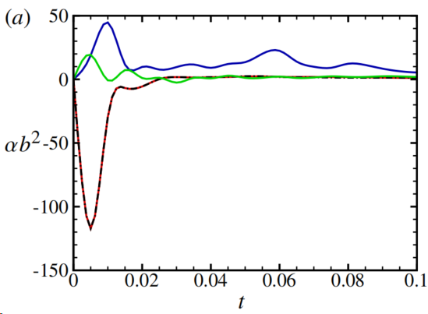
Modulation Mechanism between vortex-magnetic interaction
Cross modulation mechanism of velocity field to magnetic tube
$$DE_{b}/Dt=αb^{2}+ε_{b}$$
$$t=0.005$$
$$D_{b}O_{ω}$$
$$D_{b}D_{ω}$$
27

Slide 28
Summary
Skillful manipulation of vortices can realize effective control of force & sound
The magnetic tube undergoes a splitting process, creating finer flux tubes due to curvature effect.
The Lorentz force induced by magnetic flux tube generates localized opposing vortex dipoles, which leads to directional shifts in magnetic line and splitting.
An additional vortex tube of comparable strength to the magnetic tubes can disrupt the formation of vortex dipoles, hindering magnetic tube splitting and magnetic energy releasing.
Variations in the angle configuration of vortices notably influence the magnetic field modulation by vortex tube.
28

Slide 29
Acknowledgements
Collaborators
Funders
This work is supported by the National Natural Science Foundation of China (Grant No. 12302294, 12102365)
Jie-Zhi Wu Xi-Yun Lu
Weicheng Cui Luoqin Liu
An-Kang Gao Shiying Xiong
Renato Tognaccini Dixia Fan
Thanks!
29

Slide 31
Force Decomposition: vortex force theory
Aerodynamic force breakdown in reversible and irreversible components
$D_{i}=e_{x}⋅\left(F_{l}+F_{mρ}\right)，L=e_{z}⋅\left(F_{l}+F_{mρ}\right)$
$D_{P}=e_{x}⋅F_{w}=−\frac{1}{k}\int_{w}{x_{π}⋅\left(ρω×u\right)dS}$
$$F_{vf}=F_{l}+F_{mρ}+F_{w}+F_{μ}$$
$F_{l}=−\int_{V_{f}}{ρω×u dV}$
$F_{mρ}=\frac{1}{k}\int_{V_{f}}{x×\left[∇\left(\frac{q^{2}}{2}\right)×∇ρ\right] dV}$
$F_{w}=−\frac{1}{k}\int_{w}{x×\left[n×\left(ρω×u\right)\right] dV}$
$F_{μ}=O(1/Re)$, negligible for $Re≫1$
$F_{l}, F_{ρ},F_{w}$ only exist in vortical region
NACA0012,
$α=4^{∘}$,
$M_{∞}=0.75$,
$Re=6×{10}^{6}$
$$C_{D}×{10}^{4}$$
Elliptic wing, $α=2^{∘}$, $M_{∞}=0.5$, $Re=3×{10}^{6}$
$$C_{d}×{10}^{4}$$
31

Slide 32
Numerical Method
Two-time step method
Prediction step: solve advection equation in time $t$
Correction step: correct towards MSF in pseudo time $τ$
Implicit numerical viscosity ε_{WENO} for dissipative regularization
5th-WENO and 3nd TVD Runge-Kutta schemes
Solid curve：MSF solution
Dashed arrow：prediction step
Solid arrow：correction step
Y. Yang and D. I. Pullin, J. Fluid Mech., 2011

Slide 33
Sound
Moment
Lift
Airfoil
Drag
Impinging vorticity
Boundary layer
Shed vortex

Slide 34
Acknowledgements
Collaborators
Funders
This work is supported by the National Natural Science Foundation of China (Grant No. 12302294, 12102365)
Contact me
kanglinlin@westlake.edu.cn
Jie-Zhi Wu Xi-Yun Lu
Weicheng Cui Luoqin Liu
An-Kang Gao Shiying Xiong
Renato Tognaccini Dixia Fan
Thanks!
34

