Slide 1
Multi-objective optimization for generating a weighted multi-model ensemble
: application of the Virtual Information Fabric Infrastructure (VIFI) distributed analytics framework
Kyo Lee
Science Data Understanding group (http://dus.jpl.nasa.gov),
Jet Propulsion Laboratory (JPL), California Institute of Technology
© 2017 California Institute of Technology. Government sponsorship acknowledged.

Slide 2
Outline
Introduction
  Climate assessment and climate model evaluation
  JPL’s Regional Climate Model Evaluation System (RCMES)
Methodology
  Combining multiple metrics into one: multi-objective optimization
Preliminary results and challenges
  Another related project: the Virtual Information Fabric Infrastructure (VIFI) distributed analytics framework

Slide 3

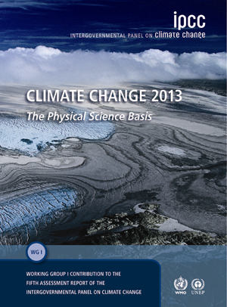
Importance of climate assessment
Climate assessment at various scales (local, regional, national and international) is growing in its importance to provide a scientific resource for climate change understanding and assessment of impacts crucial for economic and political decision-making.
A core element of the climate assessment is numerical model projections that not only provide a foretelling of physical indicators of future climate but also indirectly provide information on societal impacts and thus provide a key resource for addressing adaptation and mitigation questions.
Chapter 9 of the Intergovernmental Panel on Climate Change report (2013): Evaluation of Climate Models

Slide 4
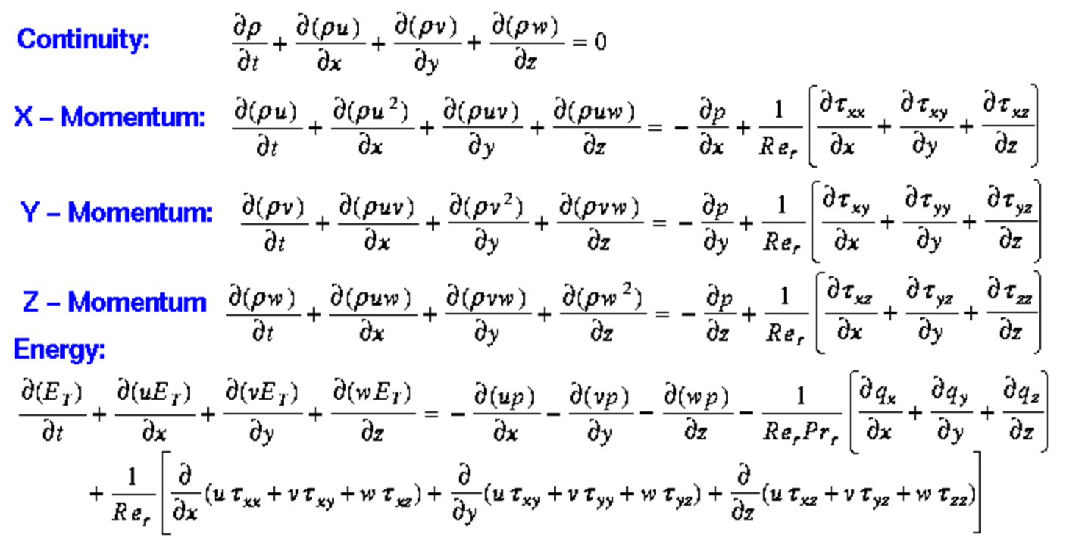
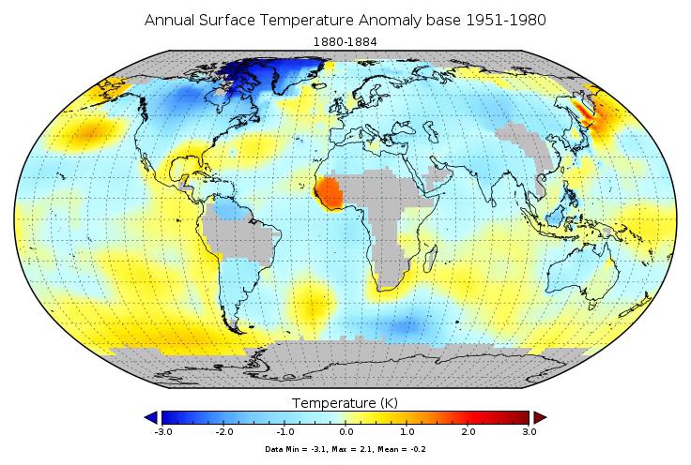
Climate models
The climate system is described by basic physical, chemical, and biological principles.
A climate model is comprised of a series of equations expressing these laws: e.g. conservation of mass, momentum and energy.
Supercomputers at NASA Center for Climate Simulation (NCCS)
from NASA GISS
(http://data.giss.nasa.gov/gistemp/animations/)

Slide 5
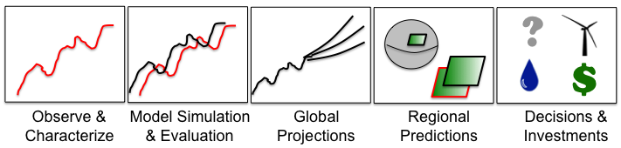
Translate observations and climate model simulations
Despite the recent improvements in climate models, it is important to bring as much observational scrutiny to them as possible.
In other words, we need to compare climate model simulations with observational data and explore uncertainty of climate models and their future projections.
Notes:
the steps and components needed to translate observations and climate model projections into actionable information for climate change related decision-making.
1) the use of observations for identifying climate change/variability, 2) the development of models capable of representing the observed variability and change, 3) the use of those models to project climate into the future, 4) downscale and/or analyze results on regional scales, and 5) the dissemination of information in a format suitable for decision support.

Slide 6
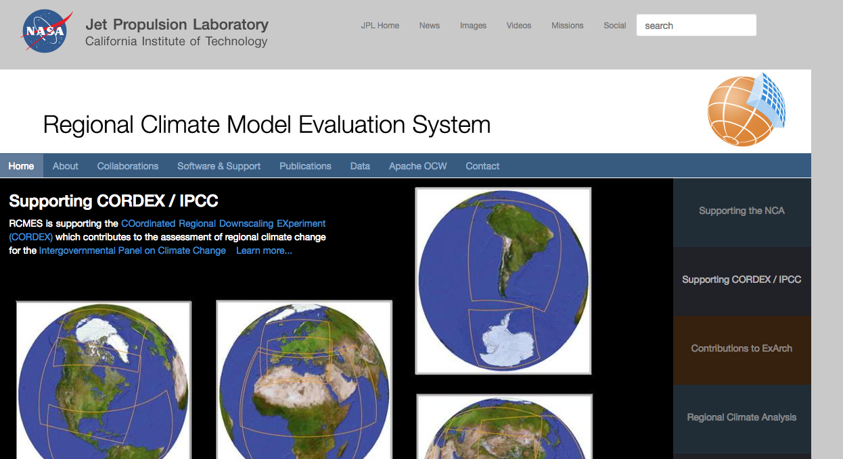
Regional Climate Model Evaluation System
(http://rcmes.jpl.nasa.gov)
Python-based open source software powered by the Apache Software Foundation’s Open Climate Workbench
GOALS
  Support the U. S. National Climate Assessment by providing access to data and tools for climate model evaluation.
  Make observation datasets, with some emphasis on satellite data, more accessible to the regional climate modeling community.
  Make the evaluation process for regional climate models simpler, quicker and physically more comprehensive.
BENEFITS
    Quantify model strengths/weaknesses for development/improvement efforts.
    Improved understanding of uncertainties in predictions.
Notes:
Provide researchers more time to spend on analysing results and less time coding and worrying about file formats, data transfers, etc.

Slide 7

Regional Climate Model Evaluation System
High-Level Architecture
User Input
Observation for Evaluation
Model data for Evaluation
obs4MIPs
Over 30 Satellite variables on ESGF
ESGF
Several Models
(e.g. CMIP5, CORDEX)
Spatial Boundaries
Temporal Boundaries & Resolution
Extract OBS data
Extract model data
Other Data Centers
Other Data Centers
Local Disk
Regridder
Put the OBS & model data on the same spatial grid
Local Disk
RCMES Observational Database
(e.g., TRMM, CRU, UDEL)
Metrics Calculator
(Calculate evaluation metrics)
Data extractor to netCDF
Use the re-gridded data for user’s own analyses and visualization.
Visualizer
(Plot the metrics)
RCMES captures the entire workflow.
Another user can reproduce the same results using the captured workflow.

Slide 8
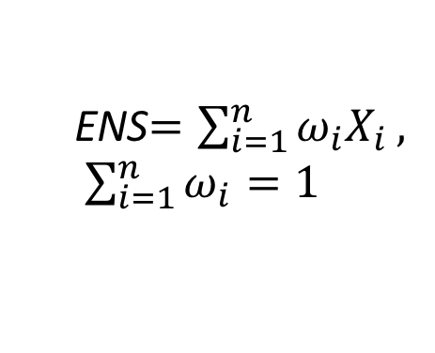
Evaluation of the annual-mean surface insolation using RCMES
satellite-based observation
five models
Multi-model ensembles (ENS), including equally weighted multi-model averages, generally show better skill than a single model.
multi-model ensemble
(An arithmetic mean of the five models)
ENS$=\sum_{i=1}^{n}{ω_{i}X_{i}}, \sum_{i=1}^{n}{ω_{i}}=1$

Slide 9
How to combine multiple evaluation metrics into one?
[Glecker et al., 2008]
The more metrics, the better.
Trade-offs between metrics
Representativeness and meaningfulness of the combined metrics is key.

Slide 10
Outline
Introduction
  Climate assessment and climate model evaluation
  JPL’s Regional Climate Model Evaluation System (RCMES)
Methodology
  Combining multiple metrics into one: multi-objective optimization
Preliminary results and challenges
  Another related project: the Virtual Information Fabric Infrastructure (VIFI) distributed analytics framework

Slide 11
Conventional approach: evaluation => multi-model ensemble
Evaluation
metric
n climate models
a weighted
multi-model ensemble
Model 1: M₁(x,y,t)
Score₁
Model 2: M₂(x,y,t)
Score₂
Model 3: M₃(x,y,t)
Score₃
.
.
.
This is a process of building a multi-model ensemble based on model evaluation result.
ex) If Model 3 shows better performance against observations than Model 2, ω₃ > ω₂.
Model n: M_{n}(x,y,t)
Score_{n}

Slide 12
Evaluation of multi-model ensembles
Let’s assume that we evaluate model to find the best weighted multi-model ensemble.
[ω_{1,} ω_{2, …,} ω_{n}] are random numbers between 0 and 1.
By changing [ω_{1,} ω_{2, …,} ω_{n}] , we can calculate scores of multiple evaluation metrics for each Ens(x,y,t).
 | Metric 1 | Metric 2 | … | Metric k
0.8*M₁ + 0.15*M₂+0.05*M₃ | 0.2 | 0.3 | … | 0.6
0.3*M₁ + 0.60*M₂+0.1*M₃ | 0.5 | 0.1 | … | 0.5
… | … | … | … | …
0.1*M₁ + 0.2*M₂+0.7*M₃ | 0.9 | 0.8 | … | 0.7
0.1, 0.2 and 0.7 could be interpreted as combined metrics for the three models.
best scores

Slide 13
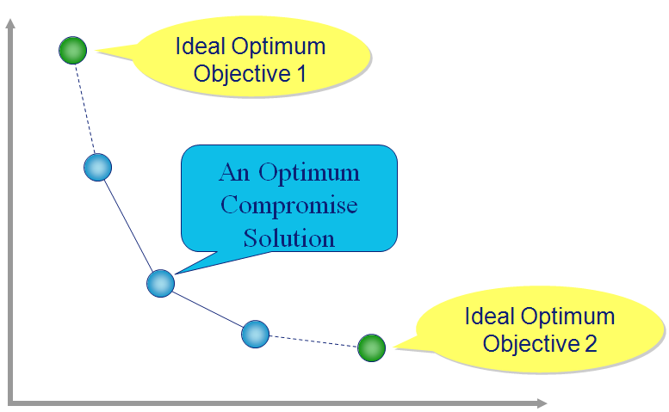
How to Estimate [ω₁*, ω₂*, …, ω_{n}*]
(weighting factors for the best ensemble)?
=> Multi-Objective optimization
The objective optimization is a mathematical process of finding the best solution involving objective functions to be optimized simultaneously.
Goal: minimize price and commuting time!
Multi-objective optimization has been applied in many fields of science, economics and engineering.
In climate model evaluation,
  solution: weighting factors
  objective functions: model evaluation metrics
distance
from work
better
better
price
from http://www.noesissolutions.com/
In most of cases, there does not exist a single solution. In general, there exist a number of Pareto optimal solutions.

Slide 14
Outline
Introduction
  Climate assessment and climate model evaluation
  JPL’s Regional Climate Model Evaluation System (RCMES)
Methodology
  Combining multiple metrics into one: multi-objective optimization
Preliminary results and challenges
  Another related project: the Virtual Information Fabric Infrastructure (VIFI) distributed analytics framework

Slide 15
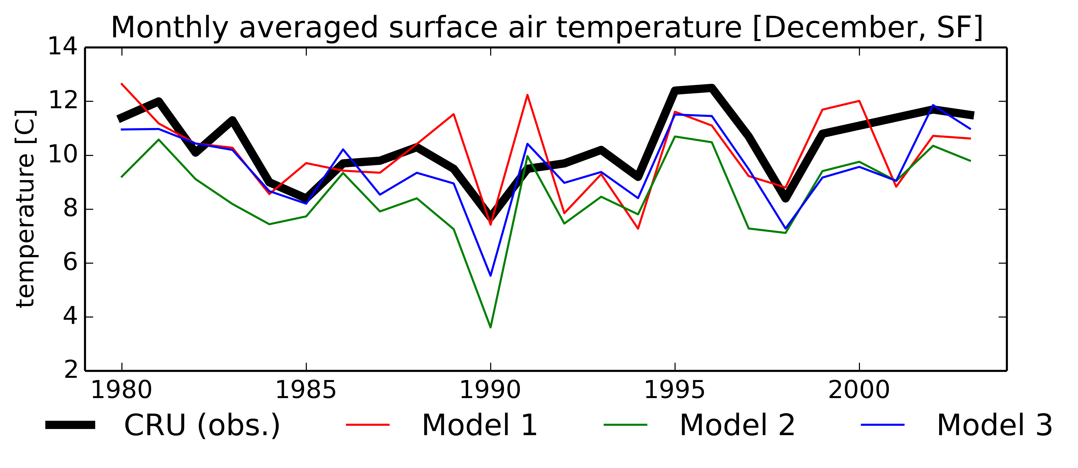
Example) near surface air temperature in San Francisco
[1980-2003, monthly averaged in December]
 | Metric 1: Bias | Metric 2: RMSE
Model 1 (M1) | -0.25 | 1.67
Model 2 (M2) | -1.74 | 3.90
Model 3 (M3) | -0.78 | 1.19
What about the bias and RMSE of weighted ensemble time series?

Slide 16
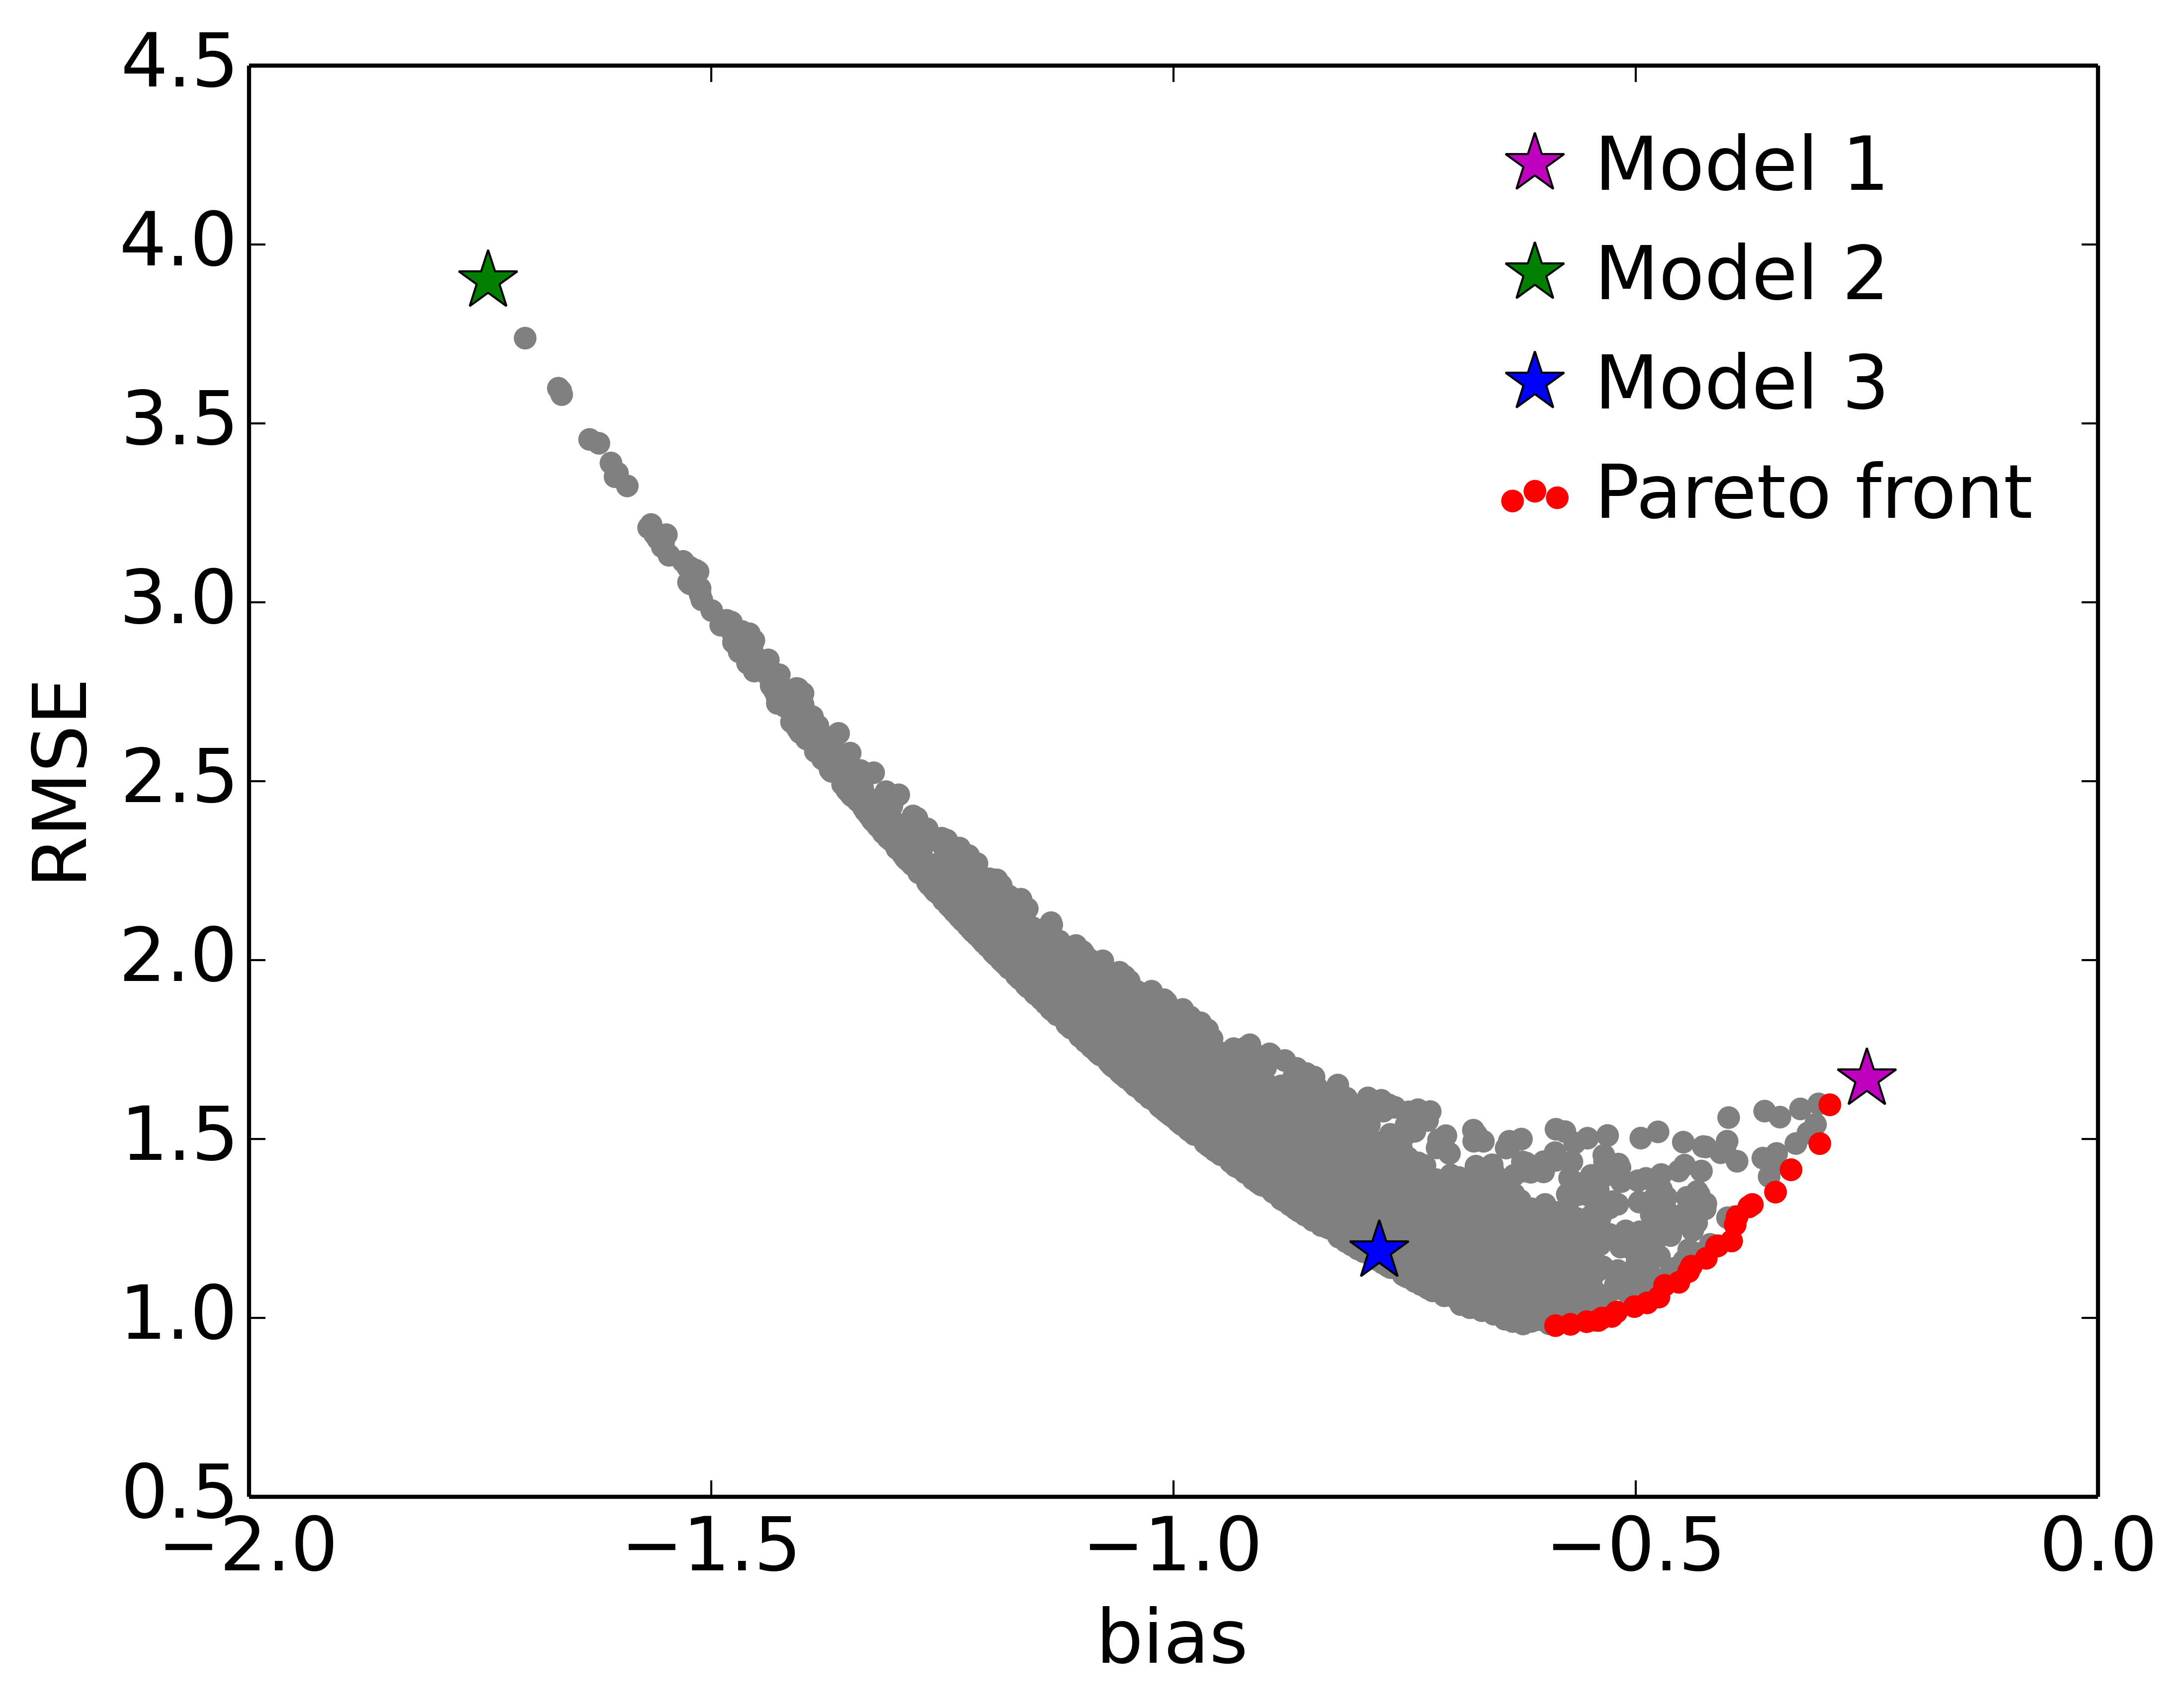
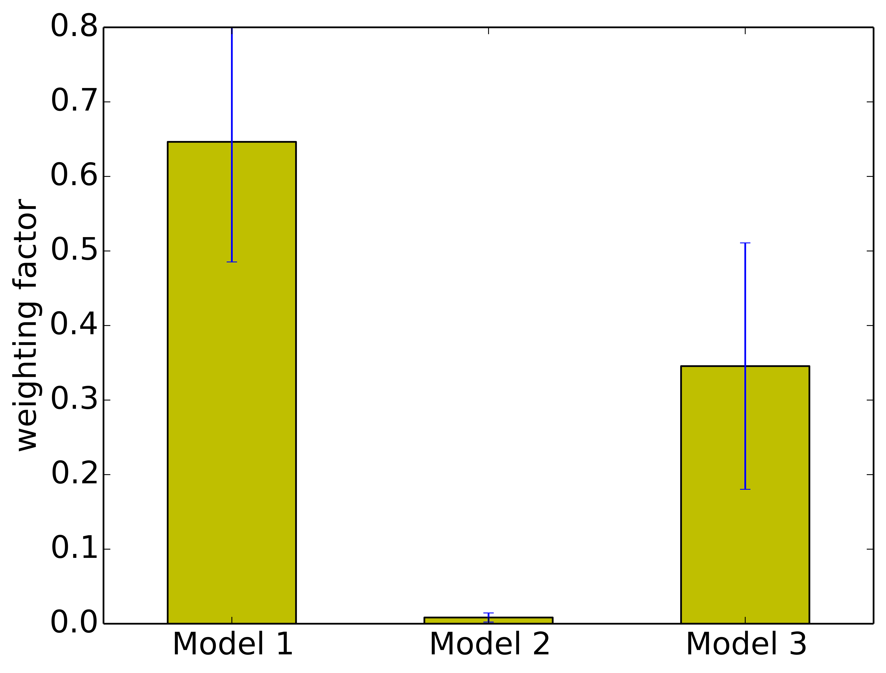
Optimized (minimized |bias| and RMSE ) Weighting Factors [ω₁, ω₂, ω₃]
Each grey point represents the bias and RMSE of one combination of the three models.
better
standard deviation of
N ω₁ values (red dots)
mean of N ω₁ values
(red dots)
better

Slide 17
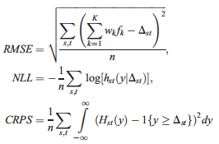
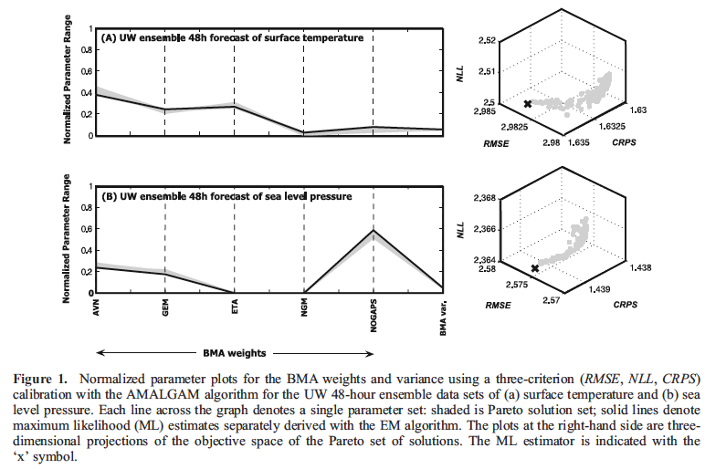
Multi-Objective Calibration of Forecast Ensembles Using BMA [Vrugt et al., 2006]
The Pareto set of solutions
trade-off
To measure the sharpness of the weighted ensemble mean,
NLL (negative log likelihood): ignorance score
CRPS: continuously ranked probability score
Grey dots represent the Pareto optimal solutions for the three evaluation metrics of the multi-model.
Notes:
This multi-criteria framework is more advanced than the BMA approach as it considers several different metrics of model skills (Vrugt et al., 2013) while providing uncertainties for model weights.

Slide 18
Big Data challenges of the optimization
The bias in the example is a linear metric.
However, most of popularly used metrics are not linear. So the metric scores for each simulation, valuable information as they are, can not be used to find the best (optimized) ensemble.
Model | Metric 1 | Metric 2 | … | Metric k
M₁ | 0.9 | 0.3 | … | 0.4
M₂ | 0.5 | 0.5 | … | 0.3
… | … | … | … | …
M_{n} | 0.95 | 0.8 | … | 0.5
Ens. | Metric 1 | Metric 2 | … | Metric k
Ens 1 | 0.4 | 0.2 | … | 0.1
Ens 2 | 0.3 | 0.3 | … | 0.7
… | … | … | … | …
Ens N | 0.6 | 0.6 | … | 0.4
As climate models continues to generate a massive amount of datasets distributed all around the world, the optimization process rests on computational efficiency and technology infrastructure.

Slide 19
Outline
Introduction
  Climate assessment and climate model evaluation
  JPL’s Regional Climate Model Evaluation System (RCMES)
Methodology
  Combining multiple metrics into one: multi-objective optimization
Preliminary results and challenges
  Another related project: the Virtual Information Fabric Infrastructure (VIFI) distributed analytics framework

Slide 20
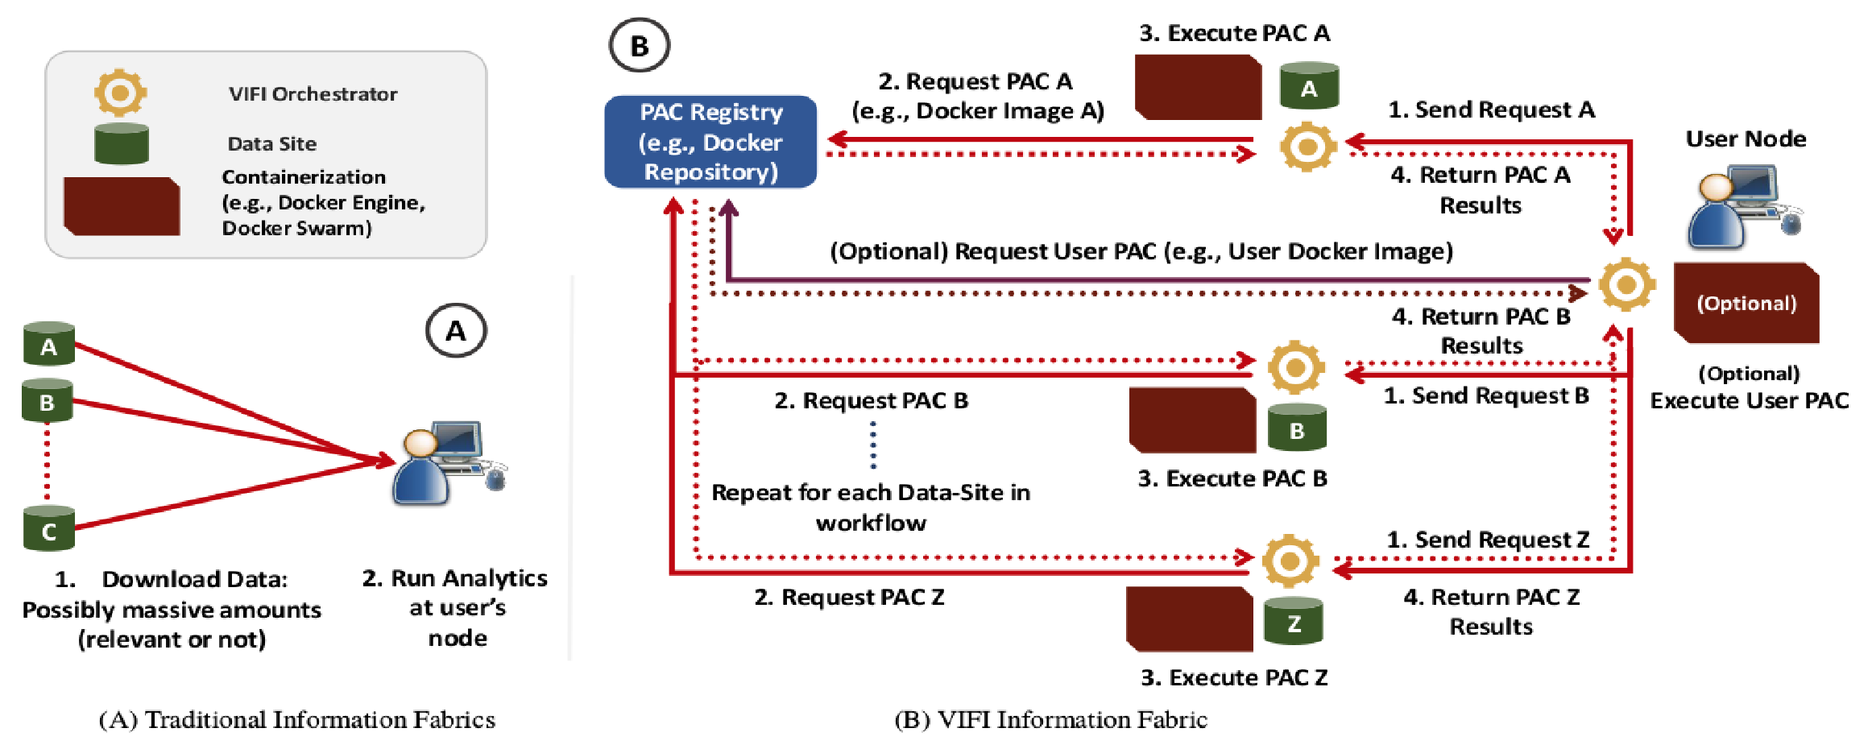
VIFI for data-driven decisions from distributed data
(Virtual Information Fabric Infrastructure)
Traditional climate model evaluation: manually downloading distributed datasets to a local server.
VIFI: a novel approach to conduct the evaluation-in-place by distributing analytics to the distributed repositories without moving the massive datasets.
[Talukder et al., 2016]
Notes:
Funded by NSF’s Data Infrastructure Building Blocks (DIBBs) program.

Slide 21
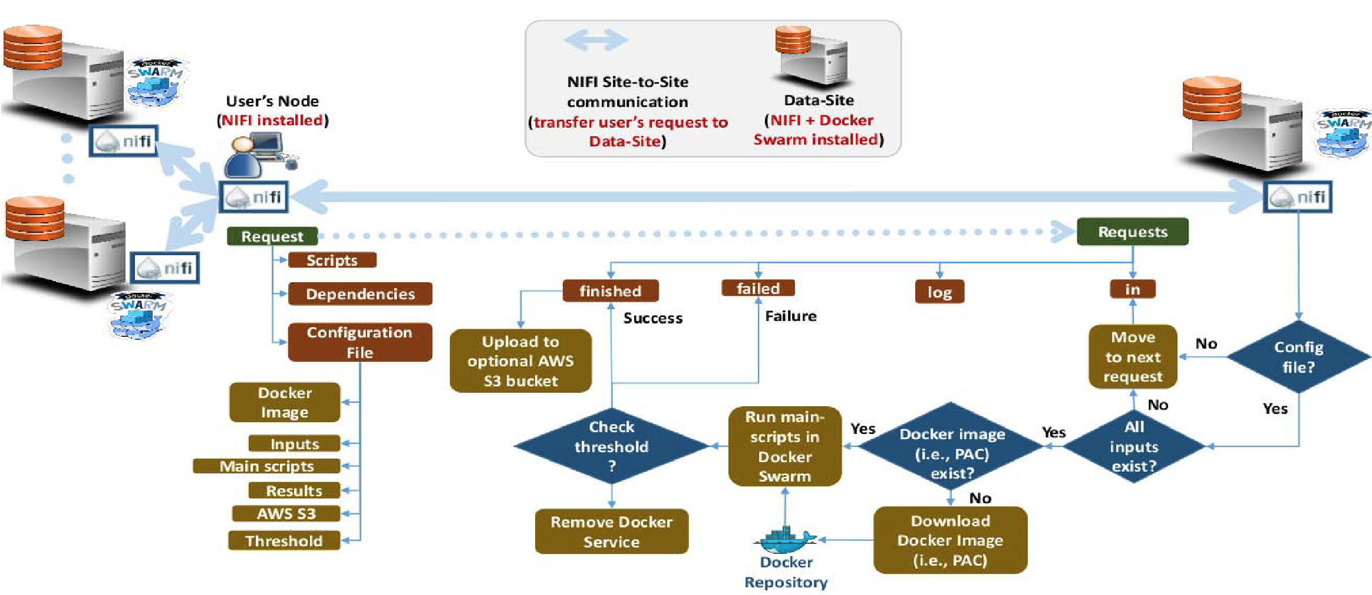
VIFI implementation of climate model evaluation
Docker container technology with workflow tool NIFI allows automated orchestration of distributed analytics on multiple data repositories.

Slide 22
Summary and future plans
In our application of the multi-objective optimization, objective functions are different metrics to evaluate climate models. model evaluation metrics. The output, an optimized set of parameters, are the weights assigned to models (ω_{i} for X_{i}) , and associated uncertainty of ω_{i}.
ω_{i} as a comprehensive score reflecting different evaluation metrics.
VIFI is expected to offer efficient workflow for Big climate datasets which are widely distributed.
To make full use of multi-objective optimization in climate model evaluation, we need to develop metrics which are almost linear while highlighting climate models’ performance.
Notes:
What makes our project unique is

