Slide 1

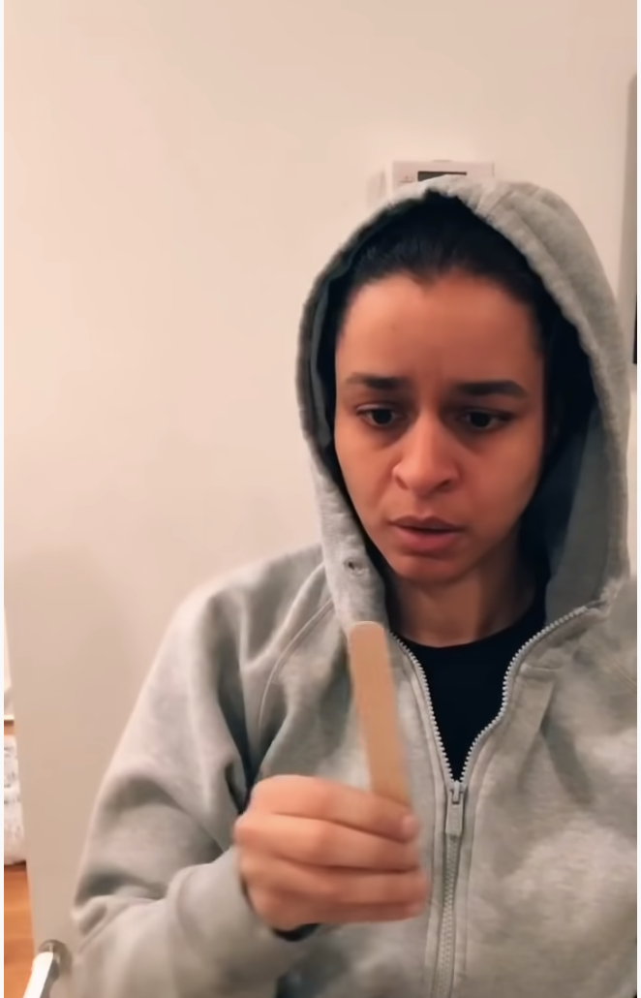
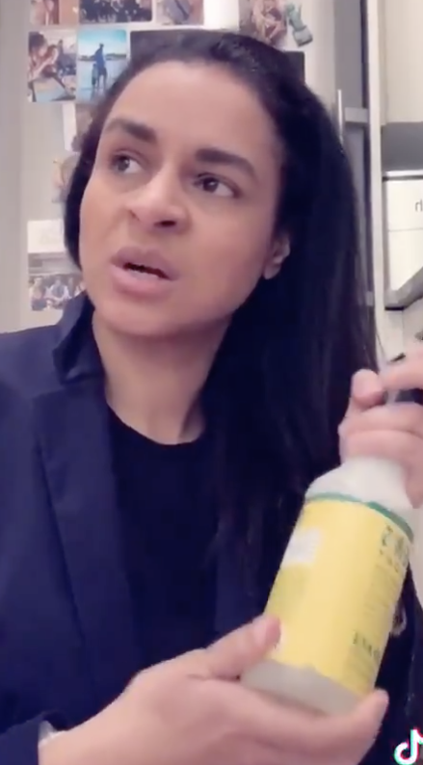
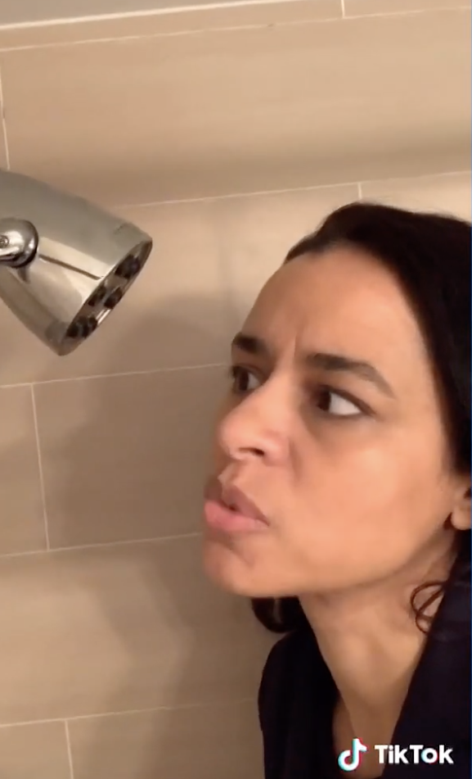
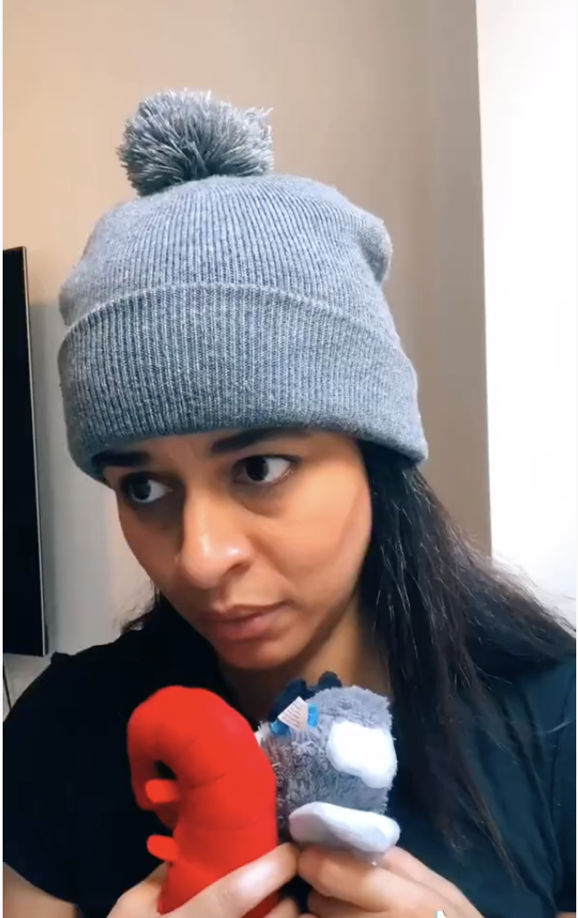
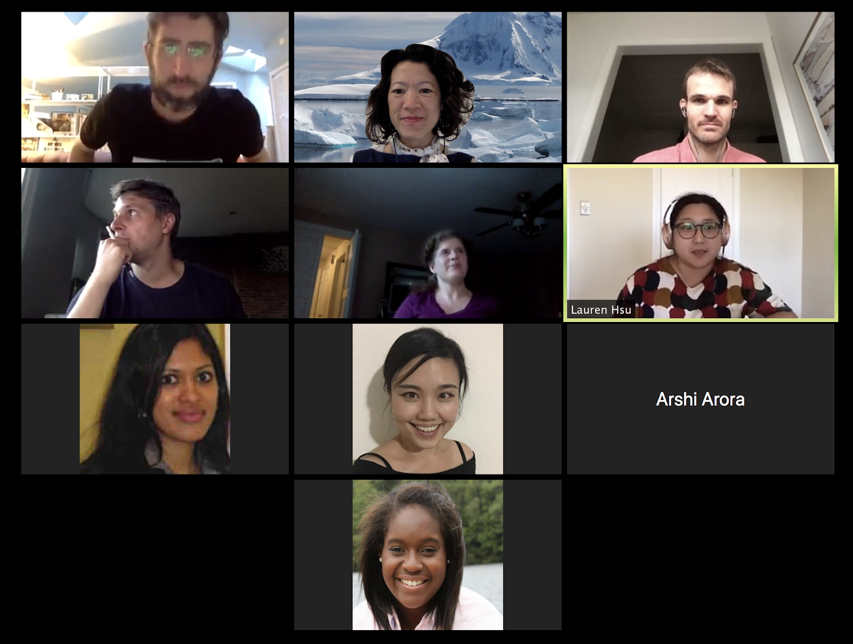
How to… benchmark
Mike Love, Kim-Anh Lê Cao, Matt Ritchie,
Ruben Dries, Aedin Culhane, Lauren Hsu,
Ayshwarya Subramanian, Sehyun Oh, Arshi Arora,
Taylor Ferebee

Slide 2
Session goals
Establish performance benchmarks and assessment standards for the multi-omics integration community
Deliver open-source resources for multi-platform analysis with common benchmark datasets to benchmark method performance
Question for Hackathon participants. Tell us what your benchmarking plan would have involved? What were barriers they encountered (lack of time, poor results, no ‘ground truth anyway’?)
Challenge Ia: How to… create new sc-multi-omics benchmark datasets
Challenge Ib: How to… simulate sc-multi-omics data
Challenge II: How to… performance metrics for sc-multi-omics methods benchmarking
Challenge III: How to… package software + data to support benchmarking

Slide 3

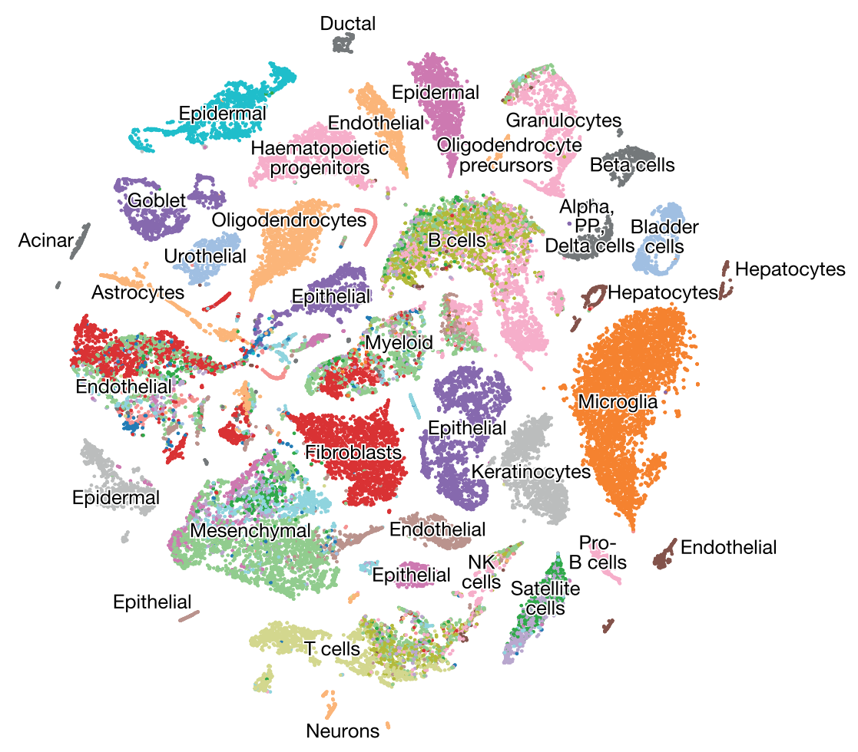
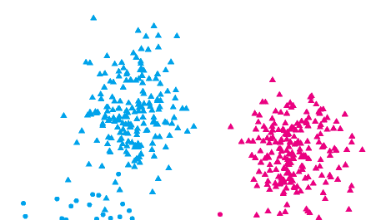
What do you mean benchmarking? Data + Methods + Metrics
'Real’ data
Control data
Simulated data
^
Complexity
Complexity
Complexity
Ground truth
Ground truth
Ground truth
Biological information
Biological information
Biological information
Silver-standard vs Gold-standard*
Svensson et al. (2017) Nat Methods; Wang et al. (2019) bioRxiv; Cole et al. (2019) Cell Systems; Zhang et al. (2017) bioRxiv;
Soneson et al. (2018) Nat Methods; Saelens et al. (2019) Nat Biotechnol;
*Freytag et al. (2018) F1000Res
^Zappia et al. (2017) Genome Biol https://www.bioconductor.org/packages/splatter
Notes:
This question is far from a trivial question. In order to crown the best method we need to know some ground truth. When looking at different clustering methods, we need to know which cells are of which cell type. When assessing different trajectory methods, we need to know the order of the cells according to their development as well as branching points in their lineage. Benchmarking datasets are datasets where we know the underlying truth or suspect we know something about the underlying truth. Benchmarking in Bioinformatics is very similar to biologists testing their antibodies on a positive control to see whether they work or not. In Bioinformatics, using benchmarking datasets we can test the accuracy of methods as well as how robust methods are to changes. We can also investigate how long a method takes, something that is very important to every Bioinformatician, since you do not want to sit around and wait for your analysis.

Slide 4
Challenge Ia: How to… create new sc-multi-omics benchmark datasets
If you had $$$$$ what experiment would you generate to help with multi-omics benchmarking?
For inspiration, look to the gene expression literature:
  3 main strategies used in control experiments designs for gene expression: spike-in (ERCCs, SIRVs, sequins), dilution series, mixtures
  For scRNA-seq various groups have used cell mixtures with known inputs and created reference samples with baked-in structure that is profiled by different protocols and used to compare technologies and analysis methods (Tian et al. (2019) Nat Methods; Mereu et al. (2020) Nat Biotechnol; Ding et al. (2019) bioRxiv)

Slide 5
A brief history of control experiments for gene expression
What are they? Experiments where we know what’s going up / down / not changing
Why do them? Built-in truth allows platform /protocol / computational methods comparisons
Who does them? Manufacturers, individual labs, through to large-scale consortia (MAQC / SEQC)
3 main flavours: spike-in (ERCCs, SIRVs sequins), dilution, mixture
For scRNA-seq, mixture designs reign supreme! (Tian et al. (2019) Nat Methods; Mereu et al. (2020) Nat Biotechnol; Ding et al. (2019) bioRxiv). One dilution Grün et al. (2014) Nat Methods

Slide 6
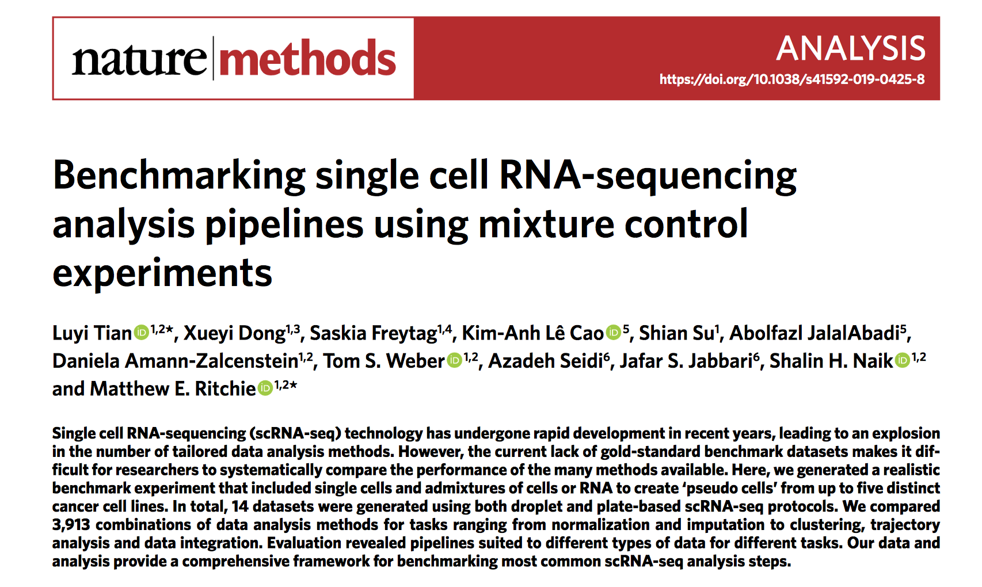
https://rdcu.be/bEAvh
https://bioconductor.org/packages/CellBench

Slide 7
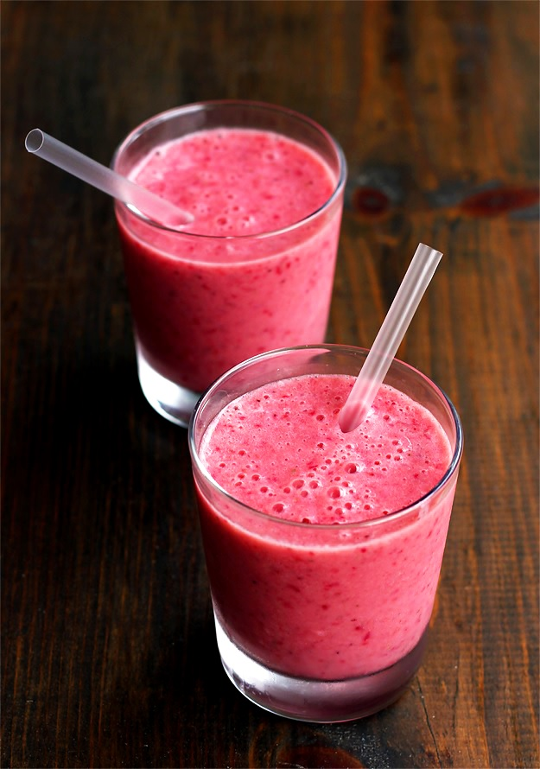
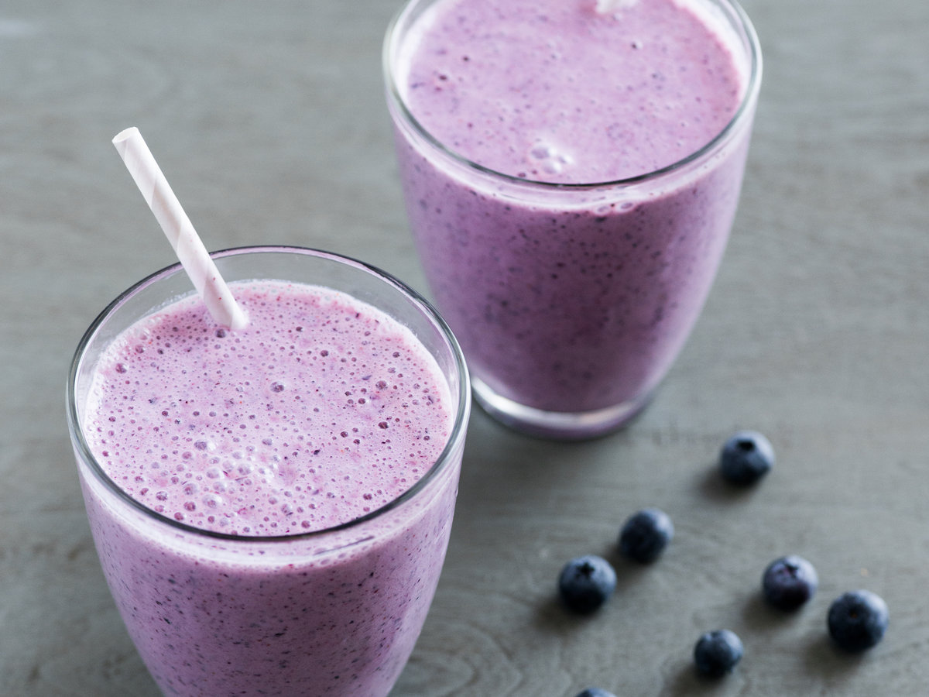
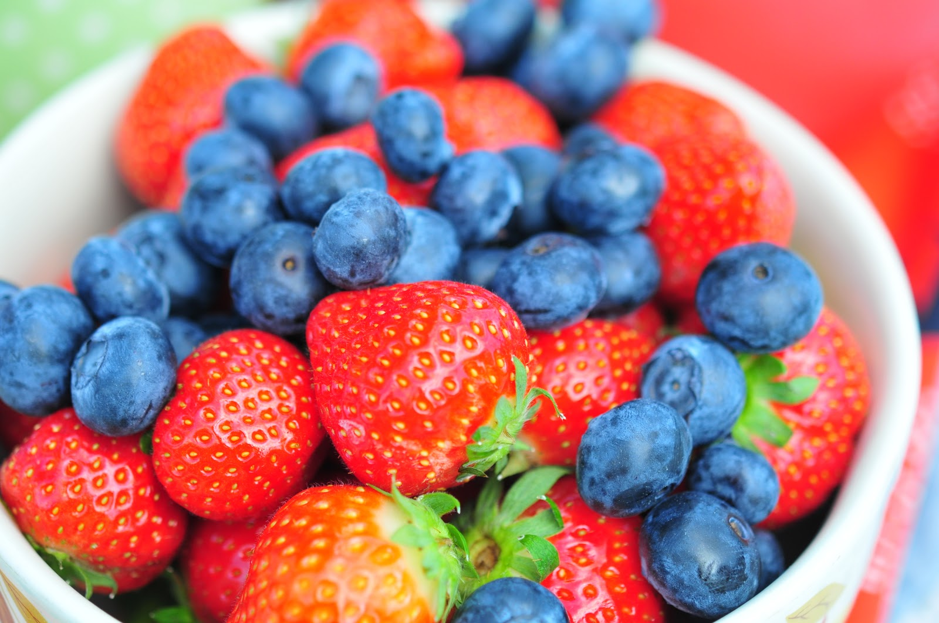
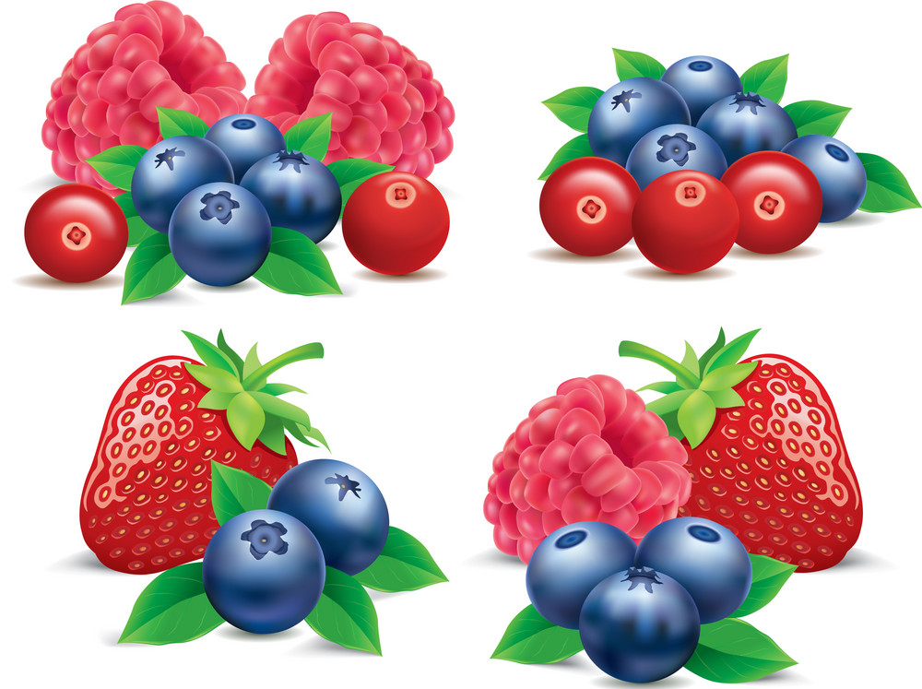
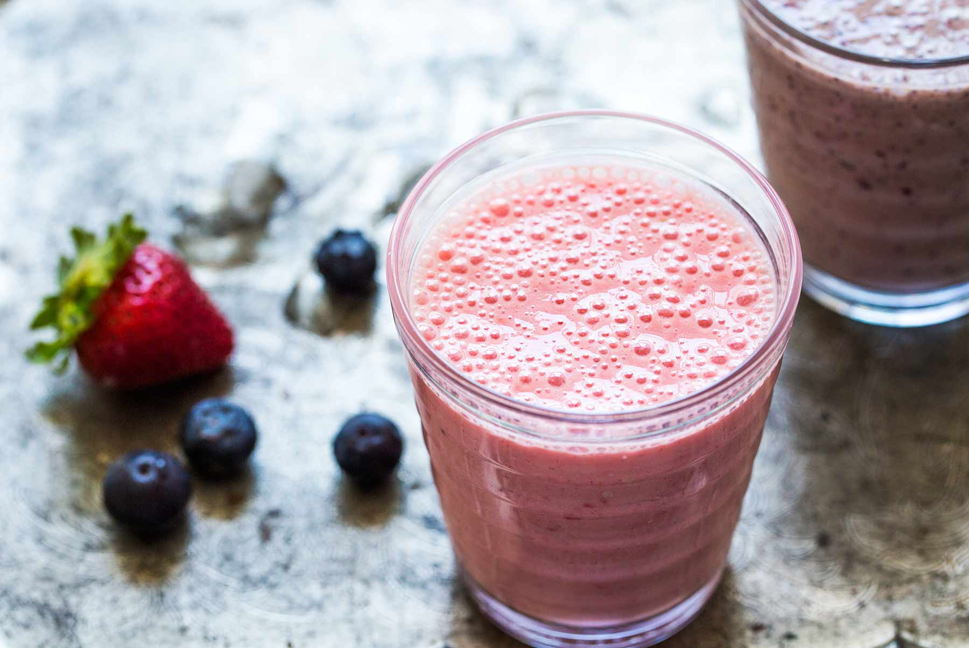
scRNAseq mixology
Mixture control experiment that use lung adenocarcinoma cell lines (we know what we put in)
Single cells
Cell mixtures
RNA mixtures
H2228
H1975
HCC827
H2228
H838
H2228
H1975
A549
H1975
HCC827
HCC827
Notes:
cell lines used in previous benchmarking study performed at WEHI
Extract RNA from each cell lines in bulk and mix them in certain proportions.

Slide 8
scRNAseq mixology datasets
A collection of 14 datasets generated using 10X, CEL-seq2, Drop-seq and SORT-seq protocols.
H2228
H838
H1975
A549
HCC827
single cells(n=902)
single cells (n=3918)
cell mixture (n=288)
RNA mixture (n=340)
single cell
doublets
PCA visualization

Slide 9
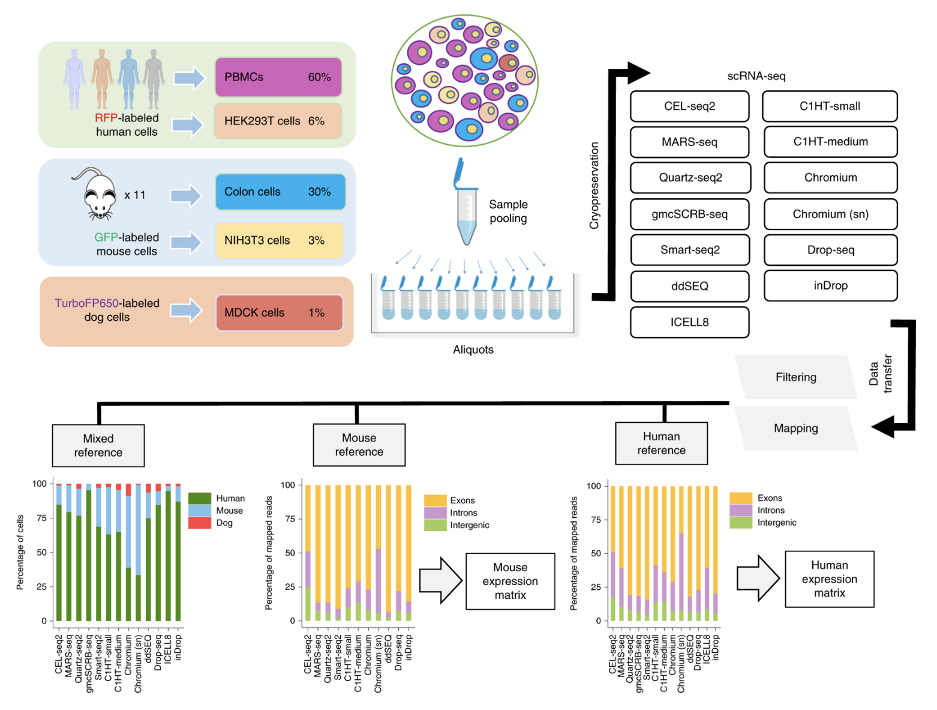
Mereu et al. (2020) Nat Biotechnol

Slide 10
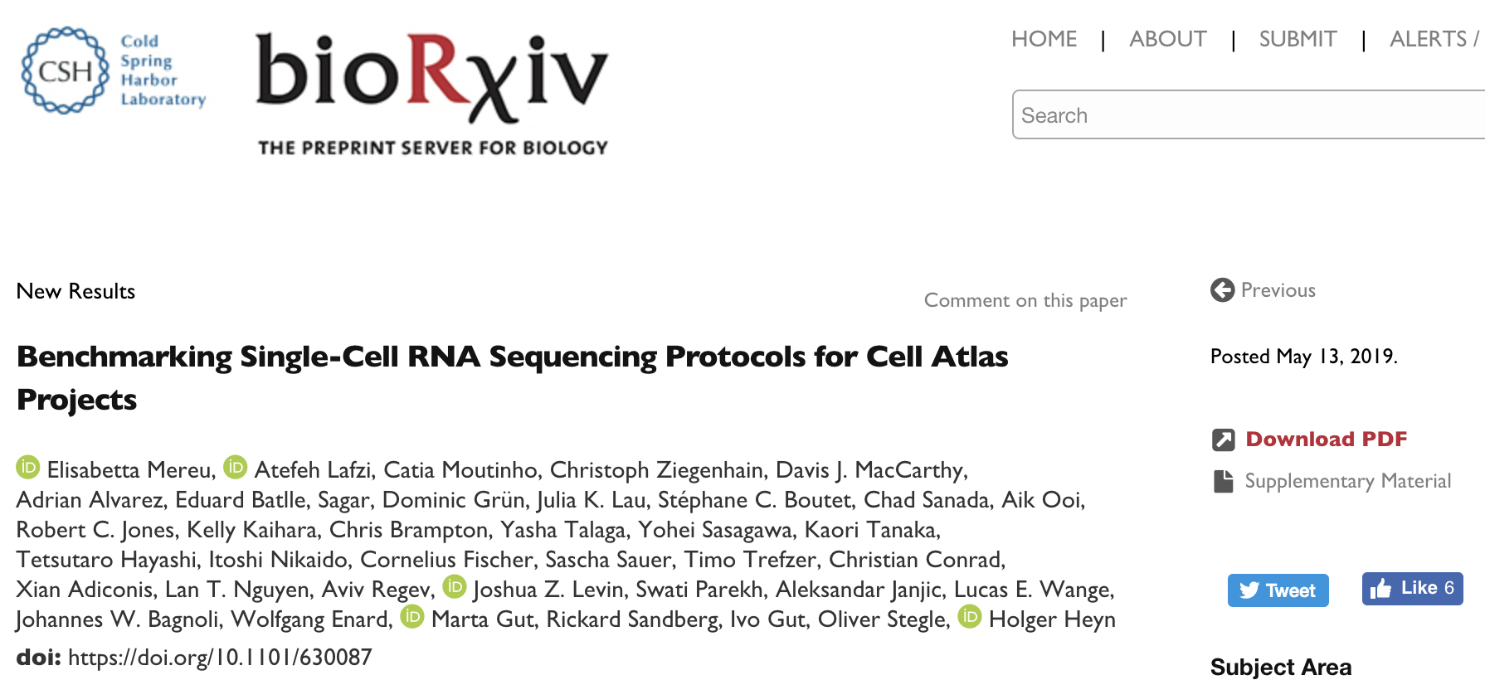
https://www.nature.com/articles/s41587-020-0469-4

Slide 11
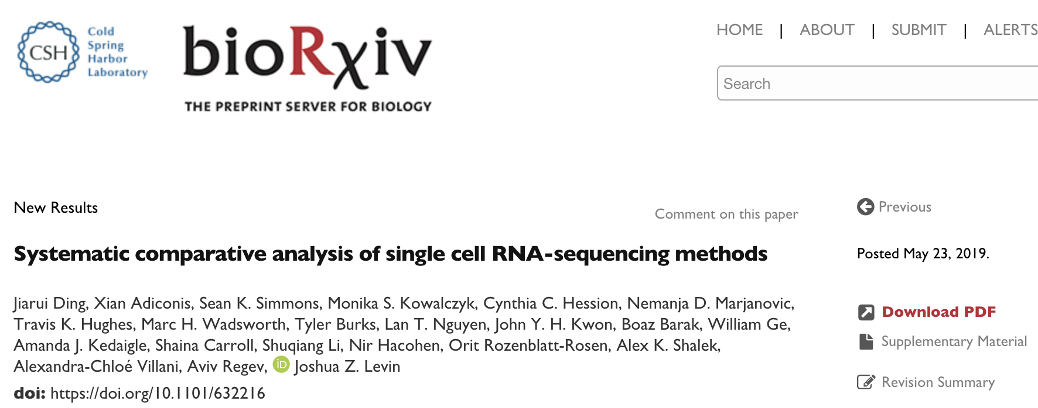

Slide 12
Challenge Ia: How to… create new sc-multi-omics benchmark datasets
  Does the mixing idea extend to:
    sc-spatial technologies ✖️
    sc-targeted proteomics ✖️
    scNMT-seq ✔️
  Potential outcome: plan and commission such benchmark experiments and share data to kickstart methods development
  -> Need to understand the biological question / task that the data can help benchmark (methods comparisons vs technology platforms). Current data sets focus on providing labels for cell type.

Slide 13
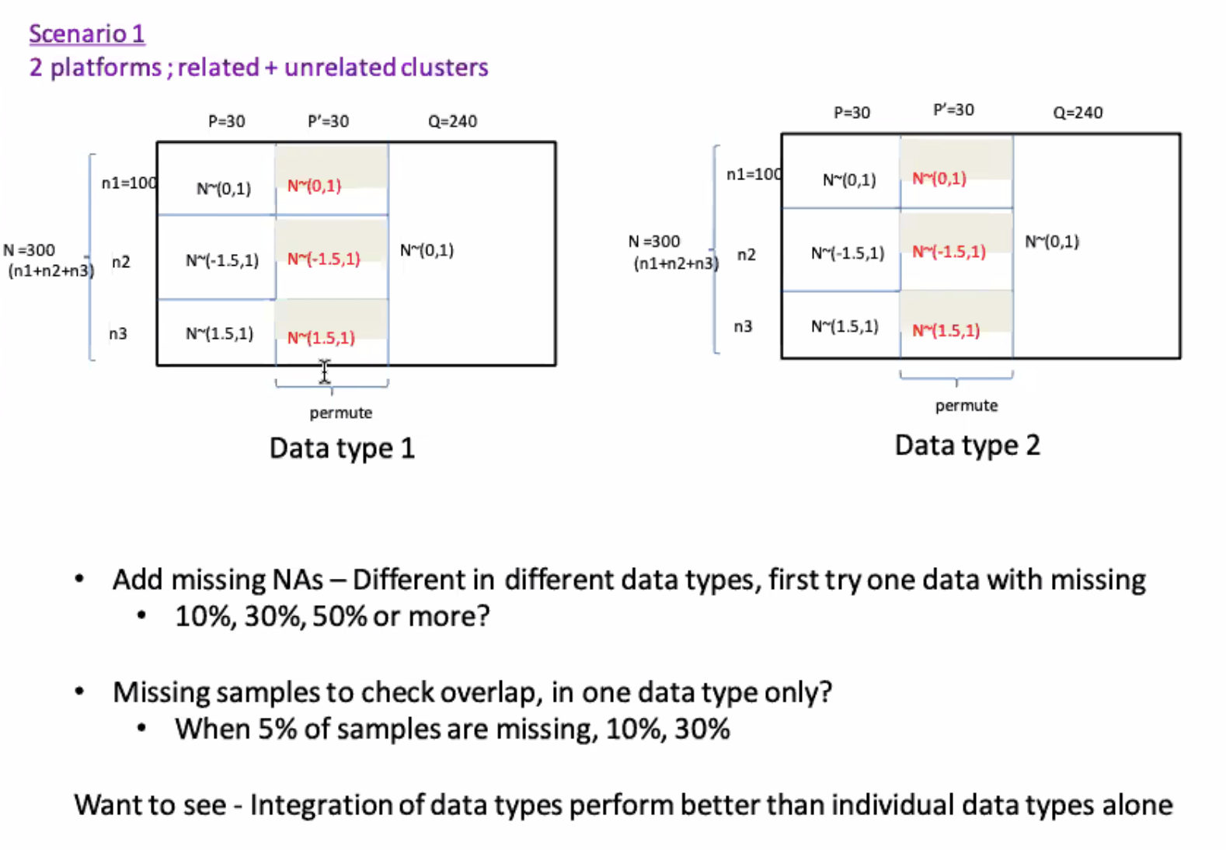
Challenge Ib: How to… simulate sc-multi-omics data
Arshi Arora
MOSAIC

Slide 14
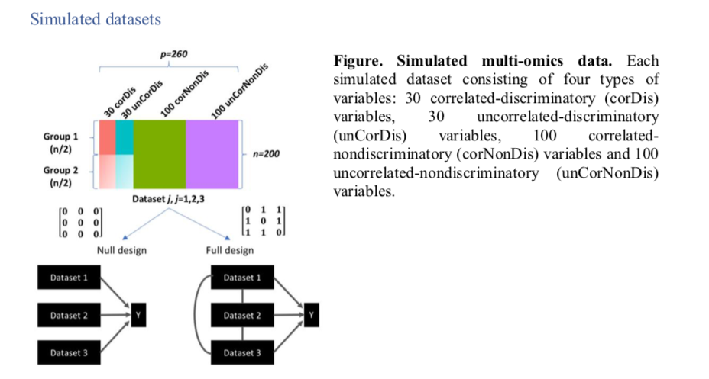
Challenge Ib: How to… simulate sc-multi-omics data
Amrit Singh
Singh et al. (2019) Bioinformatics
Potential outcome:
sc-multi-omics

Slide 15
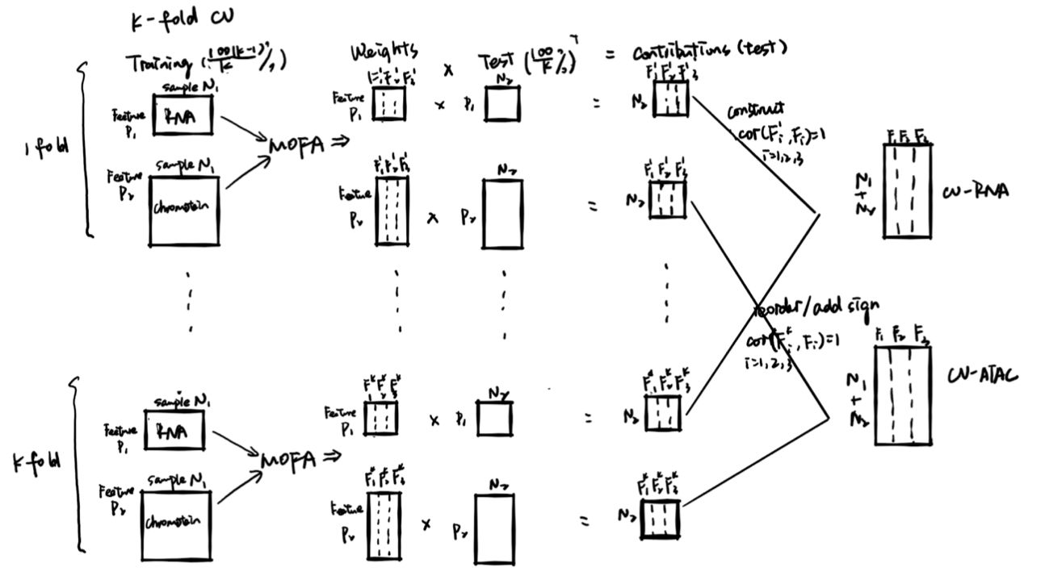
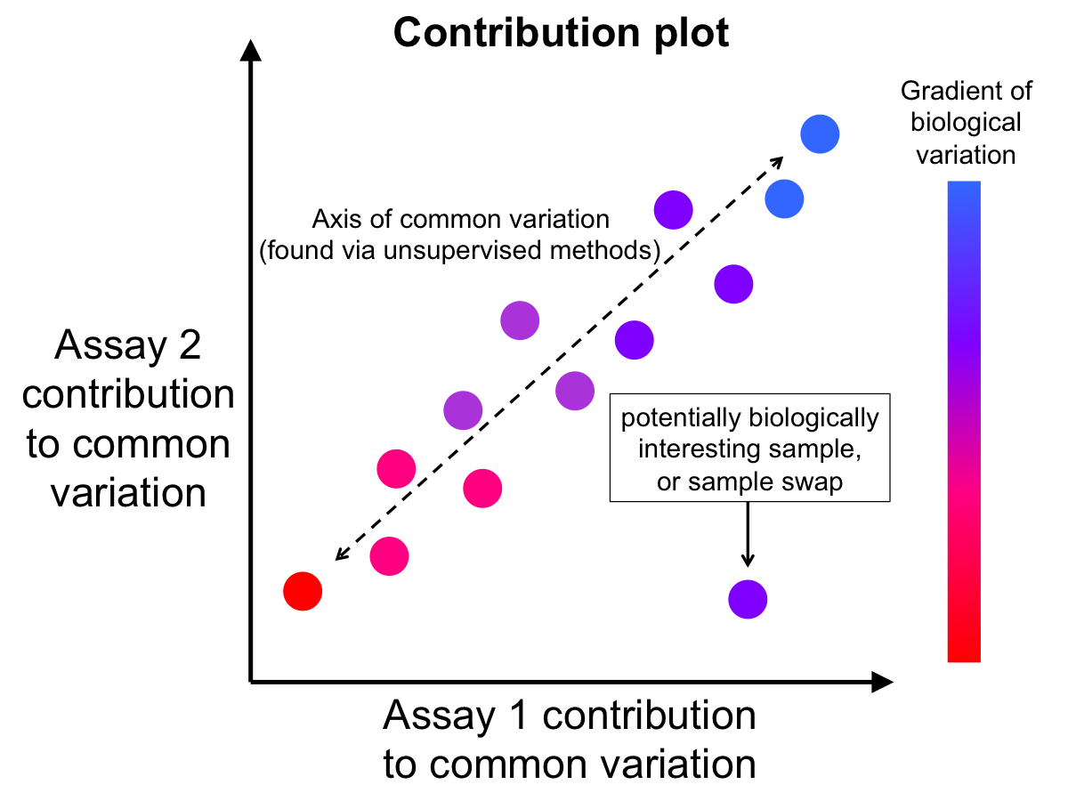
Challenge II: How to… performance metrics for sc-multi-omics methods benchmarking
  ARI/AWS/Silhouette for assessing recovery of cell types
  Consistency vs biologically relevant (Mike Love)
  Alignment of data you expect to be the same - variance between platforms (Lauren Hsu)

Slide 16
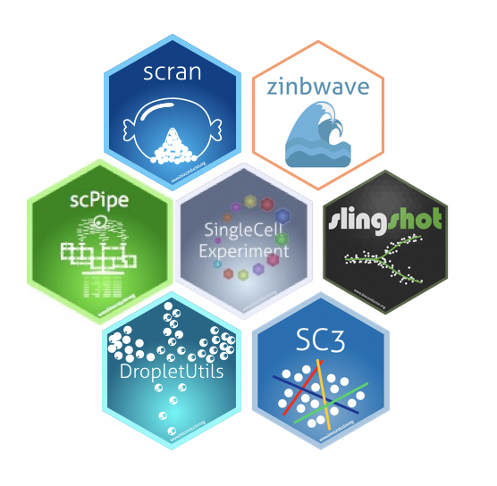

Challenge III: How to… package software + data to support benchmarking
Datasets
Potential outcome: Agree on data standards and common storage classes?
SingleCellMultiModal / SpatialExperiment

