Slide 1
Debriefing: sc targeted proteomics
Aedỉn Culhane

Slide 2
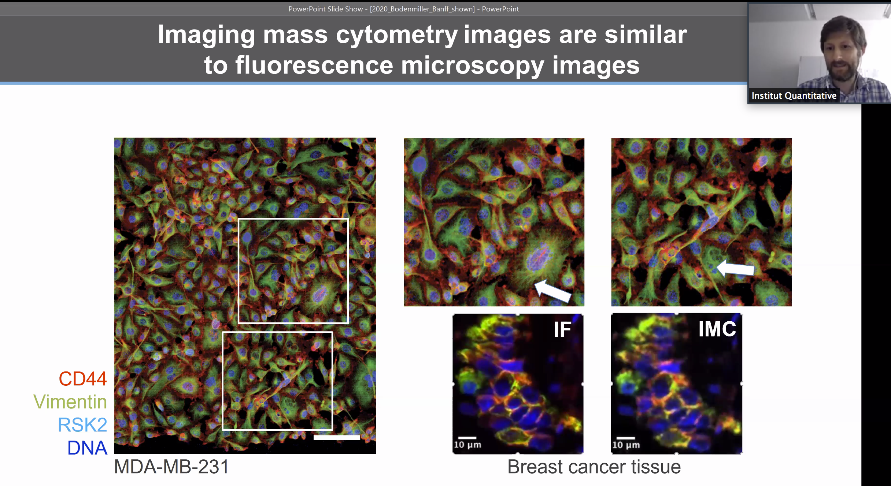
sc targeted Proteomics; Application and Future
Increasing resolution, 3D, but limited # Proteins,
Good on FFPE so many samples available
Spatial/co- expression of known molecular targets, small molecule inhibitor
Longitudinal Clinical/Biological
Widespread use depend on clinical utility and cost
Cell properties- shape/size, type
Cell type proportions /composition
Cell location, co-location analysis
Cell higher architecture (clusters of cells)
Cell-cell interaction (eg tumor-immune)

Slide 3
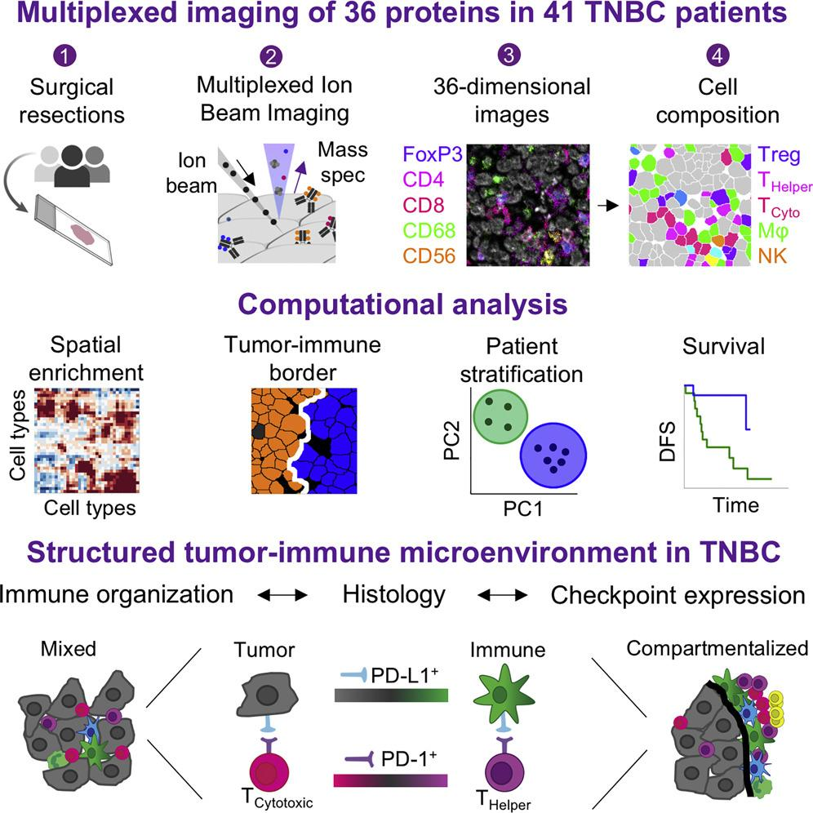
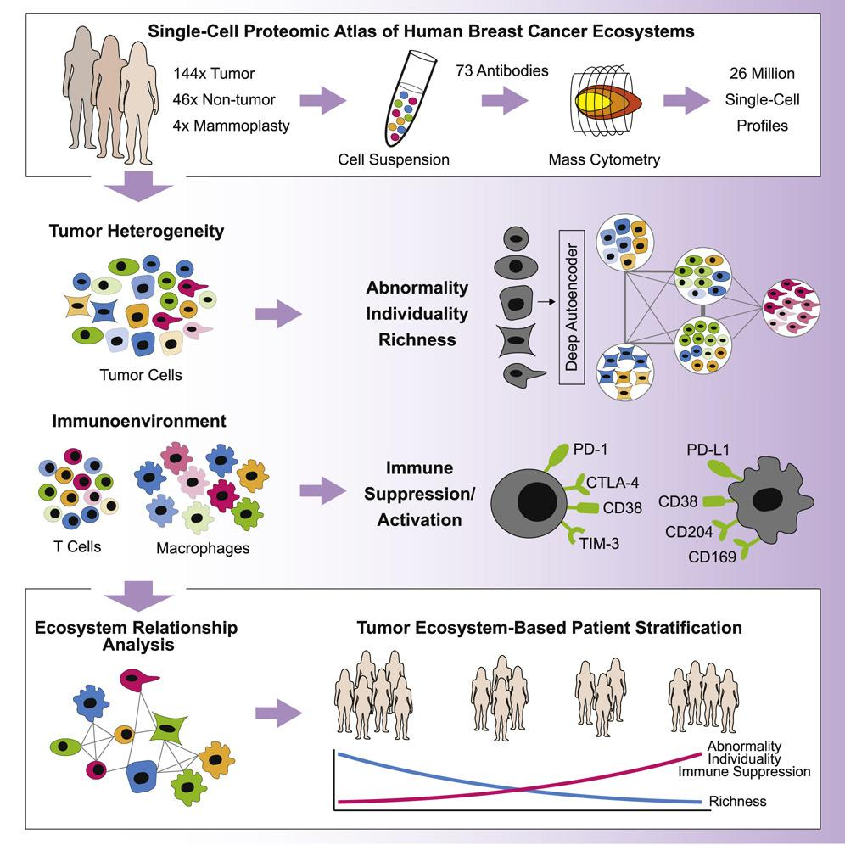
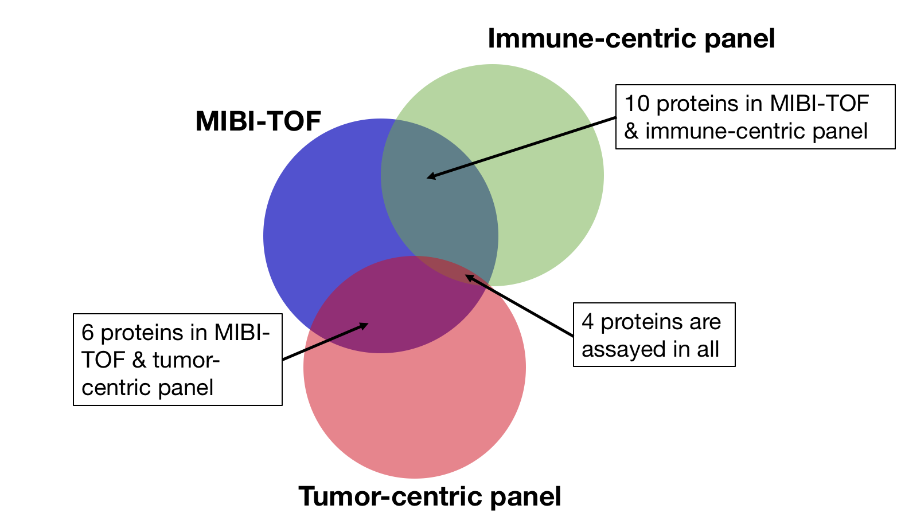
Data challenge
Single-cell targeted proteomics across technologies
Data from 2 studies characterizing the breast cancer tumor immune microenvironment, using:
Multiplexed ion beam imaging by time-of-flight
(MIBI-TOF)
Mass cytometry
(aka mass tag, CyTOF)
36 proteins
41 TN breast cancer patients
73 proteins across 2 panels: tumor and immune
140 breast cancer patients, 6 TN
… with a total of 20 overlapping proteins
Keren, et al. (2018)
Wagner, et al. (2019)

Slide 4
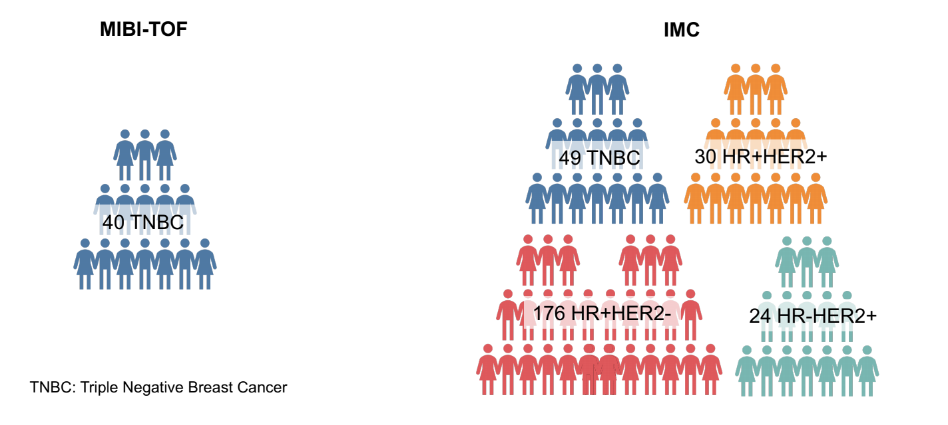
Data Challenge was challenging
Limited overlap in phenotype: only 6 TN patients in the CyTOF dataset
Limited overlap in proteins → some cells cannot be detected in one platform
Few features. Can’t integrate features at Gene Ontology or Pathway level
No obvious “ground truth” for validation

Slide 5
Hackathon Challenge Questions
How should we approach integrating partially-overlapping proteomic data collected on different patients with similar phenotypes?
Can we integrate other 'omics datasets to support the results of these proteomic analyses?
Without including the spatial x-y coordinate data, how well can we predict cell co-location?
Can we predict the spatial expression patterns of proteins measured on mass-tag but not measured in the MIBI-TOF data?
What additional information can we learn about the different macrophage and immune populations in breast cancer by conducting integrated analyses of these datasets?

Slide 6
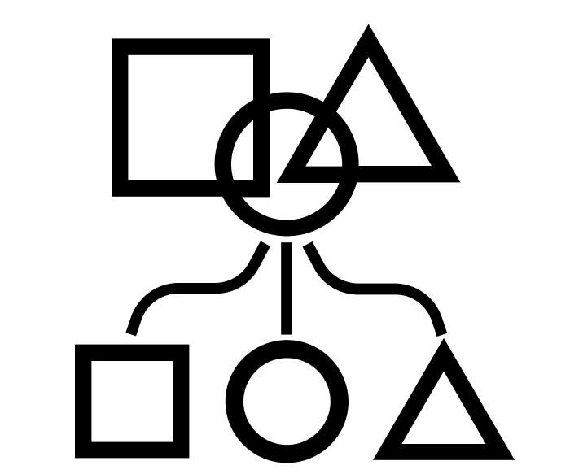
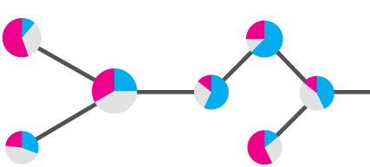
Challenges
Integration of features
Prediction
Spatial structure co-location, autocorrelation
Cross-platform
Transfer Imputing features across datasets
Transferring cell labels between datasets
Spatial co-location, structure
clinical significance

Slide 7
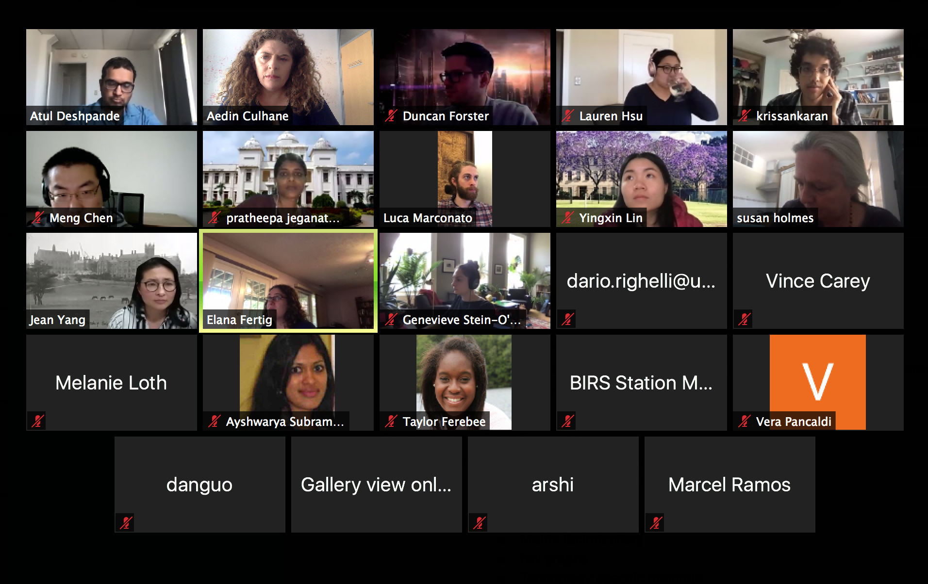
sc targeted Proteomics Brainstorm

Slide 8
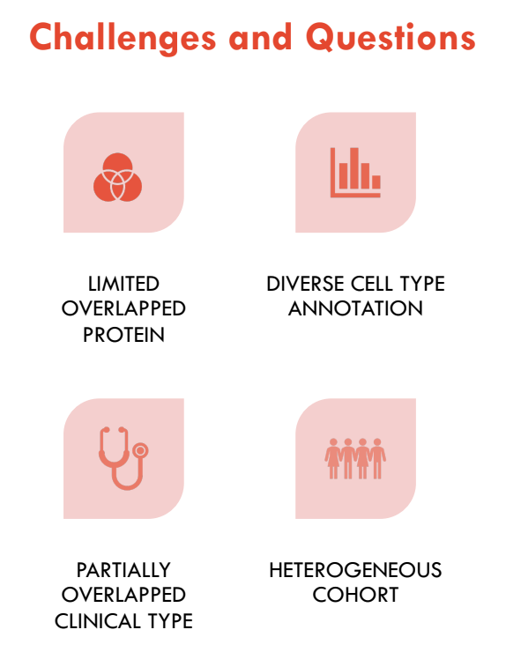
Challenges in Data Integration
Connecting partially overlapping datasets (feature)
Gene Ontology (Duncan- cell type specific map)
Combining different scales
Normalization
Scale - connecting partially overlapping datasets (cell)
Coarse and fine grained resolution
(single cell-> bulk-> spatial->communities)
Hierarchical , layers
Integration at clinical level

Slide 9
Data Challenges: Normalization
Transform - log, arcsinh, sqrt?
Order of magnitude in scale
Questions about the validity of normalizing by Cell Size (neurons v leukocytes)
Cell type markers maybe only 1 cell type
Quantile -can’t assume composition or sum of expression uniform
Different physical technologies, strong batch effects
Funky MIBI not mass Tag Umap - Why?
Outlier effect of cell type marker in low feature space, where markers unique to cell?

Slide 10
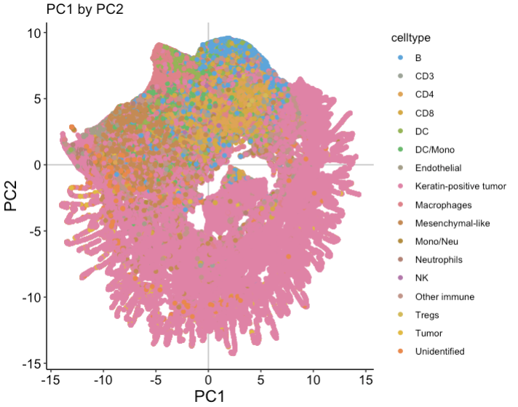
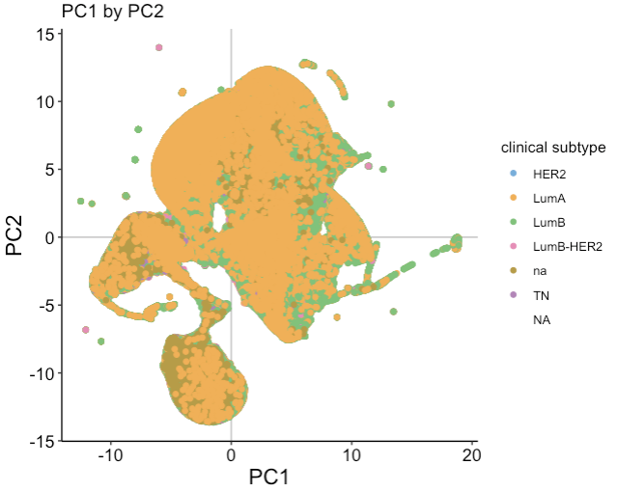
The UGLY MIBI UMAP!!!
mibi
cyTOF

Slide 11
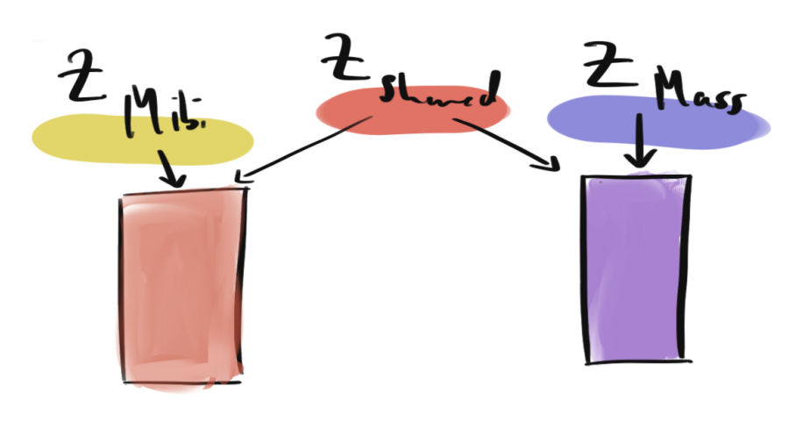
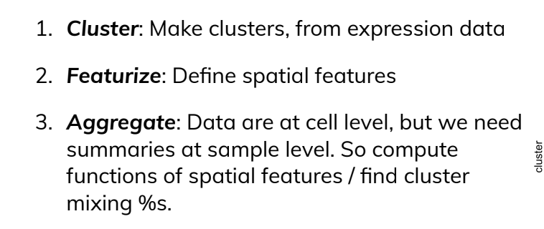
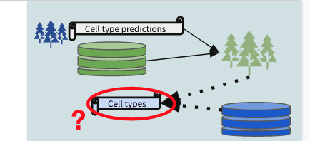
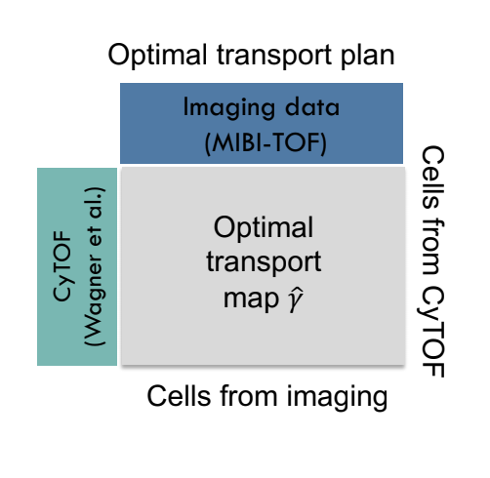
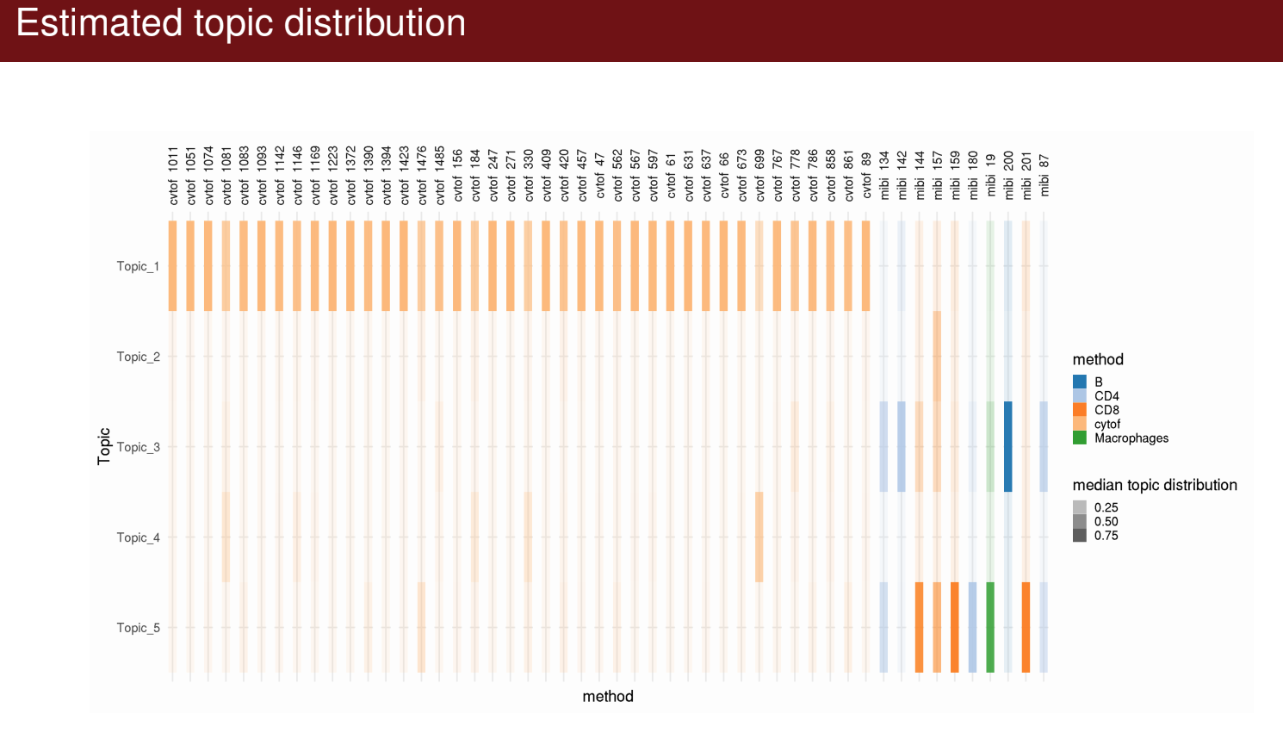
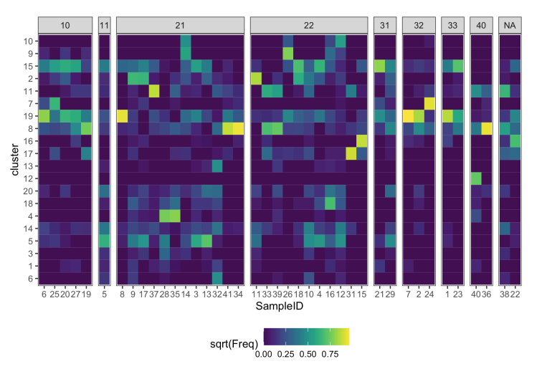
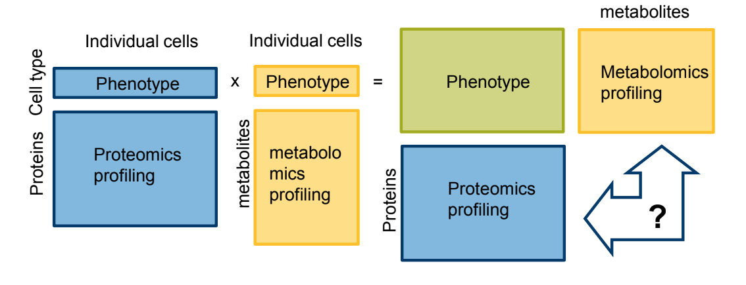
Connecting Partially overlapping Data
Cells/Clusters/Clinical - Two broad approaches Embedding or Graph - Taxonomy

Slide 12
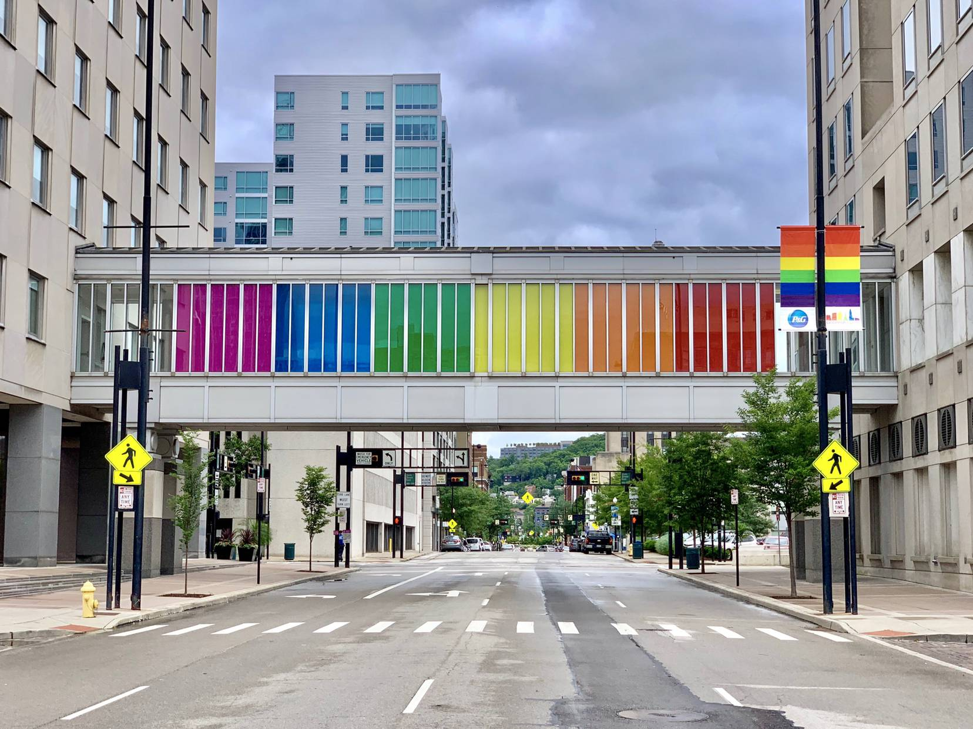
Bridge to connect data with partial/little overlap
Proteins as cell type or state marker
“BRIDGE”
Presence/Absence of Cell States
Cell compositions/proportions
Spatial Structure (eg Morans)
Biological Sample Phenotype
Clinical features
Survival (interval/right censored discussion)

Slide 13
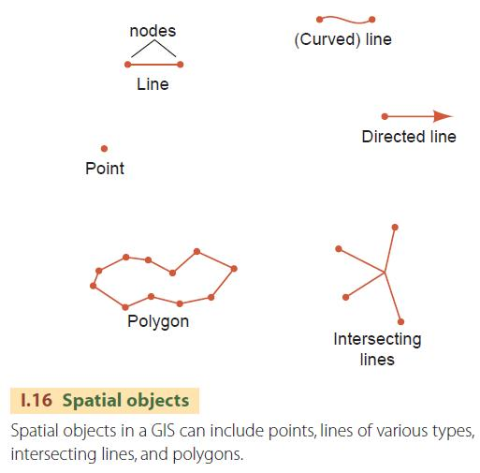
Integration of Spatial data - Scale, SWM
Scale and space in biological systems
How to define spatially- points, lines, polygons
XY centroid may poorly capture
Cell size or shape (neuron)
Neighbours may depend on cell size/shape
Community
Partially overlapping

Slide 14
Integrating Spatial Data -
Biological data have always been spatial
Spatial statistics already well established in other fields
GIS, Ecology, Plant science (Taylor Ferebee), Weather (Elana Fertig)
Statistics based on Euclidean distance (Sphere), graph triangulation (Moran, Gabriel), K-NN etc
15 years ago applied Ripley’s K factor on biopsy (Susan Holmes)
Test statistics to associate spatial patterns with covariates

Slide 15
Connecting features to spatial across platforms
Need to unify scaling (Vera Pancaldi)
Limited expected map of
The physical structure
Cell composition in structure
Expected level of protein expression
How to connect Coarse v Fine resolution neighborhoods ?

Slide 16
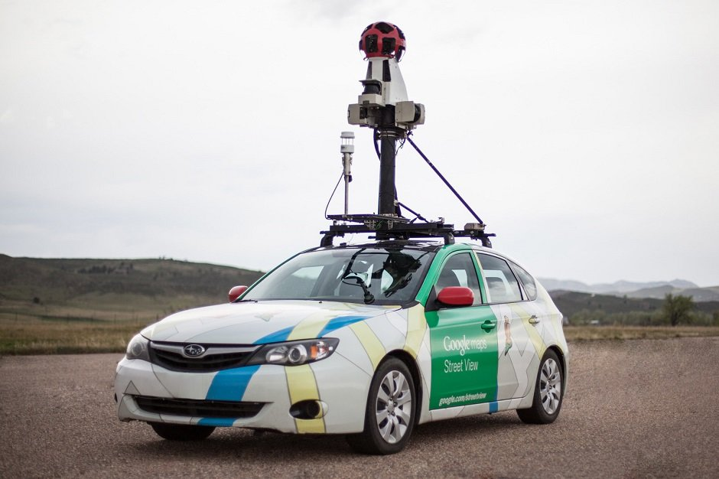
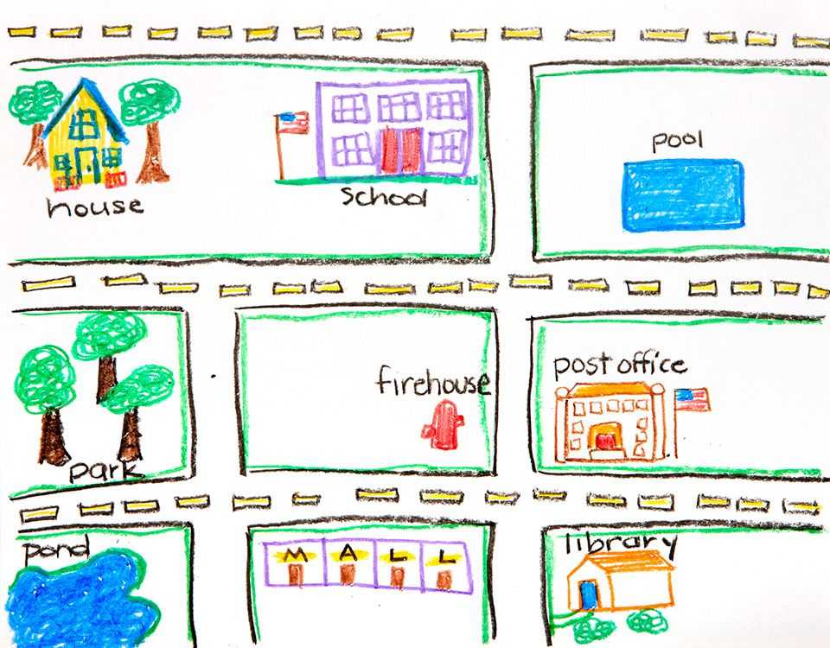
Connecting features to spatial across platforms
Need to unify scaling (Vera Pancaldi)
Limited expected map of
The physical structure
Cell composition in structure
Expected level of protein expression
How to connect Coarse v Fine resolution neighborhoods ?
NEED

Slide 17
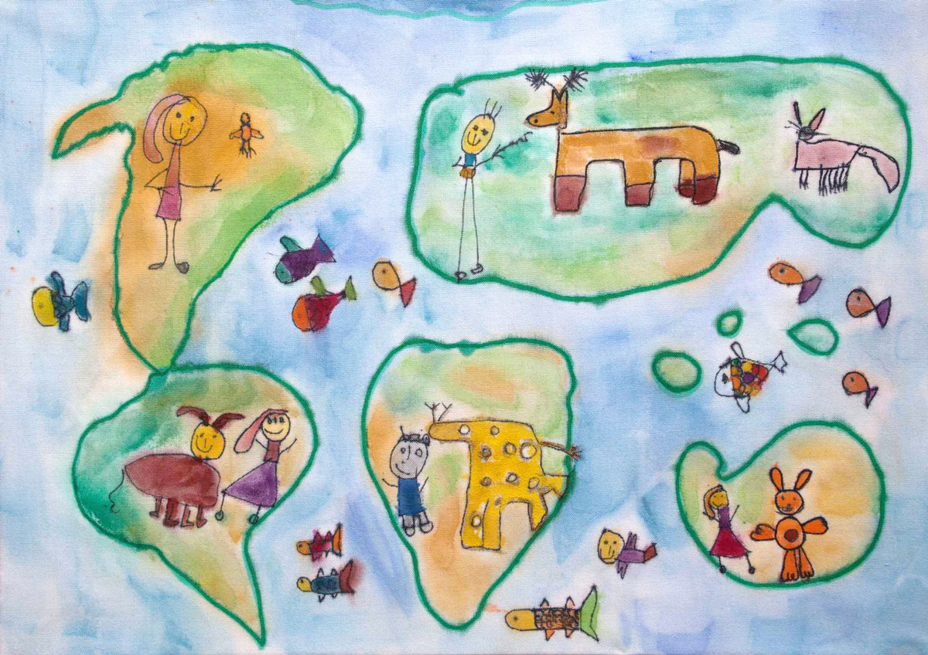
Have - Digital ‘Omics + Analog Map
Library, Trinity College Dublin, Ireland
Will be “driving” blindly until we have a digital cell location map

Slide 18
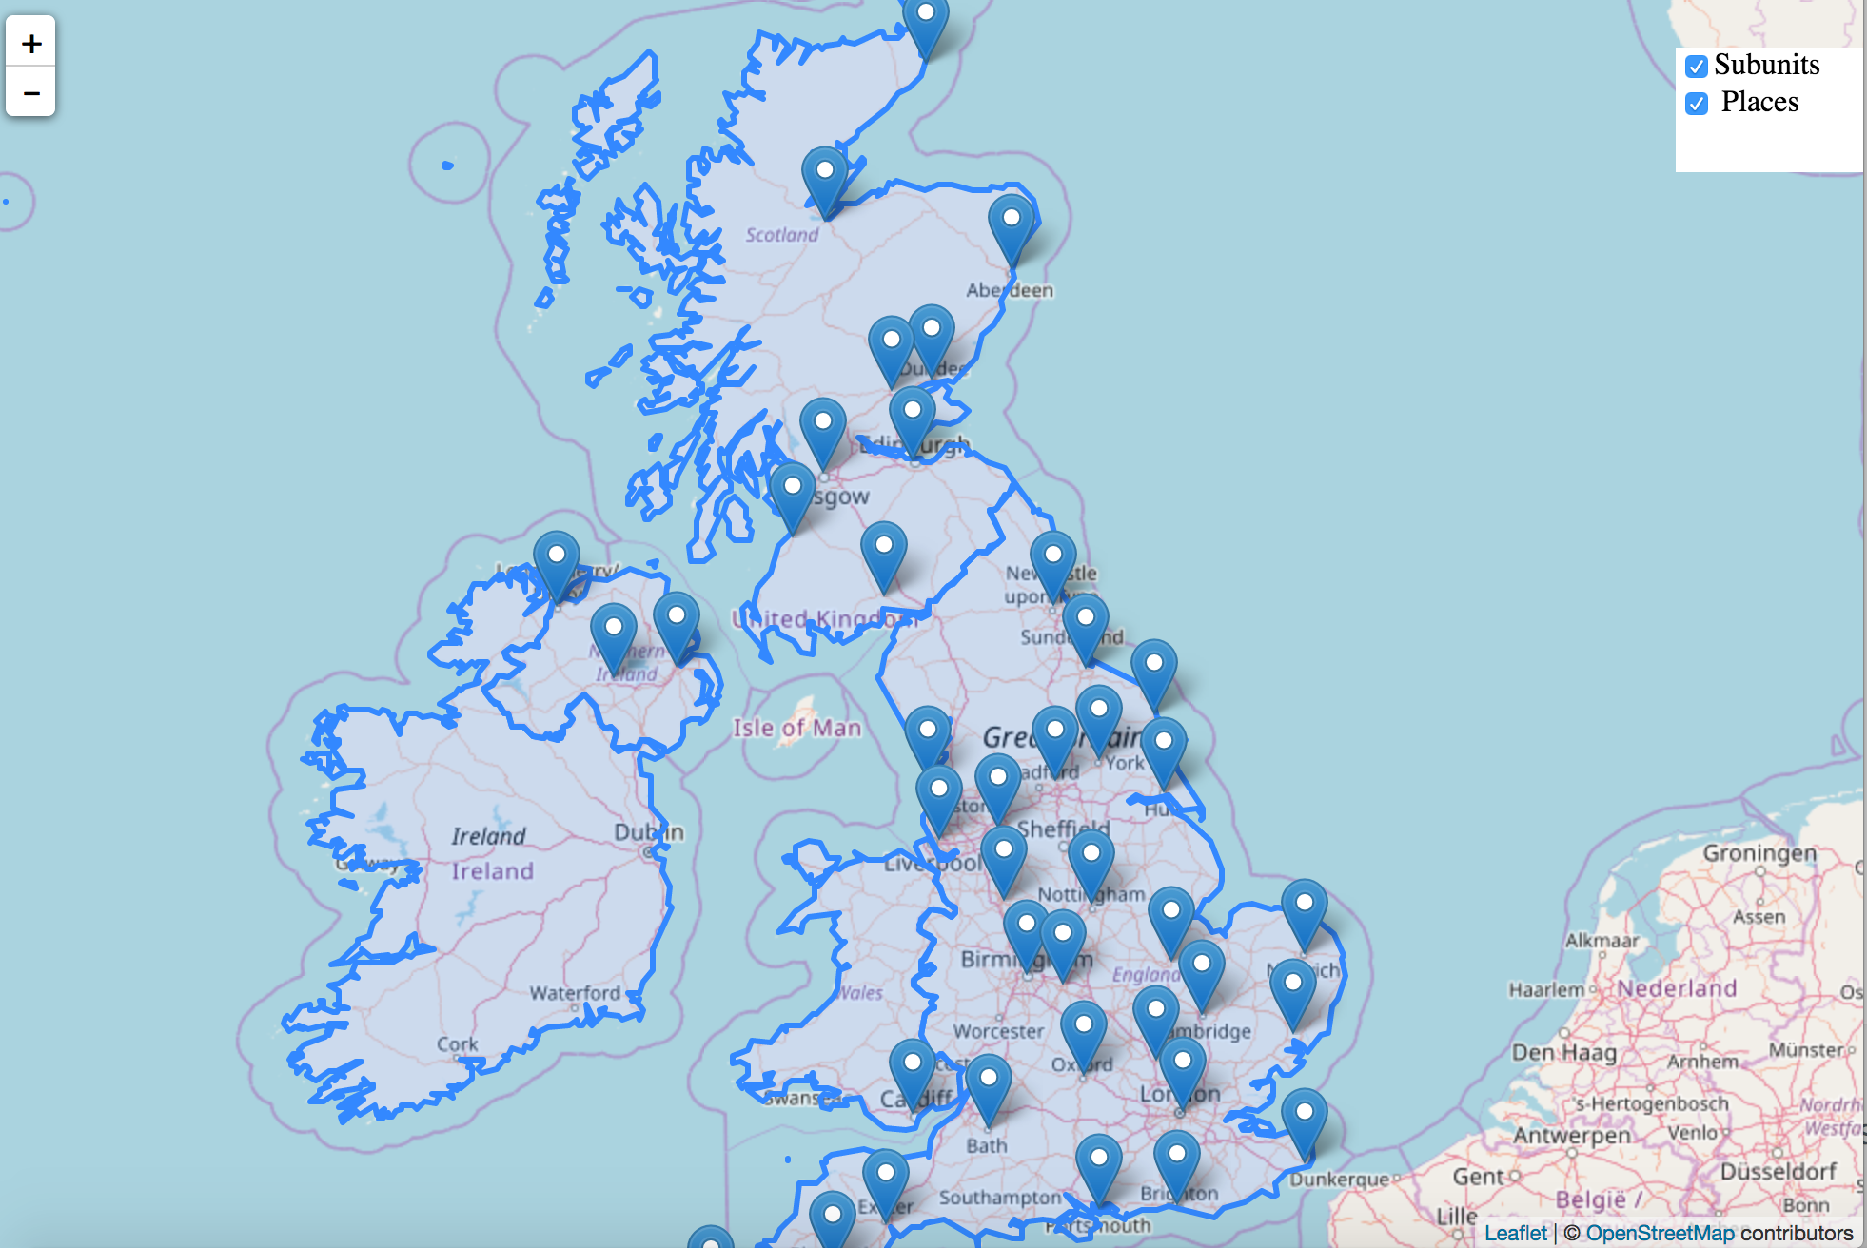
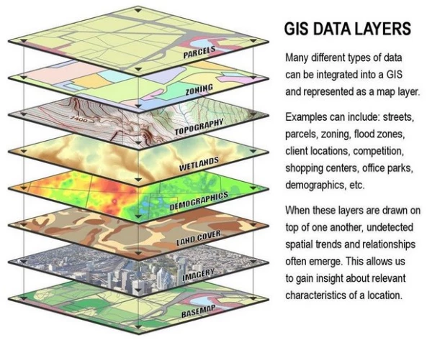
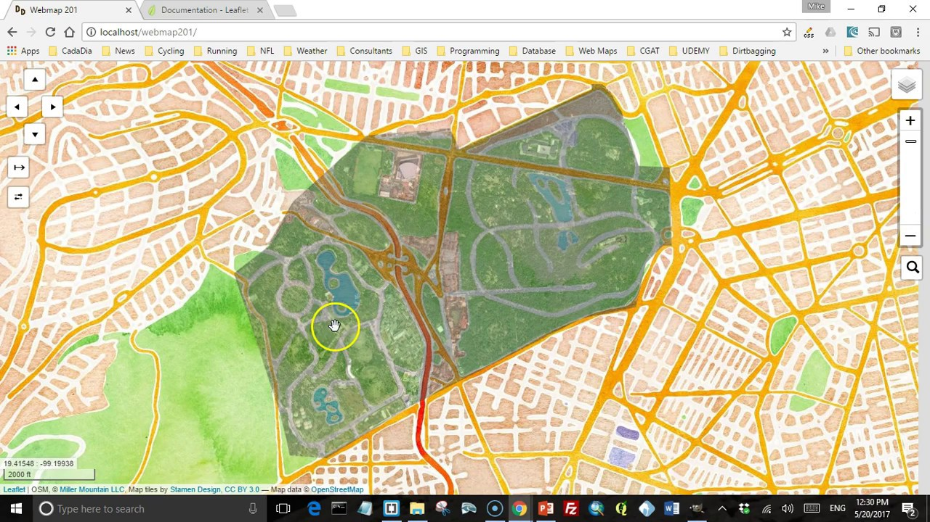
Have layers in GIS data (Susan Holmes)

Slide 19
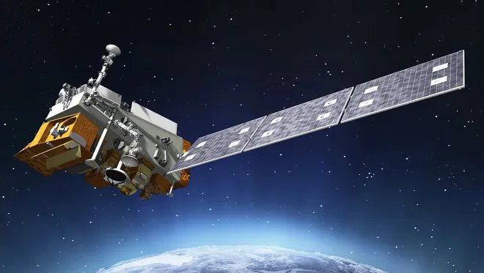
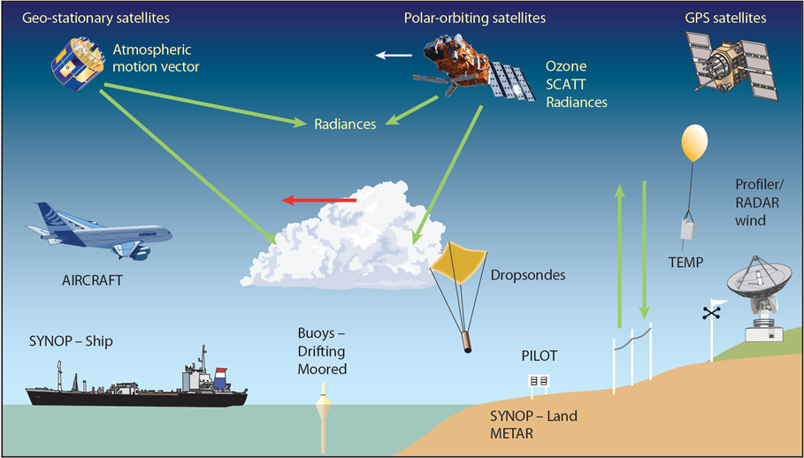
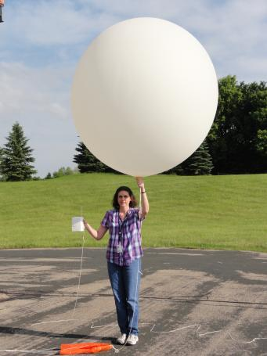
Weather layers: Satellites, Weather Balloons (Elana)

Slide 20
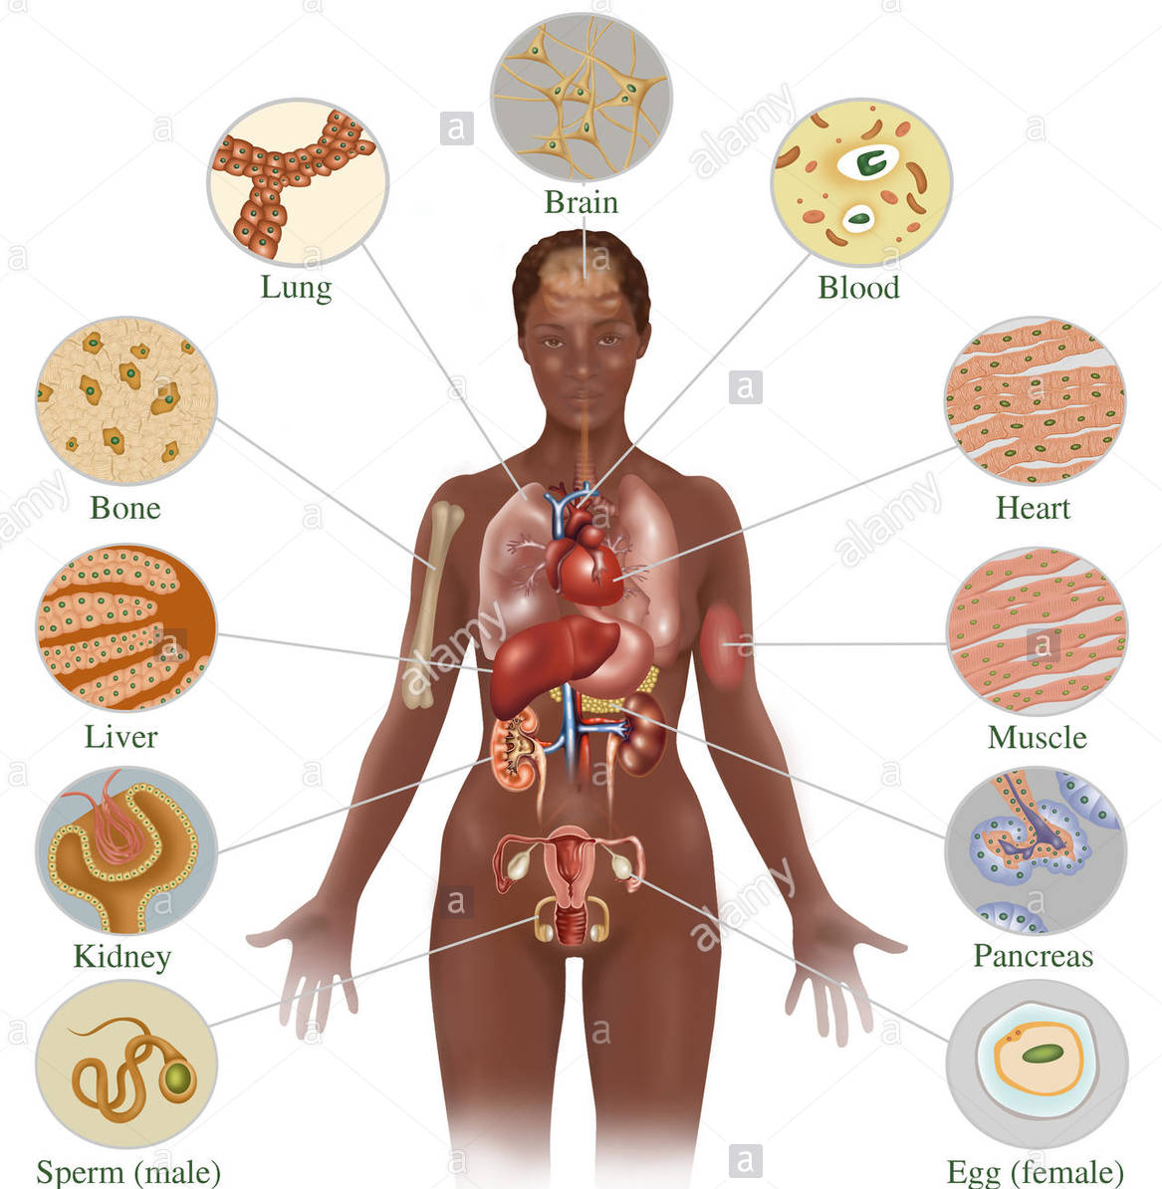
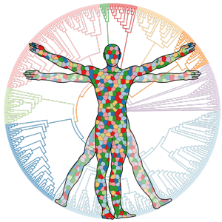
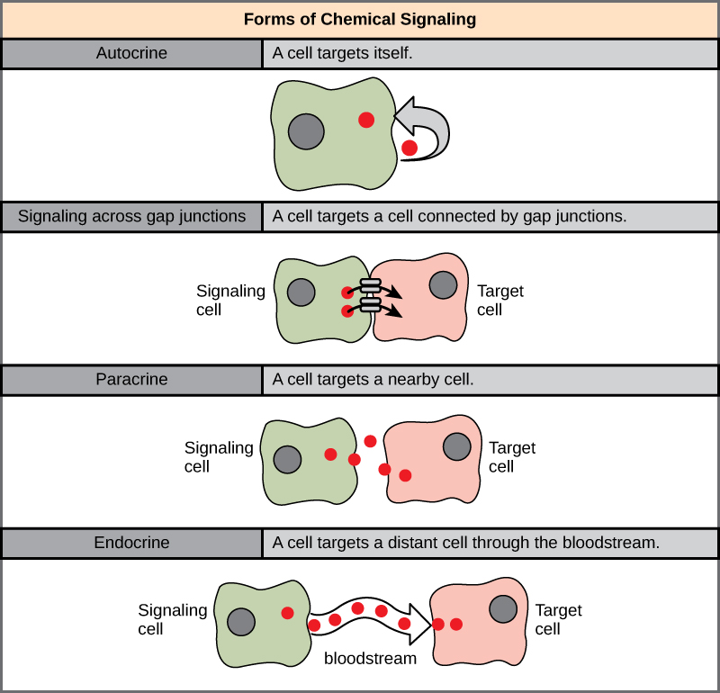
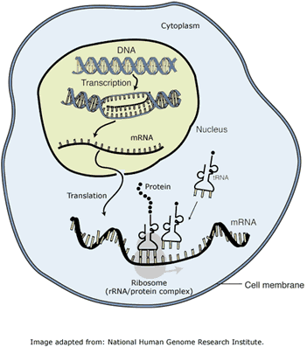
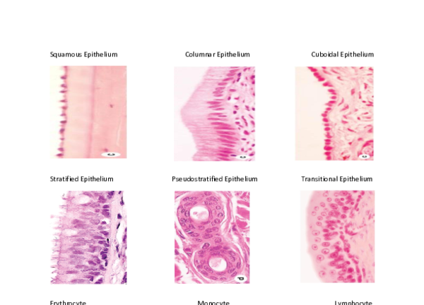
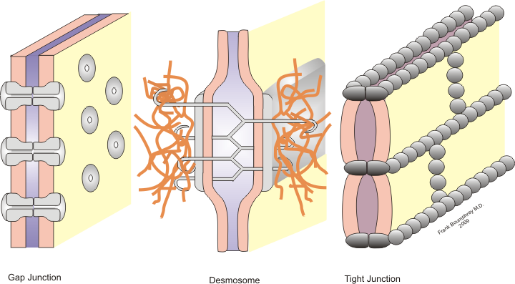
Single Cells ->Bulk -> Communities
Human Phenotype defined by
Systems,
Organs that are composed of Cell
Communities
Composed of organized
Cells types, polarity
Connected by signnaling
(paracrine, endocine
Gap junctions, autocrine)
‘Omics DNA Chromatin RNA Protein Glycosylation- metabolites etc

Slide 21
Spatial Proteomics Future Directions
Need a digital map and to define variables of interest
Can this be built from existing data
New benchmark datasets
Methods - leverage existing, build new
spatial scale measures
Other methods for validation (prediction strength, can we large number of “observations” cells)
What are the limitations of the physical technologies and what directions are the technologies headed?
Limited channels

Slide 22
Output
Table of Data types
Table/Figure of Spatial measures
Table of Taxonomy of methods
(there was support for packaging up data/code vignettes in an R package )
Figures :
Bridging Studies: mapping between datasets: pheno, cells, features
Methods: Embed/Graph - Optimal Trans/Matrix Factor/Topic Modelling/Forests
Communities Clusters/UMAP → Spatial Structure: XY- Line-Polygon. SWM (distance/grid/graph tri, neighbors, etc)
Annotation (Duncan)

Slide 23
Table? Descriptors of different data types (sc’OMICS)
N Typical number of features (proteins/genes) measured
P Typical number of samples/cells measured
Distributions/orders of magnitude
Sample type (single-cell, multi-cell, bulky)
NA Missing values (%, the typical way to impute missing values)
Count data/intensity (continuous)
Omics : genomics/transcriptomics/proteomics/PTM/metabolomics
Typical normalization method (log transform)
State of the art publications
Clinical data -- potentially following clinical trials can help control for diversity of patients; also incorporating EHR
Spatial info (no, 2D, 3D)

Slide 24
Table - “Taxonomy” of methods
Represent as a Table, or decision tree figure to manuscript?
Matrix factorization
NN graphs
Technology specific methods
Still want consensus
Methods broadly divided into
Embedding
Graph
Hierarchical Bayesian

Slide 25
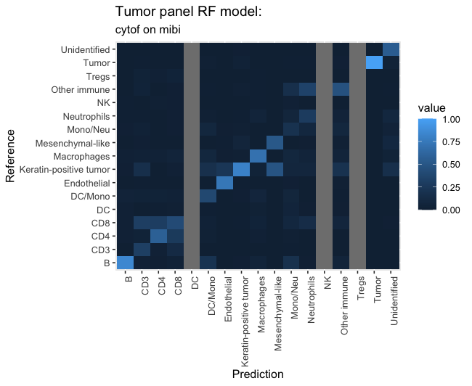
Figures Aligning data/Learning Across Studies
INSERT FIGURES????

Slide 26
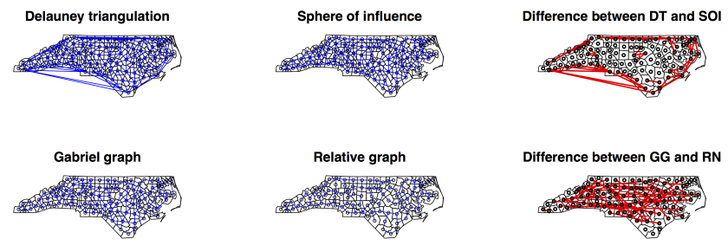
Figure: Spatial → Biology
Measures XY/Lines/Polygons
SWM Sphere (distance)/GRID/ Graph

