Slide 1
Liquidity of the US Physical Natural Gas Markets: Measurement and Trends
Vincent Kaminski
BIRS Workshop
September 23, 2019

Slide 2
Outline
The results of a research project completed in 2017 – 2018 during secondment to the Federal Energy Regulatory Commission in Washington (a visiting scholar program)
US physical natural gas markets
  Trading venues and transaction types
  Price discovery
Definition and measures of market liquidity
Market liquidity trends

Slide 3
US NATURAL GAS MARKETS

Slide 4
Trading Platforms and Transaction Types
CME (Nymex) futures contract with delivery location at Henry Hub, Louisiana
  One of the most successful futures contracts
  A benchmark for prices of natural gas at other US locations (and potentially international LNG prices)
  The shale revolution and emergence of new producing regions reduced the importance of the Henry Hub contract
  Only a small percentage of the overall transaction volume goes to delivery
Intercontinental Exchange (ICE) – next-day and same-day physical natural gas contracts with multiple delivery locations

Slide 5
Trading Platforms and Transaction Types (2)
OTC transactions
  Long-term transactions based on floating prices (index transactions) or formulaic prices
  Next-month transactions negotiated during the 5-day period at the end of the previous calendar month, called Bid Week
  Next-day transactions for gas flowing next day (or Saturday through Monday)
  Natural gas storage transactions
  Volumetric production payments (prepaying for future deliveries of natural gas)
  Asset management deals

Slide 6
Price Formation
Price discovery
Monthly and daily transactions are reported on a voluntary basis to Price Reporting Agencies (PRAs)
  Platts, Argus Media, Natural Gas Intelligence calculate monthly and daily indexes (volume-weighted prices)
  Only flat price (outright) and physical basis transactions are included. Physical basis transactions are negotiated as a differential to the final NYMEX Henry Hub expiring contract settlement price.
  Basis (Index – Nymex settlement price) trades as a single underlying for many locations
  Indexes are used in floating price transactions, as benchmarks for settlement of financial derivatives and in pipeline/storage facilities tariffs
  Indexes were subject to widespread manipulation in the late 1990s

Slide 7
Reporting Trends
Physical transactions exceeding certain aggregate annual volume are reported to FERC on Form 552 every year
The submissions are analyzed and reported by Cornerstone Research
Main conclusions:
  Growing importance of index (floating price) transactions
  Falling levels of reporting to Price Reporting Agencies
  Tail-wagging-the-dog situation
  A source of concern to the regulators

Slide 8
Transaction Volume by Transaction Type
Source: Cornerstone Research

Slide 9
Fixed Price Volume by Reporting and Non-Reporting Companies
Source: Cornerstone Research

Slide 10
MARKET LIQUIDITY: DEFINITION

Slide 11
Market Liquidity
The ability to transact in large volumes, over short periods of time, without (or with limited) price impact, and at low transaction costs
Additional attributes of liquid markets:
  Breadth
  Depth
  Resiliency
Trade-offs between different attributes listed above complicate measurement of market liquidity
Market liquidity, like beauty, is in the eye of the beholder

Slide 12
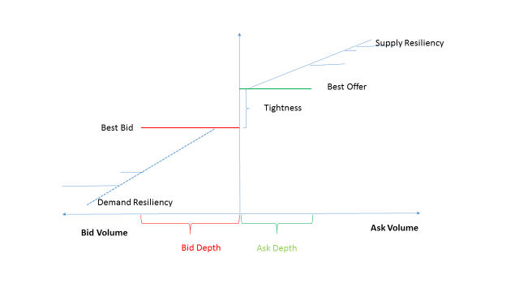
Source: Angelo Ranaldo, "Intraday Market Liquidity on the Swiss Stock Exchange,"
Financial Markets and Portfolio Management, Volume 15, 2001, No.3, Pages 309-327.

Slide 13
MARKET LIQUIDITY: MEASUREMENT

Slide 14
Measures of Market Liquidity
Market liquidity is studied by the branch of applied economics known as market microstructure theory
Three types of market liquidity indicators
  Market activity related data;
  High frequency transaction data; and
  Price impact
Given multidimensional character of market liquidity, no single indicator tells the full story

Slide 15
Market Activity Indicators
Market liquidity is assessed through the data related to:
  The number of transactions
  Transaction volumes
  Average transaction size
  The number of active counterparties
  The number of counterparties presenting themselves as market makers
All these indicators should be taken with a grain of salt
  High transaction volumes may be a symptom of over brokered markets, a daisy chain of transactions inflating the final prices to the end-users

Slide 16
“Matters are quite different when the dominant mode of market trading involves short-term speculators trading with each other. Ticket touts can serve a useful role at popular sporting events when demand may exceed supply but when the majority of tickets are in possession of ticket touts, the price will be volatile – determined mainly by the expectations of other ticket touts about the future prices – and the need of genuine fans ill served.”
John Kay, “Other People’s Money. The Real Business of Finance,” Public Affairs, New York, 2015.

Slide 17
High Frequency Data
High frequency data: the time series of executed intraday transactions (prices and volumes data) and/or posted bid-offer spreads, with reliable time stamps
Most indicators of liquidity based on intraday prices evolve around bid-offer spreads, treated as the bellwether of prevailing market conditions
Bid-offer spreads can be estimated from market prices using econometric models, even if they are not observed directly
If the actual bid-offer spreads are available, they can be used to evaluate the quality of the econometric model
High frequency data can be obtained for ICE transactions

Slide 18
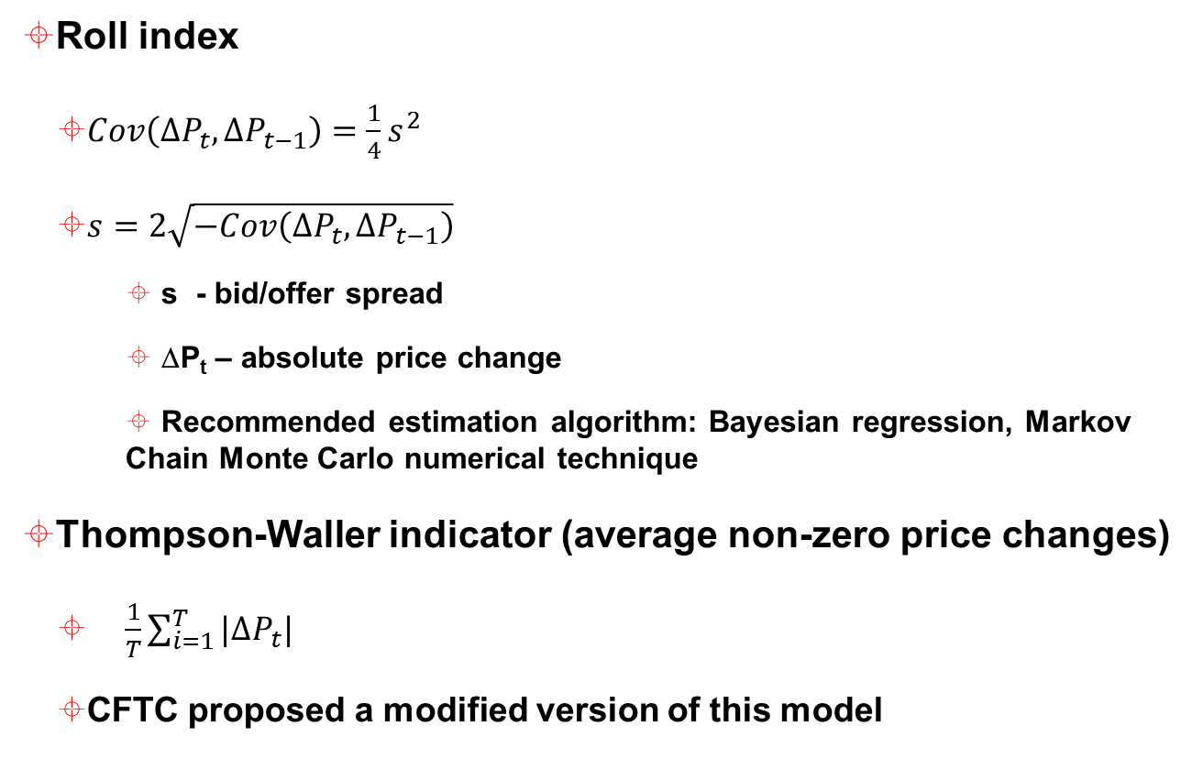
Estimates of Bid-Offer Spread
Roll index
  $Cov\left(∆P_{t},∆P_{t−1}\right)=\frac{1}{4}s^{2}$
  $s=2\sqrt{−Cov\left(∆P_{t},∆P_{t−1}\right)}$
    s - bid/offer spread
    ΔP_{t} – absolute price change
    Recommended estimation algorithm: Bayesian regression, Markov Chain Monte Carlo numerical technique
Thompson-Waller indicator (average non-zero price changes)
  $\frac{1}{T}\sum_{i=1}^{T}{|∆P_{t}|}$
  CFTC proposed a modified version of this model

Slide 19
Offer
Price
Bid
2
1
1
1
3
Time

Slide 20

Price Impact Measure
Amihud index
  $Illiquidity=Average(\frac{\left|r_{t}\right|}{{Volume}_{t}})$
  |r_{t}| - absolute price return
  Volume can be replaced with the dollar value

Slide 21
Intraday Bid-Offer Spreads
Bid-offer spreads can be observed on ICE
Typical shape: inverted letter J
  Very high bid-offer spreads in the early hours of trading with no transactions
  Bid-offer spreads collapse once active trading starts
  Observed bid-offer spreads corresponding to consummated transactions are reasonably well-tracked by bid-offer spreads estimated using econometric techniques
  Spreads increase towards the end of the trading days

Slide 22
ICE Transactions - Assessment
ICE transactions in the next-day physical natural gas
  Price – discovery
  Mop-up trades
  Price print for structured transactions
  Conclusions based on conversations with the traders

Slide 23
Liquidity Trends

Slide 30
OTC Markets
Information about OTC liquidity trends is limited
  Transactions reported to the PRAs
  Transactions reported to FERC on Form 552 on the annual basis
  ICE next-day transactions are reported to Platts since 2018
Under conditions of extreme stress liquidity on ICE disappears
  Polar Vortex of 2018
There is some evidence that liquidity trends on ICE correlate with liquidity in the OTC markets (canary-in-the-mine)

