Slide 1
2017 Wildfire Season Summary
November 6, 2017

Slide 2
Hectares Burned
1,200,000 hectares
of land burned by this year’s 1,347 wildfires

Slide 3
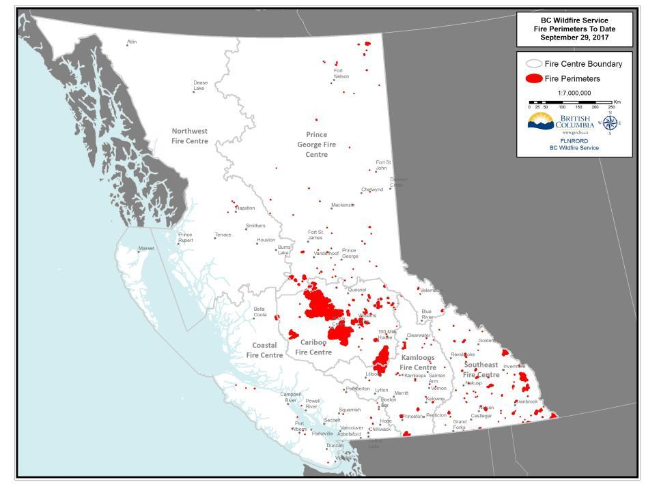

Slide 4
Hectares Burned
Historical Records (1912 – 2017): Hectares Burned

Slide 5
Fire Suppression Costs
Total cost of $560,000,000
for wildfire suppression

Slide 6
Fire Suppression Costs
Historical Records (1991–2017): Season Costs

Slide 7
2017 Fire Season Statistics
Total fires: 1,347 Total fires in 2003: 2,473
People displaced: 65,000 People displaced by Horse River fire: 88,000 People displaced in 2003: 45,000
First Nations communities who authorized: Evacuation Orders: 8 communities Evacuation Alerts: 7
Suppressant used: 49.9 million litres Suppressant used in 2014: 13.9 million litres
Retardant used: 20.8 million litres Retardant used in 2009: 18.6 million litres
Notes:
Total evacuation orders and alerts were approx. 70

Slide 8
2017 Resourcing
At peak capacity, BCWS was utilizing:
4,700+ personnel total
1,200+ out-of-province personnel
2,000+ contract personnel
236 aircraft
300+ personnel from the Canadian Armed Forced
Out-of-province personnel came from every province and territory in BC (except Nunavut), as well as from the following countries:
Mexico
Australia
New Zealand
USA

Slide 9
Other Season Highlights
A Provincial Declaration of Emergency was put in place for the first time since 2003
It started on July 7 and was rescinded on Sept 15, lasting 70 days
2003’s Provincial Declaration of Emergency lasted 43 days
Backcountry Closures were implemented in the Cariboo Fire Centre and Rocky Mountain Natural Resource District
Off-road vehicle bans were implemented in the Cariboo, Kamloops and Southeast fire centres
The Canadian Armed Forces were brought in for the first time since 2003

Slide 10
July 6-8: the turning point
The 2017 season was relatively calm until July 6. Over 220 fires started between July 6 and July 8.
July 7
July 8

Slide 11
Cumulative Hectares Burned by Date

Slide 12
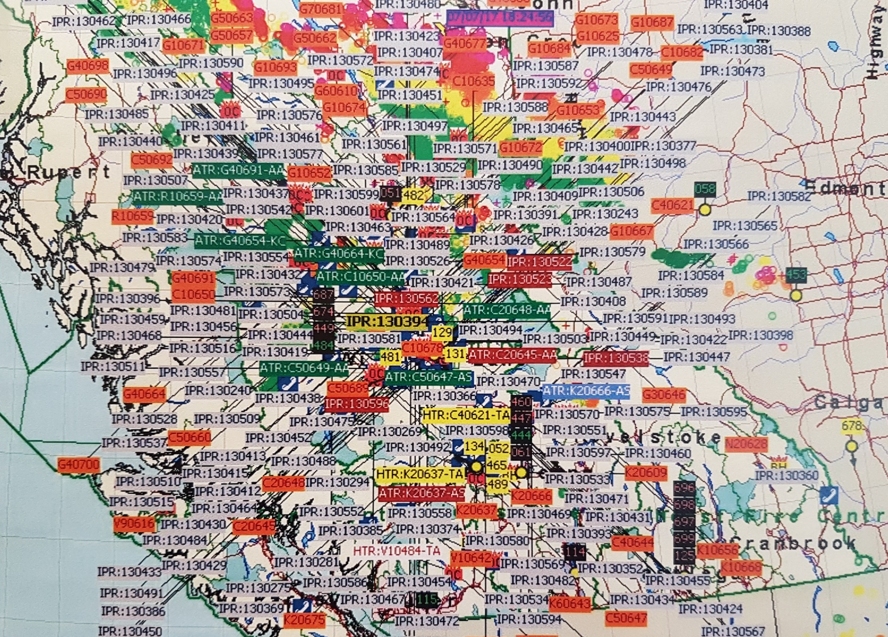
July 6-8: the turning point Dispatch map on July 7, 2017
Notes:
Just to get the idea of how much activity was going on through Dispatch

Slide 13
July 6-8: the turning point Build Up Index (BUI) Records

Slide 14
July 6-8: the turning point Widespread Cariboo lightning strikes

Slide 15
July 6-8: the turning point Williams Lake Airport

Slide 16
Elephant Hill Wildfire
Notes:
Human caused

Slide 17
Cariboo wildfires
Plateau fire
Hanceville-Riske Creek fire
Notes:
Started by Lightning

Slide 18
Southeast / Southern Interior wildfires

Slide 19
Largest wildfires on record
No. | Year | Name of Fire | Size (ha) | Cause
1 | 2017 | Plateau Fire | 521,012 | Lightning
2 | 1958 | Kechika River | 285,935 | Human
3 | 2017 | Hanceville/Riske Creek | 239,298 | Lightning
4 | 2017 | Elephant Hill | 191,865 | Human
5 | 1982 | Egnell Lake/Liard River | 182,725 | Lightning
6 | 2014 | Chelaslie | 133,100 | Lightning
7 | 1948 | Beatton River (East of Pink Mtn.) | 132,261 | Human
8 | 1971 | Teeter Creek/Liard River | 110,334 | Lightning
9 | 1950 | Gundy - Townsend Creek/Cameron River | 99,767 | Human
10 | 1950 | Chinchaga Fire - Blueberry and Beatton River | 76,923 | Human
Notes:
3 of the top 10 fires ever in BC came this year

Slide 20
Opportunities for Improvement

Slide 21
Constructive feedback
Improve short-term wildfire response and immediate fuel reduction treatments
Integration of Wildland-Urban Interface (WUI) zoning and proactive landscape planning
Improve approach to forest restoration and adaptive forest management
Investment in research to inform adaptive wildfire management
Better reduction of residual risk through science-based mitigation activities
Improve collaboration with external research partners and make funding available to academia.
Notes:
Feedback taken from internal/external debriefs that have occurred, research recommendations from universities/colleges, and other sources.

Slide 22
Constructive feedback
Improve engagement with First Nations communities, ranchers, industry and other stakeholders
Better utilization of local traditional knowledge
Improve public understanding of risk reduction using fire management options (i.e. prescribed fire, planned ignitions)
Improve understanding and ability to mitigate the impact of wildfire on communities and communicate that risk effectively

Slide 23
Looking Ahead: After Action Review

Slide 24
After Action Review
The 2017 wildfire and freshet proposed After Action Review has four components:
Tier 1 – Internal debriefs and community outreach
Tier 2 – Provincial cross-ministry response review
Tier 3 – Province and Partners response review
Tier 4 – Provincial-level event response review
Tiers 1-3 are Operational Level reviews that are led by the Province
Tier 4 would be an independent review of the Province’s response to the wildfire / freshet events, that would be led by an independent external consultant
Notes:
Tier 1 is currently underway with BCWS
Tier 2 meetings are scheduled for December
Tier 3 meetings are scheduled for January
Tier 4 TBD

Slide 25
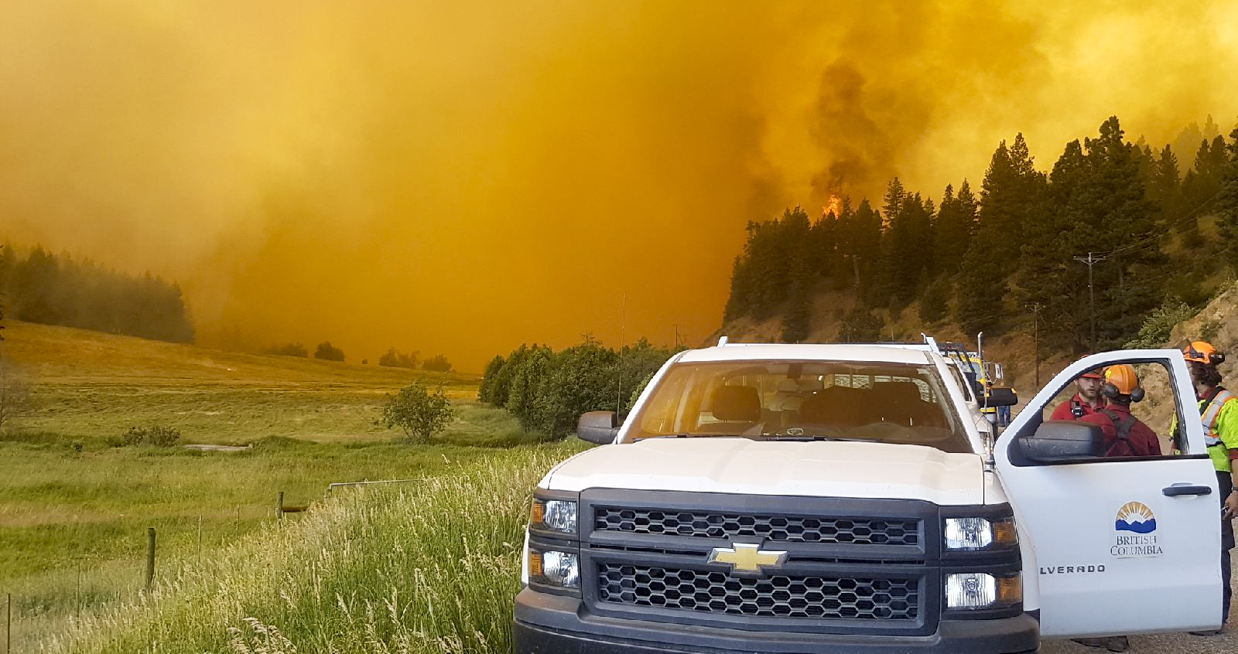
Research Model
Social Research
Biological Research
Physical Research
Forest Fire Management Victoria
Improve quality of decision making in fire management by investing in scientific research
Notes:
-BCWS is currently looking into other jurisdictional models, where the State of Victoria model fits well with our Vision going forward.
-Organized under 3 main Themes: Social, Biological and Physical
-BCWS is also looking to build a research and development program that brings in Universities/Colleges to assist in such research – hence why we’re here to listen to the ideas a share learnings.

Slide 26
Research Model Social Research Examples
Community – understanding, impacts and values
How does land use practices affect wildfire risk?
The relationship between fuel hazards associated with post-harvest debris and fire risk, especially around communities
Combining science-based fire management practices and First Nations traditional ecological knowledge in landscape-level strategies
Understanding the full impacts of wildfire beyond suppression and rehabilitation costs to include environmental and social impacts
Notes:
Theme 1: Social Research Examples
(These examples are from BCWS internal research analysis, while also scanning recommendations from other sources)
-These examples are to just get the conversation starting.

Slide 27
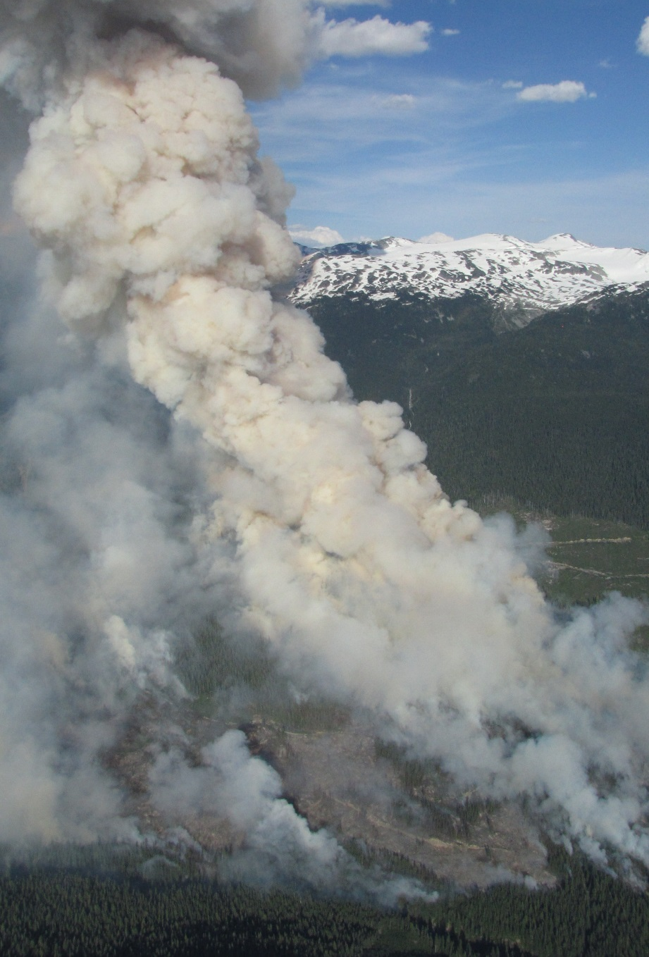
Research Model Biological Research Examples
Hazard management, ecosystem, monitoring, resilience, fuels and planned burning
The relationship between fuel hazards associated with post-harvest debris and fire risk, especially around communities
Studies on the duration of effectiveness of fuels treatments and how to best maintain benefits over time
Research into the accuracy of various sampling techniques and fuel loading determinations including qualitative and quantitative
Notes:
Same as slide 30 – just the Biological exmaples

Slide 28
Research Model Physical Research Examples
Smoke modeling, wildfire management, aircraft and fire retardant
Understanding the relationship between short term carbon release and long term carbon sequestration
Fuel Typing Approaches for BC that improves the spatial data set for fire behaviour predictions
Studying and designing linkages between different modelling tools (i.e. fire behaviour prediction and fire management software applications)
Notes:
Same – just Physical examples

Slide 29
Questions?
Please contact
Aaron.Pawlick@gov.bc.ca | Manager, Strategic Initiatives
Tony.Falcao@gov.bc.ca | Deputy NW Fire Centre Manager
Mary.Myer@gov.bc.ca | Director, Corporate Governance
Ian.Meier@gov.bc.ca | Director, Wildfire Operations
Madeline.Maley@gov.bc.ca | Executive Director

