Slide 1
Incorporating Global Information into Active Contour Models
Anthony Yezzi
Georgia Institute of Technology

Slide 2
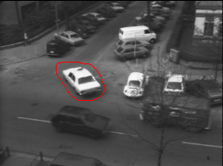
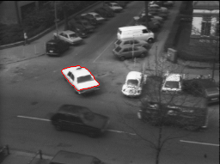
Snakes: Active Contour Models
Snakes or Active Contours pose the segmentation as an energy minimization problem.
  Kass, Witkins & Terzopoulos.
Initialization
Final Segmentation

Slide 3
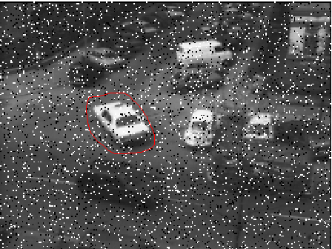
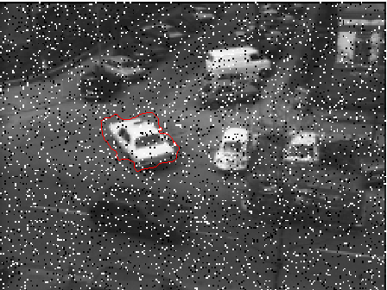
Local Minima
One major drawback of Active Contour model is the tendency to get stuck in “Local minima” caused by subtle irrelevant edges and image features.
Initialization
Final Segmentation

Slide 4
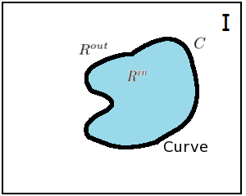
Avoiding Local Minima
Balloon Force: (Cohen)
  Makes assumption about the initialization.
  Biased final segmentation result.
Region-based Energy:
  Makes Strong assumptions about the image.
Global minimum of Edge-based Energy:
  Global minimal path for open curves/geodesics. (Cohen & Kimmel)
  Not suitable for closed curves (Geodesic Active Contours used instead)
Image Domain

Slide 5
Active Geodesics
Region-based active contour segmentation with a Global Edge-based Constraint

Slide 6
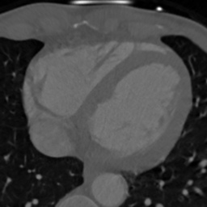
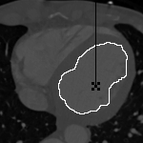
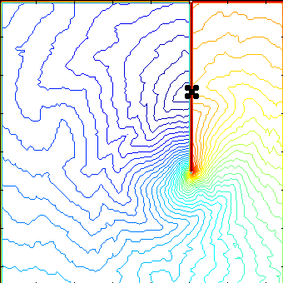
Edge-based Segmentation
Globally Optimal Geodesic Active Contours - (GOGAC)
  Appleton B. and Talbot H.
Introduce an artificial cut in the image domain and search for an optimal open geodesic with end points on either side of the cut.
Test Image
GOGAC
Propagating Fronts

Slide 7
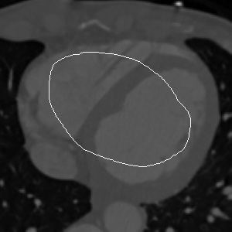
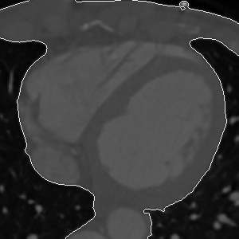
Purely Region-Based Segmentation
Region-based energy minimization.
  Chan-Vese Model (Mumford-Shah special case)
Initialization
Final Segmentation

Slide 8
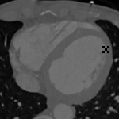
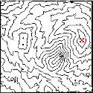
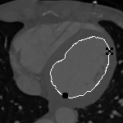

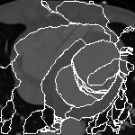
Incorporating Region-based Energy in Edge-based Segmentation
Test Image
Propagating Fronts
Closed Curve with
least Region-based
Energy
Saddle Points
Associated Closed
Curves

Slide 9
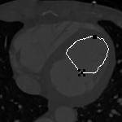

Active Geodesics
Initialization away
from object boundary
Reverse roles of
Source/saddle point
Minimize the region-based energy and restrict evolution to a single local degree of freedom: translation of saddle point in the normal direction to the curve at that point.

Slide 10
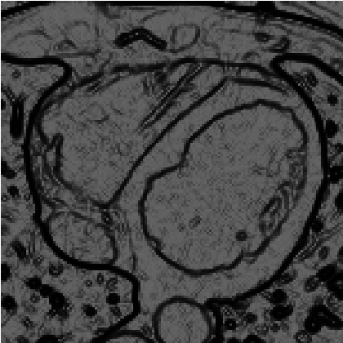
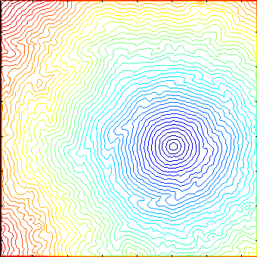
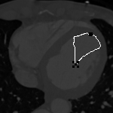
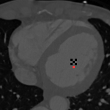
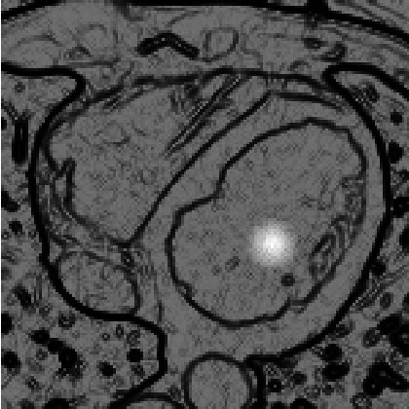
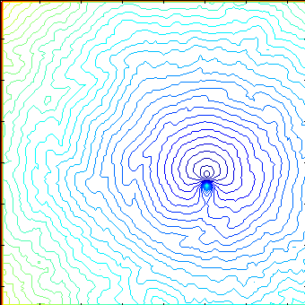

Continuum of “Closed” geodesics
Propagating Fronts
Segmentation
Test Image

Slide 11
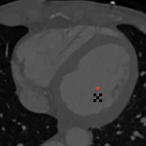
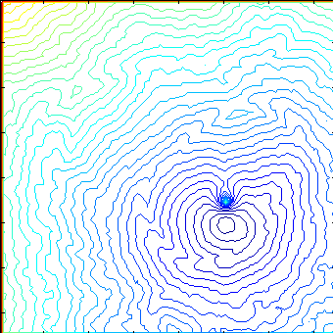
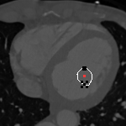
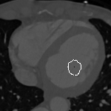
Region-based Evolution
Segmentation after
2nd iteration
Move Saddlepoint
New Source
Propagating Fronts
Segmentation after
3rd iteration

Slide 12

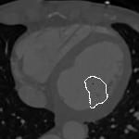
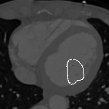
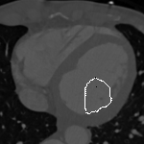
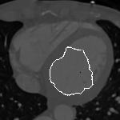
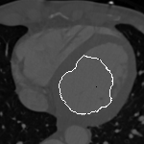


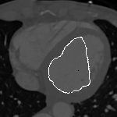
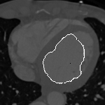


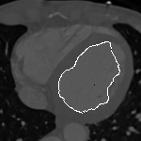
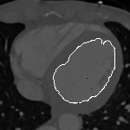

Evolution (Left Ventricle Segmentation)
Iterations – 4 to 18

Slide 13
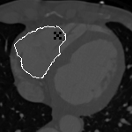
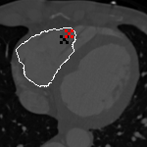
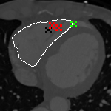
Right Ventricle Segmentation
User can interact with the segmentation algorithm by adding poles and zeros, to attract and repel the contour towards desired edges.
Red ‘X’ – Additional Pole (Repeller)
Green ‘X’ – Additional Zero (Attractor)
Initial Right Ventricle Segmentation with Active Geodesics
Segmentation after
adding a repeller
Final segmentation
with 2 repellers and
1 attractor

Slide 14
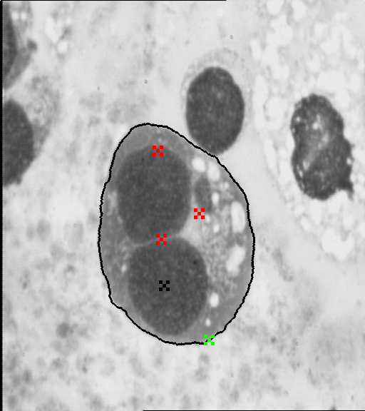
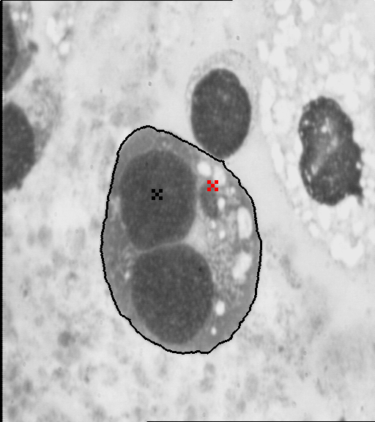
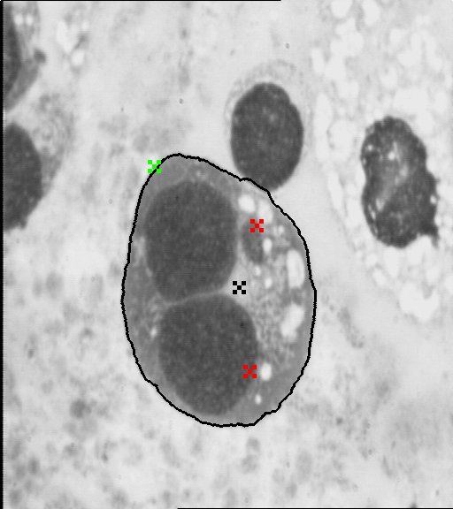
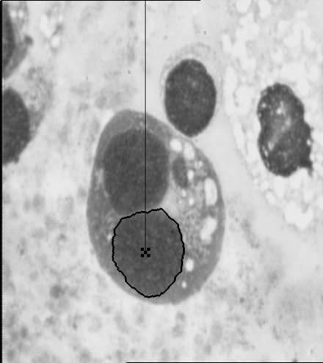
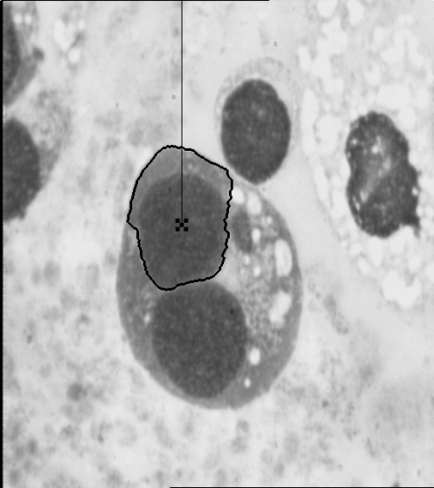
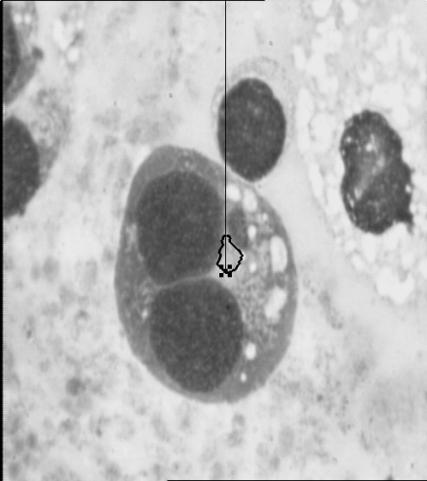
Cell Segmentation
Active geodesic-based segmentation with three different initializations
Edge-based GOGAC segmentation for three different initializations

Slide 15
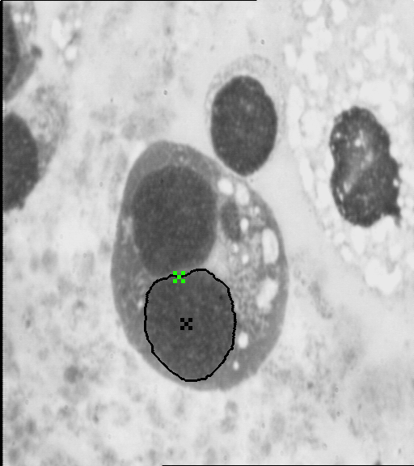
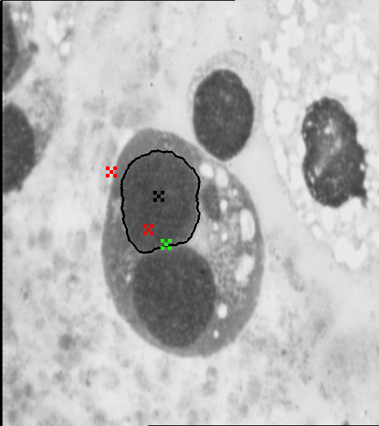
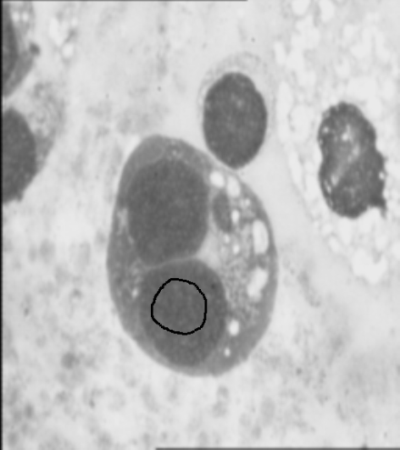
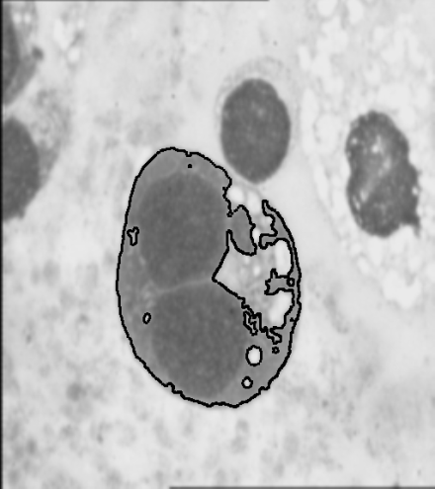
Nuclei Segmentation
Nuclei segmentation with same initialization as the previous slide
Region-based Chan-Vese segmentation for nucleus segmentation

