Slide 1
Building Anatomical Models Automatically – Theory to Practice
Chris Taylor, Tim Cootes and Carole Twining
Imaging Science & Computer Science
University of Manchester
chris.taylor@manchester.ac.uk

Slide 2
Key result
28th August 2011
Manchester United 8 – Arsenal 2

Slide 3
Overview
Preliminaries and Motivation
Shape statistics and correspondence
Building appearance models
Robust initialisation
Practical application?

Slide 4
Preliminaries
Set of n centred shapes {S_{i}} drawn from a population
  continuous curves (2D) or surfaces (3D)
Each S_{i} sampled at m points using parameterisation φ_{i}
  points equally spaced wrt φ_{I} (basis function representation )
  shape vector x_{i}(φ_{i}, R_{i}, σ_{i}) where: R is rotation, σ is scale
  extension to infinite m straightforward
Given 2(+) shapes the {φ_{i} } define correspondence

Slide 5
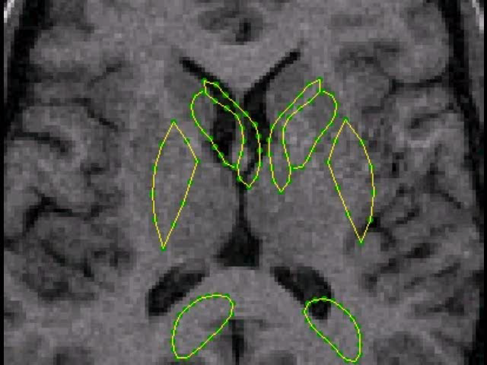
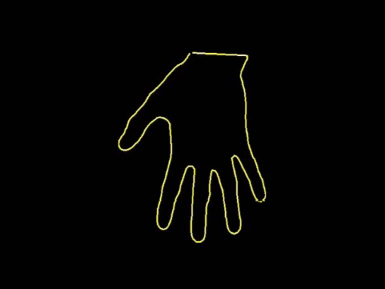
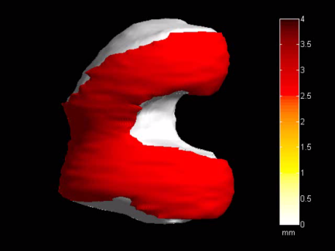
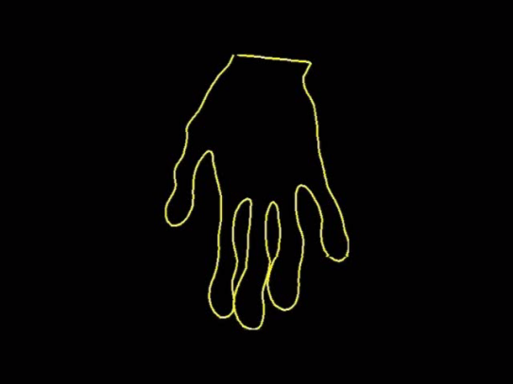


Motivation
Generative models of shape and appearance
  eg PCA of {x_{i}}
Applications in medical image analysis (and others)
  interpretation by synthesis
  localising structures of interest
  characterising populations
  classifying individuals
Establishing correspondence
  key step – need to automate
  good correspondence – good model
  bad correspondence – bad model
PCA 1
PCA 1

Slide 6
Distances between shapes
Pairwise distances d(S_{i}, S_{j}) key to statistical analysis
  difference measure integrated over pair of shapes
  should depend on φ_{i} relative to φ_{j}
  should not depend on common re-parameterisation
Integral must include suitable area measure
  area on mean shape (Manchester)
  transformation to Q-space (Florida State)
Can we define d(S_{i}, S_{j}) sensibly knowing only S_{i} and S_{j} ?
  or do we need knowledge of the ensemble?

Slide 7
Distance between two shapes (1)
Suppose we have ‘sensible’ d(S_{i}, S_{j}) given (φ_{i}, R_{i}, σ_{i})
Each shape forms an orbit wrt (φ_{i}, R_{i}, σ_{i})
Minimise d(S_{i}, S_{j}) wrt (φ_{i}, R_{i}, σ_{i,} φ_{j}, R_{j}, σ_{j})
S₁
min [d(S_{i}, S_{j})]
S₂
S₃

Slide 8
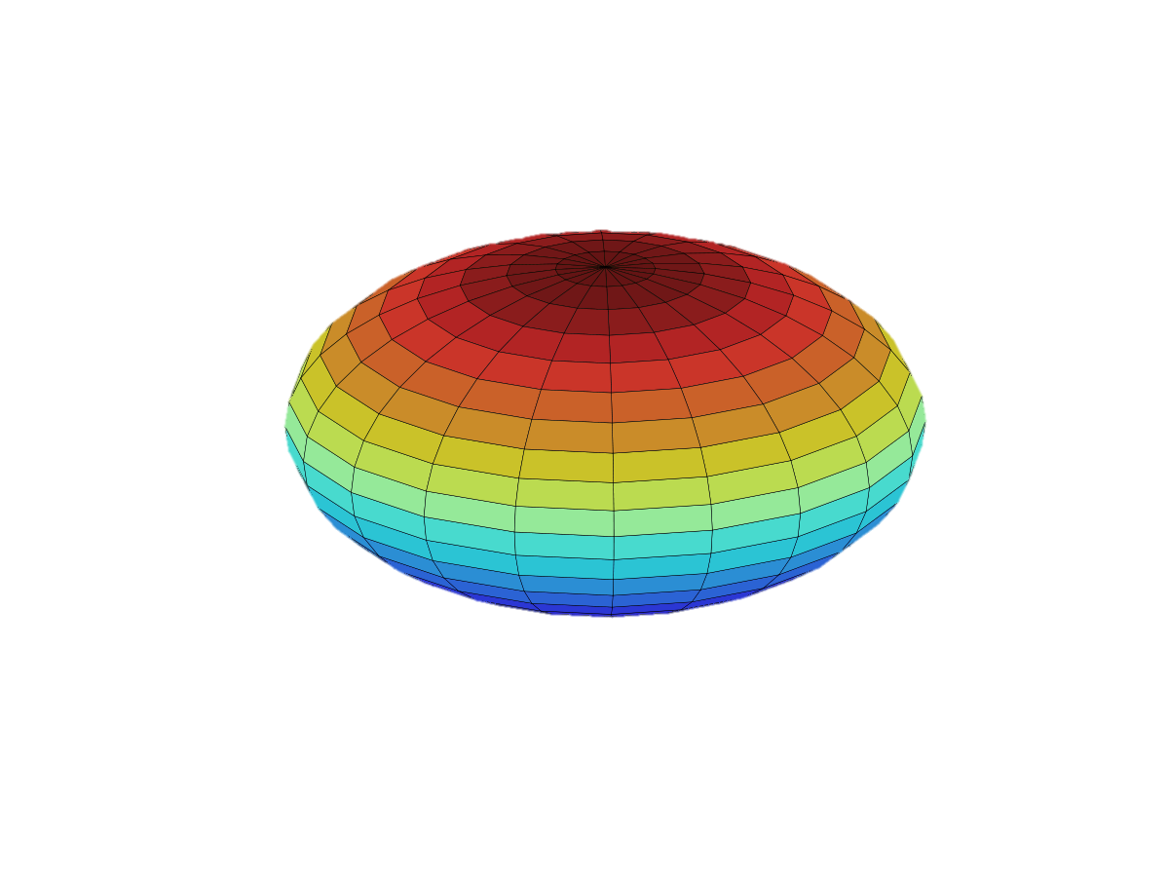
Distance between two shapes (2)
Shapes centred, mean radius = 1, given (φ_{i}, R_{i})
Space of all shapes
S_{i}
S_{j}

Slide 9
Groupwise correspondence
Distance on manifold of shape class (not all shapes)
  d(S_{i}, S_{j}) must depend on the ensemble
  optimise simultaneously over ensemble wrt {φ_{i}, R_{i}, σ_{i}}
What objective function?
  compactness (eg variance wrt Karcher mean)
  minimum description length (‘quality’ of resulting model)
MDL objective function
  cost of coding the ensemble using the model
  F = L_{model} + L_{coding}

Slide 10
Compactness objective function
Minimise total variance ∑d(S_{i}, S_{mean})² wrt Karcher mean
Treats shape variability as ‘noise’ rather than structured

Slide 11
MDL objective function
Using PCA model favours low-D hyperplane model
Corresponds points that behave similarly

Slide 12
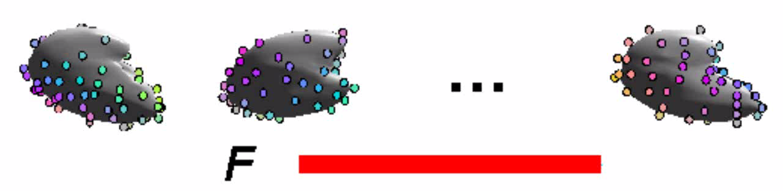
Minimising DL for a set of shapes
Parameterisations {φ_{i}} represented by sets of kernels
Colour coding shows parameterisation
Nelder-Mead optimisation

Slide 13
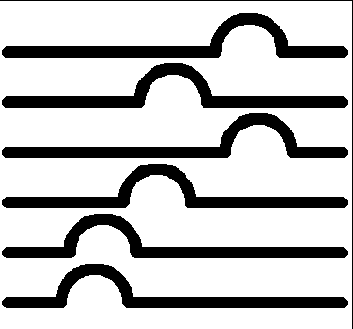
Does it matter?
Set of shapes
Parameterisation
‘Correct
Arc-length
Objective Function | Parameterisation
 | Correct | Arc-length
Euclidean compactness |  | Best
Geodesic compactness |  | Best
Euclidean MDL | Best
More generally improves image interpretation and statistical power

Slide 14
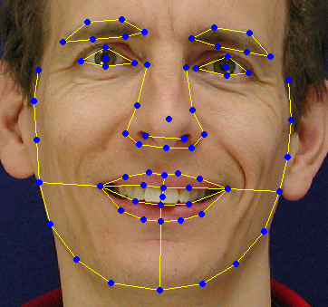
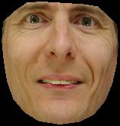
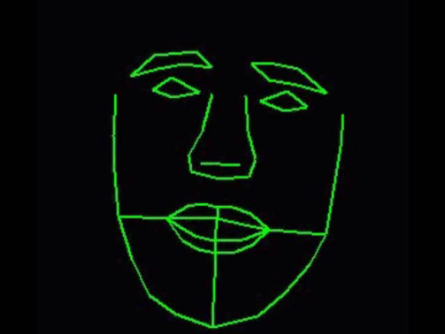
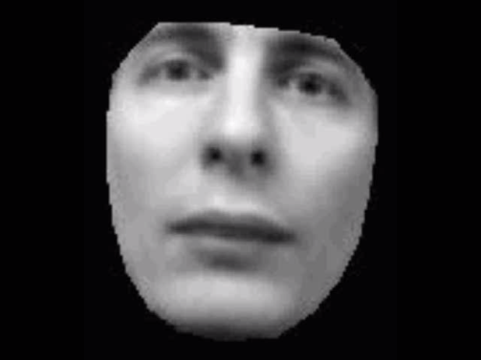
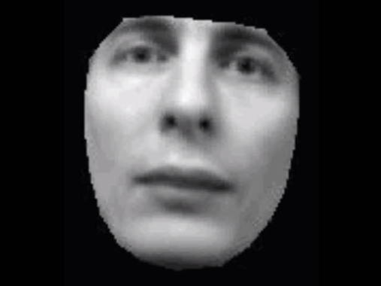
Modelling Appearance
For each example
For the training set
Shape x
Texture g
Warp to
mean
Raster scan
+
=

Slide 15
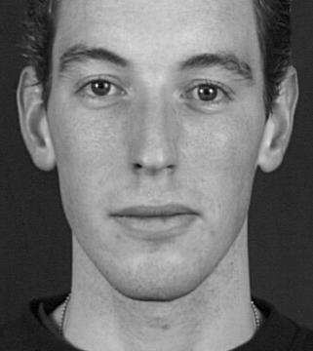
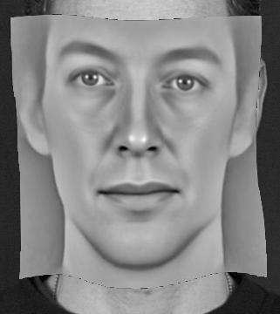
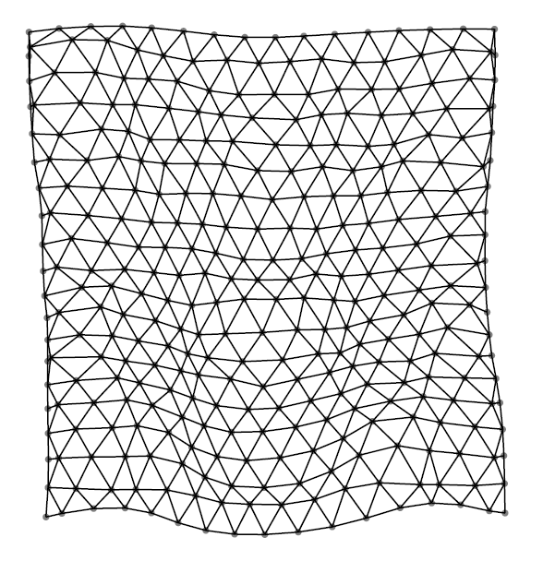
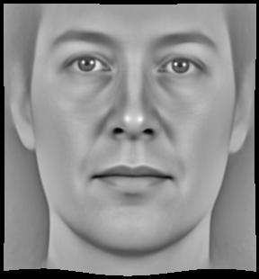
MDL for Appearance Models
…
Optimise correspondences in image space
to minimise
I₁
I₂
I_{n-1}
I_{n}
Input images
Pixel discrepancies
…
Synthesized
images
Shape
Model

Slide 16
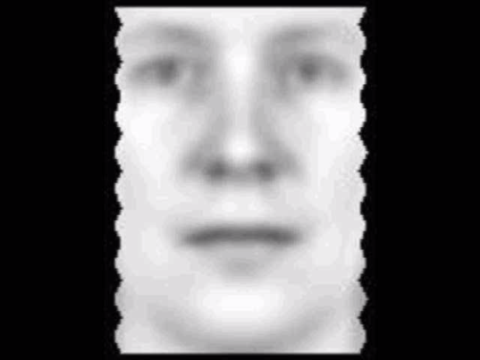
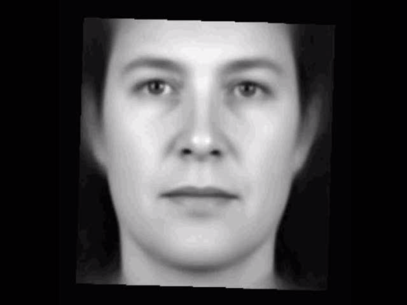

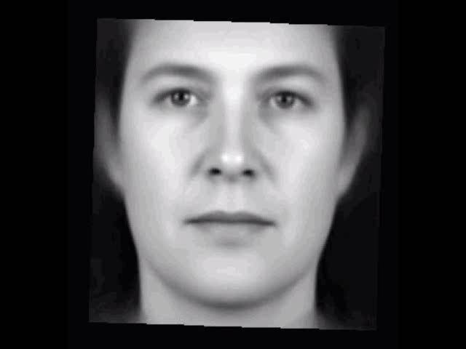
Appearance Model Optimisation
Rough Initialisation
During Optimisation
Model Mean
Mode 1
Mode 2
Mode 3

Slide 17
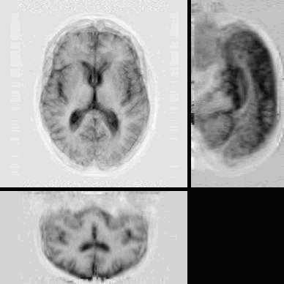
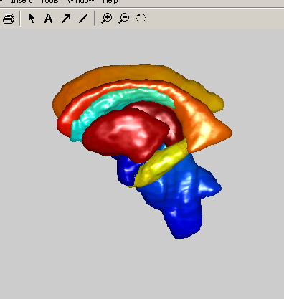
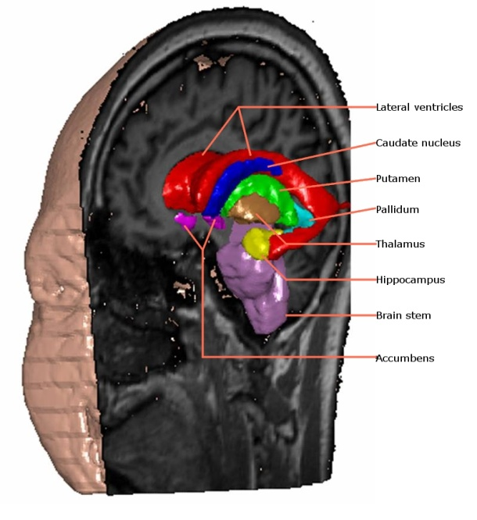
3D Model Building
Model During Optimisation
Mode 1
Mode 2

Slide 18
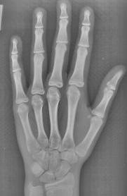
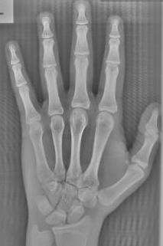
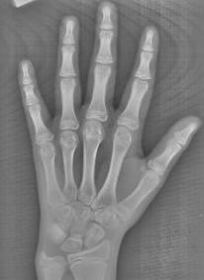
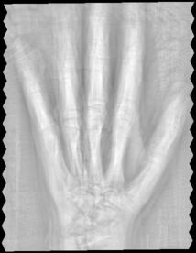
Initialisation can be problematic
Parts + geometry model (Pei Zhang)
  constructed from training set automatically
  random parts (eg image patches)
  multiple random P+G models tested
  models vote for parts
  iterated with best parts
…

Slide 19
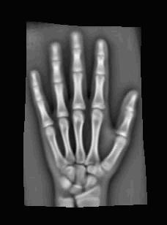
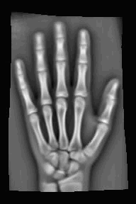
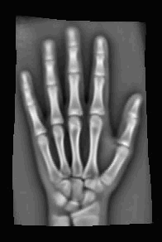
Robust model building
P+G Model
Match to image
Initial mean
After MDL
Mean
Mode 1
Mode 1
Mode 3

Slide 20
End?

Slide 21
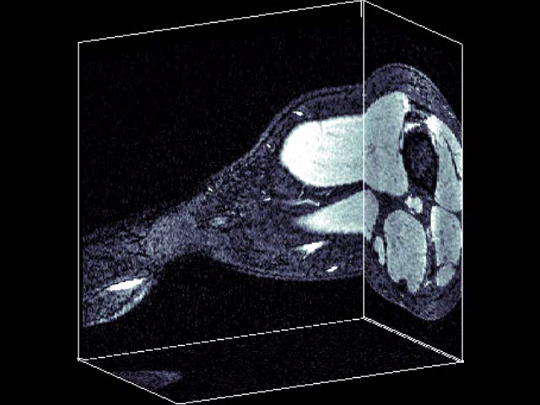
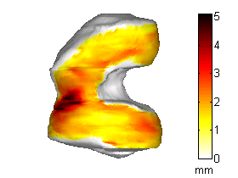
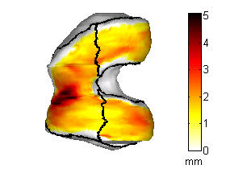
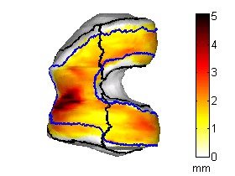
Cartilage Thickness Analysis
Measure loss of cartilage in OA
  biomarker for drug development
Magnetic Resonance Images
  knee joint
3D cartilage thickness maps
Challenging measurement problem
  changes small
  focal changes
  ill-defined margins
population analysis
regional analysis
trimming
Notes:
Our biomarkers measure cartilage loss during Osteoarthritis
We use Magnetic Resonance Imaging as a non-evasive means of providing detailed information cartilage.
Here we have a 3D MRI of the knee with the cartilage shown as high signal between the dark bones
We build detailed cartilage thickness maps.
This is a 3D view of the femur head with
cartilage thickness shown on a temperature scale; red and darker colours indicating regions of thicker cartilage
There are a number of challenges involved in making quantitative measures of cartilage;
Changes due to osteoarthritis are small, in the sub-millimetre region
Too small to be measured reliably in individuals over short time periods
We therefore examine aggregate changes in a population in order to increase sensitivity to change
Changes due to osteoarthritis are focal
thinning is expected in most regions, but
diseased cartilage may experience swelling and thickening.
For this reason, Global measures of cartilage made for whole compartments are confounded by these regional differences
our method enables independent analysis of sub-regions of joint in order to
quantify regional changes and determine if they are statistically significant.
The edges of cartilage are difficult to identify in MR images and prone to measurement errors
Our method enables trimming of the edges in anatomically consistent manner
allowing measured to be restricted to the central, load-bearing regions of the joint
which are more involved in the disease process

Slide 22
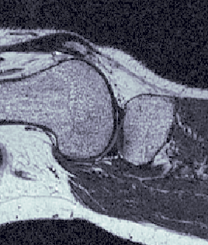
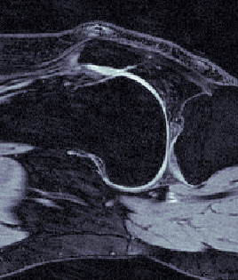
MR Imaging
‘Bone’ image – stable reference
‘Cartilage’ image
AAM segmentation
T2 – Bone
T1 Fat Sat – Cartilage
Notes:
We choose to use the bone, rather than the cartilage itself, as the basis for making cartilage thickness measurements
this is because it is more stable than the cartilage; less likely to change over time
and more consistent between patients
During each patient visit, two MR images taken, one to highlight the bone surface and another to highlight the cartilage
Segmentation is performed to locate the bone and cartilage structures in each image slice

Slide 23
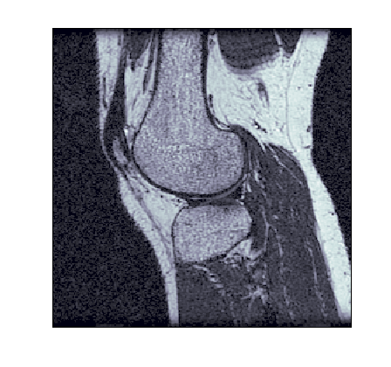
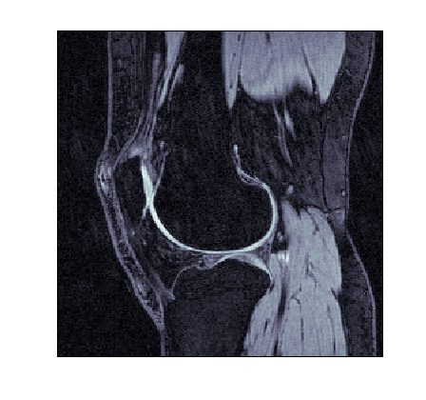
Cartilage Thickness Maps
Segmentation
Surface
Construction
Thickness
Measurement
Thickness & Change Maps

Slide 24
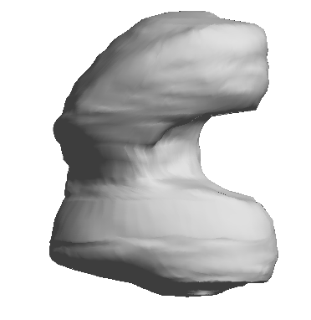
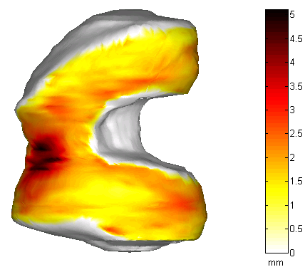
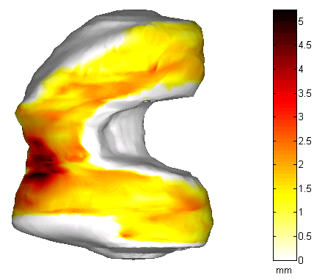
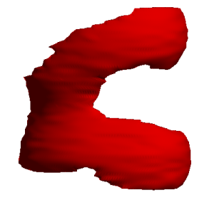
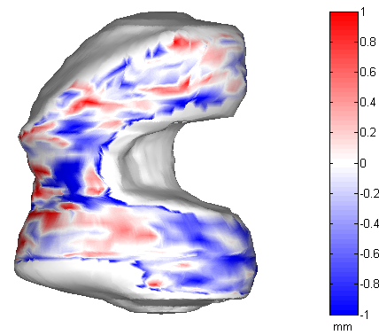
Cartilage Thickness Maps
Timepoint 1
Timepoint 2
Segmentation
Surface
Construction
Thickness
Measurement
Thickness & Change Maps
Notes:
In order to enable 3D measurement of cartilage thickness, surface representations of the bone and cartilage are constructed from the segmentations
The bone and cartilage surfaces obtained from the different MR images are registered
Thickness maps are produced by measuring cartilage at dense points on the bone surface
at each measurement point, 3D normal to the bone surface defined
its points of intersection with the inner and outer cartilage surface found
thickness measured as the distance between these points
This results in a bone-referenced cartilage thickness map
This is repeated for subsequent visits of the same patients
By comparing cartilage measured at the same anatomical locations at different time-points for the same patient,
a map of change in cartilage thickness can be constructed as shown here.
Blue indicates regions of cartilage thinning while red indicates thickening or swelling of the cartilage.

Slide 25
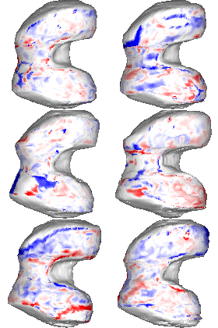
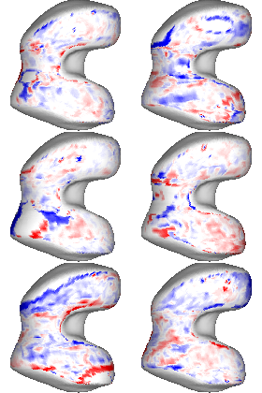
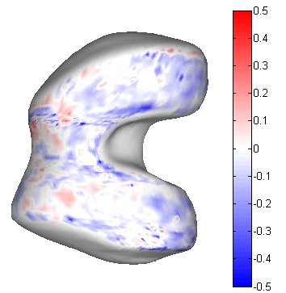
Corresponding Thickness Maps
Individual Difference Maps
Sampled on Mean Bone Shape
Aggregate
Map
Notes:
Now we have the means of projecting the individual difference maps onto a common frame of reference
Changes in cartilage thickness over time are measured at the corresponding points for each individual and,
using the mapping of anatomical correspondences,
are projected onto the mean bone shape.
We now have them on a consistent frame of reference
Aggregate maps are produced by point-wise averaging of individual difference maps
Blue denotes thinning while red denotes regions of thickening or swelling
On this aggregate difference map, there is evidence of cartilage loss toward the posterior aspect of the femur
These aggregate difference maps are informative but difficult to analyse and draw definite conclusions due to their high dimensionality
we need to quantify changes to cartilage thickness in different regions of the joint and determine if these changes are statistically significant changes

Slide 26
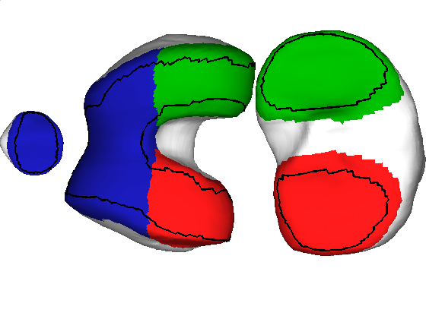
Functional regions and results
Defined on mean bone
  full compartment
  trimmed
Significant change in 6 months for small groups (~30)
MF: Medial Femurotibia
MT: Medial Tibia
P: Patella
TrF:Trochlea of Femur
LF: Lateral Femurotibia
LT: Lateral Tibia
MF
MT
P
TrF
LF
LT
Eckstein et al (OA&C, 2006)
Notes:
Include nomenclature reference

Slide 27
References
Davies, R.H., C.J. Twining, and C.J. Taylor, Statistical Models of Shape: Optimisation and Evaluation, 2008. Springer. 302 pages.
Cootes, T.F., et al., Computing Accurate Correspondences across Groups of Images. IEEE Transactions on Pattern Analysis and Machine Intelligence, 2010. 32(11): p. 1994-2005.
Davies, R.H., et al., Building 3-D Statistical Shape Models by Direct Optimization. IEEE Transactions on Medical Imaging, 2010. 29(4): p. 961-981.
Williams, T.G., et al., Anatomically corresponded regional analysis of cartilage in asymptomatic and osteoarthritic knees by statistical shape modelling of the bone. IEEE Trans Med Imaging, 2010. 29(8): p. 1541-59.
Zhang, P., Cootes, T.F., Automatic Part Selection for Groupwise Registration. In Proceedings of Information Processing in Medical Imaging, 2011.

Slide 28
End

Slide 29
Compactness

Slide 30
MDL

