Slide 1
ProbExplorer: Uncertainty-guided Exploration and Editing of Probabilistic Medical Image Segmentation
Ahmed Saad^{1,2}, Torsten Möller¹, and Ghassan Hamarneh²
¹Graphics, Usability, and Visualization (GrUVi) Lab,
² Medical Image Analysis Lab (MIAL),
School of Computing Science, Simon Fraser University, Canada

Slide 2
Outline
Medical image segmentation challenges
ProbExplorer framework
Case studies
Highlight suspicious regions (e.g. tumors)
Correct misclassification results
Uncertainty visualization using shape and appearance prior information
Conclusion and future work

Slide 3
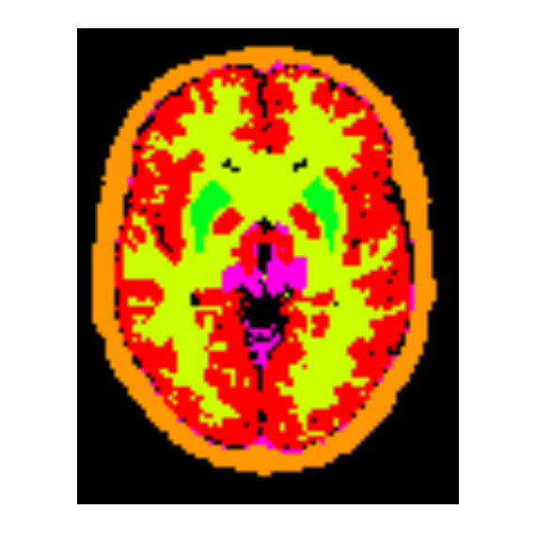
Medical image segmentation
Partitioning the image into disjoint regions of homogeneous properties
Useful for statistical analysis, diagnosis, and treatment evaluation
Medical Image Segmentation

Slide 4
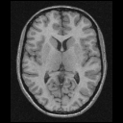
Segmentation challenges
Low signal-to-noise ratio
Partial volume effect
Anatomical shape variability
Multi-dimensional data
Magnetic Resonance Imaging
Positron Emission Tomography

Slide 5
Segmentation challenges
Low signal-to-noise ratio
Partial volume effect
Anatomical shape variability
Multi-dimensional data

Slide 6
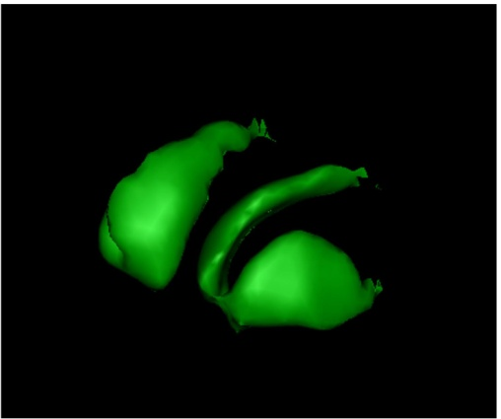
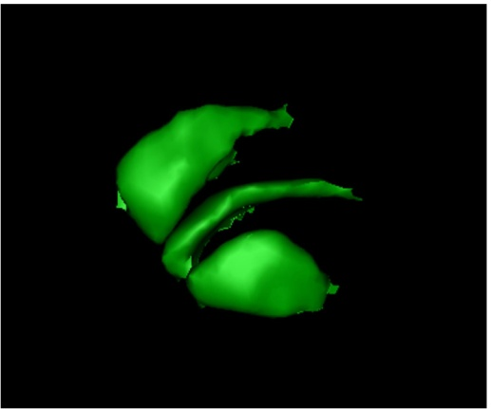
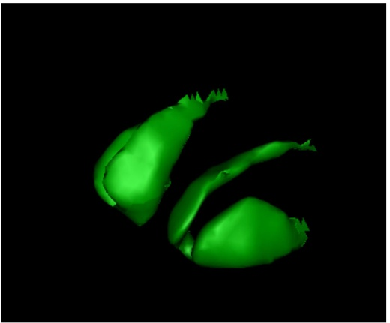
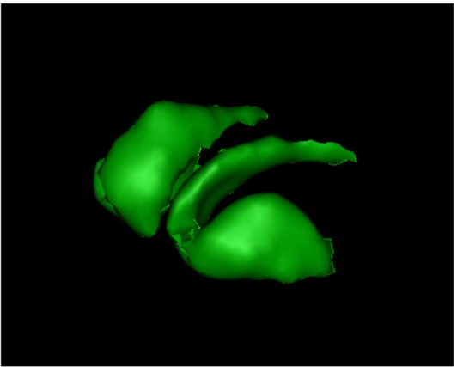
Segmentation challenges
Low signal-to-noise ratio
Partial volume effect
Anatomical shape variability
Multi-dimensional data
Patient 1
Patient 2
Patient 3
Patient 4

Slide 7
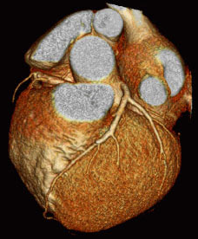
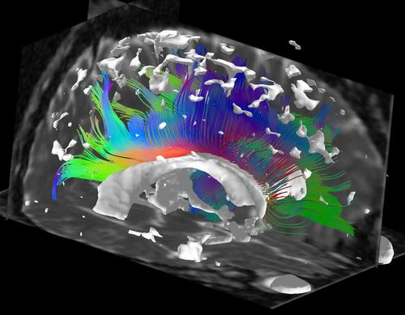
Segmentation challenges
Low signal-to-noise ratio
Partial volume effect
Anatomical shape variability
Multi-dimensional data
4D CT
dPET
DTMRI

Slide 8
Segmentation output
Max
Crisp
Probabilistic (Fuzzy)
70%
Putamen
Putamen
20%
White matter
10%
Grey matter

Slide 9
Outline
Medical image segmentation challenges
ProbExplorer framework
Case studies
Highlight suspicious regions (e.g. tumors)
Correct misclassification results
Uncertainty visualization using shape and appearance prior information
Conclusion and future work

Slide 10
Goal
Given probabilistic segmentation results, we will allow expert users to visually examine regions of segmentation uncertainty to
Highlight suspicious regions (e.g. tumors)
Correct misclassification results without re-running the segmentation

Slide 11
ProbExplorer
Probabilistic segmentation
Preprocessing
Selecting voxels
Editing
Commit an editing action
Change selection

Slide 12
ProbExplorer
Probabilistic segmentation
Preprocessing
Selecting voxels
Editing
Commit an editing action
Change selection

Slide 13
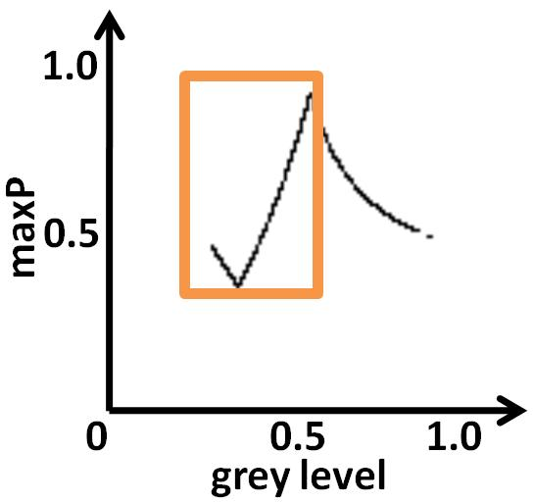
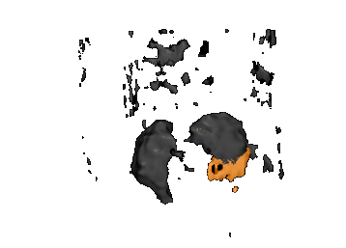
ProbExplorer
Probabilistic segmentation
Preprocessing
Selecting voxels
Editing
Commit an editing action
Change selection

Slide 14
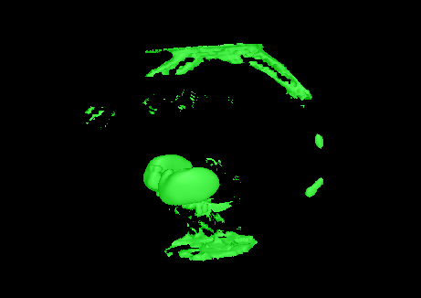
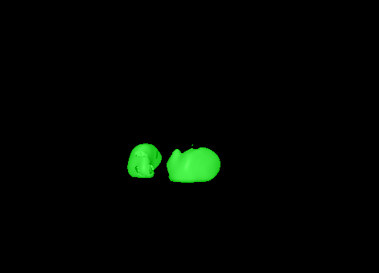
ProbExplorer
Probabilistic segmentation
Preprocessing
Selecting voxels
Editing
Commit an editing action
Change selection
Before
After

Slide 15
Preprocessing
A probabilistic vector field
Sort

Slide 16
Outline
Medical image segmentation challenges
ProbExplorer framework
Case studies
Highlight suspicious regions (e.g. tumors)
Correct misclassification results
Uncertainty visualization using shape and appearance prior information
Conclusion and future work

Slide 17
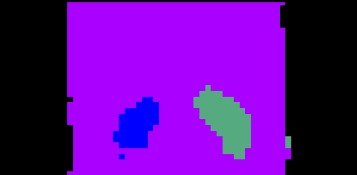
Renal dynamic SPECT
4D image of size 64 x 64 x 32 with 48 time steps with an isotropic voxel size of (2 mm)³
Raw data
Crisp segmentation

Slide 18
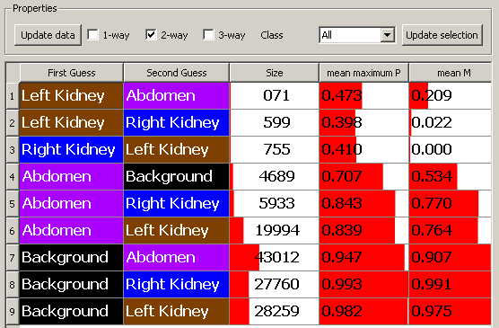
Uncertainty interaction overview widget
?



Slide 19
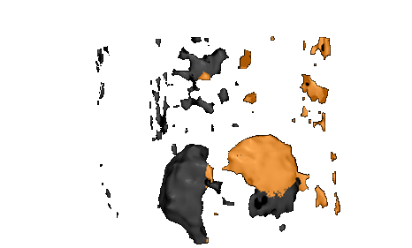
Selection of normal behavior

Slide 20
Selection of abnormal behavior

Slide 21
Outline
Medical image segmentation challenges
ProbExplorer framework
Case studies
Highlight suspicious regions (e.g. tumors)
Correct misclassification results
Uncertainty visualization using shape and appearance prior information
Conclusion and future work

Slide 22
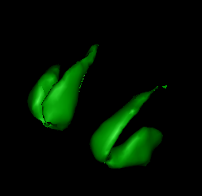
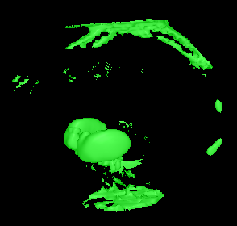
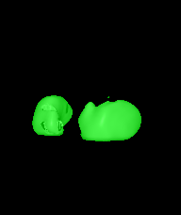
Uncertainty-based segmentation editing
Ground truth
Overestimation
Underestimation

Slide 23
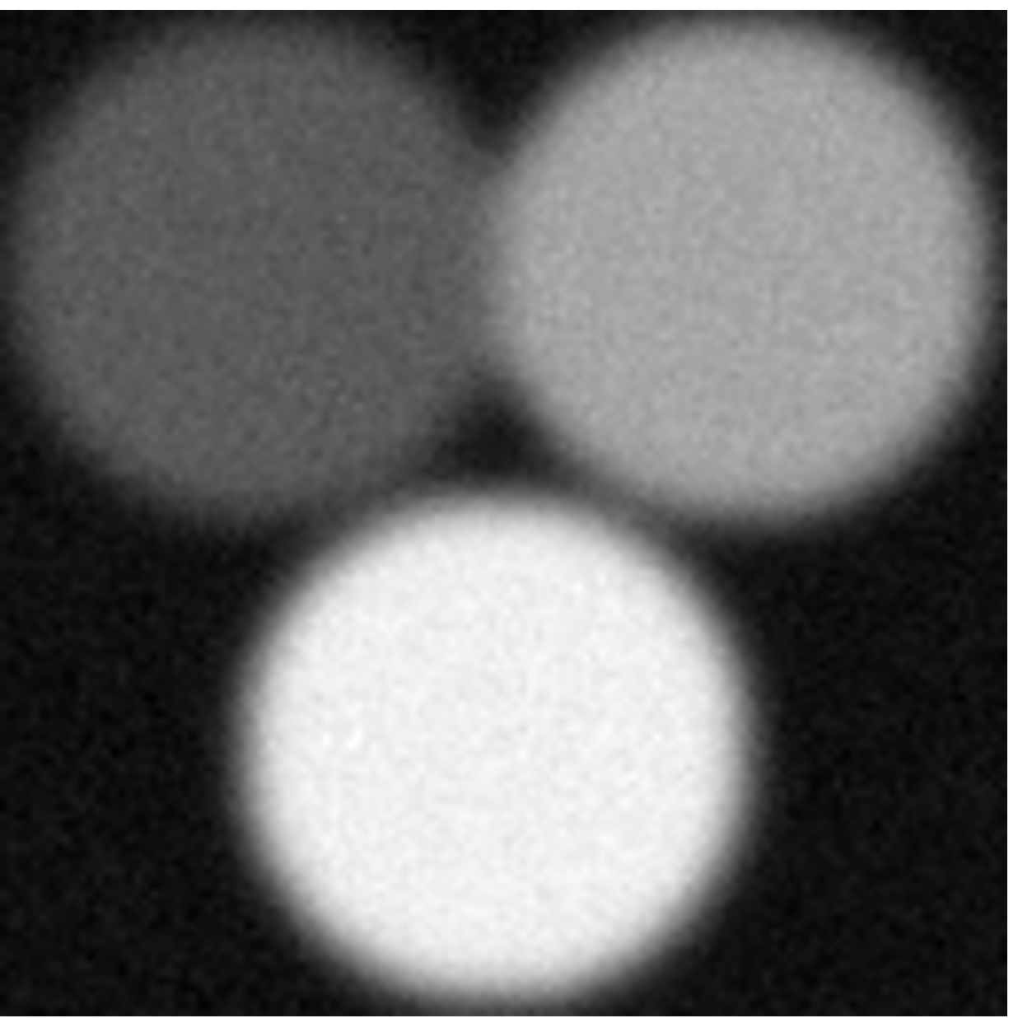
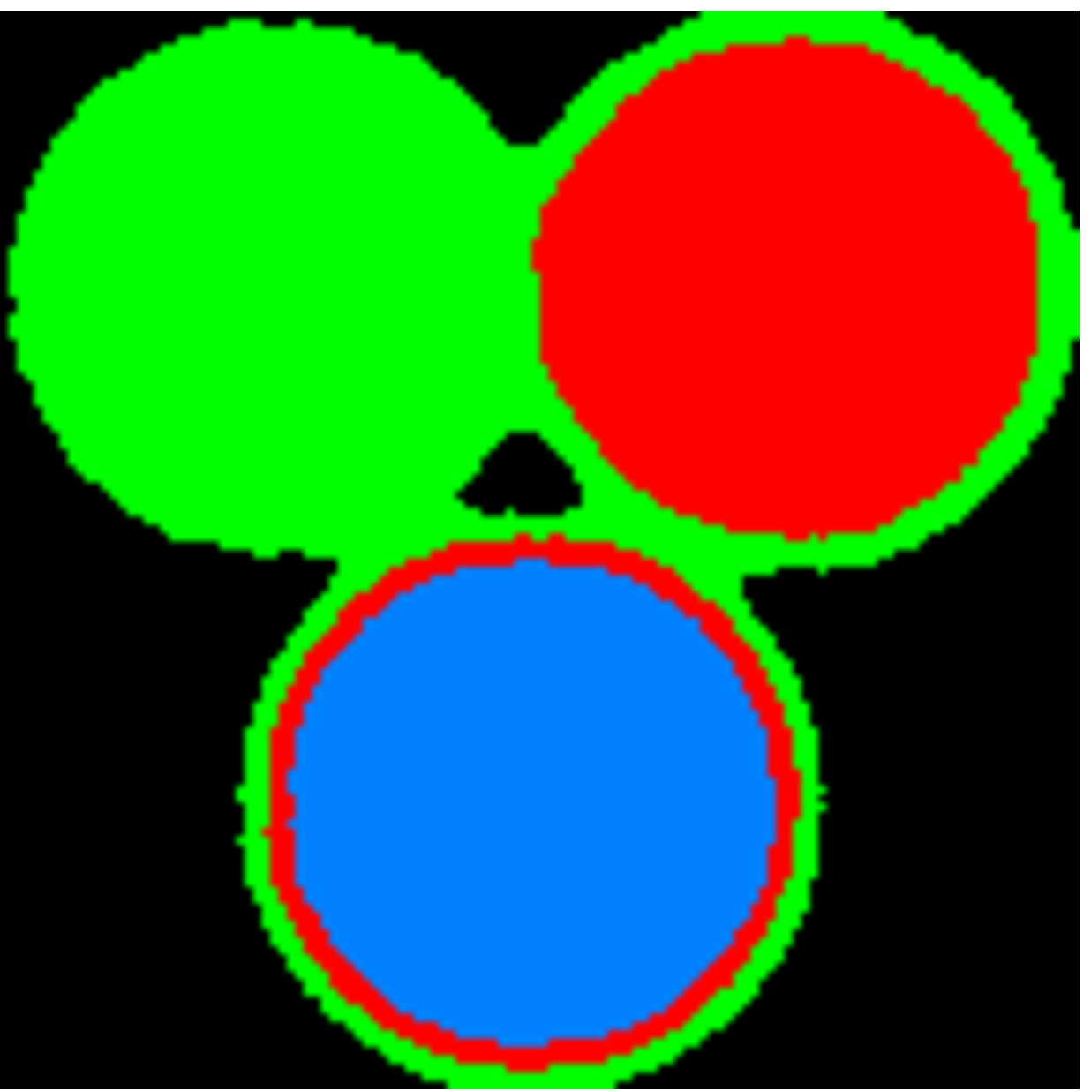
Synthetic example
No noise no PVE
Observed = noise + PVE
Ground truth
Current segmentation

Slide 24
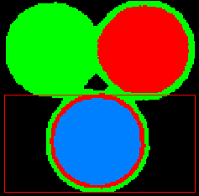
Synthetic example: push action
Source set
Destination set
Push action

Slide 25
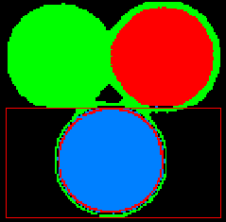
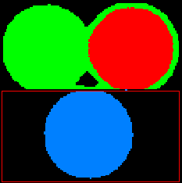
Synthetic example: push action
is the first best guess
0.3
Swap
0.4
0.3
0.4
0.2

Slide 26
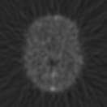
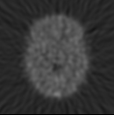
Dynamic PET brain

Slide 27
Overestimated putamen
Ground truth
Overestimated Putamen

Slide 28
Uncertainty interaction overview widget

Slide 29
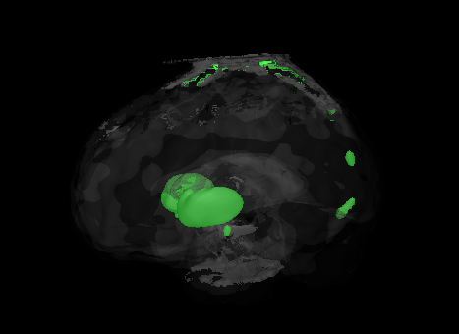
Dynamic PET brain

Slide 30
Dynamic PET brain
Source set
Destination set
Background
Push action
Skull
Putamen
Grey matter
Cerebellum

Slide 31
Dynamic PET brain
After 2 editing actions

Slide 32
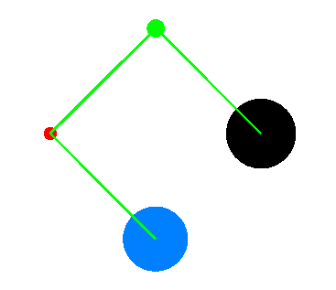
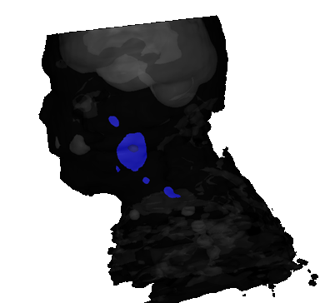
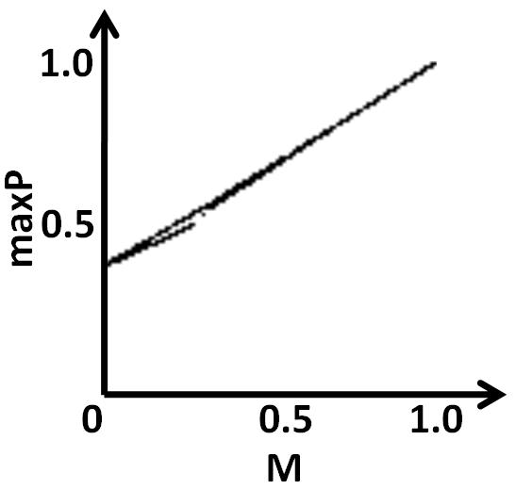
More (Saad et al., EuroVis10)
Selection

Slide 33
Outline
Medical image segmentation challenges
ProbExplorer framework
Case studies
Highlight suspicious regions (e.g. tumors)
Correct misclassification results
Uncertainty visualization using shape and appearance prior information
Conclusion and future work

Slide 34
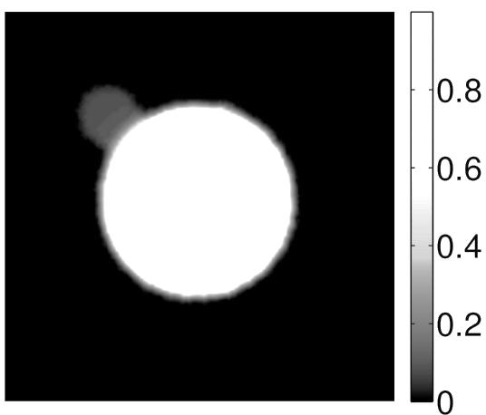
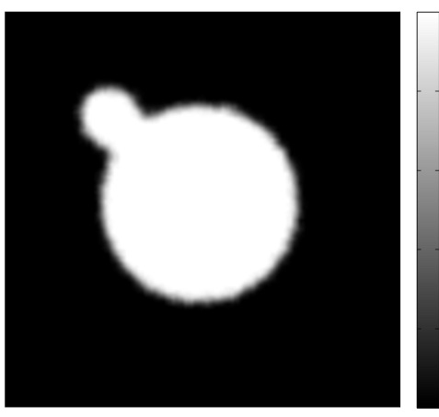
Bayesian perspective
$$P\left(Class \right|Features)= \frac{P\left(Features \right|Class) ∙P(Class)}{Normalization}$$
Maximum-a-posteriori principle
$Final segmentation$
$=\max{ P\left(Class \right|Features)}$
Posterior
Likelihood
Prior

Slide 35
Framework
New image
New probabilistic
segmentation
Image-to-Image registration
Population
representative image
Aligned
likelihood
Likelihood
Probabilistic
shape prior
Images
Atlas construction
Shape prior
Likelihood
Expert binary
segmentations
Probabilistic
appearance prior
Appearance prior

Slide 36
Mathematical notations
$$P\left(C_{i} | X,F\right)= \frac{P\left(X,F | C_{i}\right)∙P(C_{i})}{\sum_{i=1}^{K}{P\left(X,F | C_{i}\right)∙P(C_{i})}}$$
$X$ is a spatial location in $ℝ^{3}$
$F$ is a feature vector associated with $X$ that can be constructed from intensity, gradient, etc.
$P(C_{i})$ can be decomposed into:
$P(C_{i};X)$ is the shape prior
$P(C_{i};F)$ is the appearance prior

Slide 37
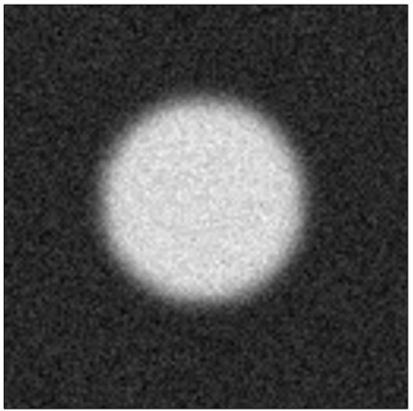
Algorithm demonstration using synthetic example
Piecewise constant
Blurring
Noise
100 noise realizations and random translations

Slide 38
Atlas construction: Shape prior modeling
We adopt the method used
by Hamarneh and Li [JIVC 09]
Alignment of binary shapes
Shape histogram $SH(X)$

Slide 39
Atlas construction: Shape prior modeling
Alignment of binary shapes
Shape histogram $SH(X)$
Distance transform DIST(X)

Slide 40
Atlas construction: Shape prior modeling
Alignment of binary shapes
Shape histogram $SH(X)$
Distance transform DIST(X)
Probabilistic shape prior
$$P\left(C_{i};X\right)=$$
$$\left\{\begin{aligned}s_{2}+s_{1}SH\left(X\right), ifX∈W \\ &s_{2}(1−DIST(X)),otherwise\end{aligned}\right.$$

Slide 41
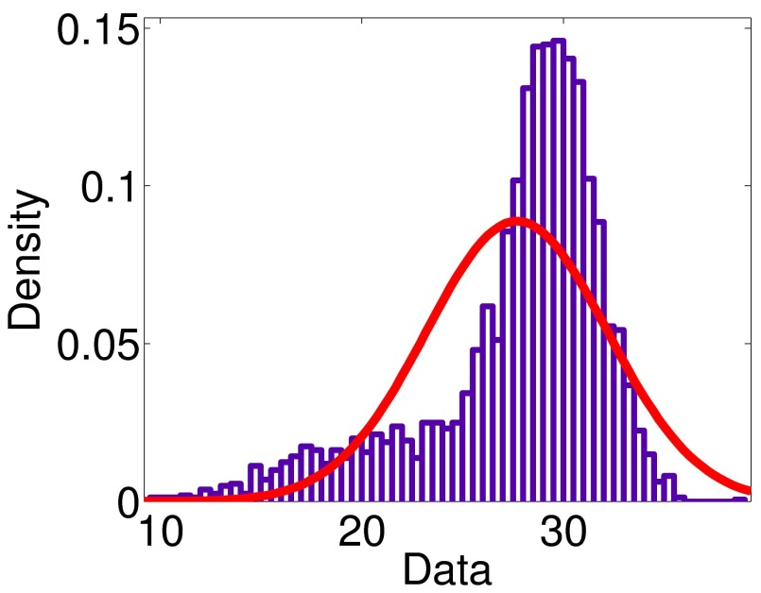
Atlas construction: Appearance prior modeling
Multivariate Gaussian fitting
$$P\left(C_{i};F\right)= \frac{1}{{(2π)}^{\frac{n}{2}}det⁡(COV_{i})} exp⁡(−\frac{1}{2}{\left(F−μ_{i}\right)}^{T}COV_{i}(F−μ_{i}))$$

Slide 42
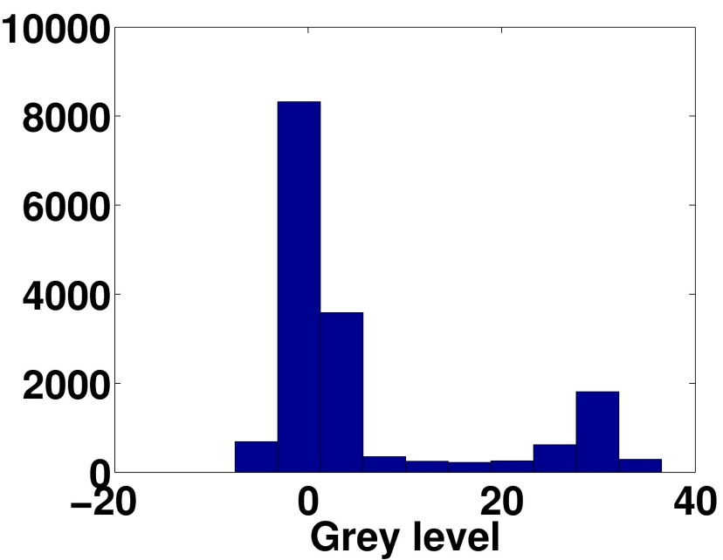
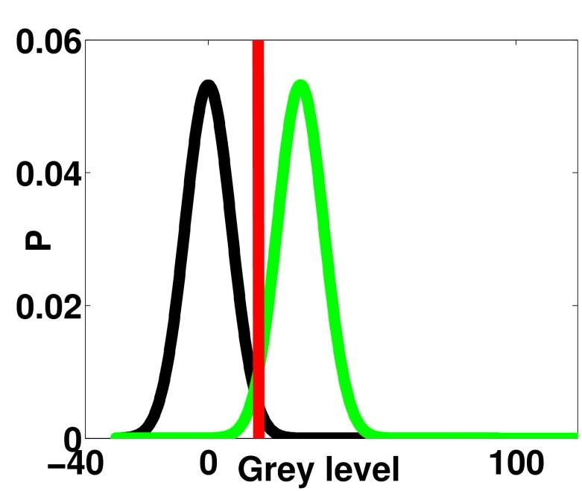
Likelihood
Mixture of Gaussians
Other probabilistic segmentation techniques can be used, e.g. Random walker, Probabilistic SVM, etc.

Slide 43
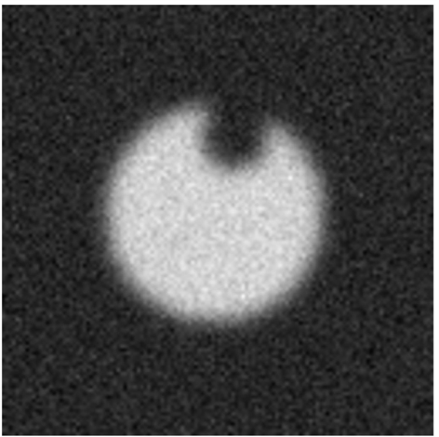
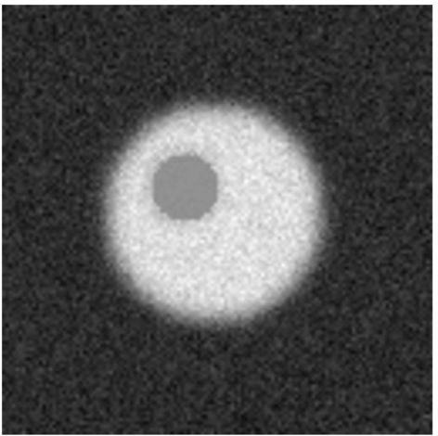
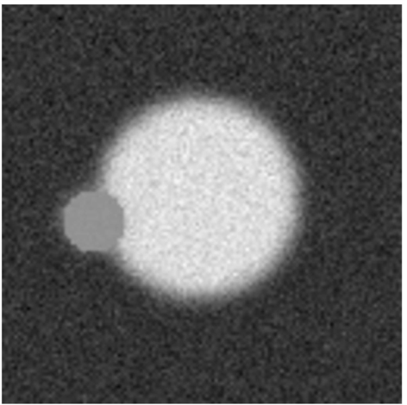
Abnormal cases

Slide 44
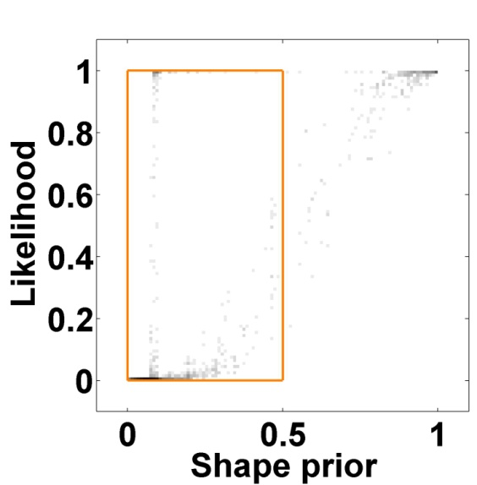
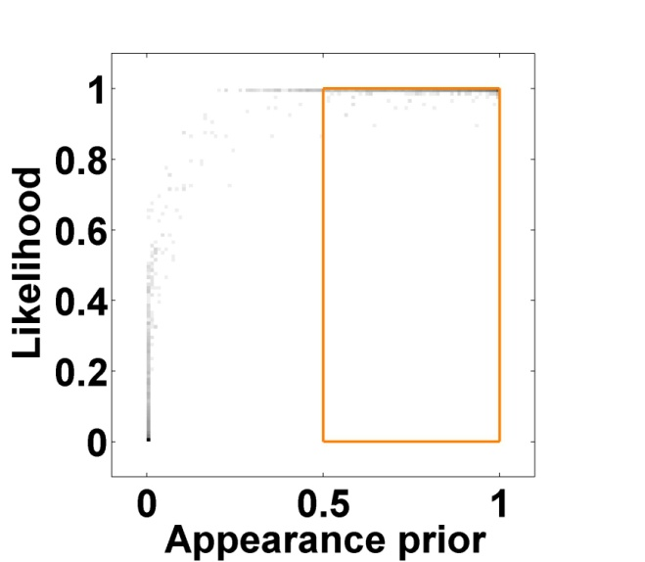
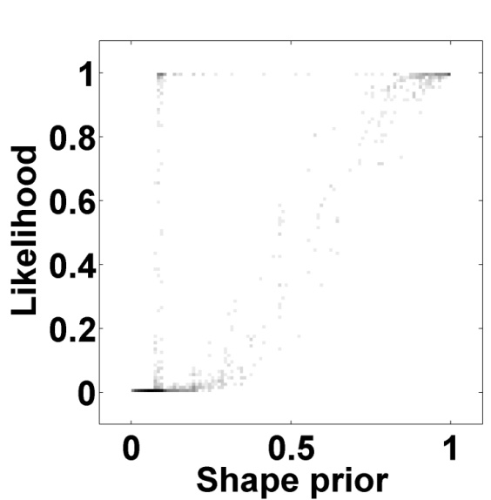
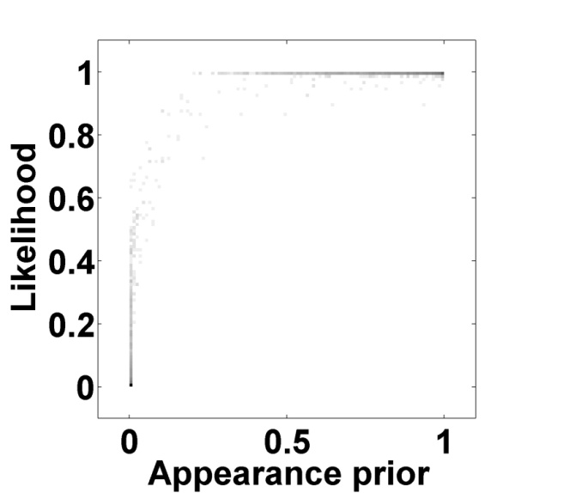
Abnormal shape
Data
Maximum likelihood
Selection

Slide 45
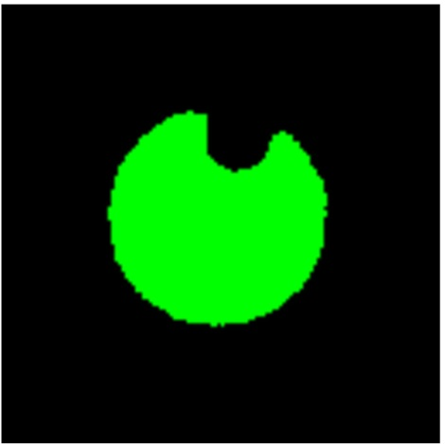
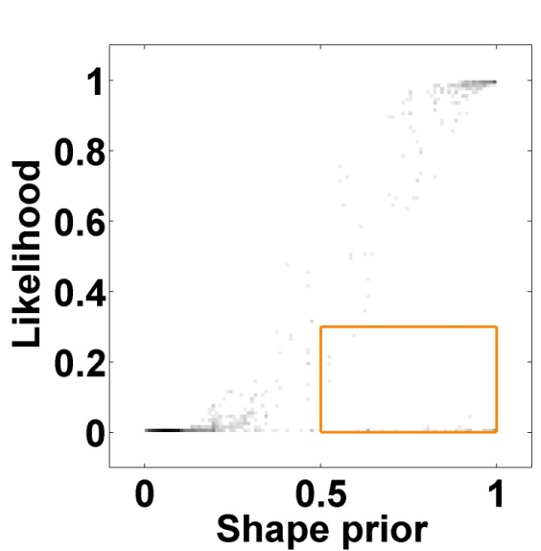
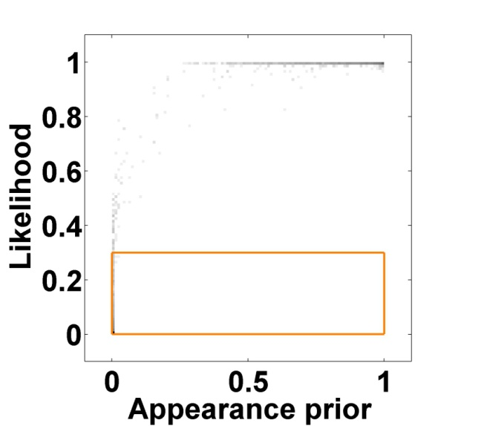
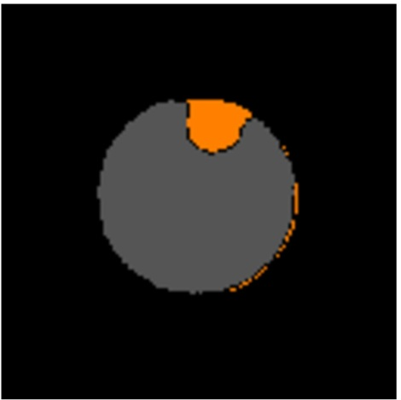
Abnormal shape
Data
Maximum likelihood
Selection

Slide 46
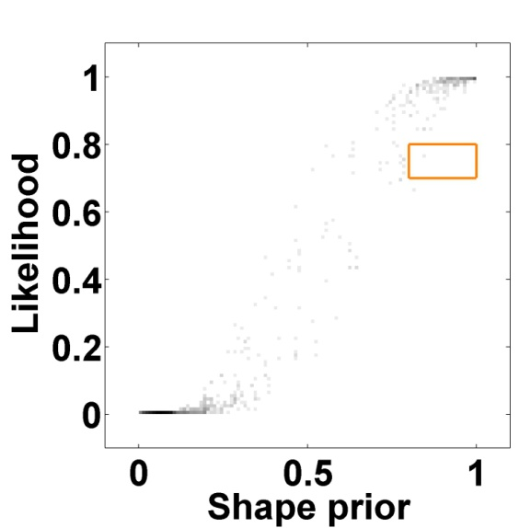
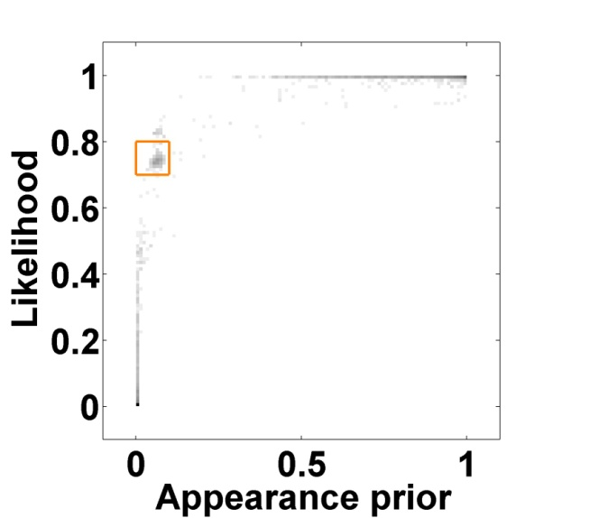
Abnormal appearance
Data
Maximum likelihood
Selection

Slide 47
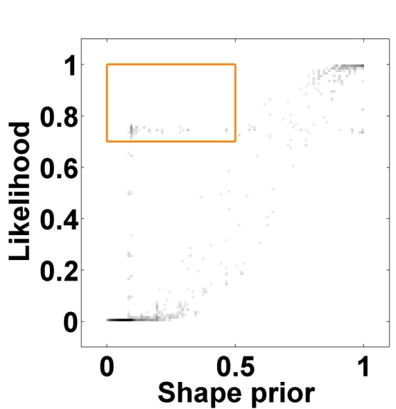
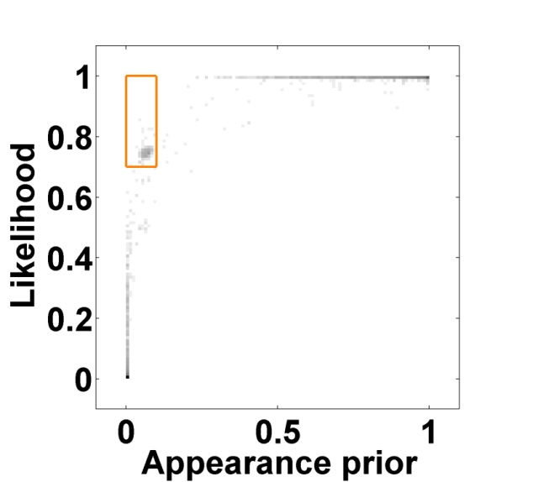
Abnormal shape and appearance
Data
Maximum likelihood
Selection

Slide 48
Misclassification correction
Dice: 0.32
Dice: 0.75

Slide 49
More (Saad et al., IEEEVis10)

Slide 50
User evaluation
Our clinical collaborators showed how ProbExplorer can be used to achieve highly accurate segmentation from a very noisy dSPECT renal study (Humphries et al. IEEE Nuclear Science Symposium/Medical Image Conference 2009)

Slide 51
Conclusion
ProbExplorer: a framework for the analysis and visualization of probabilistic segmentation results
We provided a number of visual data analysis widgets to reveal the different class interactions that are usually hidden by a simple crisp visualization

Slide 52
Future work
Spatial dependency between voxels during interactive editing
Investigate the behavior of the resulting probabilistic results from different segmentation techniques
Multi-structure atlas
Registration uncertainty visualization

Slide 53
Acknowledgements
Natural Sciences and Engineering Research Council of Canada (NSERC)
Prof. Vesna Sossi, Prof. Anna Celler, Thomas Humphries, and Prof. Manfred Trummer

Slide 54
Ahmed Saad
www.sfu.ca/~aasaad
aasaad@sfu.ca

