Slide 1
Space-time trends in temperature extremes in south central Sweden
Peter Guttorp, UW/NRC
Peter F. Craigmile, OSU

Slide 2
Projections from IPCC AR4
Can be used to look for signals in data
Fewer frost days (very likely everywhere)
Less intense cold extremes (very likely Northern Europe, South Asia, East Asia)
Reduced diurnal temperature range (likely on most continents)

Slide 3
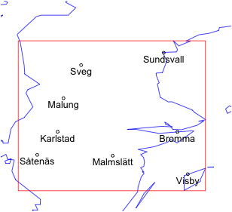
Data network
Synoptic stations in south central Sweden with 48 years of data
Jönköping

Slide 4
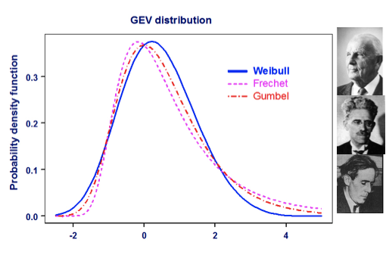
GEV distribution

Slide 5
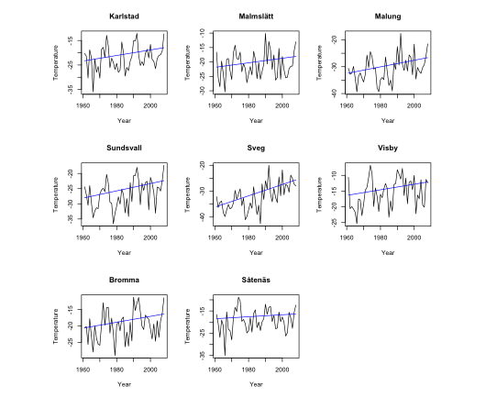
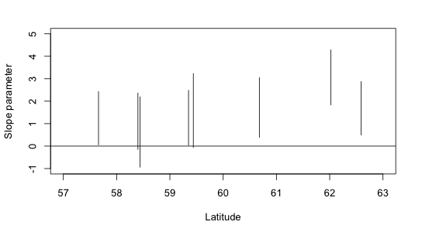
ML fits with linear trend

Slide 6
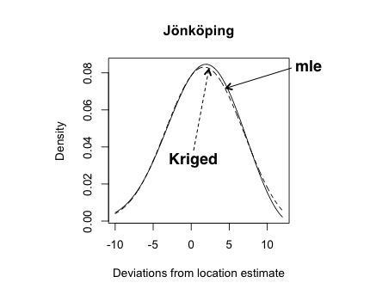
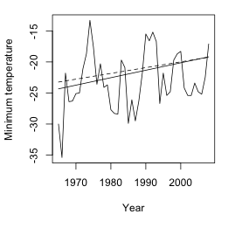
Prediction of Jönköping (44 yrs)
Spatial fit of GEV parameters vs mle fit

Slide 7
Spatial model
where
Allows borrowing estimation strength from other sites
Can include more sites in analysis

Slide 8
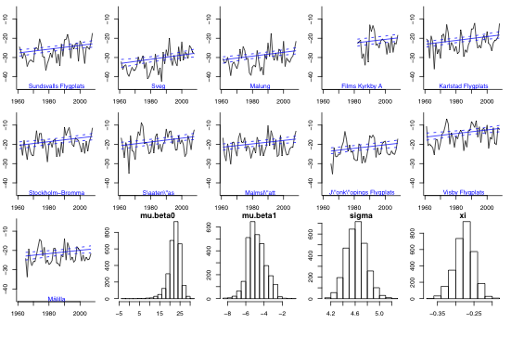
Bayesian fit
Posterior probability of slope ≤ 0 is very small everywhere

Slide 9
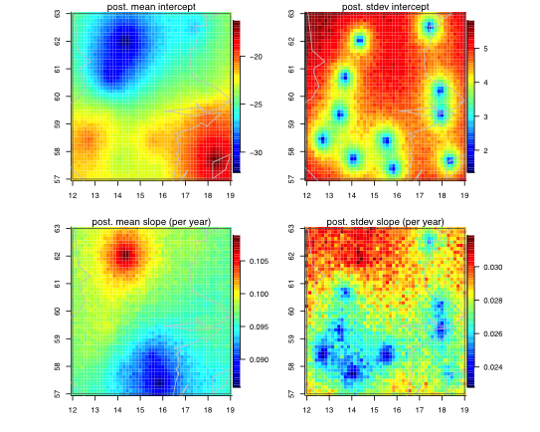
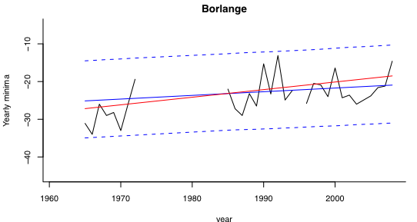
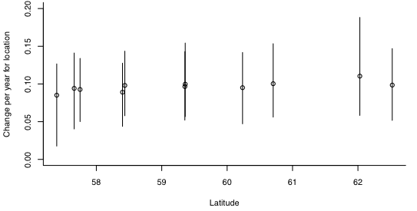
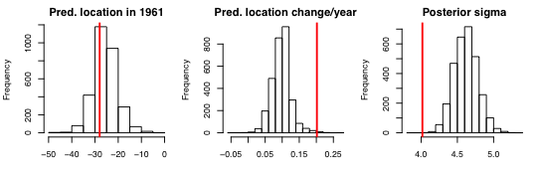
No real model for joint distribution at several sites. Here prediction at single site:
Bayes
mle

